Slide 1


RSAT Training Tool:
Trauma-Informed Correctional Care

Slide 2

Niki Miller, M.S. CPS
Advocates for Human Potential
www.ahpnet.com

Slide 3
Goal
Introduce:
  Trauma theory
  Research
  Practice
Notes:
The goal is to introduce Trauma theory, research, and practices that will help you work with people in substance treatment within the justice system who may be effected by histories of exposure to violence and trauma

Slide 4
Objectives
Explain the effects of trauma, its mental health consequences, its relationship to recovery from addictive disorders
Articulate the principles of trauma-informed care, its purpose, its promise, and implementation basics
Recognize which interventions are effective for RSAT clients with co-occurring Posttraumatic Stress Disorder (PTSD)
Notes:
Counselors and Correctional staff have different goals but share common objectives like staff and institutional safety, a firm, fair and consistent environment and helping offenders change their behavior.
Both need to know how to bring an inmate back to the hererand now, when his or her response is rooted in terror, defensiveness or disconnection precipitated by a resurfacing fear they are powerless to control.

Slide 5
Module I: Context and Background
Prisons & Jails = A challenge for TIC
  Designed to house perpetrators, not victims
Unavoidable Triggers for inmates with PTSD
  Shackles, over crowded housing units, lights, loud speakers, limited privacy, pat downs, strip searches, discipline, restricted movement
    May mimic certain dynamics of past abuse
Notes:
Walk through your facility through the eyes of an inmate with PTSD. Let’s say you also have a substance use disorder (SUD) and alcohol has been your main coping mechanism for trauma responses and triggers. Suddenly, the alcohol is no longer available and you have entered a prison.
This give you and idea of why trauma related symptoms tend to worsen when abstaining from drugs and alcohol and upon entry into a correctional environment.

Slide 6
Course Relevance
    Address the challenges of providing TIC within the limitations of prison or jail settings
    Allow staff to play a major role in minimizing triggers and stabilizing offenders
    Highlight the importance of self-care for professionals working with trauma survivors
Notes:
Lastly, this course touches on self care for the workforce. Correctional officers, facility staff , counselor's, and case managers all face the demands of working with a highly traumatized population and may be dealing with the effects of traumatic incidences they have witness on the job on top of any issues in their personal lives. Recognizing staff needs, supervision, self care issues and practices that support staff resilience are part of a creating a trauma-informed environment.

Slide 7
Module I: Self-Care Check
Check-In
Notes:
Before continuing with this course, please take a moment to gauge your potential reactions to this module. Trauma-informed programming highlights self-care for clients and staff—beginning with you. Discuss responses.

Slide 8
Module I: Research
Prevalence: The Case for Universal Precautions in RSAT Programs
  Universal strategies address entire groups that share the same general risk. Universal strategies are applied to groups without any prior screening, when the entire group is capable of benefiting.
Notes:
Just as we take universal precautions for HIV and put the gloves on before we draw blood from ANYONE, in correctional systems TC staff can apply the principles of TIC to all individuals. The majority of clients with trauma will benefit and it won’t hurt the minority that don’t have a trauma history.

Slide 9
Module I: Research
PTSD in General Population
PTSD among Justice Population
10.4% of women
5% of men (NIMH, 2008)
48% of female inmates
30% of male inmates (Tull, 2005)
Trauma may still gravely affect the way people see the world even if they do not have a PTSD diagnosis.
Notes:
General prevalence:
Men are statistically more likely to be exposed to violence, but less likely to develop PTSD as a result.
Men are most commonly exposed to traumatic events that involve seeing someone killed or critically injured or being physically assaulted
Women are more likely to have been sexually victimized
Women may also take longer to recover from trauma and are four times more likely than men to have long-lasting PTSD, and to have accompanying depression and anxiety (GAINS Center, 2002; National Center for PTSD, 2007).

Slide 10
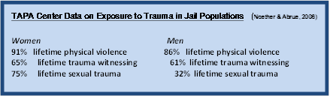
Module I: Research
PTSD in the Justice Population
  TAPA Center for Jail Diversion (Noether and Abrue, 2005)
  Significant rates of PTSD found among death row inmates (Freedman and Hemenway, 2000)
  Violent offenders are more likely to have PTSD than not (Carlson and Shafer, 2010).
Notes:
One large scale study in jails suggests men have very high rates of exposure to trauma but that the types of experiences and their reactions to them differ from women’s.

Slide 11

Module I: Context and Background
Gender Differences in Trauma.
  Males:
    Risk of being threatened, pressured, or forced into sex, and the possibility of witnessing another inmate being sexually assaulted increases dramatically when they enter jail or prison
    Threat of violence and physical assault also increases
    Jail/Prison = less safe from sexual assault
Notes:
Men who have experienced trauma may also find the environment very triggering, but may react differently.
What type of reactions do you think male offenders with trauma histories have to a correctional environment.

Slide 12

Module I: Context and Background
Gender Differences in Trauma Continued.
  Females:
    Studies show as many as 90% have experienced interpersonal or sexual violence in their lives (WPA, 2006)
    The rate of sexual assault in US prisons 4.3% (Beck and Harrison, 2010)
    The rate of sexual assault on US college campuses is 20%-25% (BJS, 2010)
    Women may be safer in a Jail/Prison but may feel less safe.
    Data suggest the experience of rape is most likely to result in PTSD for both men and women.
Notes:
Although women may be statistically safer in prison than before entering a correctional facility, why do you think they feel less safe?

Slide 13
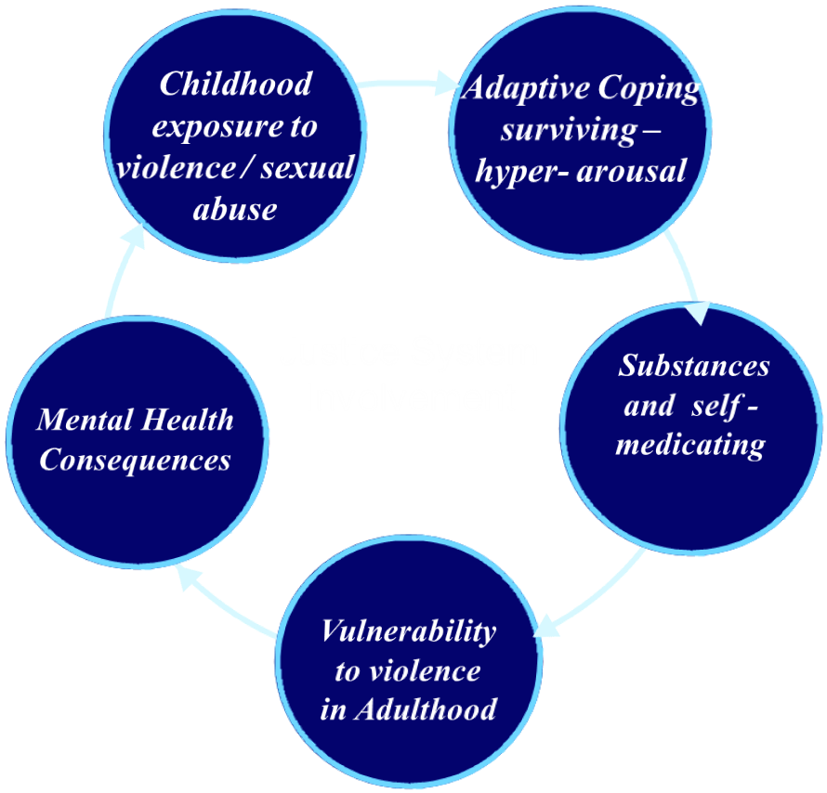
Module I: Research
What about Substance Abuse?
Most men and women in substance abuse treatment report childhood physical or sexual abuse
Men with PTSD tend to misuse alcohol in response to traumatic experiences at almost twice the rate of women with PTSD.
Notes:
When early childhood trauma sets the stage for early initiation of substance use, especially in chaotic or abusive families, a cycle is set into motion that can result in complex trauma histories, increased vulnerability and multiple exposures to violent and sexual victimization. This type of history is not uncommon in male and female offenders with histories of IV drug use.

Slide 14
Module I: Research
Veterans and Trauma: Prevalence
  PTSD = most common MH disability among Operation Iraqi Freedom (OIF) and Operation Enduring Freedom (OEF) veterans
  ¼ veterans will return with Depression, PTSD, or Traumatic Brain Injury
    Often complicated by substance abuse or problems controlling anger
Notes:
The overall rate of PTSD diagnosis at the VHA is three times higher among OIF/OEF veterans than for those who served in other conflicts (DVA, 2010). ( about 9%)
It is important to note that self-reported rates of PTSD among veterans are higher than rates reported by the VHA and that many veterans do not seek mental health services in the VA system for a variety of reasons, including stigma and fear of consequences for their military careers.

Slide 15
Module I: Research
Veterans and Trauma: Types
  Vicariously experienced trauma
  Direct Injury
  Military sexual trauma (MST)
Veterans and Trauma: Jail and Prison
  10 % of US jail and prison inmates are veterans
  Typically dealing with many issues (alcohol use, co- occurring psychiatric illness, chronic homelessness, unemployment)
Notes:
Veterans comprise a little more than 10% of the US population…..and the same is true for the prison and jail populations as well.
Generally veterans with SUD’s that have entered the justice system have complex issues including trauma, homeless, mental health issues and physical disabilities.

Slide 16
Module II: Trauma
What is Trauma?
  Trauma is extreme stress brought on by shocking or unexpected events that overwhelm a person’s ability to cope, resulting in feelings of helplessness, and extreme fear and horror. The survivor perceives the event as a bodily violation or a threat of serious injury or death or of self or a loved one. Events may be witnessed (vicariously) or experienced directly.

Slide 17
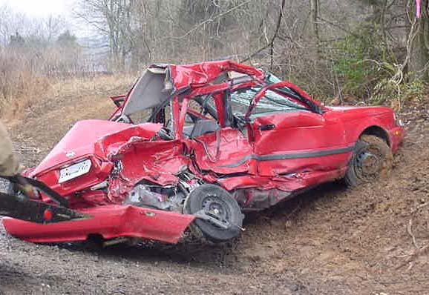
Module II: Trauma
Some examples of events likely to be traumatic when experienced or witnessed include:
Hate crimes, genocide, torture, combat and war
Domestic violence and family violence
Childhood physical abuse
Adult or childhood sexual abuse or assault
Natural or man-made disasters
Automobile and airplane accidents
Confinement, imprisonment, forced institutionalization
Persecution, oppression and community violence
Psychological and emotional abuse
Childhood sexual abuse/exploitation
Sex work, sexual exploitation or harassment
Homelessness, displacement
Medical trauma or intense surgical interventions

Slide 18
Module II: Trauma
What is the Nature of a Traumatic Experience?
  What one person may perceive as a frightening, traumatic event, another might experience as difficult or distressing, but not traumatic.
Notes:
One’s ability to cope, perception of control and safety, and level of preparedness can all affect the way an event is experienced and remembered. To some extent, trauma is in the eye of the beholder.

Slide 19
Module II: Trauma Exercise
Rochelle is Joelle’s older half-sister. Rochelle lived with her dad for part of her childhood, but moved in with her sister, Joelle, when their mom re-married. One night, the girls saw their mom’s new husband break her nose. Rochelle was devastated and Joelle was traumatized because each perceived what they saw differently as illustrated below
Joelle Perceptions | Rochelle Perceptions
Mommy is going to die. Her head is all bloody. | Got to get help. I think he broke her nose.
He is going to kill us too. | If he comes near me I’ll call the police.
My heart is racing. I have to cry. | We have to keep quiet, Joelle, don’t cry.
This is happening to us because I am bad. | Why did I have to come back here to live?
Notes:
Trainer can pass this out as an exercises for small groups by using the handout version.

Slide 20
Exercise II
What would qualify Joelle’s experience as a traumatic event.
Perception of threat to her survival
Overwhelms her capacity to cope
Unusual, sudden or out of the ordinary
Feelings of helplessness and extreme horror
Threat of death or serious injury to self or loved one
How about Rochelle?
Perception of threat to her survival
Overwhelms her capacity to cope
Unusual, sudden or out of the ordinary
Feelings of helplessness and extreme horror
Threat of death or serious injury to self or loved one
Notes:
Answers: Joelle had all 5 of the qualifying factors and experienced the event as traumatic. Rochelle had one qualifying factor; the event was unusual, sudden or out of the ordinary. Rochelle was certainly distressed, but did not perceive the level of threat to her survival that her younger sister did, and she was prepared to take some action in response to the events.

Slide 21
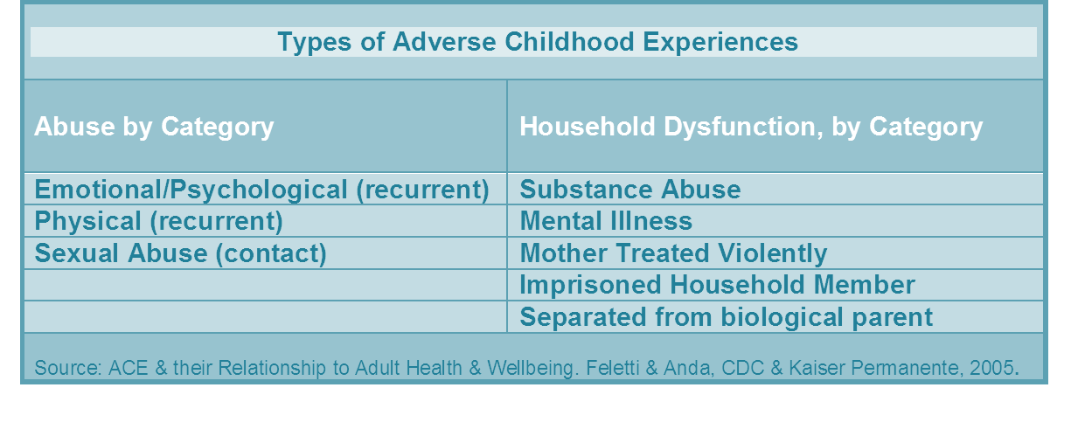
Module II: Research & Practice
The Adverse Childhood Experiences (ACE) Study:
  The largest study of its kind ever done to examine the health, social, and economic effects of adverse childhood experiences over the lifespan (17, 421 participants)
Notes:
Compelling data has shown that multiple types of traumatic or adverse childhood experiences are a risk factor for addictive and mental disorders. One of the largest studies on childhood abuse and household dysfunction, the Adverse Childhood Experience Study was conducted by the Centers for Disease Control and Kaiser Permanente.

Slide 22

Module II: Research & Practice
Ace Score:
  The ACE study used a simple scoring method to determine the extent of exposure to childhood trauma. Exposure to each category of adverse childhood events counts as one point; points are added for a total ACE score. An ACE score of 0 would indicate no exposure to any of the categories of adverse events, while a score of 8 would indicate at least one exposure in all of the categories listed.
Notes:
This study was conducted among adults coming in for a routine physical their at primary care provider. The researchers were shocked by the number of adults that reported childhood trauma and how highly correlated trauma exposure was to difficulties in adulthood.

Slide 23

Module II: Research & Practice
The Impact of Childhood Trauma on Adult IV Drug Use and Adult Alcoholism
Women with 4 types of childhood trauma had a 78% attributable risk for IV drug use.
Women who did not experience any of these instances had a .05% attributable risk for IV drug use.
Women with histories of childhood sexual abuse were 60% more likely to abuse alcohol and 70% more likely to use illegal drugs.
Notes:
The ACE stud found that those with four or more different types of adverse childhood experiences had a strongly correlated risk of chronic physical problems, mental health disorders and alcoholism, and IV drug use. The results for mental health and substance abuse were dramatic, but the results for women addicted to drugs were among the most dramatic:

Slide 24
Module II: Research & Practice
The Impact on Males and on Chronic Disease
A male child who experienced at least 6 types of adverse childhood experiences was 4,600% more likely to become an IV drug user
Self-acknowledged alcoholism in men and women increased 500% in relation to adverse childhood experiences.
Among the 7% of the sample that did experience 4 or more types of abuse or dysfunction, high rates of mental illness, tobacco and substance use, teen pregnancy and chronic disease were found (Felitti, 2007).
Notes:
Males also experience the profound effects of childhood trauma. Since the study was conducted with a group of “middle class” insured adults, it is reasonable to assume that other groups, such as prison and jail inmates, have a greater proportion of people that experienced compound abuse or dysfunction in childhood --- and will benefit greatly from trauma-informed substance abuse treatment in prison and jail RSAT programs!

Slide 25
Module II: Impact of Trauma
Trauma Can lead to MH Problems
  Dealing with the ongoing effects of trauma is often more painful than the original event
  Increased risk for future victimization and additional trauma
Notes:
Many people can benefit from learning how to control the ongoing effects of past trauma.

Slide 26
Module II: Impact of Trauma
What is PTSD?
  Anxiety Disorder developed after seeing or living through a terrifying event that prevents survival responses from functioning properly.
    Not everyone who experiences danger/violence get PTSD!
Notes:
PTSD persists long after the traumatic experience has passed.

Slide 27
Module II: Impact of Trauma
How the Brain and Body React to Trauma:
  Amygdala: part of the brain that initiates a “fight or flight” response
  Increased heart rate and respiration
  Blood flows out of the thinking centers of the brain and into the limbs to prepare for action.
  When the threat is over, the brain should return the body to normal.
Notes:
Those exposed to continual danger may not be able to return the body and brain to a normal state. Responses often become difficult and unpredictable. This can lead to serious mental health problems, such as Posttraumatic Stress Disorder (PTSD).

Slide 28
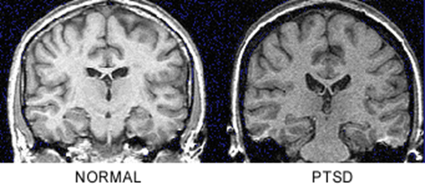
Module II: Impact of Trauma
Trauma and Altered Cognitive and Emotional Functioning
  Scientists speculate that as the pathways through which sensory stimuli reach the Amygdala are worn “deeper and wider”, activation of the “fight or flight” response becomes more excitable, faster and more automatic (Phelps, 2004).
  Ventricles may enlarge, crowding the path from the Amygdala to memory circuits; as these paths narrow it slows down the brain’s ability to put information in context and decide whether or not it poses a threat (Smith, 2005).
  Young brains are more malleable, the earlier the exposure to trauma, the more rapidly these changes take place and the more long-lasting they appear.
Notes:
Cognition and emotion both involve chemical and physical processes within the brain.
Studies of brain function after prolonged or repeated exposure to danger or highly traumatic experiences suggest there are changes in the brain’s normal processes (Bremner, 2002):

Slide 29
Module II: Impact of Trauma
Arousal
Extreme levels of excitability and responsiveness to external stimuli or numbing and detachment from the outside world.
Hyper-arousal←←←→→→numbing
Attention
The mind’s energy is directed away from situations, completely inattentive and absent or toward them, deeply and exclusively focused.
dissociation←←←→→→ hyper-focus
Notes:
PTSD can interfere with thinking and memory. Thoughts and reminders of a traumatic experience make emotions difficult to regulate. These changes can gain momentum and affect neurological processing of information, which in turn sets physiological changes in motion.

Slide 30
Module II: Impact of Trauma
Perception
Pupils dilate: vision and hearing are sharpened or dulled and memory is absent
heightened←←←→→→dulled
Emotion
Feelings are devastating and painful or inappropriately detached from experience.
absent←←←→→→overwhelming
Notes:
People with PTSD may swing from one extreme to the other.

Slide 31
Module II: Impact of Trauma
Avoidance
  Voluntary suppression of memory
  Restriction of daily activities
  Dissociation; substance use
Arousal
  Startle Reflex
  Inability and Vigilance
  Sleep disturbances
Intrusion
  Flashbacks
  Nightmares
  Trauma Re-enactment
3 Groups of PTSD Symptoms
Notes:
Intrusion—Unwanted thoughts and reactions, often triggered by sensory details that symbolize the trauma. Nightmares and flashbacks; re-running the event. Anxiety and physical distress in response to upsetting memories. Re-enactments that repeat the dynamics of the event in an attempt to triumph or find rescuers.
Arousal—Startle reflex for example, in response to being touched or loud noises, trouble getting to sleep; frequent awakening. Poor concentration; irritability, angry outbursts or violence. Constant guardedness, extremely distrustfulness, cautious or withdrawn. Hyper-vigilance, emotional volatility or exhilaration in the face of danger, desensitization to pain and thrill seeking.
Avoidance—Altered states of consciousness, dissociating, checking out, memory lapses, unavailable for experience and learning new information. Substance use, binging and purging, voluntary suppression of memory, restriction of daily activities, isolation, numbing, detachment from surroundings, submissiveness, avoidance of conflict and inaccurate perceptions of safety and danger.
Ask participants for example of each of the symptom groups.

Slide 32
Exercise IV
Although both males and females with PTSD may have any and all categories of responses to trauma, can you guess which of the three groups of PTSD symptoms is more predominate in females and which tends to be more typical of males with trauma-related disorders?
Notes:
Answer: Avoidant responses are more frequently seen in women; while arousal is more common in men. However, both men and women may have any and all types of symptoms.

Slide 33
Module II: Impact of Trauma
Primitive Survival Responses to Fear and Trauma:
  Fight- hyper vigilance on conscious and unconscious levels, prepared to defend; flooding of physiological changes related to aggression.
  Flight- blood flows to the limbs preparing to run; flight is often thwarted, giving no relief or outlet to a primed nervous system. Avoidance, dissociation, hiding and other psychological “flight” behaviors can also become disruptive.
  Fright- responding with a state of terror, often to seemingly benign triggers; fright and anxiety permeates all areas of life. Shortness of breath, startle responses, sleeplessness and inability to focus or think clearly.
Notes:
Prison and jail environments can trigger re-experiencing symptoms that make it difficult for inmates with trauma to adjust to a correctional environment and may make offenders difficult to manage. Some research has shown that trauma survivors in prison settings have been misdiagnosed with psychosis due to re-experiencing symptoms that were thought to be hallucinations. When treatment with anti-psychotic medications was ineffective, psychiatrists discovered the inmate was re-experiencing rather than hallucinating.

Slide 34
Module II: Impact of Trauma
  Freeze- response observed in animals, accompanied by slowed and shut down metabolism. Can also be a learned response as an attempt to remain safe and invisible; paralyzes the victim—actually making them more vulnerable and reinforcing helplessness in each new situation.
  Flail- perceived as aggression, but physical movement, such as flailing of the arms, is meant to create a safe space around the body rather than connect with a target. As when some animals puff up or fan out to keep aggressors from closing in.
  Shield-Protective--- like flailing, shielding and raising hands over head and body make it physiologically prepared for injury. Trauma survivors may shield in response to noises or non-violent conflict.
Notes:
These primitive response are set into motion by triggers and memories, often on an unconscious level.

Slide 35
Module II: Impact of Trauma
  Flirt-Particular to some women offenders who survived sexual violence in childhood. Instinctive placating behavior for little girls who were sexualized in violent homes. Incest perpetration has been found to be highly correlated with violence (Edleson, 1999; Paveza, 1988).
  Submit - Renders the victim vulnerable, but may be an attempt at safety or escape. Animals will submit to predator if flight is impossible. Submission or numbing in the face of danger may be labeled “risk taking” behavior.
Notes:
Hyper-arousal symptoms are usually constant, rather than triggered and may lessen over time. Symptoms like angry outbursts, startle responses, constant tension and a violent response to authority, especially among males, can present a potential threat to safety and security. Teaching additional coping skills and self-soothing techniques in RSAT programs, if practiced over time, can lessen arousal response and provide an alternative to using substances for relief.

Slide 36
Module III:
Integrated Treatment and the Criminal Justice System
Notes:
Treating clients with multiple disorders is often challenging.

Slide 37
Exercise VI
Trauma can contribute to criminal thinking and behavior.
Criminal Thinking/Values
Anti-social Personality Traits
Criminal Associates

Slide 38
Exercise VI
“I was sent to church camp every summer. One of the ‘brothers’ came into our bunks at night and did stuff. I didn’t know he was doing it to the other boys. I thought there was something about me that made him do it, so I was ashamed to tell. The summer I was 14, I broke into the camp office, took whatever cash I could find and ran away. I decided to make my way stealing and dealing. There was no reason to play by the rules. Nobody else did.”
Notes:
Answer: A. Retribution and revenge at people or institutions for real or imagined wrongs can justify criminal behavior. Abuse by authority figures in childhood may lead distrust of all authority and lead to criminal thinking, making it easier to join in criminal activities.

Slide 39
Module IV: Topics
Foundations of Trauma-Informed Care
Identifying Triggers and Alternative Coping
Integrating Trauma-Specific Approaches
Notes:
The section will emphasize TIC principles that can be applied even if trauma-specific treatment is not available.

Slide 40
Module IV: Foundations of Trauma-Informed Care
Trauma informed substance abuse programs:
All staff understands trauma & its impact on the addiction/recovery process
Services are designed to enhance safety, minimize triggers, and prevent re-traumatization
Staff and clients relationships are based on power sharing and healing; survivors are empowered with info, referrals, and hope.
Trauma specific services
Clinical and program staff have specialized training in integrating trauma treatment and recovery practices.
Specific groups and effective interventions are aimed at coping with the aftermath of trauma, decreasing symptoms of trauma-related disorders and increasing knowledge about trauma.
People are empowered to manage the effects of victimization and trauma in ongoing recovery.
Notes:
Trauma-informed services are the standard of care in many service systems. They are guidelines that any one can use. Trauma-specific services usually involve specialized training and preparation.

Slide 41
Module IV: Foundations of Trauma-Informed Care
Principles of Trauma-Informed Care
Recovery from trauma encompasses multiple aspects of people lives, involves changing deep-seated beliefs and gaining knowledge and skills.
The assumption of a trauma history guides every encounter, whether or not clients disclose or even remember trauma
Responses are reframed as survival strategies that served a safety function and are seen as evidence of strength and resiliency.
Creating safety is a primary task; the safer and more predictable the treatment environment, the better the engagement.
Education and information about trauma and recovery is part of treatment.
Power-sharing is the basis of helping relationships that are founded on respect, information, connection and hope.
Notes:
Trauma-informed care is founded on a set of principles that guide the culture of treatment programs. Applying these principles in correctional settings is challenging, but possible. No matter how triggering an environment may be, therapeutic relationships with staff that understand and embody these principles can result in a more effective treatment experience for offenders with trauma histories. Returning a sense of control and minimizing heretical relationships are effective approaches.

Slide 42
Module IV: Foundations of Trauma-Informed Care
Trauma Stabilization
    Grounding →
    Self-soothing
    Self-care
  Strength-based
“When the CO told me to pick up the mop, I could feel myself starting to get crazy. I could something pounding up through my chest and into my throat; my fists were clenched. I began grounding. I counted the trees outside that lined the fence perimeter. Then I counted how many colors were on each tree. I forgot why I was so pissed off and picked up the mop.”
Notes:
Staff of Trauma-informed programs can learn simple grounding techniques and other approaches that help offenders in RSAT programs to regulate their responses.

Slide 43
Module IV: Triggers and Alternative Coping
Advanced Directives: Working with clients to answer:
  What kinds of reminders are difficult to deal with?
  What helps you calm down when you are triggered?
  What are the things staff can do to help when you are reacting to a trigger?
Notes:
Having a plan in advance to reduce reactions to reminders or “triggers” puts the survivor in charge even when he or she is emotionally upset. Encourage clients to identify triggers and develop coping skills to deal with them. This is the same type of skill that clients develop to plan for high-risk using or drinking situations.

Slide 44
Module IV: Triggers and Alternative Coping
PEACE: An acronym for the approach to coping with unavoidable triggers
Predict and prepare—“When we go to court, your husband will be in the room. Tell me what steps would make you feel safest in court?...What would you like to do to take care of yourself afterward?”
Enlist—“What has helped you in the past not to drink when you had to deal with your mother yelling at your kids?”
Acknowledge—“Many people have a difficult time sleeping with the lights on all night. I can understand why it makes you anxious.”
Choice and control—“We have to search everyone’s cell for contraband because a weapon was found earlier today. Do you want to be in the room when I check yours or is it better to do it while you are in group?”
Explain—“We ask each person to go through the metal detector to check for anything unsafe that might come into the building. If you turn your back toward me I won’t have to reach around you. I will need to run this wand along side you. Would you mind putting your arms out?”(Miller, 2010)
Notes:
Triggers can’t be eliminated in a correctional environment. But staff can support clients by anticipating triggers and helping clients to learn to prepare for them.

Slide 45
Module IV: Foundations of Trauma-Informed Care
Trauma Screening Guidelines
Explain the screening in advance, how the information will be used to benefit the client.
Let the client know that yes or no answers are fine unless he or she wishes to say more.
Use valid screening tools that focus on present-day symptoms (ex: Trauma Symptom Checklist)
If screening for specific types of past trauma, use a checklist the client can read and mark off rather than asking about past abuse during an interview.
Give the client as much control as possible, including time and location, passing on questions and taking breaks.
Be aware of your own nonverbal responses during the interview.
If the clients become upset or agitated redirect them by asking about strengths, the people and things that helped them get through how these events affect them today and what works to help feel better.

Slide 46
Module IV: Integrating Trauma-Specific Approaches
Treating PTSD
  Pharmacological
  Physiological approaches
  Past-based
  Present-based
Notes:
There are many types of treatment that can be helpful for those with PTSD. Generally substance abuse programs use present day based approaches

Slide 47
Module IV: Integrating Trauma-Specific Approaches
Examples of Manualized Treatments for Integrating Trauma Recovery:
  Seeking Safety
  Essence of Being Real
  Trauma, Addiction, Mental Health, and Recovery (TAMAR)
  Trauma Recovery & Empowerment Model (TREM)
  Addiction & Trauma Recovery Integration Model (ATRIUM)
  Trauma Affect Regulation: Guide for Education & Therapy (TARGET)
Notes:
More information about each of these interventions is available in the manual.

Slide 48
Module IV: Secondary Trauma, Burnout, Counter Transference
Secondary or Vicarious Trauma: changes in the inner experience of service providers that come about as a result of empathic engagement with the people who have experienced trauma.
  Intrusive flashbacks or obsessive thoughts
  Difficulties with emotional regulation
  Physical symptoms such as frequent illness
Notes:
Secondary trauma among providers can result in responses that resemble PTSD symptoms. Staff working in RSAT programs can help each other identify these changes and support self-care. Taking a break, rotating job duties, recreation and outside support are important.

Slide 49
Module IV: Secondary Trauma, Burnout, Counter Transference
ABC: Building Personal Resistance to Secondary Trauma
  Awareness- monitor emotions, needs, limits and resources.
  Balance- set aside time for reflection, play, relaxation, and family.
  Connections- utilize social support, resist tendencies to isolate.

Slide 50
For more information on RSAT training and technical assistance visit:
http://www.rsat-tta.com/Home
or email Jon Grand, RSAT TA Coordinator at
jgrand@ahpnet.com

Slide 51
Next Presentation
Thinking for a Change Integrated
Cognitive Behavior Change Program
March 21, 2012 2:00-3:00 PM EST
Cognitive Behavior Programs have evolved over the last thirty years, impacted by a variety of researchers and practitioners. A number of approaches, drawing largely on cognitive-behavioral methods, have also been developed to address criminal thinking, the most popular among these being Thinking for a Change (T4C), issued by the National Institute of Corrections (NIC) (Bush et al. 2000). When integrating (T4C) into a therapeutic community program, offenders can learn to recognize thinking errors and to understand how those errors can lead to behavior that gets them into trouble. This webinar will look at the core components of Thinking for a Change (T4C) and how best to incorporate this approach into a treatment TC.
Presenter: Phillip Barbour

