Slide 1


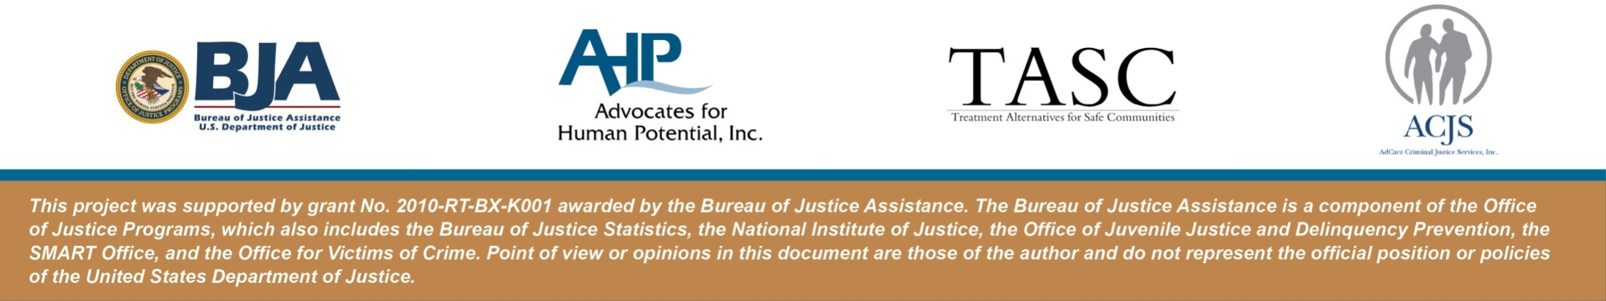
Thinking for a Change
Integrated Cognitive Behavior Change Program
March 21, 2012

Slide 2
About the Presentation
This presentation is large part is taken from the actual curriculum developed by The National Institute of Corrections. The slides will highlight the core elements of the curriculum with resources as to where additional information can be found.

Slide 3
About the curriculum
The Thinking for a Change curriculum uses as its core, a problem solving program embellished by both cognitive restructuring and social skills interventions.

Slide 4
Learning Objectives
Upon completion of this presentation, participants will :
Know the three types of skills needed for change
Know how many lessons are in the curriculum
Know the basic structure for the lessons
  Homework, modeling new skills, contract to practice outside of class
4
Notes:
4

Slide 5
About the curriculum
The National Institute of Corrections has offered a training seminar, “Cognitive Approaches to Changing Offender Behavior”, for the last six years at their Academy in Longmont, Colorado, and more recently as cooperative training programs in various locations throughout the country. Essentially, the curriculum which was developed by a panel of experts in cognitive behavioral interventions presented many of the cognitive restructuring and cognitive skills concepts in a generic, yet practical manner.

Slide 6
The Premise
By taking charge of our thinking we can take control of our lives

Slide 7
Three Key Skills #1
Cognitive Self-Change - Paying attention to the thoughts and feelings that go on inside of us to avoid the kinds of thoughts and feelings that lead us to trouble.
Social Skills – Behaviors or abilities we use in situations that involve other people
Problem Solving Skills – Skills to help us make better choices

Slide 8

Showing what goes on in our head

Slide 9
Three Key Skills #2
Cognitive Self-Change - Paying attention to the thoughts and feelings that go on inside of us to avoid the kinds of thoughts and feelings that lead us to trouble
Social Skills – Behaviors or abilities we use in situations that involve other people.
Problem Solving Skills – Skills to help us make better choices
Notes:
This represents the largest part of the cirriculum.

Slide 10
Three Key Skills #3
Cognitive Self-Change - Paying attention to the thoughts and feelings that go on inside of us to avoid the kinds of thoughts and feelings that lead us to trouble
Social Skills – Behaviors or abilities we use in situations that involve other people
Problem Solving Skills – Skills to help us make better choices.
Notes:
Initiating a new way of thinking.

Slide 11

Iceberg Analogy
Notes:
We can think of cognitive structure like an iceberg. What is above the water is what you can see. But danger of the iceberg lies beneath the surface. Cutting off the top won’t significantly alter the mass of the iceburg. Likewise, unless we deal with thinking - the behaviors we can’t see. It is difficult to change the actions that we can.

Slide 12
Cognitive Restructuring
External Behaviors
Actions
Thoughts
Feelings
Attitudes/Beliefs
Internal Behaviors
Notes:
We can think of cognitive structure like an iceberg. What is above the water is what you can see. But danger of the iceberg lies beneath the surface. Cutting off the top won’t significantly alter the mass of the iceburg. Likewise, unless we deal with thinking - the behaviors we can’t see. It is difficult to change the actions that we can.

Slide 13
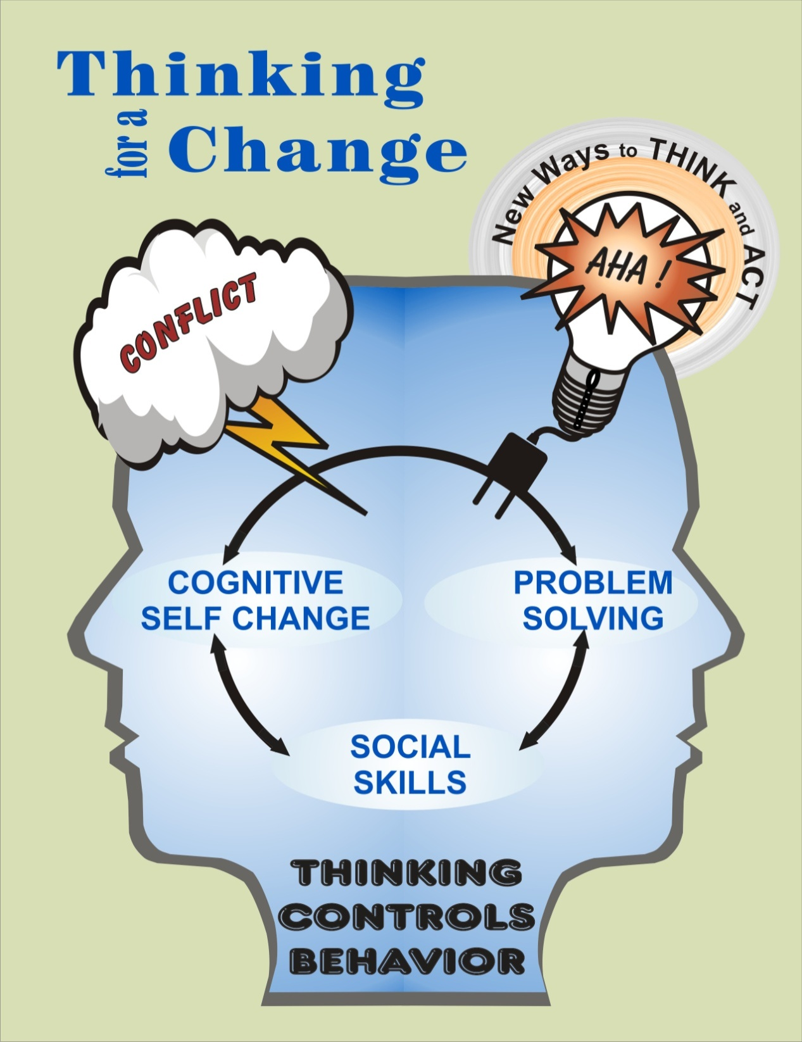

Slide 14
Thinking For A Change
I
Will
Decide
I Am
My Own
Authority
Notes:
The ultimate goal or outcome.

Slide 15
Curriculum Lessons
Social Skills
Social Skills
Active Listening
Asking Questions
Giving Feedback
Knowing Your Feelings
Thinking Controls Behavior
Cognitive Self Change
Paying Attention to Our Thinking
Recognizing Risk
Use New Thinking
Thinking
Check-In
Understanding Others Feelings
Social Skills
Making a Complaint
Apologizing
Responding to Anger
Negotiating

Slide 16
Curriculum Lessons
Problem Solving
Introduction
Stop & Think
State the Problem
State the Goal and Gather Information
Practice Steps 17-19
Think of Choices and Consequences
Making a Plan
Do and Evaluate
Problem Solving Application
Total 24 Lessons in T4C

Slide 17
Lesson Structure
Social Skills
Active Listening
Asking Questions
Giving Feedback
Knowing Your Feelings
Thinking Controls Behavior
Best suited for orientation phase

Slide 18
Lesson Structure
1. Homework review
2. Learn next social skill
  Facilitators introduce and model new skill
  Group members role play new skill and receive feedback
3. Transfer training: Contract to practice
new skill outside of class (home work)

Slide 19
Lesson 1 - Social Skills
Social skills are the skills we use when we deal with other people
Good social skills help get us what we want; maximizing positive responses, and minimizing negative responses from other people

Slide 20
Lesson 2 - Active Listening
An active way of hearing what the other person is saying to you

Slide 21
Active Listening Skills
1. Look at the person who is talking
2. Think about what is being said
3. Wait your turn to talk
4. Say what you want to say

Slide 22
Lesson Review
When did you practice the skill? Where? With whom?
What did you do to follow each step of the skill? Be specific
Tell us another situation where
you will use the skill

Slide 23
Tools & Techniques
T4C

Slide 24
Cognitive Restructuring
Pay Attention to Our Thinking
Recognize Risk
Use New Thinking

Slide 25
Parts of the Thinking Report
Part 1 - State what happened (stick with the facts)
Part 2 - List every thought you can remember
(exact words that were in your mind at the time)
Part 3 - List all the feelings you remember
having
Part 4 - List beliefs you held in this situation (beliefs are rules, principles and opinions that you carry into lots of different situations)

Slide 26
Parts of the Thinking Report
Part 1 Situation: | State the facts of what happened Who was involved and what was said and done?

Slide 27
Parts of the Thinking Report
Situation:
Part 2 Thoughts: | List every thought you can remember Use the exact words that were in your mind at the time

Slide 28
Parts of the Thinking Report
Situation:
Thoughts:
Part 3 Feelings: | List all the feelings you remember having Use words that seem right to you Feelings can be either emotions or bodily sensations, or both

Slide 29
Parts of the Thinking Report
Situation:
Thoughts:
Feelings:
Part 4 Attitudes/Beliefs: | List your attitudes and beliefs Attitudes and beliefs are rules, principles, values, or ways of thinking that you carry into lots of different situations

Slide 30
Processing a Thinking Report
Helpful Hints for Staying Objective
Don’t judge
Don’t blame
Don’t make excuses
Don’t “second guess” (suggestions about how you should have or could have thought)

Slide 31
Practice Problem Solving
Pick one real life problem situation and practice the first 2 problem solving skills
If you were not able to do the first 2 skills while the problem was actually happening, then you were to write out how you could have done each skill

Slide 32
Problem Solving Skill 1
Step 1: Stop!
Pay attention to your warning signs
Step 2: Think!
Reduce your risk

Slide 33
Problem Solving Skill 2
State the Problem
Step 1: Identify a warning sign
Step 2: Describe what happened
objectively
Step 3: Identify a risk reaction
“I (think/feel) ____________ because _______________, and my risk reaction is ____ _____________________.”

Slide 34
Problem Solving Goals
Step 1: Identify a positive
and realistic goal
Step 2: Gather Information
  Facts
  The other person’s thoughts and feelings

Slide 35
Problem Solving Goals
Keep your goal realistic–something you can make happen
Make it positive–something that doesn’t hurt you or others
Make a simple goal statement starting with the words, “I want…..” and then describe the goal
Or “ I want…, but I don’t want…”

Slide 36
Summary
Three core elements to T4C
  Social skills, Cognitive Restructuring, Problem Solving
24 lessons that help develop the above skill set
Objective, systematic approach to identifying thinking, beliefs, attitudes, and values that bring on risk
Modeling and practicing new thinking and problem solving to reduce risk

Slide 37
Summary
National Institute of Corrections
http://nicic.gov/t4c

Slide 38
Next Presentation
Title of next months presentation
Date & Time
38
Notes:
38

