Slide 1
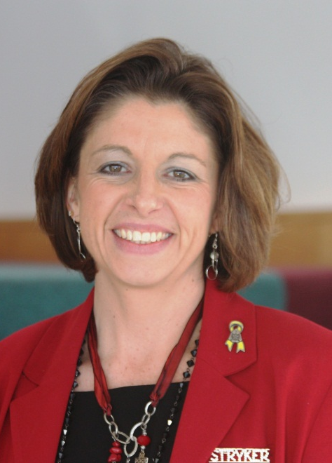
The Rules of Engagement
UNDERSTANDING THE MILITARY EXPERIENCE TO EFFECTIVELY TREAT THE INCARCERATED VETERAN

Slide 2
Learning Objectives
After completing this session, participants will be able to:
Identify four characteristics of the “military mindset” and the implications for each in treating this population.
Discuss four of the post-deployment affects that can potentially lead to incarceration.
Identify five effective clinical responses to the needs of veterans and five critical knowledge areas for clinical staff.

Slide 3

Why is this information important?
Direct and indirect interaction
Understand the culture
Provide better more effective services

Slide 4
DVA defines Veteran as:
Anyone who served in the active military, naval, or air services and who was discharged with an other than dishonorable discharge.
Who is a Veteran?
Notes:
4

Slide 5
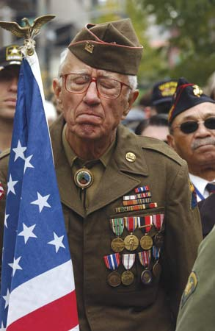
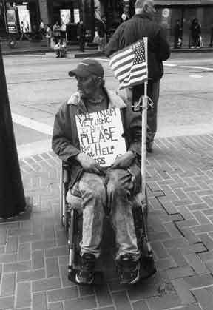
More than 21 Million Veterans in the U.S.
2.5 million OIF/OEF/OND
In communities across the country
Struggling to survive, cope, and care for their families
Estimated 140,000 veterans in state and Federal prison (BJS, 2007)

Slide 6
The Warrior

Slide 7
1.5 million all over the world
All volunteer
Active or Reserve
5 branches
United States Armed Forces
Notes:
7

Slide 8
Who Enlists?
On average:
Educated and middle-class
95% AC officers- bachelor/38% higher degrees
92% AC enlistees: HS diploma/ 87% in reserves
Score higher on intelligence tests than avg. American
RAND, 2006
Notes:
8

Slide 9
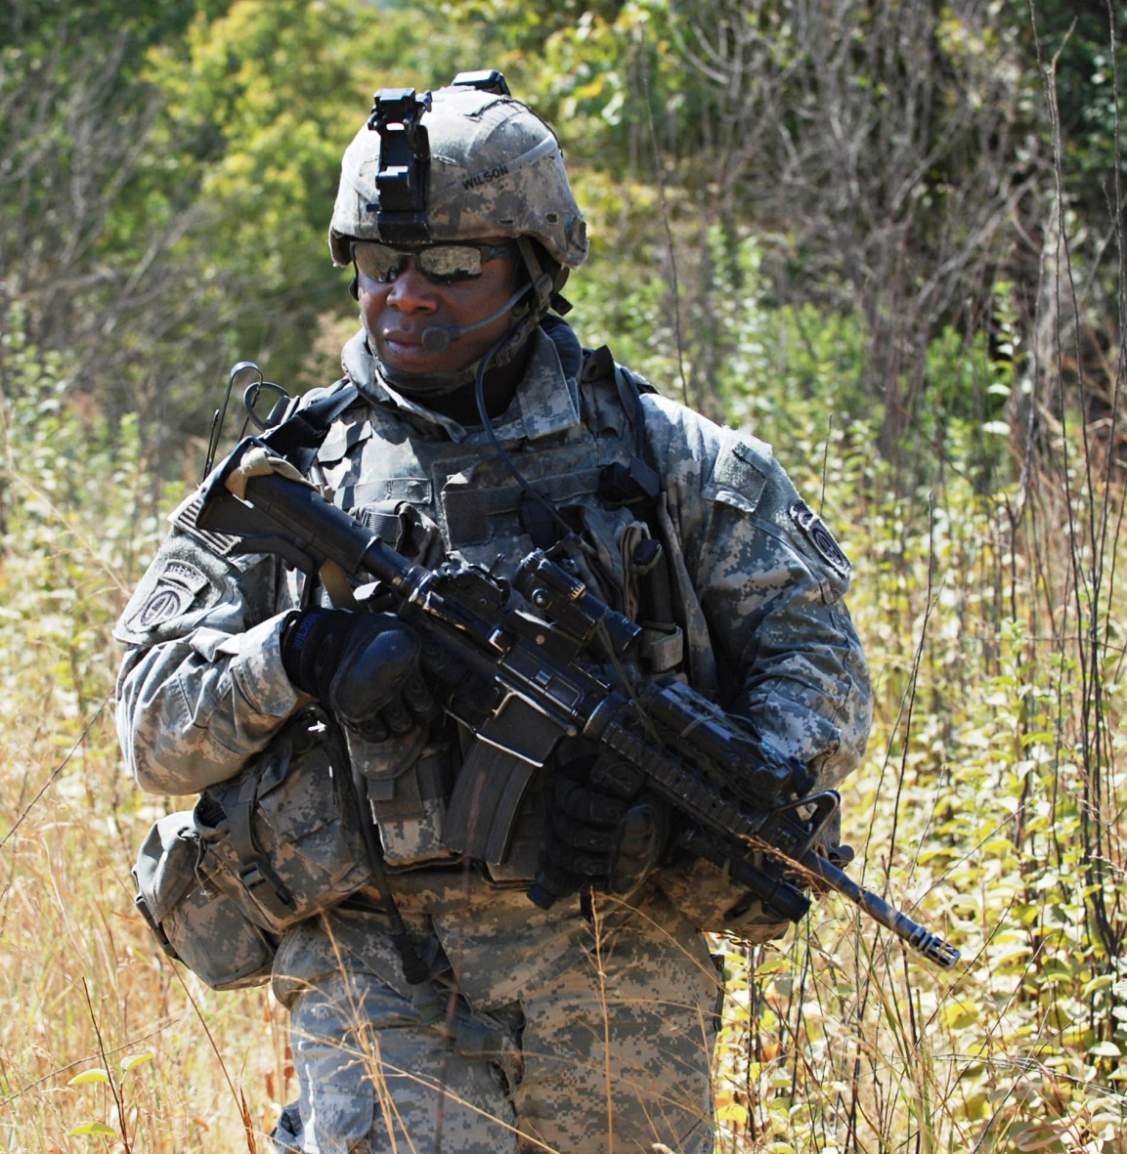
Demographics
16% are African American (14% in the civilian pop)
Latinos make up 14% of the armed forces, 16% in the general pop.
15% AC are female (2% in 1973); 16% of the Officer Corps
Middle or lower class
The South is overrepresented
RAND, 2006

Slide 10
Why Enlist?
Patriotism
Giving back
Part of the solution
Friends enlisted
Education benefits
A job
Loyalty
Finish the mission
Home doesn’t work anymore

Slide 11
Military Mindset
First trained to kill
Mission first
Control
Discipline
Ingrained through repetition
Follow orders
Military Values

Slide 12

The Combat Experience

Slide 13
Surviving Wounds
Today military members are surviving wounds that in previous wars would have killed them.
Visible and invisible wounds

Slide 14
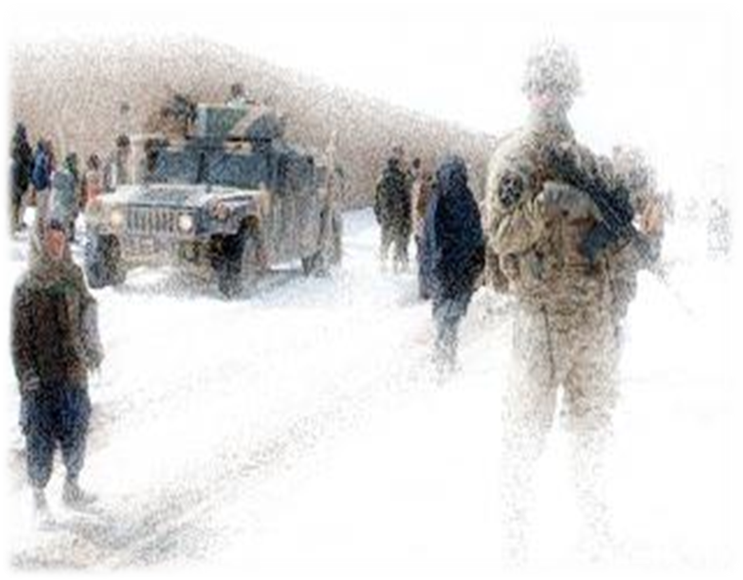
The Combat Zone
Confusion
Disruption
Uncertainty

Slide 15
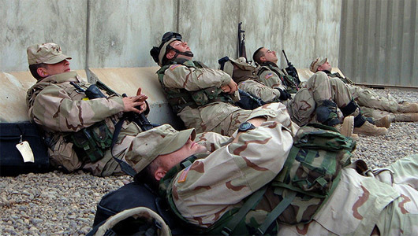
Sleep Deprivation

Slide 16
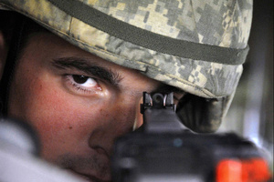
Constant Tactical Awareness
No “front”
Even when it’s safe
it’s not safe
Insurgency war

Slide 17
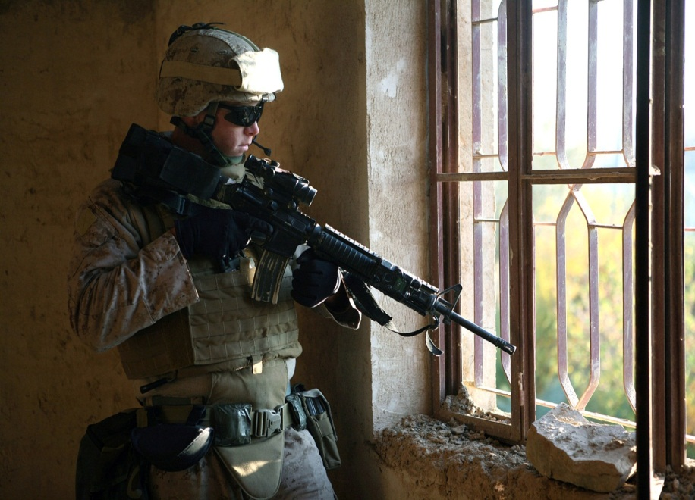
Split-second decisions
Accelerator and brake

Slide 18

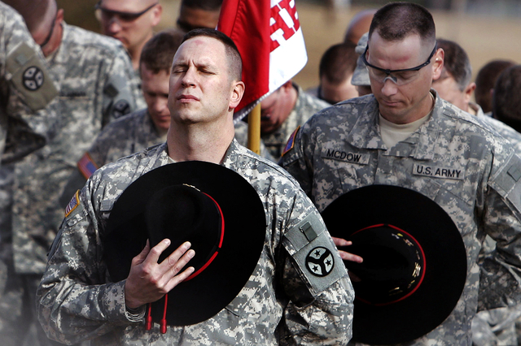
Multiple losses, grief, and guilt

Slide 19
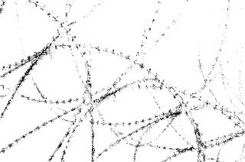
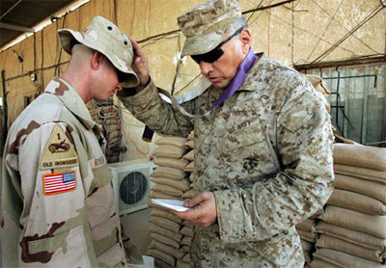
Maximum moral and spiritual damage
Maximum moral and spiritual damage

Slide 20

When We Come Home

Slide 21

Transition and Reintegration
Most challenging period of time following a deployment
Rebuild personal relationships: family members and friends; employers and colleagues, etc.
Return to “normal”??
The majority of returning vets reintegrate without long terms issues.
However,…

Slide 22
PTSD: Prevalence estimates 12-18% post-deployment (Hoge et al, 2004) Higher rates in Reserve personnel.
Depression: Post-deployment screenings found major depression symptoms in 14% of veterans. Depression co-occurs with PTSD in about 60% of those with PTSD (Tanielian & Jaycox, 2008).
TBI: Estimates at 15-19%; difficult to determine numbers and long-term effects. **Evaluation is critical.
SUD: correlates to PTSD, MDD, and TBI; prescription drug use; self-medicating
Poor health: Chronic musculoskeletal issues, poly trauma, blast-related injuries
…Many struggle with:
PTSD
Depression
TBI/mTBI
Substance Use
Poor overall health

Slide 23
Women veterans struggle with multiple issues

Slide 24
How do we know help is needed?
Much closer to trauma, multiple tours of duty, 40% “mental health issues,” 60% of those have SUDs (Danforth, 2007)
A little more than half who meet criteria for PTSD, depression, TBI have sought help or been evaluated (Tanielian & Jaycox, 2008)
Higher risk for suicide; Depression, PTSD, TBI (Tanielian & Jaycox, 2008)
Significant numbers are avoiding treatment for fear of stigma and its effects (Tanielian & Jaycox, 2008)

Slide 25
As a result…
Degradation of personal relationships
Increase in inter-personal violence
Risk-taking behavior

Slide 26
Incarcerated Veterans

Slide 27
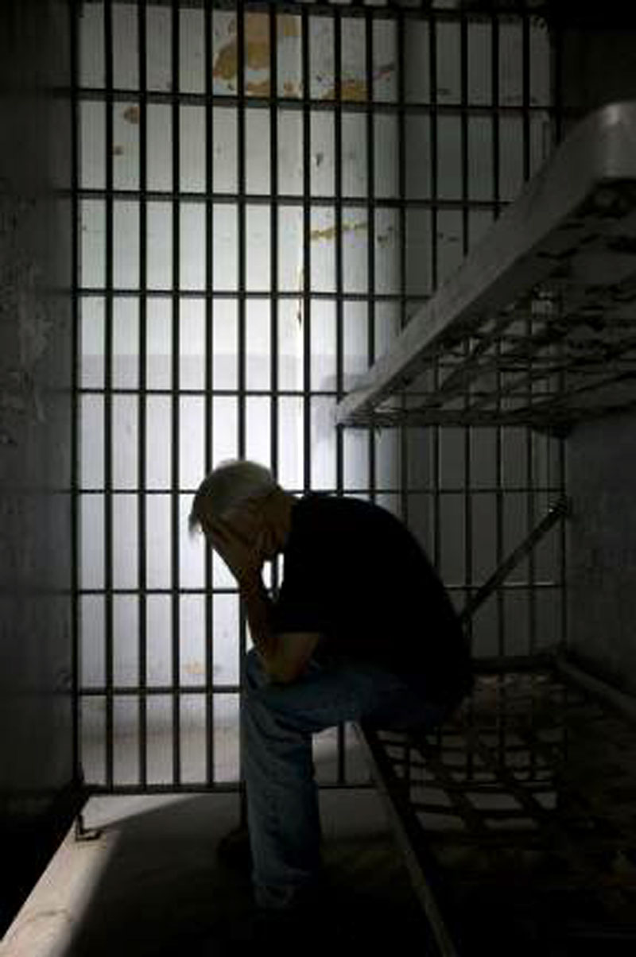
Demographics
99% Male
Older than non-veteran population
Better educated than non-veteran population
More than half served during a war era, 20% had been in combat (state prisons)
Federal prisons: two-thirds served during wartime, 25% combat veterans
60% had been honorably discharged
BJS, 2007

Slide 28

Criminal Background
Shorter criminal histories
Longer average sentences
Over half of veterans (57 percent) were serving time for violent offenses
Nearly one in four veterans in state prison were sex offenders
Veterans were more likely to have victimized females and minors.
More than a third of veterans in state prison had maximum sentences of at least 20 years, life or death.
BJS, 2007

Slide 29
Screening
Screening and assessment
Trauma, SUDs, Co-occurring disorders, risk of suicide etc.
Avoid re-traumatization
Match appropriate services/treatment planning
Combat Exposure Scale
Deployment Risk and Resiliency Inventory

Slide 30
Treatment Approaches
CBT found to be most effective
Seeking Safety
Psychoeducation
Anxiety management
Exposure and cognitive restructuring (Most effective)
Exposure therapy
Prolonged Exposure
Cognitive Processing Therapy
VA Clinical practice guidelines http://www.healthquality.va.gov/ptsd/PTSD-FULL-2010a.pdf

Slide 31
Treating the Veteran
Focus on safety
Where possible—peer supports/peer groups
Individualized treatment plan created in conjunction with the veteran

Slide 32
The Effective Clinician
Military-informed
An understanding of the self and any limitations
Avoid assumptions and stereotypes
Recognition of any personal beliefs about war and those who fight them
(Woll, Finding Balance, 2008)

Slide 33
Self-Care for the Clinician
Skills for avoiding secondary trauma/re-traumatization
Remember therapist is only one step—check the ego!
Ongoing self assessment/inventory
Strong supervisory network/support
Be able to walk away
(Woll, Finding Balance, 2008)

Slide 34
Resources for Veterans

Slide 35
Dept. of Veteran’s Affairs
VHA (Health care)
VISNs
VBA (Benefits)
National Cemetery Association

Slide 36
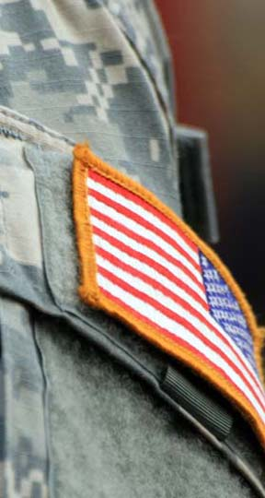
VA Resources
OIF/OEF Coordinators
Health Care for Re-entry Veterans
http://www.va.gov/HOMELESS/Reentry.asp
Veterans Justice Outreach
http://www.va.gov/homeless/vjo.asp

Slide 37
VA Benefits
Continue during incarceration
Reduced on 61st day of incarceration for felony; no reduction for misdemeanor
Health care continues post-incarceration
Dependents can receive benefits while veteran is incarcerated
Resumption of benefits upon release
Pre-release planning— VA

Slide 38
Other Resources
Health care for re-entry Veterans Guides
State by state resources
http://www.va.gov/homeless/reentry_guides.asp
MilitaryOne Source
Incarcerated Veterans’ Transition Program
http://www.usich.gov/funding_programs/programs/incarcerated_veterans_transition_program/

Slide 39
QUESTIONS?

Slide 40
For more information on RSAT training and technical assistance visit:
http://www.rsat-tta.com/Home
or email Jon Grand, RSAT TA Coordinator at
jgrand@ahpnet.com

Slide 41
Next Presentation
Co-occurring Disorders and Integrated Treatment Approaches for RSAT Programs
May 16, 2012 2:00-3:00 PM EDT
Integrated treatment has become the standard of care for individuals with substance treatment needs and co-occurring mental health disorders (CODs). New research tells us that CODs are more prevalent among people entering substance use treatment than previously assumed, and even more common still among those incarcerated in US prisons and jails. The challenge for RSAT staff is to ensure the individuals complete treatment with an understanding of how their substance use and mental health disorders interact and the strategies that will help sustain recoveries from both. Although many professionals tend to label individuals with CODs as resistant or difficult to treat, research has identified effective practices that RSAT staff can successfully employ during treatment and in aftercare planning. The goal of this training is to introduce integrated treatment approaches that RSAT programs can apply at the screening, assessment and intervention levels.
Presenter: Niki Miller

