Slide 1

Partnering with Public Behavioral
Health Authorities to Build Effective
Aftercare Programs
Bruce Emery, Deputy Director
Technical Assistance Center
bemery@ahpnet.com
Advocates for Human Potential
www.ahpnet.com

Slide 2
Objectives
Introduce participants to the goals and structure of state systems of public behavioral health care.
Discuss possible partnerships between mental health and substance abuse authorities and corrections agencies.
Review the kinds of aftercare program related activities that these partnerships have produced and depend on.
Understand the health care environment facing public mental health and substance abuse authorities.

Slide 3

Context and Background
Aftercare
RSAT programs must collaborate with other State and local vocational, health and human services providers!
Single State Agency (SSA): Each unit of state government has a SSA for substance abuse treatment efforts.
RSAT programs are required to work with the SSA to coordinate a continuum of care for RSAT participants in community substance abuse treatment facilities as they are released.

Slide 4
Single State Authorities (SSA) and State Mental Health Authorities (SMHA)
Each State has an appointed:
Single State Authority for Alcohol and Drug Abuse prevention and treatment.
State Mental Health Authority.
Similar functions:
  Provide system leadership and vision
  Allocate and manage resources (i.e., contract for services, establish performance expectations, evaluate outcomes, comply with fiscal regulations and federal expectations, etc.)
  Establish and monitor licensure and certification requirements
  Advocate for resources at community, state and national level

Slide 5
Look Beyond the SSA…
Two Reasons:
The SSA most frequently “sits” within the SMHA and reports to the State Mental Health Commissioner
SMHAs also deliver alcohol and drug abuse services, no matter where the SSA is located in state government, so they can be effective partners.

Slide 6
States with Mental Health and Substance Abuse Responsibilities in One Agency: 1970 to 2010

Slide 7
Substance Abuse Agency Relationship to the SMHA: 2010

Slide 8
Numbers of Layers between SMHA Commissioner/Director and State Governor (2010)

Slide 9
Aiming for a “Good and Modern” System of (Mental Health & Substance Abuse) Behavioral Health Care
A modern mental health and addiction service system provides a continuum of effective treatment and support services that span healthcare, employment, housing and educational sectors.
Integration of primary care and behavioral health are essential.
A modern addictions and mental health service system is accountable, organized, controls costs and improves quality, is accessible, equitable, and effective.
It is a public health asset that improves the lives of Americans and lengthens their lifespan.

Slide 10


Slide 11
“Do more with less!”
Impact of State and Federal Budgets
Centers for Medicare and Medicaid (CMS)
Healthcare Reform
  “Healthcare Reform is on the agenda—You can’t go!”
  “Don’t leave us out…again.”
State Mental
Health Authorities & Single State Agencies
Pressure Points
Integration
Trauma Informed Care, Reduction of Seclusion and Restraint…and then there’s OSHA
  “Don’t say behavioral health!”
  “We’ll be swallowed!”
Prevention
  “We don’t feel safe unless we can use more seclusion and restraint.”
Risk, Rights, and Responsibilities: DOJ, Olmstead, and Housing
  “Mental illness can’t be prevented!”
NASMHPD Mental Illness & Violence Toolkit
“All people who mentally ill are violent!”
  “If you don’t do it,
  we’ll sue!”
  “Not in my backyard!”
Notes:
--Click mouse twice for animation of pressure points.

Slide 12
FUNDING

Slide 13
Primary Methods SMHAs Used to Fund Community MH and SA Services: 2010

Slide 14
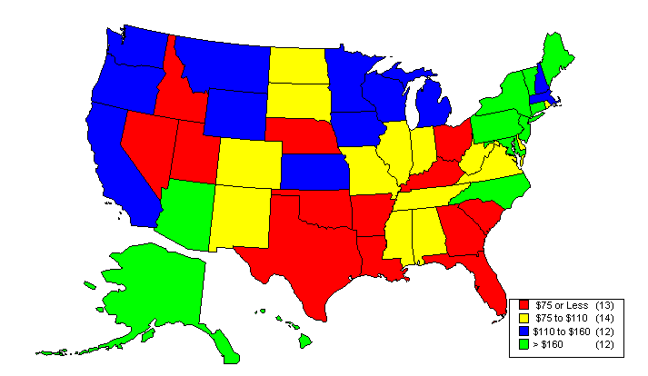
Total FY'2009 SMHA-Controlled Per Capita Mental Health Expenditures

Slide 15
Fiscal Year 2009 SMHA-Controlled
Per Capita Expenditures

Slide 16
SMHAs with Budget Cuts:
Fiscal Years 2010 to 2012
Preliminary Results Based on 47 SMHAs Reporting

Slide 17
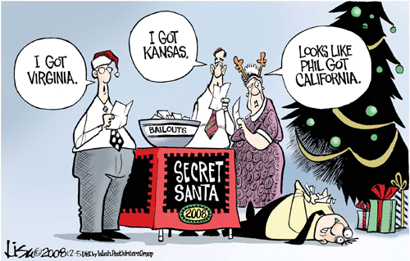

Slide 18
Level of State Mental Health and Alcohol and Drug Budget Reductions:
FY2009 to FY2012 Total $3.4 Billion in Cuts
Year | Average | Median | Minimum | Maximum | Total
FY 2009 (39 States) | $36,849,116 | $13,226,000 | $0 | $554,003,000 | $1,216,020,843
FY 2010 (38 States) | $29,123,575 | $12,300,000 | $0 | $213,591,000 | $1,019,325,136
FY 2011 (37 States) | $37,981,650 | $12,000,000 | $0 | $523,437,000 | $1,177,431,138
FY 2012 (7 states) | $12,959,616 | $6,150,000 | $0 | $32,000,000 | $77,757,695
Preliminary Results based on 47 SMHAs Reporting

Slide 19
State Budgets in FY’12 and Beyond
States have collectedly dealt with over $432 Billion in budget shortfalls from State FY 2009 to 2011
42 States and DC have projected shortfalls of $103 Billion in FY’12
State Revenues are growing, but are still below were they were in FY 2008
Federal Recovery Act (Stimulus) funds are ending

Slide 20
SMHA Responses to Cuts in Overall Budget
Summer 2010 (Percentage of States with Cuts)
Preliminary Results based on 47 SMHAs Reporting

Slide 21
SMHA-Controlled Forensic and Sex Offender Behavioral Health Expenditures As a Percentage of State Psychiatric Hospital Expenditures, FY'83 to FY'09

Slide 22
SERVICES

Slide 23
Persons Served by SMHA Systems: 2010
Consumers Served:
2010 – 6.8 million consumers received SMHA Mental Health and Substance Abuse services (2.2% of US population).
Served in Community and State Hospitals:
2010 - 95% were served in the Community and
2% served in state psychiatric hospitals.

Slide 24
Change in Persons Served by SMHAs
(2002 to 2010)
Notes:
2007 to 2008-
Average increase of 2.7% (percentage served in Community)
Average increase of 3.0% (percentage served in State Hospitals)

Slide 25
Increased Demand for Behavioral Health Services During the Recession
Percentage of States Experiencing Increased Demand for Services
Preliminary Results based on 47 SMHAs Reporting

Slide 26
What We Share…
Recovery Oriented Outcomes

Slide 27
Outcomes of Mental Health and Substance Abuse Services
Reduced
Substance Abuse
Work/School Performance
* NOM
Reduced Symptoms
Reduced Re-Hospitalization * NOM
Increased Functioning* NOM
Independent Community Living * NOM
Reduced Symptom Distress
Reduced Criminal Justice Involvement * NOM
Increased Social Connectedness * NOM
Recovery

Slide 28
National Outcome Measure (NOM) 1:
Increased Access to Services
59 States and Territories reported in 2010
6,835,040 Consumers Were Served by the States
2.2% of the population of the United States received state mental health agency services
  Range from 0.1% to 4.4% of State or Territory Population
SAMHSA TEDS Data for Substance Abuse shows 1,963,089 Admissions in 2009
  42% were Alcohol Related

Slide 29
A Recovery-Oriented Continuum for Behavioral Health Care and RSAT
SAMHSA defines “recovery” as a process of change through which individuals work to improve their own health and wellbeing, live a self-directed life, and strive to achieve their full potential.
SAMHSA has delineated four major dimensions that are essential to a life in recovery:
  Health;
  Home;
  Purpose; and
  Community.
RSAT programs should work with people, pre-release to achieve success within each of these four domains. During the re-entry phase of the program clients can begin laying the ground work in each of these areas.
Notes:
Reach out to state authorities to partner in any of these areas: to improve health, home, purpose and community of shared clients.

Slide 30
An RSAT Continuum of Care
Building a Continuum of Care
A sequential progression through the following stages of recovery services:
  Pre-Treatment
    After risk and need assessment indicates substance abuse is risk factor, a more comprehensive substance screening or assessment is required (TCU II, ASI).
    Strengthen motivation for tx
  Primary Treatment
    Provide the level of treatment indicated by the assessment.
    Primary tx needs addressed (ex: abstinence from AODs, develop adaptive life/problem-solving skills, recovery management, family issues, etc.)
  Transition Services
    Adequate preparation for discharge.
    Develop partnerships with community-based treatment and other health and human services providers to connect inmates prior to release from incarceration.

Slide 31

Health
Health: Overcoming or managing one’s disease(s) as well as living in a physically and emotionally healthy way.
Research suggests that the connection between health and other desirable outcomes may be underestimated

Slide 32
Health
RSAT clients returning to communities need healthcare services.
  1/2-2/3 of CJ involved men and women are diagnosed w/ one or more chronic condition
  5-11 times the rate of HIV
  Prevalence of Hep C is 6-7 times higher
  Substance Abuse/ MH/ Co-Occurring
Re-entry Phase Tasks:
  State or Local jurisdiction is responsible for healthcare needs
  Refer to RNR for service needs
  Confirm benefit eligibility and enroll is appropriate
  Identify necessary health services
    Patient centered medical homes/community health centers
    Transitional supplies of medications
  Compile health care discharge summary, and other records needed for continuity of care.

Slide 33
Home
Home: A stable and safe place to live.
RSAT clients re-entry housing accommodations play an important role in reducing criminogenic factors and providing the stability needed to implement a re-entry/aftercare plan.
  Housing needs may already be assessed and flagged as part of the client’s case plan.
  Center stage for high and medium risk offenders, but are an important part of stabilizing all re-entering individuals.
  Housing safety for any re-entering offender with a substance use disorder is a consideration (there are also gender specific assessment tools for women)
Re-entry Phase Tasks:
  Is the housing accommodation free from substances, violence, and criminal associates?
  Are household members likely to drink or use drugs?
  Are there housing programs the client might qualify for?
  What is the client’s plan to cope with triggers and temptation if he or she is planning to live in a high risk neighborhood with lots of bars, dealers, and old friends?
Notes:
The answers to the following questions will inform the objectives and tasks the client needs to list under the goal of safe, sober, and stable housing in the pre-release plan.

Slide 34
Purpose
Purpose: Meaningful daily activities, such as a job, school, volunteerism, family caretaking, or creative endeavors, and the independence, income, and resources to participate in society.
RSAT clients need structured time.
  High Risk Offenders: Fill post-release time with an intense level of activities and programming
  All Offenders: Large amounts of downtime are not desirable in early recovery
Re-entry Phase Tasks:
  Compile offenders’ certifications, diplomas, transcripts, letters of recommendation from jobs, identification and documentation.
  Identify local employment centers that work with offenders
  Complete Federal Financial Aid Application
  “Plan B” activities in case employment is not readily available
  Pro-social leisure and recovery-oriented activities (community rec centers, recovery support meetings, etc.)

Slide 35
Community
Community: Relationships and social networks that provide support, friendship, love, and hope.
RSAT clients, like other offenders, have risk factors for recidivism
  Most predictive risk factors for recidivism include: criminal associates, criminal thinking and anti-social values and personality traits.
Re-entry Phase Tasks:
  Challenge clients to demonstrate how they will cultivate pro-social relationships and contacts and what character building, value-based activities, and learning they will undertake.
  Membership at the YMCA? Attending a church? AA meetings? Exposure counts!
  Actively coach clients to consider strengths, talents, preferences, and affiliations; their cultural backgrounds and extended networks.
  Identify friends, allies, contacts and relationships.

Slide 36
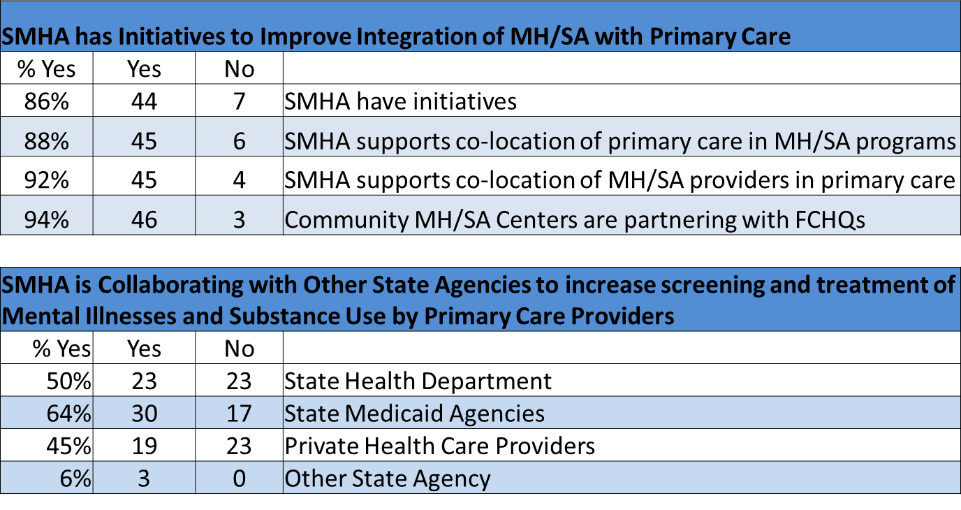
State Initiatives to Integrate Health with Mental Health and Substance Abuse Care

Slide 37
Relevance of Public Mental Health and Substance Abuse Authorities to RSAT
Federal funds for RSAT programs require the States to give preference to programs that provide aftercare and coordinate services with alcohol and drug rehabilitation agencies at the State and local levels.
However:
  Only 10% is directed toward post-release programming
  Restrictions on the use of community-based tx funds directed towards pre-release inmates….SO
  Partnerships with public substance abuse and mental health authorities are essential to effective aftercare programs

Slide 38
Partnering with State Mental Health and Substance Abuse Authorities for RSAT Programs is Effective
Shared Values and Recovery Orientation
Common Approaches to Distinct Life Domains
Economic Necessity of Scarce Resources
Better Outcomes for Complex Client Problems

Slide 39
Next Presentation
Medication Assisted Treatment (MAT)
August 15, 2012 2:00 – 3:00 p.m. EDT
There has been much published in the past 10 years on the advantages of using Medication Assisted Treatment (MAT) for certain substance use disorders, most notably for opiate and alcohol dependency. Research has shown the benefits of using a combination of medication and psychotherapy outweigh the negative aspects, which have long prevented MAT from being used consistently. This presentation will look at the different types of medication being used in Opioid Replacement Therapy (ORT) and alcohol treatment, their efficacy as an intervention, and several studies being conducted by the federally funded CJ-DATS II project.
Presenter:
Phillip Barbour
39
Notes:
39

