Slide 1
Voices from the Field: Innovations in RSAT Programming
RSAT Staff from Barnstable, Berkshire, Middlesex, and Norfolk County Jails

Slide 2
RSAT
Barnstable County
Massachusetts
April 16, 2014

Slide 3
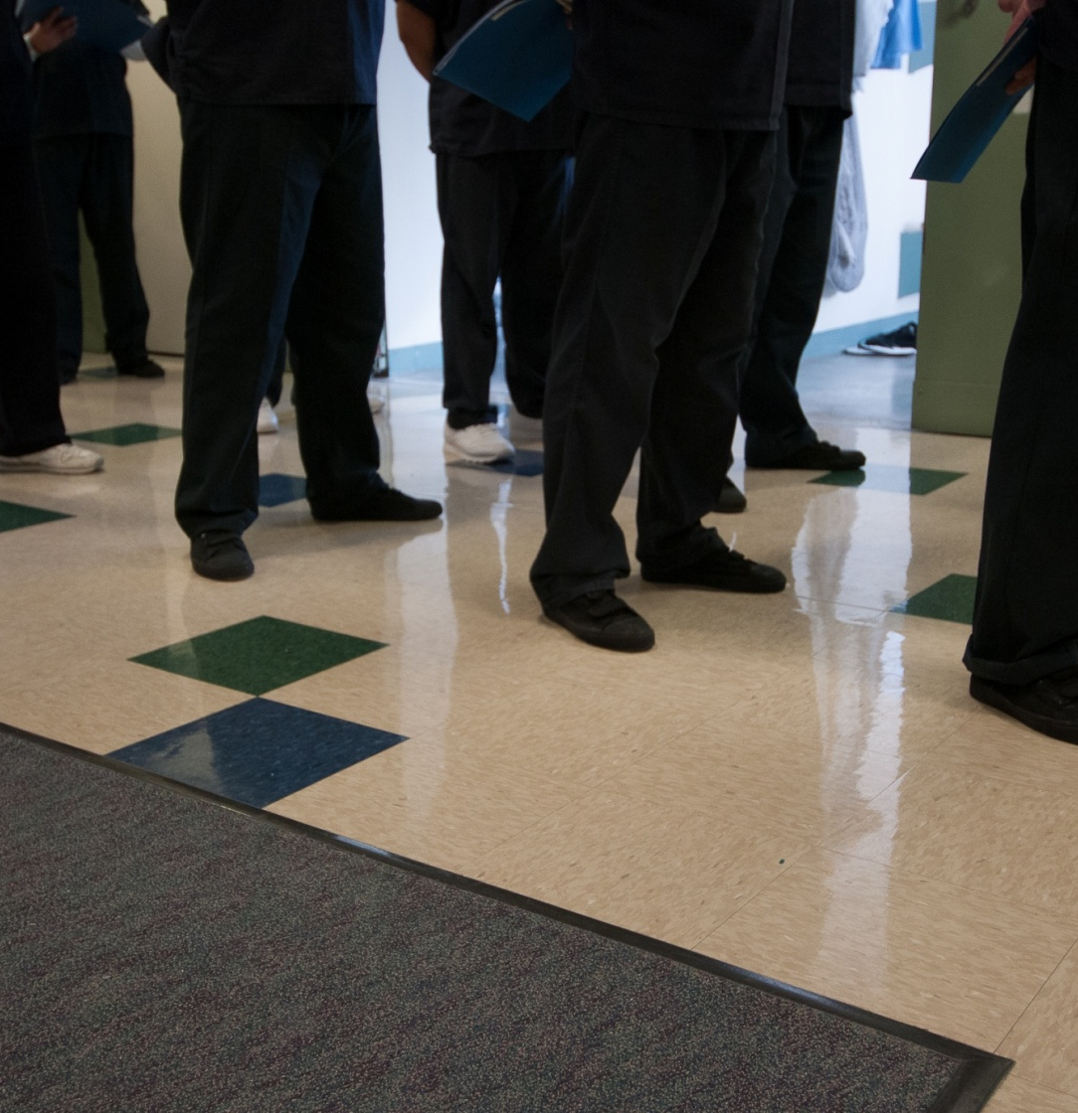
A therapeutic community utilizing a military-based lifestyle.
Not a boot camp.
Community is emphasized as the element of change.

Slide 4
Advantages to a Military-Based Lifestyle
Creates daily rituals that require self-awareness and awareness of community traditions
Easily recognized community standards
Routines establish a safe and quiet environment
Develops observable self-discipline and responsibility
Daily events performed as a unified unit
Well-defined difference from the general population units helps with the sense of community

Slide 5
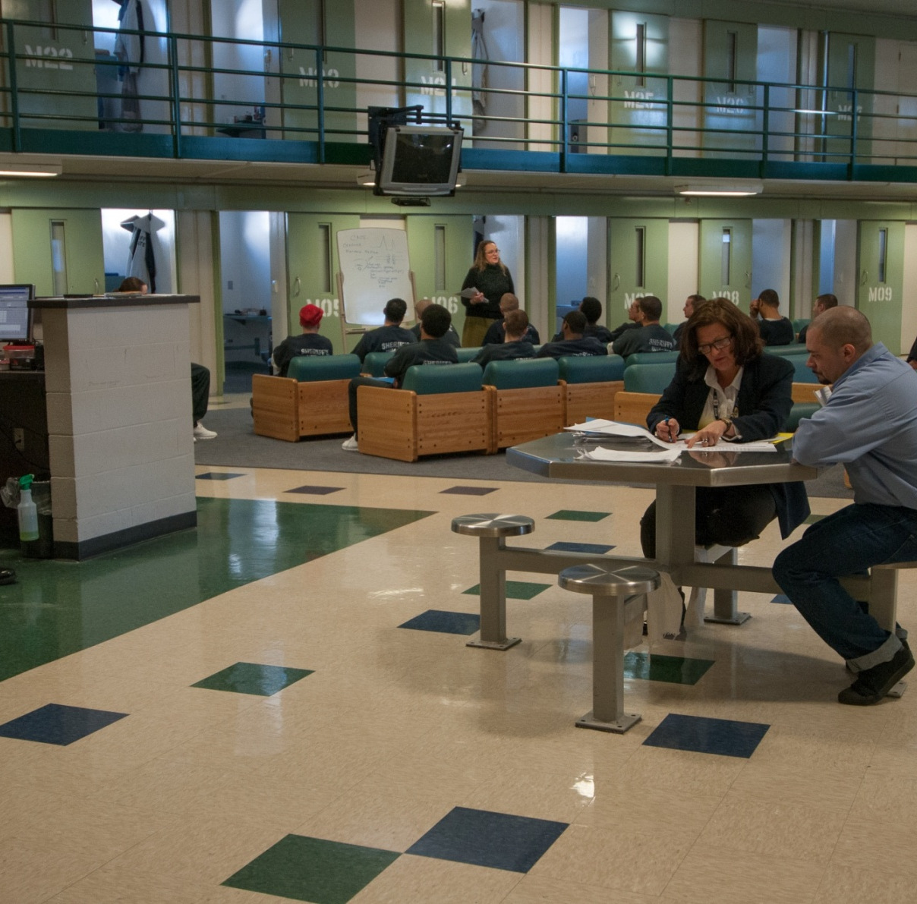
Peer Leadership
ProgressiveDiscipline
Progressive Rewards

Slide 6
Progression
First 60 days a community member is on Prep status
60 day review will approve advancement to higher status and increased privileges
120 day review will assure community member is meeting requirements of program
One month prior to completion, community member is reviewed for completion status.
Certificate of completion awarded at weekly community meeting

Slide 7
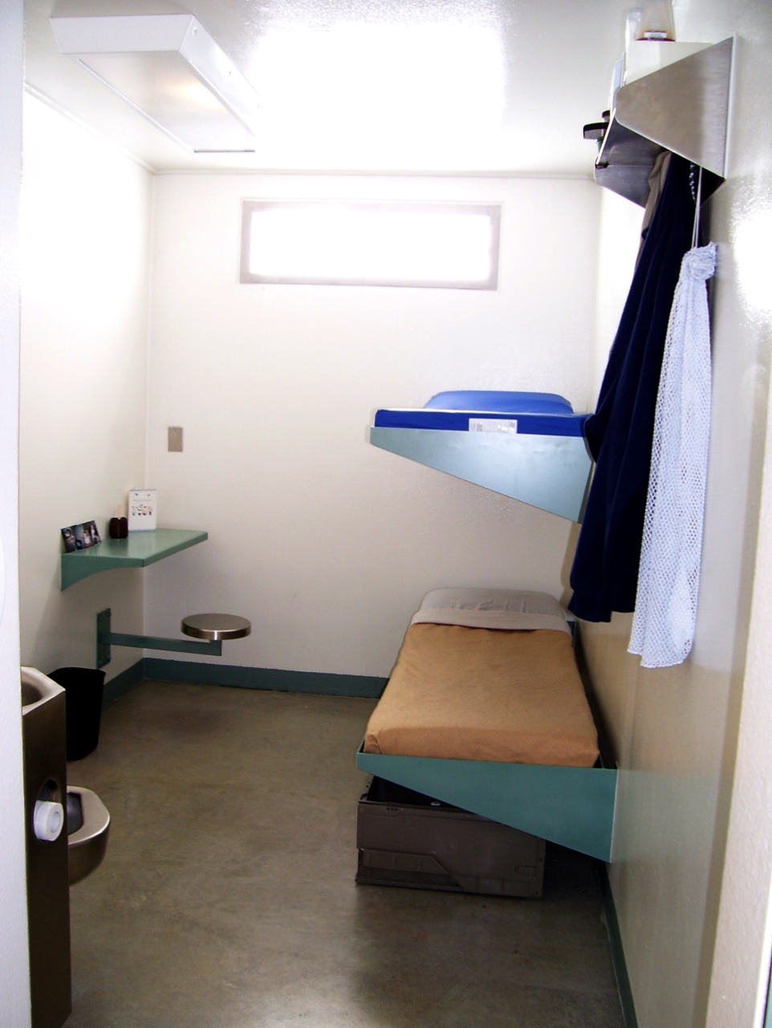

Slide 8
RSAT Officers
Require RSAT Training prior to supervising unit
Serve as role models for effective and respected rational authority
Familiar with program content

Slide 9
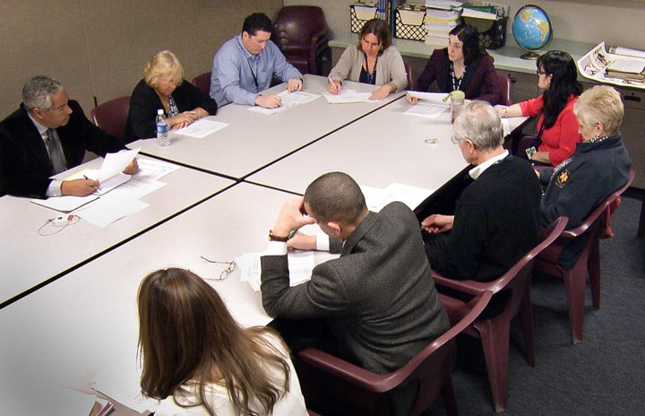
Re-Entry

Slide 10
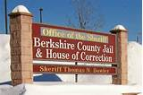
Berkshire County Jail & House of Correction
RSAT –
The Bridge Program

Slide 11
The Bridge Program
An intensive substance abuse treatment program designed to confront, challenge and change substance abuse and/or criminal thinking and/or behavior.
Underlying principles:
  Individuals are responsible for their behavior
  Individuals are able to change their behavior
  Bio-Psycho-Social-Spiritual perspective

Slide 12
The Bridge Program - EBP
Evidenced-based program elements:
  Motivational Enhancement Therapy (MET )
    A consumer-centered, directive method for enhancing intrinsic motivation to change by exploring and resolving ambivalence
    a systematic intervention approach for evoking change
    based on principles of motivational psychology
    designed to produce rapid, internally-motivated change
      Source: William R. Miller, Ph.D.
  Cognitive Behavioral Therapy
    A therapeutic approach that attempts to solve problems resulting from dysfunctional thoughts, moods, or behavior through brief, direct, and time-limited structured counseling.
    An approach that focuses on understanding a person’s behavior in the context of his or her environment, thoughts, and feelings.

Slide 13
The Bridge Program - EBP
Evidenced-based program elements:
  Integrated Mental Health and Substance Abuse Services - Treatment and service provision to support recovery from co-occurring mental illness and substance abuse through a single agency or entity.
  Psychopharmacology - Treatment that uses one or more medications (e.g., antidepressants) to reduce depression, psychosis, or anxiety by acting on the chemistry of the brain
  **12-Step or Other Mutual Aid Groups (**Promising Programs) - Groups of non-professionals who share a problem and support one another through the recovery process

Slide 14
The Bridge Program - Curriculum
TOPICS:
Process of Change
Barriers to Change
Motivation
Communication
Accountability
Rational vs. Irrational Thinking
Wellness (Physical, Nutritional, Emotional, Spiritual)
Managing Addictive Thoughts, Feelings, Behaviors
Damaging Consequences of Addiction

Slide 15


MIDDLESEX HOUSE OF CORRECTION
Peter J. Koutoujian, Sheriff
Sean McAdam, Superintendent
VIVITROL® PILOT PROGRAM
A Medically-Assisted Treatment Component of the A.R.C. Program
Edward R. Bleu, MA LADC I
Middlesex County Regional Manager
AdCare Criminal Justice Services, Inc.
Notes:
A.R.C. is the abbreviation for our 90-day treatment program of personal Accountability, personal Reimaging and respectful Community reintegration

Slide 16
The A.R.C. Program
Middlesex House of Correction
VIVITROL® is:
A monthly extended-release injectable formulation of naltrexone used to treat alcohol and opiate dependence
Administered by a healthcare professional
An effective complement to psychosocial treatments
A opioid blocker (i.e. antagonist)
Notes:
Vivitrol is a registered trademark of Alkermes, Inc. of Waltham , MA.

Slide 17
The A.R.C. Program
Middlesex House of Correction
VIVITROL is not:
● A narcotic
● Pleasure producing
● Addictive
● Associated with abuse
Notes:
These features support the underlying treatment philosophy of the A.R.C. program which is based on Dr. Stephen Valle’s “Accountability Training”® model.

Slide 18
The A.R.C. Program
Middlesex House of Correction
Inmates and returning citizens who have acquired a measure of sobriety and reimaging should be reminded that the structured lifestyle which served to promote their recovery efforts was manufactured. That is, their sobriety was imposed on them by design.
Though they may be justly confident in their stability under supervision, severe challenges await them upon release.
Triggered by familiar surroundings, “urges and cravings” may become so pervasive and intense that they overwhelm the “protective factors”* that a client may possess.
Notes:
*”Protective Factors” are an individual’s most important values.

Slide 19

Vivitrol’s construct is designed to neutralize these urges, thereby effecting a bio-psycho-social “releasing” of the client to fully participate in a continued network of support after supervision. As a result, a person feels free to focus on what to do as opposed to what not to do.
“90 in 90”*
Supportive People
Physical Well-Being
Education
Pro-social
Activities
Finances
Spiritual Growth
The A.R.C. Program utilizes both peer-mentoring as well as an interactive journaling system to nurture positive, cognitive-behavioral change.
A.R.C. is founded on
Dr. Stephen Valle’s Accountability Training® model which empowers people to accept personal responsibility for their actions as they assume respectful positions in their communities.
Notes:
*“90 Meetings in 90 Days” can include appointments as well as conventional self-help meetings!

Slide 20
The A.R.C. Program
Middlesex House of Correction
Protocol for Participation in the Vivitrol Pilot Program
● Potential participants identified by initial assessments as opiate dependent
● Select individuals are invited to participate, authorizing our Medical
Department to contact them as their release date approaches
● Medical Department staff conference with the returning citizen on several
occasions, discussing the particulars of the Vivitrol formulation and its
administration.
● Concurrently, participants are linked to Vivitrol and counseling providers in
their communities as a continuum of care component.*
● The first Vivitrol injection is administered approximately one week prior to
release
● Monthly compliance to Vivitrol/Counseling regimen is documented
Notes:
*Participants must agree to allow MHOC to track their compliance for outcome measure assessment of program.

Slide 21



The A.R.C. Program
Middlesex House of Correction
Sean McAdam, Superintendent
Middlesex House of Correction
269 Treble Cove Rd., North Billerica, MA. 01862
e-mail: SMcAdam@sdm.state.ma.us T +1 978-932-3376
Ed Bleu, ACJS e-mail: ebleu@sdm.state.ma.us T +1 978 932 3304
Middlesex House of Correction, POD A
269 Treble Cove Rd., North Billerica , MA 01862
Pamela O’Sullivan, Associate Director State Government Relations
Alkermes, Inc.
852 Winter St., Waltham, MA 02451-1420 USA
e-mail: pamela.osullivan@alkermes.com T +1 508 944 8436

Slide 22
The RSAT Intensive ReEntry Program
Norfolk Sheriff's Office
Sheriff Michael G. Bellotti

Slide 23
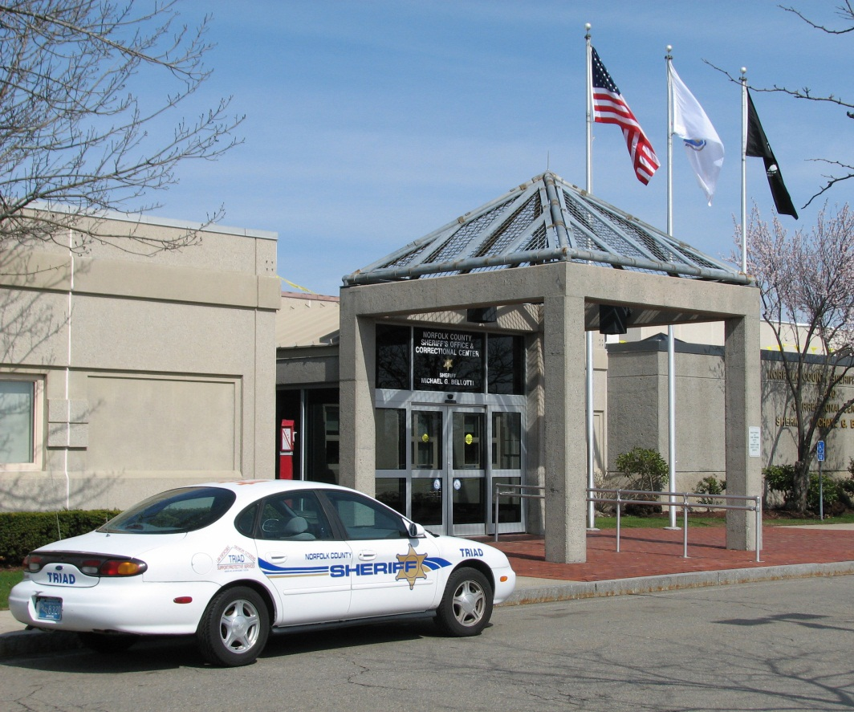
The Norfolk Sheriff’s Office
Mission: Serve the citizens of Norfolk County by enhancing public safety through operation of direct supervision correctional facilities and community re-entry programs.
Average Daily Population of 626 inmates
Average Length of Stay: 152 days
Gender: Male
Age range: 41% (20-29)
Inmates with Drug offenses: 11%
Inmates with MV/Alcohol offenses: 14%
78% self-reported substance abuse issues upon admission

Slide 24

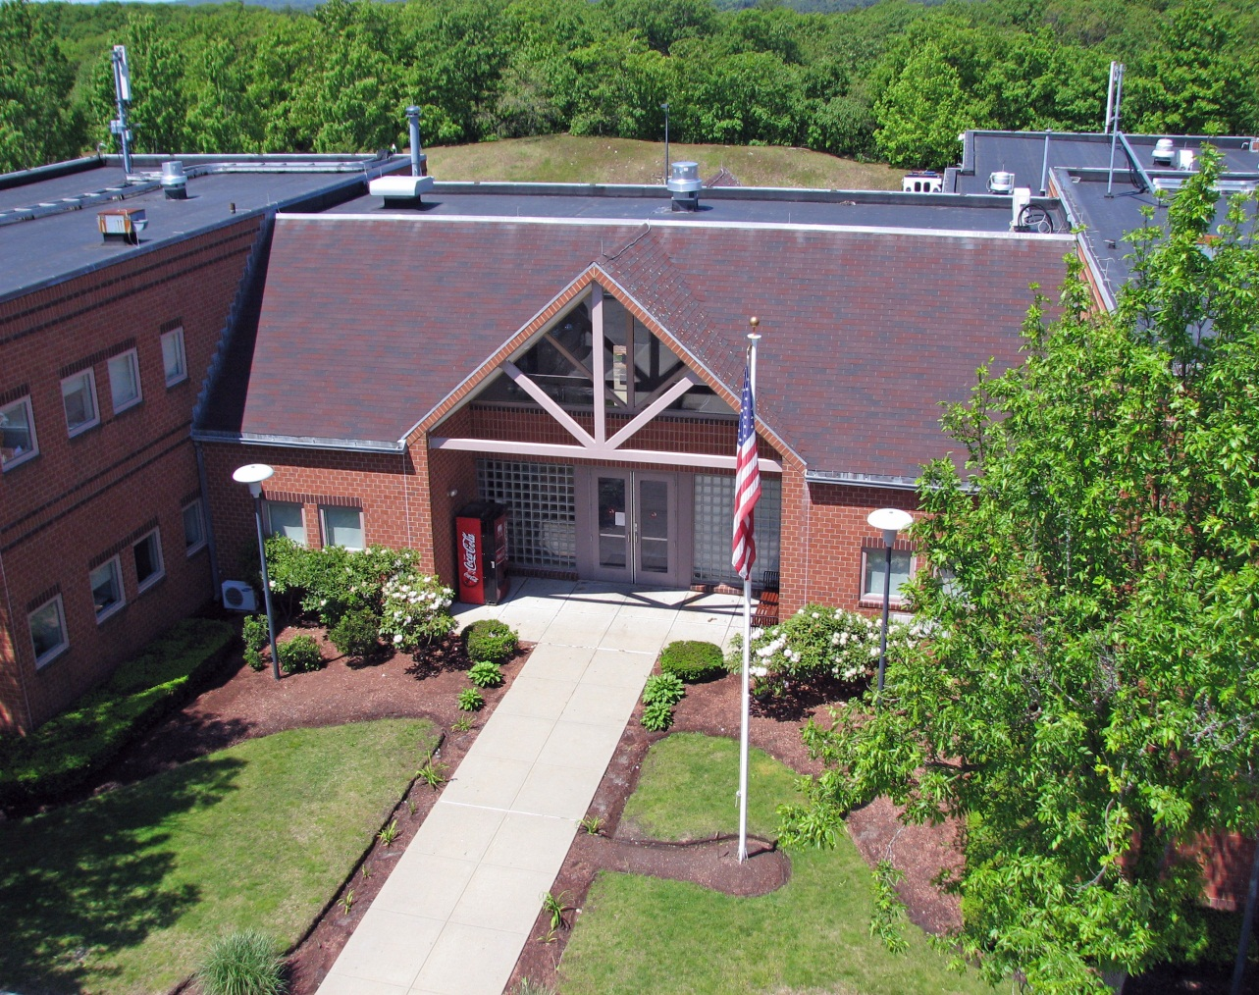

RSAT Intensive ReEntry Program
A 12 week program made up of 14 unique classes that address the transition of an inmate to the community with an emphasis on improving major areas of an individual’s life.
Focuses on substance abuse treatment, assists with practical skills such as job and employment readiness, as well as supports an individual in his commitment to maintaining a sober lifestyle.
RSAT participants are housed at the facility’s lower security housing unit, Dedham Alternative Center and all 10 members of the program attend each of the classes together.

Slide 25

Selection, Assessment and Screening Process
Rolling Admission
Assessment & Screening
Using the inmate’s PROXY Pre-screen and LSI-R , the classification department is able to asses an inmate’s risk to reoffend, determine their programmatic needs, and create an individualized transitional plan.
When an available space opens up for RSAT, an inmate will be selected for the program based on their treatment needs, parole eligibility, and their end of sentence date.
Once in the program, the inmate is administered an AUDIT, DUDIT, PHQ-9, TCU Drug Screen II, TCU Thinking Scale and an Individual Assessment.
After their scores and assessment are reviewed by a team of RSAT program facilitators, the Individualized Transition Plan is updated for the inmate and he is assigned a staff advisor.

Slide 26


RSAT PROGRAM CLASS LIST
Required Classes
Substance Abuse
Anger
Stress Management
Thinking For a Change
Decisions
Relapse Prevention
Boundaries
Transition Skills
Transition to Community
Employment Readiness
Computers
*Food Safety
Book Shop
*OSHA
Voluntary Classes
AA
Meditation
Men’s Health
Legion of Mary
Breaking The Cycle (Parenting)
Writing Class
Computer Free Time

Slide 27

Next Presentation
Mentoring for Success: Completing the
RSAT Continuum of Care
May 21, 2014
2:00 – 3:00 p.m. EDT
This presentation will provide participants with an inexpensive yet highly effective option for providing aftercare and post-release treatment for RSAT clients. It will describe the model developed by Spectrum Health Systems in partnership with the Massachusetts Department of Correction under a Second Chance Act grant program. It is designed to use volunteer peer mentors to bridge the gap between pre-release treatment and coordination of post release services to assist RSAT clients to quickly stabilize in the community. Finally, the webinar will provide outcomes for the peer-mentoring program demonstrating the high rate of client engagement and significant reduction in recidivism.
Presenters: Earl Warren, Jacqueline Chowaniec

