Slide 1
Vicarious Trauma: Recognition, Impact, Management and Prevention
Roberta C. Churchill M.A., LMHC
ACJS, Inc.

Slide 2
Course Objectives
Upon completion of this presentation, participants will be able to :
List three of the four descriptors of Vicarious Trauma
Identify three manifestations of Vicarious Trauma
List three consequences of Vicarious Trauma
Develop three methods to prevent Vicarious Trauma

Slide 3
Module I: Research
Many of us do a pretty good job of
holding back our true feelings …
It may be we are too busy to express our feelings …
…and we don’t have enough
time to express them …

Slide 4
Module I: Research
Or maybe we’re just “too polite” to tell others what we’re feeling …
…and don’t want to bother
anyone else with our problems.

Slide 5
At the same time, we also find that we’re having a
difficult time managing stress …
this can unfortunately lead to …

Slide 6
Vicarious Trauma

Slide 7
Vicarious Trauma
Definition and Recognition
7

Slide 8
Module I: Research
What is it?
Vicarious Traumatization
Secondary Traumatic Stress (Disorder)
Compassion Fatigue
Burnout

Slide 9
Module I: Research
What is it?
Vicarious Traumatization
Secondary Traumatic Stress (Disorder)
Compassion Fatigue
Burnout

Slide 10
Module I: Research
What is it?
Vicarious Traumatization
Secondary Traumatic Stress (Disorder)
Compassion Fatigue
Burnout

Slide 11
Module I: Research
What is it?
Dual Relationships
Vicarious Trauma is a predictable but avoidable condition associated with work in the helping and criminal justice professions.
Insidious risk for all those who provide offender services.
Destructive force that can erode one’s view of the world, of other people and of oneself.
It can infiltrate one’s identity, personal relationships, core values and sense of efficacy.

Slide 12
Module I: Research
Review of Trauma
Dual Relationships
Trauma can occur when an individual has either:
“Experienced, witnessed or was confronted with an event or events that involved actual or threatened death or serious injury, or threat to the physical integrity of self or others (repeated or extreme indirect exposure to aversive details of the event or events) and the person’s response involved intense fear, helplessness or horror.”
(APA, 2000, p.467 with updates from DSM-V in parentheses)

Slide 13
Module I: Research
Review of Trauma
Dual Relationsh
Experiencing or witnessing emotional, physical or sexual abuse or assault
Extremely painful or frightening medical procedure
Catastrophic injuries or illnesses
Learning, indirectly, that a close relative or friend was exposed to trauma
Having been mugged, domestic violence, burglary, being in combat, long-term neglect
Repeated or extreme indirect exposure to aversive details of an event(s), e.g., first responders, forensic professionals, repeatedly being exposed to details of child abuse

Slide 14
Module I: Research
Trauma History Among Inmates

Slide 15
Module I: Research
What is it?
Dual Relationships
Vicarious Traumatization is a negative transformation that occurs within the worker as a result of:
Listening to descriptions of horrific events
Hearing disclosure of traumatic events
Bearing witness to people’s cruelty to one another
Daily interaction with trauma survivors

Slide 16
Module I: Research
What is it?
Dual Relationships
It results in disruptions in a worker’s sense of identity, worldview, spirituality, ability to tolerate strong emotions, and core beliefs about safety, trust, self-esteem, control and intimacy
The world is a dangerous place
People are not to be trusted

Slide 17
Module I: Research
What is it?
Dual Relationships
Some trauma survival traits can appear:
Numbing
Disengagement/Avoidance
Hyper vigilance
Emotionality
Physical Illness

Slide 18
Module I: Research
Voices from the Field
Dual Relationships
“Since working with this population, I am hyper-vigilant, bordering on paranoid, about protecting my personal / family identity. I don’t use social networking sites, my home address and phone numbers are unlisted. I have a PO box and don’t have a mailbox with my name on it. I change my email address at least a couple times a year and don’t let my children go online without my supervision. I try to make it very difficult for people to track me down online.”

Slide 19
Module I: Research
What is it?
Dual Relationships
If unaddressed, the results of Vicarious Trauma can be widespread ranging from:
Occasional non-empathic distancing from clients
Victim blaming
Progressive loss of energy and idealism
Depression
Precursor to Burnout

Slide 20
Module I: Research
What is it?
Dual Relationships
Three Components
of Burnout
Lack of Enthusiasm
Withdrawal
Frequent Absenteeism
Blunting of Empathy
and Callousness
Dehumanizing of Clients
Fatigue
Emotional Exhaustion
Depersonalization
Reduced feelings of Personal Accomplishment
Notes:
Depersonalization - an unfeeling and impersonal response toward recipients of one's service, care treatment, or instruction

Slide 21
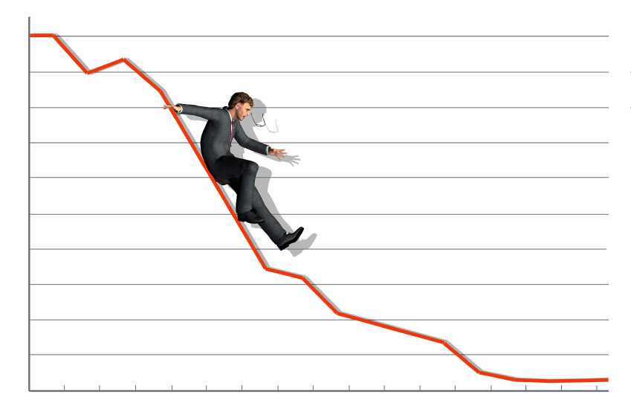
What is it?
Negativity
Powerlessness
Hopelessness
Lack of confidence in skills / avoidance
Somatic symptoms including:
Headaches, GI distress, elevated blood pressure, insomnia
Distress in personal life
Decrease in healthy self-care
Increase in maladaptive coping behaviors including substance use
Relapse to addiction

Slide 22
Module I: Research
Voices from the Field
Dual Relationships
“I find myself, at times, surprised when people actually hold their tempers in situations or haven’t been to jail at some point in their lives. I tend to forget that there are people who do use substances in safety without tearing apart their lives or hurting others. My work has made me more cynical about how much social programs actually help people. It sometimes feels like everyone abuse welfare, SSI or several other programs meant to help people. I know that this isn’t true, but working with so many people who do abuse the system wears on me.”

Slide 23
Vicarious Trauma
Impact and Consequences
23

Slide 24
Module I: Research
Countertransference
A counselor’s response to how a client is “experiencing” themselves during interactions with the counselor
Positive or negative
Conscious or unconscious
Spoken or unspoken

Slide 25
Module I: Research
Common Trauma-linked Countertransference Responses
Dual Relationships
Rescue fantasies and intense preoccupation with clients; a strong need not to fail clients; a need that contains a mixture of care and concern for clients as well as insecurity about their own professional competence

Slide 26
Module I: Research
Common Trauma-linked Countertransference Responses
Dual Relationships
Staff feel silenced and controlled by clients; they have tried every technique to “get through to” a client but feel all options are closed off; staff begin to lose their perspective and identify more with the clients’ sense of reality

Slide 27
Module I: Research
Common Trauma-linked Countertransference Responses
Dual Relationships
Staff may feel shock or hurt that clients see them as another “perpetrator”, “part of the system”, “the man”
Staff are likely to feel frustrated in their wish to be seen as a helper or have a more therapeutic alliance; they may gain a sense of guilt for feeling inadequate which could turn into feelings of isolation and/or anger

Slide 28
Module I: Research
Common Trauma-linked Countertransference Responses
Dual Relationships
Staff may see clients as vulnerable, victimized and helpless and feel inadequate to meet all their needs as client’s demands (emotional and otherwise) increase

Slide 29
Module I: Research
Common Trauma-linked Countertransference Responses
Dual Relationships
The intense trauma that clients have experienced and perpetrated are apt to destroy some staff’s deeply held core beliefs about human nature
In response, staff may attempt to intellectualize, generalize and see clients as labels / diagnoses rather than individuals; staff become disengaged and counter-therapeutic

Slide 30
Module I: Research
Common Trauma-linked Countertransference Responses
Dual Relationships
Staff may simply become confused, emotionally exhausted and frustrated by the clients’ alternating moods, strong affect, impaired ability to cope and seeming contradictory behaviors

Slide 31
Boundaries Issues
Giving a gift
Accepting a gift
Giving a hug
Be a AA / NA sponsor to a client
“You’re a very special person to me”
Comparing client to one’s adult child
Giving out your cell phone number
Using profanity
“I’m going through a rough divorce myself right now”
“You’re very attractive”
Swapping photos of your children
Sexual / Physical
Boundaries
Role Boundaries
Emotional /Psychological
Boundaries
Dual Relationships

Slide 32
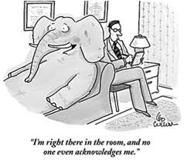
Module I: Research
Who does it Affect?
Vicarious Traumatization is different for everyone
It may appear after one specific traumatic event
Symptoms may not show until years of being in the field due to the cumulative nature of the work
It may not develop at all

Slide 33
Module I: Research
Who does it Affect?
Those at greater risk for Vicarious Traumatization
Greater involvement with direct client services
Working more than 40 hours per week
New workers in the field (under two years)
Women reported more emotional and physical trauma symptoms than men
Working with sexual and/or violent offenders
Workers with a history of trauma in their own lives

Slide 34
Module I: Research
Burnout is More Likely …
In a time when counseling staff are being asked to:
Carry heavier caseloads
Work with fewer staff members
Treat needier clients (co-occurring issues, trauma issues, multi-systemic issues)
Implement evidence-based techniques and measure performance
Accept less pay / less frequent increases in pay

Slide 35
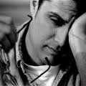
Predictors of Burnout include …
Ambiguous work assignments
Role conflict
Poor relationships with peers / colleagues
No sense of purpose
Inability to detach
Lack of Clinical Supervision

Slide 36
Module I: Research
Voices from the Field
Dual Relationships
“I was actually in a training with other educators and I felt overwhelmed, anxious – I wanted to leave the training. I just got really overwhelmed, uncomfortable, tearful. Sometimes after work I want to go home and stare at walls. Sometimes it’s hard to interact with normal people and I get extremely irritable hearing about other people’s work problems.”

Slide 37
Module I: Research
Vicarious Trauma: It’s Impact
Clients feel devalued, avoided
Co-workers may feel concern, a desire to intervene, resentment, a heavier burden to compensate.
The entire staff and program may “catch” the negativity, cynicism and indifference of a burned-out staff member over time without intervention.

Slide 38
Vicarious Trauma
Management and Prevention
38

Slide 39
Recognizing Vicarious Trauma
Inability to focus
Losing track of details normally on top of
Frequent absence or tardiness
Disproportionate detachment, numbing, denial
Distance from clients and coworkers
Avoidance of supervision
Not being able to get a client’s story out of one’s head

Slide 40
Recognizing Vicarious Trauma
Feeling overwhelmed
Impaired self-care (not exercising, skipping meals, over-eating, inattention to dress)
Over-emotional, moody
Nausea, headaches, sleep disturbances
Difficulty trusting others
Hyper-vigilance related to keeping self and loved ones safe

Slide 41
Ongoing Help Before Crisis Occurs
Organizational acknowledgment and validation of the impact of trauma-linked countertransference and vicarious traumatization
Clinical supervision that does the same and addresses such issues
Peer process and/or supervision groups

Slide 42
Ongoing Help Before Crisis Occurs
Staff training is provided and encouraged
Personal counseling
Overt recognition and valuing of staffs’ hard work
Attention is given to organization dynamics which may interfere with staff development

Slide 43
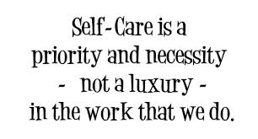
Managing and Surviving
Vicarious Trauma
Learn to ask for help
Maintain personal boundaries
Maintain realistic expectations while doing this type of work
Allow the experience of emotion
Seek out non-client related activities

Slide 44
Managing and Surviving
Vicarious Trauma
Be aware of unresolved issues that may be
impacted
Maintain discipline and structure, the key elements
for holding on during burnout
Develop “Time Outs” on and off the job
Diversify your responsibilities

Slide 45
Prevention of Vicarious Trauma
Avoid professional isolation
Participate in a support group with other offender treatment professionals
Pursue holistic self-care which includes physical, mental, emotional, spiritual and aesthetic domains
Learn about Vicarious Trauma, burnout and talk about it with colleagues
Seek lifestyle balance

Slide 46
Prevention of Vicarious Trauma
Develop personalized methods of managing
stress
Have strategies for managing “out of balance times”
Be prepared to recognize and respond to early warning signs
Practice mindfulness or relaxation skills
Keep a journal for cathartic or inspirational purposes
Laugh

Slide 47
Prevention of Vicarious Trauma
Regular and ongoing Clinical Supervision by a trauma-informed professional
Support of colleagues
Job duties that are not all
trauma related
Self Care in personal life
Good support systems
Adequate rest
Proper nutrition
Exercise
Hobbies
Spiritual practices

Slide 48
Module I: Research
Voices from the Field
Dual Relationships
“I’d like to think that overall I’ve become a more sympathetic person having worked with this population for so long. In working here you get to see the people behind the crime instead of just the crimes. It’s hard for the people on the outside to be compassionate and understanding unless you work, like we do, with the offenders and see the wounded people they are and a good many of them have never really known happiness since childhood, if then. I find it very sad but it makes me grateful for what I’ve been blessed with despite my own hardships. Working here has also personally made me a stronger person all the way around. “

Slide 49
Remember
Our Work Demands Us to be Present and Fully Experiencing with Very Wounded People
Our Work Demands Us to be Consistent, Empathic, Collected and An Agent of Change
Our Work Demands Us to be Role Models of Effective Coping and Appropriate Boundaries
Our Work Demands SELF CARE

Slide 50
References
Mascotta, M. (2006) Vicarious Traumatization: A Guide to Recognizing, Responding to, and Preventing a Serious Consequence of Providing Mental Health Care in Jails, Prisons, and Community Corrections. NIC Newsletter, Corrections and Mental Health.
Newmann, Debra A. & Gamble, Sarah J. (1995) Issues in the Professional Development of Psychotherapists: countertransference and vicarious Traumatization in the New Trauma Therapist. Psychotherapy, 32(2), 341 – 347.
Pearlman, L.A. & Mckay, L. (2008) Understanding and Addressing Vicarious Trauma. Headington Institute, www.headington-institute.com
Sommer, Carol A., (2008) Vicarious Traumatization, Trauma-Sensitive Supervision and Counselor Preparation. Counselor Education & Supervision (48) 61 – 71.

Slide 51
Next Presentation
Evidence-Based Practice
September 17, 2014
2:00 – 3:00 p.m. ET
This webinar will define evidence-based practice, focusing on the fact that it requires more than the adoption of one or more evidence-based programs. Such programs must be implemented not only with fidelity to the specific components of the programs as validated by the research, but they must be embedded in an environment that is consistent with evidence-based practices.
Presenter: Andrew Klein

