Slide 1
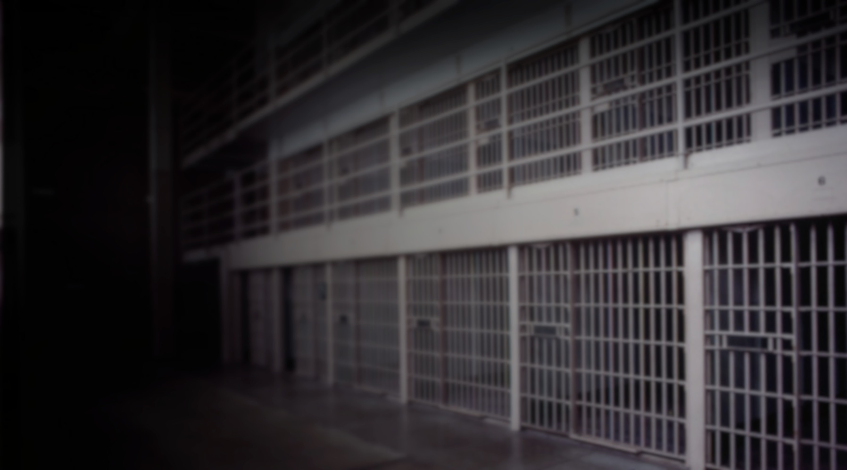

Secure Connected Tablet Solution to Enhance Educational Opportunities Behind Bars
Indiana Department of Correction
Division of Youth Services

Slide 2




Slide 3
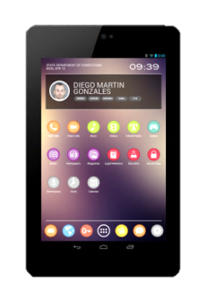
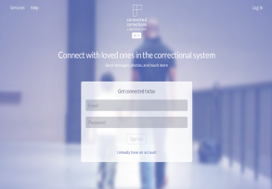


APDS = Tablets + Platform + Network
SECURE ANDROID TABLETS for INMATES
APDS tablets provide inmates with secure, monitored access to our digital education, rehabilitation, job training and job placement resources.
PLATFORM FOR PROGRAMS
The APDS platform allows for the distribution of partner programs, and hosts a range of tools and services to support correctional programs.
NETWORK SECURITY
APDS offers a private network that governs all functions of inmate tablets. A white hat hacking firm recently declared the APDS network to have “no vulnerabilities.”

Slide 4
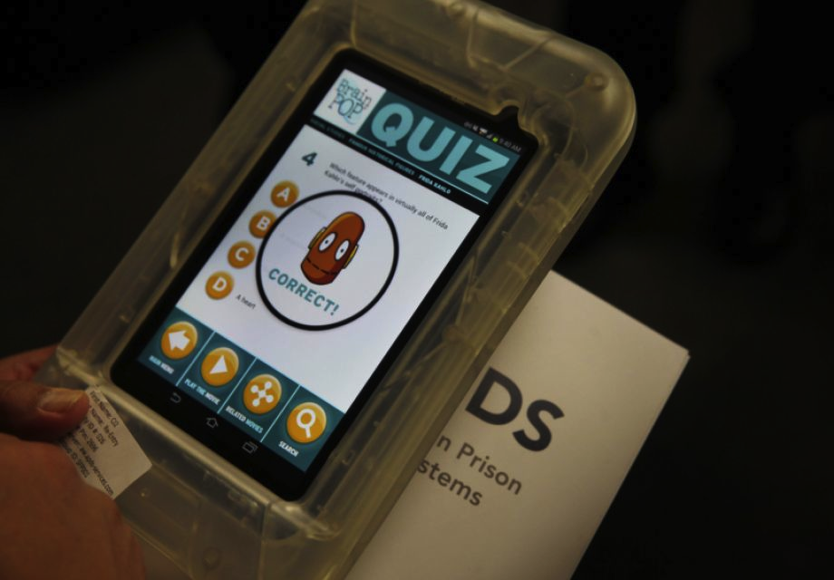
Secure android tablets for inmates
The APDS tablet is a secure delivery vehicle for our educational, vocational, job placement, and rehabilitation programs.
PHYSICAL SECURITY
Tablets are small and lightweight
Military-grade case cannot be opened
Screens are protected from shard-removal
Battery protected from removal
CUSTOMIZED ANDROID OS
Disables WiFi, camera
Disables settings
Monitors & reports tablet abuse
Supports GPS for location

Slide 5
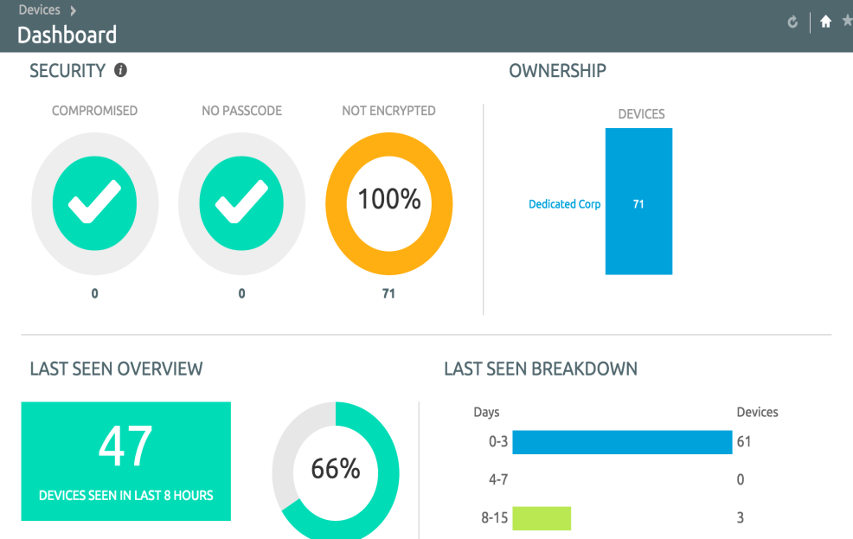
The Command Center allows remote tablet control
CONFIGURATION
Define applications and availability
Define accessible services
Alerts to active tablet abuse
MONITORING
Observe real-time usage
Use predefined alerts
Detect non-compliance
Retrieve historical data / audit
REMOTE CONTROL
Remotely lock tablets
Wipe content remotely
Deliver message
Identify location
INTERACTION
By individual, cohort, large group
With varied permissions by staff rank
Access from any desktop or phone

Slide 6









Blended learning tools that put teachers in the driver’s seat
      National Corrections Library
      Secure Content Locker
      Connected Corrections
      APDS Virtual Classroom

Slide 7
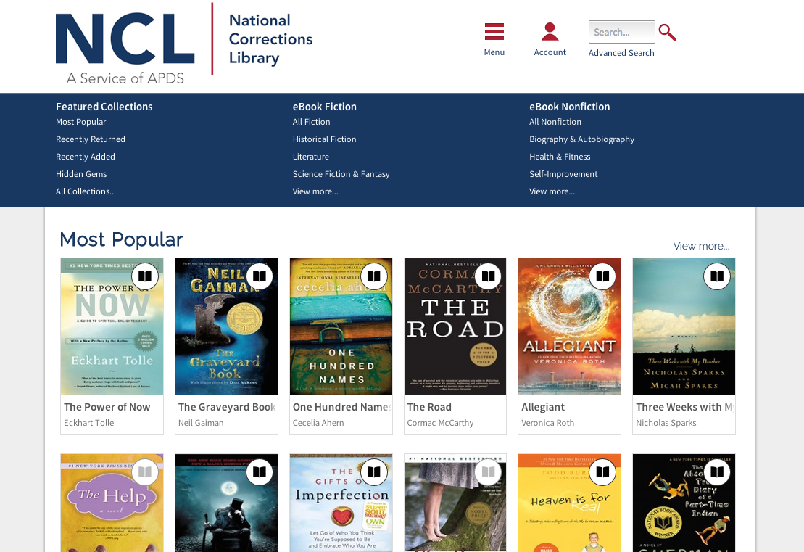
National Corrections Library
The first online library curated for corrections.
A service of APDS.
NCL offers 1000+ titles in the following categories: Nonfiction Business and careers Religion and spirituality Family, relationships, self-improvement Health and Fitness History Science and technology Biography and autobiography Fiction Classic literature Humor Drama Fantasy and science fiction Mystery, suspense, thriller Romance

Slide 8
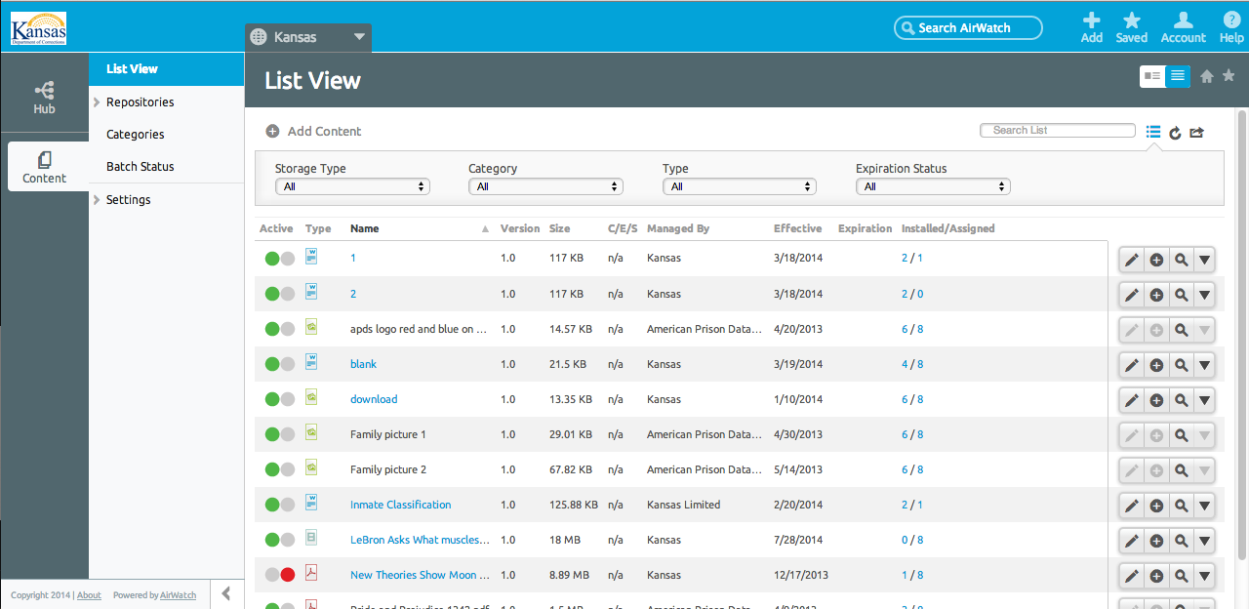
Secure Content Locker
A cloud-based file sharing system that enables administration and staff to upload material for inmate review
Secure Content Locker (SCL) allows document upload by administration and staff for on-tablet access by groups of inmates. SCL supports a broad range of file types, including MS Office files, images, music, videos, and more, and file sizes up to 200MB. Benefits: Allows programs staff to upload educational, career and wellness resources Allows administration to upload and seamlessly update the facility handbook, shared calendars, health alerts, etc. Enables one upload for delivery to multiple users Resources can be cataloged in a file tree for easy discovery.

Slide 9
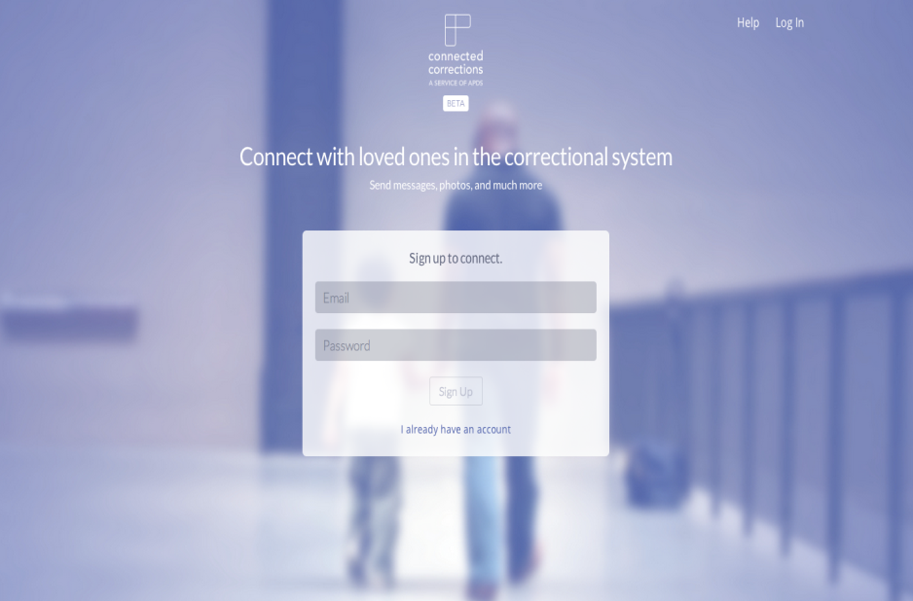
Connected Corrections
A secure communications system, built for corrections.
A service of APDS.
Connected Corrections allows messaging between inmates and the people who care about them. Secure, private messaging for PREA, attorneys, health workers Secure, monitored messaging for staff Secure, monitored messaging for friends, families, and other approved external parties Benefits: Allows teachers and other corrections staff to answer inmate questions remotely. Supports PREA compliance Eliminates paper mail to reduce cell clutter and the cost of paper mail review. Reduces the risk of contraband delivery Stores all messages for discovery, as needed

Slide 10
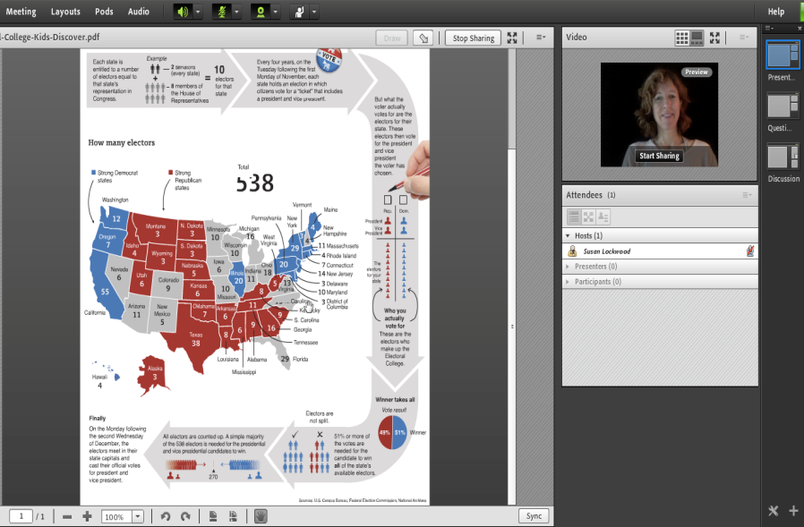
APDS Virtual Classroom
A secure virtual classroom to enable remote presentations.
A service of APDS.
APDS Virtual Classroom eliminates the boundaries of space and time; allowing teachers, inspirational speakers, religious leaders, and re-entry professionals to present remotely to groups of inmates. Participants can: see the presenter on-screen see the presenter’s material on-screen ‘raise their hands’ and interact directly with the presenter via chat or microphone during Q&A Benefits: Allows presentations to groups of any size Gives far-flung facilities access to the range of teachers and other presenters, without the time and cost of travel. Reduces dependence on limited classroom space.

Slide 11

The Indiana Experience

Slide 12
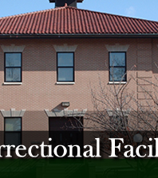
Madison Juvenile: program overview
A maximum security juvenile girls facility
50 Female Juveniles: 149 total to date
Every student has an educational tablet
Subset of entertainment tablets for positive behavior support
Notes:
Tablets are event used in administrative segregation when necessary

Slide 13

Madison Juvenile: program overview
A maximum security juvenile girls facility
Each teacher has a tablet
Content is customized by teachers
Blended learning trainings to support teachers
Security and operations training to support tablets
Notes:
Tablets are event used in administrative segregation when necessary

Slide 14
How Do The Tablets Work?
https://www.youtube.com/watch?v=zQ0l9UnwQF4

Slide 15

Preliminary Outcomes of Tablet Use
160 Library cards, 926 Library Checkouts
  Most Popular: 7 Habits of Highly Successful People
SCL downloads
  Most Installed “Everything’s Gonna Be Alright,” by Bob Marley

Slide 16

Preliminary Outcomes of Tablet Use
~10,000 messages sent
  From a teacher : “How did we reach her? She found the tablet less threatening than talking in person.”
PREA messaging

Slide 17
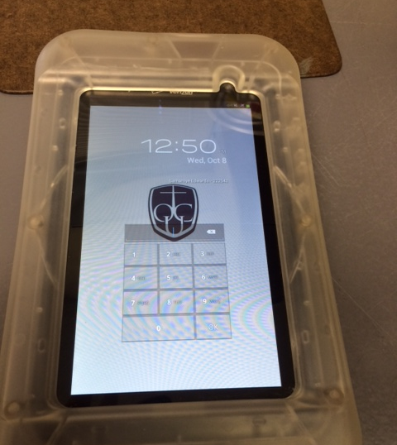
Other Benefits
Tablets act as a way to expand depth and breadth of content
Students are engaged with relevant content at a higher degree
Mental Health content enabled counselors to reach students based on what they were downloading

Slide 18

Other Benefits
Tablets act as a way to expand depth and breadth of content
Less violence – instead of fighting when upset, they reach for a tablet
Internal messaging feature allows issues to be resolved quickly
Calmer facility overall

Slide 19
TGG Survey Results
Preliminary Findings from a Survey of Juvenile Clients at the Madison, IN Juvenile Correctional Facility
August 2015

Slide 32
Questions?
Contact information
Tim Greathouse
812-265-6154 ext 310
tgreathouse@idoc.in.gov

