Slide 1
RSAT and DV
ANDY KLEIN
Project Director, RSAT TTA
Author: Practical Implications of Current Domestic Violence Research: For Law Enforcement, Prosecutors and Judges, National Institute of Justice Special Report, June 2009

Slide 2
Why should RSATs worry about DV?
RSAT inmates are disproportionately likely to be DV perps or victims.

Slide 3
Why should RSATs worry about DV?
Approximately 35–60% of male and female patients in substance abuse treatment committed at least one act of physical IPV in the past year.
Brown TG, Werk A, Caplan T, Shields N, Seraganian P (1998) The incidence and characteristics of violent men in substance abuse treatment. Addict Behav 23: 573–586. doi: 10.1016/S0306-4603(98)00004-5.
Chermack ST, Fuller BE, Blow FC (2000) Predictors of expressed partner and non-partner violence among patients in substance abuse treatment. Drug Alcohol Depen 58: 43–54. doi: 10.1016/S0376-8716(99)00067-8.
Chermack ST, Walton MA, Fuller BE, Blow FC (2001) Correlates of expressed and received violence across relationship types among men and women substance abusers. Psychol Addict Behav 15: 140–151. doi: 10.1037//0893-164X.15.2.140.
Chermack ST, Blow FC (2002) Violence among individuals in substance abuse treatment: The role of alcohol and cocaine consumption. Drug Alcohol Depen 66: 29–37. doi: 10.1016/S0376-8716(01)00180-6.
Murphy CM, O’Farrell TJ (1994) Factors associated with marital aggression in male alcoholics. J Fam Psychol 8: 321–335. doi: 10.1037/0893-3200.8.3.321.
Stuart GL, Moore TM, Ramsey SE, Kahler CW (2003) Substance abuse and relationship violence among men court-referred to batterer intervention programs. Subst Abuse 24: 107–122. doi: 10.1080/08897070309511539.
Maiden RP (1997) Alcohol dependence and domestic violence: Incidence and treatment implications. Alcohol Treat Quart 15 (2): 31–50. doi: 10.1300/J020v15n02_03.
Stuart GL, Moore TM, Ramsey SE, Kahler CW (2003) Relationship aggression and substance use among women court referred to domestic violence intervention programs. Addict Behav 28: 1603–1610. doi: 10.1016/j.addbeh.2003.08.038.

Slide 4
Why should RSATs worry about DV?
Substance abuse is associated with DV victimization as well.
Chermack ST, Walton MA, Fuller BE, Blow FC (2001) Correlates of expressed and received violence across relationship types among men and women substance abusers. Psychol Addict Behav 15: 140–151. doi: 10.1037//0893-164X.15.2.140.
Hien D, Ruglass L (2009) Interpersonal partner violence and women in the United States: An overview of prevalence rates, psychiatric correlates and consequences and barriers to help seeking. Int J Law Psychiat 32: 48–55. doi: 10.1016/j.ijlp.2008.11.003.
Chermack ST, Murray RL, Walton MA, Booth BA, Wryobeck J, et al. (2008) Partner aggression among men and women in substance use disorder treatment: Correlates of psychological and physical aggression and injury. Drug Alcohol Depend 98: 35–44. doi: 10.1016/j.drugalcdep.2008.04.010.
El-Bassel N, Gilbert L, Schilling R, Wada T (2000) Drug abuse and partner violence among women in methadone treatment. J Fam Violence 15 (3): 209–228. doi: 10.1007/s10896-008-9183-6.
El-Bassel N, Gilbert L, Frye V, Wu E, Go H, et al. (2004) Physical and sexual intimate partner violence among women in methadone maintenance treatment. Psychol Addict Behav 18 (2): 180–183. doi: 10.1037/0893-164X.18.2.180.
Gilbert L, El-Bassel N, Chang M, Wu E, Roy L (2012) Substance use and partner violence among urban women seeking emergency care. Psychol Addict Behav 26 (2): 226–235. doi: 10.1037/a0025869.
Kantor GK, Straus MA (1989) Substance abuse as a precipitant of wife abuse victimization. Am J Drug Alcohol Abuse 15: 173–189. doi: 10.3109/00952998909092719.
Stith SM, Smith DB, Penn CE, Ward DB, Tritt D (2004) Intimate partner physical abuse perpetration and victimization risk factors: A meta-analytic review. Aggress Violent Behav 10: 65–98. doi: 10.1016/j.avb.2003.09.001.

Slide 5
Why DV?
i.e. Barnstable County RSAT Program (188 males)
Prior Arrests: 246 Protective Order Violations!
33% had prior DV convictions
Many had active protective orders

Slide 6
Why DV?
Post Release Recidivism:
16 arrested for new substance abuse offenses
13 arrested for Violation of Protective Order
17 arrested for assaults

Slide 7
Why DV?
The overwhelming majority of women in prison are survivors of domestic violence. Three-quarters have histories of severe physical abuse by an intimate partner during adulthood, and 82% suffered serious physical or sexual abuse as children (ACA)
In 2007 more than 50% of the women in jail reported to have been physically or sexually abused before their imprisonment, as were ~10% of the men (BJS)

Slide 8
Why DV?
Typical pathways for women to end up incarcerated:
DV →→trauma (PTSD) →→self medication/binge drinking →→crime →→incarceration
Abusers →→DV Victims to Commit Crimes →→incarceration

Slide 9
What is DV?
Intimate Partner Violence
Spouse, boy/girl friend, current or former, with or without children, date
Intra-Family Violence
Other family member, blood relative, in-law, intergenerational, siblings, child abuse

Slide 10
What is DV?
Physical, sexual, psychological, economic abuse and stalking are the five multi-faceted methods of violence and abuse that perpetrators utilize to achieve, maintain and regain control of their intimate partners. Coercion or terroristic threats coupled with any of the five methods of abuse is intimate partner violence. [CDC & Klein, 2009]

Slide 11
What is DV?
NOT:
Situational Violence: Isolated stemming from conflict turned violent
Violent Resistance
Trauma-related hyper aggressiveness
If no history of coercion, intimidation, or threats

Slide 12
Which Jail & Prison Inmates Most High Risk For Reabuse?
?

Slide 13
Why RSAT inmates?
Risk Factors for Reabuse:
Prior criminal history
Younger
First offense at early age
Substance/alcohol abuse

Slide 14
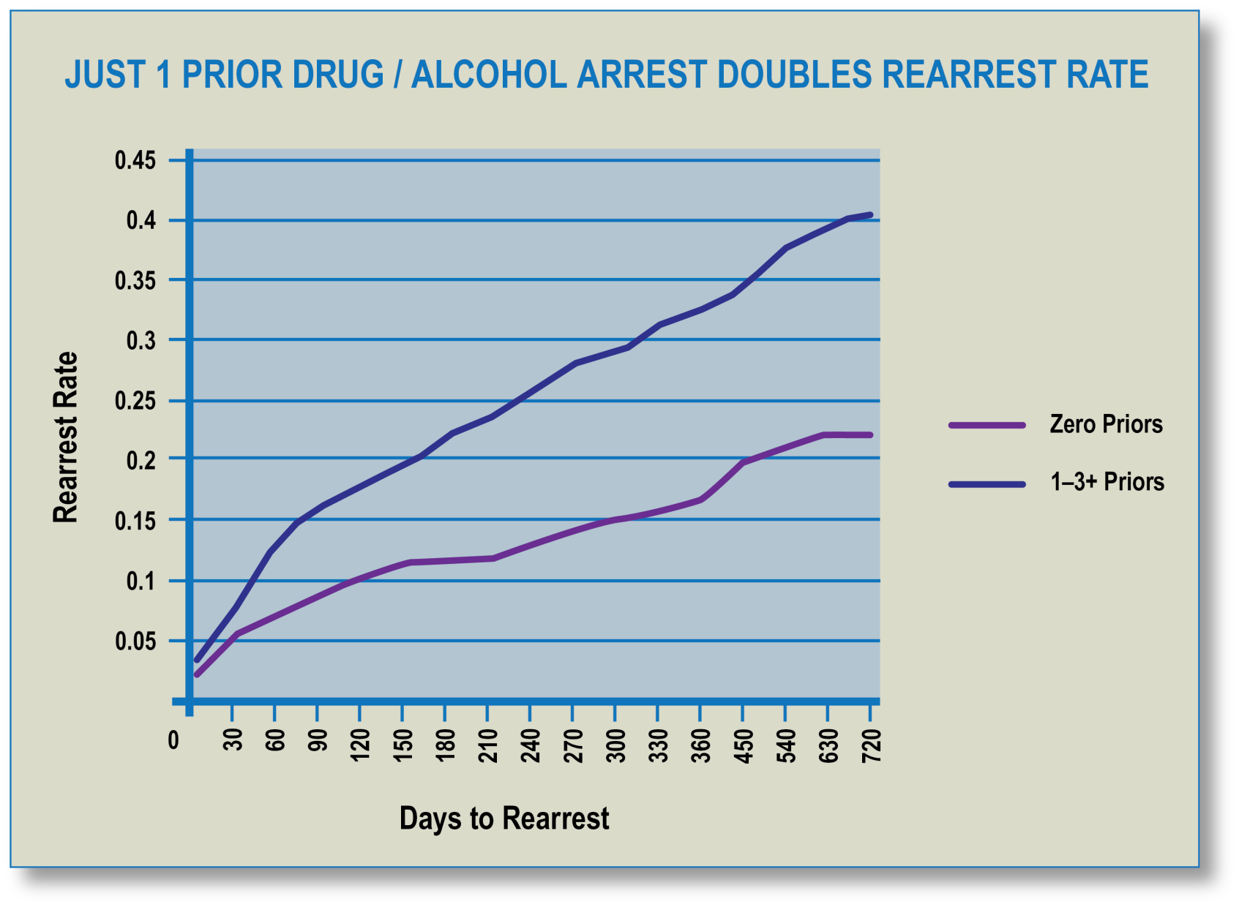
Why RSAT inmates?

Slide 15
Which RSAT inmates at risk for most injurious abuse?
From their hospital beds, victims report:
63.7% alcohol abusers
36.7% drug abusers
51.6% drinking at time of assault
14.8% on drugs at time of assault
Studies add:
Intermittent employment/ recent unemployment
Less than high school education

Slide 16
Which RSAT inmates at risk for most injurious abuse?
Access to firearms
Threats to kill
Prior strangulations
Forced sex
Escalating assaults
Control over daily activities
Children not abusers
Short courtships

Slide 17
Which female RSAT inmates at risk for lethal abuse?
Suffered most severe, chronic and increasing abuse
Fewer resources, including employment, high school education.
In long term relationship

Slide 18
Which RSAT inmates most vulnerable for DV victimization?
Unmarried
First child young age
Poorly educated
Low education
Child sexual victimization
Relationship in which substance abuse and crime are featured
Depressed

Slide 19
What RSAT inmates most vulnerable for DV victimization?
Some research indicates that substance use/abuse and alcohol abuse by women can increase the risk of being victimized by one’s domestic partner as well as inhibit a victim’s capacity to protect herself, increasing frequency of abuse over time.

Slide 20
Which RSAT inmates most vulnerable for DV victimization?
There is consensus in the literature that binge drinking and abusive drinking among women is more problematic than for men. Women become intoxicated after drinking half as much, metabolize alcohol differently, and have greater risk of dying from alcohol-related accidents and higher risk of being victims of violence and suffering from depression.

Slide 21
What RSAT inmates most vulnerable for DV victimization?
A general population study across New Zealand found that binge drinking by men and women (5 or more drinks/ at least once a month) → → twice as likely to be an aggressor → → three times as likely to be a victim of partner aggression vs. people who did not binge.
Although binge drinking → → female & male aggression, men → → more likely physically violent towards partners

Slide 22
What is the impact RSAT inmates experienced as a result of DV?
National Survey (2011):
Fear
Trauma/Depression
Injury
Pregnancy
Missed work/school
Sexually transmitted disease
Medical care
Homelessness

Slide 23
What is the impact RSAT inmates experienced as a result of DV?
National Survey (2011):
Only 19.2% women victims reported no adverse effects while 65.3% of men reported no adverse effects of DV.

Slide 24
What is the impact RSAT inmates experienced as a result of DV?
For Perps:
To the extent that their DV crimes are unarrested, unprosecuted and unsentenced, abusers will be undeterred from future DV crimes.
RSAT Implications:
Just because the RSAT abuser has been incarcerated, if for a non-DV crime, does not mean he will be deterred from more DV upon release. Research indicates, in fact, may be significantly more likely to reabuse.

Slide 25
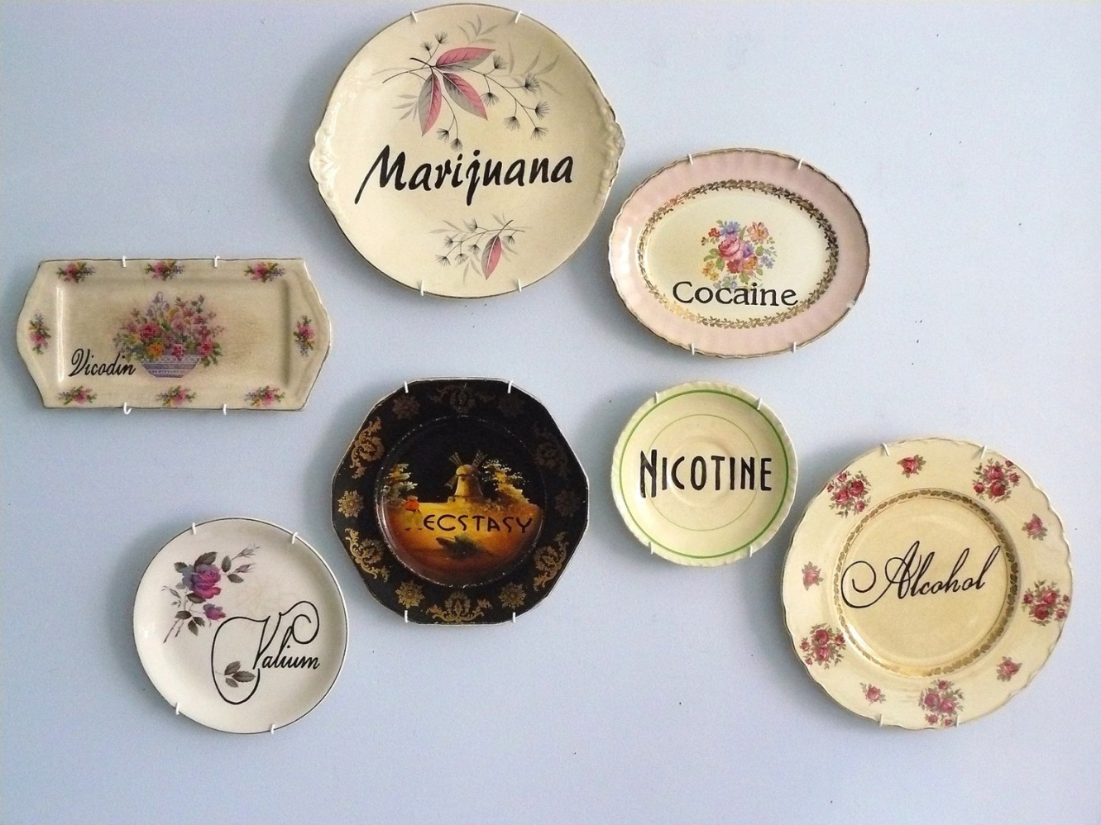
So what’s a RSAT program to do?
Isn’t substance abuse treatment enough?!

Slide 26
So what’s a RSAT program to do?
Identify Abusers/Victims
Identify resources to integrate into or supplement RSAT programming for both (separately)

Slide 27
So what’s a RSAT program to do?
Identifying abusers
Prior dv/assault arrests/ police incident reports
Prior participation in batterer intervention program
Child protective services case
Had/has civil/criminal protective order
Federally prohibited from possessing firearm (NICS)
Interview current or former intimate partner

Slide 28
So what’s a RSAT program to do?
Identifying Victim
Ask if former/current intimate partner:
ever hit/ slapped/ pushed/ choked her
threatened her/ children/ family pet
fear he might hurt you/ children
violently or constantly jealous or controls your daily activities
have you ever left him/her or separated after living together or being married
does he follow or spy on you, leave threatening messages
has anyone else worried about your safety?

Slide 29
So what’s a RSAT program to do?
Resources for abuser treatment
State Domestic Violence (and Sexual Assault) Coalition for certified/ recommended batterer intervention program (BIP) contacts
State agency responsible for certifying BIPs
Child Protective Services for recommended parenting programs

Slide 30
So what’s a RSAT program to do?
Monitor communications with intimate partner to ensure allowed and not abusive (threatening, controlling, blaming)
Inform parole of abuser status/ potential vulnerable victim in the community
Check state protective order file
Make sure firearms are removed from household
Make sure parole aware of any current no contact/ stay away orders
Make sure victim warned of pending release

Slide 31
So what’s a RSAT program to do?
For Victims
Trauma informed and trauma specific treatment:
supplementing or with substance abuse treatment (i.e. Seeking Safety, TAMAR)

Slide 32
So what’s a RSAT program to do?
See: http://www.rsat-tta.com/Files/Trainings/Trauma_Informed_Manual

Slide 33
So what’s a RSAT program to do?
Victim Support and Safety Planning
State DV (and SA) Coalition
Mentoring/support programs/ volunteers
National DV hotline: 1-800-799-SAFE
Direct connection to DV resources available in the caller’s area provided by a advocate

Slide 34
So what’s a RSAT program to do?
In 1998, the Iowa Department of Corrections implemented Moving On for women under correctional supervision. Evaluation found it had statistically significant lower re-arrest rates than the matched comparison group up to 18 months.
Gender-responsive programming, targeting specific risk factors and needs unique to women, is effective in reducing recidivism. Further, cognitive behavioral programming fits the bill as an appropriate treatment modality for women offenders.

Slide 35
So what’s a RSAT program to do?
Moving On
26-session, curriculum based programs combining Relationship Theory, Motivational Interviewing and Cognitive-Behavioral Intervention in 9 modules: 1) setting the context for change; 2) women in society; 3) taking care of yourself; 4) family messages; 5) relationships; 6) coping with emotions and harmful self-talk; 7) problem-solving; 8) becoming assertive; and 9) moving on.
Designed to address the gendered risks and needs of women offenders, including dealing with histories of trauma and abuse, mental health issues, substance abuse, parenting issues, and relationship issues.
The program helps participants realize why they offend and motivates them to use positive coping mechanisms to avoid these criminogenic circumstances and choose positive, crime-free alternatives.

Slide 36
So what’s a RSAT program to do?
Jail Program for Incarcerated Female DV Victims
Unlike other inmates, abused women behind bars may not be looking forward to their release due of abusive partners. Help and Emergency Response Inc. (DV shelter in Portsmouth, Virginia) sponsors a DV counseling program for women in Hampton Roads Regional Jail. Focuses on DV warning signs and how abuse can lead to low self-esteem. Jail officials are supportive, having noticed that during substance abuse classes, inmates also talked about DV in their lives.

Slide 37
Thanks for Listening

Slide 38
Next Presentation
PREA Basics: What RSAT Sites need to Know
July 17, 2013, 2:00 PM EDT
This webinar will familiarize participants with the history of the Prison Rape Elimination Act of 2003 (PREA). Since the passage of the federal law, implementation efforts have focused on developing standards at the national level and policies at the state and local levels. PREA law was universally supported by bipartisan effort; however, the controversy begins when facilities and jurisdictions need to define, develop procedures and policies to prevent, and address it. This webinar will outline progress we have made in implementation and standards over the last 10 years. The presenter, a former PREA administrator, will discuss the PREA basics and the impact they may have for RSAT programs.
Presenter: Niki Miller

