Slide 1
Reducing Recidivism and Promoting Recovery: Implications of National and State Trends for Improving Treatment Programs
Alexa Eggleston, J.D.
Program Director, Substance Abuse
The Justice Center, Council of State Governments
RSAT Webinar
October 17th, 2012

Slide 2
Council of State Governments
Justice Center
National non-profit, non partisan membership association of state government officials
Represents all three branches of state government
Justice Center provides practical, nonpartisan advice informed by the best available evidence
Criminal Justice & Behavioral Health
Consensus Project
Reentry Policy Council
National Reentry Resource Center
Justice Reinvestment

Slide 3
Today’s Presentation
Introduction
What Works: Developing Effective Responses for Justice Involved with Behavioral Health Needs
State and Local Application
Conclusion

Slide 4
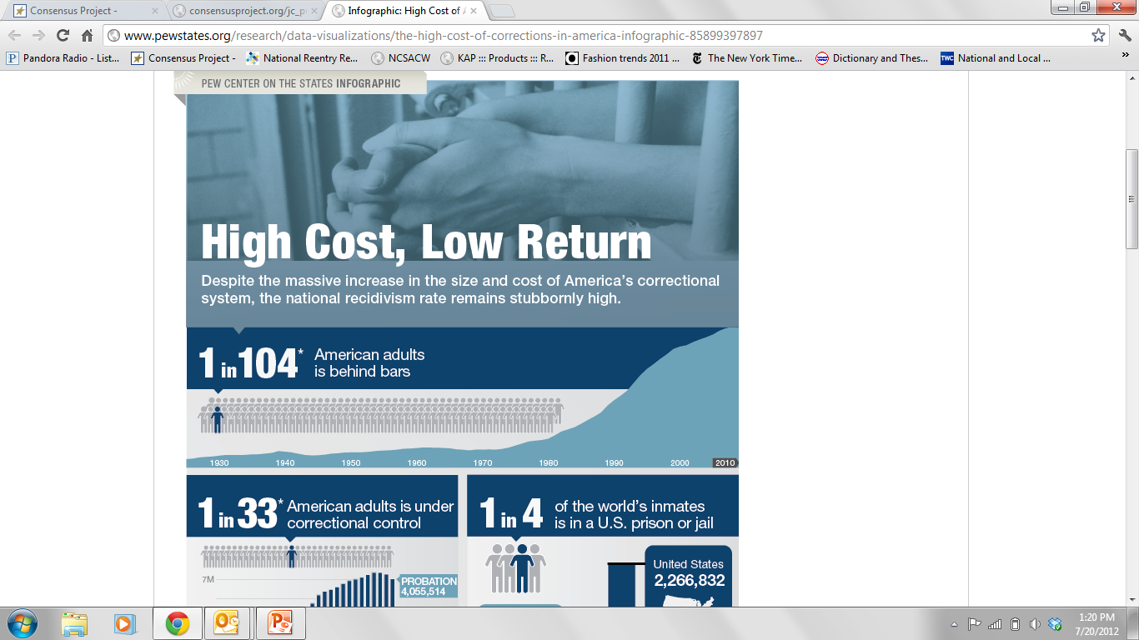
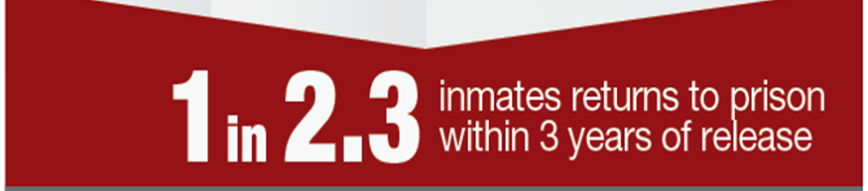

Slide 5
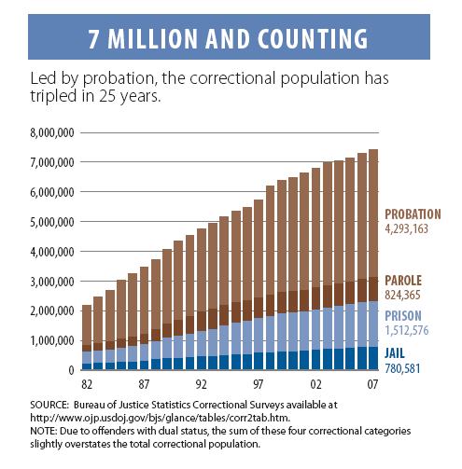

An Expanding Population
Notes:
3.2% of the adult population

Slide 6
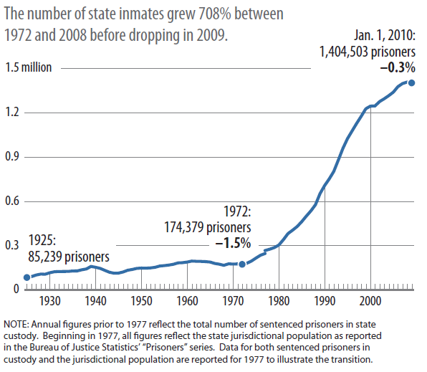
Recent Decline in State Prison Population
First decline in state prison populations in 38 years
Source: The Pew Center on the States; Public Safety Performance Project

Slide 7
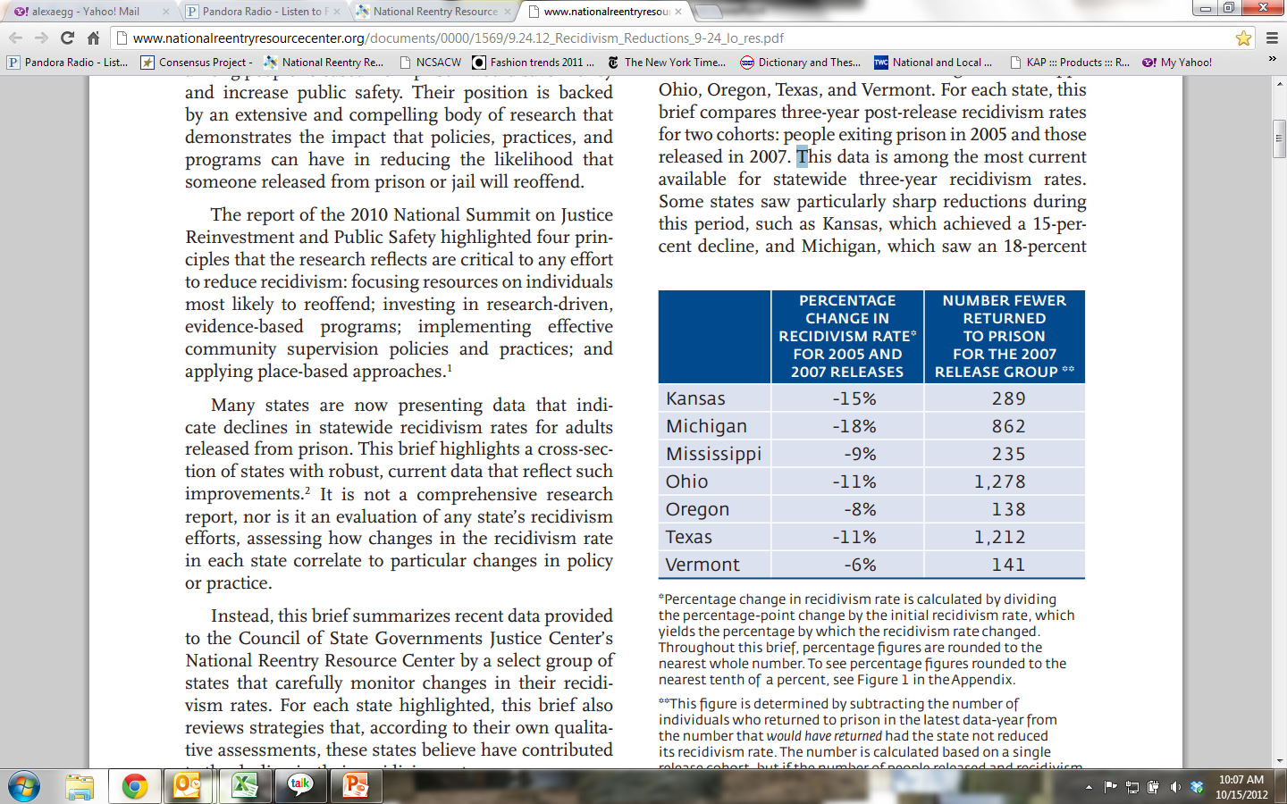
States Report Reductions in Recidivism
http://www.nationalreentryresourcecenter.org/documents/0000/1569/9.24.12_Recidivism_Reductions_9-24_lo_res.pdf

Slide 8
Common Strategies Across States
Targeting individuals at high risk of reoffending
Development of training programs for probation and parole officers
Funding for community-based programming as ‘alternative to incarceration’ and/or post-release ‘reentry’

Slide 9
States Everywhere Committed to Reducing Recidivism
More than 80 percent of the 43 states have developed or are currently developing a plan to reduce recidivism.
Leaders in 29 states have either already set a recidivism-reduction target or anticipate setting a target in the near future.
A majority of these states have identified specific action items to advance their recidivism-reduction plans.
Need to ask how RSAT, reentry and ‘what works’ in substance abuse/mental health fit into recidivism reduction plans?

Slide 10
Today’s Presentation
Introduction
What Works: Developing Effective Responses for Justice Involved with Behavioral Health Needs
State and Local Application
Conclusion

Slide 11
Substance Abuse & Addiction in Criminal Justice
Percent of Population
8 %
Source: Compton et al., Am J Psychiatry, 2010.
Notes:
Nationwide more than 4 in 10 state prison inmates are dually diagnosed with substance abuse and mental health disorders.

Slide 12
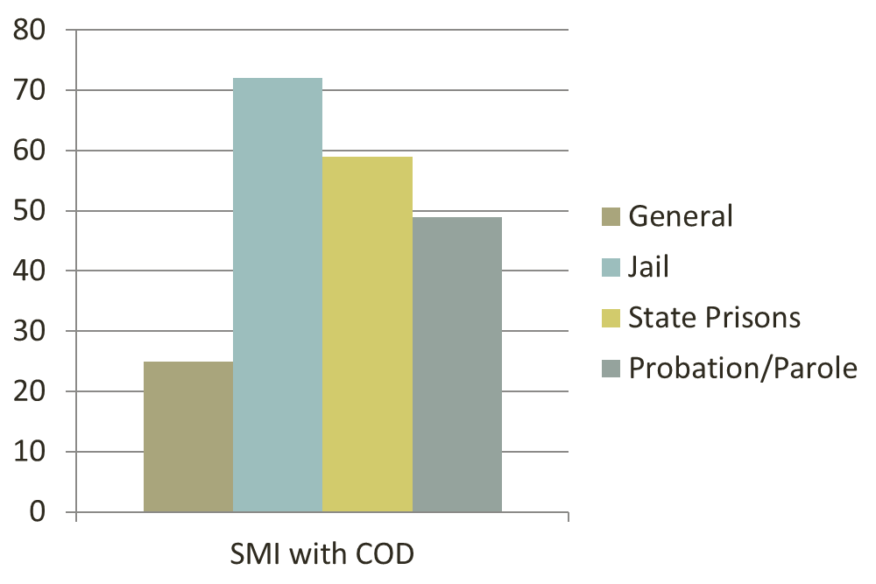
SMI with Substance Abuse/Dependence in Criminal Justice
Source: General Population (Kessler et al. 1996), Jail (Steadman et al, 2009), Prison (Ditton 1999), James (2006)

Slide 13
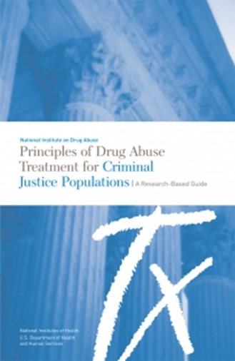
Key Elements of Effective Substance Abuse Programs
Standardized substance abuse assessment tool(s)
Standardized risk assessment tool(s)
Interventions to encourage engagement and motivation
Cognitive behavioral/behavioral modification techniques
Target factors that are associated with criminal behavior
Services that address co-occurring medical and mental health disorders
Family involvement in treatment
Treatment duration of 90 or more days
Systems integration and a continuum of care
Use of sanctions and incentives

Slide 14
The Cornerstone of Effective CJ Programming: Risk-Need-Responsivity
Use criminogenic and clinical screening and assessment tools to identify high RISK cases and focus resources on them
Target criminogenic NEEDS antisocial behavior, substance abuse, antisocial attitudes, and criminogenic peers
RESPONSIVITY – Tailor the intervention to learning style, motivation, culture, demographics, and abilities. Address the issues that affect responsivity (e.g. mental illnesses).
Notes:
Focus on Risk – We know that the largest impact on recidivism takes place when one focus on those individuals with highest risk
AND that one can actually increase recidivism if LOW risk individuals are the focus of treatment and supervision
Target Criminogenic Needs – a strength of our corrections workforce. And the more criminogenic needs targeted, the larger the effect
AND Responsivity – the connection between justice involved persons with MI and effective practice.
While mental illness itself is not a criminogenic risk, it can have a major impact on responsivity;
If I’m depressed, feeling hopeless, not sleeping, no energy, no ability to concentrate…..then I’m not likely to benefit from cognitive programs targeting needs.
SO, HOW CAN WEUSE RNR PRINCIPLES TO EFFECTIVELY RESPOND TO THE OVERREPRESENTATION??

Slide 15
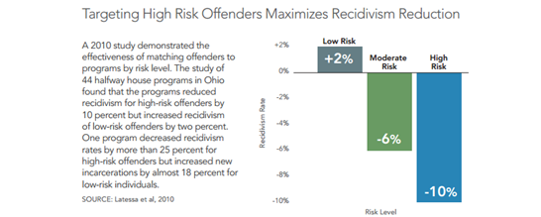

Following RNR Principles Impacts Recidivism
Notes:
A number of CBCF and HWH programs have demonstrated an ability to reduce recidivism rates by large percentages, but the impact of these programs was offset by others that failed to reduce recidivism or increased recidivism rates for participants.
Low risk offenders placed in either HWHs or CBCFs showed the worst outcomes, with recidivism increases between 3 and 10 percentage points, depending on the measure (new felony conviction, any new conviction, or new incarceration).
CBCFs and HWHs achieved the best outcomes among the high-risk population, with recidivism reductions up to 5 percentage points, depending on the measure used.

Slide 16
Use of Cognitive-Behavioral Interventions
ACTION-ORIENTED…engage individuals in activities, such as role plays as part of therapeutic process.
FOCUSED ON THE PRESENT…aimed at changing current risk factors that impact behavior.
FOCUS ON LEARNING…significant amount of time learning and practicing new ways to handle risky situations.
            University of Cincinnati Corrections Institute, Cognitive Behavioral, Interventions for Substance Abuse
Notes:
Designed to change cognitions that influence maladaptive behavior

Slide 17
Static Risk Factors
  Criminal history (number of arrests, number of convictions, type of offenses)
  Current charges
  Age at first arrest
  Current age
  Gender

Slide 18
Dynamic Risk Factors
Anti-social attitudes
Anti-social friends and peers
Anti-social personality pattern
Substance abuse
Family and/or marital factors
Lack of education
Poor employment history
Lack of pro-social leisure activities

Slide 19
Target Factors Associated with Criminogenic Risk
Risk Factor | Need
History of Antisocial Behavior | Build alternative behaviors
Antisocial Personality Pattern | Problem solving skills, anger management
Antisocial Cognition | Develop less risky thinking
Antisocial Attitudes | Reduce association with criminal others
Family and/or Marital Discord | Reduce conflict, build positive relationships
Poor school and/or work performance | Enhance performance, rewards
Few leisure or recreation activities | Enhance outside involvement
Substance abuse | Reduce use through integrated tx
Source: Andrews, 2006
Notes:
Key Points:
This is just a preview for “Evidence-Based Sentencing”- informing sentencing decisions by available evidence about how to address criminogenic risks by targeting needs
Persons with Mental Illnesses have more of these risk factors than those without
Assess criminogenic needs and address these needs through focused interventions
Place higher-risk/higher-need individuals in treatment slots
Prioritize a person’s “high” needs FIRST when developing a case plan

Slide 20
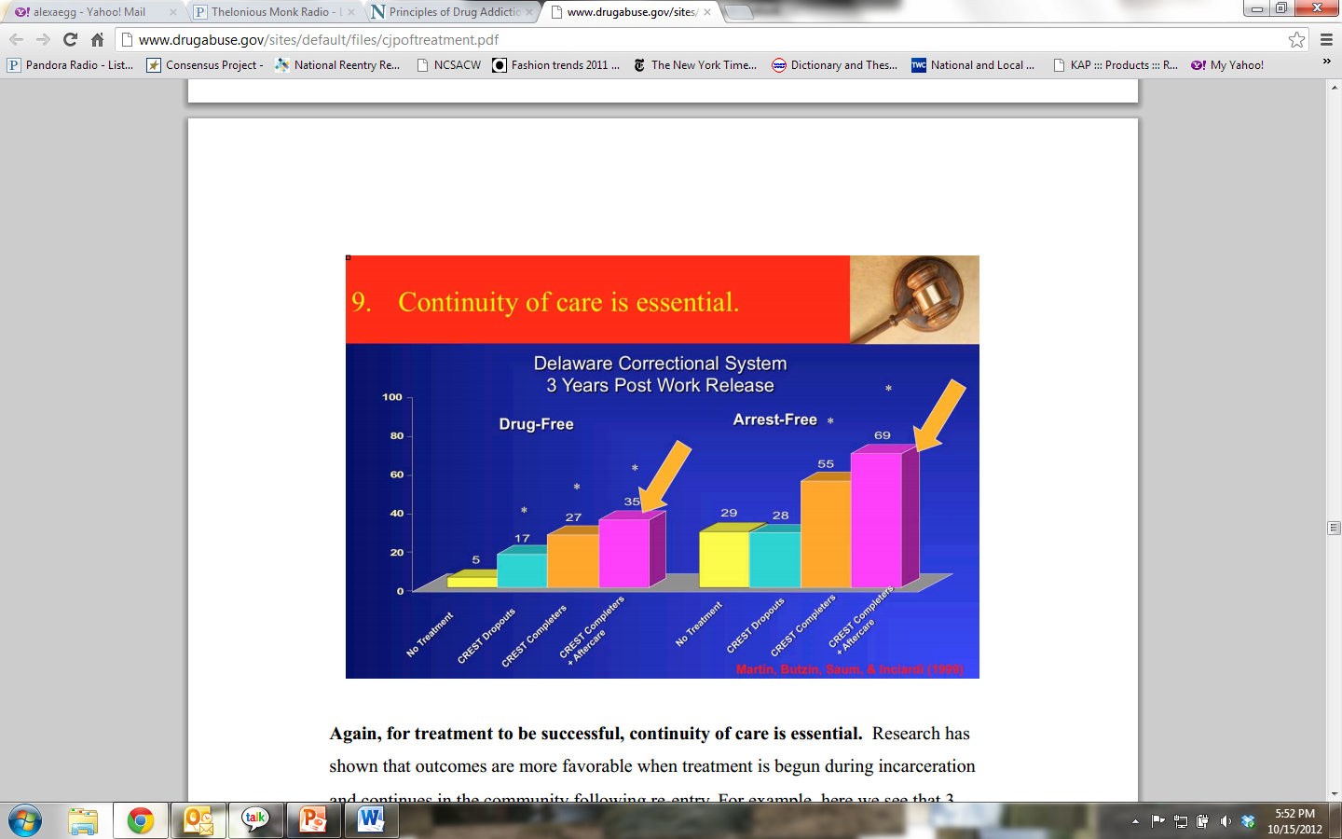
Systems Integration Can Improve Outcomes
Notes:
3 years post-treatment, those who received prison-based treatment followed by community-based treatment were more likely to be drug- and arrest-free 3 years after release compared to those who did not participate in treatment or who participated only in prison-based treatment.

Slide 21
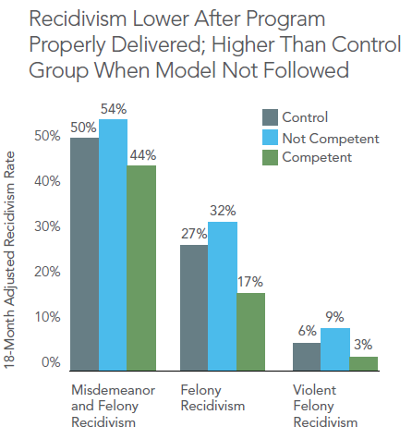

The Importance of Fidelity

Slide 22
Unfortunately, Criminal Justice Treatment has Faltered in Several Key Areas:
1. Use of valid and standardized screening and assessment processes
2. Identification of individuals who are most in need, i.e. high risk and high need target population
Tailoring programming to respond to criminogenic factors
Provision of post-release services

Slide 23
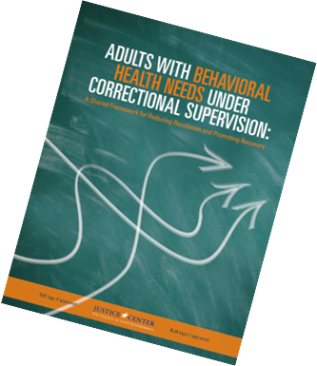


Framework for Criminal Justice and Behavioral Health

Slide 24

Prioritizing Your Target Population

Slide 25
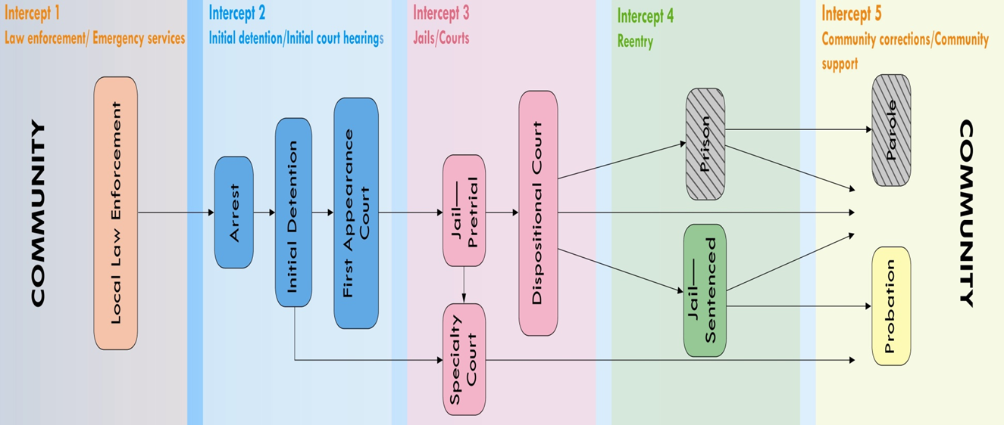
Sequential Intercept Model

Slide 26
Today’s Presentation
Introduction
What Works: Developing Effective Responses for Justice Involved with Behavioral Health Needs
State and Local Application
Conclusion

Slide 27
Lessons Learned: Second Chance Act
Clear risk/need criteria for program eligibility
  Prioritizing based on risk and need
  Engaging ‘less motivated’ clients
  Use of standardized curricula that incorporate cognitive-based approaches
  Emphasis on Continuity of Care
    Intro to post-release programming and what to expect
    Set appointment prior to release
    Develop treatment continuation plan
    ‘Inside - Out’ service delivery

Slide 28
Lessons Learned: Second Chance Act
Innovations in strengthening use of EBP’s
  Family programming
  Co-occurring capacity
  Skype
  MAT access
  Peer support programs
Supervision policies post-release have significant impact on transition
Opportunity to strengthen and leverage RSAT funding

Slide 29
Additional Opportunities to Improve Practice
The Adult Offender Comprehensive Statewide Recidivism Reduction Demonstration Program
Awards $6.1 million to seven states for programs aimed at achieving reductions in baseline recidivism rates through planning, capacity-building, and implementing effective and evidence-based interventions.
  Arkansas
  Georgia
  Kansas
  Louisiana
  New York
  Ohio
  Rhode Island

Slide 30
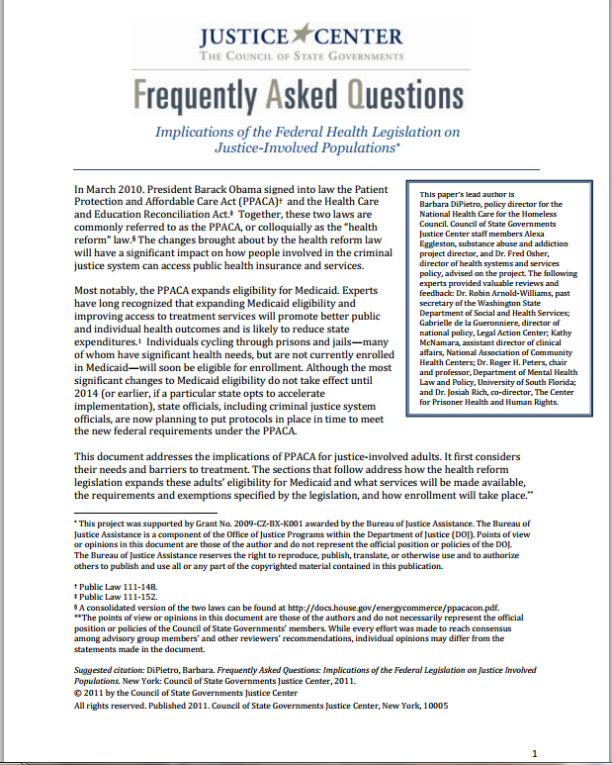
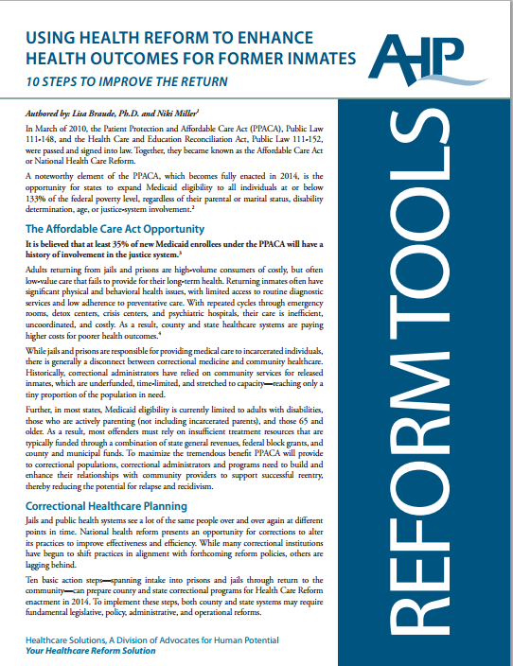
Opportunity for Health Reform to Improve Reentry

Slide 31
Today’s Presentation
Introduction
What Works: Developing Effective Responses for Justice Involved with Behavioral Health Needs
State and Local Application
Conclusion

Slide 32
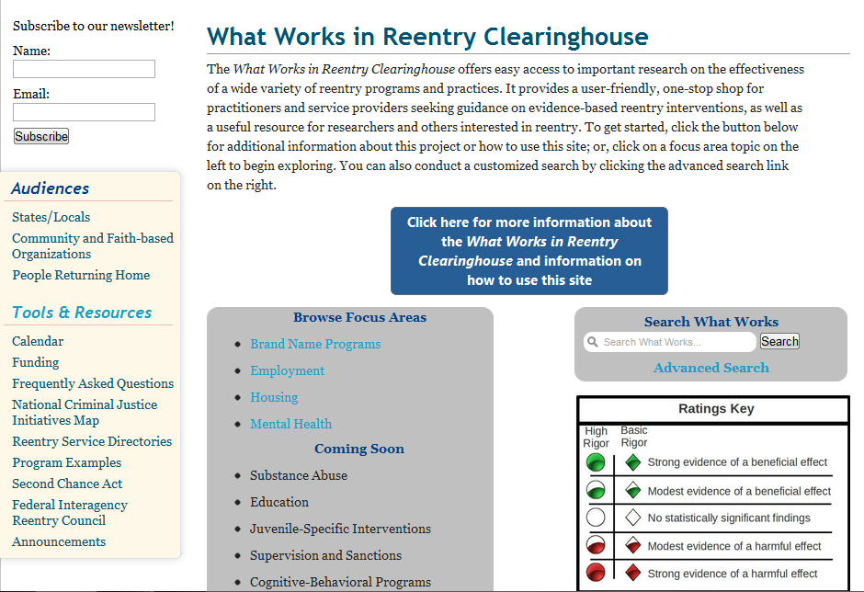
Resource: ‘What Works’
http://nationalreentryresourcecenter.org/what_works

Slide 33
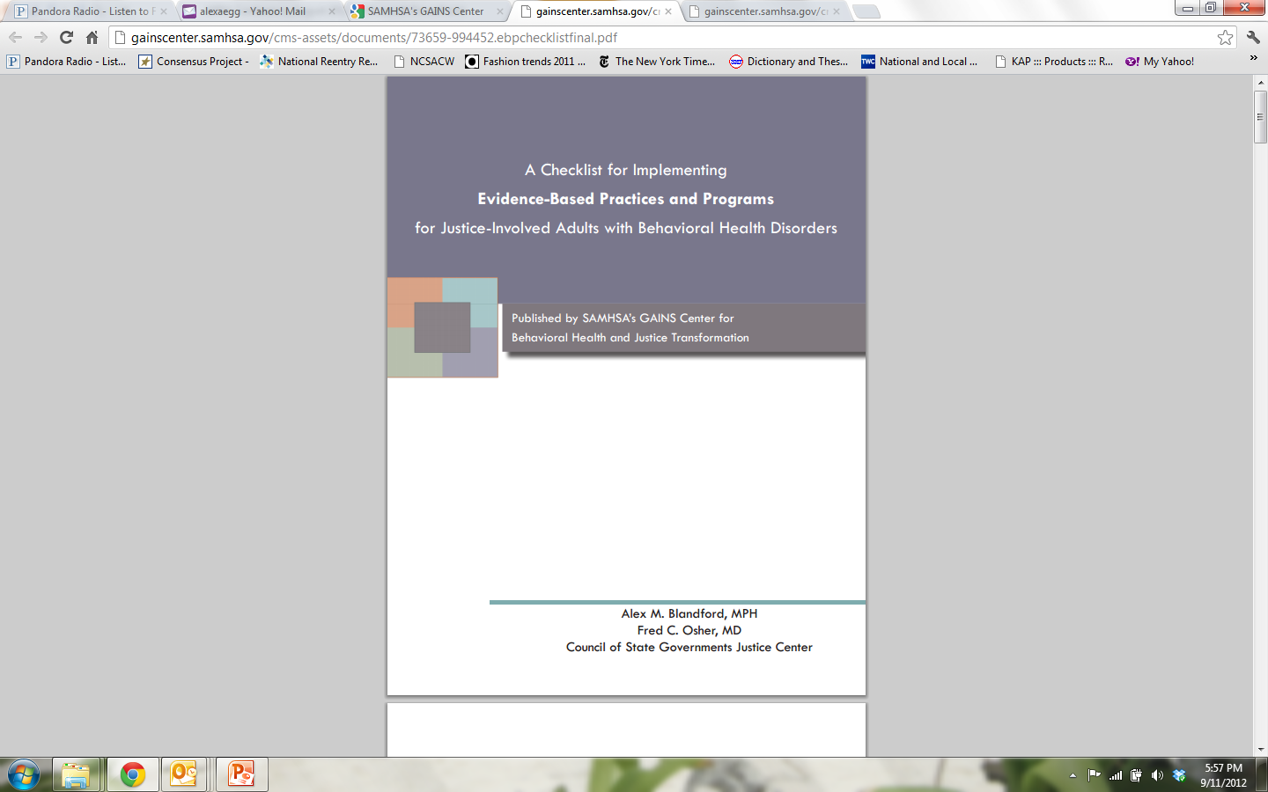
Resource:
A Checklist for Implementing EBP’s for Justice-involved with Behavioral Health Disorders
http://gainscenter.samhsa.gov/cms-assets/documents/73659-994452.ebpchecklistfinal.pdf

Slide 34
Thank you!
Alexa Eggleston
aeggleston@csg.org
For more information:
www.justicecenter.csg.org

