Slide 1

A Drug Policy for the 21st Century
RSAT Webinar
November 18, 2015
Mary Lou Leary
Deputy Director for State, Local, and Tribal Affairs
Office of National Drug Control Policy

Slide 2
National Drug Control Strategy
The President’s science-based plan to reform drug policy:
Prevent drug use before it ever begins through education
Expand access to treatment for Americans struggling with substance use disorders
Reform our criminal justice system
Support Americans in recovery

Slide 3

Overdose: A Public Health Epidemic
Prescription opioids are potentially dangerous drugs – overdoses involving these drugs claimed more than 175,000 lives between 1999 and 2013.
From 1999 to 2010, a 4-fold increase in opioid sales paralleled a more than 4-fold increase in prescription opioid-involved overdose deaths.
4X

Slide 4
Major Causes of Death from Injury, 1999-2013
% CHANGE
2008 to 2013
MOTOR VEHICLE ACCIDENTS
+ 21%
+ 14%
-11%
SUICIDE
+ 6%
FIREARMS
DRUG POISONING
HOMICIDE
-10%
Source: Centers for Disease Control and Prevention, National Center for Health Statistics. Multiple Cause of Death 1999-2012 on CDC WONDER Online Database, released 2014. Data for 1999 to 2012 were extracted by ONDCP on December 2, 2014. Data for 2013 are from Detailed Tables for the National Vital Statistics Report “Deaths: Final Data for 2013” (December 30, 2014).
1/2015

Slide 5
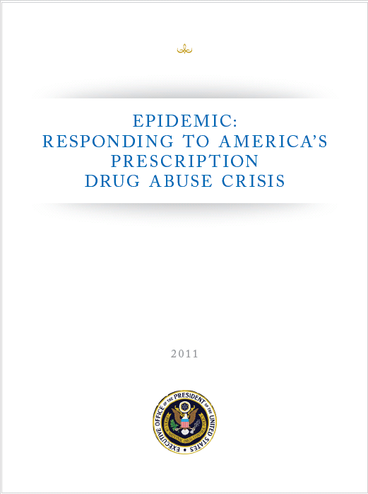
Prescription Drugs and Heroin:
The Federal Response
Prescription Drug Abuse Prevention Plan
    Education
    Prescription Drug Monitoring Programs
    Proper Disposal of Medication
    Enforcement
Naloxone for Overdose Reversal
  Medication-Assisted Treatment for Opioid Use Disorders

Slide 6
  Medication-Assisted Treatment (MAT) is the
  Standard of Care for Opioid Use Disorders
Source: Weiss RD, Potter JS, Griffin ML, McHugh RK, Haller D, Jacobs P, Gardin J 2nd, Fischer D, Rosen KD. Adjunctive Counseling During Brief and Extended Buprenorphine-Naloxone Treatment for Prescription Opioid Dependence: A 2-Phase Randomized Controlled Trial Published in final edited form as: Arch Gen Psychiatry. 2011 December; 68(12): 1238–1246.

Slide 7
Medications Currently Available
For Opioid Use Disorder
Methadone
Naltrexone (Vivitrol)
Buprenorphine
For Nicotine Use Disorder
Nicotine Replacement Therapies (NRT)
Bupropion
Varenicline
For Alcohol Use Disorder
Disulfiram
Naltrexone
Acamprosate
Naltrexone Depot
Principles of Drug Addiction Treatment, National Institutes of Health – National Institute on Drug Abuse

Slide 8
How RSAT Programs Can Help
TREAT people with opioid use disorders using every tool at our disposal, including medication-assisted treatment where appropriate
PREVENT overdose by educating your program clients on their risk of overdose and the tools that exist to help prevent it
Help people TRANSITION to their communities with connections to treatment

Slide 9
For More Information
WhiteHouse.gov/ONDCP

Slide 11
Federal Drug Policy for the 21st Century
Residential Substance Abuse Treatment Webinar (RSAT)
November 18, 2015
Melinda Campopiano, MD
Melinda.campopiano@samhsa.hhs.gov
SAMHSA
Notes:
Committee composition
Conceptualization of the topic and work
Activities
Questions for the taskforce
Key recommendations

Slide 12
Today’s Talk
Secretary’s Opioid Initiative
Opportunity and imperative of re-entry
Overdose prevention
  Naloxone
  Medication Assisted Treatment

Slide 13
HHS takes strong steps to address opioid-drug related overdose, death and dependence
March 26, 2015
Reduce unnecessary/inappropriate opioid prescribing
Increase availability of naloxone
Increase access to medication assisted treatment
Notes:
Evidence-based, bipartisan efforts focus on prescribing practices and treatment to reduce prescription opioid and heroin use disorders
U.S. Health and Human Services Secretary Sylvia M. Burwell today announced a targeted initiative aimed at reducing prescription opioid and heroin related overdose, death and dependence. Deaths from drug overdose have risen steadily over the past two decades and currently outnumber deaths from car accidents in the United States. The President’s FY 2016 budget includes critical investments to intensify efforts to reduce opioid misuse and abuse, including $133 million in new funding to address this critical issue.
The Secretary’s efforts focus on three priority areas that tackle the opioid crisis, significantly impacting those struggling with substance use disorders and helping save lives.
1.Providing training and educational resources, including updated prescriber guidelines, to assist health professionals in making informed prescribing decisions and address the over-prescribing of opioids.
2.Increasing use of naloxone, as well as continuing to support the development and distribution of the life-saving drug, to help reduce the number of deaths associated with prescription opioid and heroin overdose.
3.Expanding the use of Medication-Assisted Treatment (MAT), a comprehensive way to address the needs of individuals that combines the use of medication with counseling and behavioral therapies to treat substance use disorders.

Slide 14
Re-entry is uniquely high-risk
In the immediate two weeks after release, people in this group are almost 130 times more likely to die of an overdose than the general population.

Slide 15
Overdose prevention prior to release works
30% reduction in deaths in N-ALIVE (England)
4.7% opioid related deaths in first 4 weeks in 2013 compared to 9.8% in 2006-2010. (Scotland)
San Francisco, Rhode Island, New Mexico, Pittsburgh
Notes:
Though in the early stages of evaluation, the naloxone
investigation (N-ALIVE) randomized trial in the United Kingdom
involves assigning 56,000 incarcerated individuals to either receive a
take-home supply of emergency naloxone upon release in conjunction
with overdose education or to education alone.92 Amongst the
control group of 28,000 eligible ex-prisoners that receive naloxone,
researchers expect to detect a 30% reduction in overdose deaths—
from the anticipated 140 deaths during the first four weeks of release
down to a lower level of just under 100 deaths.93

Slide 16
Re-entry overdose prevention strategies
Overdose prevention education
  Don’t use alone. Don’t mix with other drugs or alcohol. Recognize and respond appropriately when overdose is happening
Option to have naloxone kit in their property when released from custody or supportive housing
Link to overdose prevention, mental health and medication assisted treatment in the community

Slide 17
Medication Assisted Treatment (MAT)
Reduces mortality by half
Reduces HIV infection by half
Improves compliance with medical treatment
Reduces recidivism and criminal behavior
Outcomes optimized by receiving behavioral health services and social services to address the social corollaries of opioid use disorder

Slide 18
Comprehensive Treatment
MAT is one component of the comprehensive treatment of opioid use
To be of maximum benefit evidence based behavioral therapy and case management services must also be provided
Not all services have to be delivered by the same provider

Slide 19
Extended Release Injectable Naltrexone
Monthly injection
Optimal approach is for patients to receive first dose prior to leaving corrections/detox/rehab
Patient must be medically detoxed first
Cannot be used by patients who require opioids for pain
Also indicated for alcohol use disorder

Slide 20
Extended Release Injectable Naltrexone
Extended Release Injectable Naltrexone is expensive but covered by many state Medicaid plans
Can be prescribed/ordered by any licensed prescriber including advanced practice nurses and physician assistants

Slide 21
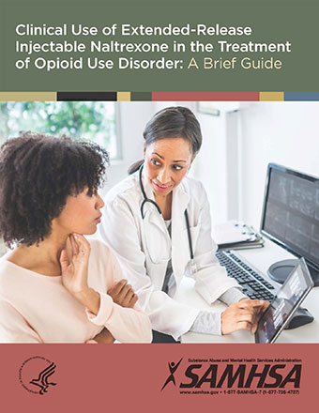
Naltrexone Resources
Pcssmat.org
http://store.samhsa.gov/product/Clinical-Use-of-Extended-Release-Injectable-Naltrexone-in-the-Treatment-of-Opioid-Use-Disorder-A-Brief-Guide/SMA14-4892R

Slide 22
Buprenorphine
Formulated with or without naloxone
buprenorphine monoproduct (without naloxone) is only for pregnancy
Few interactions with HIV or HCV meds
Can be used in pregnancy
Does not require detoxification to begin
Generics available

Slide 23
Buprenorphine
Requires physician prescriber
Patient capacity limited to 30 per provider for first year. After one year of experience may request increase to 100 patients/per provider
Covered by most state Medicaid
Becoming certified as an opioid treatment program (OTP) removes the patient capacity limit

Slide 24
Physician requirements to prescribe buprenorphine
Obtain waiver to Controlled Substances Act by filing “notice of intent to prescribe”
Licensed and registered with DEA
One of the following:
  Board specialization in addiction medicine or addiction psychiatry
  Completed 8 hour training
  Investigator in trials to approve buprenorphine
  Has training or experience approved by state licensing board.

Slide 25

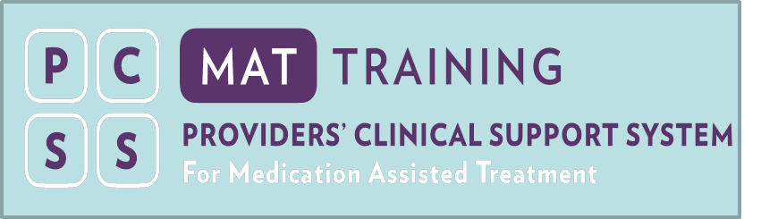
Buprenorphine Resources
How to get a waiver and everything else you need.
http://buprenorphine.samhsa.gov/
Required prescriber training
and other resources
pcssmat.org

Slide 26
Methadone
Requires certification as an opioid treatment program and program DEA registration
  Dpt.samhsa.gov 240-276-2700
Methadone must be administered and dispensed at the program
pcssmat.org

Slide 27
Fatal Re-Entry: Legal and Programmatic Opportunities to Curb Opioid Overdose
Tragedy results when mass incarceration meets our society’s failure to adequately treat substance abuse and mental health problems.
Northeastern University Law Journal 2015
Notes:
Beletsky, Leo and LaSalle, Lindsay and Newman, Michelle and Paré, Janine M. and Tam, James S. and Tochka, Alyssa B., Fatal Re-Entry: Legal and Programmatic Opportunities to Curb Opioid Overdose Among Individuals Newly Released from Incarceration (July 1, 2015). Northeastern University Law Journal, Vol. 7, No. 1, pp. 155-215 (2015); Northeastern University School of Law Research Paper No. 235-2015. Available at SSRN: http://ssrn.com/abstract=2628297

