Slide 1


Post-Release Substance Use Disorder Treatment:
The Role of Insurance in Creating Access to Care

Slide 2
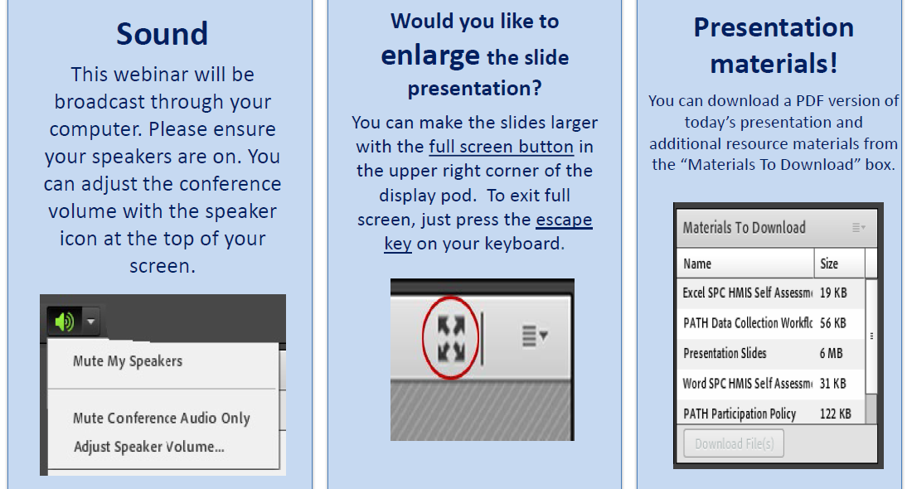
Housekeeping: Functions

Slide 3
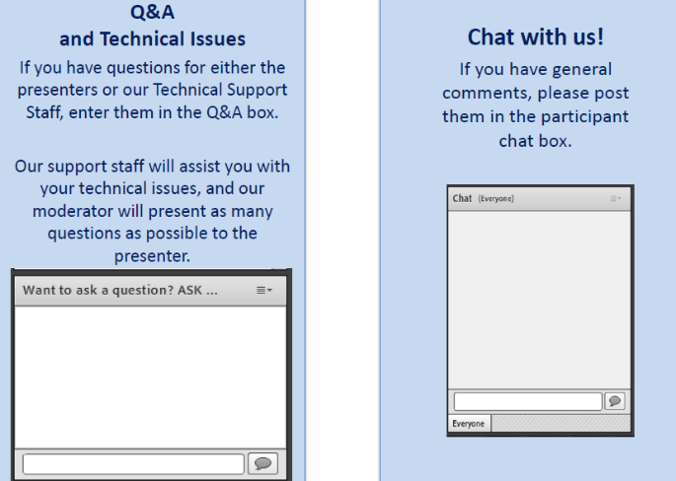
Housekeeping: Communication

Slide 4
  Post-Release Substance Use Disorder Treatment: The Role of Insurance in Creating Access to Care
Presenter
Maureen McDonnell
Moderator
Stephen Keller
Training/TA Coordinator, RSAT-TTA
http://www.rsat-tta.com/Home
Notes:
Example:
If you can understand the form that allows your insurance to bill at a hospital – you can’t be seen.
If you can’t understand the consent to treat form, you don’t’ get tx
Pretty basic, but the research shows that most people do not understand these forms….they mostly sign them anyway….but lets look at some research that applies to our populatiomn

Slide 5

Maureen McDonnell
MMcDonnell@tasc-il.org
Treatment Alternatives for Safe Communities (TASC)
http://www2.tasc.org/

Slide 6
Presentation Agenda
SUDs Very Prevalent Among Prisoners
Who Pays for Services Now?
How Do the Major Insurance Programs Work?
What Can Your RSAT Program Do to Increase Use of Insurance to Access SUD Treatment?

Slide 7
Substance use and mental illness are driving factors in justice-system involvement
Sources: James and Glaze, 2006; Ditton, 1999 and Metzner, 1997 as cited in Osher, D’Amora, Plotkin, Jarrett, and Eggleston, 2012; Mumola and Karberg, 2006; Karberg and James, 2005; NSDUH at SAMHSA, 2013
68%
64%
56%
53%
19%
16%
17%
9%
4%
GenERAL State Prison Local population Jail
General State Prison Local population Jail
General State Prison Local
Population Jail
ANY MENTAL HEALTH PROBLEM
SERIOUS MENTAL ILLNESS
SUBSTANCE USE DISORDER

Slide 8
Reentry = High Risk Time
At Release:
12-20x higher death rates
Overdose, suicide, homicide, heart attack
Needed for Safe/Healthy Release:
Immediate access to SUD treatment
Medications
Primary care appointments

Slide 9
Who Pays for SUD Services in the Community?

Slide 10
In 2014: (SAMHSA TEDS Data)
Source of Payment | Share of All Admissions
Medicaid | 23.1%
Medicare | 0.8%
Other Government Programs (state, local, federal block grant) | 43.5%
Commercial Insurance | 5.6%
Self-pay | 12.4%
Other | 9.8%
No Charge | 4.8%

Slide 11
What are the major insurance/funding resources for SUD treatment for people leaving prison?
Medicaid
Medicare
Veteran’s Administration
State or county programs for people leaving prison
  Ex: Sheridan CC (Illinois)
Community Health Centers (FQHCs)

Slide 12
Medicaid
National program
Federal/State partnership – co-funded
  Federal share 50-100%
  State defines covered services
Major eligibility groups
  Seniors/Persons with Disabilities
  Pregnant Women
  Children/Custodial parents
  Low-Income Adults (ACA expansion population)

Slide 13
Medicaid Policy Initiatives (State)
1115 Medicaid waivers
  Make pre-release service planning a reimbursable service (30 days prior)
Managed care contracts
  Require plans to work with members pre-release
Medicaid enrollment initiatives
Behavioral health initiatives
  Waivers, justice reinvestment, local investments
  Goal: Increase community capacity and access

Slide 14
Medicaid
What if your state did not expand Medicaid for the newly eligible ACA population?
You can still maximize existing Medicaid coverage
  Locate those eligible due to disability status
    Medical or mental health are most common
  Examples
    Buncome County NC (Asheville NC)
    Hospital DSRIP districts arrangements (Texas)

Slide 15
Medicare
National program
  Turned 50 last year
Funded through payroll tax
Eligibility categories
  Over 65
  Under 65 if disabled with work history (SSDI)
    Often Medicaid/Medicare (“dual eligible”)

Slide 16
Veterans Administration
National Program
Eligibility categories depend on length of service and status of discharge
VA is a health system and an insurance program
  Increasingly contract outside of their system for services, including behavioral health services
Need to know: Veterans Justice Outreach staff

Slide 17
What Can Your RSAT Program Do?
Become aware of all public insurance programs available in your state
  And in communities with large numbers of returning individuals
Enroll releasing individuals into all programs for which they are eligible
Educate on how to use these benefits to get needed SUD services

Slide 18
Questions?
Type your question in the Q&A box
on your computer screen
Speaker Contact Info:
Maureen McDonnell: MMcDonnell@tasc-il.org
or
her colleague, Phillip Barbour: pbarbour@tasc-il.org

Slide 19
Always Happy to Hear From You
Thank you all for the great work you do!
We know your job is not easy, but we aim to make it a bit easier & are always happy to hear how we can do so…
Contact me anytime with inquiries about the topics we have covered: Skeller@ahpnet.com
Also appreciate hearing about your experiences & innovations…
Thank you for your participation …

Slide 20
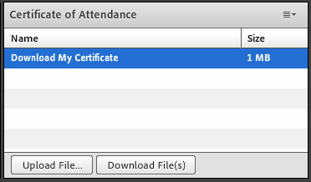
Certificate of Attendance
Download now!

Slide 21
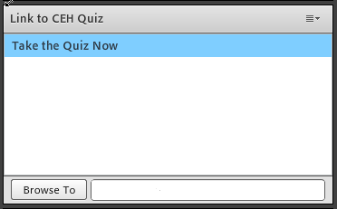
Continuing Education (CEH)
1 NAADAC CEH
Pass 10-question quiz with 7 correct answers
Receive certificate immediately

Slide 22
RSAT Technical Assistance and Training Center
For more information on RSAT training and technical assistance visit:
http://www.rsat-tta.com/Home
or email Stephen Keller, RSAT TA Coordinator at
skeller@ahpnet.com

