Slide 1
Taking the Next Steps: Integrated Recidivism Reduction and Treatment Planning for Individuals with Co-Occurring Disorders
Debra A. Pinals, M.D.
Director, Program in Law, Psychiatry, and Ethics
Clinical Professor of Psychiatry
University of MICHIGAN
and faculty University of Massachusetts Medical School Department of Psychiatry

Slide 2
With appreciation
David Smelson, Psy.D., Massachusetts Department of Mental Health, Department of Correction, Probation Services, Executive Office of the Trial Court, University of Massachusetts Medical School, Michigan Department of Health and Human Services, the Substance Abuse and Mental Health Services Administration (SAMHSA), the Bureau of Justice Assistance, the Council of State Governments and Policy Research Associates, Inc.

Slide 3
Maria
35 y.o. female arrested: armed robbery offense (10th arraignment)
Jail course: opioid withdrawal, marijuana abstinence, depression, anxiety and occasional “hearing voices” related to PTSD, suicide watch
Competence to Stand Trial evaluated but ok
Trauma history, malingering per the SIRS
Released on bail, defaulted two days later at a drug court appearance on a different case
Now incarcerated and in RSAT program after earning good time
Notable reactivity, hypersensitivity, isolativeness

Slide 4
Jack
24 year old male
Repetitive domestic violence and robbery charges, 10 arrests
Using substances since age 12 when started with alcohol
Serving a two year sentence on armed robbery related to trying to get money to support heroin habit
Mother died recently, father not in the picture
Adjustment to incarceration poor, several initial disciplinary issues
Now incarcerated for one year and settled in
Attending treatment in RSAT but mostly to earn good time to get out and return to same situation

Slide 5
Refining Target Population and Approaches

Slide 6
Risk-Need-Responsivity (RNR) Model as a Guide to Best Correctional Practices
Focus resources on high RISK cases
Target criminogenic NEEDS, such as antisocial behavior, substance abuse, antisocial attitudes, and criminogenic peers
RESPONSIVITY – Tailor the intervention to the learning style, motivation, culture, demographics, and abilities of the offender. Address the issues that affect responsivity (e.g., mental illnesses)
Andrews, Bonta, Hoge 1990

Slide 7
Criminogenic Risk Factors:
The Risk-Need-Responsivity Paradigm and Sup
Risk Factor
History of antisocial behavior
Antisocial personality pattern
Antisocial cognition
Antisocial attitudes
Family and/or marital discord
Poor school and/or work performance
Few leisure or recreation activities
Substance abuse
Source: Andrews (2006)

Slide 8
Criminogenic Risk and Mental Illness Simple Logic Model: Not So Simple
Mental Health Symptoms lead to criminalization
Expand Mental Health Services
Criminalization of persons with Mental Illness will Decrease
BUT…. More mental health services do not necessarily decrease the percentage of persons with mental illness in jail (Fisher 2000)
Steadman 2013; Rotter, 2015

Slide 9
Contributory Factors
Personality Factors
Mental Health Factors
Substance Use
Social
and
Contextual Factors
Childhood History
of Abuse
Adult Victimization

Slide 10
Caveats Regarding Risk Language
What risk is the concern? What risk is being measured?
Risk of violence
Risk of re-arrest
Risk of failing to appear in court
Risk of technical violations
“CRIMINOGENIC” risk does not naturally fit with strength-based thinking and recovery principles- systems linking together thoughtfully

Slide 11
LS/CMI Sections (Andrews, Bonta, Wormith 2004)
1. General Risk/Need Factors
2. Specific Risk/Need Factors
3. Prison experience/institutional factors
4. Other client issues (psychological and physical health, financial, victimization)
5. Special Responsivity Considerations
6. Risk/Need Summary and Override
7. Risk/Need Profile
8. Program/Placement Decision
9. Case management plan
10. Progress Record
11. Discharge summary

Slide 12
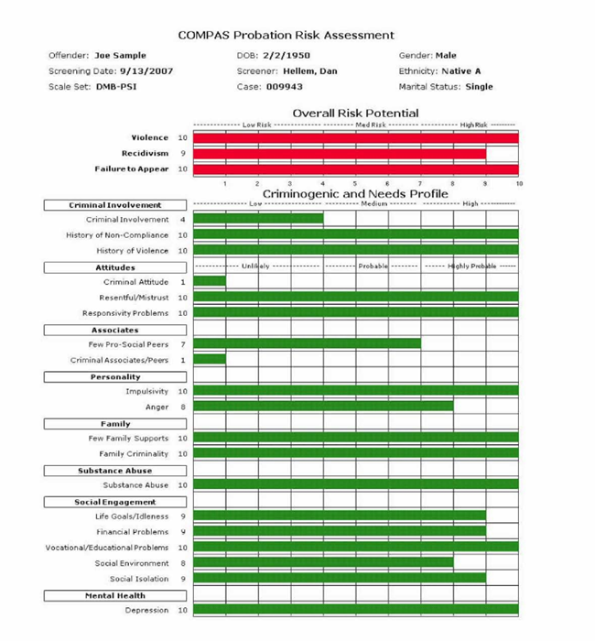
*note separate analyses for violence, recidivism, and failure to appear
http://www.criminaljustice.ny.gov/crimnet/ojsa/opca/compas_probation_report_2012.pdf

Slide 13
Creating Cross-System Collaboration
Integrated
Framework
What Works in Substance Use Treatment
What Works in Mental Health Treatment
What Works in Recidivism Reduction

Slide 14
Identifying Strategies to Work with Target Population of Persons with Mental Illness by Criminogenic Need and Functional Impairment
High
Intensive Treatment in collaboration with supervision
Integrated supervision and treatment services
Functional
Impairment and /or substance use severity
Low
Criminogenic Risk
High
Treatment and supervision coordinated as needed
Intensive supervision in collaboration with treatment
Low
Prins and Osher, Council of State Governments Justice Center, 2009

Slide 15
Pinals, CNS Spectrums, In Press

Slide 16
From Theory to Practice: Strategies for Recovery and Risk Mitigation through Integrated Treatment Plan Development

Slide 17
Person-Centered approach to Risk Mitigation
“High, medium, low risk” label has value but treatment planning requires next steps
Instead: How did they get here???
Join the client/patient wherever they are, help motivate for positive change
Hold hope of individual potential and identify small and big steps
Understand goals then, goals now
Understand barriers to goal attainment

Slide 18
a process of change through which individuals improve their health and wellness, live a self-directed life, and strive to reach their full potential (SAMHSA 2014)
RECOVERY
e.G., Symptom Resolution, Sobriety, Reduced Recidivism, Social Connectedness, Employment, Education, Independent Living, Self-Reliance

Slide 19
Integrating RNR Into Treatment: One Example

Slide 20
MISSION: Criminal Justice (MISSION-CJ) (www.missionmodel.org)
Systems Level (Sequential Intercept Model)
Reduce penetration of persons with mental illness into CJ system/Reduce recidivism | Identify and Link individuals to community-based mental health treatment | Improve mental health outcomes | Improve public safety
Assessment Level (RNR)
Match level of treatment to the level of risk to re-offend | Identify criminogenic needs and use these to inform treatment | Maximize engagement by understanding responsivity of the individual to treatment interventions and the ability of providers to address the risk factors identified while still emphasizing traditional treatment focus
Intervention/Person Level (MISSION-CJ)
Provide direct treatment services to address co-occurring disorders with trauma-informed approaches that support recovery | Additional focus on criminogenic needs and responsivity to reduce recidivism; focus also on traditional treatments | Promote stable and successful living with positive daily activities and health and wellness, with explicit attention to the additional goal of decreased recidivism | Coordinate care, access to housing, employment supports and other services as needed

Slide 21
MISSION-CJ Model
Combining evidence-based services into a comprehensive system of care
MISSION-CJ
Core Services
Support Services
Risk-Need-Responsivity (RNR)
Critical Time Intervention (CTI)
Vocational and Educational Support
Dual Recovery Therapy (DRT)
Trauma Informed Care
Peer Support
Pinals, Smelson, et al 2014; Smelson, Pinals et al 2014
Notes:
Important to note Core Services vs. Support Services in MISSION-CJ
MISSION-CJ focuses on The Core Services listed here. The Support Services are included in the model to provide guidance on important areas of service that should be included in treatment, but perhaps not directly by the MISSION-CJ team.
MISSION-CJ includes a variety of evidence-based practices such as CTI and DRT.
-Critical Time Intervention (Susser et al, 2007)
-Dual Recovery Therapy (Ziedonis et al, 1997)
-Peer Support (Chinman et al, 2010)
-Vocational/Educational Support (Ellison et al, 2012)
-Trauma Informed Care (Najavits et al, 2011)
-Risk-Need-Responsivity (Blanchette & Brown, 2006; Ward, Mesler & Yates, 2007)

Slide 22
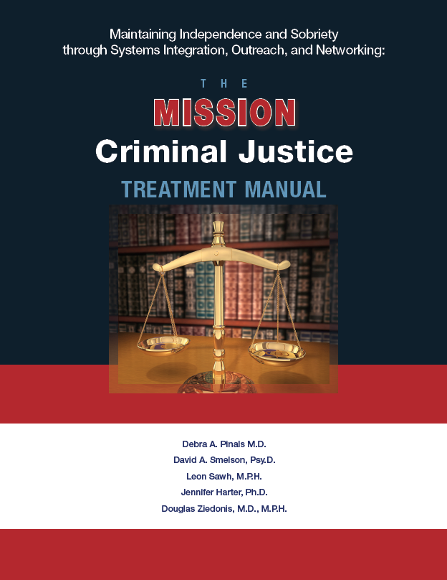
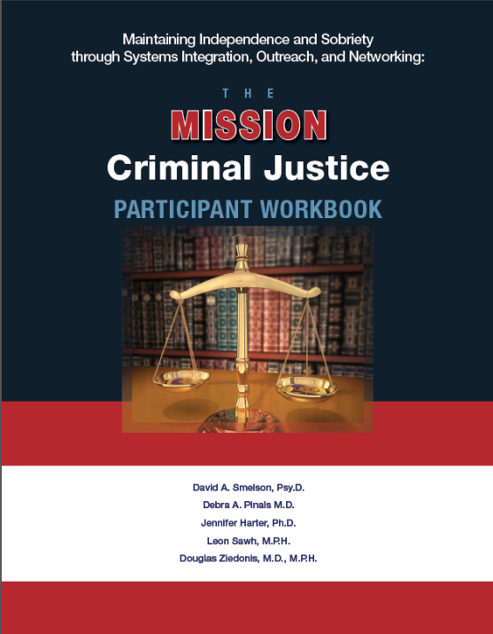
MISSION-CJ Materials
(ava at www.missionmodel.org)
Treatment Manual
Participant Workbook
Additional Resources:
Fidelity Measure
Measure that tracks the integration of the complex service structure
Consultation conducted during projects

Slide 23
PREVIOUS MISSION PROJECTS
Model Development (1999-2005) PI David Smelson Supported by VA OPCS/VISN 3 MIRECC | Components: Model Development, Pilot Testing Setting: Acute psychiatry/inpatient treatment program
Brief 2-month Intervention (2005-2009) PI David Smelson Supported by VA HSR&D | Components: Critical Time Intervention (CTI), Dual Recovery Therapy (DRT), and Peer Support. Setting: Acute psychiatry/inpatient treatment program
MISSION NJ (2004-2010) PI David Smelson Supported by SAMHSA | Components: CTI, DRT, Peer Support, and Vocational Support; Treatment Length: 12 months Setting: Residential treatment program
MISSION CREW (2010-2011) PI Deb Pinals Supported by the Bureau of Justice Assistance (BJA) | Components: Dual Recovery Therapy, Critical Time Intervention, and Vocational Support with trauma-sensitive contributions; Treatment Length: 3 months pre-release and 6 months post-release Target Population: female offenders with co-occurring substance abuse and mental health disorders who committed a non-violent offense
Recent and Current MISSION PROJECTS
MISSION Jail Diversion and Trauma Recovery Project (2008-2013) PI Deb Pinals Supported by SAMHSA-CMHS. | Treatment Length: 12 months (treatment begins after adjudication) Target Population: returning OIF/OEF Dually Diagnosed Veterans with a Trauma History who have been diverted from jail and selected by judge to receive treatment rather than serve jail time
HUD-VASH Randomized Controlled Trial (2011-2013) PI David Smelson Supported by VA National Center for Homeless Veterans | Components: In addition to standard HUD-VASH Case Management, for 6 months, participating Veterans will receive either MISSION-VET, Telephone Counseling or symptom monitoring via telephone; Treatment Length: 6 months Setting: Formerly homeless, dually diagnosed Veterans who have received housing placements through HUD-VA Supportive Housing Program
MISSION-Vet Implementation Study (2011-2014) PI David Smelson Supported by VA ORD/HSR&D/National Center on Homelessness Among Veterans | Components: Compare Implementation as Usual to Getting To Outcomes (GTO) to determine the most effective implementation strategy for the MISSION-Vet Intervention within VA Homeless Services Setting: Formerly homeless, dually diagnosed Veterans who have received housing placements through HUD-VA Supportive Housing Program in Boston, MA, Washington D.C., and Denver, CO.
MASS-MISSION: Ending Chronic Homelessness in Central and Western MA(2011-2014) PI David Smelson Supported by SAMHSA-CABHI | Components: Housing Placement, CTI, DRT, Peer Support, Trauma-Informed Care, Vocational and Educational Support Treatment Length: 12 months Setting: Place chronically homeless individuals in permanent housing and receive case management and peer support services for co-occurring disorders
MISSION RAPS (2011-2012 BJA 2011-RW-BX-010) MISSION I-RAPS BJA Grant 2013-RW-BX-003), MISSION WI-RAPS BJA Grant 2015-RW-BX-0006) PI Debra Pinals Supported by the Bureau of Justice | Treatment Length: 3 months pre-release and 6 months post-release Target Population: medium- and high-risk male and female offenders with co-occurring substance abuse and mental health disorders (may have committed a violent or non-violent offense) Components: Dual Recovery Therapy, Critical Time Intervention, and Vocational Support with trauma-sensitive contributions
MISSION-CREST (SAMHSA Grant 1H79SM061663-01) PI D. Pinals and MISSION FORWARD SAMHSA Grant TI025074-01) PI Karen Pressman | Treatment Length: 12 months (treatment begins after adjudication) Target Population: Specialty court involved individuals with co-occurring disorders and trauma histories including veterans; Setting: Implemented through specialty courts in conjunction with probation supervision,;

Slide 24
MISSION: CJ Key Goals
Improve Clinical Outcomes and functioning
Maximize Community Tenure
Reduce Re-Arrest
Reduce Serious criminal activity
Prevent Incarceration (Reduce Jail Days)
Reduce mental health and substance use symptoms
Identify and link individuals to comprehensive and effective community-based behavioral health care
Prevent Homelessness
Enhance public safety

Slide 25
MCJ Clinical Teams
Team Members
Case Manager Specialist
Peer Support Specialist
Delivers 13 Dual Recovery Therapy (DRT) sessions
Clinical, therapeutic, and diagnostic expertise
Intervenes during clinical emergencies
Delivers 11 peer-led sessions
Expertise based on personal experiences
Facilitates use of Participant Workbook
Provides active community outreach

Slide 26
MISSION Linkage Support
Housing
Educational and Vocational Support
Case Management
and Peer Support
Benefits
General Medical Care
Mental Health Services
Substance Use Treatment
Criminal Justice

Slide 27
CRIMINOGENIC RISKS, NEEDS AND SAMPLE TREATMENT PLANNING
Criminogenic Risks | Needs | Potential Approaches/Enhance Responsivity
Antisocial Behaviors | Reduce antisocial acts | Education, frequent contact with case manager/peer, strong communication between provider and probation/parole
Antisocial Personality Patterns | Decrease impulsivity, irritability, irresponsibility, help coping, problem-solving | Stress management exercises, problem-solving exercises, trauma informed care (TIC)
Antisocial Cognitions | Decrease antisocial cognitions, risk thinking | Referral to EBPs such as MRT, Thinking for a Change, etc.
Antisocial Peers | Decrease association with other criminals, enhance prosocial contacts | Peer supports, activities that allow for prosocial associations (e.g. volunteering, community service), fostering hope and positive connections
Family/marital relationships | Improve relationships with family and significant others when possible | Treat symptoms of mental illness, Help examine broken ties and how to rebuild, TIC, factor in criminal issues (e.g., DV)
Employment/Education | Assist in enhancing employment/academic skills and achieving goals | Identify housing, treat mental illness, Vocational skills linkages, employment supports, rewards for positive achievement
Leisure and recreation | Increase time in prosocial activities | Identify schedules, activities, community service
Substance abuse | Decrease substance use, enhance motivation for change | Active treatment (not just detox), monitoring as needed, plan for relapses, treat co-occurring mental illness

Slide 28
Need for Evidence Based Practices and Engagement Strategies
Psychopharmacology
Substance use treatments (SBIRT, MAT, RSAT, etc)
Supportive services with focused models (e.g. FACT, Critical Time Intervention)
Cognitive behavioral type practices and the need for further research
Treatments that address criminal thinking patterns
Treatments that address behavioral challenges
Trauma specific practices
EMDR
Seeking safety
Etc.
Engagement Strategies
Motivational interviewing

Slide 29
Responsivity Factors
Mental Illness
Trauma
Culture
Housing
Etc.

Slide 30
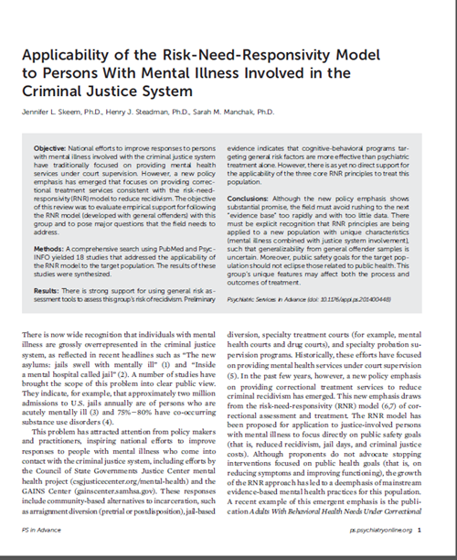
Caveats with regard to MI (Skeem, Steadman, Manchak 2015)
Risk assessment tools likely helpful in assessing risk of recidivism in population with MI
CBT type treatments may be more effective than psychiatric treatment alone in appropriate populations
Further research is needed to see how RNR principles specifically treat a population of individuals with mental illness and criminal justice involvement
Symptomatic treatment is still critical as some individual incidents may or may not be linked to symptoms
Responsivity as a principle needs further researched support

Slide 31
Criminal Justice and Institutions as Traumatizing
Pre-arrest circumstances
Arrest circumstances
Disruptions in social networks
Exposure to high noise level
Exposure to individuals with traumatic and tragic life circumstances
Exposure to individuals with antisocial and violent propensities
Loss of control
Humiliation
Public exposure
Fear of unknown
Pinals 2015; Miller and Najavits 2012

Slide 32
Case 1: Maria
Significant Trauma, Recurrent Substance Use, Antisocial factors
Is trauma a factor? What should be part of the treatment plan to help this person maximize engagement?
Clinical Tools for Trauma Symptoms
Identify triggers within the institution
Develop plan for increased sense of safety
Establish both perceived and real trust
Provide psychoeducation about trauma and substance abuse
Teach coping skills to control trauma symptoms
Adapted from Najavits & Cottler (2014)

Slide 33
Jack
Positive Resiliency Factors |  | Opportunities and Targeted Goals to Foster Strengths
1. Attending programming 2.Behavior less volatile |  | Motivational Interviewing to help move motivation rationale Identify positive peer models
Sample Criminogenic Risks Rated High | Needs | Targeted Goals for Intervention (include who and time line)
Antisocial Behaviors | Reduce antisocial acts and criminal behaviors Reduce irritability contributing to behavior | Weekly 1:1 for monitoring, encouragement, education (probation- 3 months) DRT session(one additional dose per case manager and client); trauma awareness Attend one prosocial activity ( with peer; within two weeks)
Antisocial Attitudes | Reduce sense of mistrust and negative cognitions | Peer support Social structure in RSAT commitment meetings
Poor family relations | Family relations repair/resolution Recognize depression as impairing engagement | Therapy with family focus while incarcerated, planning, identifying support Treat depression (medications, therapy)
Significant use | Substance use treatment | RSAT programming focused on addiction recovery

Slide 34
Conclusions
Persons with Co-Occurring Disorders who also have Criminogenic Features present with complex needs, but potentially improved outcomes
Focus must integrate different approaches and continue to refine with lessons learned
Implementation successes and challenges
Engagement maximized with peer support
Fidelity tracking and case discussions- developing techniques
Staff training needs to be ongoing
Unique re-entry coordination and systems challenges

