Slide 1


Gender-Responsiveness in the Correctional Setting
A web presentation for
RSAT - T&TA
by Deana Evens, MA
Corrections Transitions Programs Administrator

Slide 2
Training Objectives
Identify 5 characteristics to understand and work more effectively with women offenders.
Recognize 4 Behaviors/Consequences that women with substance abuse problems have.
State 6 Gender Responsive Guiding Principles.

Slide 3
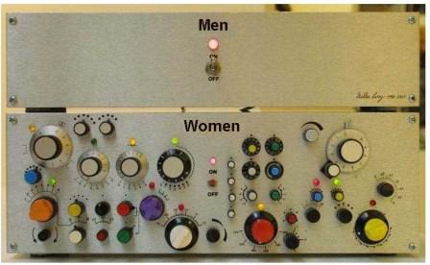

Slide 4
What is Gender Responsiveness?
Individually
Understanding the realities of women’s lives and being responsive to the issues of female offenders.
Organizationally
Developing methodologies for integrating gender and the needs of women onto the programs, services policies and procedures and institutional practices.
GLATTC 2001

Slide 5
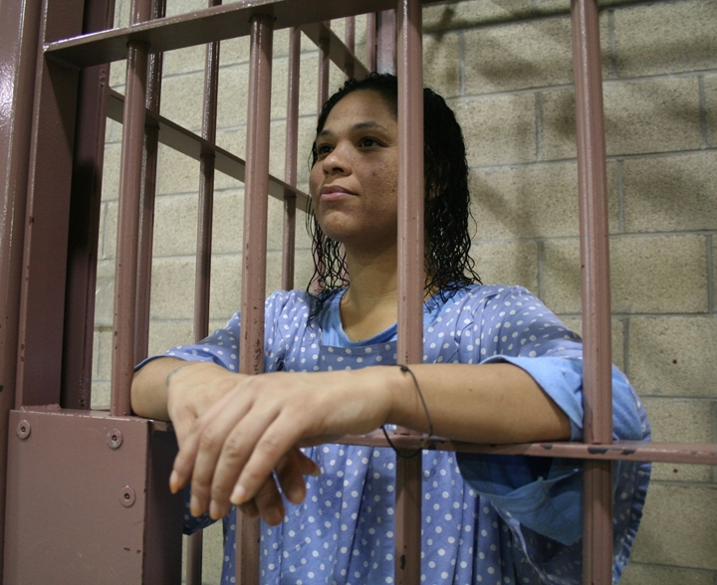

Slide 6
Why Focus on Female Offenders?
To find the safest and most effective ways of working with a growing population in correctional systems.
To understand the forces that have shaped the lives of many of these women in order to help them improve their lives and make your work with them safer and more effective.
Appropriate strategies contribute to better outcomes.
GLATCC 2001

Slide 7
Women in the Correctional System
The number of women entering into correctional institutions has tripled in the last 30 years.
Nearly 2/3 of the women confined in correctional institutions are women of color.
Female offenders generally have more economic difficulties than male offenders prior to arrest.
Female offenders are less likely to have committed a violent offense.
GLATCC 2001

Slide 8
Understanding Women
Many of the women entering correctional institutions have a history of being victimized.
The process or entry into the correctional system can add trauma.
The importance of relationships and the tendency to focus on others.
Their sense of responsibility in holding the family together.
Women have more chronic health problems.
Many women suffer from emotional, physical, spiritual or intellectual abuse.
GLATCC 2001

Slide 9
Substance Abuse and Addiction
Abuse
A maladaptive pattern of use of alcohol or other drugs that leads to physical or negative social consequences at work, home, school or in the legal system.
Dependence
Compulsive use with the loss of control. Marked by cognitive, behavioral, and physiological consequences and withdrawal symptoms when the drug is not present.
GLATCC 2001

Slide 10
Substance Abuse
Shared characteristics of drug abusers:
Low self-esteem
Problems with authority
Problems with responsibility
Poor impulse control
Unrealistic expectations
Difficulty coping with feelings & frustrations
Dishonesty/Self-deception
Guilt (self, others, community)
Deficits (education, attention)
TC Model

Slide 11
Cycle of Addiction
GLATCC 2001

Slide 12
Women with Addiction & Substance Abuse Problems
GLATCC 2001
Many women in correctional settings have problems with alcohol and other drugs. In general, they are more likely to:
Have primary care of children and/or elderly parents.
Be involved with partners who also have problems with alcohol and other drugs.
Have lost important relationships because of their substance abuse.
Experience depression and other physical and mental health problems.

Slide 13
Important issues to address for women in RSAT…
GLATCC 2001
What are you doing to address the following gender differences….
Relationships
Trauma
Mental health
Physical health
Victimization/abuse

Slide 14
Moms & Babies
Illinois Program
60-70 babies born annually to incarcerated mothers
Moms spend 24 hours with babies before they are placed with family (or go into DCFS care)
2001pilot program approved /2007 first baby born
Cost savings
Programming
Community partnerships
Recidivism

Slide 15
Gender-Responsive Guiding Principals
Guiding Principal #1
Gender
Women’s participation in crime differs from that of men in their motivation for committing the crime.
Crime rates for women are lower than for men and women’s crimes tend to be less serious and significantly less violent.
Family violence, trauma and substance abuse play a significant role in women’s criminality and influence their pattern of offending more so than for men.
Gender Responsive Strategies for Women Offenders
National Institute Corrections
April 2005

Slide 16
Gender-Responsive Guiding Principles
Gender Responsive Strategies for Women Offenders
National Institute Corrections
April 2005
Guiding principal #1 (cont)
Gender
Women’s responses to community supervision, incarceration and treatment differ from those of men.
Women have higher rates of disciplinary infractions for less serious rule violations as compared to men, but demonstrate less violence during incarceration.
Women’s behavior is influenced significantly by their concern for their children and their relationships with staff & other offenders during incarceration.

Slide 17
Gender-Responsive Guiding Principals
Gender Responsive Strategies for Women Offenders
National Institute Corrections
April 2005
Guiding Principal #2
Environment
Safety: in which female offenders are free from physical, sexual and verbal abuse.
Programming is based on women’s life circumstances and treatment focuses on their needs rather than male-based models.

Slide 18
Gender-Responsive Guiding Principals
Gender Responsive Strategies for Women Offenders
National Institute Corrections
April 2005
Guiding Principal #3
Relationships
Develop policies, practices and programs that are relational and promote healthy connections to children, family, significant others and the community.

Slide 19
Gender-Responsive Guiding Principals
Gender Responsive Strategies for Women Offenders
National Institute Corrections
April 2005
Guiding Principal #4
Services & Supervision
Address substance abuse, trauma, and mental health issues through comprehensive, integrated, and culturally relevant services and appropriate supervision.

Slide 20
Gender-Responsive Guiding Principals
Gender Responsiveness Strategies for Women Offenders
National Institute Corrections
April 2005
Guiding Principal #5
Socioeconomic Status
Life skills
Educational programming
Job skills
Safe housing
Medical & mental health

Slide 21
Gender-Responsive Guiding Principals
Guiding Principal #6
Community
Establish a system of community supervision and reentry with comprehensive, collaborative services.
Gender Responsiveness Strategies for Women Offenders
National Institute Corrections
April 2005

Slide 22
Re-entry
Re-entry begins prior to release
Needs Assessments
Collaboration
  Community partners
  Public buy in
Case management or Recovery Support Services

Slide 23
The road to success is always under construction.
Author unknown

Slide 24
The End
Q&A
This project was supported by grant No. 2010-RT-BX-K001 awarded by the Bureau of Justice Assistance. The Bureau of Justice Assistance is a component of the Office of Justice Programs, which also includes the Bureau of Justice Statistics, the National Institute of Justice, the Office of Juvenile Justice and Delinquency Prevention, the SMART Office, and the Office for Victims of Crime. Point of view or opinions in this document are those of the author and do not represent the official position or policies of the United States Department of Justice.

Slide 25
OUR NEXT WEBINAR
Wednesday, September 21, 2011, 2:00 p.m. EDT
Socialization and Change of the Drug Involved Offender
Participants in this webinar will explore the pilgrimage individuals make into the life of crime and addiction. The presenter will cover how social learning impacts addictive choices. In addition, the culture of addiction will be covered, the use of the stages of change as a method of examining pathways in and out of addiction will be discussed as well. Risk reductions and three
determinants of change will be reviewed.
Presenter: Kenneth L. Osborne, M.S
http://www.rsat-tta.com

