Slide 1
Prevalence of Drug Overdose Deaths upon Release from Prisons and Jails
Andrew Klein & Jon Grand

Slide 2
I. Drug Overdoses
Drug overdoses leading cause of injury-related death in US for people between 35-54 and the 2nd leading cause for young people under age 35.
Drug overdose deaths now exceed those from, firearms, homicides or HIV/AIDS.

Slide 3
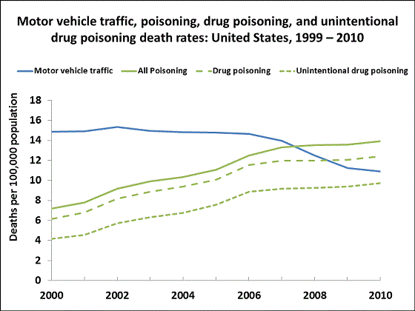
I. Drug Overdoses
Drug Poisoning includes unintentional, intentional and undetermined. Source: National Vital Statistics, 2000-2010

Slide 4
I. Drug Overdoses
Prescription Drug Overdose Death Rates Vary
from a high of 27 per 100,000 in New Mexico and 25.8 in West Virginia to a low of 5.5 in Nebraska, 7.1 in Iowa, and 7.2 in Minnesota.
http://www.cdc.gov/HomeandRecreationalSafety/rxbrief/states.html

Slide 5
I. Drug Overdoses
http://www.cdc.gov/nchs/data/factsheets/factsheet_drug_poisoning.htm

Slide 6
I. Drug Overdoses
Drug overdose deaths up for males and females, all race and ethnic groups, and all ages.
78% of drug deaths were unintentional,
14% were suicides,
and 8% were of undetermined intent
(2010)

Slide 7
I. Drug Overdoses

Slide 8
I. Drug Overdoses
Drugs Overdosed
e.g. Florida 2003-2009
76.1% prescription medication
23.9% illicit drugs

Slide 9
I. Drug Overdoses
Prescription Medication in overdose deaths up 84.2%:
Greatest increase:
oxycodone/oxycontin (264.6%),
Alprazolam/xanax (233.8%),
methadone (79.2%),
Hydrocodone/vicodin (34.9%)
morphine (26.2%)
CDC Drug Overdose Deaths-Florida, 2003-2009, MMWR (July, 2011)

Slide 10
I. Drug Overdoses
Risk Factors for Overdose Death: Women
21st Century:
Nearly 48,000 women died of prescription (opioid or narcotic) painkiller overdose between 1999 and 2010
Prescription painkiller overdose deaths increased about fivefold from the year 1999 to 2010
Overdose rates highest among women ages 45-54
Prescription painkillers are involved in 1 of every 10 suicides
Overdose death rates now 60% men, 40% women)
- CDC Vital Signs (July 2013)

Slide 11
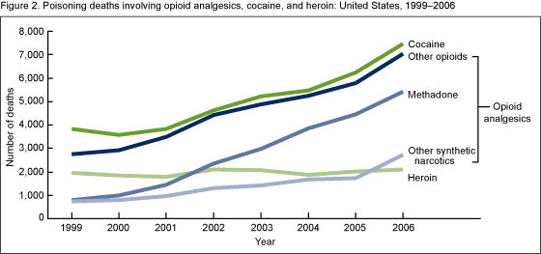
I. Drug Overdoses
Drugs not mutually exclusive.
Source: CDC/NCHS, National Vital Statistics System

Slide 12
I. Drug Overdoses
ED visits for drug overdoses for non-medical use of prescription drugs.
Between 2004-2008, ED visits up 111% to 305,900 per year, up 29% from 2007 to 2008.
Greatest number for oxycodone, hydrocodone, and methadone. Benzodiazepines up 89%.

Slide 13
I. Drug Overdoses
Buprenorphine, (Suboxone), was involved in 30,135 emergency room visits in 2010, up from 3,161 visits in 2005. Over half of the hospitalizations were for non-medical use of buprenorphine – with some users taking the drug to get high or ease pain of withdrawal when opioids are unavailable.
Source: http://www.samhsa.gov/data/2k13/DAWN106/sr106-buprenorphine.htm

Slide 14
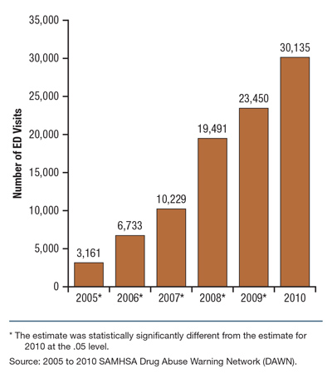
I. Drug Overdoses ED Visits for Buprenorphine

Slide 15
I. Drug Overdoses
We are not including Deaths as a result of excessive alcohol consumption.
The CDC reports: "From 2001–2005, there were approximately 79,000 deaths annually attributable to excessive alcohol use. Excessive alcohol use is the 3rd leading lifestyle-related cause of death for people in the United States each year.

Slide 16
II. Reentry Drug Overdoses
Within 2 weeks of release, former inmates are nearly 129 times at greater risk for drug overdose death than the general population of similar demographics.
Binswanger IA, Stern MF, Deyo RA, Heagerty PJ, Cheadle A, Elmore JG, Koepsell TD. Release from prison-a high risk of death for former inmates. N Engl J Med. 2007;356(2):157–165.

Slide 17
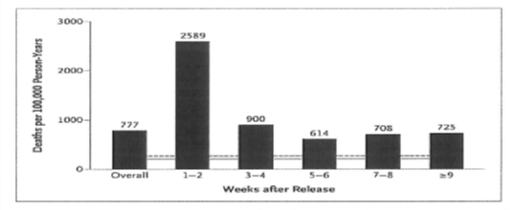
II. Reentry Drug Overdoses
Risk of death greater in first two weeks than any later period.

Slide 18
II. Reentry Drug Overdoses
Reentry Overdose Deaths:
Accidental and suicide

Slide 19
II. Reentry Drug Overdoses
Risk Factors for Overdose Death:
Older than 25 (Extended SA careers)
72% between 25-39
72% assessed as drug dependent in prior year
40% dependent on opiates & stimulants
85% used drugs month before prison term
54% drug free while in prison

Slide 20
II. Reentry Drug Overdoses
Risk Factors for Overdose Death:
Both drug use month prior to incarceration and in-prison drug abstinence independently associated with post release drug overdose deaths (logistic regression model). Also re-offenders are at increased risk of post release death.
Sources: Harding-Pink, 1990; Hobbs et al, 2006

Slide 21
II. Reentry Drug Overdoses
Risk Factors for Overdose Death:
Cumulative detrimental effect of periods of reduced tolerance due to:
Sporadic disruption to drug or treatment habits
Post release inmates not currently receiving maintenance pharmacotherapy
Having experienced drug or treatment discontinuity as a consequence of incarceration
Source: Kariminia et al, 2007.

Slide 22
II. Reentry Drug Overdoses
Mixing Drugs
Concurrent use of multiple drugs, with every additional illicit drug consumed in combination with opioids, nearly doubles the risk of death from opioids.
Source: L. Moller, Acute drug-related mortality of people recently released from prisons

Slide 23
II. Reentry Drug Overdoses
Risk Factors for Overdose Death: Women
Higher risk
Younger age, 20-29 years (vs. males 25-39)
Drug choice: benzodiazepines, cocaine, tricyclic antidepressants, multi-drug use

Slide 24
II. Reentry Drug Overdoses
Risk Factors for Overdose Death
For jail populations:
▪ Histories of homelessness (also for suicide)
▪ Longer jail stays in jail associated with shorter time until death after release
S. Lim et al (2011). Risks of Drug-Related Death, Suicide, and Homicide During the Immediate Post-Release Period Among People Released From New York City Jails, 2001–2005

Slide 25
II. Reentry Drug Overdoses
Risk Factors for Overdose Death
Histories of mental illness (42.7%) and pain (56.6%) documented in OD deaths. Psychotropic drugs contributed to 48.8% of the deaths, with benzodiazepines involved in 36.6%.
Benzodiazepines contributing to death were not associated with mental illness, while all other psychotropic drugs were.
Source: R. Toblin et al. (2010). Mental Illness and Psychotropic Drug Use Among Prescription Drug Overdose Deaths: A Medical Examiner Chart Review

Slide 26
II. Reentry Drug Overdoses
Why Relapses?
Poor social support, medical co-morbidity and inadequate economic resources;
Ubiquitous exposure to drugs in their living environments;
Intentional overdose, "a way out" given situational stressors; and accidental overdose related to decreased tolerance.

Slide 27
II. Reentry Drug Overdoses
Why (not) Relapses?
Protective Factors:
1) Structured drug treatment programs (aftercare!),
2) Spirituality/religion,
3) Community-based resources (including self-help groups), and
4) Family
Source: I. Binswanger, et al.(2012) Return to drug use and overdose after release from prison: a qualitative study of risk and protective factors

Slide 28
III. Reentry Challenges
The re-entry context: social support, financial needs, and other re-entry challenges
Social isolation: "I just don't go around nobody. It's kind of hard 'cause my whole family gets high."
Finances: "Most people relapse in the first six months because it's so stressful because they have no help. There's no financial help to even get housing or to... buy clothes for work or a bus pass to even try to look for a job.“
Temptation: "With the mix of the people that have mental problems and the homeless, people that are, you know, doing drugs and it's just a mess down there [at the shelter].... They stand out there and sell drugs all day long on the corners and it's like a safe zone down there.... It's totally out of control.“

Slide 29
III. Reentry Challenges
Medical and mental health conditions among drug- and alcohol-involved former inmates
Health: "[The biggest threat] to my health [after release]? Drinking like the way I did, 'cause I'm a diabetic…. My sugar was so high 'cause... the Department of Corrections didn't release me with my insulin."
Medication: "The biggest threat to my health is the issue of trying to get that medication… I'm still without a psychiatrist at this point, you know? And I have a month worth of [mental health] medicine before that runs out...."
Despair: "My biggest challenge [after release] is to not use [drugs and alcohol] and not let... all of the frustration and stuff that you feel build up...."

Slide 30
III. Reentry Challenges
Temptation: "You get asked 50 times if you want some coke before you get into the [shelter] door.“
"Well, when I first got out, peoples come around….Hey man, I remember you, man you used to look out for me, here, here you go.”
“(P)eople have offered to get me high for free, hey you want to hit this pipe? …You know, stuff like that and just avoiding it, trying to, you know, keep myself out of those situations is really the only way I've been, you know, I focus.... I think about my son…so I don't want to use drugs 'cause they will probably take me back to prison, so I'm trying to stop myself from going in a circle.
Peers in Community: “…it was hard for me to just say, 'Hey, I can't not be your friend, but I just can't be around you at this time, because that's just too much of a trigger for me cause it's just one little slip up and I go back'.... [T]he hardest thing is not going back into the lifestyle that got me put in prison and finding a job.“

Slide 31
III. Reentry Challenges
Coping with Daily Stresses: Use drugs and alcohol to "numb out," and "forget about" the daily stresses of the transition period, combined with easy availability and pressure from old friends and new acquaintances to "party."
"What led me to [use] this last time... was... frustration and wanting to feel released....”
No RSAT in prison/jail: "If you don't go to [a therapeutic community] in prison, then you never really stopped using. You just stopped intaking it, so your body still wants it, your mind still wants it, and it's all you think about while you're in prison, but if you go to rehab and people show you a different way of life, then you start thinking maybe I don't want it. But most people who are in prison are just waiting for their next hit.“

Slide 32
III. Reentry Challenges
Why overdoses?
Lack of knowledge about lowered tolerance levels after limited access to drugs during incarceration,
Increase in potency level of street drugs over years of incarceration, and
Intentional overdose as a means of coping w/ stress and anxiety that seemed unbearable.

Slide 33
III. Reentry Challenges
“Doses: The last time I OD'd, I was on parole. I did too much. I went back to my normal dosage, what I was doing before I went in and that didn't work.... I wound up in intensive care three days later from a coma.... I know that when you come out of [the Department of Corrections] your body is clean so... you need to be careful and know what you're doing... and you never know what you get.“
“I've lost quite a few friends that have came out and were very fresh to this street life, and they OD'd on heroin you know. Just a sad thing. Of course they had only been out a couple weeks.“
Suicide: "It [overdose] would have to be on purpose, because parole makes it so difficult to make it.“
It's like they purposely want you to screw up so you go back.... If I foul up, they're going to file escape charges on me... that's 48 years off the top. I'm going back for the rest of my life. I would... rather die than go back and give them 48 years of my life. So, it's like... you got a choice. Go back to prison for the rest of your life or die. They going to choose death.“
Thus, overdose was considered a physiologically driven phenomena--a coping mechanism (albeit poor) for the seemingly insurmountable challenges faced by former inmates and a "way out" if the challenges became too great.

Slide 34
III. Reentry Challenges
What Worked?
Staying in touch with my parole and with my TASC lady, staying in touch with her (treatment case manager)…
I got involved with Empowerment (community org), gone to church, been to some meetings like AA and NA, and talked to like my mom and stuff about it, been more open w/people and not hiding it, except from my parole officer, of course (laughing)..…you know.
Housing away from shelter: “There’s a lot of drugs, and…alcohol, and there should be some statute pertaining to people like myself on parole homeless to get housing somewhere upon release.”

Slide 35
III. Reentry Challenges
What worked?
"If I'd been in the real world, I probably would have relapsed already, but being because I am in this structured environment [residential drug treatment facility] and I have the support I need, I haven't relapsed; but if anybody is an addict and they are out there without the support, it's a probably nine-to-one chance that they're going to relapse.“
"It's the way you act, the way you present yourself, [your] perception, you know? And it all has to be re-learned cause it's not... that you say one day, 'I want to be a dope dealer' (laughing), you know? It's something that happens with time, and everything has to be re-learned.“
"I haven't been sober this long for a long time, so now then I'm back out and re-integrating into the community, it's kind of weird, because I didn't know how to have sober fun. I didn't know how to communicate with people without being high on drugs or drunk or... so, it's a new experience and it's kind of hard, but then at the same time, it's just... it's another challenge that I'm willing to take on."

Slide 36
III. Reentry Challenges
Drug Use After Release
If not drug free immediately upon release, significantly more likely to return to prison for new criminal behavior.
Martin, S et. al. (1999). Three year outcomes of therapeutic community treatment for drug-involved offenders in Delaware: From prison to work release to aftercare, The Prison Journal, 79, 294-320.

Slide 37
IV. Preventing ODs
Naloxone Hydrochloride (also known as Narcan™), a low-cost drug available generically that was first approved by the FDA in 1971.
Naloxone is an opioid antagonist that blocks the brain cell receptors activated by heroin and other opioids, temporarily restoring normal breathing within two to three minutes of administration. Lasts for 30 to 75 minutes, time for EMTs….

Slide 38
IV. Preventing ODs
Naloxone’s only effects are to reverse respiratory
failure resulting from an opioid overdose and to cause uncomfortable withdrawal symptoms in the dependent user. It has no pharmacological effect if administered to a person who has not taken opioids and has no potential for abuse.
Injected or nasal mist

Slide 39
IV. Preventing ODs
Examples of Naloxone Use:
San Francisco reported 148 heroin overdose reversals over three years (2004-06) with naloxone availability. Overdose deaths in the city declined, while overdoses in the rest of California increased by 42%.
More than 1,000 opiate overdoses have been reversed from 2007-2011 in Massachusetts.
ODs down 20% in New Mexico since the state’s Department of Health began a naloxone distribution program in 2001

Slide 40
IV. Preventing ODs
Addicts as 1st Line of Defense on the Streets:
A 2008 Yale U. study found that people who
use illegal drugs can learn to identify and respond to opioid overdoses just as effectively as medical
professionals. Funded by the National Institute of Mental Health, research found people who use heroin who receive training can recognize an overdose and determine whether and when naloxone should be administered.

Slide 41
IV. Preventing ODs
911 Good Samaritan laws (New Mexico, 2007, was first)
As of July, 2013, in 13 other states (California, Colorado, Connecticut, Delaware, Florida, Illinois, Massachusetts, New York, New Jersey, North Carolina, Rhode Island, Vermont, and Washington – also District of Columbia).
The Network for Public Health Law (http://www.networkforphl.org)

Slide 42
IV. Preventing ODs
What RSAT Programs Can Do:
Plan, arrange, and facilitate Continuing Care from RSAT jails/prison programs to the community

Slide 43
IV. Preventing ODs
e.g. From Cincinnati Enquirer
Judge Robert Peeler of Warren County, Ohio, had three defendants die of heroin overdoses after he released them from jail. “They died because I released them. It’s impossible to keep them all in jail.” As a result, Peeler took the unprecedented act of ordering soon-to-be released defendants to undergo a series of nine to 12 injections of Vivitrol. He ordered some to receive the first injection while in jail.
As described in past RSAT webinars, several county jail RSATs are doing the same.

Slide 44
Next Presentation: Mentoring for Success: Completing the RSAT Continuum of Care
November 20, 2013
2:00 – 3:00 p.m. EST
This presentation will provide participants with an inexpensive yet highly effective option for providing aftercare and post-release treatment for RSAT clients. It will describe the model developed by Spectrum Health Systems in partnership with the Massachusetts Department of Correction under a Second Chance Act grant program. It is designed to use volunteer peer mentors to bridge the gap between pre-release treatment and coordination of post release services to assist RSAT clients to quickly stabilize in the community. Finally, the webinar will provide outcomes for the peer-mentoring program demonstrating the high rate of client engagement and significant reduction in recidivism.
Presenters: Earl Warren, Jacqueline Chowaniec

