Slide 1
Medication Assisted Treatment & Reentry
Andrew Klein
Project Director
RSAT TTA
Advocates for Human Potential

Slide 2
Learning Objectives:
1. Identify the three FDA approved medications for opioid use disorder and three for alcohol use disorder.
2. Identify the proven benefit of MAT as a supplement to other treatment modalities as well as specific challenge and risk posed by each medication.
3. Learn the 3 basic components of a correctional MAT program for re-entering inmates, including linkage to community aftercare.

Slide 3
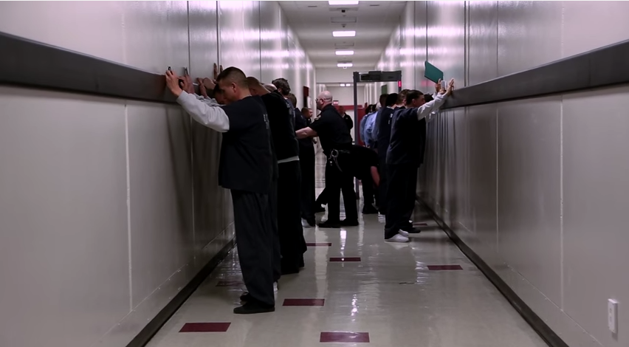

Slide 4
Challenge: Treating Justice-Involved
► Co-occurring Disabilities
►Alcohol and/or Substance Use Disorder
►Criminogenic Needs (crime producing factors that are strongly correlated with risk for recidivism & relapse)
►Mental Illness (unresponsive to treatment)
►Medical: HIV/AIDS, Asthma, Hep B, Diabetes, etc.
►Low rates of post incarceration aftercare
► High drop out rates from pyschosocial treatment

Slide 5
Challenge: Treating Justice Involved
Requires every edge we can provide.
Antisocial/procriminal attitudes, values, cognition, and beliefs; procriminal associates; temperament and personality factors; history of antisocial behavior; family factors, and low levels of educational, vocational or financial achievement
Plus alcohol/substance use disorders

Slide 6
What is MAT?
Medicated Assisted Treatment (MAT) combines medications with counseling and behavioral therapies, monitoring, community-based services, and recovery support to treat the bio-psychosocial aspects of alcohol and opioid use disorders.
MAT assists, not replaces, other treatment & recovery efforts.

Slide 7
MAT vs. Detox
Detox is quick and technically easy, but preventing relapse is extremely difficult. Short term MAT to counter withdrawal rarely results in long term abstinence.
Treatment w/medication for a period of 12 months or more required if brain is to repair its ability to regulate stress, pain and mood for sustained abstinence.

Slide 8
Evidence-Based vs. Belief
MAT severely under utilized, including in correctional treatment programs, for practical and philosophical reasons. Prisons/Jails are concerned with contraband and some have found buprenorphine (FDA approved medication) to be a drug of abuse, not promised cure. Believe inmate detoxed and clean in prison/jail, why encourage him/her to put drugs back into his/her body?!

Slide 9
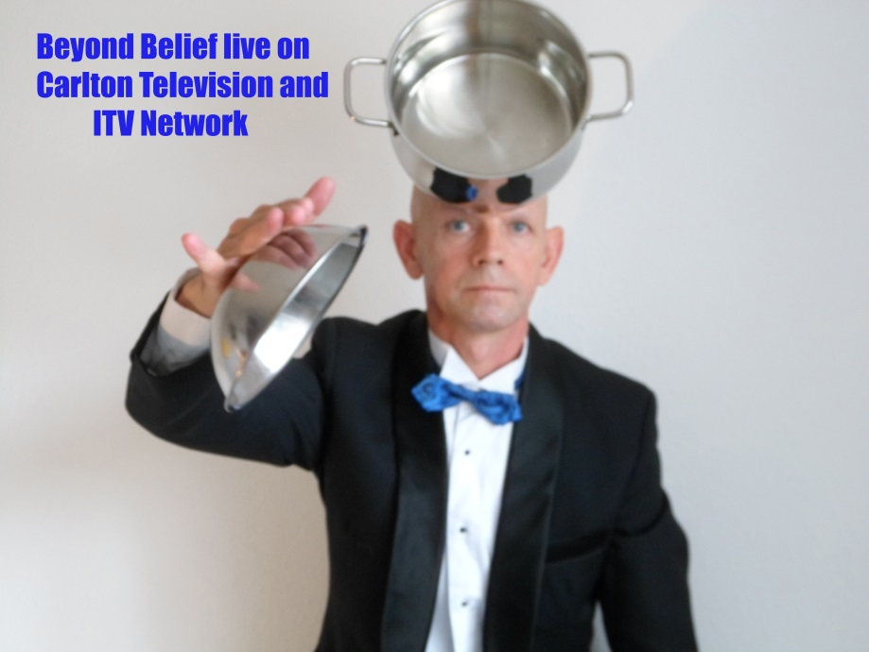
Evidence-Based vs. Belief
I got sober without medication….
What worked for me, good for all.

Slide 10
But….
Being evidence-based means being driven by objective analyses of research. If the data show that medication works to contribute to recovery and public safety, we must set aside personal opinions and bias.

Slide 11
What the Experts Say
“When prescribed and monitored properly, medications … are safe and cost-effective components of opioid addiction treatment. These medications can improve lives and reduce the risk of overdose, yet medication-assisted therapies are markedly underutilized.”’
NIDA Director, Nora Volkow, M.D.

Slide 12
MAT is Evidenced-Based
When treatment for justice-involved opioid users combined prescribed medication, behavioral counseling and ongoing support, the effects are many times greater than treatment without medication.
Marlowe, 2003
We have highly effective medications that, when combined with other behavioral supports, are the standard of care for the treatment of opioid use disorders.
ONDCP, 2015

Slide 13
ONDCP Healthcare Brief
“(I)T is crucial that providers in both primary and specialty care settings become trained in MAT…”
Because addiction is a chronic relapsing condition, a comprehensive approach to treatment should include assessment, diagnosis, treatment planning, psychosocial treatment, medication monitoring to promote adherence, and a host of social services to support patients…

Slide 14
Most recent evidence:
5-site pilot demonstrated the feasibility of outpatient sustained-release naltrexone induction and monthly treatment among parolees and probationers, and found significantly less opioid use among participants retained in naltrexone treatment for 6 months.
Coviello DM, Cornish JW, Lynch KG, Boney TY, Clark CA, Lee JD, Friedmann PD, Nunes EV, Kinlock TW, Gordon MS, Schwartz RP, Nuwayser ES, O'Brien CP. A multisite pilot study of extended-release injectable naltrexone treatment for previously opioid-dependent parolees and probationers. SubstAbus 2012;33(1):48-59.

Slide 15
Huffington Post: Feb 6, 2015
Federal Government Set To Crack Down On Drug Courts That Fail Addicts
WASHINGTON -- The federal government is cracking down on drug courts that refuse to let opioid addicts access medical treatments such as Suboxone, said Michael Botticelli, acting director of the White House’s Office of National Drug Control Policy, on Thursday.
Drug courts that receive federal dollars will no longer be allowed to ban the kinds of medication-assisted treatments that doctors and scientists view as the most effective care for opioid addicts, Botticelli announced in a conference call with reporters…

Slide 16
SAMHSA Drug Court Grant Instruction
“Under no circumstances may a drug court judge, other judicial official, correctional supervision officer, or any other staff … deny the use of these medications when made available to the client under the care of a properly authorized physician and pursuant to a valid prescription...”

Slide 17
Kentucky Sued In Federal Court Over Drug Treatment Practices
Two law firms have teamed up to file a federal lawsuit against the state of Kentucky for its practice of forbidding opiate addicts from receiving medical treatment while under the supervision of the criminal justice system.
A HuffPost analysis found that in Northern Kentucky in 2013, a majority of opioid addicts who died from overdoses lost their lives shortly after leaving jail or after having at least some experience with an abstinence-based program.
\J. Cherkis & R. Grim, 3/10/2015

Slide 18
Two Crutches are Better than One

Slide 19
Re-entry Challenge
Alcohol and drug addiction are major drivers of recidivism that affect up to 70% of inmates; 50% with substance/alcohol use disorders relapse within a month of release.
Aftercare helps.
Aftercare with MAT helps more.

Slide 20
Why MAT?
Better retention in treatment
Reduced recidivism
Increased employment
Reduced risk of HIV/AIDS
And, fewer overdose deaths

Slide 21
MAT and Corrections
A systematic review of studies of MAT programs for prisoners finds consistent positive health outcomes, with 55 to 75% reduction in IV drug use, decreases HIV and hepatitis C infection, and increased retention in community-based treatment after release.

Slide 22
Drug Deaths Higher Than Motor Vehicle Accident Deaths

Slide 23
Alaska: 11.1--12.9 deaths/100,000

Slide 24
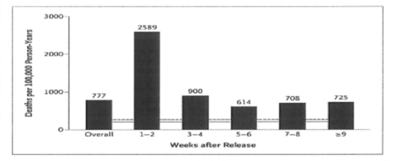
Reentry Death Rate from Dug Overdose
Within 2 weeks of release, ex-inmates nearly 129 times at greater risk for death by drug overdose than general population of same demographics.
Binswanger IA, Stern MF, Deyo RA, Heagerty PJ, Cheadle A, Elmore JG, Koepsell TD. Release from prison-a high risk of death for former inmates. N Engl J Med. 2007;356(2):157–165.

Slide 25
What About Contraband?
Well implemented prison MAT programs can reduce contraband.
i.e. Riker’s Island methadone program since 1987; Prison programs in Pennsylvania, Maryland, Connecticut, New Mexico, Florida and more…..

Slide 26
Justice Involved Right to MAT
California case: Drug Court judge ordered defendant to stop methadone maintenance treatment. Subsequently died of heroin overdose. California legislature then enacted law prohibiting judges from banning MAT.

Slide 27
Right to MAT
People who receive or need MAT for opiate addiction are “individuals with a disability,” protected by the ADA and Rehabilitation Act.
Denial of Access to MAT in prisons, jails, drug courts, alternative sentencing programs, probation and parole is discrimination “because of” disability.

Slide 28
FDA Approved Medications
Opioids
Methadone
Buprenorphine
Naltrexone
Alcohol
Acamprosate Calcium
Disulfiram
Naltrexone

Slide 29
Opioid Replacement Therapy (ORT)
Methadone and Buprenorphine are controlled substances for opioid replacement therapy (ORT). Both can be abused. Methadone’s effects are strong, and can only be dispensed in daily doses at licenses treatment programs.
Buprenorphine can be prescribed by specially trained physicians. Comes as a pill or film (Suboxone) that dissolves under the tongue. Easy to conceal under postage stamp!

Slide 30
ORT Medication Warnings
Methadone: Black box warning for heart problems, high overdose risk during first phase of treatment or if combined with other drugs. Potentially fatal interaction with benzodiazepines.
Buprenorphine: Moderate to low overdose risk. Potentially fatal interaction with benzodiazepines. Moderate to high risk of overdose when combined with other substances.

Slide 31
Benzodiazepines
Chlordiazepoxide (librium)
Alprazolam (Xanax)
Clonazepam
Diazepam
Lorazepam
Oxazepam
Prazepam
Used in alcohol withdrawal.

Slide 32
Opioid Blocker
Naltrexone is not a controlled substance, no potential for abuse. It blocks the actions of opioids, preventing euphoric and analgesic effects. May interact when opioids are in the system to cause withdrawal symptoms.
Administration: Pill, daily or Injected (Vivitrol), lasts 30 days
Deterrent against relapse for re-entering offenders.

Slide 33
Agonists v. Antagonists
Agonists
Replaces drug of abuse to
help regulate areas of brain
that are affected. Long
acting, slow effects flatten
out the highs and lows of
rapid acting opioid and leave the system slowly, staving off withdrawal symptoms and reducing cravings.
Antagonists
Blocks the action of opioid. Helps avoid relapse by blocking the reinforcing and pain killing effects of opioids.

Slide 34
Medications for Alcohol
Acamprosate Calcium (Campral): Anti-craving, relieves symptoms of protracted alcohol withdrawal or post-acute withdrawal, pill 3X day
Disulfiram (Antabuse): Aversive, causes severe physical discomfort if patient consumes alcohol, including severe nausea, daily pill
Naltrexone: Antagonist: Pill (Depade, ReVisa), daily; Injected (Vivitrol), monthly
None of above are controlled substances.

Slide 35
Alcohol Medications Warnings
Acamprosate: Increases suicidal thoughts and depression possible; maybe contraindicated for those with kidney problems
Disulfiram: Risk of liver damage, drug interactions and negative effects for people with certain mental disorders
Naltrexone: Black Box liver warning. Risk of overdose due to decreased tolerance or using large amounts of alcohol/opioids to override blocking effects. Risk of drug interactions during medical emergency (i.e. painkillers)

Slide 36
MAT: Four steps
Induction: assessment, individualized dosages, high risk for overdose
Stabilization: Adjustment to medication, withdrawal and cravings begin to recede
Maintenance: long-term, periodic reassessment
Tapering: medically managed withdrawal

Slide 37
Model Re-entry MAT Program

Slide 38
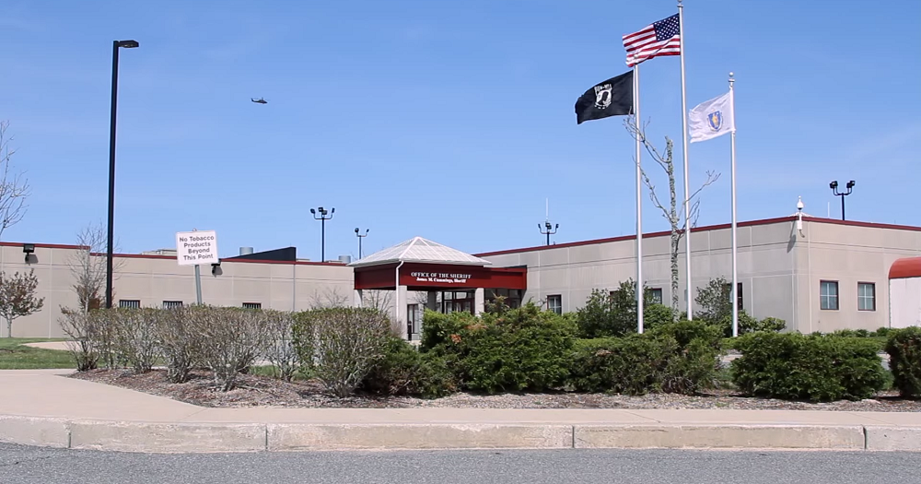
Barnstable House of Correction

Slide 39
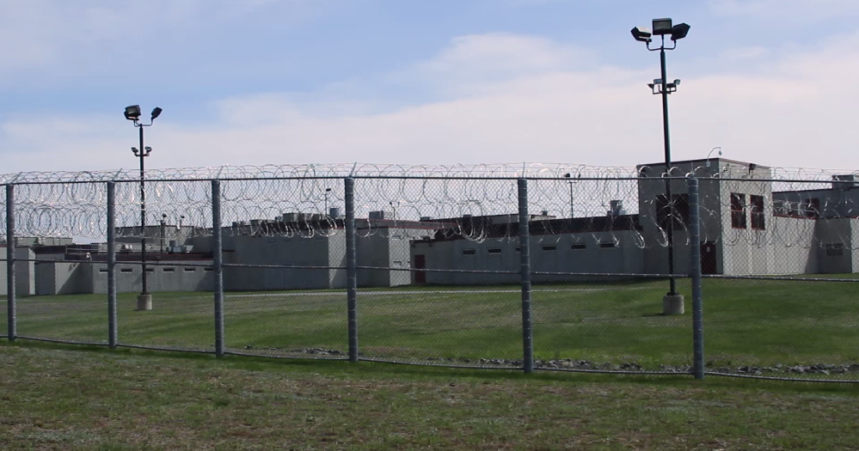

Slide 40
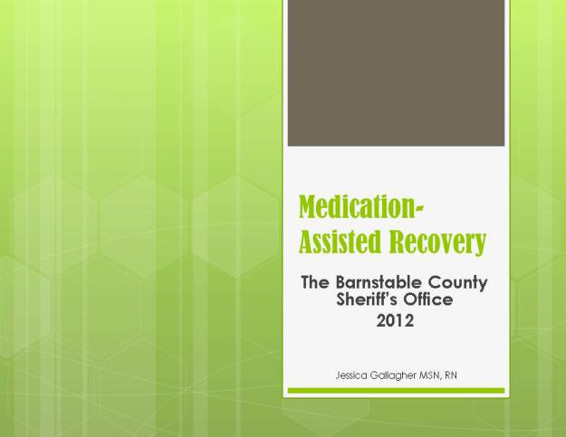
Barnstable County, Massachusetts Sheriff’s Office Inmate MAT Education Program

Slide 56
MAT Vivitrol Program
►Approved by Medical Staff.
► Appointment arranged at one of two community clinic/drug treatment programs.
► Must sign up for continued counseling.
► First injection three days before release.

Slide 57
Barnstable MAT Results
Since April 2012,
114 Inmates released after Vivitrol Injection
78% showed up at community treatment provider
On Average: Stayed on Vivitrol for 5 months
Half completed or remained in treatment or continued abstinent in community up to 3 years.
18% reincarcerated
5 deaths (3 overdoses, 1 suicide &1 murder)

Slide 59
Next Presentation
The Benefits of Computer Tablets in Corrections Settings
April 15, 2015
2:00 – 3:00 p.m. ET
Description: This webinar will describe cutting edge technology that is now being utilized at jails and prisons as an aid to counselors. The computer tablets have been specially configured, both physically and technologically, to ensure inmates have access only to secure websites. It enables them to complete homework assignments as well as have entry to a secure repository of educational curriculum.
Presenter: Warden Robert L. Green

