Slide 1
Understanding and addressing trauma in the lives of those we serve…..
Presented By: Joan Gillece, Ph.D.
SAMHSA Promoting Alternatives to Seclusion and Restraint through Trauma-Informed Practices

Slide 2
Important Things to Remember
Not what’s wrong with you but what happened to you.
Symptoms are adaptations.
Violence causes trauma and…trauma causes violence.

Slide 3
What is Trauma Informed Care?
Individual trauma results from an event, series of events, or set of circumstances that is experienced by an individual as physically and emotionally harmful or threatening and that has lasting adverse effects on the individual’s physical, social, emotional, or spiritual well-being.
Draft Definition (SAMSHA, 2012)
Notes:
In trauma informed care systems, we want to integrate these principles into all our clinical interventions. We want to include the survivor’s perspective. That’s so important as we move from our controlling environments, to collaborative supported environments. We recognize that coercive interventions are contraindicated for people who have been abused. It is re-traumatizing and recapitulates victimization.

Slide 4
The Three E’s
Events and Circumstances
The individual’s experience of these events or circumstances helps to determine whether it is a traumatic event.
The long-lasting adverse effects on an individual are the result of the individual’s experience of the event or circumstance.
Griffin, 2012

Slide 5
What is trauma informed?
A program, organization or system that is trauma-informed realizes the widespread impact of trauma and understands potential paths for healing; recognizes the signs and symptoms of trauma in staff, clients, and others involved with the system; and responds by fully integrating knowledge about trauma into policies, procedures, practices, and settings.

Slide 6
The Three R’s
A definition of trauma-informed incorporates three key elements: (1) realizing the prevalence of trauma; (2) recognizing how trauma affects all individuals involved with the program, organization, or system, including its own workforce; and (3) responding by putting this knowledge into practice.

Slide 7
What are the Key Principles of a Trauma-informed Approach?
Safety: throughout the organization, staff and the people they serve feel physically and psychologically safe; the physical setting is safe and interpersonal interactions promote a sense of safety.
Trustworthiness and transparency: organizational operations and decisions are conducted with transparency and the goal of building and maintaining trust among staff, clients, and family members of people being served by the organization.
Notes:
This slide identifies the types of trauma that are typically considered most problematic and leads to serious mental health problems. Generally speaking the most harmful trauma experiences tend to be those that were:
Perpetrated by someone close – someone well known to the victim
Intentional
Repeated
Prolonged
And the earlier this happened, the more profound the impact on development as we already reviewed in the Neurobiology of Trauma module.
Obviously, 1-time events can also be equally traumatic – we do not want to minimize single occurrences like a rape, a serious automobile accident, or being involved in a natural disaster, like Hurricane Katrina. Obviously these types of events can be just as devastating and impactful.

Slide 8
What are the Key Principles of a Trauma-informed Approach? (Con’t)
Collaboration and mutuality: there is true partnering and leveling of power differences between staff and clients and among organizational staff from direct care staff to administrators; there is recognition that healing happens in relationships and in the meaningful sharing of power and decision-making.
Empowerment: throughout the organization and among the clients served, individuals’ strengths are recognized and validated and new skills developed as necessary.
Voice and choice: the organization aims to strengthen the clients’ and family members’ experience of choice and recognize that every person’s experience is unique and requires an individualized approach.

Slide 9
What are the Key Principles of a Trauma-informed Approach? (Con’t)
Peer support and mutual self-help: are integral to the organizational and service delivery approach and are understood as a key vehicle for building trust, establishing safety and empowerment.
Resilience and strengths based: a belief in resilience and in the ability of individuals, organizations, and communities to heal and promote recovery from trauma; builds on what clients, staff and communities have to offer rather than responding to their perceived deficits.
Inclusiveness and shared purpose: the organization recognizes that everyone has a role to play in a trauma-informed approach; one does not have to be a therapist to be therapeutic.

Slide 10
What are the Key Principles of a Trauma-informed Approach? (Con’t)
Cultural, historical and gender issues: are addressed; the organization actively moves past cultural stereotypes and biases, offers gender responsive services, leverages the healing value of traditional cultural connections, and recognizes and addresses historical trauma.
Change process: is conscious, intentional and ongoing; the organization strives to become a learning community, constantly responding to new knowledge and developments

Slide 11
Self Inflicted Injuries
People use self-harm because it helps them manage what feels unbearable in the moment. There is a great deal of intensity behind the acts of self-injury.
Feeling states such as profound despair, anguish, rage or terror, or a fear of losing oneself or being swallowed by traumatic flashbacks or re-enactments are just some of the stressors leading to self-inflicted violence (SIV).
(Mazelis, n.d.)

Slide 12
Dissociation
A mental process which produces a lack of connection in a person’s thoughts, memories, feelings, actions, or sense identity.
During dissociation certain information is not associated with other information as it normally would be.
For example: during a traumatic experience, a person may dissociate the memory of the place and circumstances of the trauma from his ongoing memory, resulting in a temporary mental escape from the fear and pain of the trauma and, in some cases, a memory gap surrounds the experience.
(Sidran Institute, 1999 )

Slide 13
Post-Traumatic Stress Disorder (PTSD)
Symptoms of PTSD
Intrusive Re-experiencing
Avoidance
Arousal
(Sidran Institute, 2000)

Slide 14
Intrusive Re-experiencing
People with PTSD frequently feel as if the trauma is happening again. This is may be called a flashback, reliving experience, or abreaction. The person may have intrusive pictures in his/her head about the trauma, have recurrent nightmares, or may even experience hallucinations about the trauma.
(Sidran Institute, 2000)

Slide 15
Intrusive Re-experiencing
Intrusive symptoms sometimes cause people to lose touch with the "here and now" and react in ways that they did when the trauma originally occurred.
For example, many years later a victim of child abuse may hide trembling in a closet when feeling threatened, even if the perceived threat is not abuse-related.
(Sidran Institute, 2000)

Slide 16
Avoidance
People with PTSD work hard to avoid anything that might remind them of the traumatic experience. They may try to avoid people, places or things that are reminders, as well as numbing out emotions to avoid painful, overwhelming feelings. Numbing of thoughts and feelings in response to trauma is known as "dissociation" and is a hallmark of PTSD. Frequently, people with PTSD use drugs or alcohol to avoid trauma-related feelings and memories.
(Sidran Institute, 2000)

Slide 17
Arousal
Symptoms of psychological and physiological arousal are very distinctive in people with PTSD. They may be very jumpy, easily startled, irritable and may have sleep disturbances like insomnia or nightmares. They may seem constantly on guard and may find it difficult to concentrate. Sometimes persons with PTSD will have panic attacks accompanied by shortness of breath and chest pain.
(Sidran Institute, 2000)

Slide 18
Prevalence of Trauma: Adults in Mental Health Settings
90% of public mental health clients have been exposed to trauma
(Mueser et al, 2004; Mueser et al, 1998)
51-98% of public mental health clients have been exposed to trauma (Goodman et al, 1997; Mueser et al, 1998)
97% of homeless women with SMI have experienced severe physical & sexual abuse – 87% experience this abuse both in childhood and adulthood (Goodman et al, 1997)
Most have multiple experiences of trauma
(Mueser et al, 2004; Mueser et al, 1998)
Notes:
Kim Mueser and his colleagues from Dartmouth University in NH have done a good deal of research on people in the public mental health system and found that 90% of individuals in the systems they studied have been exposed to trauma.
In a separate study, Goodman found that 51-98% of public-sector clients were exposed to trauma.
Additional trauma research by colleagues in SC indicates that 91% of public sector clients served had histories of trauma. SC has contributed much to the literature about trauma – particularly ‘sanctuary trauma’ – the trauma that occurs in treatment settings, such as when seclusion or restraint are used.
Homeless women with SMI have not only previous trauma histories but their current circumstance magnifies the potential for trauma exposure as well – this information is absolutely horrific.

Slide 19
Prevalence of Trauma: Children and Adolescents - Juvenile Justice Settings
Being abused or neglected as a child increases the likelihood of arrest as a juvenile by 59% (Widom, 1995)
Arrest rates of trauma-exposed youth are up to 8 times higher than community samples of same-age peers (Saigh et al, 1999; Saltzman et al, 2001)
70% - 92% of incarcerated girls reported sexual, physical, or severe emotional abuse in childhood (DOC, 1998; Chesney & Sheldon, 1997)
A 2003 OJJDP survey of youth in residential placement found that 70% had some type of past traumatic experience, with 30% having experience frequent and/or injurious physical and/or sexual abuse.
(Sedlak & McPherson, 2010)
Notes:
Youth in juvenile justice settings also appear to have significant histories of trauma - although the data varies widely ... (read slide) ....
The last bullet here identifies rates of trauma exposure with girls who are incarcerated: 70 – 92%. This rate is no different than the rates reported by psychiatric inpatient facilities. This population, too, is equally impacted by trauma.

Slide 20
Other Key Trauma Findings: Relationship of Childhood Trauma to Adult Health
Adverse Childhood Experiences (ACE) have serious health consequences
Adoption of health risk behaviors as coping mechanisms
eating disorders, smoking, substance abuse, self harm, sexual promiscuity
Severe medical conditions: heart disease, pulmonary disease, liver disease, STDs, GYN cancer
Early Death
(Felitti et al, 1998)
Notes:
Adopting health risk behaviors can be a coping response to trauma – such as drinking alcohol to manage flashbacks. This can put the person at greater risk and perpetuate the cycle of trauma and adversely impact their physical health and mortality.
Perhaps one of the largest, if not the largest ongoing health risk studies that established this relationship between trauma exposure and physical health is the ACES study which was organized by the CDC and Kaiser Permanente in San Diego, CA in which >17,000 insured individuals were administered a survey from 1995-1997 about their history of ACEs.
What the researchers found: (taken from the CDC web-site:)
Childhood abuse, neglect, and exposure to other traumatic stressors (ACEs) are common. Almost two-thirds of our study participants reported at least one ACE, and more than one in five reported three or more ACE. The short- and long-term outcomes of these childhood exposures include a multitude of health and social problems. The ACE Study uses the ACE Score, which is a count of the total number of ACE respondents reported. The ACE Score is used to assess the total amount of stress during childhood and has demonstrated that as the number of ACE increase, the risk for the following health problems increases in a strong and graded fashion and with that a direct, negative impact on mortality and longevity.

Slide 21
ACE Questions:
While you were growing up, during your first 18 years of life:
1. Did a parent or other adult in the household often or very often… Swear at you, insult you, put you down, or humiliate you? Or Act in a way that made you afraid that you might be physically hurt?
2. Did a parent or other adult in the household often or very often… Push, grab, slap, or throw something at you? Or Ever hit you so hard that you had marks or were injured?
3. Did an adult or person at least 5 years older than you ever… Touch or fondle you or have you touch their body in a sexual way? Or Attempt or actually have oral, anal, or vaginal intercourse with you?
4. Did you often or very often feel that … No one in your family loved you or thought you were important or special? Or Your family didn’t look out for each other, feel close to each other, or support each other?

Slide 22
ACE Questions: Con’t
5. Did you often or very often feel that … You didn’t have enough to eat, had to wear dirty clothes, and had no one to protect you? Or Your parents were too drunk or high to take care of you or take you to the doctor if you needed it?
6. Were your parents ever separated or divorced?
7. Was your mother or stepmother: Often or very often pushed, grabbed, slapped, or had something thrown at her? Or Sometimes, often, or very often kicked, bitten, hit with a fist, or hit with something hard? Or Ever repeatedly hit at least a few minutes or threatened with a gun or knife?
8. Did you live with anyone who was a problem drinker or alcoholic or who used street drugs?
9. Was a household member depressed or mentally ill, or did a household member attempt suicide?
10. Did a household member go to prison?

Slide 23
ACE Study
“Male child with an ACE score of 6 has a 4600% increase in likelihood of later becoming an IV drug user when compared to a male child with an ACE score of 0. Might heroin be used for the relief of profound anguish dating back to childhood experiences? Might it be the best coping device that an individual can find?” (Felitti et al, 1998)

Slide 24
ACE Study
Is drug abuse self-destructive or is it a desperate attempt at self-healing, albeit while accepting a significant future risk?”
(Felitti, et al, 1998)

Slide 25
Essential Components
1. Triggers
2. Early Warning Signs
3. Strategies
Notes:
Read slide…

Slide 32
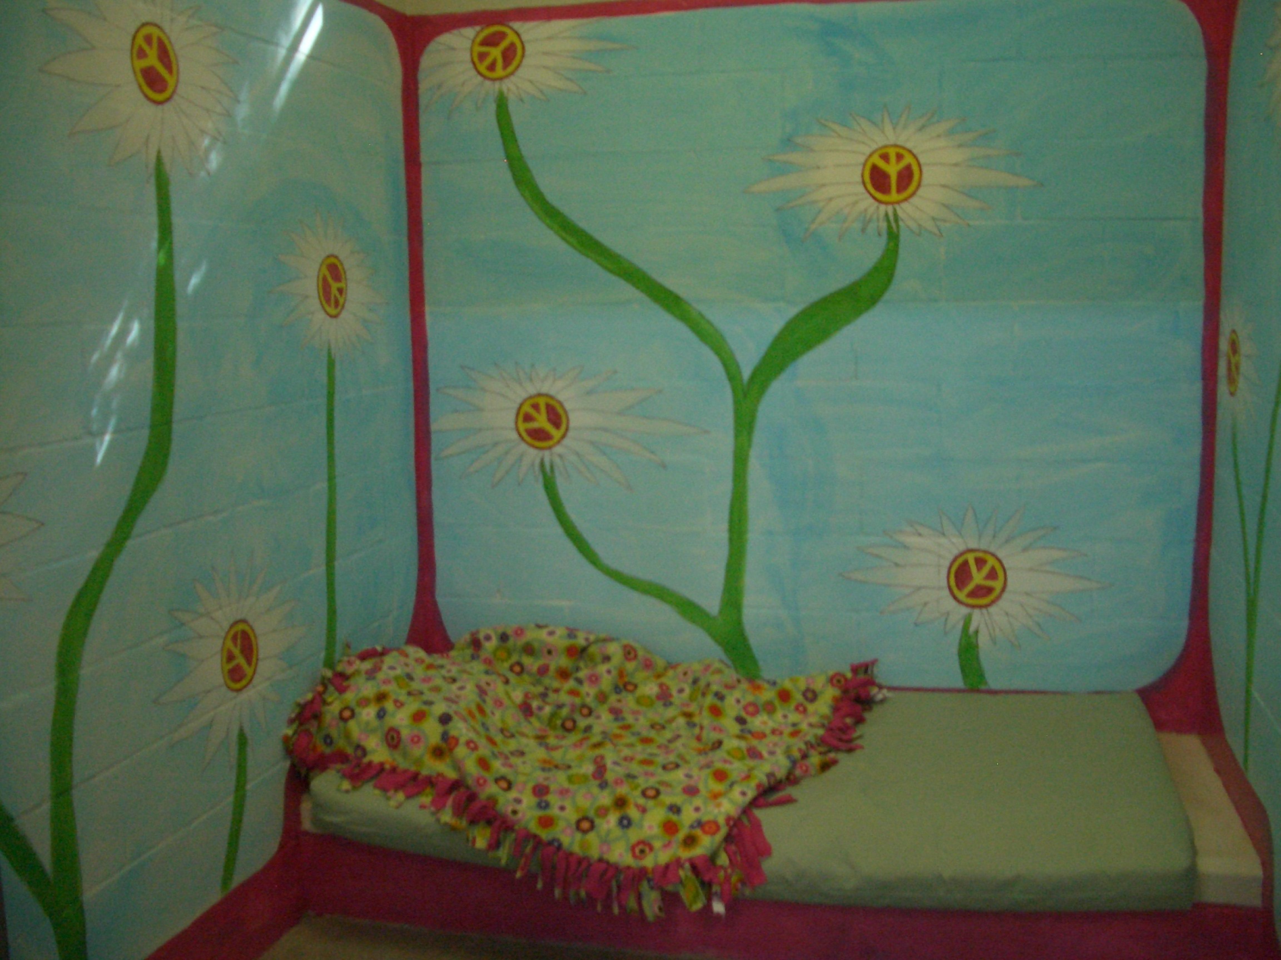

Slide 35
I've learned that people will forget what you said, people will forget what you did, but people will never forget how you made them feel.
~ Maya Angelou

Slide 37
Contact Information
Joan Gillece, PhD
SAMHSA National Center for Trauma Informed Care
Joan.gillece@nasmhpd.org
703-682-5195

