Slide 1


TCU Interventions for Substance Abuse Treatment Programs
Phillip Barbour / CHJ Master Trainer
Notes:
Welcome and introduction. I’d like to provide a little background before we begin on TCU and how our agency got involved with them.
TCU is located in Fort Worth Texas and they have a national research institute, called the Institute of Behavioral Research which focuses on addiction treatment studies. Over the past 50 years their work has culminated in over 700 free treatment resource files available to the addictions field including assessments and treatment manual interventions.
Over the past 10 years TASC, which provides assessment, linkage and case management for the justice involved, has been involve with several of the CJDATS research projects including the CJDATS Assessment Study, HIV Prevention and Medication Assisted Treatment research. TASC also uses some of the TCU assessment tools and screening instruments in both it’s prison reentry program and Adult Criminal Justice Program. Our history with TCU has been long and fruitful as it relates to bringing evidenced based practices to the field working with the criminal justice population.
In 2013 TCU contracted with the Center for Health and Justice at TASC to provide training and technical assistance nationally on the use of the TCU tools. Several of our program administrators throughout Illinois have been trained on implementing the TCU Interventions and are skilled in using a variety of these tools and interventions. As the training partner for TCU, CHJ will be your “go to” resource for training and TA.

Slide 2
Introduction to
TCU Mapping-Enhanced Counseling (MEC)
“TCU Mapping-Enhanced Counseling”
Notes:
We are going to talk specifically today about a particular TCU resource, Mapping Enhanced Counseling. TCU Mapping is an EBP and research data and references can be found at SAMHA’s national registry for Evidenced-based Programs and Practices.

Slide 3

Phil’s Dog
American Eskimo - Standard
Weight 40lbs
His name was Sharky
He shed a lot of hair
RIP on Father’s Day 2009
Worker breed
Had him for 10 years
Given to me by my Nephew

Slide 4
Phil’s Dog
What was his breed?
How much did he weigh?
What was his name?
American Eskimo - Standard
His name was Sharky
Weight 40lbs
My only complaint?
When did he die?
He shed a lot of hair
RIP on Father’s Day 2009
This breed is know for being?
How long did I have him?
Worker breed
Had him for 10 years
How I get him?
Given to me by my Nephew

Slide 5
What is TCU Mapping-Enhanced Counseling?
TMEC makes use of graphic representations, primarily node-links mapping, to enhance client and counselor communication and thinking.
TMEC is designed to give the counselors the flexibility to tailor the use of the node-link graphic representations to supplement and compliment their preferred method of counseling, as well as to meet the needs and preferences of their clients.
Notes:
TMEC makes use of graphic representations, primarily node-links mapping, to enhance client and counselor communication and thinking.
It is designed to give the counselors the flexibility to supplement and compliment their preferred method of
counseling, as well as to meet the needs and preferences of their clients.

Slide 6
Cognitive Foundations
The success of visual approaches, in particular node-link mapping, in education led to applications in counseling starting in 1989.
There are over 20 studies that show that clients randomly assigned to TMEC have better during and after treatment outcomes than clients who are randomly assigned to “counseling as usual.”
In essence, TMEC provides an independent visual adjunct to spoken language.
Notes:
What are the cognitive foundations of TMEC?
TMEC evolved from earlier work on graphic representation to improve the communication and thinking of teachers and students. The success of visual approaches, in particular node-link mapping, in education led to applications in counseling starting in 1989. Since then, mapping has undergone extensive research and development in a variety of counseling arenas.
It is important to understand that TMEC can be used as a framework for most group and individual counseling methodologies, including cognitive behavioral, psychodynamic, motivational enhancement, or 12-step-oriented. In essence, TMEC provides a visual adjunct to spoken language.

Slide 7

A way to “see” relationships and connections using boxes and lines
A memory enhancer for learning and for identifying options and future possibilities
Mapping
A shorthand “snapshot” of a problem, situation, or goal and possible solutions/steps
A creative focuser for self-clarification of ideas, feelings, plans
© 2013
Notes:
A graphical representation of the Cognitive Foundations. Discuss nodes (circles) and links (lines). Nodes represent milestones, goals, ideas, etc. Links show the process or direction those nodes flow.

Slide 8
Visit IBR website for details:
www.ibr.tcu.edu
Mapping
Treatment
Engagement
Life and
Recovery skills
Working Alliance
with counselor
Missed
sessions
Ideas and
insights
Self-confidence
Self-efficacy
Communication
Rapport
Drug use
per UA
Problem-solving
Communication
Follow-up:
Drug Use Needle Use
Crime
Ratings of self-
progress and
treatment rogram
Notes:
Since the first studies on mapping, there are now more than 50 that support its effectiveness. The arrows that point downward represent reductions in a specific problem or issues with clients and treatment. The upward arrows represent where mapping improved outcomes, client progress, and the working alliance with counselors.

Slide 9
Overview of TCU Interventions
TCU Institute of Behavioral Research
© 2013
Notes:
Before we get into a more specific discussion on mapping, I would like to quickly discuss the broad array of TCU interventions available in their treatment manuals that incorporate the use of mapping.

Slide 10
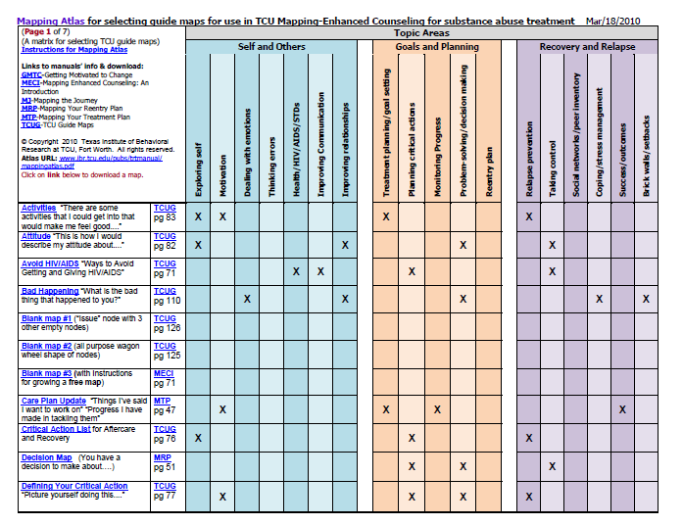
TCU Mapping Atlas
Use the TCU Mapping Atlas to select and download treatment maps located in TCU training manuals for 18 counseling topics.
© 2013
Notes:
TCU has a number of helpful guides or inventories that demonstrate the various types of maps and interventions available for free on their website. In the mapping atlas on this slide you can see that the maps are categorized around various topic areas including self and others, goals and planning, and recovery and relapse.

Slide 11
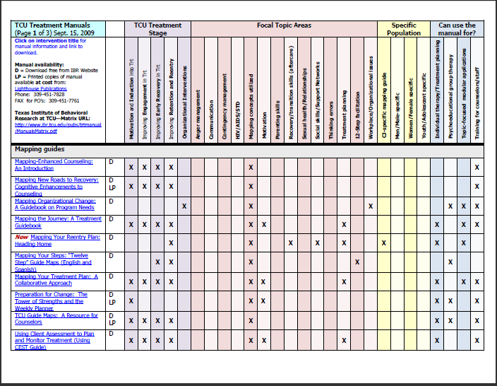
TCU Intervention Matrix
Matrix shows Interventions sorted by:
TCU Treatment Stage
Topics
Special population
Method of clinical use
© 2013
Notes:
In addition to the maps, TCU has created a number of treatment manuals that incorporate the use of maps. Again these are inventoried in the matrix seen on your screen that break downs interventions by treatment stage, focal area, and specific population.

Slide 12
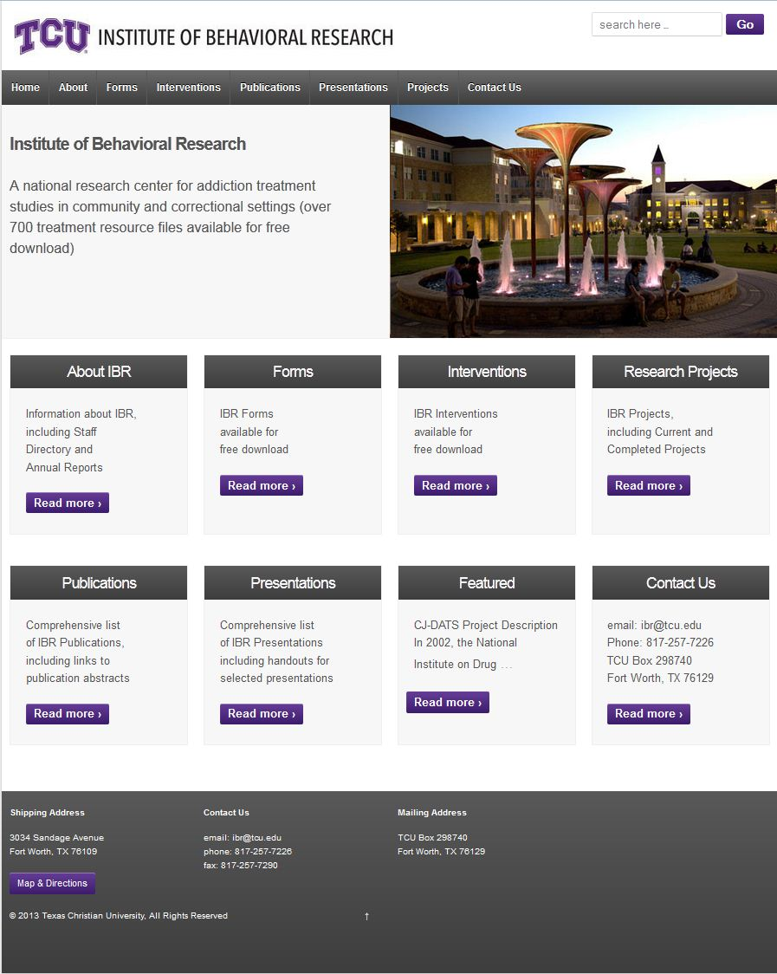
www.ibr.tcu.edu
Notes:
Again the TCU website (www.ibr.tcu.edu) contains the references, abstracts and other free downloadable manuals that will help you
incorporate TMEC into your program.
This Website also contains information about assessments and other complimentary interventions that can be used with TMEC, as well
as models that show how this integration can be accomplished to facilitate client and organizational change.

Slide 13
Three types of maps
Free maps that are drawn “from scratch” as counseling proceeds or as homework.
Guide maps are “fill in the blanks” templates selected from a collection that covers a variety of common counseling topics.
Information maps are prepared independent of the clients by outside experts or counselors to present key topics.
Notes:
I’d like now to discuss the types of maps that are available to use in a counseling setting.
First of all there are Free maps that are drawn “from scratch” as counseling proceeds or as homework. The map that I used for my background is a free map. You still use the basic node-link components but clients are available to create maps in any format as they wish. I’ve visited residential treatment facilities and have seen clients describe their life story by overlaying nodes on a ship in a storm or on sheet music.
Next are Guide maps. Essentially they are “fill in the blanks” templates selected from a collection that covers a variety of common counseling topics. Guide maps are completed by filling in nodes for discussion during the session or as homework.
Finally you have Information maps which are prepared independent of the clients by outside experts or counselors to present key topics. Information maps are used primarily during psychoeducational sessions. This can be effective in educating clients over a variety of topics including HIV awareness and drug use.
TMEC is designed to give the counselors the flexibility to tailor the use of the node-link
graphic representations to supplement and compliment their preferred method of
counseling, as well as to meet the needs and preferences of their clients. Consequently,
in doing TMEC a counselor may use maps individually or in combination to stimulate
discussion, clarify and organize thinking, and to increase memory for what has been
covered.

Slide 14
More Maps
In all there are more than 70 maps that are designed to enhance the treatment experience and guide clients toward recovery
Notes:
70 maps available on the TCU website.

Slide 15
General Benefits of TMEC
Provides a workspace for exploring problems and solutions
Helps illustrate cause and effect, feedback loops, and other patterns
Focuses attention on the topic at hand
Provides easy reference to earlier discussions
Provides a method for getting “unstuck”
Creates memory aids for client and counselor
Helps the client think in clearer and more systematic way
Notes:
What are some of the benefits of mapping enhanced counseling?
Include in treatment plan to reference again for future counseling sessions.
Get unstuck by identifying patterns.

Slide 16
How does TMEC fit with client assessments?
TMEC has been shown to be especially useful in providing clients with feedback based on assessment instruments that are used to inform treatment planning or during-treatment monitoring.
Notes:
One area that mapping has been found to be especially useful in is at the assessment phase of treatment. It can provide feedback based on the assessment tool. (Identify environmental triggers, motivational obstacles, negative peer influences, and cause/effect relationships)

Slide 17

Map Types
Road Maps
  Description: Simple maps based around a visual road metaphor. Space is provided on each side of the “road” to create nodes with relevant ideas, events, memories, or proposed tasks.
    “You are here and you want to get there”
    “When did the present difficulty start/you are here today”
    “Starting point/year/you are here”
Notes:
Draw this illustration on the clip board

Slide 18
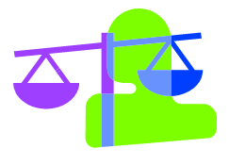
Map Types
Decisional Maps
  Description: Structured maps based around a visual metaphor of opening different doors. Space is provided for clients to describe the decision or plan they are considering, the choices available, the risks/benefits of these choices, and some thoughts about what seems best to do.
    “You have a decision to make about…”
    “You are about to take a big step”
Notes:
The first – “You have a decision to make about…” – provides a
general decisional balance worksheet for considering decisions, choices,
the “pros and cons” of the available choice, and a preliminary decision
based on the information.
The second – “You are about to take a big step” – offers clients a
structure for exploring the potential benefits or consequences of a
decision the client may have already made or be on the verge of making
by inviting them to explore how things will be different once they have
proceeded with their plan or decision.

Slide 19

Map Types
Strengths Maps
  Description: The center node invites clients to consider their strengths in a visual metaphor for the “parts of the self” and to consider how these strengths benefit them.
  Simple customizations of
  the map are possible by changing the
  Stem questions in the last node or by
  changing the descriptors of different
  parts of self.
Notes:
Purpose:
A strength map invites clients to consider their strengths in a visual metaphor. It is often one of the
first maps counselors use with a client to help with rapport building and motivation.
This is a good map for clients to complete and keep with them as a
reminder and affirmation of the personal resources they have available
for dealing with problems, making decisions, or getting through a
difficult time, by inviting them to explore how things will be different
once they have proceeded with their plan or decision.
Simple customizations of the map are possible by changing the stem
questions in the last node or by changing the descriptors of different
parts of self.

Slide 20
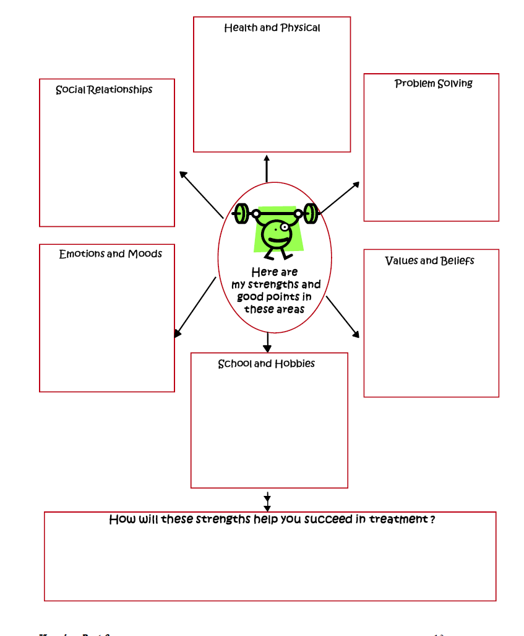
Notes:
Here is an example of a strength map.

Slide 21

Map Types
Planning Map
  Description: Guide maps that help walk clients through establishing “SMART” goals (specific, measurable, attainable, realistic and timely) and considering resources they can call on to help them prevail.
    “Planning Rocket”
    “My next goal”
    “What is your primary concern”
Notes:
Three examples of these planning maps are included:
The first – “Planning Rocket” – organizes the planning process
with the visual metaphor of the goal as a rocket about to blast off.
The second – “My next goal” – uses a basic visual format to invite
clients to consider steps, timelines, possible challenges, and personal
strengths related to their goal.
The last one – “What is your primary concern” – approaches the
planning process from a slightly different perspective by inviting clients
to think about why each of the needed steps/tasks toward the goal are
important.

Slide 22

Map Types
Outcomes Maps
  Description: Guide maps for exploring the events, choices, and actions that were associated with either a “successful” or “unsuccessful” outcome the client has experienced.
    “What was your success”
    “Brick wall”
Notes:
Three examples of these outcome maps are included:
The first – “What was your success” – guides the client in
revisiting a successful decision or outcome using the visual metaphor of
a star.
The second – “Brick wall” – uses the metaphor of “running into a
brick wall” to help the client consider outcomes of an unsuccessful
choice or decision and how to avoid having it happen again.
The last one is a customization of the “Brick wall” that changes the
perspective of an unsuccessful attempt or outcome by inviting clients to
consider what they did to keep things from being worse.

Slide 23

Map Types
Relationship Maps
  Description:
  Structured maps for identifying positive or supportive social relationships and for improving communication.
    ““Peer inventory”
    “An important conversation”
Notes:
Two examples of this guide map are provided.
The first – “Peer inventory” – provides a general structure for
considering people who are a support for recovery and what makes these
people helpful to the client.
The second – “An important conversation” – offers clients a
visual suggestion of the “back and forth” of communicating effectively
with others. It allows clients to plan ways to communicate assertively
about a particular issue or request and to anticipate how the other person
might respond.

Slide 24
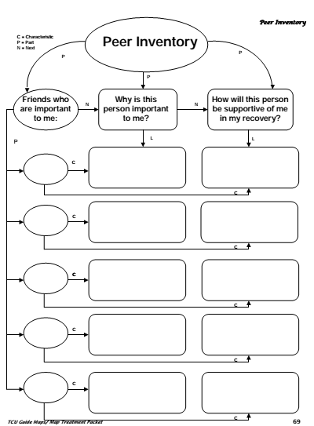
Map Types

Slide 25
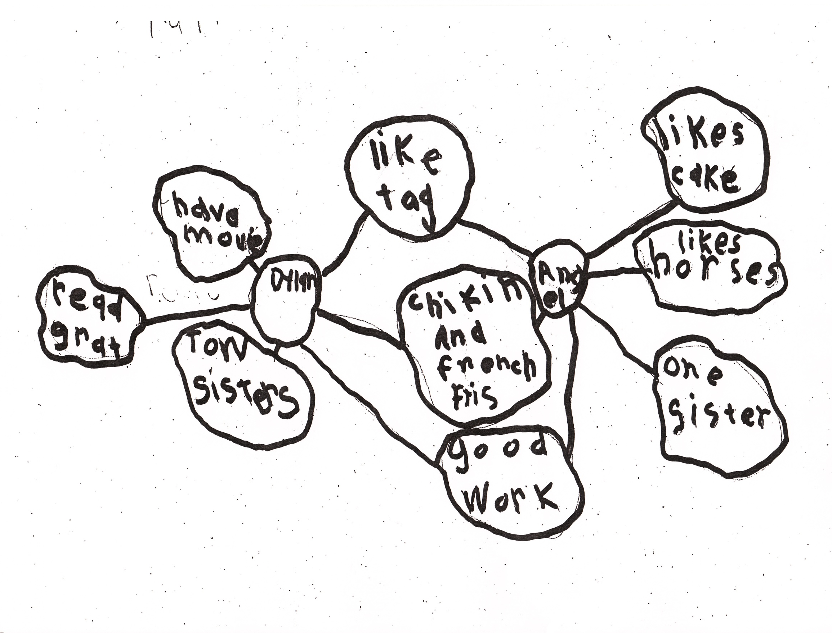
Relationship Map

Slide 26
Maps and Manuals
Mapping New Roads to Recovery: Cognitive Enhancements to Counseling – This mapping “primer” features step-by-step information and practice exercises.
TCU Guide Maps: A Resource for Counselors – This manual presents a collection of fill-in-the-blank maps that cover numerous counseling topics.
Notes:
Now that I’ve reviewed examples of guide maps available through TCU, I’d like to reference a few treatment manuals that incorporate the use of mapping. First I want to mention a couple manuals that were created specifically for the counselor to educate them on the use of mapping.

Slide 27
Maps and Manuals
Mapping Your Steps: Twelve Step Guide Maps – This is a more targeted manual that provides guide maps for learning and processing the information in 12 step programs.
Straight Ahead: Transition Skills for Recovery – This manual uses guide maps and information maps for relapse prevention and building social support for recovery.
Notes:
I’m going to now briefly review some treatment manuals that are designed for specific treatment points and processes.

Slide 28
Maps and Manuals Specific Topics
Getting Motivated to Change – This manual uses mapping worksheets to help clients visualize decisional balances, self-identify motivations for change, and plan goals.
Mapping Your Treatment Plan – This manual presents a mapping-focused guide for working with clients to establish meaningful and useful treatment goals.
Unlock Your Thinking, Open Your Mind – This manual uses mapping to focus on identifying and changing unproductive cognitive distortions that interfere with treatment and recovery.

Slide 29
Getting Motivated to Change
A collection of materials for leading counseling sessions that address motivation and readiness for change.
Group leader check list
Four parts to this manual
  Motivation 101
  The Art of Self Motivation
  Staying Motivated
  Making it Second Nature
Step-by-step guide for delivering the topic
Notes:
This major segments of getting motivated to change are shown on the screen.

Slide 30
Other Manuals
Mapping your Reentry Plan
Building Social Networks
Mapping Your 12-Steps
Straight Ahead
Understanding Angry Feelings

Slide 31
Phillip Barbour
Center for Health and Justice at TASC
  312-575-8354
  pbarbour@tasc.org

