Slide 1

Addressing the issue of Father Absence in Substance Abuse Treatment
Presented by
Kenneth L. Osborne

Slide 2

Social impact of Father Absence
63% of youth suicides are from fatherless homes.
90% percent of all homeless and runaway youths are from fatherless homes.
85% of children who exhibit behavioral disorders are from fatherless homes.
71% of high school dropouts are from fatherless homes.
70% of youths in State institutions are from fatherless homes.
75% of adolescent patients in substance abuse centers are from fatherless homes.
85% of rapists motivated by displaced anger are
from fatherless homes.

Slide 3

Is the forward movement of Women creating the Vanishing Man?
Women are the majority in the workforce for the 1st time in US history
They make up much of the managerial class
More of them are college educated, making them better suited for the postindustrial society
Traditional male roles in society have significantly shifted over the last 20 years

Slide 4

Men’s Responses to the cultural shift
Perceive themselves as Losing Power: Personal vs. Collective
Pressure to Perform and to Change
Being Groomed for Violence
Barren Father-Son Relationships
Deny themselves emotional skill development
Not asking for help when it’s needed

Slide 5
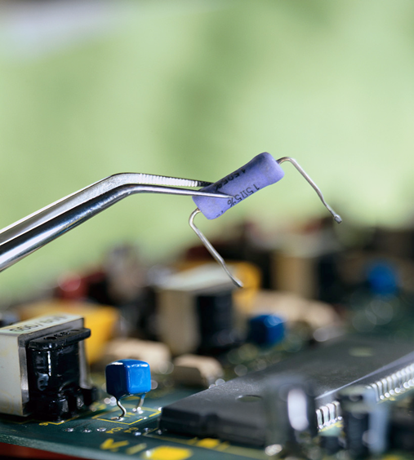
Have technological advances help to further alienate men from their familial obligations?
There are many who believe technology has helped drive men further into their emotional and psychological man caves.

Slide 6

Lessons learned from trying to have it all
Cleanliness is next to prosperity
Look but don’t touch
Specialize
Sit still and stay indoors
Live by the clock
Wear the uniform
Keep your distance, stay your pace
Desensitize yourself
Don’t trouble yourself with large moral issues

Slide 7
Father absence is a Global incident
 | Children in two- parent family | Children in solo mother family
Sweden | 2.2 | 5.2
Denmark | 2.5 | 7.3
Finland | 1.9 | 7.5
Belgium | 3.2 | 10.0
Italy | 9.5 | 13.9
Norway | 1.9 | 18.4
Netherland | 3.1 | 39.5
Canada | 7.4 | 50.2
Australia | 7.7 | 56.2
United States | 11.1 | 59.5

Slide 8
Causes of Father absence
Fatherlessness is a complex phenomenon produced by many circumstances and situations. Some are related to choices people make about fertility, marriage, and cohabitation. But others are the result of unexpected events, illnesses, or incarceration.

Slide 9
Contemporary causes of Father absence
Having a culture that heavily stresses individualism
Have an economic system that ignore familial obligations
Have an educational system that does not stress childrearing as a major adult responsibility
Sexualizing our society
Make marriage a very weak institution
Through the media and social discourse deemphasize the importance of children to the continuation of society
Overlook the importance of fathering when discussing male gender roles
Don’t mention that fathers are unique and irreplaceable as protectors, challengers, disciplinarians and guides.
Explain that the role of fathers is to be more like mothers: say that it is perfectly possible for “daddies to be good mommies”.

Slide 10
Contemporary causes of Father absence cont.
Paternal choice
The Fall of the Nuclear family and the Rise of Family diversity
The Divorce Revolution
Changing Laws
Step families
Non marital cohabitation
The Sperm Donor Father
Incarceration

Slide 11
Core Healthy Family Themes
Nurturance & Trust
Support
Expectations & Control
Relationships & Self Esteem

Slide 12
Stages of the World of Abnormal Rearing
Conception
Pregnancy
Wanted/ Unwanted

Slide 13
Themes & Stages of the WAR Cycle
Nurturance & Trust
Support
Conception
Pregnancy
Relationship Fails
Unrealistic Expectations
Select Partner
Role Reversal
Selection of Friends
Compliance
Isolation
I’m No Good
Expectations & Control
Trust Not Learned
Relationships & Self Esteem

Slide 14
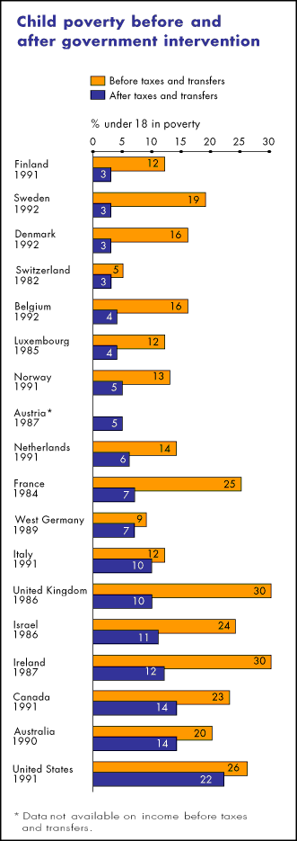
The high cost of Father absence
Notes:
Only Ireland and Israel have poorer children than US
In dollar terms, children living in the richest American families easily top the international league table. Only Canada and Switzerland come close. But when it comes to the poorest, the United States drops to 16th place. Only the children of Ireland and Israel are worse off.
"While the US has a higher real level of income than most of our comparison countries," say the authors of the Luxembourg Income Study report, "it is the high-income and middle-income children - especially the high-income children - who reap the benefits. The average low-income child in the other 17 countries is at least a third better off than the average low-income American child."
Gap between rich and poor children
The table shows the after-tax household income of a poor family of four with children and a rich family of four (including food stamps and earned income tax credit). Poor means poorer than 90% and richer than 10% of all households in the country. Rich means richer than 90% and poorer than 10% of households.

Slide 15
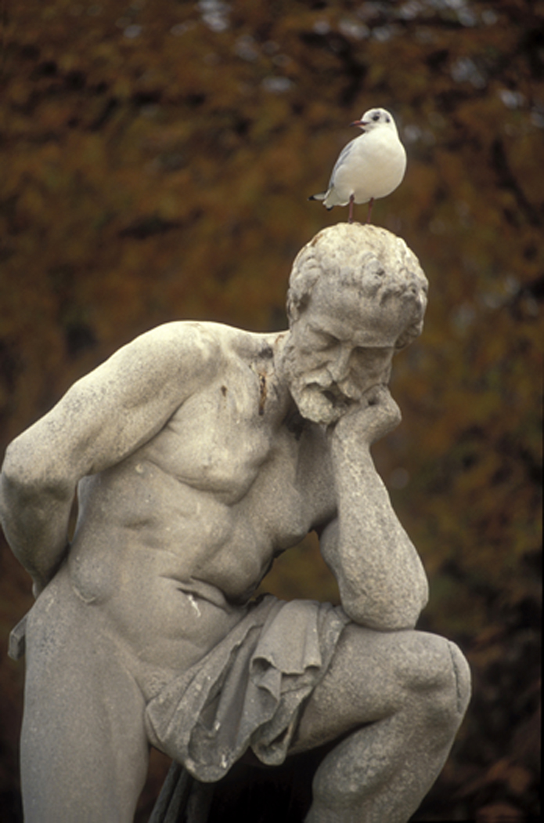
The Politics of Father Absence
Salient public policy debates within psychology, sociology, and law, fatherhood has received little attention from political scientists. This neglect is not a minor omission. The conventional wisdom—enunciated by political leaders, media commentators, and scholars on both left and right—assumes the problem stems from paternal abandonment. Clinton said the fathers pursued by his administration "have chosen to abandon their children" (Clinton 1992). David Blankenhorn writes that "the principal cause of fatherlessness is paternal choice . . . the rising rate of paternal abandonment" (Blankenhorn 1995, 22–23).

Slide 16
The Politics of Father Absence cont.
No government or academic study has ever shown that large numbers of fathers are voluntarily abandoning their children. In the largest federally funded study ever undertaken on the subject, psychologist Sanford Braver found that the "deadbeat dad" who walks out on his family and evades child support "does not exist in significant numbers." Braver found at least two-thirds of divorces are initiated by women. Studies have found that "who gets the children is by far the most important component in deciding who files for divorce"
Cases of unmarried fathers, usually younger and poorer, are more difficult to document. The evidence contrasts with the stereotype. The most common reason given by these fathers for not having more contact with their children was the mothers' reluctance to let them. Most of these men were proud to be seen as competent caregivers and displayed a knowledge of child-care issues" (Speak et al. 1999).
Notes:
So if fathers are not abandoning their children in record numbers, why are so many children without fathers? Some 40% of the nation's children and 60% of African-American children live in homes where their fathers are not present (Popenoe 1993).

Slide 17

The Politics of Father Absence cont.
A Rutgers-Texas study found that many fathers state governments want to track down for child support are so destitute that their lives focus on finding the next job, the next meal, or next night's shelter. "They struggle with irregular, low-wage employment," the authors write. "But economically and emotionally marginal as many of these fathers were, they . . . continue to make contributions to their children's households and to maintain at least a relationship with those children" (Edin and Lein 1998).
Part of the answer may be found by examining the governmental institutions that regulate the relationships between parents and their children. Part of the regulation machinery requiring thorough review are the functions of Family Courts, Restraining Orders and government and private child support enforcement agencies.

Slide 18
The Criminalization of Father Absence
What we are seeing today are criminal penalties imposed on citizens who have committed no act but are made outlaws through the actions of others. This phenomenon proceeds largely from involuntary divorce and is affected by family courts.
The presumption of guilt pervades child support enforcement where the burden of proof may be shifted to the defendant according to one ruling. In clear violation of the constitution it has been held that “not all child support contempt proceedings classified as criminal are entitled to a jury trial,” even indigent fathers are not necessarily entitled to a lawyer.

Slide 19
The Criminalization of Father Absence
Men are now forced to support children who are acknowledged not to be theirs biologically. Stepfathers are ordered to pay support for stepchildren. Grandparents and second wives are pursued by child support prosecutors. Minor boys statutorily and forcibly raped by adult women must pay child support to the criminals who raped them.
A presumption of guilt also pervades allegations of domestic violence made during custody proceedings, where a father’s contact with his children is criminalized through restraining orders that are routinely issued with no evidence of wrongdoing whatever – orders that cannot protect anyone only prohibit a father’s contact with his own children.

Slide 20
The Criminalization of Father Absence
No figures are available on how many fathers are incarcerated for “family crimes.” Informal estimates put as much as one-third of the nation’s jail population consisting of fathers on contempt-of-court charges. Some jurisdictions now propose creating forced labor camps specifically for fathers to relieve overcrowded jails. Not since the fall of the Weimar republic has a democracy treated millions of its own citizens in this fashion.

Slide 21
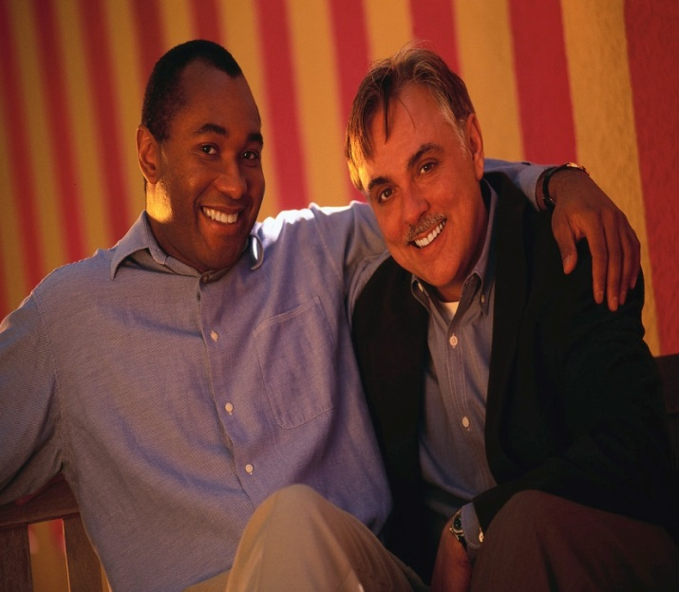
The Socialization of Men
Logical Thinking
Anger Expression
Assertive Behavior
Suppression Of Emotions
Mental Compartmentalization
Protect At Personal Sacrifice
Reluctance To Be Emotionally Vulnerable
Useful In Times Of Crisis
Masculine Role Conflict
May Result In Using Alcohol & Drugs

Slide 22

Male Socialization:
If men are defined by strength, courage,
toughness and control there is no room for
victimization and fear
Being a man and a victim are incompatible

Slide 23
Male fear and vulnerability:
Men often experience a disconnection dilemma
If men are defined by strength, courage,
toughness and control there is no room for
victimization and fear
Being a man and a victim are incompatible
Fear, powerlessness and vulnerability require
a disconnect from male gender role
expectations

Slide 24

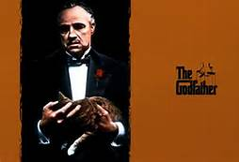
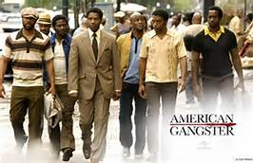


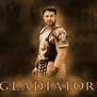

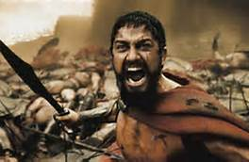


Slide 25
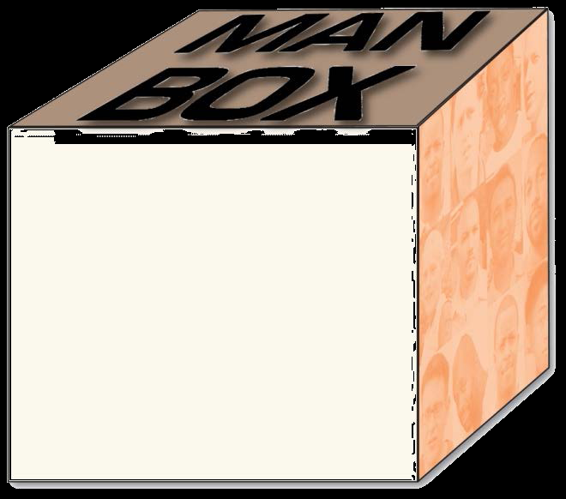
Addressing the collective socialization of Men
Anything associated with being a women
Anything associated with being gay
Sensitive
Being vulnerable
Being weak
Showing emotion
Soft
Needs to “Man Up”

Slide 26
THE COLLECTIVE SOCIALIZATION OF MEN OFTEN RESULTS IN
Having Less Value in Women
Treating Women as Property
Objectification of Women
Violence toward Women

Slide 27
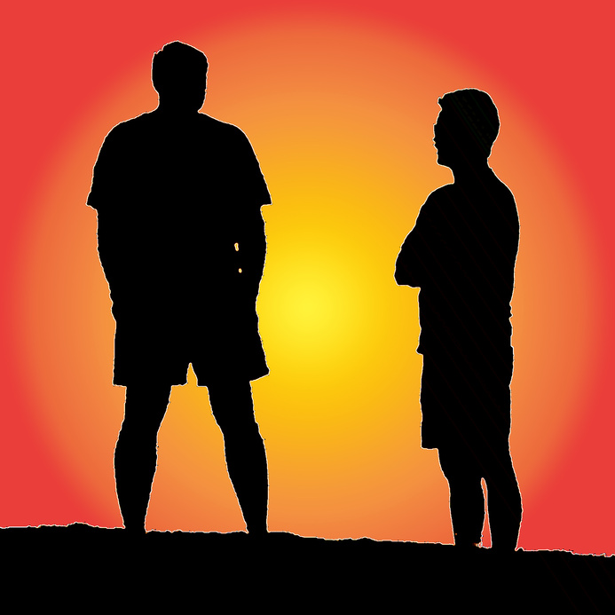
Understanding the treatment needs of Men
Women’s recovery is about Empowerment
Men’s recovery is about emotional Literacy
and Relationships

Slide 28
Ending Father Absence: The Treatment Environment
Demands of Self-Help
Vs.
Demands of Traditional
Masculinity

Slide 29
Masculinity Demands | Treatment Demands
SHOWING STRENGTH | SHOWING WEAKNESS
EXPERIENCING PRIDE | EXPERIENCING GUILT & SHAME
ACTING INVINCIBLE | ACTING VULNERABLE
Vs.

Slide 30
Masculinity Demands | Treatment Demands
BEING SELF-RELIANT | SEEKING HELP
BEING STOIC | EXPRESSING FEELINGS
TAKING ACTION | BECOMING INTROSPECTIVE
Vs.

Slide 31
Performance Measurement:
Program Design
Is the design culturally sensitive and relevant?
Does the program integrate more enhancing or basic interventions?
Are client opinions solicited or included?
How often are clinical assessments done?
How is assessment/ re-assessment data used?

Slide 32
At intake make sure to assess
Abuse History
Resiliency Factors

Slide 33
Create a treatment culture that promotes “Mistakes as wonderful opportunities to learn.”

Slide 34
Intervention Strategies:
A key recovery skill for men is the development
of a broader range of options for expressing
emotions and fear of being in healthy
relationships
Men also need to learn “relational mutuality”
A key intervention is to build on strengths
and “bridge skills”
Reframing specific problem behaviors
as survival skills from the family origin issues

Slide 35
Ending Father Absence: other special group topics for Men
Define 21st Century masculinity: The New Heavy Lifting:
Knowledge, Wisdom and Understanding of Self
A Spiritual Center and Focus
Answer the questions “Who am I” “What do I want out of life”
Healing family of origin issues
Practicing sexual responsibility
End self and other objectification (ATM’s v/s Porn Stars)

Slide 36
Moving from relationsick to relationship
Talk to men about forming a relationship with themselves first
Talk to men about what role does spirituality plays in their sex conduct
Have men closely examine their relationship picker and change it if necessary
What are his needs v/s her needs

Slide 37
Relationship Needs
His needs
Sexual fulfillment
Recreational Companionship
An attractive spouse
Domestic Support
Admiration

Slide 38
Relationship Needs
Her needs
Affections
Conversation
Honesty and openness
Financial support
Family commitment

Slide 39
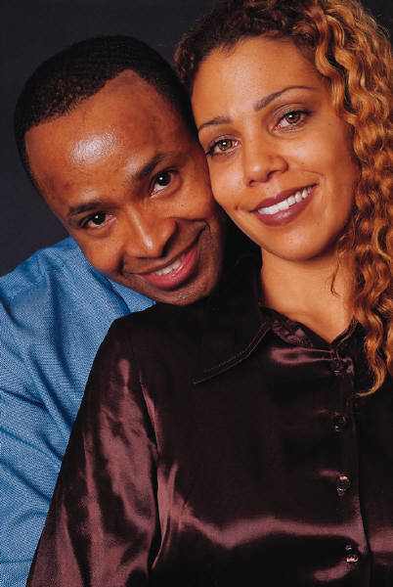
Recovery skills for men
A key recovery skill for men is the development
of a broader range of options for expressing
emotions and fear of being in healthy
relationships

Slide 40
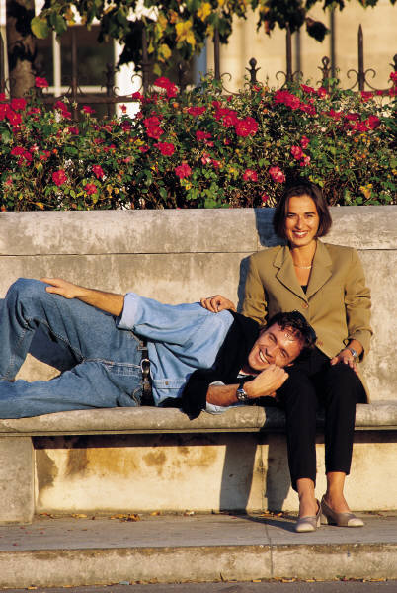
Recovery skills for Men
Men also need to learn “relational mutuality”

Slide 41

Recovery skills for Men
A key intervention is to build on strengths and “bridge skills”

Slide 42
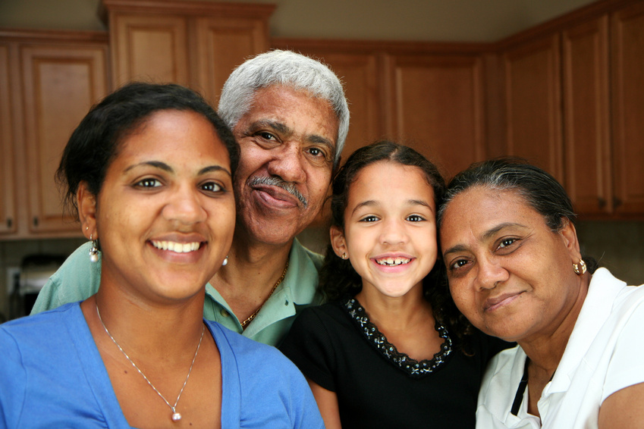
Recovery skills for Men
Reframing specific problem behaviors
as survival skills from the family origin issues

Slide 43

When Mama is Daddy
The Father’s role has shrunk drastically over the years. American fathers have been losing authority within the family and psychologically withdrawing from a direct family role in child rearing almost since colonial times.
Notes:
Parental androgyny is not what children need. Males and females bring different qualities to children. Mothers tend to be responsive and fathers firm; mother stress emotional security and relationships, and fathers stress competition and risk taking; mothers express more concern for the child immediate well being, while fathers are typically more active and arousing in their nurturing activities, fostering certain physical skills and emphasizing autonomy and independence. Men and women do not have to be straight-jacketed into these gender types.

Slide 44
When Mama is Daddy – things not to do
Raise him to think he’s cute and let him think the world revolves around his cuteness
Be involved with a steady stream of different men. Let him see how you manipulate men to get your needs met (bills, money, etc)
Emphasize the importance of sexual rather than intellectual prowess
Make your son you man. Not sexually but emotionally Keep him away from his father and put his father down

Slide 45

Things not to do cont.
Let your son talk and act grown
Let him hear you engage in sexual activity with different men in the next room
When he gets into trouble make sure its always the other person or the teachers fault

Slide 46
When Mama is Daddy: Challenges for Mom
Stop talking so much and start doing
Understanding the “Boy Code”
The Pillars of the Boy code: the Tough kid, the Hellraiser, the big shot, I Ain’t no Sissy and Silent Bob
The gender straight jacket
Getting behind the mask
The Emotional Disconnect

Slide 47
When Daddy is Home
What Fathers do is different from mothers. Fathers style of parenting tends to be very complementary of what Mother’s do and sets a tone for optimum child rearing.
Play
Competition, Risk taking and Independence
Discipline and Structure
Intellectual competence and academic achievement
Psychological well being

Slide 48
Next Presentation
Voices from the Field: Innovations in RSAT Programming (Massachusetts Jail Consortium)
April 16, 2014
2:00 – 3:00 p.m. EDT
The four Massachusetts programs were selected as Mentor Host Sites for their evidence-based institutional programming. They are also recognized for their first in the nation adoption of medication assisted treatment as a re-entry component to both prevent drug overdose deaths, all too common among recently released inmates, as well as promote successful long term recovery in the community.
Presenters: RSAT Staff from Barnstable, Berkshire, Middlesex, and Norfolk County Jails

