Slide 1






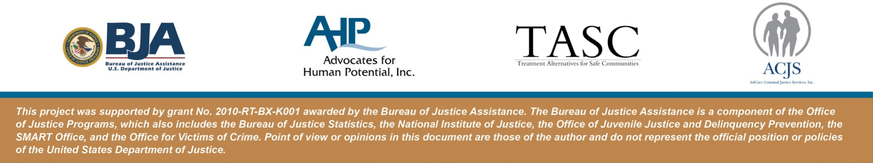
Correctional RSAT Leadership
West Virginia Department of Corrections
February 29-March 2, 2012
Lisa Talbot-Lundrigan, MA
Steve K. Valle, Sc.D., M.B.A.

Slide 2
Adult Learners
You are in a learning environment
You will be directly involved in what we do
You will have a variety of learning modes
You will learn at different speeds
You will get a chance to practice
You will have a variety of activities
You will apply theory to practice
You will walk away with something useful
You will learn why this is valuable
We are flexible
What are your expectations?

Slide 3
Evidence Based Practices
NIC’s Integrated Model of Correctional Treatment and Management for Leaders

Slide 4
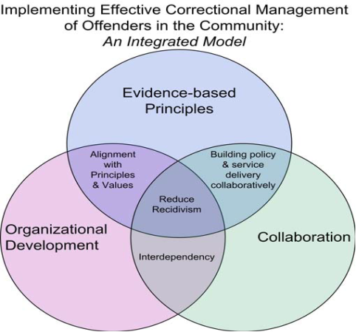
Evidence-Based Correctional Management
Source: NIC, CJI & CRJ; 2004, 2009
Notes:
Our work together over these 3 days will focus on providing you with information in all three realms and the

Slide 5
What Doesn’t Work?
Talking cures
Self-Help programs alone
Vague unstructured rehabilitation programs
Medical model
Fostering self-regard (self-esteem)
“Punishing smarter” (boot camps, scared straight, etc.)
Latessa, 2002

Slide 6
What Doesn’t Work?
Drug prevention classes focused on fear and other emotional appeals
Shaming offenders
Drug education programs
Non-directive, client centered approaches
Freudian approaches
Latessa, 2002

Slide 7
What Works In Corrections?
“What works in corrections” is not a program or a single intervention but rather a body of knowledge that is accessible to criminal justice professionals.
(Latessa and Lowencamp, 2006)
7
Notes:
7

Slide 8
What Are Evidence Based Practices?
Correctional Practices in Which:
(1) there is a definable outcome
(2) it is measurable and
(3) it is defined according to practical realities, such as recidivism, victim satisfaction, etc. (Bogue et al. 2004).

Slide 9
1. Assess Actuarial Risk / Need
  Use of Empirical, Validated Assessment Instruments
  Objective Classification Systems
  Awareness of Criminogenic Risk/Need/Responsivity Principles
Notes:
Measurement of risk/need is objective: ORAS, COMPAS, LS/RNR

Slide 10
Needs of Offenders
CRIMINOGENIC
Anti-social behavior history (low self-control)
Anti-social personality traits
Anti-social peers (criminal companions)
Anti-social values
Substance abuse
Dysfunctional family
Education/Employment
Leisure/Recreation
LESS CRIMINOGENIC
Self esteem
Anxiety
Neighborhood improvements
Group cohesiveness
Andrews & Bonta (1990)
Notes:
Big 4 are the anti-social criminogenic needs

Slide 11
2. Enhance Intrinsic Motivation
Motivation to Change is Enhanced by Positive and Respectful Interactions with Authority
Behavioral Change is Best Achieved via interpersonal learning:
  The RSAT Therapeutic Community
  Staff and Officers are active supporters.

Slide 12
3. Target Interventions
3a) Risk Principle: Prioritize supervision and treatment resources for higher risk offenders.
3b) Need Principle: Target interventions to criminogenic needs.
3c) Responsivity Principle: Be responsive to temperament, learning style, motivation, culture, and gender when assigning programs.
3d) Dosage: Structure 40-70% of high-risk offenders’ time for 3-9 months.
3e) Treatment Principle: Integrate treatment into the full sentence / sanction requirements.
Notes:
Low risk offender actually fare worse if given intensive treatment than if given no treatment at all. Big four criminogenic needs are anitsocial behaviors, attitudes, associates and personality

Slide 13
4. Skill Train With Directed Practice
Use Cognitive Behavioral Techniques that:
  Focus Upon Changing Behavior and Thinking
  Provide Skills Training and Opportunities for Skill Rehearsal
  Teach the Offender to:
    Become aware of his/her thinking
    Verbalize his / her thoughts
    Stop Reacting to Automatic Thoughts
    Understand How Thoughts and Beliefs Trigger Criminal and Addictive Behaviors

Slide 14
5. Increase Positive Reinforcement
Behavior Change is Maximized By Positive Reinforcement
  Research shows that 4 positive reinforcers for every one negative reinforcer is the ideal.
  Unlike negative reinforcement, which must be consistent and predictable to have an effect, positive reinforcement can be random and spontaneous.
  Swift and certain sanctions for rule violation or inappropriate behavior ALWAYS supersede positive reinforcement

Slide 15
6. Engage Ongoing Support in Natural Communities
The Community to Which the Offender Returns has enormous impact upon the likelihood of Relapse and Recidivism
  Engage the community resources
  Mobilize family and pro-social peers
  Develop Pro-Social Peer Network
      RSAT Peer-To-Peer Learning
      Peer Reentry Liaison
      Twelve Step/ Mutual Help / Faith Networks

Slide 16
7. Measure Relevant Processes/Practices
Regular Measurement of Offender Behavior Change During Incarceration
    Homework and Tests
    Pre-Post Testing
    Measures of Institutional Conduct
Outcome Evaluation
    Tracking Recidivism
    Long-Term Follow-Up
Staff Assessment
    Regular and Ongoing Performance Evaluation
    Training and Supervision

Slide 17
8. Provide Measurement Feedback
For Offenders
    Feedback from RSAT peers, counselors and officers in real time builds accountability and encourages behavior change
For Staff
    Feedback from colleagues in custodial and non-custodial roles enhances job performance
For The Department of Corrections
    Increases Fidelity, Transparency and Stakeholder Accountability

Slide 18
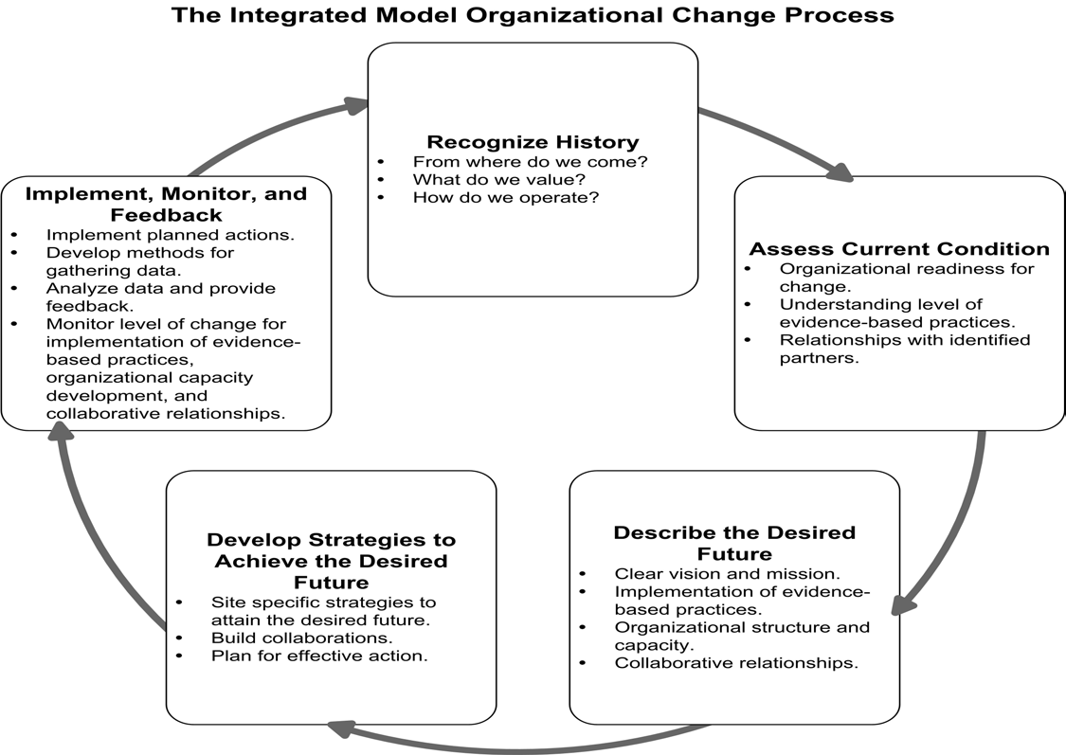
National Institute of Corrections, 2004

Slide 19
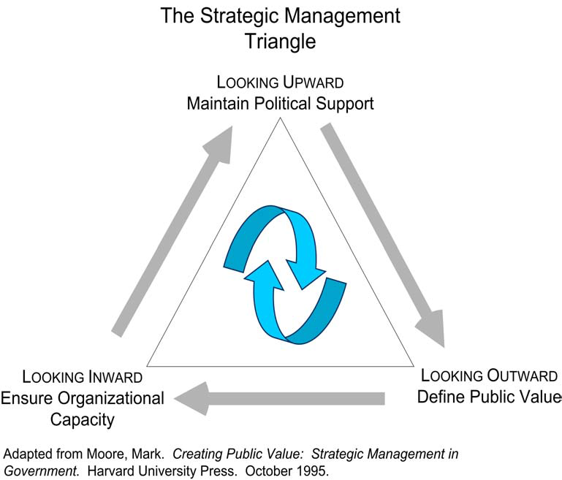

Slide 20
Leading Organizational Change: The Fifth Discipline (Senge, 1990)
Personal Mastery: Continually clarifying and deepening our personal vision, focusing our energies, developing patience, and seeing reality objectively;
2. Mental Models: Understanding the deeply ingrained assumptions, generalizations, or mental images that influence how we understand the world and how we take action (manage offenders);
3. Building a Shared Vision: Collaborative creation of organizational goals, identity, visions, and actions shared by members;
4. Team Learning: Creation of opportunities for individuals to work and learn together (collaboratively) in a community where it is safe to innovate, learn, and try anew; and
5. Systems Thinking: View of the system as a whole (integrated) conceptual framework providing connections between units and members; the shared process of reflection, reevaluation, action, and reward.

Slide 21
The Integrated Model of Corrections Management (NIC, 2009)
Evidence Based Practices
Collaboration
External Strategy
Organizational Development
Internal Variables

Slide 22

principles of drug addiction treatment
A research-based guide

Slide 23
About the Presentation
Three decades of scientific research
and clinical practice have yielded
a variety of effective approaches to
drug addiction treatment. The principles in this presentation is an overview of that work.

Slide 24
Principles of Drug Addiction Treatment
National Institute on Drug Abuse (NIDA)
National Institutes of Health
U.S. Department of Health and Human Services
NIH Publication No. 09–4180
Printed October 1999; Reprinted July 2000, February 2008; Revised April 2009
24
Notes:
24

Slide 25
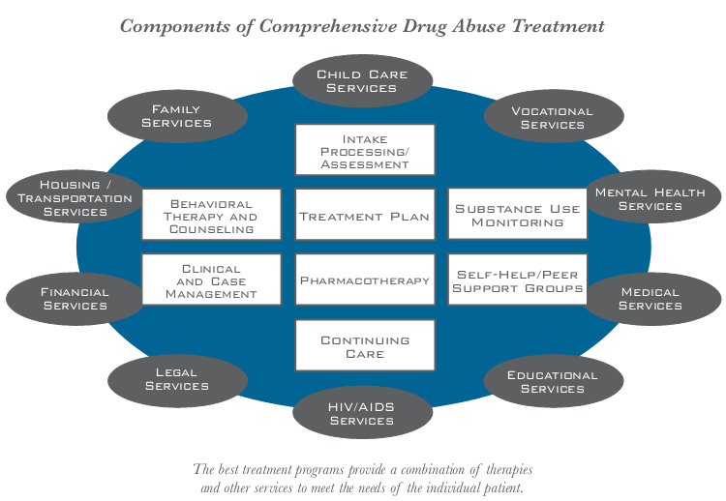
Principles of Drug Addiction Treatment
25
Notes:
The move is on from “Acute Care Treatment” to “Chronic Care Treatment”.
25

Slide 26
Principles of Drug Addiction Treatment
Addiction is a complex but treatable disease that affects brain function and behavior. Drugs of abuse alter the brain’s structure and function, resulting in changes that persist long after drug use has ceased. This may explain why drug abusers are at risk for relapse even after long periods of abstinence and despite the potentially devastating consequences.
26
Notes:
26

Slide 27
Principles of Drug Addiction Treatment
2. No single treatment is appropriate for everyone. Matching treatment settings, interventions, and services to an individual’s particular problems and needs is critical to his or her ultimate success in returning to productive functioning in the family, workplace, and society.
27
Notes:
27

Slide 28
Principles of Drug Addiction Treatment
3. Treatment needs to be readily available. Because drug-addicted individuals may be uncertain about entering treatment, taking advantage of available services the moment people are ready for treatment is critical. Potential patients can be lost if treatment is not immediately available or readily accessible. As with other chronic diseases, the earlier treatment is offered in the disease process, the greater the likelihood of positive outcomes.
28
Notes:
28

Slide 29
Principles of Drug Addiction Treatment
4. Effective treatment attends to multiple needs of the individual, not just his or her drug abuse. To be effective, treatment must address the individual’s drug abuse and any associated medical, psychological, social, vocational, and legal problems. It is also important that treatment be appropriate to the individual’s age, gender, ethnicity, and culture.
29
Notes:
29

Slide 30
Principles of Drug Addiction Treatment
5. Remaining in treatment for an adequate period of time is critical. The appropriate duration for an individual depends on the type and degree of his or her problems and needs. Research indicates that most addicted individuals need at least 3 months in treatment to significantly reduce or stop their drug use and that the best outcomes occur with longer durations of treatment.
30
Notes:
30

Slide 31
Principles of Drug Addiction Treatment
5. Remaining in treatment for an adequate period of time is critical (cont). Recovery from drug addiction is a long-term process and frequently requires multiple episodes of treatment. As with other chronic illnesses, relapses to drug abuse can occur and should signal a need for treatment to be reinstated or adjusted. Because individuals often leave treatment prematurely, programs should include strategies to engage and keep patients in treatment.
31
Notes:
31

Slide 32
Principles of Drug Addiction Treatment
6. Counseling—individual and/or group—and other behavioral therapies are the most commonly used forms of drug abuse treatment. Behavioral therapies vary in their focus and may involve addressing a patient’s motivation to change, providing incentives for abstinence, building skills to resist drug use, replacing drug-using activities with constructive and rewarding activities, improving problem solving skills, and facilitating better interpersonal relationships.
32
Notes:
32

Slide 33
Principles of Drug Addiction Treatment
6. Counseling—individual and/or group—and other behavioral therapies are the most commonly used forms of drug abuse treatment (cont). Also, participation in group therapy and other peer support programs during and following treatment can help maintain abstinence.
33
Notes:
33

Slide 34
Principles of Drug Addiction Treatment
7. Medications are an important element of treatment for many patients, especially when combined with counseling and other behavioral therapies. For example, methadone and buprenorphine are effective in helping individuals addicted to heroin or other opioids stabilize their lives and reduce their illicit drug use. Naltrexone is also an effective medication for some opioid-addicted individuals and some patients with alcohol dependence.
34
Notes:
34

Slide 35
Principles of Drug Addiction Treatment
7. Medications are an important element of treatment for many patients, especially when combined with counseling and other behavioral therapies(cont). Other medications for alcohol dependence include acamprosate, disulfiram, and topiramate. For persons addicted to nicotine, a nicotine replacement product (such as patches, gum, or lozenges) or an oral medication (such as bupropion or varenicline) can be an effective component of treatment when part of a comprehensive behavioral treatment program.
35
Notes:
35

Slide 36
Principles of Drug Addiction Treatment
8. An individual’s treatment and services plan must be assessed continually and modified as necessary to ensure that it meets his or her changing needs. A patient may require varying combinations of services and treatment components during the course of treatment and recovery. In addition to counseling or psychotherapy, a patient may require medication, medical services, family therapy, parenting instruction, vocational rehabilitation, and/or social and legal services. For many patients, a continuing care approach provides the best results, with the treatment intensity varying according to a person’s changing needs.
36
Notes:
36

Slide 37

Principles of Drug Addiction Treatment
9. Many drug-addicted individuals also have other mental disorders. Because drug abuse and addiction—both of which are mental disorders—often co-occur with other mental illnesses, patients presenting with one condition should be assessed for the other(s). And when these problems co-occur, treatment should address both (or all), including the use of medications as appropriate.
37
Notes:
37

Slide 38
Principles of Drug Addiction Treatment
10. Medically assisted detoxification is only the first stage of addiction treatment and by itself does little to change long-term drug abuse. Although medically assisted detoxification can safely manage the acute physical symptoms of withdrawal and, for some, can pave the way for effective long-term addiction treatment, detoxification alone is rarely sufficient to help addicted individuals achieve long-term abstinence. Thus, patients should be encouraged to continue drug treatment following detoxification. Motivational enhancement and incentive strategies, begun at initial patient intake, can improve treatment engagement.
38
Notes:
38

Slide 39

Principles of Drug Addiction Treatment
11. Treatment does not need to be voluntary to be effective. Sanctions or enticements from family, employment settings, and/or the criminal justice system can significantly increase treatment entry, retention rates, and the ultimate success of drug treatment interventions.
39
Notes:
39

Slide 40
Principles of Drug Addiction Treatment
12. Drug use during treatment must be monitored continuously, as lapses during treatment do occur. Knowing their drug use is being monitored can be a powerful incentive for patients and can help them withstand urges to use drugs. Monitoring also provides an early indication of a return to drug use, signaling a possible need to adjust an individual’s treatment plan to better meet his or her needs.
40
Notes:
40

Slide 41
Principles of Drug Addiction Treatment
13. Treatment programs should assess patients for the presence of HIV/ AIDS, hepatitis B and C, tuberculosis, and other infectious diseases as well as provide targeted risk-reduction counseling to help patients modify or change behaviors that place them at risk of contracting or spreading infectious diseases. Typically, drug abuse treatment addresses some of the drug-related behaviors that put people at risk of infectious diseases. Targeted counseling specifically focused on reducing infectious disease risk can help patients further reduce or avoid substance-related and other high-risk behaviors.
41
Notes:
41

Slide 42
Principles of Drug Addiction Treatment
Summary
Treatment varies depending on the
type of drug and the characteristics
of the patient. The best programs
provide a combination of therapies
and other services.
42
Notes:
42

Slide 43
RSAT Programs
Core Conditions and The Culture of Treatment in Correctional Settings

Slide 44
The Mission of Correctional
RSAT Programs
“To promote public safety by
reducing recidivism through
effective programming”
Valle & Talbot, 2001
44
Notes:
44

Slide 45
Accountability Training® Change Model Recidivism Reduction Pyramid
RECOVERY
C O M M U N I T Y
CORRECTIONAL LEADERSHIP PROCESS
ACCOUNTABILITY
RESPECT
R E S P E C T
© 2011, Stephen K. Valle
Valle, 2011

Slide 46
Why RSAT in Corrections?
More than 80% of inmates have substance abuse disorders and 45% meet the criteria for substance dependence
Substance abuse is the largest contributing factor to recidivism.
This directly contributes to overcrowding and increased costs
Common Mission
Source: Mitchell, Wilson & McKenzie (2007)
CASA, Behind Bars II (2010)
46
Notes:
46

Slide 47
Why RSAT in Corrections?
The Mission of Corrections and Treatment is to correct / change criminal behavior
Effective inmate management tool
Enhances staff morale
It works!
47
Notes:
47

Slide 48
WHY RSAT IN CORRECTIONS?
Overwhelming research evidence that treatment works
Reduces recidivism from 10-50%
Reduces direct corrections operational costs
Reduces victim related costs
Delaware/Crest Program (1999)
BOTEC Barnstable County RSAT Program

Slide 49
What’s in it for Security Staff?
Decreased Recidivism
More Manageable Inmates
Fewer Acts of Inmate-Staff Violence
Fewer Acts of Inmate-Inmate Violenc
Fewer Mental Health and Medical Calls
49
Notes:
49

Slide 50
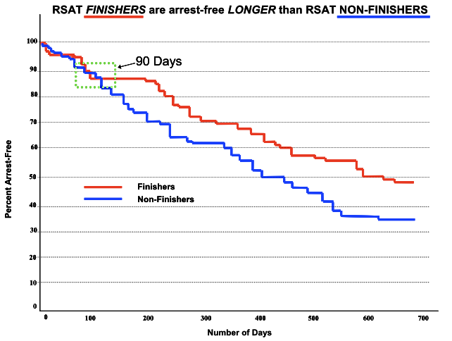
50
Notes:
50

Slide 51

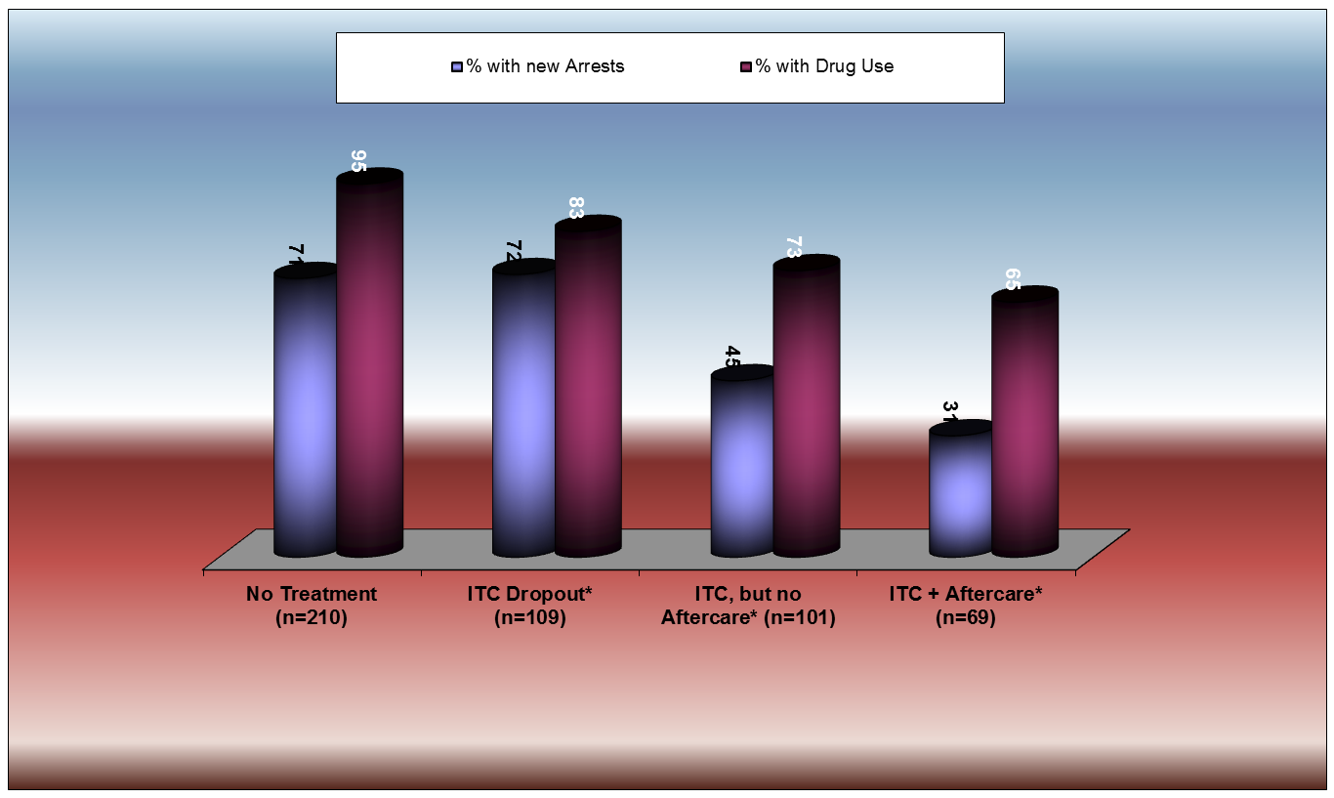
51
Notes:
51

Slide 52
BJA’s Requirements for Correctional RSAT Programs
Last at least 6-12 months
Make every effort to separate RSAT participants from the general correctional population
Focus on inmates’ substance abuse problems
Develop inmates’ cognitive, behavioral, social, vocational, and other skills to solve the substance abuse and related problems
Are science based and effective

Slide 53
How Does RSAT Work?
Structure – Discipline – Consistency
Critical for model to be successful (inmates & staff)
“Hymn Book Principle”
  Essential for custody and treatment staff to be on the same page
  Consistency is key
  There is no “I” in TEAM
The Therapeutic Community (TC) is the method for change, not the treatment specialist or the individual.
Training is critical and on-going.
53
Notes:
53

Slide 54

Addiction
Understanding Addiction as a
Brain Disease
3/7/2012
54

Slide 55
Paradigm Shift
“JUST SAY NO” vs.
THE DISEASE MODEL OF ADDICTION
55
Notes:
55

Slide 56
ASAM Definition of Addiction
“Addiction is a primary, chronic disease of brain reward, motivation, memory and related circuitry. Dysfunction in these circuits leads to characteristic biological, psychological, social and spiritual manifestations. This is reflected in an individual pathologically pursuing reward and/or relief by substance use and other behaviors.
Addiction is characterized by inability to consistently abstain, impairment in behavioral control, craving, diminished recognition of significant problems with one’s behaviors and interpersonal relationships, and a dysfunctional emotional response. Like other chronic diseases, addiction often involves cycles of relapse and remission. Without treatment or engagement in recovery activities, addiction is progressive and can result in disability or premature death.” (ASAM, 2011)
Notes:
Public Policy statement revised 2011. Places emphasis upon the brain and the physiology of addiction.

Slide 57
The Disease Model
Addiction is a chronic, progressive, relapse - prone illness that has the potential to be fatal if left untreated.
Chronic - The World Health Organization defines chronic diseases as having:
A clearly defined onset
An identifiable and predictable set of symptoms
A responsiveness to treatment as evidenced by a decrease in symptoms
The ability to be arrested ( not cured) by appropriated treatment
A progressive nature without treatment
57
Notes:
57

Slide 58
The Disease Model
Addiction is a chronic, progressive, relapseable illness that has the potential to be fatal if left untreated.
Progressive diseases:
Get worse, not better, over time.
Tolerance develops.
Relapse:
Relapse is a common aspect of all chronic diseases. But relapse is not pre-determined. Relapse, for some, can be avoided. Relapse, for many, is common and can be managed effectively.
Fatality:
Chronic diseases can and do kill - addiction is no different
58
Notes:
58

Slide 59
Symptoms – Areas Affected by Addiction
Physical
Psychological
  Mental
  Emotional
  Behavioral
Spiritual
Social
Cultural
Environmental
Socio-Economic/Political
59
Notes:
59

Slide 60
Choice and Addiction
Individuals do not choose the diseases that they suffer but they do choose how they treat them.
60
Notes:
60

Slide 61
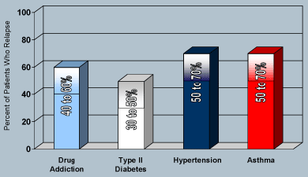
Relapse Rates for Chronic Diseases
McLellan et. al. (2000) via NIDA at www.drugabuse.gov

Slide 62

Pleasure Unwoven
Pleasure Unwoven:
An Explanation of the
Brain Disease of Addiction
(2010)
DVD
Kevin McCauley (Director)
62
Notes:
62

Slide 63
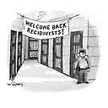
Anticipating Challenges
New York Times
Defining Success

Slide 64
Evidence-Based Organizations
Everyone Shares a Common Mission and Vision.
Resources Are Used Effectively and Efficiently.
Offenders Are Held Accountable.
Evidence-based organizations are not soft on crime. They expect offenders to be active participants in treatment and work to reduce risk.
Data Drives Decisions
Learning Innovations Are Welcome
System Players Communicate and Collaborate
Source: NIC, CJI & CRJ; 2011

