Slide 1

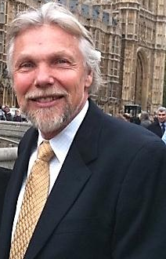

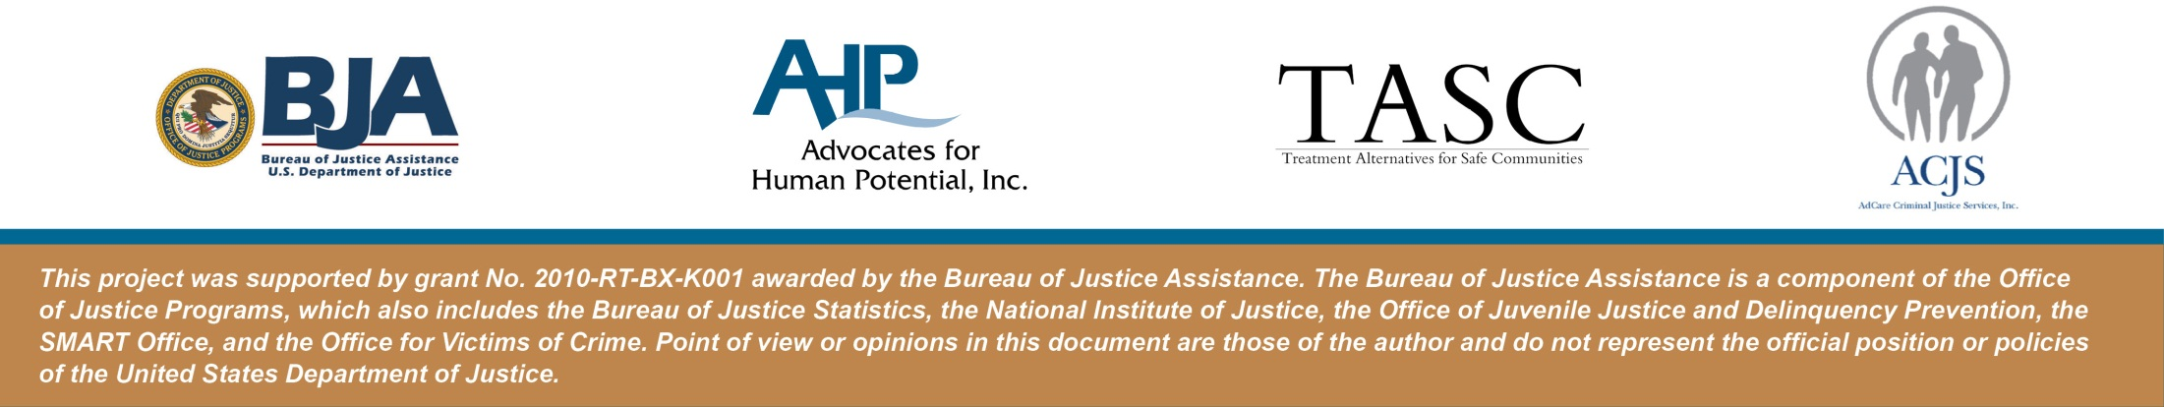
Building Stronger Relationships Between Corrections and Treatment
Texas Corrections Association
June 11, 2012
Stephen K. Valle, Sc.D., M.B.A.,
Core Faculty
Lisa Talbot-Lundrigan, MA
Core Faculty

Slide 2
Goals and Objectives:
We will explore the relationship between correctional and treatment staff and discuss ways of maximizing our partnership. Specifically we will:
  identify the shared goals of corrections and treatment;
  describe one public safety model of treatment;
  articulate common values of correctional and treatment agencies.

Slide 3
“Collaboration is a mutually beneficial and well-defined relationship entered into by two or more organizations to achieve common goals. The relationship includes a commitment to: a definition of mutual relationships and goals; a jointly developed structure and shared responsibility; mutual authority and accountability for success.”
Source: Griffith (2000), as cited by NIJ, CRJ, CJI, (2009)

Slide 4
THE CHALLENGE FOR CRIMINAL JUSTICE SYSTEM
ADDRESS THE DISEASE....
CHANGE THE BEHAVIOR

Slide 5
Corrections and Treatment
So what are the shared goals in our work with offenders?

Slide 6
Similarities Between Corrections and Treatment Professionals
Corrections Professional | Treatment Professional
Upholds community safety as an important value and works to reduce recidivism | Upholds community safety as an important value and works to reduce recidivism
Provides services (such as linkage and case management) for offenders to maximize positive outcomes for the community, the victim and the offender | Provides services (such as specialized treatment) for offenders to maximize positive outcomes for the community, the victim and the offender
Believes in behavior change | Believes in behavior change
Sees offender‘s strengths and competencies | Sees offender‘s strengths and competencies
Models pro-social behavior and confront anti-social behavior | Models pro-social behavior and confront anti-social behavior
Source: NIC, CRJ, CJI (2008)

Slide 7
Corrections and Treatment
And, how are we different? What goals are NOT the same?

Slide 8
Differences Between Corrections and Treatment Professionals, NIC 2008
Corrections Professional | Treatment Professional
ETHICAL DECISION-MAKING Ethical decisions tend more to be uniform and consistent across all offenders, oriented by common conditions of supervision | ETHICAL DECISION-MAKING Ethical decisions tend more to be individualized, taking into account contextual variables
ACCOUNTABILITY (External/visible) Holds offender accountable to general and specific conditions of supervision (rules that apply to everyone in a particular sub-group, i.e. probationers or sex offenders) Is accountable to the courts and community | ACCOUNTABILITY(Internal/invisible) Holds offender (and sometimes family members) accountable to signed treatment plan, developed in collaboration with the offender and the referral source (usually the corrections professional) Is accountable to a referral source but extent of information sharing is determined by authorizations to release information Is accountable to ethics and licensing boards, and sometimes health insurance funders or contracting agencies
INFORMATION SHARING Some criminal information is public information Public information and controlled information, guided by local correctional policies Case information is entered into a state-wide system and available to criminal justice personnel throughout the state | INFORMATION SHARING A & D and mental health information is confidential unless appropriate releases are signed Clinical records are generally kept in a locked file behind two locked doors Only information that needs to be shared should be shared (e.g. treatment compliance, clinical recommendations, discharge summary and discharge recommendations) Any other information that is shared should be explicitly negotiated with the offender client Harm to self or others is not confidential

Slide 9
Differences Between Corrections and Treatment Professionals, NIC 2008
CASE PLAN Investigates and adjudicates based on assessment of criminogenic factors Individualized plan to address strengths and criminogenic factors | TREATMENT PLAN Clinically assesses Individualized plan to address behaviors that interfere with adaptation, based on biopsychosocial assessment
DURATION OF INVOLVEMENT Broader and longer term Length of community supervision is determined by court, dependent on crime of conviction Number of contacts is determined by assessed risk to community | DURATION OF INVOLVEMENT Limited to a specific episode of care (coordination of treatment services and other services needed to complete treatment plan) Length of and intensity of treatment is determined by client need and completion of treatment plan goals Medically/clinically determined discharge from services
ABSTINENCE Represents the abstinence-based world to the offender Ultimately conditions of supervision require offender to abstain from substances (even though most corrections professionals understand principles of harm reduction) | HARM REDUCTION Treatment professionals let clients know that relapse happens and plan for how to handle it, even while helping the client adapt to living in an abstinence-based world

Slide 10
Differences Between Corrections and Treatment Professionals, NIC 2008
MONITORS COMPLIANCE Represents the court‘s authority to the offender Is an arbiter of right and wrong for the offender Monitors conditions of supervision Holds offender accountable to rules that apply to everyone | THERAPEUTIC NEUTRALITY Correctional treatment is still client centered Some of the power of the therapeutic relationship derives from the treatment provider maintaining reasonable neutrality about choices, good or bad, that offenders make. However, treatment providers are not neutral about violent or criminal behavior, harm to self or others
DETERMINES SANCTIONS Determines appropriate sanctions for non-compliance based on graduated sanctions | MAY CONSULT ON CONSEQUENCES AT TIMES Must stay out of the business of consequencing

Slide 11
Perhaps we do not have different goals but rather have different roles in reaching the same goal.

Slide 12
The Accountability Training Program Model®
An integrated, evidence-based, multi-disciplinary approach to offender change

Slide 13
Steps for Learning Accountability
Awareness that our behavior has an effect on others
All behavior has Consequences for self and others
Recognize that, with awareness, behavior is a Choice
Acceptance – Owning one’s role in the behavior and in the consequences
Accountability means taking empathic Action to change
© 2009, Dr. Steve Valle

Slide 14
Respect
Community
Recovery & Change
Accountability
The Formula for Recovery & Change

Slide 15
Accountability Training® Change Model
Recidivism Reduction Pyramid
Recovery & Behavior Change
ACCOUNTABILITY
C O M M U N I T Y
THE
CHANGE
PROCESS
Others –- Self – Higher Power
Pro-Social Connections – Safe Housing – Meaningful Work
R E S P E C T
Others – Self - Authority
© 2009, Dr. Steve Valle.

Slide 16
Core Philosophy of Accountability Training® for Offender Change Programs (Paradigm)
Grounded in public safety philosophy – safety takes precedent over public health or mental health philosophies
The common good of the group supersedes the rights/interests of the individual (the “we before me” principle)

Slide 17
Core Philosophy of Accountability Training® for Offender Change Programs (Paradigm)
The taxpayer is the primary client, not the offender. Accountability to society is foremost priority.
Offenders change “not because they see the light, but because they feel the heat”

Slide 18
3 Assumptions of Accountability Training® Programs That Drive Service Delivery
Offenders CAN change their addictive and criminal behaviors with appropriate combination of sanctions and interventions/treatment
2. Implementation of EVIDENCE BASED PRACTICES DOES result in positive outcomes including reduction in recidivism, cost savings, decrease in drug misuse, and criminality

Slide 19
Assumptions of Accountability Training® Programs That Drive Services (con’t)
3. Motivation to change is not required – “motivation myth”
    Offenders are motivated - but not necessarily to change
    “What’s in it for me” – conditional buy-in is good enough
    Commitment to “ACT AS IF” is key; velvet covered brick metaphor – AT brings motivation to clients by applying therapeutic leverage factors as motivators to participate (“the only failure is the failure to participate”)
    Research shows that mandated or coerced treatment is effective (CASA Behind Bars II, February 2010;NIDA 2009)
11

Slide 20
Mandated Treatment Works
Research has demonstrated that individuals who enter treatment under legal pressure have outcomes as favorable as those who enter treatment voluntarily.
Those under legal pressure tend to have higher attendance rates and to remain in treatment for longer periods, which has a positive impact on treatment outcomes.
Findings suggest that people can learn from the 'teachable moment' offered by a judicial mandate, even though the initial motivation for treatment is external.
Principles of Drug Abuse Treatment - NIDA, 2009
NIDA Notes, Research Findings, Vol.20, No.6, 2006
Notes:
The implications of research findings go beyond the criminal justice population. The idea that patients must want to change seems to permeate current practice, but the drug abuse treatment field must reexamine its definition of motivation. Clinical measures of motivation mostly indicate intrinsic drive to change, but extrinsic motivators as well as rewards can increase treatment entry and improve long-term outcomes.
The most effective models integrate criminal justice and drug treatment systems and services. Treatment and
criminal justice personnel work together on treatment planning—including implementation of screening,
placement, testing, monitoring, and supervision—as well as on the systematic use of sanctions and rewards.
"Once in a therapeutic environment, mandated patients seem to reflect on their situation and accept the need for treatment," says Dr. John Kelly, lead investigator of the study, conducted at the VA Palo Alto Healthcare System and Stanford University School of Medicine. "Our findings suggest that people can learn from the 'teachable moment' offered by a judicial mandate, even though the initial motivation for treatment is external. Judicial mandates may provide an opportunity for offenders to gain access to and benefit from needed treatment."

Slide 21
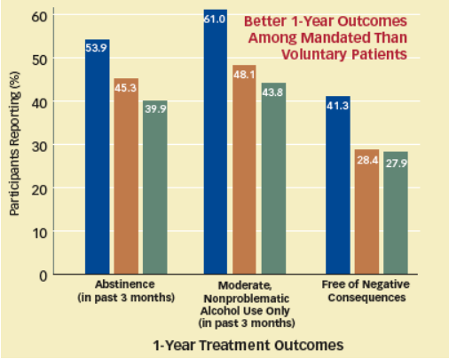

Slide 22
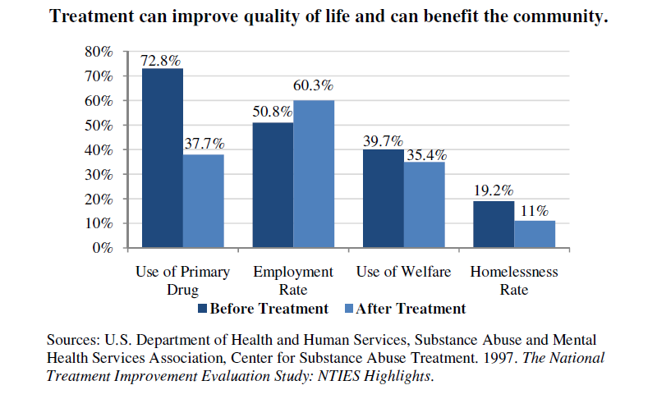
Notes:
A U.S. Department of Health and Human Services study revealed that clients who participated in federally funded substance abuse treatment programs were not only able to reduce their drug use by about 50 percent, but were also able to make other substantial changes in their lives that decreased the need for public services, yielding savings related to fewer hospital visits and less involvement in the criminal justice system. The overall mental and physical health of the patients improved as they reported reduced numbers of medical visits and safer sexual habits.

Slide 23
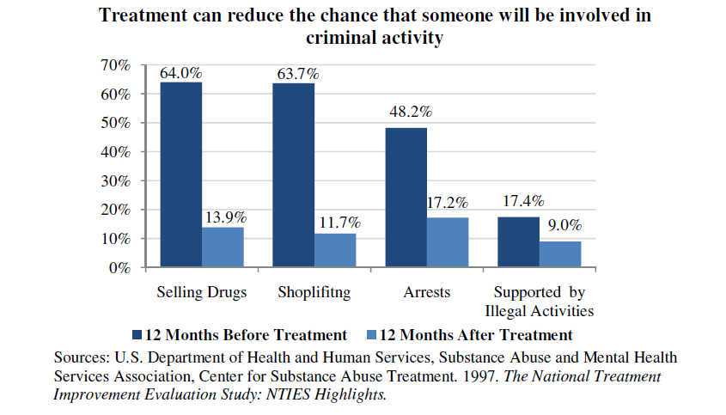
Notes:
Substance abuse treatment prior to contact with the justice system yields public safety benefits early on.
Substance-involved individuals have come to compose a large portion of the prison population, and substance use may play a part in the commission of certain crimes. According to a recent Bureau of Justice Statistics report,
• 53 percent of state prisoners and 45 percent of federal prisoners meet criterion of drug abuse or dependence;
• 16.6 percent of state prisoners and 18.4 percent of federal prisoners committed their crimes to obtain money for drugs;
• one in three state prisoners reported using drugs at the time of their offense, and one in four violent offenders reported drug use at the time of their crime
• 64 percent of state prisoners who committed a property offense reported drug use in the month prior to arrest, and 38 percent reported use during the time of the offense.
Participation in a drug treatment program has been shown to reduce the chances that a drug involved person will commit crime. The National Treatment Improvement Evaluation Study (NTIES) showed that drug treatment significantly reduced respondents’ self-reported criminal activity:
a 78.3 percent reduction in drug selling
an 81.6 percent decline in shoplifting
a 64.3 percent reduction in arrests for any crime
a 48.3 percent reduction in supporting themselves through illegal activities

Slide 24
Stages of Change in Accountability Training® For Justice Involved Clients (precedes pre-contemplation stage)
Stage I: DEFIANCE
Stage II: RESISTANCE
ACCOUNTABILITY
Stage IV: COOPERATION
Stage III: COMPLIANCE
© 2009, Dr. Steve Valle

Slide 25
Components of Effective Correctional Treatment
The Synergistic Partnership of Treatment and Correctional Professionals

Slide 26
How Does Correctional Treatment Work?
Structure – Discipline – Consistency
Critical for model to be successful (inmates & staff)
“Hymn Book Principle”
  Essential for custody and treatment staff to be on the same page
  Consistency is key
  There is no “I” in TEAM
The Therapeutic Community (TC) is the method for change, not the treatment specialist or the individual.
Training is critical and on-going.
Notes:
26

Slide 27
Every interaction is an opportunity for learning
In an integrated Program, both Criminal Justice Staff and Treatment Staff share the responsibility to:
Reinforce pro-social thinking / attitudes / behaviors.
Direct thinking towards less riskier / more healthier ways of thinking.
  Program Rules and Community Standards
  12 Steps
  Problem-solving skills
  Thinking Report
Notes:
27

Slide 28
Power of Role Models
Supervising Agency Staff, Treatment Staff, and the relationship between all of us – role model healthy behaviors for RSAT participants.
Provides opportunities to show authority figures in a positive manner.
Effective use of authority – firm, fair and consistent.
Program Participants must act within the standards of the program if they want to stay– however – the Choice is always Theirs.
Notes:
28

Slide 29
Drama Triangle of
“Cops, Cons and Counselors”
Correctional Officer vs. “Prison Guard”
COPS
(persecutor)
COUNSELORS
(rescuer)
CONS
(victim)
Notes:
29

Slide 30
Drama Triangle of
“Cops, Cons and Counselors”
Correctional Officer vs. “Prison Guard”
COPS
(persecutor)
COUNSELORS
(rescuer)
Blames
Criticizes
Oppresses
Dehumanizes
CONS
(victim)
Notes:
30

Slide 31
Drama Triangle of
“Cops, Cons and Counselors”
Correctional Officer vs. “Prison Guard”
COPS
(persecutor)
COUNSELORS
(rescuer)
Enable
Protect
Indulge
Spoil
Blames
Criticizes
Oppresses
Dehumanizes
CONS
(victim)
Notes:
31

Slide 32
Accountability
COPS
(Correctional Officers)
COUNSELORS
(Treatment Staff)
Firm
Fair
Consistent
CONS
(Community Members)
Notes:
32

Slide 33
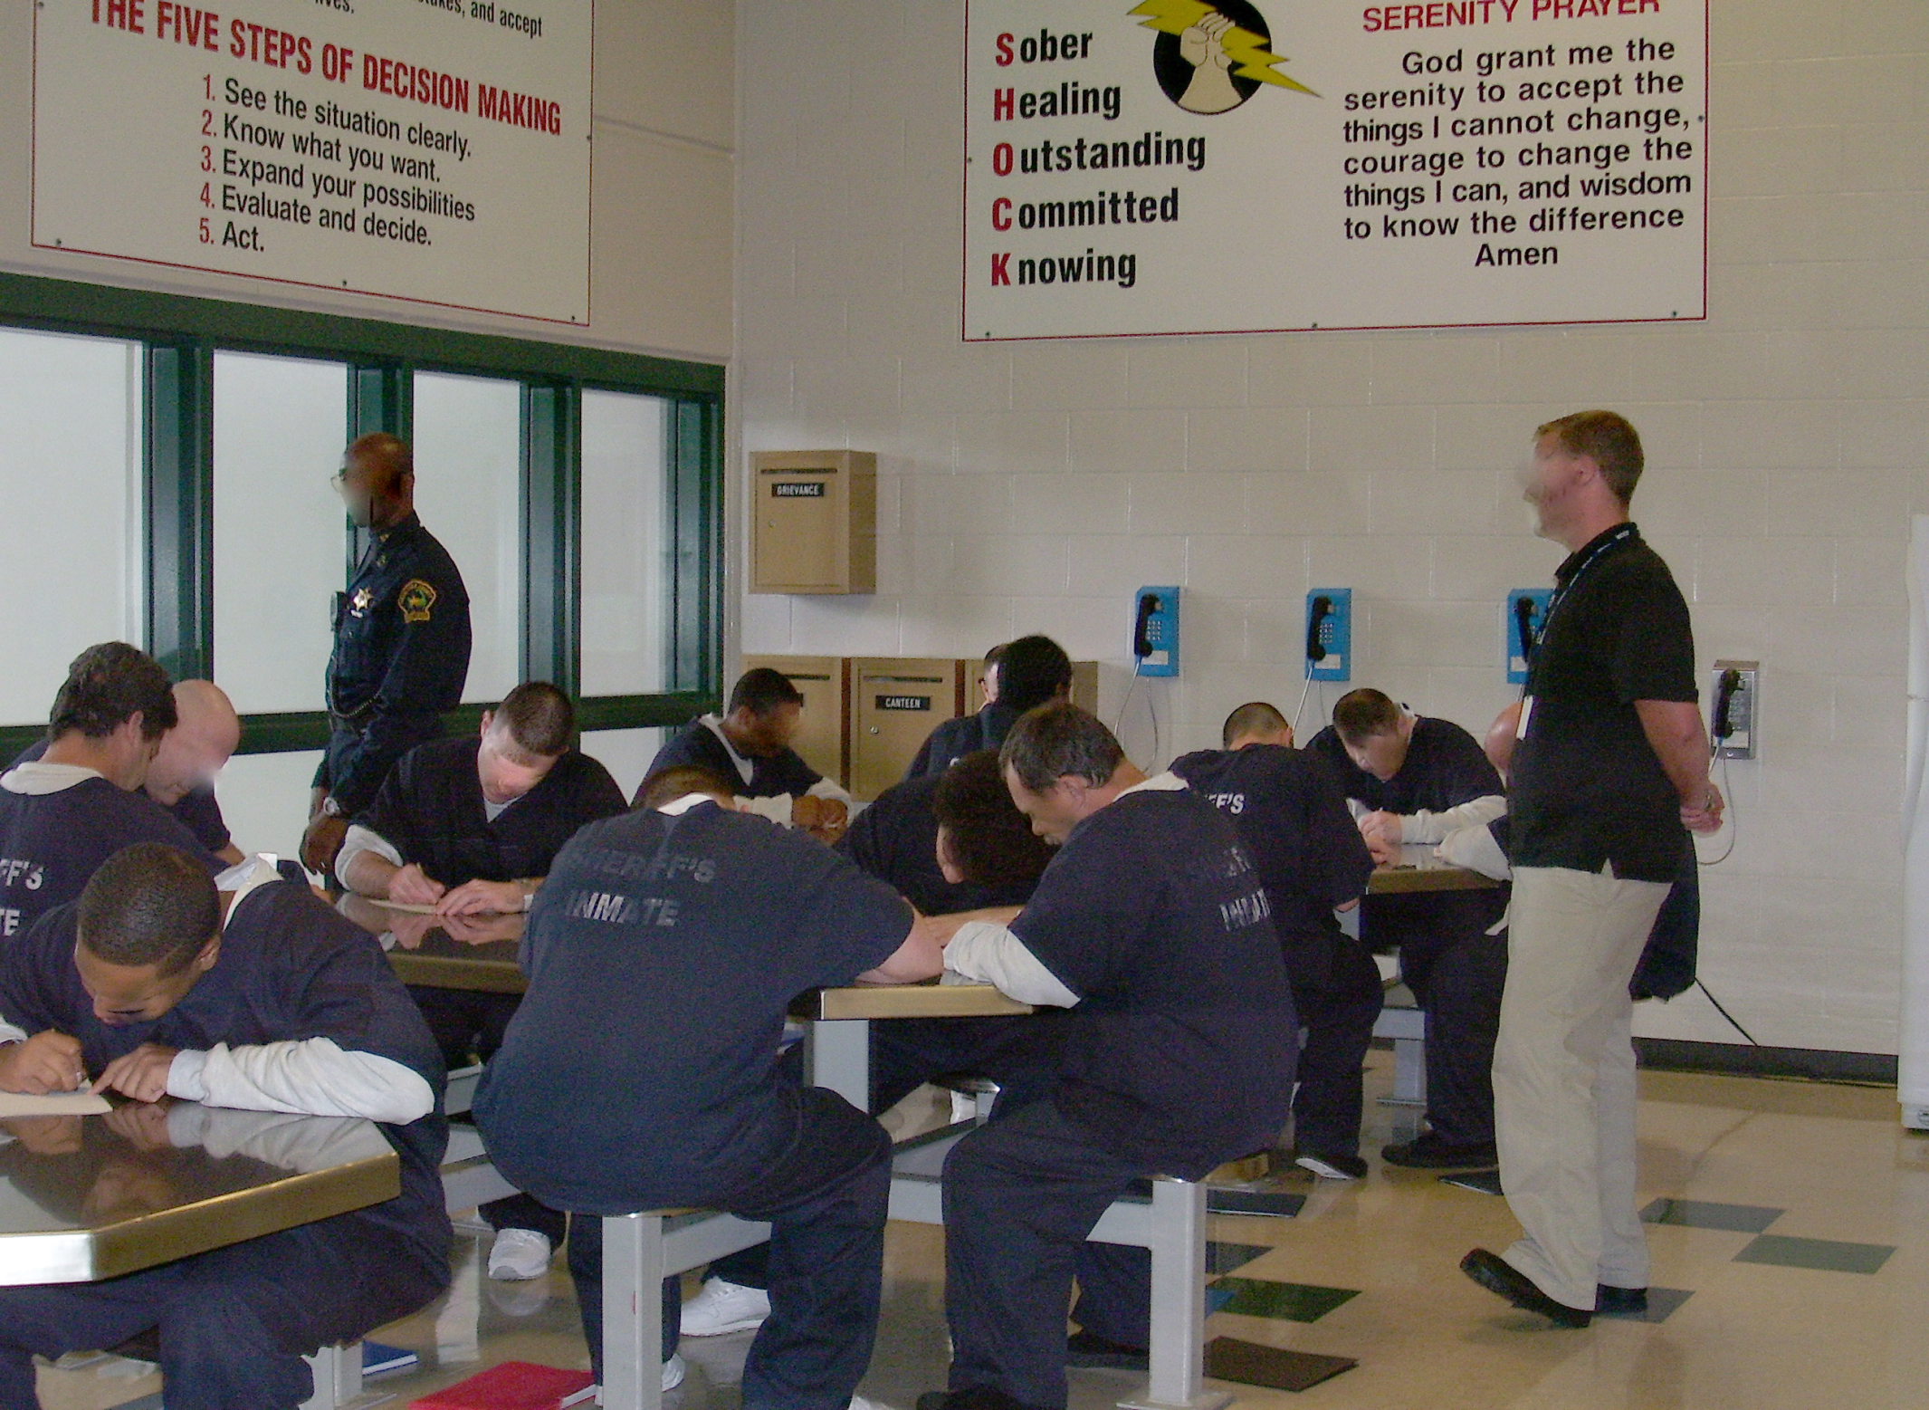

Slide 34
Shared Expectations Among Staff
ALL staff follow consistent rules and schedules every day and every shift
      Orderly entrance to groups, chow, morning inspections
      Guidelines should be agreed upon and followed by all
      staff
ALL staff model the behaviors that RSAT community members are taught.
      Listen and respond respectively – even when holding
      community member accountable for unacceptable
      behaviors
Notes:
34

Slide 35
Shared Expectations Among Staff
  ALL staff will emphasize praise for positive efforts rather than punishment for mistakes.
  Address inappropriate behavior as much as possible within the program as opposed to disciplining community members out of the program.
  ALL staff will combine efforts to address inappropriate behaviors.
Notes:
35

Slide 36
Shared Expectations Among Staff
  ALL staff will be able and willing to run a community meeting or other appropriate program service.
  Confrontation should focus on negative behavior and attitudes and not on the individual.
  Professional staff will refrain from the use of coarse language and outbursts of anger.
Notes:
36

Slide 37
Shared Expectations Among Staff
Both Treatment and Correctional Staff are expected to know:
  Program Standards
  Program Philosophy
  Program Benchmarks
  Program Objectives
Notes:
37

Slide 38
Shared Expectations Among Staff
Both Treatment and Correctional Staff are expected to attend and participate in relevant program activities:
  Daily Meetings
  Officer Meetings
  Weekly Meetings
  Community Meetings
Notes:
38

Slide 39
Shared Expectations Among Staff
Both Officers and Treatment Staff are involved in:
  Learning Experiences for RSAT Participants (disciplinary decisions)
  30-Day Reviews which includes when participants are ready to move on to the next step of the program
  Accessing client assessment
  Attending weekly treatment / clinical meetings
  Regular Clinical Supervision
Notes:
39

Slide 40
Shared Expectations Among Staff
Both Officers and Treatment Staff are involved in:
  Cross-Training to the Greatest Extent Possible.
  In an ideal scenario:
  Officers trained in the implementation of assessment instruments, MI techniques,
  Accountability Training, addiction related trainings
  Treatment staff attend week-long therapeutic community / officer training and other security training sessions
Notes:
40

Slide 41
Example of Staff Rules (developed by RSAT custody / treatment staff)
Staff will not intentionally “set up” an inmate.
Staff will not refer to inmates sarcastically.
Staff will emphasize praise for positive efforts rather than punishment for mistakes.
Address bad behavior as much as possible within the Unit as opposed to lugging / disciplining inmates out of the Unit.
Treatment staff and Correctional / Probation/ Parole Officers should combine efforts to address bad behavior.
Avoid public humiliation.
Confrontation should focus on negative behavior and attitudes, not on the individual. Staff will establish a base of respect.
Staff are capable and willing to run a community meeting.
Staff refrains from the use of coarse language and outbursts of anger.
Notes:
41

Slide 42
Techniques to develop collaborative RSAT Team
Maintain offices in close proximity to one another within the same Unit.
Frequent daily communication with one another.
Eat lunch with each other.
Attend Training together.
Plan Program Activities together, especially rule changes, procedural changes, etc.
Notes:
42

Slide 43
Techniques to develop collaborative RSAT Team
Programmatic / participant decisions are ALWAYS made collaboratively – NEVER unilaterally (security decisions excluded)
Treatment staff follow / participate in same procedures / rituals as RSAT community members / officers
  Sir, yes Sir
  Addressing colleagues by Title (“Officer Smith, Ms. Jones”)
  Stand when an Officer enters
  Follow same schedule whenever possible
Notes:
43

Slide 44
Potential Pitfalls
Breakdown of communication between Correctional/Probation/Parole Officers and Treatment staff
Lack of Cross Training & Regular Meetings
Arguments between staff on the Unit
Relaxation of rules / decorum between staff while on Unit
Negative core beliefs of staff toward each other / community members
Lack of support from administration
Notes:
44

Slide 45
“People involved in the justice system have many needs deserving treatment, but not all of these needs are associated with criminal behavior.”
- Andrews & Bonta (2006)

Slide 46
Burnout
The Challenge of Continuing to Work Effectively in the Criminal Justice System

Slide 47
Burnout is More Likely …
In a time when counseling and criminal justices staff are being asked to:
    Carry Heavier Caseloads / Inmate Ratios
    Work with Fewer Staff Members / Officers
    Treat Needier Clients (Co-occurring issues, trauma issues, multi-systemic issues)
    Implement Evidence-Based techniques and Measure Performance (Treatment and Criminal Justice)
    Accept less pay/less frequent increase in pay

Slide 48
Predictors of Burnout
Correctional Officers | Substance Abuse Treatment Staff
Ambiguous Work Assignment | Heavy Caseloads
Role Conflict (Morgan et. al, 2002) | Isolation from Peers
Negative Inmates Contact (Dignam, 1986; Lindquist & Whitehead, 1986) | Low pay/program funding
Poor Relationship with Peers | Inability to Detach
No Sense of Purpose | Increased Number of Performance Standards
 | Lack of Clinical Supervision
Sources: Morgan, VanHaveren, Pearson (2002);
Deighton et. al. (2007)

Slide 49
The Burnout Cycle In CJ Programs
Officer
Poorly Defined Role
Lack of Support
Counselor
Heavy, Demanding Caseload
Inadequate Supervision
Administration
Lack of Unified Leadership
Inadequate Staffing
Negative Interactions with Inmates
Depersonalized Relationship with Inmates
Inadequate Self-Care
Poorly Defined Job Descriptions
Poor Communication with Employees and Among Managers

Slide 50
Burnout: What is It?
Burnout is a predictable but avoidable condition associated with work in the helping professions.
Burnout is characterized by:
  Lack of Enthusiasm
  Withdrawal
  Frequent Absenteeism
  Blunting of Empathy and Callousness
  Dehumanizing of Clients
  Fatigue

Slide 51
Burnout: What is It?
  Negativity
  Powerlessness
  Hopelessness
  Lack of Confidence in Skills/Avoidance
  Somatic symptoms including headaches, GI distress, elevated blood pressure, insomnia
  Distress in Personal Life
  Decrease in Healthy Self-Care
  Increase in Maladaptive Coping Behaviors, including Substance Use
  Relapse to Addiction

Slide 52
Burnout: It’s Impact
Clients feel devalued, avoided
Co-Workers may feel concern, a desire to intervene, resentment, a heavier burden to compensate.
The entire staff and program may “catch” the negativity, cynicism and indifference of a burned-out staff member over time without intervention.

Slide 53
There MUST be not just COMMUNICATION
between Correctional Officers and Treatment Staff
but POSITIVE COOPERATIVE RELATIONSHIPS as well.
Notes:
53

Slide 54
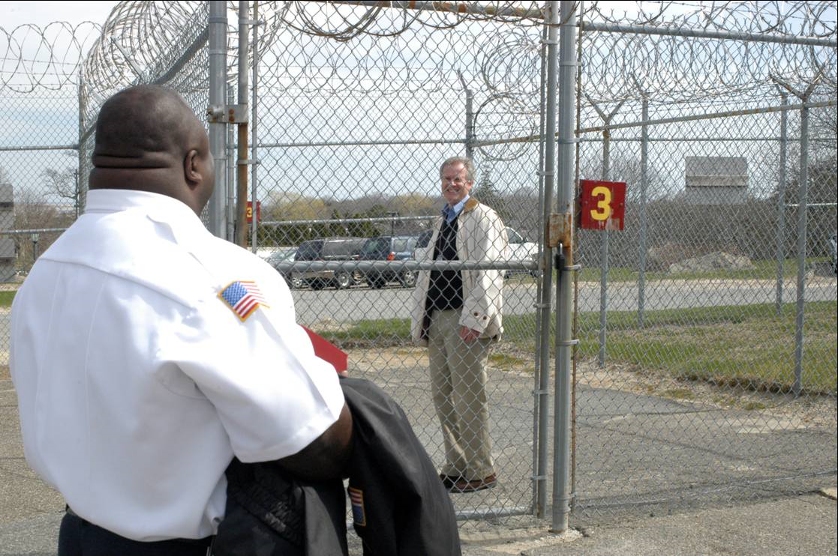

Slide 55
CJ System’s Role in Addressing Treatment Issues
Recognize that immediacy is a key component of the treatment process (Hora, Schma & Rosentahl (1999) Notre Dame Law Review)
Detox is only the first stage of treatment and by itself does little to change long-term substance abuse
Remaining in treatment for an adequate period of time is critical
Proper assessment is primarily the responsibility of service providers but all supervising / court officers should be concerned
Drug Courts: The Second Decade, NIJ, 2006
Notes:
Research indicates that drug courts can reduce recidivism and promote other positive outcomes.
By quickly placing an offender before a judge, the drug treatment court creates an immediate crisis for the offender and can force substance abusing behavior into the open, making denial difficult (U.S. Department of Justice 1997). In their study of the Denver drug court, Granfield, Eby, and Brewster (1998) state that "the sooner an offender receives treatment after an arrest/violation/positive drug test, the more likely the intervention will be effective." Other drug treatment literature suggests that a processing delay or allowance for continuances fail to compel an offender to confront their drug use and criminal behavior (White and Wright 1998).
Although medically assisted detoxification can safely manage the acute physical symptoms of withdrawal and, for some, can pave the way for effective long-term addiction treatment, detoxification alone is rarely sufficient to help addicted individuals achieve long-term abstinence. Thus, patients should be encouraged to continue drug treatment following detoxification.
The appropriate duration for an individual depends on the type and degree of his or her problems and needs. Research indicates that most addicted individuals need at least 3 months in treatment to significantly reduce or stop their drug use and that the best outcomes occur with longer durations of treatment. Recovery from drug addiction is a longterm process and frequently requires multiple episodes of treatment.
Proper assessment and treatment of offenders is primarily the responsibility of service providers, but all court
team members should be concerned with the integrity of treatment planning, service delivery, and performance
reporting (including drug test results). Teams that are educated in addiction and substance abuse theory,
treatment approaches, and relapse prevention are better able to ensure that offender needs are met.

Slide 56
CJ System’s Role in Addressing Treatment Issues
Drug / Alcohol use during treatment must be monitored continuously, as lapses during treatment do occur
Treatment / service plans must be assessed continually and modified as necessary to ensure that it meets the client’s changing needs
Principles of Drug Addiction Treatment – NIDA, 2009
Notes:
Drug use during treatment must be monitored continuously, as lapses during treatment do occur. Knowing their drug use is being monitored can be a powerful incentive for patients and can help them withstand urges to use drugs. Monitoring also provides an early indication of a return to drug use, signaling a possible need to adjust an individual’s treatment plan to better meet his or her needs.
An individual’s treatment and services plan must be assessed continually and modified as necessary to ensure that it meets his or her changing needs. A patient may require varying combinations of services and treatment components during the course of treatment and recovery. In addition to counseling or psychotherapy, a patient may require medication, medical services, family therapy, parenting instruction, vocational rehabilitation, and/or social and legal services. For many patients, a continuing care approach provides the best results, with the treatment intensity varying according to a person’s changing needs.
Effective treatment attends to multiple needs of the individual, not just his or her drug abuse. To be effective, treatment must address the individual’s drug abuse and any associated medical, psychological, social, vocational, and legal problems. It is also important that treatment be appropriate to the individual’s age, gender, ethnicity, and culture.
Offenders report that interactions with the judge are one of the most important influences on the experience they have while in the program. They respond to the judge’s interpersonal skills and ability to resolve legal problems expeditiously and provide ready access to services. Offenders who interact with the same judge, rather than multiple judges, may be more likely to comply with program demands.
Family involvement in substance abuse treatment is positively associated with increased engagement rates for entry into treatment, decreased dropout rates during treatment, and better long-term outcomes. (Substance Abuse Therapy and Family Therapy – Tip 39 – SAMHSA/CSAT, 2005)

Slide 57
CJ System’s Role in Addressing Treatment Issues
Effective treatment attends to multiple needs of the individual, not just his or her substance abuse.
Criminal justice involved clients report that interactions with the Judge are one of the most important influences on the experience they have while in treatment.
Ensure family involvement whenever possible during the treatment process.
Principles of Drug Addiction Treatment – NIDA, 2009
Notes:
Drug use during treatment must be monitored continuously, as lapses during treatment do occur. Knowing their drug use is being monitored can be a powerful incentive for patients and can help them withstand urges to use drugs. Monitoring also provides an early indication of a return to drug use, signaling a possible need to adjust an individual’s treatment plan to better meet his or her needs.
An individual’s treatment and services plan must be assessed continually and modified as necessary to ensure that it meets his or her changing needs. A patient may require varying combinations of services and treatment components during the course of treatment and recovery. In addition to counseling or psychotherapy, a patient may require medication, medical services, family therapy, parenting instruction, vocational rehabilitation, and/or social and legal services. For many patients, a continuing care approach provides the best results, with the treatment intensity varying according to a person’s changing needs.
Effective treatment attends to multiple needs of the individual, not just his or her drug abuse. To be effective, treatment must address the individual’s drug abuse and any associated medical, psychological, social, vocational, and legal problems. It is also important that treatment be appropriate to the individual’s age, gender, ethnicity, and culture.
Offenders report that interactions with the judge are one of the most important influences on the experience they have while in the program. They respond to the judge’s interpersonal skills and ability to resolve legal problems expeditiously and provide ready access to services. Offenders who interact with the same judge, rather than multiple judges, may be more likely to comply with program demands.
Family involvement in substance abuse treatment is positively associated with increased engagement rates for entry into treatment, decreased dropout rates during treatment, and better long-term outcomes. (Substance Abuse Therapy and Family Therapy – Tip 39 – SAMHSA/CSAT, 2005)

