Slide 1
The Residential Substance Abuse Treatment (RSAT) Aftercare Study: Major Findings
Kristin Stainbrook, Ph.D.
6th Annual RSAT TTA Meeting
Louisville, KY
August 2, 2017
This study was supported by grant number MU-CX-0057 awarded by the National Institute of Justice, Office of Justice Programs, U.S. Department of Justice. The opinions, findings, and conclusions or recommendations expressed in this presentation are those of the authors and do not necessarily reflect those of the Department of Justice.
.

Slide 2
Study Goal
The goal of this study is to provide programmatic information about the treatment and aftercare services funded by the Bureau of Justice Assistance (BJA) Residential Substance Abuse Treatment (RSAT) for State Prisoners Formula Grant Program, to help understand the extent to which RSAT-funded programs are fulfilling their mandate under the Second Chance Act of 2007 to connect participants to aftercare services.

Slide 3
Study Aims and Research Questions
AIM 1. Understand how states use BJA RSAT funds for treatment and aftercare services.
1.1. How do states decide what services to fund with RSAT dollars? 1.2. How do states assure RSAT-funded programs are connected to aftercare? 1.3. What is the relationship between states and RSAT-funded programs?
AIM 2. Describe the specific substance use disorder treatment and other services supported by BJA RSAT grants and the nature of these services.
2.1. What specific substance use disorder treatment services are supported through RSAT funding and how do services and programmatic characteristics vary by facility type (prison, jail)? 2.2. What types of evidence-based practices or other specific program models are used by RSAT grantees? 2.3. What types of substance use disorder treatment and related services are provided to individuals transitioning to the community, generally?
AIM 3. Describe aftercare services supported by BJA RSAT grants and other sources, as well as the challenges and facilitators to implementing aftercare.
3.1. What types of aftercare services are supported through RSAT funding? 3.2. What aftercare services are available to RSAT participants transitioning to the community, generally? 3.3. What challenges or facilitates the implementation of aftercare for individuals transitioning to the community, including pre-release planning?

Slide 4
Study Design
Two major data collection activities:
  State Coordinator Program Inventory to understand states’ approaches to distributing RSAT funds, including aftercare
  Subgrantee Program Inventory to document RSAT-funded program activities and approaches for treatment and aftercare
Aftercare is broadly defined as any community-based step-down treatment or case management services to support ex-offenders’ recovery.

Slide 5
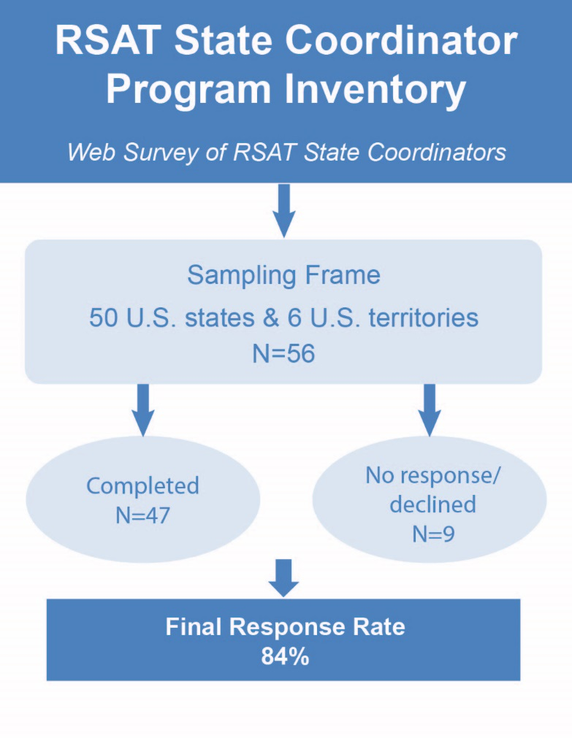
State Coordinator Program Inventory Sample & Methods
Administered as a web survey; primarily close-ended questions
Questions center on:
  process for distributing funds
  use of additional federal or state funding sources to support RSAT
  dedicated funding for aftercare
  role of RSAT Point of Contact (PoC)

Slide 6
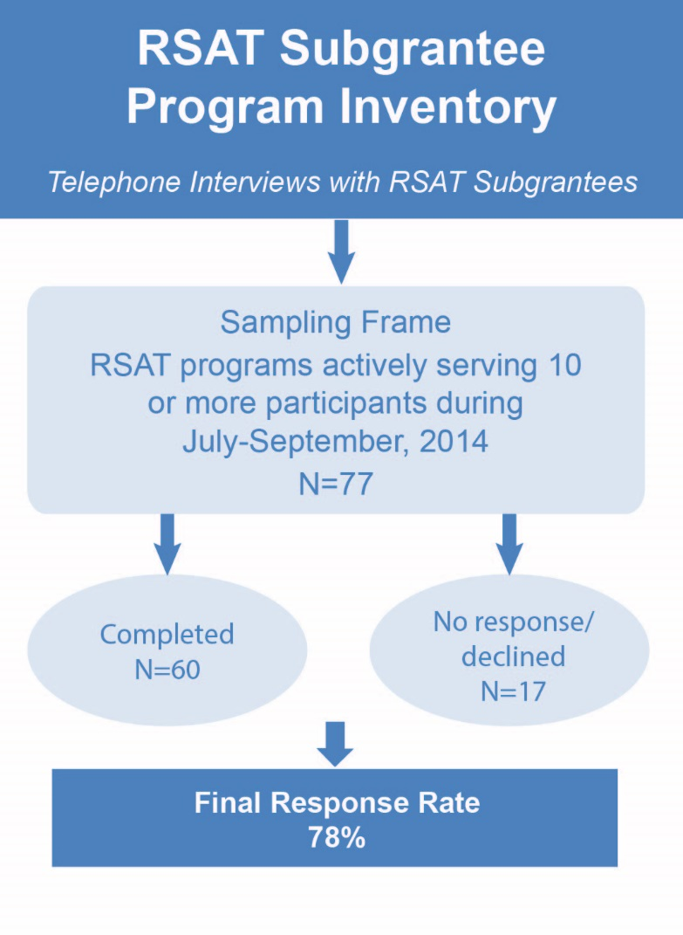
RSAT Subgrantee Program Inventory Sample & Methods
Administered as a telephone interview; mix of close- and open-ended questions
Questions center on:
  program setting and enrollment criteria
  screening and assessment procedures
  types of services and evidence-based practices
  pre-release planning activities
  aftercare-related activities
  barriers and facilitators to aftercare
Notes:
Talk about details of sampling frame: some states may fund multiple programs, others may have one, and some states may have no active programs during a given quarter. To ensure that we would be reaching out to active programs, we chose to focus on a single reporting quarter using the most current PMT data- July-September 2014. Due to large amount of resources telephone interviews entail, programs that served fewer than 10 individuals in the reporting quarter were excluded. However given the focus of the study, all aftercare programs identified in the PMT data were included in the sample regardless of the number of individuals served.

Slide 7
State Inventory Findings

Slide 8
Major Findings from State Inventory
Distribution of RSAT Funds
About two-thirds of states (64%, n=30) adopted a funding process that makes RSAT monies available on a competitive basis.
  Some states use RSAT funds as seed money or to launch new programs.
A little more than half of states (51%, n=24) report use of other funds to support RSAT programming.
  Resources must be leveraged from other resources to fully fund programming.
  Although this approach allows local innovation and targeting of a tailored set of needs, it does not allow establishment of a comprehensive model.
Notes:
In some states, it appears that RSAT resources are used as seed money to launch or enhance programming. Several of the aftercare services funded under RSAT were used to fill a specific programmatic gap in a community and enhance existing treatment services.

Slide 9
Major Findings from State Inventory
Funding for Aftercare
Despite the BJA requirement that RSAT programs assure connections to aftercare programs, only 55% (n=23) reported they require RSAT subgrantees to provide aftercare services, and even fewer reported using RSAT funds specifically for aftercare (29%, n=12).
Reported reasons aftercare is not required:
  Other state resources for aftercare are available to RSAT participants
  Resources for aftercare are too limited to require these services
Notes:
Several respondents explicitly indicated that all RSAT funds are needed to support facility-based programming in their state.

Slide 10
Major Findings from State Inventory
PoC Involvement in Programmatic Activities
RSAT Point of Contact (PoC) Activities (n=45)
Types of Activities with Subgrantees | Frequently % (n) | Sometimes % (n) | Not at all % (n)
Review quarterly PMT data | 93% (41) | 7% (3) | ---
Monitor contracts | 64% (29) | 23% (10) | 11% (5)
Monitor program implementation | 50% (22) | 46% (20) | 5% (2)
Conduct monitoring visits | 42% (19) | 47% (21) | 11% (5)
Involved with quality improvement issues | 29% (13) | 36% (16) | 36% (13)
Involved with treatment quality issues | 18% (8) | 31% (14) | 51% (23)
Involved with client eligibility issues | 15% (7) | 24% (11) | 60% (27)
Percentages may vary due to missing data.
Notes:
Only a small percentage of POCs are actively involved in treatment quality or client eligibility issues. This finding suggests that RSAT programs across the country lack a consistent official responsible for uniform oversight of the program’s essential treatment activity.

Slide 11
Major Findings from State Inventory
PoC Involvement in State Level Activities
Most state PoCs do not report significant involvement with state policy issues related to substance use treatment or corrections.
  83% (n=38) are highly involved in how funds are distributed
  22% (n=8) report “quite a bit” of involvement with state policy issues related to substance use treatment or corrections
PoC position titles vary
  Most common is grant management/admin. (n=12)
Mean tenure 5.5 years
  24% (n=11) in position less than year
  19% (n=8) ten years and longer
Notes:
POCs were asked about their involvement in stats level activities- found that while most are involved RSAT funding state policy issues- or state legislative programming, or DOC health policies.
This is less surprising when we consider the POC position- which most often had to do with grants management- and the fair number of only a few years in that role.
These data suggest that many POCs may are not highly involved with state level activities and as a result, they play no role in shaping overall correctional department policies to ensure that they are consistent with or supportive of RSAT programs. Additionally, POCs may not be knowledgeable about issues relevant to RSAT programs, potentially missing opportunities to support and leverage resources for programming.

Slide 12
Subgrantee Inventory Findings

Slide 13
Major Findings from Subgrantee Inventory
Types of Programs Funded
The majority of RSAT funds are used to support treatment services provided in correctional settings (85%, n=53); less than a fifth of programs use RSAT funds to support step-down treatment or aftercare services (18%, n=11).
Although the recent lifting of the 10% funding restriction (2013) for community-based services may partially account for the small number of aftercare programs, it is more likely that states have chosen to focus on correctional-based treatment services because of the limited funding available for the RSAT program.
Notes:
Respondents reported that the need for treatment services for offenders is high, and it is challenging to determine the most effective use of limited funds.

Slide 14
Major Findings from Subgrantee Inventory
Screening & Assessment Practices
RSAT Program Screening Activities (n=60)
Although almost all prison programs (95%, n=20) reported substance use problem screening, only two-thirds of jail programs (63%, n=12) did so.
Type of Screening | Programs that Conduct Screening % (n) | Programs that Conduct Screening with a Valid Instrument % (n)
Substance use problems | 97% (58) | 77% (46)
Risk assessment | 87% (52) | 67% (40)
Mental health problems | 85% (51) | 32% (19)
Trauma symptoms | 40% (24) | 23% (14)
Notes:
Reported utilization of valid screening/assessment instruments for substance use problem problems was surprisingly low in jail-based treatment programs (63%, n=12).
Use of valid mental health screening/assessment instruments was reported among fewer than one-third of programs, despite the fact that the overlap between substance use and mental health problems is well-documented.

Slide 15
Major Findings from Subgrantee Inventory
Evidence-Based Practices
Ninety-five percent (n=57) of programs reported providing at least one EBP to 75–100% of participants.
  Cognitive behavioral therapy (CBT) was the most common EBP among correctional-based treatment programs (78%, n=40).
  Motivational interviewing (MI) was the most common EBP among aftercare (82%, n=9) programs.
Notes:
The fact that this NIDA principle was not highly endorsed suggests that this may be an area for technical support. Future research should examine staff training and fidelity assessment for EBPs.

Slide 16
Major Findings from Subgrantee Inventory
NIDA Principles Endorsed
Proportion of NIDA Principles Endorsed by RSAT Correctional Programs (n=53)
Principle | Study Indicator | % (n)
Drug use should be monitored | Drug testing conducted | 100% (53)
Criminal justice supervision should incorporate TX planning; planning should incorporate transition to community | Program does treatment planning and transitional planning | 87% (46)
Assessment is the first step in treatment | Program conducts substance use screening/assessment using valid instrument | 79% (42)
TX must last long enough to produce results | Program length is longer than 3 months | 76% (40)
A balance of rewards and sanctions encourages participation | Use of both rewards and sanctions | 74% (39)
Offenders with co-occurring disorders require integrated TX | Program has co-occurring services available | 57% (30)
Continuity of care is essential for re-entry | Program connects RSAT participants to aftercare program services | 53% (28)
TX should fit the needs of the individual | Program may adjust TX sessions & intensity of service based on clinical needs of client | 45% (24)
Treatment should target criminal behavior | Program has criminal thinking EBP | 45% (24)
TX planning for re-entry should include strategies to prevent and treat serious illness | Connection to medical services post-release | 36% (19)
Medications are an important part of TX | Linkage to medication-assisted TX (MAT) post-program | 23% (12)
Notes:
One of the research goals of this study is to identify if treatment and aftercare services are science-based. Using the National Institute of Drug Abuse’s (NIDA) landmark publication Principles of Drug Abuse Treatment for Criminal Justice Populations to partially guide our research in this area, we sought to understand the extent to which RSAT programs incorporate these principles. Revised in 2014, the NIDA guide outlines 13 research-based treatment principles relevant to criminal justice populations (NIDA, 2014).
A sizable majority incorporated basic treatment principles such as drug testing, treatment planning, and screening/assessment for SUD in their programs, while they were least likely to provide connections to medical services or linkages to medication-assisted treatment post program.

Slide 17
Major Findings from Subgrantee Inventory
Transitional Planning & Aftercare
Although almost all facility-based programs reported providing transitional planning services to RSAT participants prior to release (98%, n=50), almost half are missing the connection to community-based aftercare programs that can provide recovery supports that help prevent relapse or re-offense (53%, n=28).
Twice as many jail programs use a personal contact to connect offenders to substance use providers (65%, n=12) than prisons (29%, n=6).
Notes:
Not only are there limited referrals to aftercare, there is little connection to the community based programs to assure that it occurs at all.

Slide 18
Major Findings from Subgrantee Inventory
RSAT-Funded Aftercare
Identification/referral process
  Seven programs link directly to RSAT program.
  Four programs in-reach/outreach to a facility.
Settings for services
  Four programs provide residential treatment.
  Seven programs provide case management that coordinates outpatient treatment services.
Four programs report access to Medication-Assisted Treatment (MAT).
Notes:
Three programs reported referrals from “RSAT” programs, which may not have been funded by BJA resources and were not reported in PMT data, and thus not included in the subgrantee sample frame.

Slide 19
Major Findings from Subgrantee Inventory
Aftercare Challenges and Strategies
Common Challenges and Strategies for Implementing Aftercare Programs
Enrolling participants in aftercare and engaging them in post-release services
Meet/engage with offenders before release; provide “familiar face” once in the community. Use ex-offenders to “sell” program before release; serve as program mentors.
Limited community services/resources: treatment, housing, transportation
Program leadership involvement in community re-entry initiatives/workgroups helps leverage resources.
Partnering with treatment agency capitalizes on internal resources and community connections.
Retaining clients, client relapse, & preventing parole/probation violations
Collaboration between treatment and community corrections creates opportunities to intervene and intensify treatment.
Motivational interviewing skills, connections to community resources.

Slide 20
Conclusions
The RSAT program represents an important funding source for offender substance use problem treatment.
  Many states rely on these funds to fill treatment gaps in their correctional systems, and reductions in RSAT funding in the past decade have been acutely felt by state and subgrantee respondents.
Although BJA’s removal of the 10% limitation for community treatment has allowed some communities to creatively use RSAT funds for aftercare services, RSAT resources are not sufficient to take on new aftercare programming activities.
  Treatment and resource gaps in communities prevent many RSAT-funded programs from fulfilling the legislative mandate to provide aftercare.

Slide 21
BJA RSAT Funding Allocations between 1996-2004*
*Data from some years were not available, and there are several years when an RSAT Request for Proposal (RFP) was not issued
2000-2011 RSAT Formula Grant Allocations https://www.bja.gov/Funding/05RSATAllocations.pdf https://www.bja.gov/Funding/06RSATAllocations.pdf, https://www.bja.gov/Funding/07RSATAllocations.pdf, https://www.bja.gov/Funding/09RSATallocations.pdf, https://www.bja.gov/Funding/10RSATAllocations.pdf; https://www.bja.gov/Funding/2011_RSAT_Alloc.pdf; https://www.bja.gov/Funding/12RSATAllocations.pdf, https://www.bja.gov/Funding/12RSATAllocations.pdf, https://www.bja.gov/Funding/13RSATAllocations.pdf, https://www.bja.gov/Funding/14RSATAllocations.pdf; Bureau of Justice Assistance. (2005). Residential Substance Abuse Treatment for State Prisoners (RSAT) Program, Program Update, U.S. Department of Justice, Office of Justice Programs, Bureau of Justice Assistance. http://www.prnewswire.com/news-releases/states-receive-first-installment-of-fy-1998-prison-funds-and-funds-to-continue-drug-testing-and-treatment-initiatives-77244117.html

Slide 22
Conclusions
The widespread provision of EBPs is a strength of the RSAT programs, however training and fidelity assessment activities to support EBPs was not addressed in this research.
Many state PoCs are not highly involved in RSAT program implementation, which may mean that aftercare and pre-release activities are not likely to receive priority attention.
For RSAT programs to achieve their fullest potential, they will require not only more resources, but consistent leadership on a statewide basis to ensure that inmate treatment and continuity of care is not only a correctional priority, but a public health priority.

