Slide 1
Washington State DSHS Integrated Client Database (ICDB)
Division of Behavioral Health and Recovery
Earl Long, Behavioral Health Administrator
Ahney King, Behavioral Health Criminal Justice Administrator
August 2, 2017

Slide 2
DSHS ICDB – What is it?
A longitudinal client database containing over a decade of detailed service risks, history, costs, and outcomes. Information is drawn from over 30 data systems across and outside of DSHS.
This information is used to:
Support cost-benefit and cost offset
Provide analyses, program evaluations, operational program decisions
geographical analyses and in-depth research

Slide 3
DSHS ICDB – Why?
Provides an explanation for the state’s social services for the 2.4 million DSHS clients served each year.
The ICDB is the only place where all the DSHS client information comes together. This central client database, provides a current and historical look into the life experiences of Washington residents and families who encounter the state’s social service system.

Slide 4
DSHS ICDB – Confidentiality
Strict confidentiality standards are in place to ensure protection of personal client information
Strict adherence to human subjects review applies to all research conducted from this central client database
Data management is HIPAA compliant
Meets 42 CFR confidentiality requirements

Slide 5
DSHS ICDB – What kind of data
Service spans and costs Residential history Sex, race/ethnicity and citizenship Births to Washington residents and parent/child links through Support Enforcement Length and type of social services received and their costs Medical coverage Health status, medical encounters, and prescriptions Mental health status and services Alcohol and drug problems and treatment Developmental disability services Severity of health problems, functional health status | Economic services and child support enforcement Out-of-home placement episodes and events Adult and juvenile criminal justice events (arrests, convictions, and incarcerations) Juvenile rehabilitation services Employment information (wages, hours and industry type) Vocational rehabilitation services Disabling health conditions and long-term care services Status and spells of homelessness Death and its causes

Slide 6
Dental Services
Medical Eligibility Medicaid, State Only
Hospital Inpatient/ Outpatient
Managed Care
Physician Services
Prescription Drugs
Housing Assistance
Emergency Shelter
Transitional Housing
Homeless Prevention and Rapid Re-housing
Permanent Supportive Housing
Public Housing
Housing Choice Vouchers
Multi-Family Project-Based Vouchers
Arrests
Charges
Convictions
Incarcerations
Community Supervision
Hours
Wages
Births
Deaths
Administrative
Office
of the Courts
Employment
Security Department
Housing
and Urban Development Public Housing Authority
Washington State Patrol
Department
of Corrections
Health Care Authority
Department
of Health
Department
of Commerce
External
WASHINGTON STATE
Department of Social and Health Services
Integrated Client Databases
Internal
DSHS
Aging and Long-Term Support
DSHS Children’s Services
DSHS
Developmental Disabilities
DSHS
Behavioral Health and Service Integration
Mental Health and Substance Abuse Services
DSHS
Economic Services
DSHS
Juvenile
Rehabilitation
DSHS
Vocational Rehabilitation
Nursing Facilities
In-home Services
Community Residential
Functional Assessments
Child Protective Services
Child Welfare Services
Adoption
Adoption Support
Child Care
Out of Home Placement
Voluntary Services
Family Reconciliation Services
Case Management
Community Residential Services
Personal Care Support
Residential Habilitation Centers and Nursing Facilities
Assessments
Detoxification
Opiate Substitution Treatment
Outpatient Treatment
Residential Treatment
Child Study Treatment Center
Children’s Long-term Inpatient Program
Community Inpatient Evaluation/ Treatment
Community Services
State Hospitals State Institutions
Food Stamps
TANF and State Family Assistance
General Assistance
Child Support Services
Working Connections Child Care
Institutions
Dispositional Alternative
Community Placement
Parole
Medical and Psychological Services
Training, Education, Supplies
Case Management
Vocational Assessments Job Skills

Slide 7
DSHS ICDB – Dashboards
ICDB is used to create profiles, know as dashboards, as a way of describing services
Dashboards are available for anyone’s use. Current dashboard are located at:
https://www.dshs.wa.gov/sesa/research-and-data-analysis/dashboards
Next are a few snap shots from the dashboard of drug courts

Slide 8
DSHS ICDB – Snapshots

Slide 9
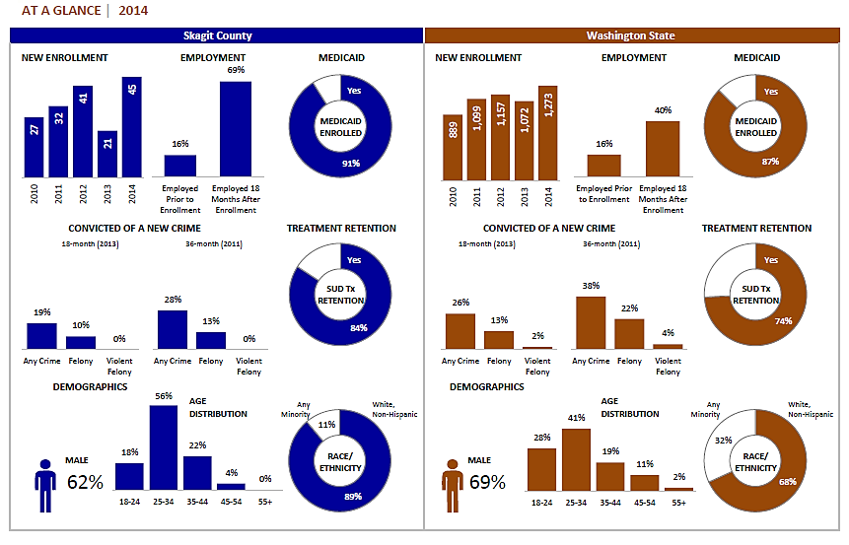
DSHS ICDB – Snapshots

Slide 10
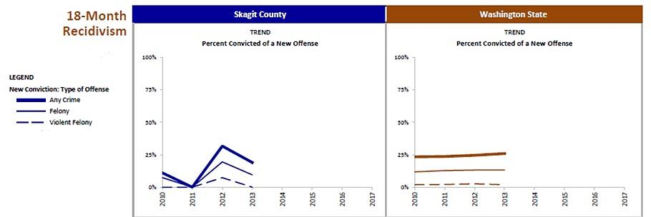
DSHS ICDB – Snapshots

Slide 11
DSHS ICDB – Snapshots

Slide 12
DSHS ICDB – Jails and RSAT
Well, we are not quite there yet with a dashboard
Why?
Jail data was not one of the data sources in the ICDB until this year
Data was not available until the Washington State Legislature passed legislation that required jails to collect data in a uniform fashion
Work is on-going with jails to develop methods to uniformly collect and submit data

Slide 13
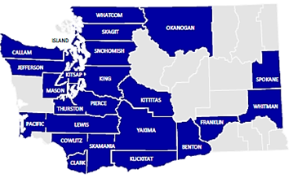
DSHS ICDB – Jails and RSAT
Washington has only one RSAT project, which is housed in the Skagit County jail
The county population is 123,000
Located 60 miles north of Seattle, Skagit County’s primary sources of employment are agriculture and tourism
A new jail will open in September 2017 and will house 400 inmates

Slide 14
DSHS ICDB – RSAT Treatment Data
Although we do not have a dashboard, we do have a few snapshots of data showing what happened to individuals who left the program:
Of 137 people who participated in RSAT between January 2014 and June 2017 :
Substance Use Disorder (SUD) Treatment Admissions in the 6-Months Following RSAT Release
 | Completed RSAT Tx (n=37) | Did Not Complete RSAT Tx (n=100)
Any Admission | 24 (65%) | 46 (46%)
None | 13 (35%) | 54 (54%)
SUD Treatment Admissions in the 6-Months Following RSAT Release
 | Completed RSAT Tx (n=24) | Did Not Complete RSAT Tx (n=46)
SUD Tx Modality
Outpatient | 23 (62%) | 41 (41%)
Long Term Residential | 6 (16%) | 10 (10%)
Intensive Inpatient |  | 2 (2.0%)
note: Clients had multiple admission during the 6-month timeperiod following RSAT Release

Slide 15
DSHS ICDB – RSAT Arrest Data
Of 137 people who participated in RSAT between January 2014 and June 2017:
Arrest Status in the 6-months Following Release from RSAT
 | Completed RSAT Tx (n=37) | Did Not Complete RSAT Tx (n=100)
Not Arrested | 24 (65%) | 46 (46%)
Arrested | 13 (35%) | 54 (54%)
Arrest Class Among Those Arrested in the 6-months following Release from RSAT
 | Completed RSAT Tx (n=13) | Did Not Complete RSAT Tx (n=54)
Felony | 11 (85%) | 35 (65%)
Gross Misdemeanor | 7 (54%) | 43 (80%)
Unknown | 6 (46%) | 24 (44%)
Misdemeanor | 2 (15%) | 17 (31%)
note: Clients might have been arrested for crimes in multiple arrest classes. Often multiple charges are filed for a single arrest event.

Slide 16
DSHS ICDB – RSAT Arrest Data
Of 137 people who participated in RSAT between January 2014 and June 2017:
Crime Type Among Those Arrested in the 6-months following Release from RSAT
 | Completed RSAT Tx (n=13) | Did Not Complete RSAT Tx (n=54)
Theft/Burglary | 10 (77%) | 35 (65%)
Alcohol/Drug Related | 7 (54%) | 25 (46%)
Tresspass/Malicious Mischief | 2 (15%) | 14 (26%)
Assault/Harassment | 1 (7.7%) | 11 (20%)
DV, Child Abuse, related | 1 (7.7%) | 9 (17%)
Probation /Supervision/Contempt | 1 (7.7%) | 16 (30%)
Reckless/Negligent Driving | 1 (7.7%) | 3 (5.6%)
Sex Related | 1 (7.7%) | 1 (1.9%)
Vehicle License Related | 1 (7.7%) | 7 (13%)
Weapons Related | 1 (7.7%) | 3 (5.6%)
DUI |  | 5 (9.3%)
Fail to comply |  | 7 (13%)
note: Clients might have been arrested for crimes in multiple categories. Often multiple charges are filed for a single arrest event.

Slide 17
Questions?
Please contact either:
Earl Long at 360-725-9985, earl.long@dshs.wa.gov
Ahney King at 360-725-3753, ahney.king@dshs.wa.gov

