Slide 1
The Role of the Corrections Officer in RSAT Programs Tuesday, August 1st, 2017

Slide 2
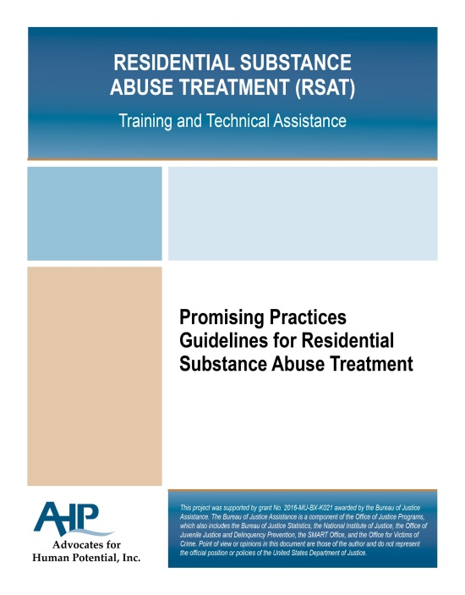
Coming Soon!
Manual on promising practices for the Role of the Corrections Officer in RSAP Programs

Slide 3
The Purpose of the RSAT Corrections Officer
Maintain the safety and security of the RSAT facility and play a cooperative role in the success of the therapeutic community
Cooperation and continuous communication between RSAT staff and corrections are essential to the autonomous functioning of the therapeutic community.

Slide 4
Golden Rule of RSAT Corrections Officer
Correctional officers must understand RSAT programming and be as committed to treatment goals as RSAT counselors and administrators.
Requires voluntary self-referral into RSAT programming
Certify and reward officers who want to work in RSAT

Slide 5
Orientation of the Corrections Officer
All RSAT CO’s should receive orientation in:
The Science of Addiction
Criminogenic Risk-Need-Responsivity
Understanding of the modified Therapeutic Community (TC)
4 Promising Practice TC’s
Minnesota Department of Correction substance use disorder treatment program
Forever Free Program at the California Institute for Women
Amity In-Prison Therapeutic Community
Delaware Department of Correction Key/Crest programs

Slide 6
Modified Therapeutic Community
Structure of the Modified Therapeutic Community includes:
Orientations to acquaint clients to the rules
Individual and group counseling
Maintaining recovery and relapse prevention
Reentry planning

Slide 7
Modified Therapeutic Community
Components of the Modified Therapeutic Community include:
Community meetings, events and ceremonies
Seminars
Group encounters
Group therapy
Tutorial learning sessions
Education classes
Client job-work responsibilities

Slide 8
Modified Therapeutic Community
Rules of the Modified Therapeutic Community include:
Cardinal rules – which protect the community from behaviors that threaten its viability
Major rules – which define the relationship between individual members and community and identify behaviors to be corrected
House rules – which define the “norms” for the community resulting in verbal and written reprimands if violated.
**Institutional rules take precedent over TC rules but CO’s should have familiarity of TC rules to promote recovery of the community

Slide 9
Modified Therapeutic Community
Roles of the Modified Therapeutic Community include:
Corrections officer as the ultimate “Rational Authority”
As rational authorities CO’s are responsible to direct community member’s behavior within the training activities, learning experiences and community scheduling.

Slide 10
Role of the Officer in a RSAT facility
Officers are one of the most influential staff members in the program
Must be familiar with the values and philosophy of the program and model the attitudes of the program
Lack of knowledge by officers of the TC components often causes the concerns of the correctional facility to overwhelm the concerns of the treatment program

Slide 11
Role of the Officer in a RSAT facility
Sanctions
Sanctions are still utilized as consequence of non-compliance (i.e.: positive drug test, no show, prohibited behavior, etc) in RSAT
However, lesser infractions of TC house rules are seen as opportunities for inmates to learn more appropriate behavior. Staff may allow inmate opportunity to redeem a privilege lost initially
Officers need to be aware of how they can leverage the influence of the group with direction from TC staff to promote behavior change in place of traditional sanctions

Slide 12
Role of the Officer in a RSAT facility
Sanctions
When imposing sanctions to a RSAT inmate, it is important for the officer to depersonalize the conflict. This means to depersonalize :
officer authority,
the specific controls an officer imposes on a person,
the conflicts that may occur between the officer and the client.

Slide 13
Role of the Officer in a RSAT facility
Incentives
Officers are often less familiar with the use incentives in correctional settings but they can be a powerful tool in promoting long-term behavior change over the immediate compliance that sanctions will often produce. These can include:
Public recognition
Awards
Preferred meals
Additional recreation time, etc

Slide 14
Role of the Officer in a RSAT facility
Supportive Environment with Accountability
Relying too heavily on authority can result in unsuccessful engagement of inmates into recovery
Society may isolate the inmate while incarcerated, but it is an officer’s role and professional responsibility to create cooperative relationships
To personalize cooperation means conveying an officer’s personal willingness to enter into a cooperative relationship with the inmate to achieve treatment goals. It does not imply liking the participant or approving of them.

Slide 15
Role of the Officer in a RSAT facility
Collaboration with RSAT staff
Collaboration/communication between officers and RSAT staff is critical element to RSAT success!
RSAT staff and officers should determine conditions for imposing both therapeutic and institutional sanctions
Need regular meetings between staff and officers to:
Address inmate behaviors or non-compliance
Review retention rates
Likely dropout points
Review relapse rates of participants

Slide 16
Role of the Officer in a RSAT facility
Collaboration with RSAT staff
Amity TC model uses collaboration between offices and staff to:
Select inmates for RSAT programs
Conduct disciplinary hearings
Develop treatment plan goals
Formulate discharge plans

Slide 17
Role of the Officer in Aftercare Treatment
Similar to facility officers, probation or parole officers should be given opportunity to self-select assignment of RSAT caseload
PO’s should be given similar orientation on RSAT concepts as facility officers before them. Special training should also be provided on Opioid Overdose Prevention protocols

Slide 18
Role of the Officer in Aftercare Treatment
Key elements of Officer Aftercare Activities
Collaborative case planning with RSAT staff
Leveraging existing resources in the community
Case management of the SUD offender

Slide 19
Role of the Officer in Aftercare Treatment
Collaborative case planning with RSAT staff
Address basic needs such as housing & employment
Finding appropriate housing to support recovery
Should include recreational activities for pro-social outlets
Begin vocational services at the beginning of aftercare treatment

Slide 20
Role of the Officer in Aftercare Treatment
Leveraging existing resources in the community
Assist with obtaining insurance to access resources
Identify treatment providers in community who will cater to criminal justice population and target their needs (criminal thinking, antisocial attitudes & SUDs)
Establish MOU’s to outline expectations of justice and treatment partners (ie. Exchanging information; protocol for violations)

Slide 21
Role of the Officer in Aftercare Treatment
Case Management of the SUD Offender
Risk containment vs. Risk reduction
Containment: Focus on preventing all criminal activity and violations while on supervision
Reduction: Focus on reducing criminogenic needs both during and after criminal justice supervision
**Which produces better long-term effects for the individual?

Slide 22
Role of the Officer in Aftercare Treatment
HICA Case Management
HICA: Holistic, Integrated, Collaborative, Aligned
Purpose: Improve linkages between treatment and criminal justice – two different philosophies
Goal: Maximize treatment completion rates

Slide 23
Role of the Officer in Aftercare Treatment
HICA Case Management
How: increase access to treatment, reduce barriers, resolve problems, ensure treatment engagement
Enforce graduated sanctions for relapse occurrences
Mandated referrals + Access + Retention = Success (reduction in risk factors & reduced criminality)

Slide 24
Key to successful corrections & treatment collaboration
Joint-training sessions with RSAT staff and corrections officers
Treatment and corrections should learn from each other
Counselors can benefit from training in security guidelines and learning about inmate attitude and behaviors
Corrections can benefit from training on specific populations, components of substance abuse treatment and their role in shaping a therapeutic environment
Avoid us vs. them mentalities

Slide 25
Key to successful corrections & treatment collaboration
Joint-training sessions topics
Overview of how the system works
Education on the language and jargon of both systems
Clarification of system and personnel roles
Establishing communication and managing system conflicts
Understanding the RSAT inmate: trauma and gender responsive issues
Confidentiality
Application of sanctions & incentives
Medication-assisted treatment

Slide 26
Testimony of importance of corrections & staff collaboration
RSAT video
Notes:
End video after Lieutenant who speaks following Steve Valle at 14:45

Slide 27
Phil Barbour
Master Trainer
Center for Health and Justice at TASC
(312) 573-8354
pbarbour@tasc.org
http://centerforhealthandjustice.org

