Slide 1
ROSC: Recovery Oriented Systems of Care
Phillip Barbour
Center for Health and Justice at TASC
TASC, Inc. Chicago, Illinois

Slide 2
Goals of Presentation:
Define ROSC
Discuss what it means for you
Questions & Answers

Slide 3
There is some movement
Discovery that addiction shares many characteristics with other chronic medical disorders (McLellan, et al, 2000)
Growing interest in addressing the question “how would we treat addiction if we really believed it was a chronic disorder?”
Adopting models of “disease management” in primary health care to long-term management of addictive disorders

Slide 4
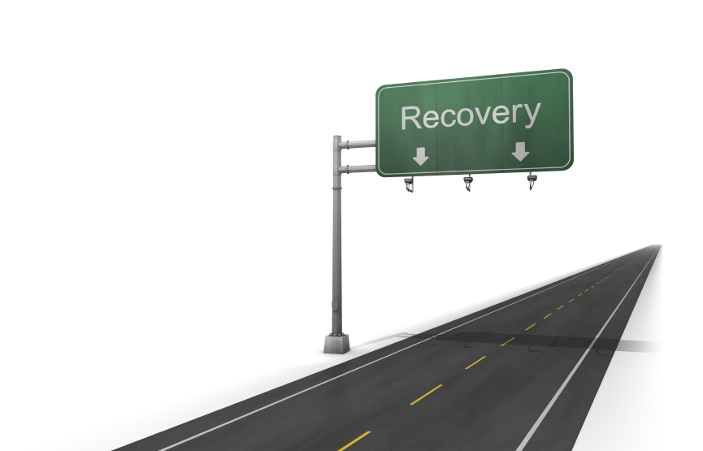
Recovery from alcohol and drug problems is a process of change through which an individual achieves abstinence and improved health, wellness, and quality of life.
Notes:
SAMHSA/CSAT 2010

Slide 5
Conceptual & Language Clarity
Recovery management (RM) is a philosophical framework for organizing addiction treatment and recovery support services across the stages of pre-recovery identification and engagement, recovery initiation and stabilization, long-term recovery maintenance, and quality of life enhancement for individuals and families affected by severe substance use disorders.
--- William White

Slide 6
RECOVERY-ORIENTED SYSTEMS OF CARE (ROSC)
A ROSC is a coordinated network of community-based services and supports that is person-centered and builds on the strengths and resilience of individuals, families, and communities to achieve abstinence and improved health, wellness, and quality of life for those with or at risk of alcohol and drug problems.
Notes:
SAMHSA/CSAT 2010

Slide 7
Recovery Management Application and Stages of Recovery
Focus of attention/intervention:
Stages of Recovery
Pre-Recovery Initiation
Recovery Initiation and Stabilization
Recovery Maintenance
Quality of Life Enhancement
Community Health

Slide 8
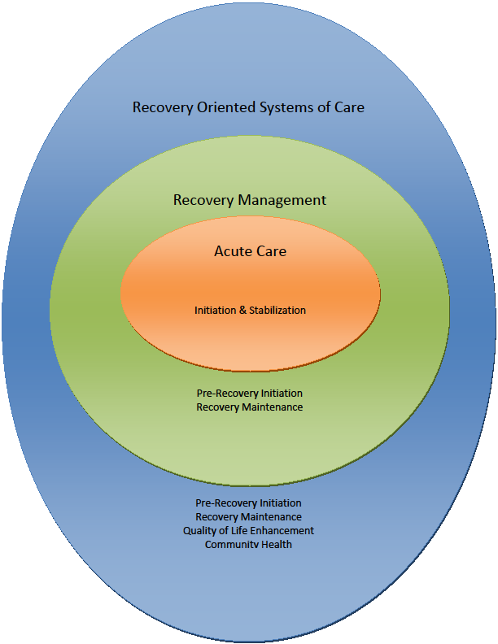

Slide 9
Values Underlying
a ROSC
Operational Elements
of ROSC
Notes:
SAMHSA/CSAT
2010

Slide 10
Values Underlying a ROSC
Person-centered
ROSC places the individual at the center of the services and supports offered. ROSC recognizes that there are many pathways to recovery, including treatment, peer-to-peer recovery support, faith-based recovery support, medication-assisted recovery, and others.
ROSC offers choice among a flexible menu of services and supports designed to meet each individual’s specific needs.

Slide 11
Values Underlying a ROSC
Self-directed
In a ROSC, the service recipient is encouraged and assisted in exercising the greatest level of choice and responsibility of which he or she is capable.

Slide 12
Values Underlying a ROSC
Strength-based
ROSC identifies and builds on the assets, strengths, resources, and resiliencies of the individual, family, and community, rather than emphasizing needs, deficits, and pathologies.

Slide 13
Values Underlying a ROSC
Community-based services and supports
ROSC is situated within and draws on the strengths, resilience, and resources of the community, including professional and non-professional organizations and groups such as:
- Community-based organizations
- Recovery Community Organizations (RCOs)
- Faith-based Organizations
- Civic Organizations
- Schools, etc.

Slide 14
Operational Elements of a ROSC
Continuity of services & supports
Coordination ensures ongoing and seamless connections with services and supports for as long as the service recipient needs them.

Slide 15
Operational Elements of a ROSC
Service quality & responsiveness
Services and supports are evidence-based, developmentally appropriate, gender-specific, culturally relevant, trauma-informed, family-focused, and appropriate to the person’s stage of life and stage of recovery.

Slide 16
Operational Elements of a ROSC
Recovery community/peer involvement
People in recovery and their family members, caregivers, significant others, friends, and other allies are included among decision-makers and have a meaningful role in service design, provision, and quality improvement. They are involved in the design of all systems, services, and supports.
Peer-to-peer recovery support services are included in the array of services offered and provided

Slide 17
Operational Elements of a ROSC
Outcomes-driven
for the individual
for the system
Systems and service design and quality are driven by performance data that at a minimum achieve identified outcomes for the individual as well as for the system.

Slide 18
Strategies to Promote Continuity of Services and Supports
Identify and engage everyone this person interacts with
Coach family members, friends and allies on supporting recovery
Develop a menu of options
Utilize recovery coaches and peer support to help people develop or connect to a culture of recovery in their community
Utilize professional and natural supports
In areas that have few recovery resources, support the development of peer-led support groups

Slide 19
Examples of Recovery Support Services
Employment services and job training
Case management individual services coordination, with linkages to other services
Relapse Prevention
Housing assistance & services
Child care
Parent education & child development support services

Slide 20
Examples of Recovery Support Services
Transportation to and from treatment, recovery support activities, employment, etc.
Family/marriage counseling
Education (including substance abuse education)
Peer-to-peer mentoring and coaching
Self-help & support groups (including spiritual & faith-based)

Slide 21
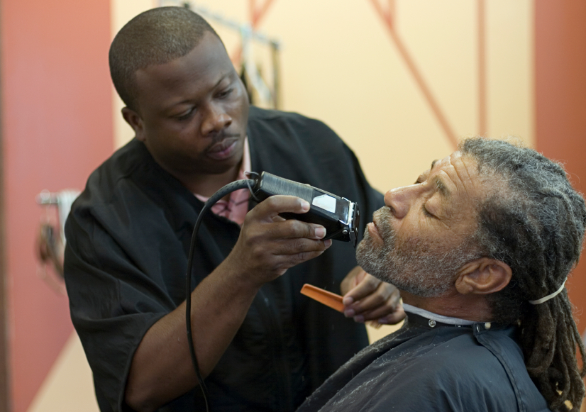
Notes:
The StOP program in Philadelphia provides a comprehensive range of services and supports for people to select from. Additionally they have formed partnerships with community stakeholders to assist people receiving services. One such partnership was formed with a local barber shop. The barber comes into the program to give people hair cuts to help them prepare for job interviews etc, but in addition, people in the program who are interested in learning this skill do an internship at this barber shop in the community. They learn valuable skills, expand their social network, develop a reference and better position themselves for employment.
Comment on lost opportunities from Alumnus construction company

Slide 22
Treatment Does Not Equal Recovery
Treatment is part of recovery – but it is not equal to recovery.
The goal of treatment is absence of symptoms; the goal of recovery is holistic health.
Treatment alone does not address other challenges, such as family, employment, housing, etc.
Recovery is different for each individual, and the social determinants of health need to be addressed before the recovery process can move forward.

Slide 23
Referral from the Criminal Justice System as a Predictor of Treatment Completion
According to Treatment Episode Data Set, across the four treatment types,* referral to treatment from the criminal justice system was consistently one of the strongest predictors of treatment completion or transfer to further treatment.
Notes:
* outpatient, intensive outpatient, short-term residential (30 days or less), and long-term residential (more than 30 days)

Slide 24
Linking the Institutional Corrections Agencies and the Community-based Organizations
ROSC’s holistic approach to recovery requires an effective collaboration between the criminal justice system and all services, systems, and agencies contributing to the client’s recovery.
Communication and case management are key components to ensure that silo-building, redundancies and gaps don’t occur.
The result: more effective treatment and more efficient use of funds.

Slide 25
Evidence-Based Practices in the Judicial System
Evidence-based programs should identify desired outcomes for offenders and include a means for measuring progress.
The implementation of evidence-based practices results in an average decrease in crime of 10-20%, whereas programs that are not evidence-based tend to see no decrease and even a slight increase in crime.
Interventions that follow evidence-based practices can achieve recidivism reductions of 30%.
Notes:
Source: Aos, S,etal, Evidence-Based Public Policy Options to Reduce Future Prison Construction, Criminal Justice Costs, and Crime Rates (Olympia,WA:Washington State Institute for Public Policy, Oct.2006) As cited in Pew Center on the States, One in 31: The Long Reach of American Corrections (Washington, DC: The Pew Charitable Trusts, March 2009).

Slide 26
National Registry of Evidence-based Programs and Practices (NREPP)
A searchable online registry of mental health and substance abuse interventions - reviewed and rated by independent reviewers.
Helps states, territories, community-based organizations, identify service models that may address your particular regional and cultural needs, and match your specific resource capacity.
Search feature identifies NREPP interventions that have been evaluated in comparative effectiveness research studies.
http://www.nrepp.samhsa.gov/

Slide 27
Implications for Criminal Justice Systems and Populations
Recovery Capital Assessments
Implications of Chronic Care Approach: Importance of Graduated Sanctions
Effectiveness of peer-support to assist with transitioning between cultures
Appropriate dose, duration and intensity of treatment
Continued monitoring AND support that integrates natural community based supports
Holistic Sentencing Recommendations: Rebuilding lives within the context of communities
Notes:
Lonnetta Albright & David Njabulo Whiters

Slide 28
Benefits for Criminal Justice Systems and Populations
Increased Attraction: People typically referred after very long addiction careers. ROSC provides increased opportunities for early intervention.
First offenders programs
Early diversion programs
Increased Access: finite capacity of the treatment system leads to long waiting lists. CJ has an opportunity to expand the use of and develop recovery natural supports. Opportunities for partnership with both prevention, treatment, and grass roots community.
Increased Engagement and Treatment Outcomes
Notes:
Lonnetta Albright & David Njabulo Whiters

Slide 29
Few Stay in Treatment 90 Days
90
60
52
42
Median Length of Stay in Days
33
30
20
0
Outpatient
Intensive
Short Term
Long Term
Outpatient
Residential
Residential
Notes:
Source: Data received through August 4, 2004 from 23 States (CA, CO, GA, HI, IA, IL, KS, MA, MD, ME, MI, MN, MO, MT, NE, NJ, OH, OK, RI, SC, TX, UT, WY) as reported in Office of Applied Studies (OAS; 2005). Treatment Episode Data Set (TEDS): 2002. Discharges from Substance Abuse Treatment Services, DASIS Series: S-25, DHHS Publication No. (SMA) 04-3967, Rockville, MD: Substance Abuse and Mental Health Services Administration. Retrieved from http://wwwdasis.samhsa.gov/teds02/2002_teds_rpt_d.pdf .
This figure shows the median length of stay by level of care

Slide 30
The Likelihood of Sustaining Abstinence Another Year Grows Over Time
After about 5 years of abstinence, 86% will make it another year
.
100%
After 1 to 3 years of abstinence, 2/3rds will make it another year
90%
Over a third of people with
less than a year of abstinence will sustain it
another year
80%
86%
70%
60%
66%
% Sustaining Abstinence
Another Year
50%
40%
30%
36%
20%
10%
0%
1 to 12 months
1 to 3 years
4 to 7 years
Duration of Abstinence
Dennis, Foss & Scott (2007)
Notes:
A key question that is often asked is how long someone is at risk of relapse. This figure shows the odds of sustaining relapsed from year 7 to year 8 based on the duration of abstinence.

Slide 31
Many Pathways to Recovery
Mutual support groups
Professional treatment
Faith-based groups
Medication-assisted treatment
“Natural” or on your own
And more indigenous routes
Notes:
We now know that there are many ways that people find and stay in long-term recovery. It’s important to let people know there is no ONE right way into recovery. Another way to say this is to say there is no wrong door into recovery as long as the person feels that it’s right and working for them and they are experiencing success. And, if one pathway doesn’t work, just like other illnesses, we want to encourage people to find the pathway that works for them.

Slide 32
What does recovery look like on average?
Duration of Abstinence
1-12 Months 1-3 Years 4-7 Years
More clean and sober friends
Less illegal activity and incarceration
Less homelessness, violence and
victimization
Less use by others at home, work and by social peers
Virtual elimination of illegal activity and illegal income
Better housing and living situations
Increasing employment and income
More social and spiritual support
Better mental health
Housing and living situations continue to improve
Dramatic rise in employment and income
Dramatic drop in people living below the poverty line
Notes:
Dennis, M.L., Foss, M.A., & Scott, C.K (2007). An eight-year perspective on the relationship between the duration of abstinence and other aspects of recovery. Evaluation Review, 31(6), 585-612.

Slide 33
The Emerging Recovery Continuum of Care
Traditional Acute-Care Addiction Treatment Continuum
Outpatient Inpatient Residential
Short-Term, Expert-Determined Environmental Restriction and Treatment Intensity
is being enhanced by…
Long-Term Recovery Continuum of Care
Self-Help Outpatient IOP Residential Institutional
Person-Directed, Outcome Informed Services
Self-Determined Risk Level & Service Intensity
Check-In Sessions Recovery Coaching Home/Work/SO Visits
Indigenous Recovery Supports Telephone/Internet-Based Contact
Notes:
What’s that? Why, it’s the Killer D’s – DSM, diagnosis, disorder, disease, dysfunction…
Be(e)ing replaced by…

Slide 34
Recovery and wellness focus
Shifting from a crisis-oriented professionally directed, acute-care approach with its emphasis on isolated treatment episodes, to a recovery management approach that provides long-term supports and recognizes the many pathways to health and wellness.

Slide 35
Building recovery-friendly communities
Our goal is to develop policies, communities, and a society that are recovery-friendly. One part of making this happen is to create what some are calling:
Recovery-oriented systems of care

Slide 36
Message of Hope
“Addiction is visible everywhere in this culture, but the transformative power of recovery is hidden behind closed doors. It is time we all became recovery carriers. It is time we helped our community, our nation, and our world recover…Recovery is contagious. Get close to it. Stay close to it. Catch it. Keep catching it. Pass it on.”
William White
Author and Recovery Advocate
www.williamwhitepapers.com

