Slide 1
Getting in the Weeds of Reentry Needs:
How Community Partners Improve Reentry Outcomes

Slide 2
Housekeeping
01
This event is being recorded: Audio is now broadcasting
02
Audio is provided through your computer speakers or headphones: Your line is automatically muted.
03
If you have issues with your speakers: Close out of Zoom, when you reconnect, check your audio options before joining.
04
Live Captioning is Available: Click the CC Live Transcription button to show and hide captions during today’s event.
05
Chat: Click the Chat icon to open the Chat panel.
06
Need help or have questions for our presenters? Please type in the Q&A box!

Slide 3
Getting in the Weeds of Reentry Needs:
How Community Partners Improve Reentry Outcomes

Slide 4
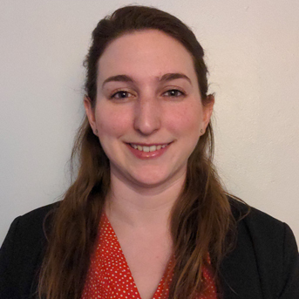
Today’s Speaker
Erin Allain, MS Senior Program Associate II Training and Technical Assistance Manager, Access to Recovery (ATR) Advocates for Human Potential, Inc.

Slide 5
Learning Objectives
Upon completion of this presentation, participants will be able to:
Describe how community partnerships improve reentry outcomes
Brainstorm and identify essential reentry supports needed in your community to improve reentry outcomes
Create actionable first steps for prioritizing existing partnerships or creating new partnerships for reentry support

Slide 6
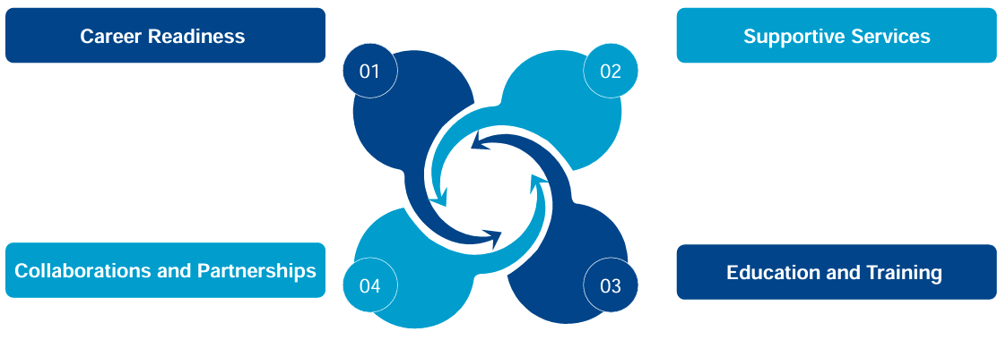
Recap: Key Components of Successful Reentry Programs (Waller & Garcia, 2023)
Notes:
Cooperation among organizations, employers, and support agencies
Resources and opportunities for successful reintegration

Slide 7
What is “collaboration”?
“a cooperative venture based on shared power and authority. It is nonhierarchical in nature. It assumes power based on knowledge or expertise as opposed to power based on role or function.”
- NIC’s Transition from Jail Initiative, Module 3
Notes:
-need representative from impacted populations

Slide 8
Let’s get started…
Describe your experience with creating collaboration and partnerships to support reentry in one word.
Why does collaboration matter for reentry success?

Slide 9
The Benefits of Reentry Collaboration: What’s in it for you?
Safe and sustainable transition into the community
Medication and prescription access upon release from jail or prison
Increased likelihood of treatment continuity (Bandara et al., 2021).
(Re)connect to community services and supports post-release via warm handoff
Navigate complex service delivery systems
Avoid duplication
Provide purpose, motivation, and hope
Reduce recidivism
Bandara, S., Kennedy-Hendricks, A., Merritt, S., Barry, C. L., and Saloner, B. (2021) Methadone and buprenorphine treatment in United States jails and prisons: lessons from early adopters. Addiction, 116: 3473–3481. https://doi.org/10.1111/add.15565
Notes:
A recent study of the implementation of opioid agonist treatments (methadone, buprenorphine) for OUD in correctional settings ( Bandara et al., 2021 ) identified the unanticipated release of patients from jail as a barrier to coordinating linkages to community-based providers. The same study described the strength of partnerships with local treatment providers as a key to coordination of post-release link- ages and identified intensive follow-up immediately after release and use of navigators as strategies to increase the likelihood of treatment continuity among patients ( Bandara et al., 2021 ).
Medicaid 115 waivers:
The new Massachusetts waiver will allow homeless individuals to maintain continuous coverage for 24 months without having to renew their coverage. Also, MassHealth enrollees recently released from correctional facilities will have 12 months of continuous coverage.
The waiver supports a more intensive form of CSP for beneficiaries who are experiencing homelessness or are justice-involved while living in the community. The Mass waiver also provides authority to pay for targeted CSP tenancy supports for beneficiaries facing eviction as a result of behavior directly related to their behavioral health condition.
The Flexible Services Program (FSP) enables MassHealth ACOs to provide targeted services to address HRSNs. ACO members with higher clinical needs can be made eligible for tenancy preservation and nutrition supports. FSP services in the package offer time-limited housing supports, medically-tailored and time-limited food assistance and nutrition education.

Slide 10
What are the challenges?
Security concerns
Conflicting interests and goals
Staff turnover
Information sharing
Unanticipated timing of release
Location and bandwidth of partners
Funding and resource limitations

Slide 11
What makes a good partnership?
Communication
Commitment to shared goals
Coordination
Cooperation & mutual respect
Interdependence
Whole-person perspective
Consistent collaboration, not a single event
Transparency & trust

Slide 12
Reentry Community Partner Example: MA Access to Recovery (ATR)
200 partners with a shared goal of helping people in early recovery to stay in recovery
Auditor | 1
Career Services | 23
Coordination Services | 2
Recovery Coaching | 4
Referring Providers | 167
Service Management System | 1
Transportation | 1

Slide 13
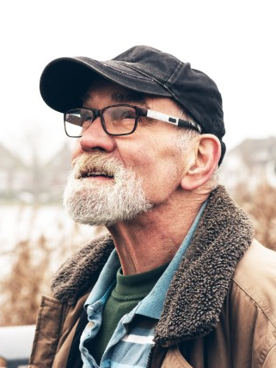
Community Partners “Get in the Weeds” of Reentry Needs
Tom was incarcerated in MA DOC for 30 years and has an array of reentry needs. He was introduced to ATR through a referral agency connected to a Sheriff’s Department.
Enrolled in ATR+
Worked with case manager to submit referral
Completed extensive intake process
Found housing through a sober home program
Completed Intro to Computers Class
Received tech to participate in class
Learn how to sign into Zoom
Adjusted medication to help him stay awake in class
Completed Job Readiness Course
Worked with coordinator to complete application
Received bus pass
Personal shopping trip
Completed Culinary Training
Worked through conflicting appointments
Retrieved ID, SSN, and resume
95% on ServSafe Food Handlers Certification
Notes:
if you mention ATR+, please also say that it is funded through a supporting successful reentry grant from the MA Department of Corrections and Probation Service. This is also a place where you could highlight the importance of some of those wrap around basic need supports, and identifying not only community partners who can offer those tangible things but also partners with the case management or coaching services to help the individual navigate the complicated processes and systems.
You could even throw in an anecdote from James about some of the shopping experiences he’s had---someone needing assistance with the self check out scanner because those didn’t exist before they were incarcerated, someone not knowing how to choose between 20+ brands and styles of undershirts, etc.

Slide 14
Who will you invite to the table?
Ask yourself what interventions are needed to address the barriers your prison or jail population faces as they return to the community.
Does your agency have the capacity and resources to address them all?
Advocacy
Affordable housing
Basic hygiene supplies
Cellphone
Cognitive decision-making
Clean clothing
Culturally responsive services
Disability support services
Educational services
Employment
Family reunification
Financial services
Food
Health care services
Mental health services
MAT Providers
Mentoring
Recovery supports
Substance use treatment
Transportation
Vocational training
…and more!
Notes:
Add poll question- which area includes the biggest barriers in your area?
***you don’t have to do all these things by yourself***
Effective transition strategies rely on collaboration and information sharing among jail- and community-based partners and joint ownership of both the problem and the solution. Given that many of the people who exit jails are already involved
with multiple social service and criminal justice agencies, a collaborative approach is essential to tackling jail transition. In addition, the scarcity of resources to manage this large population demands such an approach to avoid duplication or conflict in the delivery of valuable interventions.
https://info.nicic.gov/tjc/module-3-collaborative-structure-and-joint-ownership

Slide 15
What’s your gameplan?
Questions to Consider:
Are you ready for a collaborative reentry model?
Where are your gaps?
What could your collaborative structure look like? Who’s the backbone?
E.g. Executive level committee, implementation committee, workgroups
What are you asking your partners to do?
Who invites your partners to the table and how?

Slide 16
How ready is your organization for reentry planning with community partners?
What would it take for your organization to increase your readiness to engage or expand work with community partners by 1 point?

Slide 17
What are you taking away?
Collaboration between jails/prisons and community providers is research-supported
Partnerships with community providers can be challenging; they require staff time and resources
Reentry from incarceration can be an overwhelming experience requiring wraparound support
Assessing readiness for engaging with community partners and developing a game plan within your organization are good first steps

Slide 18
References and Resources
NIC’s Transition from Jail to Community Toolkit
NIC’s Transition from Prison to Community Handbook
National Resource Center on Justice Involved Women’s Building Effective Correctional Facility-Community Provider Partnerships for the Benefit of Justice Involved Women: Lessons Learned
National Reentry Resource Center’s Building Effective Corrections Partnerships for Community-Based Reentry Organizations
SAMHSA’s Best Practices for Successful Reentry From Criminal Justice Settings for People Living With Mental Health Conditions and/or Substance Use Disorders

Slide 19
QUESTIONS
Type your questions in the Q&A box on your screen.
Speaker Contact Info:
Erin Allain | eallain@ahpnet.com

Slide 20
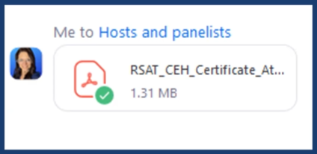
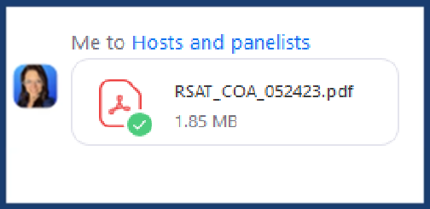
You can download the certificate of attendance from the chat.
Notes:
Graphic Design Notes
Slide Title: Chat
See sample slide. We really love the background image and would like to use same or similar.
Do not need to include specific screenshot from Adobe Connect, just editable text on screen that we can change to different text as needed.
Speaking Notes
Kristen standard chat prompt.
Kristen standard chat disclaimer.
We’re also going to do some polls and I’ll walk you through that when the time comes.

Slide 21
CERTIFICATE OF CONTINUING EDUCATION
1 Continuing Education Hour (CEH) approved by NAADAC, the Association of Addiction Professionals
Pass 10-question quiz with 7 correct answers
Download certificate upon completion of the quiz
December 13, 2023 RSAT webinar CEH quiz link:
Link Here

Slide 22
CONTACT
Stephen Keller RSAT TTA Coordinator | rsattta@ahpnet.com

