Slide 1
Marijuana Legalization
Potential Implications for Criminal Justice and RSAT Programming
Linda Frazier, MA, RN, MCHES Advocates for Human Potential, Inc.

Slide 2
Housekeeping: Functions

Slide 3
Housekeeping: Communication

Slide 4
Marijuana Legalization:
Potential Implications for Criminal Justice and RSAT Programming
Moderator
Stephen Keller
TTA Coordinator, RSAT-TTA
Notes:
Example:
If you can understand the form that allows your insurance to bill at a hospital, you can’t be seen.
If you can’t understand the consent to treat form, you don’t get treatment.
Pretty basic, but the research shows that most people do not understand these forms, but they mostly sign them anyway. Let’s look at some research that applies to our population.

Slide 5
Linda Frazier, MA RN, MCHES
Lfrazier@ahpnet.com
Advocates for Human Potential, Inc.
www.ahpnet.com

Slide 6
Objectives
Participants will be able to:
Identify key issues and concerns related to the impact cannabis legalization is having in states that have legalized medical and recreational cannabis markets
Explain the importance of surveillance data collection and analysis in monitoring and responding to emerging issues
Describe three key areas of potential impact on criminal justice, law enforcement, and prison-based programs related to cannabis legalization

Slide 7
No Conflicts of Interest to Disclose
The 2017 National Cannabis Summit was funded by the National Institute on Drug Abuse (NIDA) Blending Initiative through the Addiction Technology Transfer Center’s (ATTC) Network and the three collaborating sponsors: Advocates for Human Potential, Inc. (AHP), the ATTC Network, and the National Council for Behavioral Health.
The 2017 National Cannabis Summit was held in Denver, Colorado, August 28–30, 2017. Conference proceedings for this event will be posted on the RSAT website before the end of December or as soon as they are available.
Notes:
This presentation draws heavily on the proceedings of the 2017 NCS and the research presented at the summit. Citations are included on slides where appropriate. The slides are available for download today and on the RSAT web site. Resource links to the NCS program and presentations are at the end of the slide deck and the conference proceedings will be posted when the final draft as been approved after the new year.

Slide 8
State of the States
Poll
29 states and the District of Columbia have legalized cannabis for medical use
In 2016, nine states had medical and recreational cannabis-related questions on their ballots
63% of Americans live in states that permit medical and recreational marijuana use
Notes:
2016 – Of the nine, four passed adult recreational legalization CA, ME, MA, NV - Five passed medical use legalization AR, FL, ND, OH, PN
Now 29 states and DC have medical MJ (17 medical CBD), 8 states have passed recreational/adult use,
Using 2015 US Census estimates this includes 62.8% of the population

Slide 9
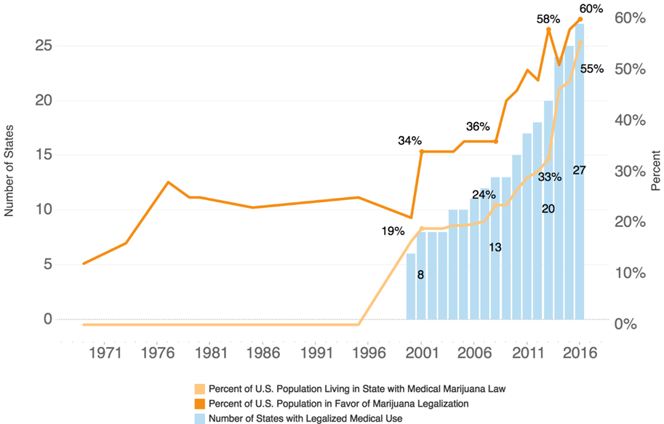
Trends in Public Opinion & Population Access
Carnevale Associates, LLC (2016, November). The Expansion of Legalized Marijuana. http://www.carnevaleassociates.com/uploaded/StateMarijuanaLegalizationResearchNeeds.pdf

Slide 10
The Paradox
Marijuana remains illegal under the 1970 U.S. Controlled Substances Act (CSA)
Classified as a Schedule I drug, which defines it as having no medical value or use (like heroin and LSD)
Trend began when California enacted Proposition 215 in 1996 with 55.6% of the vote (Murphey & Carnevale, 2016)
Has become a movement for legalization across the nation

Slide 11
This has significant implications for research; evidence-based practices; and public safety, prevention programing, and health.

Slide 12
Academies of Science Report
Updates research on known health impacts of cannabis
Evidence supports cannabis as an effective treatment for chronic pain, chemotherapy-induced nausea and vomiting, and multiple sclerosis spasticity symptoms
Identifies additional research needs—therapeutic and harms
Cites regulatory barriers that limit current research on the therapeutic value of cannabis or the potential health risks
National Academies of Sciences, Engineering, and Medicine, 2017
Notes:
Summarizes research since their 1999 report on the known health impacts of cannabis and cannabis-derived products
Concludes evidence supports cannabis as an effective treatment for chronic pain, chemotherapy-induced nausea and vomiting, and multiple sclerosis spasticity symptoms.
Identifies areas where additional research is needed on both therapeutic uses and the harms related to chronic misuse of marijuana products
Cites regulatory barriers, including classification as a Schedule I substance, that limit current research on the therapeutic value of cannabis, or the potential health risks related to cancers, diseases, mental health disorders, and injuries.

Slide 13
Therapeutic Uses of Cannabis
Evidence Supports
Chronic pain*
Nausea and vomiting
MS spasticity
240 other conditions
HIV/AIDS
Crohn’s disease
Epilepsy
Glaucoma
Allowed at the State Level
Claims that it treats ≥400+ conditions
Varies by state
No clear analysis comparing what various states allow
Notes:
National Academies of Sciences, Engineering, and Medicine. 2017. The health effects of cannabis and cannabinoids: Current state of evidence and recommendations for research. Washington, DC: The National Academies Press. http://nationalacademies.org/hmd/reports/2017/health-effects-of-cannabis-and-cannabinoids.aspx
2017 National Cannabis Summit: Science, Policy, and Best Practices. Summary of Proceedings, December 2017

Slide 14
Schedule I Classification Overview
Substance no medical value (THC & CBD)
U.S. production and research overseen by the Drug Enforcement Administration (DEA)
Federal Drug Administration (FDA) has no authority to regulate
Production and sale of cannabis products regulated by each state
Notes:
Marijuana use is prohibited and research on cannabis is overseen and regulated by the Drug Enforcement Agency (DEA). Since Schedule I designation specifies that there is no medical value to a substance, this also means that the Federal Drug Administration (FDA) has no authority to regulate the production and sale of cannabis products to limit exposure to pesticides and molds; or to control labeling and prevent the sale of cannabis edibles that look like gummy bears or candies.

Slide 15
Implications of Schedule I Classification on Research
Barriers to marijuana and cannabis research
Questions re: relevance of research to current products (potency/formulations)
State regulatory oversite of pesticides and molds
State oversite of labeling and sale of edibles that look like gummy bears or candies, tinctures, etc.
Notes:
Although some mechanisms have been identified to address barriers to marijuana and cannabis research short of changing the categorization of marijuana from a Schedule I to a Schedule III substance . The consensus among researchers is that, at minimum, changing the classification of marijuana/cannabis to a Schedule III substance is the best approach to allowing for a research agenda that can clarify the appropriate use and best practice approaches to medical marijuana; and address questions about the harms of use by pregnant women, children, and those with dependency; or untangle the complex issues of marijuana use, drugged driving, and standards for assessing driving impairment.

Slide 16
Research on Risks & Costs for Use of Illicit Substances
Research on the personal and societal impact of using mind-altering substances
Three different studies on drug-related harms
20 drugs scored on multiple drug-related cost criteria
Mortality, damage, dependence, impairment, injury, crime, environmental, international, loss of relations and tangibles, family, economic cost, and community/social cohesion
Nutt, D. J., King, L. A., & Phillips, L. D. (2010). Drug harms in the UK: A multicriteria decision analysis. The Lancet, 376(9752), 1558–1565. DOI: http://dx.doi.org/10.1016/S0140-6736(10)61462-6
Notes:
Research on the personal and societal impact of using mind altering substances
European researchers have conducted three different studies on drug-related harms. The most recent analysis by Nutt and colleagues in the United Kingdom was conducted in 2010 by the Independent Scientific Committee on Drugs (ISCD), with funding from the Centre for Crime and Justice Studies. This analysis of drug harms involved conducting a multicriteria decision analysis (MCDA) model to assess and score harms for 20 different drugs. Each was scored on multiple harm criteria including drug related mortality, damage, dependence, mental impairment, injury, crime, environmental damage, international damage, loss of relationships and tangibles, family adversities, economic cost, and impact on community social cohesion.

Slide 17
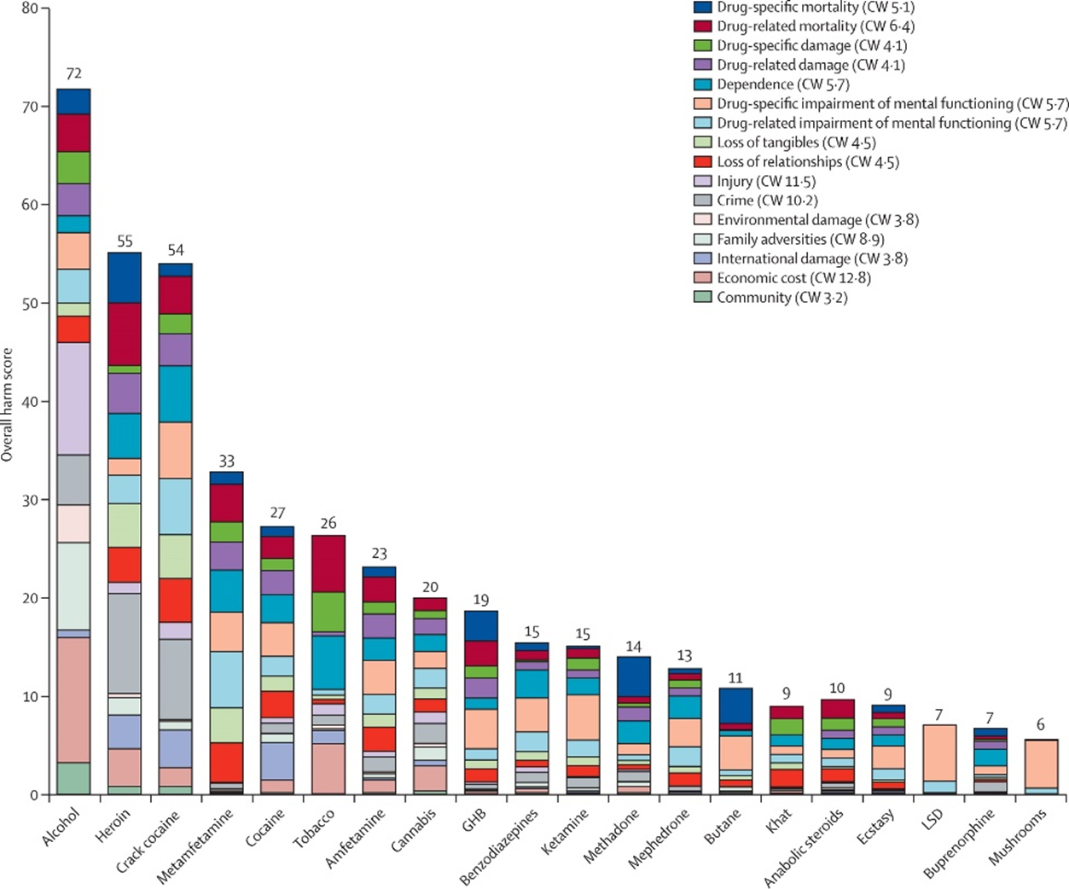

Slide 18
Policy Approaches
Prohibition—manufacture, sale, distribution
Decriminalization—de facto prior to law
Market regulation—like Rx and OTC
Prescription—testing and FDA oversite
Legalization—multiple approaches
John Kelly, 2017 National Cannabis Summit, August 2017
Poll
Notes:
Legalization
Without commercialization – NOT like tobacco or alcohol – state or federally run market
With limits on commercialization – over 21 years old, no advertising, quality/potency controls, limits on branding and marketing
Full commercialization – industry driven advertising, branding and marketing with few if any restraints

Slide 19
Notes:
MacPherson, Donald. Should Cannabis be Legalized in Canada? Simon Fraser University, November 14th, 2014. Canadian Drug Policy Coalition (CDPC).
The Policy Paradox – A Visualization
Finding a balanced approach on the continuum of prohibition (our current federal approach) and full, commercialized legalization, a middle ground of market regulation may be the sweet spot for the greatest public health and safety. It balances out the extreme of illegal, unregulated and frequently black-market marijuana products and sources; and the other extreme of a free reign, industry-driven market, focused on corporate profit and including advertising like we see for alcohol.
So, if that is the case, why does policy matter? John Kelly, PhD of the Recovery Research Institute at Harvard University, addressed this in his recent blog post and presentation Marijuana Legalization and the “Answer” to Our Drug Problems [Kelly, July 2017]. Professor Kelly summarizes the available policy approaches, best summarized by the graph below, and concludes that how (and if) we move forward with decriminalization matters greatly. He reminds us that with legalization must come regulation, taxation, and education to prevent harm. His recommendations include taking a highly regulated approach with a ban on advertising, and a mandate of plain packaging among other measures. (Kelly, 2017)
Questions/comments in Chat box

Slide 20
What Do We Know from States that Have Legalized—Overview
Impact on use
Drugged driving
Fatal driving accidents
Assessing intoxication
Pediatric and neonatal exposure
Emergency department visits
Problematic use

Slide 21
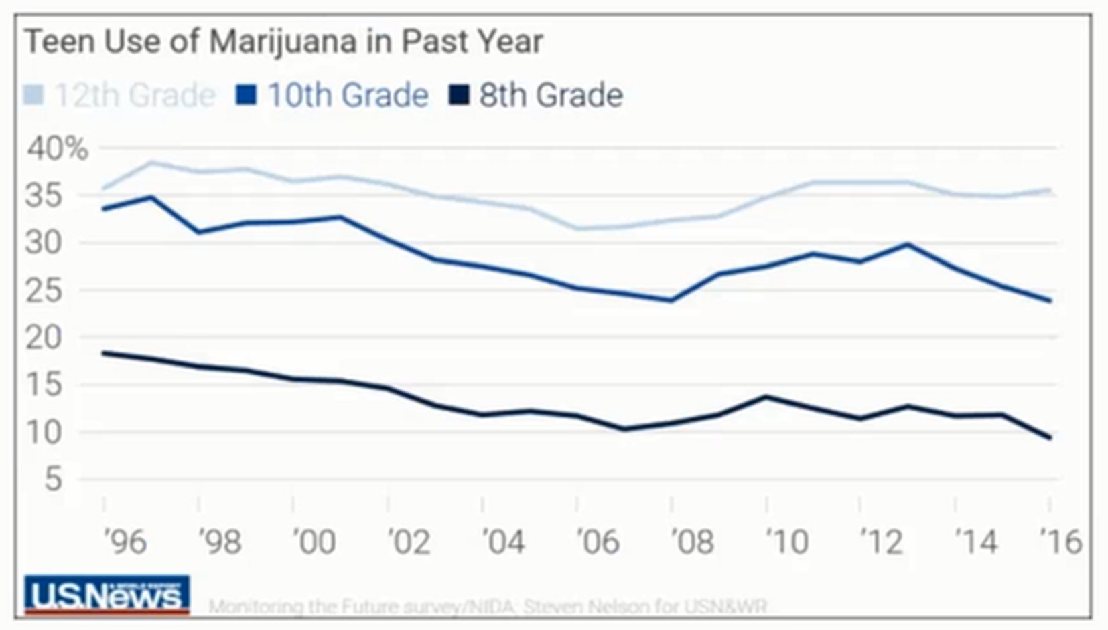
Cannabis Use Trends
Monitoring the Future Survey. NIDA. Steven Nelson for USN&WR. www.USNews.com

Slide 22
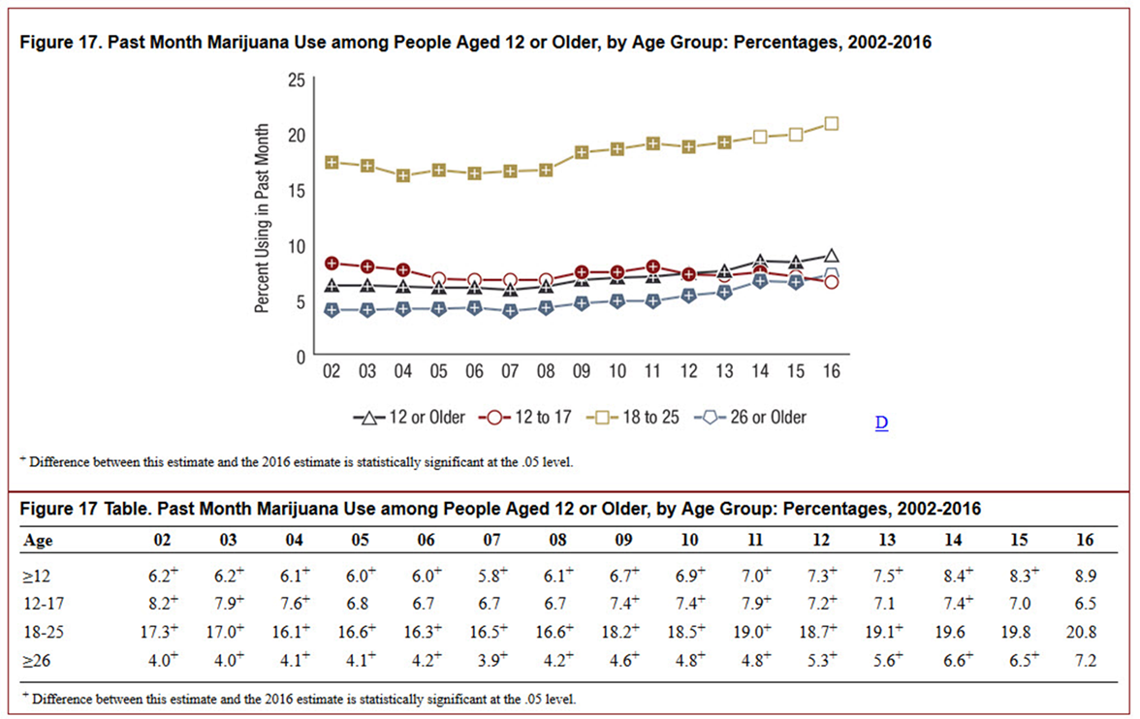
Past Month Marijuana Use
Past Month Marijuana Use among People Aged 12 or Older by Age Group: Percentages, 2002–2016 (SAMHSA.gov)
Notes:
Past Month Marijuana Use among People Aged 12 or Older, by Age Group: Percentages, 2002-2016 (SAMHSA.gov)
Is this trend in legalization driving more use of marijuana by the U.S. population? In fact, recent research confirms earlier indications that policy is not driving this shift in use rates. A study by the Alcohol Research Group looked at 30 years of data from the National Alcohol Surveys, which ask about marijuana use. This use prevalence data was compared to state legalization laws. This study found that the increase in marijuana use in the U.S. has occurred across the population and is not specifically linked to implementation of legalization laws at the state level (Kerr et al. 2017). This is consistent with an early study from 2004 that compared San Francisco and Amsterdam and found no evidence that criminalization reduced use or that decriminalization increased use (Reinarman et al., 2004). The conclusion is that increased use of marijuana in the U.S. reflects a shift in the acceptance of marijuana use among the U.S. population.
CO example - In 2015 - 2016, 9% of Colorado youths aged 12 to 17 reported using marijuana in the month prior to being surveyed. During the 2014 - 2015 period, 11% percent of youths that age reported using marijuana in the previous month. On the national level, the most recent National Survey on Drug Use and Health reported that teen marijuana use had fallen to a 22-year low.

Slide 23
Drugged Driving
Use affects motor skills and reflexes (Ramaekers et al., 2006)
Linked to increases in accidents (Asbridge et al., 2012)
Marijuana and alcohol together lead to a higher likelihood of accidents (Smiley, 1999; Vigil, 2017)
No standard for “safe” blood levels of THC or data to set a standard (Armentano, 2013)
Notes:
In states with recreational adult use laws, legalization is not causing increased use of cannabis, but it is having an impact on rates of traffic accidents and driving infractions in both Washington and Colorado (Murphy and Carnevale 2016). Research has shown that marijuana use affects motor skills and reflexes (Ramaekers et al. 2006) and is linked to increases in accidents (Asbridge et al. 2012). More specifically a 1999 study found that using both marijuana and alcohol together leads to a higher likelihood of accidents (Smiley, 1999 and Vigil, 2017). Additionally, there is no agreed upon standard for “safe” blood levels of THC or data to set a standard (Armentano 2013) like we currently have for alcohol using the blood alcohol concentration (BAC) level of 0.08 percent

Slide 24
DUI Findings
U.S. Department of Transportation (DOT) study “specific drug concentration levels cannot be reliably equated with a specific degree of driver impairment” (Berning, Compton, & Worchinger, 2015)
Washington and Colorado—positive tests for marijuana are associated with increased accidents and driving infractions
Colorado: Increase in fatal accidents from <8% in 2008 to almost 11% in 2010
Fatal accidents in Colorado increased to 19% after recreational use was legalized in 2014
Notes:
A US Department of Transportation study concluded that with marijuana use “specific drug concentration levels cannot be reliably equated with a specific degree of driver impairment” (Berning, Compton, and Worchinger, 2015). What we do know is that both Washington and Colorado data reflect that increased positive tests for marijuana are associated with increased accidents and driving infractions, but it is impossible to ascertain if this due to greater access and/or use of marijuana by current users, or law-enforcement doing more traffic-related stops and screens for marijuana use. Recent findings from the federal highway fatality reporting system for Colorado identity an increase in fatal accidents involving drivers who test positive for marijuana. This data shows an increase from less than 8 percent in 2008, to almost 11 percent in 2010, after medical marijuana was legalized. And a further increase in fatal accidents involving marijuana to 19 percent after recreational use was legalized in 2014 (Rocky Mountain High Intensity Drug Trafficking Area 2015). Washington data also show a trend of increased drugged driving between 2009 and 2015 (Couper 2015).

Slide 25
Pediatric & Neonatal Exposure
Endocannabinoid development is critical prenatally and through adolescents
Perception of risk during pregnancy
Not a perceived risk of harm
Most states do not prohibit MMJ for pregnant women
Cannabis use during pregnancy is increasing: 3% use
Pregnant teens report high past month use
Cannabinoids do cross the placenta
We do not know enough about prenatal exposure
Susan Weiss, NIDA. The State of the Science of Cannabis. 2017 National Cannabis Summit.
Notes:
ED visits for cannabis/marijuana exposure issues have increased in states that have legalized
Little data to support that marijuana/cannabis exposure is deadly

Slide 26
Problematic Use—What We Know
About 9% of users become dependent
Affects mood
Is associated with psychosis
In those with predisposition
Contributing to decrease in age of psychosis
Adolescent exposure
Adversely influences learning
Effects worse with early onset and chronic use
Risk of dependence
Linked to suicidal ideation/behavior and psychotic illness
Susan Weiss, NIDA. The State of the Science of Cannabis. 2017 National Cannabis Summit
Notes:
Research on use patterns of heavy users may indicate up to 12-15% for young adults who are regular users at a young age (Caulkins/Kilmer).

Slide 27
Criminal Justice Data
US Data
Blacks are 2.2 times more likely than Whites to be arrested for marijuana possession
Cost of enforcing possession laws in 2010 was $490,966,080
ACLU, The War on Marijuana: In Black and White, June 2013

Slide 28
Criminal Justice Data
Rates of arrest in California per 100,000 in 2015
111 Black
42 Latino
31 White
Enforcement continued to be disparate after California decriminalized marijuana in 2011
DPA/ACLU Report Marijuana Enforcement Disparities in California: A Racial Injustice, 2016

Slide 29
CA Prop. 64 Is Criminal Justice Reform
Removes/lessens criminal penalties for MJ offenses
Possession for adults 21+ legal
Most other offenses reduced
Juvenile offenses are all infractions with NO jail
Sets up process for those reductions to be retroactive
Directs significant revenue to youth and communities harmed by marijuana prohibition
Notes:
Public Health approach to decriminalization using a social justice model

Slide 30
CJ Impact of Legalization—Trends
Legalization reduces arrests
Racial and economic disparities persist
Criminal justice referrals to treatment decrease
California saw 50% fewer CJ referrals to treatment
CUD vs. referrals due to arrest
Impact on RSAT programs still unclear
CUD = Cannabis Use Disorder
Notes:
These regulatory, data, and research issues are currently left to each state to manage and individually address based on the legal status of marijuana in that state. Reclassifying marijuana would remove barriers for scientific research and support expanded research on cannabis. It would address the conflict between federal law and the rights of states that have legalized the medical use of cannabis. Finally, it would address a critical banking issue that keeps marijuana a cash industry, banned from using banks.

Slide 31
Cole Marijuana Memo (Aug. 2013)
Prevent distribution to minors
Prevent revenue from funding criminal enterprises; gangs or cartels
Prevent moving out of states where legal
Prevent legal sales as a cover for illegal activity
Prevent violence/firearms use with growing distribution
Prevent drugged driving or other public health consequences
Prevent growing on public lands
Prevent possession or use on federal property

Slide 32
Attorney General Memo to Federal Prosecutors May 10, 2017
Establishes charging and sentencing policy for the DOJ
Most serious offenses are those with most substantial guidelines – including mandatory minimum sentences
Decisions that vary from policy must be approved by U.S. AG or AAG
Sentences that depart from guidelines must be approved
Rescinds previous policy of DOJ

Slide 33
Challenges Moving Forward
Lack of surveillance and CJ data
Each individual state is approaching this differently
Barriers to research on emerging products
Lack of FDA oversite and review
Lack of national standards for impairment, potency, appropriate therapeutic use, and dosing
Understanding the role of the cannabinoids in treating chronic pain and what impact they might have on the opioid epidemic
Prevention—funding, best practice approaches
Criminal justice—impact of decriminalization and legalization
Notes:
Federal banking and security issues
Taxation rates and influence on the unregulated market
Housing and real estate issues – social use spaces, homeless use, etc.

Slide 34
Resources and Links
2017 National Cannabis Summit: https://www.nationalcannabissummit.org/program/
National Cannabis Summit Proceedings
RSAT Blog—citations included

Slide 35
Questions?
Type your question in the Q&A box on your computer screen.
Speaker Contact Info
Linda Frazier
LFrazier@ahpnet.com

Slide 36
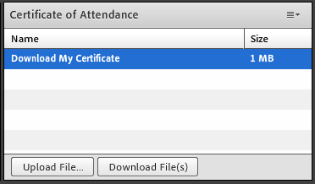
Certificate of Attendance
Download now!

Slide 37
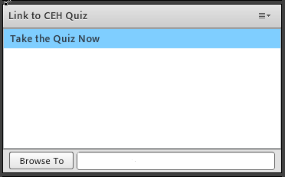
Continuing Education Hour (CEU Certificate)
1 NAADAC CEH
Pass 10-question quiz with 7 correct answers
Receive certificate immediately

Slide 38
RSAT TTA Center
For more information on RSAT training and technical assistance, visit
http://www.rsat-tta.com/Home
or
e-mail Stephen Keller, RSAT TTA Coordinator, at
skeller@ahpnet.com

