Slide 1


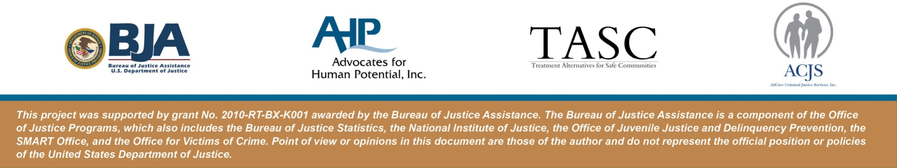
Clinical Supervision in Criminal Justice Programs
September 27, 2017
Lisa Talbot-Lundrigan, MA
Dr. Stephen K. Valle, Sc.D, MBA
Ret. Sheriff Frank Cousins, Jr.

Slide 2

Housekeeping: Functions

Slide 3
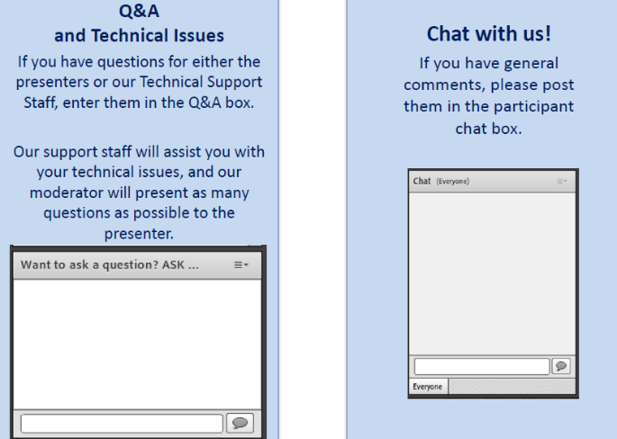
Housekeeping: Communication

Slide 4
  Clinical Supervision
  in Criminal Justice Programs
Moderator
Stephen Keller
Training/TA Coordinator, RSAT-TTA
Notes:
Example:
If you can understand the form that allows your insurance to bill at a hospital – you can’t be seen.
If you can’t understand the consent to treat form, you don’t’ get tx
Pretty basic, but the research shows that most people do not understand these forms….they mostly sign them anyway….but lets look at some research that applies to our populatiomn

Slide 5

CLINICAL SUPERVISION
Professional Growth, Evidence-Based Program Integrity and Self- Care
5

Slide 6
What is Clinical Supervision?
“ … a disciplined, tutorial process wherein principles are transformed into practical skills on four overlapping foci:
  Administrative
  Evaluative
  Supportive
  Clinical”
  Powell & Brodsky (2004)

Slide 7
Clinical Supervision
Clinical supervision is an essential part of clinical programs.
  Clinical supervision is a central organizing activity that integrates the program mission, goals, and treatment philosophy with clinical theory and evidence-based practices (EBPs). The primary reasons for clinical supervision are to ensure (1) quality client care, and (2) clinical staff continue professional development in a systematic and planned manner. In substance abuse treatment, clinical supervision is the primary means of determining the quality of care provided.

Slide 8
Clinical Supervision
Clinical supervision enhances staff retention and morale.
  Staff turnover and workforce development are major concerns in the substance abuse treatment field. Clinical supervision is a primary means of improving workforce retention and job satisfaction (see, for example, Roche, Todd, & O’Connor, 2007).
Every clinician, regardless of level of skill and experience, needs and has a right to clinical supervision. In addition, supervisors need and have a right to supervision of their supervision.
  Supervision needs to be tailored to the knowledge base, skills, experience, and assignment of each counselor. All staff need supervision, but the frequency and intensity of the oversight and training will depend on the role, skill level, and competence of the individual.
The benefits that come with years of experience are enhanced by quality clinical supervision.

Slide 9
Clinical Supervision
Clinical supervision needs the full support of agency administrators.
  Just as treatment programs want clients to be in an atmosphere of growth and openness to new ideas, counselors should be in an environment where learning and professional development and opportunities are valued and provided for all staff.

Slide 10
Clinical Supervision
The supervisory relationship is the crucible in which ethical practice is developed and reinforced.
  The supervisor needs to model sound ethical and legal practice in the supervisory relationship. This is where issues of ethical practice arise and can be addressed. This is where ethical practice is translated from a concept to a set of behaviors. Through supervision, clinicians can develop a process of ethical decision making and use this process as they encounter new situations.
Clinical supervision is a skill in and of itself that has to be developed.
  Good counselors tend to be promoted into supervisory positions with the assumption that they have the requisite skills to provide professional clinical supervision. However, clinical supervisors need a different role orientation toward both program and client goals and a knowledge base to complement a new set of skills. Programs need to increase their capacity to develop good supervisors.

Slide 11
Clinical Supervision
Culture and other contextual variables influence the supervision process; supervisors need to continually strive for cultural competence.
  Supervisors require cultural competence at several levels. Cultural competence involves the counselor’s response to clients, the supervisor’s response to counselors, and the program’s response to the cultural needs of the diverse community it serves. Since supervisors are in a position to serve as catalysts for change, they need to develop proficiency in addressing the needs of diverse clients and personnel.

Slide 12
Clinical Supervision
Clinical supervision in substance abuse treatment most often requires balancing administrative and clinical supervision tasks.
  Sometimes these roles are complementary and sometimes they conflict. Often the supervisor feels caught between the two roles. Administrators need to support the integration and differentiation of the roles to promote the efficacy of the clinical supervisor. (See Part 2.)

Slide 13
Roles of the Clinical Supervisor
Source: SAMHSA TIP 52

Slide 14
Most addictions professionals have the desire to grow and YOU have the capacity to nurture & facilitate this growth in yourself through the use of supervision.
Supervisor | Coach | Mentor
Defines and communicates job requirements; counseling and coaching for improved performance; provides job related instruction; planning, organizing, and delegation of work; evaluates performance; provides corrective & formative feedback | Managerial responsibility that involves a process of helping people develop and improve their skills. Coaching involves: Acting as a role model Creating the right climate Clarifying expectations & providing feedback Praising Providing training & resources Motivating employees to meet & stretch goals which provides employees with a greater challenge to meet than their usual goals | Can be formal or informal and helps the mentee advance while helping the mentor develop and improve both coaching and counseling skills. Mentors function as: Role models Brokers Cheerleaders Sponsors Mentors: Love learning, not teaching Treasure sharing & giving

Slide 15
Effective Clinical Supervision provides a means for …
Professional Growth
Greater Self-Efficacy
Improved Client Care
Improved Therapeutic Relationships
Positive Stress Management

Slide 16
Principles of Clinical Supervision
Clinical supervision is an essential part of all clinical programs.
Clinical supervision enhances staff retention and morale
Every clinician, regardless of level of skill and experience, needs and has a right to clinical supervision. In addition, supervisors need and have a right to supervision of their supervision.
Clinical supervision needs the full support of agency administrators.

Slide 17
Principles of Clinical Supervision
The supervisory relationship is the crucible in which ethical practice is developed and reinforced.
Clinical supervision is a skill in and of itself that has to be developed.
Clinical supervision in substance abuse treatment most often requires balancing administrative and clinical supervision tasks.
Culture and other contextual variables influence the supervision process; supervisors need to continually strive for cultural competence.

Slide 18
Principles of Clinical Supervision
Successful implementation of EBPs requires ongoing supervision.
Supervisors have the responsibility to be gatekeepers for the profession.
Clinical supervision should involve direct observation methods.

Slide 19
Direct Observation
Issue: What is happening behind the
closed door?
Assumption: Practice conforms to
policy, procedure, and clinical protocol
Verification: Rarely happens
Reality: Clinicians lack performance
feedback and mentoring

Slide 20

Direct Observation
Direct observation of counselors is the
only way to see the whole picture

Slide 21
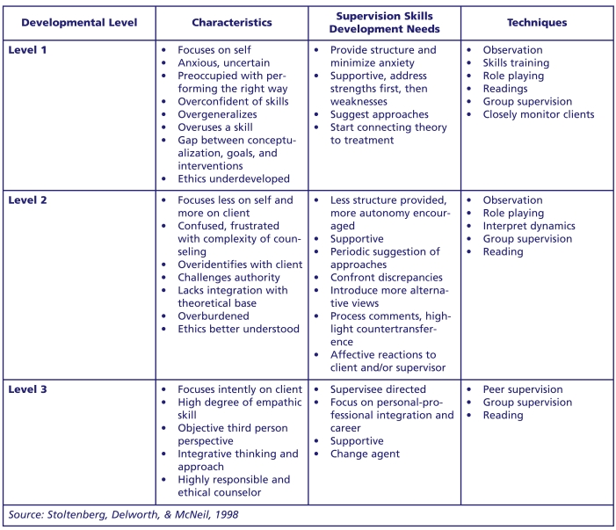
Developmental Stages of Counselors

Slide 22
Developmental Stages of Counselors
There are several important general principles about counselor development, including:
There is a beginning but not an end point for learning clinical skills; you can never “know it all.”
Effective Clinical Supervision takes into account the individual learning styles and personalities of the supervisees and fits the supervisory approach to the developmental stage of each counselor.
There is a logical sequence to development, although it is not always predictable or rigid; some counselors may have been in the field for years but remain at an early stage of professional development, whereas others may progress quickly through the stages.
The developmental level can be applied for different aspects of a counselor’s overall competence (e.g., Level 2 mastery for individual counseling and Level 1 for group counseling).

Slide 23
Mentoring Functions
Function | Action
Coaching | Teaching technical skills Helping clarify performance goals and learning objectives Suggesting strategies for achieving goals and objectives or meeting job performance requirements Reinforcing effective on-the-job performance
Increasing exposure and visibility | Providing opportunities for the protégé to demonstrate competencies and special talents Representing the protégé’s competencies and concerns to higher level administrators
Protecting | Minimizing the protégé’s involvement in controversial situations Helping the protégé avoid costly career mistakes Offering warning of various pitfalls in the organization

Slide 24
A Developmental Approach to Supervision
Level 1 Counselor – entry level
Traits | Characteristics | Supervision Issues
Dependent | Focused on basic skills | Expose to numerous orientations
Curious | Motivated by anxiety, enthusiasm | Be sensitive to trainee anxiety
Innocent | Emulates a role model | Promote autonomy
Uninhibited | Articulates one-word descriptors, categorical thinking | Introduce ambiguity
Egocentric | Learns right way, cookbook answers | Balance support with uncertainty
Enthusiastic | Highly dependent with a self focus | Use role play, application, presentations
Easily frustrated | Has difficulty conceptualizing | Help to conceptualize
Demanding of attention | Lacks self awareness | Address strengths first
 | Does not know what he or she does not know | Do not take too much control
 | Overuses a model, tunnel vision | Be aware of trainee learning style
 | Has difficulty confronting and self-disclosing | (David Powell, 1993)
 | Uses anecdotal conceptualization
 | Makes categorical statements
 | Has a limited idea of treatment planning
 | Lacks integrated ethics

Slide 25
A Developmental Approach to Supervision
Level 2 Counselor
Traits | Characteristics | Supervision Issues
Desirous of autonomy | Focused more on client | Understand that counselor is less technique oriented
Self-conscious | Exhibits greater awareness, frustration, confusion | Realize counselor is ready for confrontation and needs to learn alternatives
Confused about identity | May not look as advanced as level 1 | Be prepared for challenges to supervisor competence
Rebellious | Shows uncertainty and lingering idealism | Focus on transference
Insecure | Loses motivation after difficult clients | Develop consultation supervision
Judgmental | Has dependency/autonomy conflicts with supervisor | Encourage independence
 | Is less imitative, more self assertive | Realize the counselor knows something is wrong but lacks skills to fix it
 | Is less inclined to ask for recommendations | Provide blend of clients
 | Better articulates client classifications | Recognize need for convincing rationale
 | Evidences greater cultural awareness | Distinguish clearly between supervision and therapy
 | Uses more eclectic theory | (David Powell, 1993)
 | Uses better formed ethics

Slide 26
A Developmental Approach to Supervision
Supervisor Levels - Characteristics
Level 1 | Level 2 | Level 3
Displays a mechanistic approach | Displays confusion, conflict issues | Functions autonomously
Plays a strong expert role | Sees supervision/counseling as more complex, multidimensional | Displays self and supervisee awareness
Depends on own supervisor | Has fluctuating motivation, especially when supervisory functions are not rewarded | Differentiates boundaries/roles
Is highly motivated | Focuses on supervisee | Able to supervise at all times
Is moderately to highly structured | Loses objectivity | Prefers to work with certain level of counselors
Is invested in trainee’s adopting one’s own model | Blames supervisee for supervisor’s problems
Has trouble with Level 2 counselors but can help as a sound clinician to Level 1 counselor. | Works best with Level 1 counselors, okay with Level 2 counselors | Can supervise counselors at all levels.

Slide 27
Benefits of Clinical Supervision
Clinical supervision has a range of benefits for clinicians and the organization:
Availability of support for supervisees, and a forum to discuss clinical issues
Maintenance of clinical skills and quality practice
Promotion of standardized performance of core skills across the organization and / or field
Improvement and / or attainment of complex clinical skills
Increased job satisfaction and self confidence
Improved communication amongst workers
Improved worker retention

Slide 28
Burnout: What is it?
Burnout is a predictable but avoidable condition associated with work in the helping and criminal justice professions.
Burnout is characterized by:
  Lack of Enthusiasm
  Withdrawal
  Frequent Absenteeism
  Blunting of Empathy and Callousness
  Dehumanizing of Clients
  Fatigue

Slide 29
Burnout: What is it?
  Negativity
  Powerlessness
  Hopelessness
  Lack of Confidence in Skills/Avoidance
  Somatic symptoms including headaches, GI distress, elevated blood pressure, insomnia
  Distress in Personal Life
  Decrease in Healthy Self-Care
  Increase in Maladaptive Coping Behaviors, including Substance Use
  Relapse to Addiction

Slide 30
Burnout
Related to emotionally demanding work
Emotional/mental exhaustion
Includes a loss of passion
Precipitating Factors:
  Workload
  Institutional stress
  Job Role ambiguity

Slide 31
Burnout is More Likely…
In a time when counseling staff are being asked to:
    Carry Heavier Caseloads
    Work with Fewer Staff Members
    Treat Needier Clients (Co-occurring issues, trauma issues, multi-systemic issues)
    Implement Evidence-Based techniques and Measure Performance
    Accept less pay/less frequent increase in pay

Slide 32
Benefits of Clinical Supervision
Clinical supervision can address a number of recognized contributors to stress and burnout. For instance, clinical supervision may help with issues such as:
Stressful events. Clinical supervision may help the supervisee to develop coping strategies
Role ambiguity. Clinical supervision may help to clarify the roles and responsibilities of the job
Career development. Clinical supervision can facilitate career progression by helping supervisees to enhance clinical skills and experience and by providing (in some cases) the required credentials for registration with professional bodies
Skill use. Skill variety, task identity, task significance, autonomy and feedback are recognized contributors to job satisfaction, which in turn can impact on worker wellbeing. Clinical supervision can help to expand supervisees’ repertoire of clinical and interpersonal skills.

Slide 33
Myths That Lead to Burnout
Myth #1
    A counselor should be “together” at all time and therefore should not experience problems like other people.
Valle (1981)

Slide 34
Myths That Lead to Burnout
Myth #2
    Helping another alcoholic (addict) to attain sobriety is all fulfilling and of itself sufficiently rewarding.
Valle (1981)

Slide 35
Myths That Lead to Burnout
Myth #3
    Counselors Efforts will always be appreciated by clients.
Valle (1981)

Slide 36
Myths That Lead to Burnout
Myth #4
    Having experienced alcoholism (addiction) and gone through the recovery process is enough to be a good counselor.
Valle (1981)

Slide 37
Myths That Lead to Burnout
Myth #5
    There is status and prestige in being an alcoholism (addiction) counselor
Valle (1981)

Slide 38
Myths That Lead to Burnout
Myth #6
    The counselor will be able to devote 100% of his or her effort to helping clients
Valle (1981)

Slide 39
Predictors of Burnout
Correctional Officers | Substance Abuse Treatment Staff
Ambiguous Work Assignment | Heavy Caseloads
Role Conflict (Morgan et. al, 2002) | Isolation from Peers
Negative Inmates Contact (Dignam, 1986; Lindquist & Whitehead, 1986) | Low pay/program funding
Poor Relationship with Peers | Inability to Detach
No Sense of Purpose | Increased Number of Performance Standards
 | Lack of Clinical Supervision
Sources: Morgan, VanHaveren, Pearson (2002);
Deighton et. al. (2007)

Slide 40
Burnout: It’s Impact
Clients feel devalued, avoided
Co-Workers may feel concern, a desire to intervene, resentment, a heavier burden to compensate.
The entire staff and program may “catch” the negativity, cynicism and indifference of a burned-out staff member over time without intervention.

Slide 41
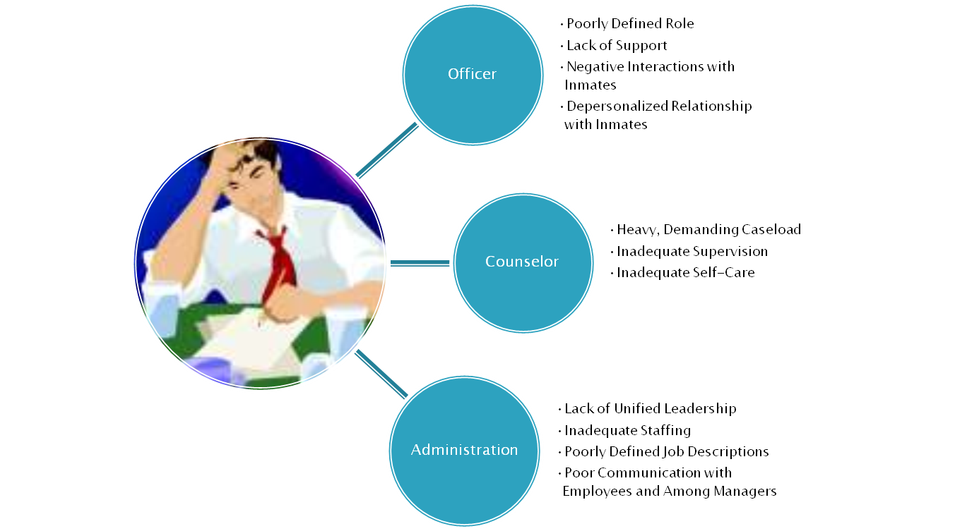
The Burnout Cycle in RSAT

Slide 42
Recognizing Burnout
Inability to Focus
Losing track of details normally on top of
Frequent Absence or tardiness
Disproportionate detachment
Distance from Clients and Coworkers
Avoidance of Supervision
SEEK HELP BEFORE CRISIS OCCURS
EAP
Private Counseling
Support Group
www.headington-institute.org

Slide 43
Managing and Surviving Burnout
Recognize the Symptoms
Learn to Ask for Help
Come to Grips with Your Limitations
Maintain Discipline and Structure, the Key Elements for Holding On During Burnout
Develop “Time Outs” On and Off the Job
Diversify Your Responsibilities

Slide 44
Avoiding Burnout
Be Informed About Your Position
    Role Clarity is a Buffer for Stress and Burnout
    Asking For Guidance from Supervisors is a Buffer for Stress and Burnout
    Actively Participate in Regular and Ongoing Clinical Supervision is Buffer for Stress and Burnout.

Slide 45
Avoiding Burnout
Identify Your Goals and Evaluate a Position Accordingly Before You Say Yes
    Professional growth does not always equate with promotions or positions of status.
    Understand your work as a part of your life
    When the Role Changes, Evaluate your Ability to Perform to the New Standard and Ask for Support

Slide 46
Avoiding Burnout
Maintain Your Own Growth at all Costs
    Losing track of individual needs in the needs of the client leads to disillusionment
    Develop Personalized Methods of Managing Stress
    Seek Lifestyle Balance
    Have Strategies for Managing “out of balance times”
    Be Prepared to Recognize and Respond to Early Warning Signs
    Laugh

Slide 47
Ethical Issues
Ethical decision-making is a continuous, active process.
Ethical standards are not a cookbook. They tell you what to do, not always how.
Each situation is unique. Therefore, it is imperative that all personnel learn how to “think ethically” and how to make sound legal and ethical decisions.
The most complex ethical issues arise in the context of two ethical behaviors that conflict; for instance, when a counselor wants to respect the privacy and confidentiality of a client, but it is in the client’s best interest for the counselor to contact someone else about his or her care.
Therapy is conducted by fallible beings; people make mistakes—hopefully, minor ones.
Sometimes the answers to ethical and legal questions are elusive. Ask a dozen people, and you’ll likely get twelve different points of view.

Slide 48
References
Center for Substance Abuse Treatment. Clinical Supervision and Professional Development of the Substance Abuse Counselor. Treatment Improvement Protocol (TIP) Series 52. DHHS Publication No. (SMA) 09-4435. Rockville, MD: Substance Abuse and Mental Health Services Administration, 2009.
Center for Substance Abuse Treatment. Competencies for Substance Abuse Treatment Clinical Supervisors. Technical Assistance Publication (TAP) Series 21-A. DHHS Publication No. (SMA) 08-4243. Rockville, MD: Substance Abuse and Mental Health Services Administration, 2007; reprinted 2008.
Neumann, D.A. and Gamble, S.J. 2009. Issues in the professional development of psychotherapists: Countertransference, and vicarious traumatization in the new trauma therapist. Psychotherapy, 32 (2), 341-347.
http://community.nicic.gov/blogs/mentalhealth/archive/2011/03/11/vicarious-traumatization-a-guide-to-recognizing-responding-to-and-preventing-a-serious-consequence-of-providing-mental-health-care-in-jails-prisons-and-community-corrections.aspx

Slide 49
Questions?
Type your question in the Q&A box
on your computer screen
Speaker Contact Info
Lisa Talbot-Lundrigan, ltalbotlundrigan@gmail.com
Dr. Stephen Valle, svalle@comcast.net
Ret. Sheriff Frank Cousins, frankcousinsjr@gmail.com

Slide 50

Certificate of Attendance
Download now!

Slide 51

Questions?
1 NAADAC CEH
Pass 10-question quiz with 7 correct answers
Receive certificate immediately

Slide 52
RSAT Technical Assistance and Training Center
For more information on RSAT training and technical assistance visit:
http://www.rsat-tta.com/Home
or email Stephen Keller, RSAT TA Coordinator at
skeller@ahpnet.com

