Slide 1
Naloxone Education and Distribution
Highlighting RI and NY RSAT Programs
Andy Klein Advocates for Human Potential, Inc.
Lauranne Howard
Rhode Island Department of Corrections

Slide 2
Housekeeping: Functions

Slide 3
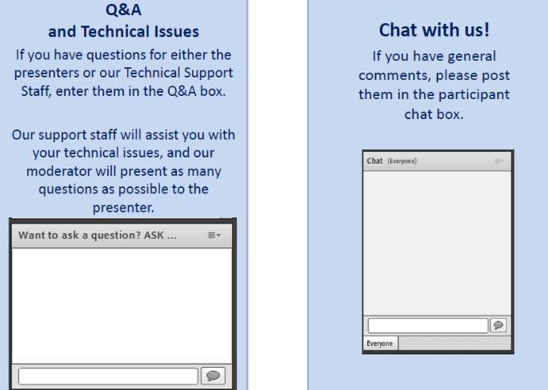
Housekeeping: Communication

Slide 4
Naloxone Education and Distribution in RSAT Programs
Moderator
Hannah Tulinski
TTA Coordinator, RSAT-TTA
Notes:
Example:
If you can understand the form that allows your insurance to bill at a hospital, you can’t be seen.
If you can’t understand the consent to treat form, you don’t get treatment.
Pretty basic, but the research shows that most people do not understand these forms, but they mostly sign them anyway. Let’s look at some research that applies to our population.

Slide 5
Andy Klein
Aklein@ahpnet.com
Lauranne Howard
Lauranne.Howard@doc.ri.gov
Advocates for Human
Potential, Inc.
www.ahpnet.com
Rhode Island
Department of Corrections
www.doc.ri.gov

Slide 6
Objectives
Participants will be able to:
Describe prospective procedures of naloxone distribution programs for individuals leaving prisons and jails
Identify potential issues in the distribution of naloxone and strategies to avoid them
Explain strategies to reach family members of inmates to educate them about naloxone

Slide 7
RI DOC Naloxone Education & Distribution
Original Procedure
Educational DVD for administering naloxone kit and assembling nasal atomizer
Monthly training for each correction facility
Quiz & option to receive kit
Requesting inmate’s info shared with Medical and Records & ID offices
Kit prepared and distributed at discharge from corrections facility

Slide 8
RI DOC Naloxone Education & Distribution
Issues
Kit not available at discharge, i.e. early release
Nurse was required to be available, but often too busy when contacted by discharge office to deliver kit before inmate left
Our distribution expectations were not being met

Slide 9
RI DOC Naloxone Education & Distribution
Develop New Procedures
SSA for substance abuse prevention, education and treatment secured 2 year grant
Narcan Nasal Spray
Updated educational DVD
New training by contracted agencies
“Standing Order” for administration of in emergencies
HUC or nurse allowed to deliver kit to discharge area

Slide 10
Grant for Narcan Kits to Families
RIDOC partnered with local non-profit
Mini-grant from Department of Health
Pilot project at Women’s Facility initiated in June
Training conducted 2 nights per week during visiting hours
Naloxone kit provided to all attendees
Early success and progress to additional facility

Slide 11
VERA Institute of Justice
Corrections-Based Responses to the Opioid Epidemic: Lessons from New York State’s Overdose Education and Naloxone Distribution (OEND) Program

Slide 12
NY State Program Development
Identifying a champion
The New York State program required strong leadership from the beginning to ensure successful implementation and expansion
Jurisdictions looking to pilot similar programs should identify a “champion”
Understands the value of the program
Ability to convincingly communicate its importance to stakeholders
Has the respect of staff at all levels

Slide 13
NY State Program Development
Generating staff buy-in
NY staff initially trained on overdose prevention
Naloxone distributed to trainees for personal use
This approach generated buy-in
Brought agency leadership on board by centrally focusing the program on staff wellness
Introduced important harm reduction concepts to staff
Limited “us” versus “them” dynamics between corrections officers and incarcerated people

Slide 14
NY State Program Development
Partnering with community-based organizations
Building strong partnerships with community-based harm reduction and public health organizations is an important first step and leads to:
Constructing the training curriculum
Solving challenges unique to each agency and community
Developing sustainability mechanisms
These organizations provided train-the-trainer trainings, conducted family trainings, and developed supplemental training resources

Slide 15
Programmatic Components
Training delivery
Effective trainings should emphasize
Flexible discussion or question-and-answer formats over more rigid curriculum-delivery methods
Seek to use credible messengers to lead the trainings, i.e. incarcerated peers or community members with experience in addiction, overdose, and/or naloxone

Slide 16
Programmatic Components
Timing and location of trainings
Trainings should be conducted during the least chaotic times
And in spaces that allow for focus so that participants can best retain the material

Slide 17
Programmatic Components
Reinforcing lessons
Interviews and focus groups revealed people appreciate opportunities to reinforce the information provided during OEND trainings
New York achieved this through hands-on training that included practice assembling the naloxone kits
Trainers also showed video that featured perspectives on naloxone and overdose prevention from people who could not be present at every training, including a person who had used naloxone while on parole to save a life

Slide 18
Programmatic Components
Family involvement
Family involvement is an important component of reentry success
In NY, family OEND trainings provided a number of benefits
They offered opportunities for visits
Encouraged larger conversations about drug use
Increased the number of kits in the community

Slide 19
Programmatic Components
Distribution methods
Facilities should consider which method of kit delivery is optimal for their populations
Opt-in methods - where people who are released from incarceration are offered a kit and may choose to take or leave it
Opt-out methods - where a kit is included in a person’s belongings at release and the individual must ask to have it removed
Opt-in preserves kits for those who find it most relevant and is useful if resources are scarce
Opt-out promotes kit distribution more widely and can be used where kit availability is not a concern

Slide 20
VERA Evaluation of OEND
People in all positions found the program to be relevant and empowering
The training increased peoples’ knowledge about overdose and confidence in administering naloxone

Slide 21
VERA Evaluation of OEND
Incarcerated people who said they would take the kit when released felt the potential to save a life and contribute to the public good trumped their fears of actual or perceived consequences for having the kit.
Trainees who said they would not take the kit cited their distrust of the justice system and concerns about the laws designed to offer legal protections for people reporting an overdose.

Slide 22
VERA Corrections-Based Responses to the Opioid Epidemic March 2018
https://storage.googleapis.com/vera-web-assets/downloads/Publications/corrections-responses-to-opioid-epidemic-new-york-state/legacy_downloads/corrections-responses-to-opioid-epidemic-new-york-state.pdf

Slide 23
Questions?
Type your question in the Q&A box on your computer screen.
Speaker Contact Info
Andy Klein
Aklein@ahpnet.com
&
Lauranne Howard
Lauranne.Howard@doc.ri.gov

Slide 24
Certificate of Attendance
Download now!

Slide 25
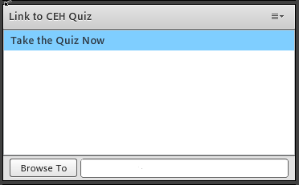
Continuing Education Hour (CEU Certificate)
1 NAADAC CEH
Pass 10-question quiz with 7 correct answers
Receive certificate immediately

Slide 26
RSAT TTA Center
For more information on RSAT training and technical assistance, visit
http://www.rsat-tta.com/Home
or
e-mail Hannah Tulinski or Stephen Keller, RSAT TTA Coordinators, at
htulinski@ahpnet.com or skeller@ahpnet.com

Slide 27
Next Month’s Webinar
Title
Technology in Corrections:
The Use of Tablets and Impact on Treatment
Presenters
Eric Baker & Desmond Lomax
Utah Department of Corrections

