Slide 1


RSAT Performance Measures

Slide 2
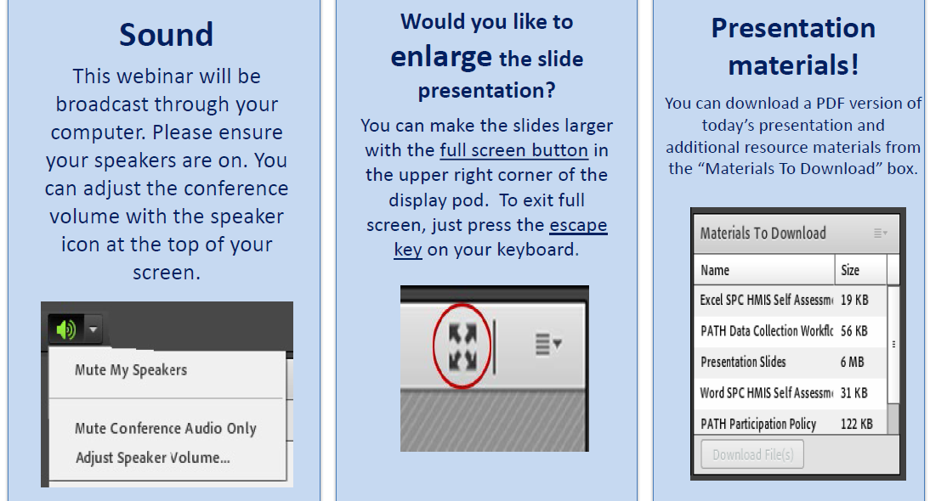
Housekeeping: Functions

Slide 3
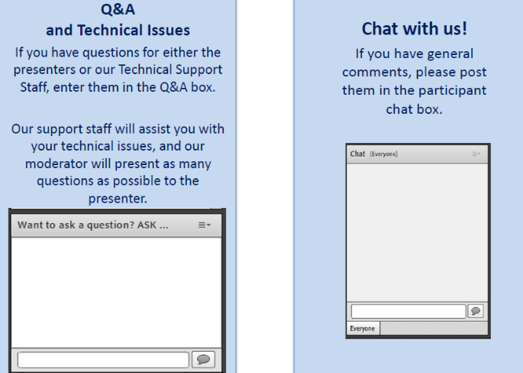
Housekeeping: Communication

Slide 4
  RSAT Performance Measures
Moderator
Stephen Keller
Training/TA Coordinator, RSAT-TTA
Notes:
Example:
If you can understand the form that allows your insurance to bill at a hospital – you can’t be seen.
If you can’t understand the consent to treat form, you don’t’ get tx
Pretty basic, but the research shows that most people do not understand these forms….they mostly sign them anyway….but lets look at some research that applies to our populatiomn

Slide 5

James Steyee MAS, PMP
Jimmy@carnevaleassociates.com
Carnevale Associates, LLC
www.carnevaleassociates.com

Slide 6
Residential Substance Abuse Treatment Program (RSAT)
Performance Measures Training
Welcome grantees and RSAT team members!
July 19, 2017
Notes:
Alissa’s welcome and introduction

Slide 7
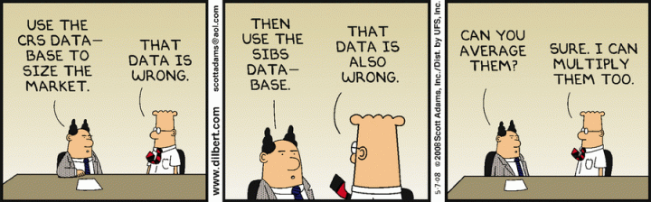
RSAT Performance Management Training
Notes:
RECORD
Laura

Slide 8
Poll Question
What is your role with the BJA funded RSAT program?
  Program/Grant Manager (grantee)
  Analyst/Data Collector
  Correctional Staff
  Social Worker
  Case Manager
  Other Service Provider
  Other
  Don’t know

Slide 9
What is performance measurement?
Definitions
Ongoing data collection to determine if a program is implementing activities and achieving objectives.
  It measures inputs, outputs, and outcomes over time.
  In general, pre-post comparisons are used to assess change (BJA Center for Program Evaluation and Performance Measurement).
Ongoing monitoring and reporting of program accomplishments, particularly progress toward program goals (Government Accountability Office).

Slide 10
Why do we have performance measures?
To identify your (grantee) successes and potential areas of improvement.
  So you can improve your program
To help us (BJA/DOJ) understand your (grantee) activity and progress
  So we can provide targeted training and technical assistance
To help us (BJA/DOJ) understand what funds are being used for
  Informs the budget, strategic plan, future funding
  Respond to external requests (e.g., congressional inquiries, media requests)
It is required by law
  Yes, we have to do it
Notes:
Performance measures are developed with input from stakeholders and are directly related to the requirements of the grant award. Performance measures help you to help you; help us to help you; and help us to provide analysis and information for transparency, including information to make decisions about the program internally and externally and provide information and analysis to external stakeholders (e.g., congress).
The measures attempt to capture information about what grantees are doing, but we do recognize that not all programs will look the same. There may be questions or even entire sections that are not applicable to your program. For example, if during the reporting period your program engaged in strategic planning, any questions about providing direct services may not be applicable. In this case, it would be perfectly acceptable to enter zeros or report no activity.

Slide 11
BJA RSAT Program Goals
“The goal of the RSAT Program is to break the cycle of drug addiction and violence by reducing the demand for, use, and trafficking of illegal drugs. RSAT enhances the capabilities of states and units of local and tribal governments to provide residential substance abuse treatment for incarcerated inmates; prepares individuals for their reintegration into the communities from which they came by incorporating reentry planning activities into treatment programs; and assists individuals and their communities through the reentry process through the delivery of community-based treatment and other broad-based aftercare services.
Treatment practices/services should be, to the extent possible, evidence-based as shown through treatment outcomes that are consistent with RSAT program objectives.”
--FY 2017 RSAT Solicitation

Slide 12
BJA RSAT Objectives
Provide residential treatment facilities set apart—in a completely separate facility, or a dedicated housing unit in a facility exclusively for use by RSAT program participants—from the general correctional population.
Focus on the substance abuse problems of the RSAT program participants.
Develop each RSAT program participant’s cognitive, behavioral, social, vocational, and other skills to solve substance abuse and related problems.
Require urinalysis and/or other proven reliable forms of drug and alcohol testing for RSAT program participants, including both periodic and random testing, and for former participants while they remain in the custody of the state or local government.

Slide 13
BJA RSAT Objectives
Develop each RSAT program participant’s cognitive, behavioral, social, vocational, and other skills to solve substance abuse and related problems.
Focus on the substance abuse problems of the RSAT program participants.
Require urinalysis and/or other proven reliable forms of drug and alcohol testing
Total enrollment (target population)
Participant completion/non-completion rates
  Reasons for non-completion
Length of time in program prior to completion (program requirement)
Utilization of MAT (if applicable)
Utilization of assessment tools
Array of services received (substance abuse treatment is required)
  Mental Health
  Employment
  Cognitive and Behavioral
  Case Planning
  Reentry
  Other (e.g., parenting classes, life skill training, education/GED)
Utilization of urinalysis testing
Rates of clean/dirty tests by participants

Slide 14
RSAT Performance Management Training
What are BJA’s PM Products and Processes?

Slide 15
Performance Management Products
Notes:
We perform data validation checks after each data entry period closes – you may be contacted if we find inconsistent data or if we have a question or want to confirm one of your responses. We then use the data in a variety of ways, as you see here. So if you hear from us with a question, it is simply because we are trying to ensure that the data are accurate and valid so that we can be confident that we are basing these various reports on high quality data.

Slide 16
What is a Grantee Feedback Report?
Contains data on key performance measures
Looks at aggregate totals, averages, and ranges
Allows you to compare your RSAT site to others and the RSAT program as a whole
Gives an overview of the program, including number of grants and funding amount
Provides you with TTA information to improve your outcomes
The central tool in our suite of new reports
Notes:
One-on-one comparisons with other similar sites
Find areas for improvement
Share with your team and external stakeholders to show your program progress
Use as a quick overview of the RSAT program to inform newcomers about RSAT

Slide 17

What is Mini-GrantStat?
The GOAL of Mini-GrantStat is to use performance data to drive internal decision making that leads to improved practices in the field.
The GOAL of GrantStat is to use data to assess grantee practices, assess the overall health of programs, and improve BJA practices, and drive
decision-making.

Slide 18
What is Mini-GrantStat?
Internal process for BJA staff to look at performance data
Provides a mechanism for the discussion of non-reporting (PMT), data inconsistencies, high performance, and under performance
Helps to identify training needs
Provides BJA staff with data that helps to develop or direct technical assistance
Notes:
Mini-GrantStat is an internal process that brings together BJA Programs and Policy staff with the TTA provider to take a critical look at performance measurement data. Based on the analysis and finding, BJA is able to identify potential high performance and areas for improvement. Ultimately, this helps direct resources in an efficient and effective manner.

Slide 19
RSAT Performance Measures:
A Brief Overview
*Poll Question

Slide 20
What is the Performance Measurement Tool?
The Performance Measurement Tool (PMT) is an online questionnaire (see https://bjapmt.ojp.gov) that grantees must complete every quarter
The PMT includes performance measures (completed quarterly) and narrative questions (completed semi-annually)
Grantees have 30 days at the end of the reporting period to complete the PMT data entry
Notes:
BJA’s intent is to use the RSAT performance measures to understand trends and changes that grantees experience over time. With this practical understanding, BJA is better able to meet requests from Congress, Office of Justice Programs, the Department of Justice, and other stakeholders to offer insight into programmatic and policy considerations. The RSAT performance measures are reported in two formats – quantitative (numeric) and qualitative (narrative responses). Quantitative data are entered into the PMT by grantees every quarter, while narrative responses are provided every six months, in January and July, and also at the end of the grant award. Responses to a set of “closeout” questions are required only at the end of the grant award.

Slide 21
RSAT Performance Measures
A few things to remember:
PMT Reporting is award-based
Required each quarter
PMT GMS reports are required every 6-months (January and July of each year)
Report PMT data for each active award separately. DO NOT DUPLICATE data.
Question Types
Administrative
Program Level/Program Characteristics
Training
Participant Level
Narrative
Notes:
PMT reporting is mandated to be award-based. In other words, BJA must collect performance data on each federal award and those associated activities. While it is understood that multiple fiscal year RSAT funds may be used to fund the same program, it is important to take necessary measures to not report duplicate data on multiple awards in this instance. A best practice is to spend down the oldest award first such that you are reporting activity on one award at a time.
The following slides will be a brief overview the RSAT performance measures. A more in-depth recorded training is available for more information if needed. That link will be provided in a later slide. The RSAT measures can be broke out into the follow question types: administrative, program characteristics, training, participant level, and narrative. I will discuss those measures now.

Slide 22
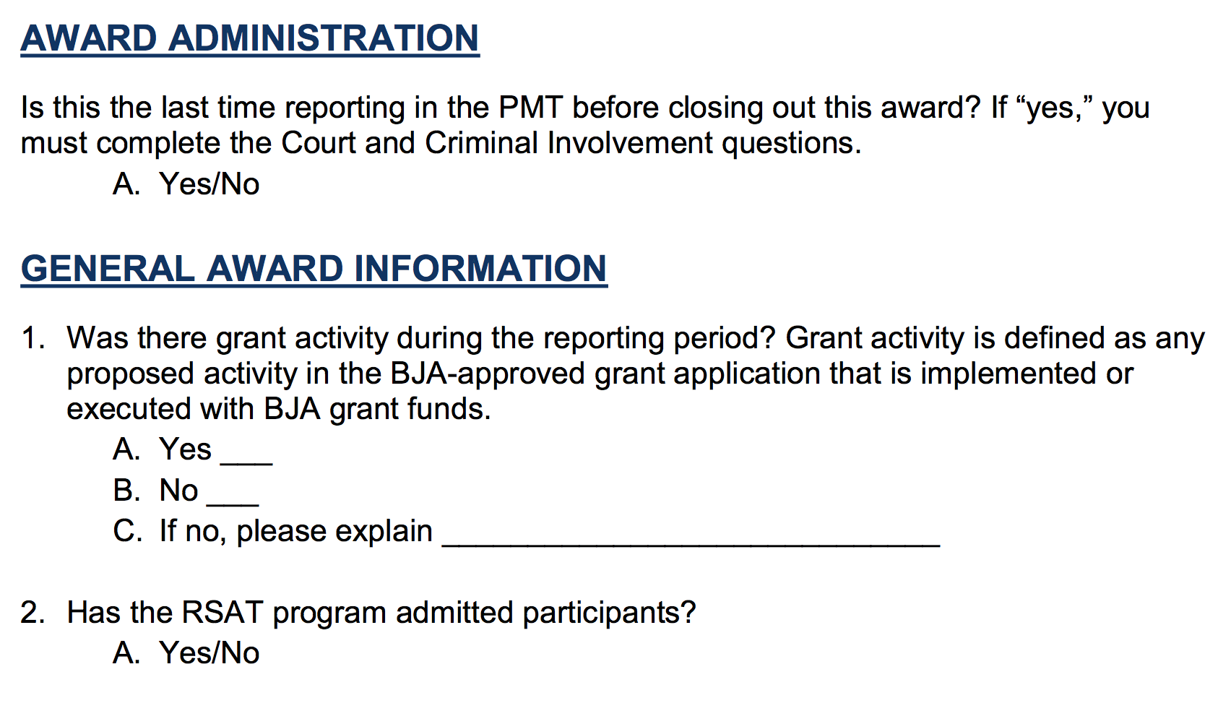
Administrative Questions

Slide 23
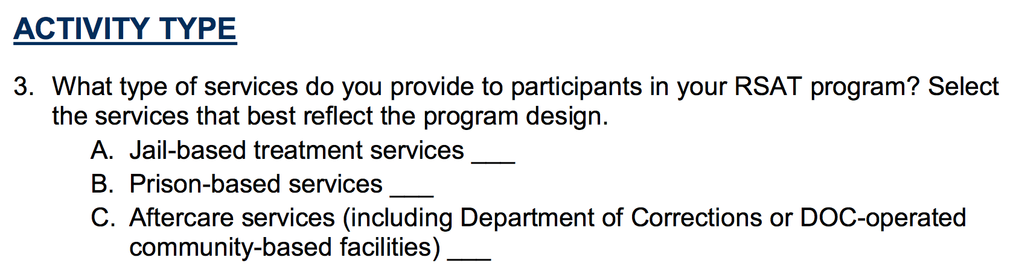
Program Level Measures

Slide 24
Program Level Measures
Please respond to this question based on the physical location of the federally funded program.
A jail-based program is one that is physically located within a locally run (non-state) entity. Jails are typically short-term facilities holding inmates of terms for less than one year.
A prison-based program is one that is physically located within a facility operated by state and typically holds felons and persons with sentences of more than one year. (This may vary by state.)
Notes:
Note that we are planning to add a juvenile option.

Slide 25
Program Level Measures
Notes:
Please be descriptive in describing your treatment model and the practices that are evidence based.

Slide 26
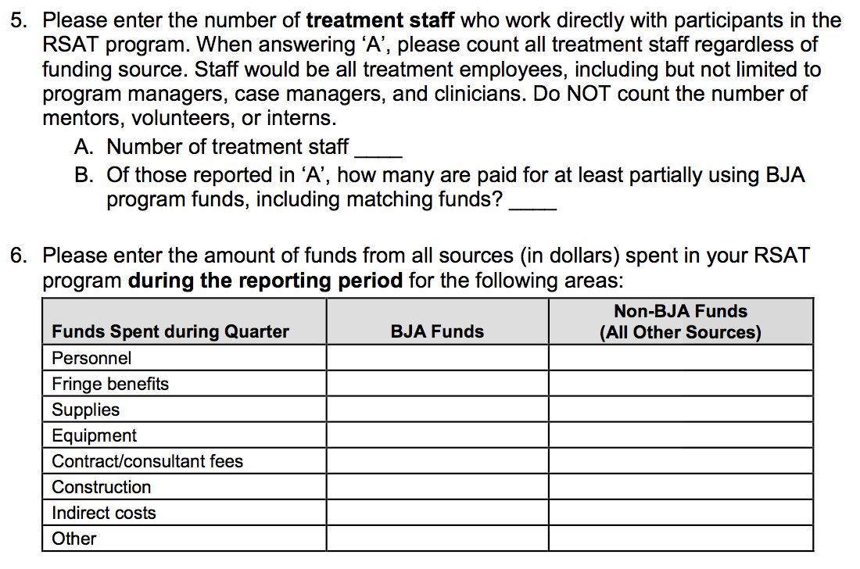
Program Level Measures
Notes:
5. Note that treatment staff include all program managers, case managers, and clinicians. Non-treatment correctional staff should not be included.
6. The dollar amount under the BJA funds should equal the federal award amount plus matching (or sub-award amount).
Non-BJA funds would be all other sources of funds that contribute to the RSAT program, to include but not limited to state and local resources. Reimbursements from insurance/Medicaid should not be reported.

Slide 27
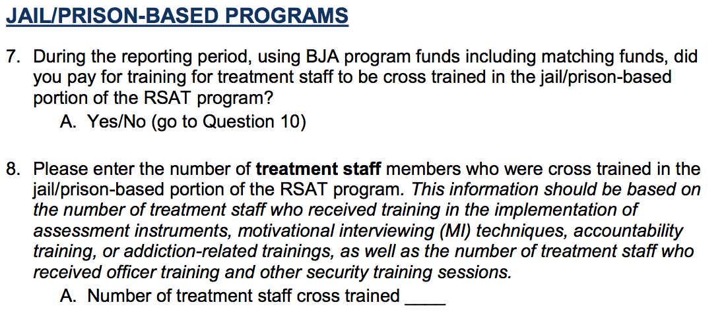
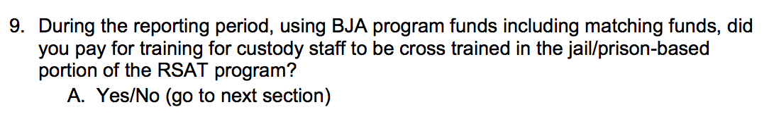
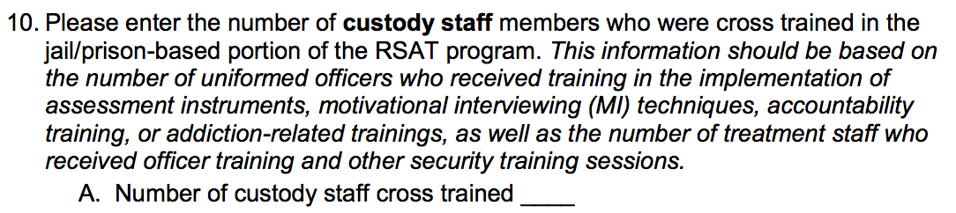
Training
9
Notes:
The training questions are focused on the use of RSAT funds including matching funds that are used to cross training treatment and custody staff on RSAT practices such as MI, addiction recovery and support, assessment tools, etc. For treatment staff, training around best practices around security measures should also be reported.

Slide 28
Participant Level Measures
The following questions pertain to individuals who are receiving services in your RSAT program. The following sections include the following: Risk Assessment and Treatment Planning, Number of Participants Receiving Services, Services Provided, Program Completion, Alcohol and Substance Involvement, and Court and Criminal Involvement. For these questions, please report the number of individuals that is equal to the proportion of the Federal funds (plus matching funds) of your total annual budget for the RSAT program. For example, if the BJA RSAT grant (plus matching funds) accounts for 65% of the total annual budget, then please report on 65% of the program participants. When applying the percentage, please round to the nearest whole number. Similarly, if BJA RSAT funds (plus matching funds) are paying for a specific number of beds/treatment spaces within your facility, please report on those individuals who are occupying those beds/treatment spaces.

Slide 29
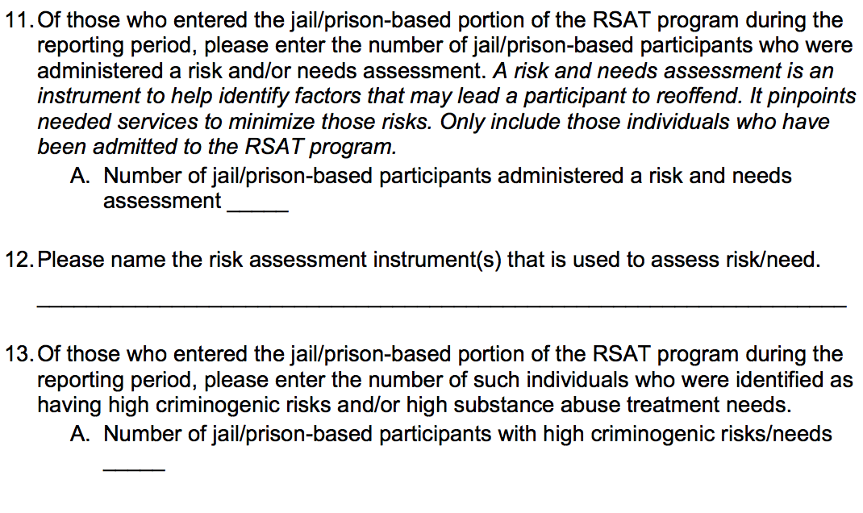
Participant Level Measures

Slide 30
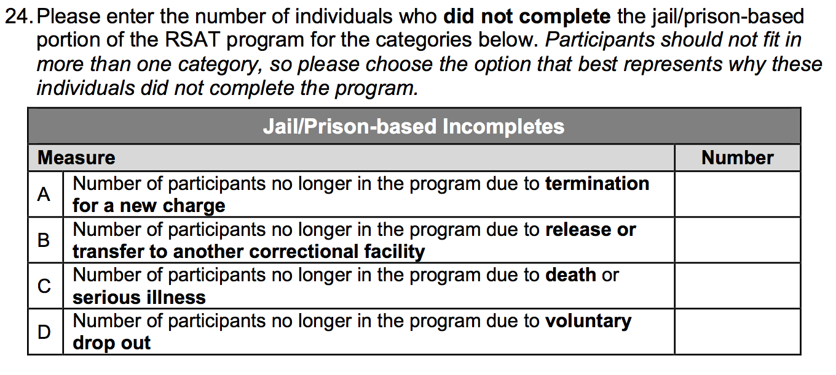
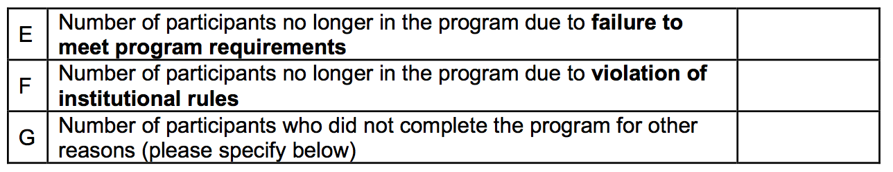
Participant Level Measures

Slide 31
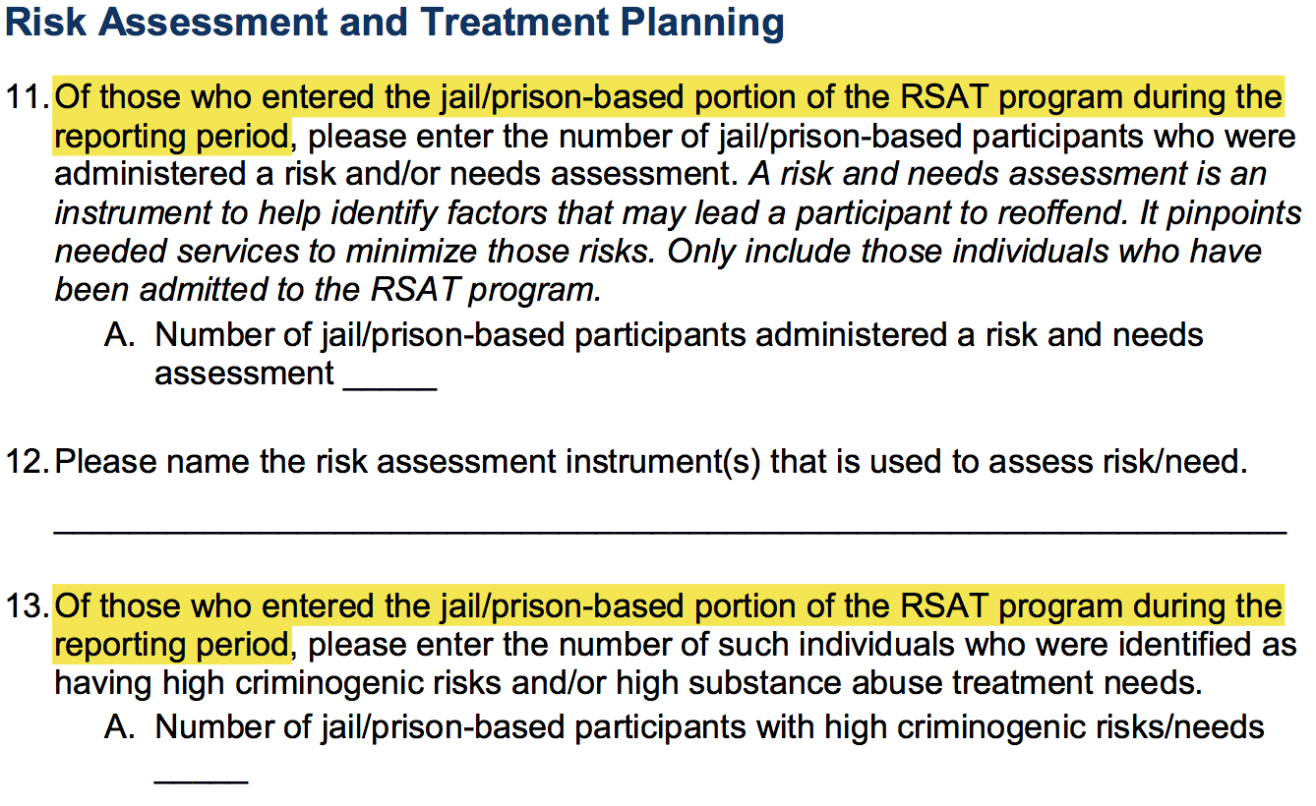
Participant Level Measures
The text highlighted should be interpreted as new participants that started in the program during the reporting period. (Question 16 for Jail/Prison and 38 for Aftercare)

Slide 32
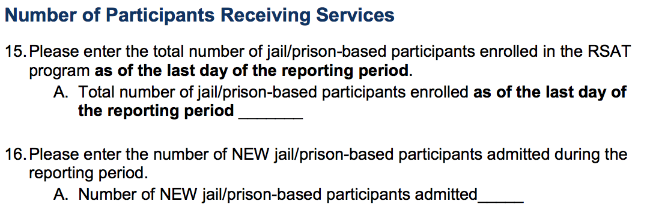
Participant Level Measures

Slide 33
Participant Level Measures
Count of the RSAT population as of a certain point in time
”NEW” means that the inmate was previously in the general population, or otherwise has not received services through the RSAT program prior to the existing reporting period.

Slide 34
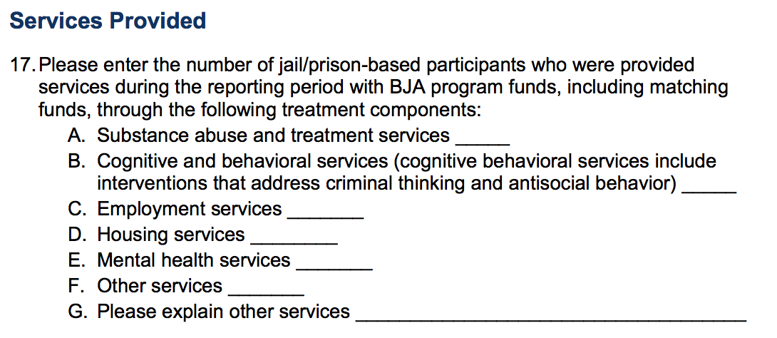
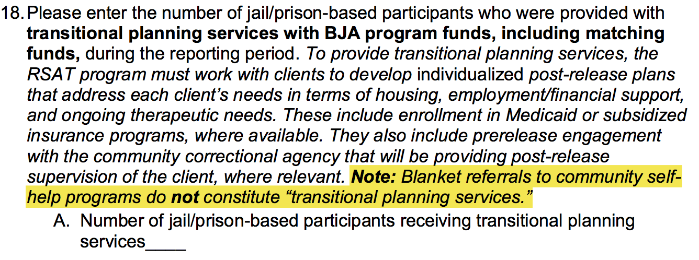
Participant Level Measures

Slide 35
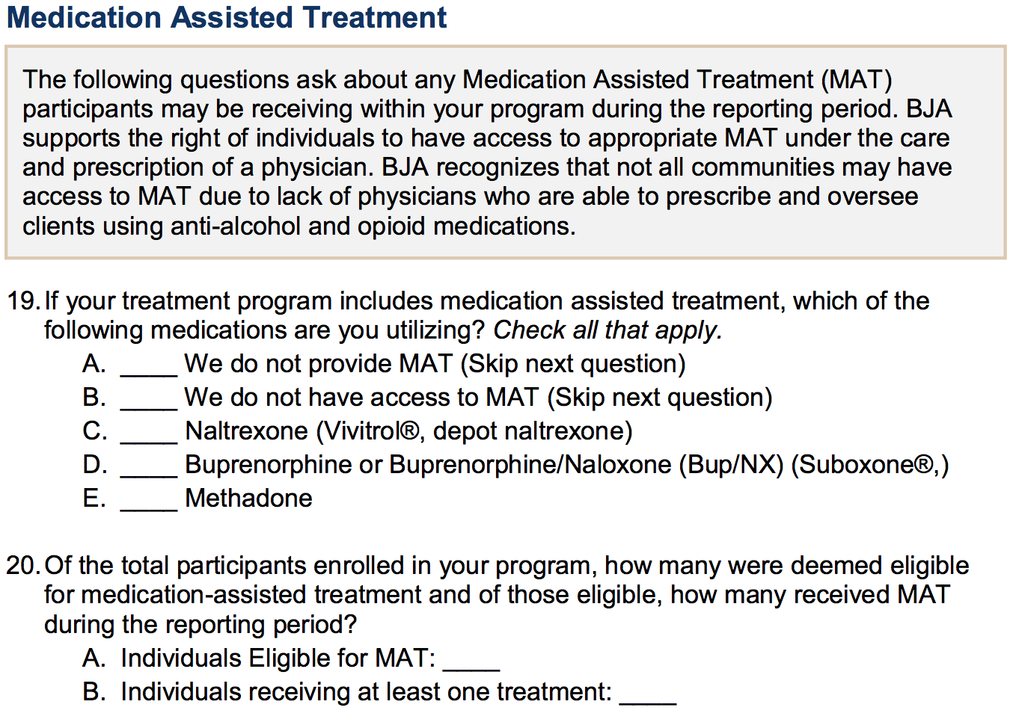
Participant Level Measures

Slide 36
Participant Level Measures
Respond to these questions even if federal grant funds are not used for MAT.

Slide 37
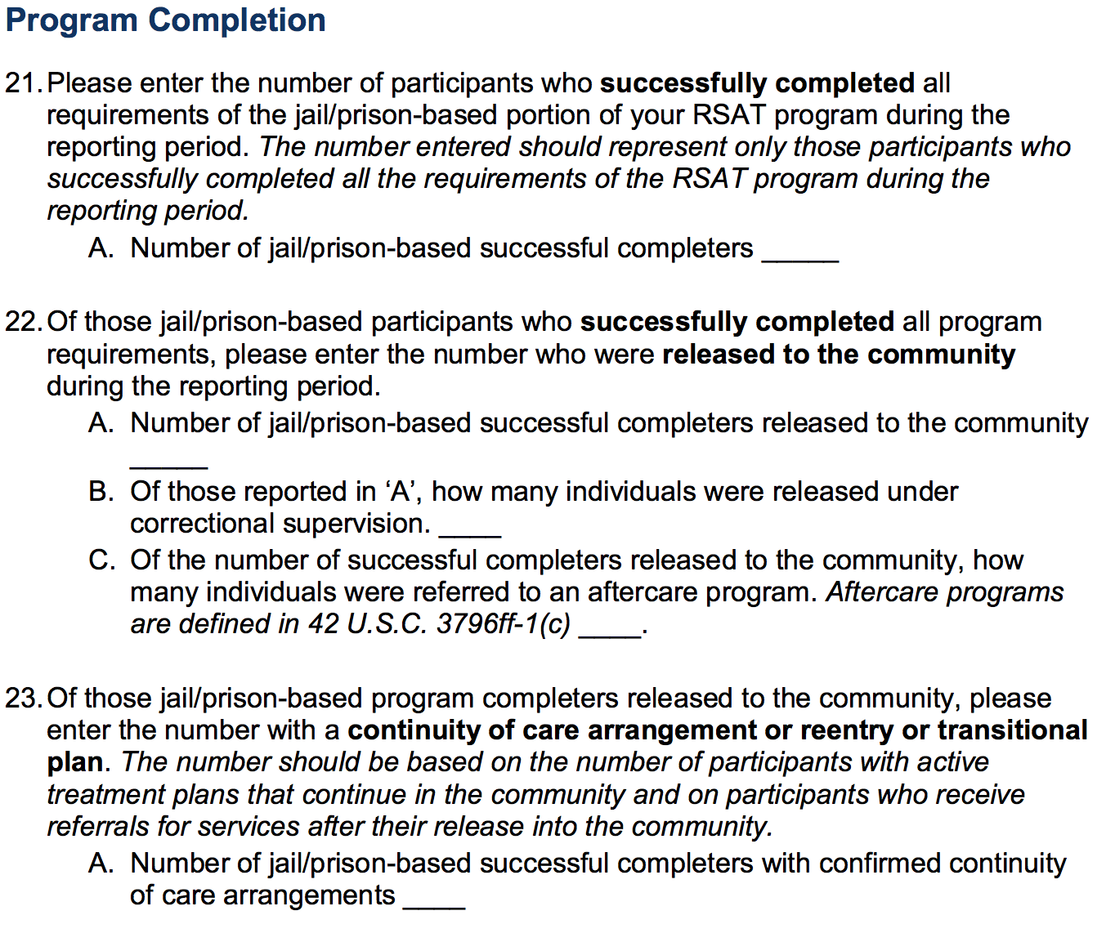
Participant Level Measures

Slide 38
Participant Level Measures
Program completion means that a program participant completed all required as determined by your policies, procedures, or practices. This could include, but not limited to length of time in the program, substance abuse treatment, administrative requirements, urinalysis testing, and other educational or cognitive services.

Slide 39
Participant Level Measures

Slide 40
Participant Level Measures
”Did not complete” means those that are no longer participating in the RSAT program and were removed without completing all the program requirements.

Slide 41
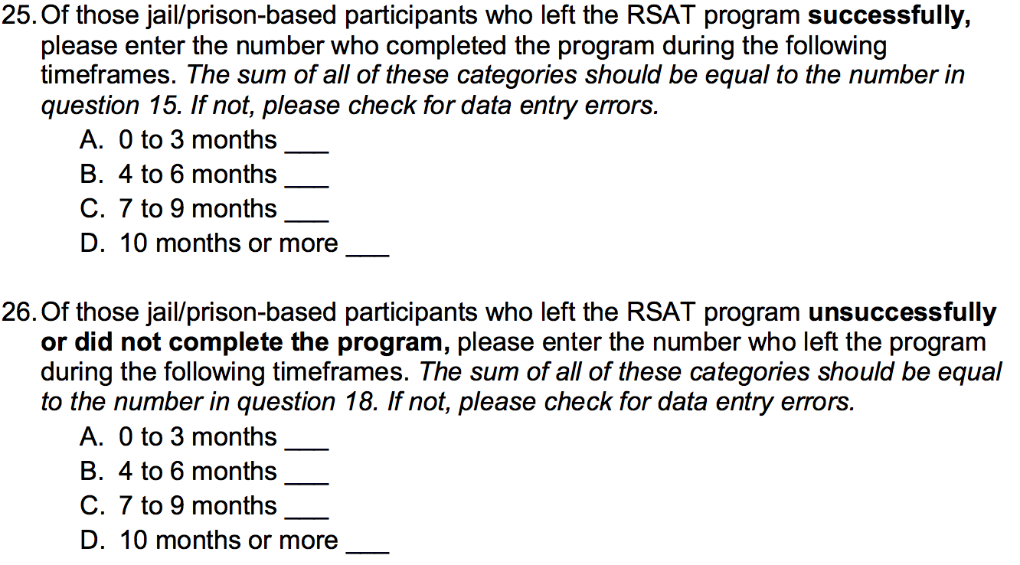
Participant Level Measures

Slide 42
Participant Level Measures
Please round up when counting months.

Slide 43
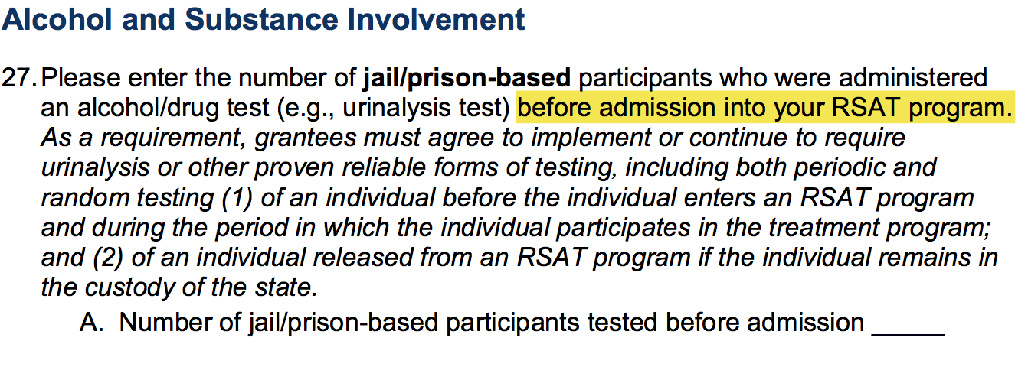
Participant Level Measures

Slide 44
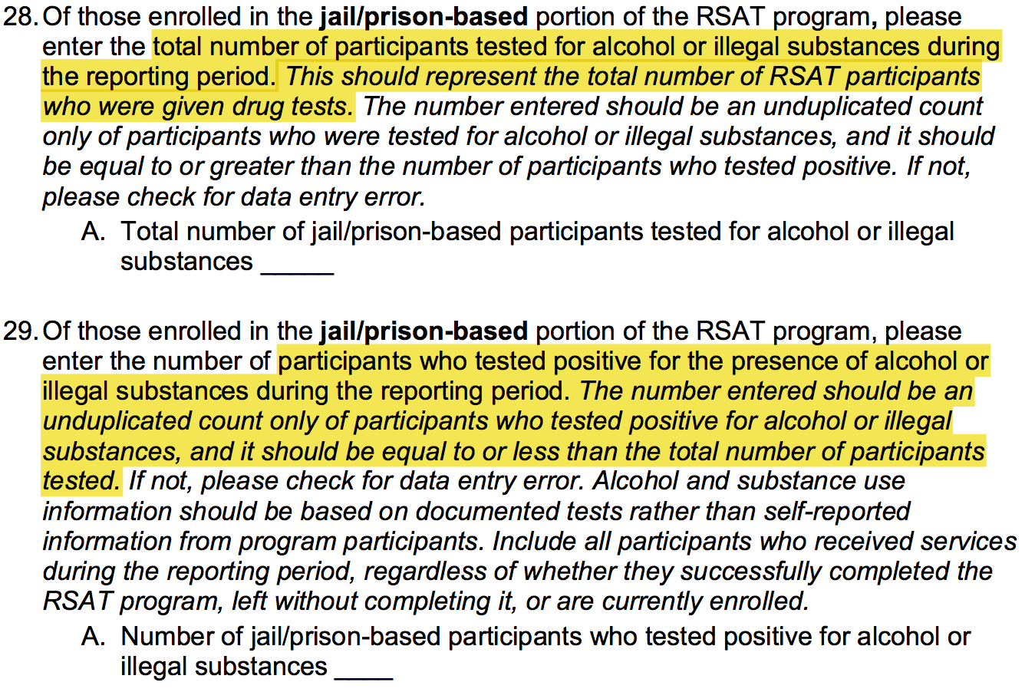
Participant Level Measures

Slide 45
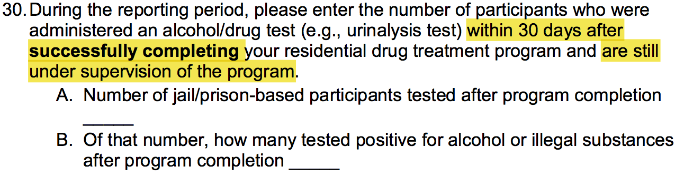
Participant Level Measures

Slide 46
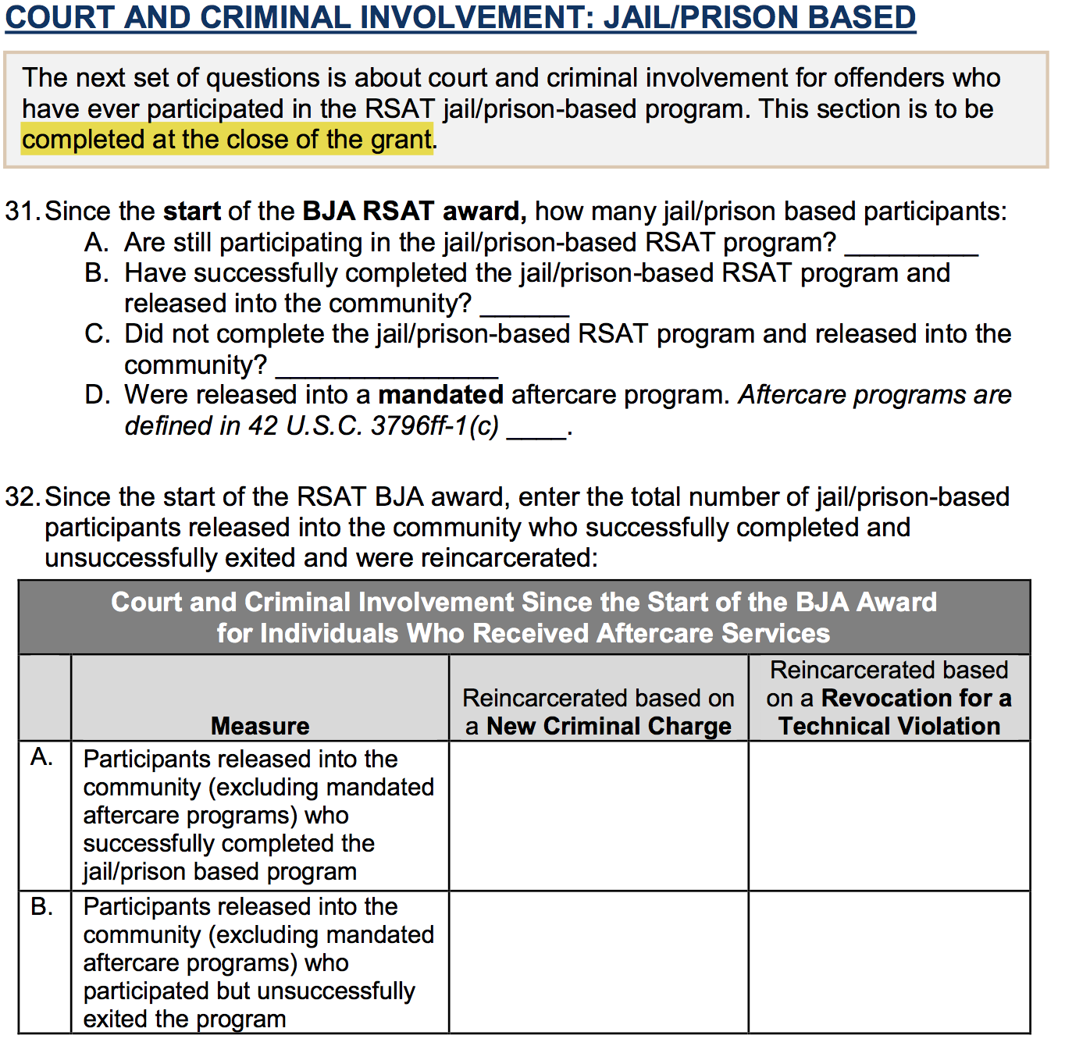
Participant Level Measures: Court and Criminal Involvement

Slide 47
Participant Level Measures: Court and Criminal Involvement
”31A” is the number of active participants in the program at closeout.
“31B/C” is the total number of participants that completed/did not complete the RSAT program during the time period that corresponds with the award start and end dates.
”31D” is the total number of participants released into mandated aftercare during the time period that corresponds with the award start and end dates.

Slide 48
Narrative Questions*
What were your accomplishments within this reporting period?
What goals were accomplished, as they relate to your grant application?
What problems/barriers did you encounter, if any, within the reporting period that prevented you from reaching your goals or milestones?
Is they any assistance that BJA can provide to address any problems/barriers identified in question #3?
Are you on track to fiscally and programmatically complete you program as outlined in your grant application?
What major activities are planned for the next 6 months?
Based on your knowledge of the criminal justice field, are there any innovative programs/accomplishments that you would like to share with BJA?
*NOTE: NARRATIVE QUESTIONS ARE ONLY REQUIRED OF THE FEDERAL GRANTEE.

Slide 49
RSAT Performance Measures
A more in depth training is available on the Information and Resources page in the PMT (link provided here):
https://bjapmt.ojp.gov/Training/Pages/RecordingInformation.html?title=BJA%20PMT%20-%20Measures%20&%20PMT%20Training%20(RSAT)-20161027%201702-1

Slide 50
A LOOK AT THE DATA:
Some Results through March 2016

Slide 51
Grant Funds
Table 1. Federal Appropriation and State Awards by Federal Fiscal Year
Fiscal Year | Total Appropriation | State Awards
 |  | Minimum | Average | Maximum
2013 (N = 53) | $10,589,247 | $42,357 | $197,301 | $1,103,224
2014 (N = 53) | 8,637,752 | 34,551 | 160,938 | 881,054
2015 (N = 53) | 8,852,961 | 35,412 | 167,037 | 908,404
2016 (N = 53) | 10,328,336 | 41,313 | 194,874 | 1,048,370
Fiscal appropriations ranged form a low of $8.6 million to a high of $10.5 million.
Average state appropriations ranged from a minimum of $34,551 to a high of just over $1.1 million.
The allocations are based on a formula that provides each State and Territory with a base amount, plus an allocation in proportion to the ratio that its prison population bears to the total prison population of all States and Territories. The prison population includes all inmates under the jurisdiction of the State or Territory for whom the State has legal authority and responsibility.
[https://www.bja.gov/Funding/16RSATAllocations.pdf]

Slide 52
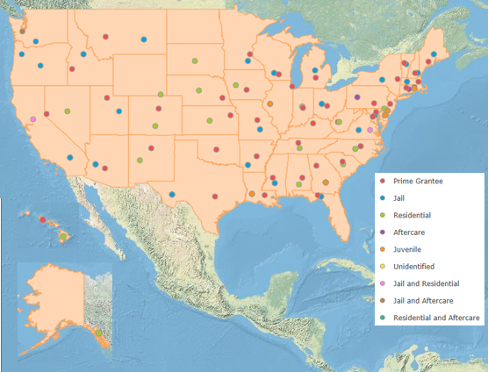
RSAT Programs
Figure 1. Map of BJA-Funded RSAT Programs: October 2015–March 2016
[1] The U.S. territories of Guam and American Samoa are not included in this map.
[2] Not all subawards are not included due to limited available geographic information.

Slide 53
BJA and Matching Funds Spent
Figure 2. Federal and Nonfederal Matching Funds Spent by Expense Category:
October 2015–March 2016
Of the $9.9 million spent during October 2015-March 2015:
  48% went to personnel and fringe benefits
  43% went to contracts, which include contracted services for treatment, housing, and employment services if not conducted in-house

Slide 54
Participant Key Measures
In October 2015 and March 2016
Enrollment on any given day is:
  Prison programs: 7,000-8,000 participants
  Jail programs: about 2,800 participants
  Juvenile programs: 450-600 participants
  Aftercare programs: 330-680 participants

Slide 55
Program Completion Rates: Prison, Jail, and Juvenile Programs
Figure 3. Percentage of Participants Completing or Unsuccessfully Exiting the Program:
October 2015–March 2016
Jail (N=42)
Residential/Prison (N=43)
Juvenile (N=9)
Note that program completion is calculated by taking the total number of participants that successfully complete the program divided by the total number of person exiting the program during a defined time period.
Notes:
The completion rate for Jail based programs is 71%, 67% for prison programs, and 53% for juvenile programs.
# completing program
Jail: 1433
Prison: 2905
Juvenile: 193

Slide 56
Program Completion Rates: Aftercare Programs
Figure 4. Number of Participants Completing Versus Not Completing Program:
October 2015–March 2016 (N=14)
Average completion rate during this 6-month period was 18.4% and atypical.
Aftercare completion rates typically range from 18 to 50%.
Note that program completion is calculated by taking the total number of participants that successfully complete the program divided by the total number of person exiting the program during a defined time period.

Slide 57
Program Completers
Figure 5. Time in Program for Program Completers
Notes:
About half of jail based program participant successfully complete in the first 3 months
For prison-based, about 4% has reported to be complete in the first 3 months, which may not comply with program requirements.

Slide 58
Participants Exiting Without Completion
Figure 5. Time in For Participants Exiting Without Completion
Notes:
# of participants leaving program without completing
Jail-587
Prison – 1450
Juvenile – 170
Most common reasons cited for jail based programs include: violation of institutional rules; release or transfer; voluntary drop out, and failure to meet program requirements
Most common reasons cited for prison-based programs include: violation of institutional rules; release or transfer, failure to meet program requirements
For Juvenile programs the reasons cited are: release or transfer and violation of rules.
For aftercare, the most common reason cited (by a long shot) was voluntary dropout (90%)
Based on this data, we can see that retention in the first 3 months of a program is critical and a possible area for technical assistance, particulary for Jail and Aftercare programs.

Slide 59
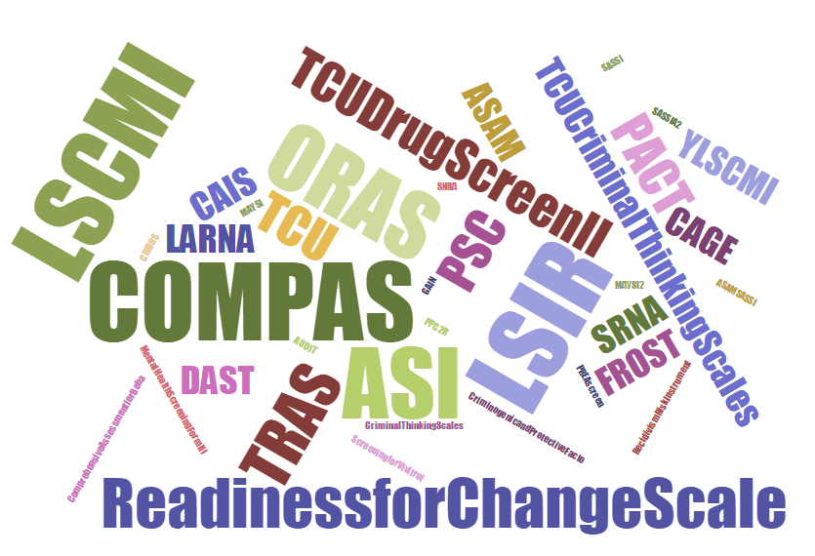
Risk and Needs Assessments
90% of jail grantees, 98 percent of prison, and 100 percent of programs serving juveniles use an assessment tool
LSI-R (17%), Compas (8%), GAIN (7%), and LSCMI (3%) are most common.

Slide 60
Resources
PMT Web Site:
https://bjapmt.ojp.gov
PMT Help Desk:
  Monday–Friday 8:30 a.m.–5:30 p.m. ET
  Toll-free number: 1-888-252-6867
  E-mail:
  bjapmt@usdoj.gov
On behalf of BJA and the PMT team,
thank you for your dedication and hard work!
Notes:
Here’s the BJA PMT Help Desk contact information. Our office hours are Monday-Friday, 8:30 am-5:30 pm Eastern Time (except U.S. federal holidays). We strive to return everybody’s e-mail and phone call within 24 hours, so please don’t hesitate to leave a voicemail or e-mail, even after business hours.
We’ll leave the Webinar open for about 5-10 minutes so you can download any handouts attached or use the Q & A box if you have any questions.

Slide 61
Questions?

Slide 62
Questions?
Type your question in the Q&A box
on your computer screen
Speaker Contact Info
Jimmy Steyee
Jimmy@carnevaleassociates.com

Slide 63
Always Happy to Hear From You
Thank you all for the great work you do!
We know your job is not easy, but we aim to make it a bit easier & are always happy to hear how we can do so…
Contact me anytime with inquiries about the topics we have covered: Jimmy@carnevaleassociates.com
Also appreciate hearing about your experiences & innovations…
Thank you for your participation …

Slide 64
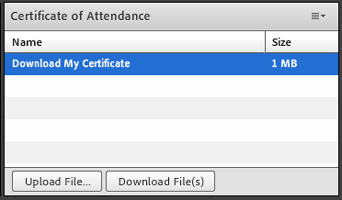
Certificate of Attendance
Download now!

Slide 65
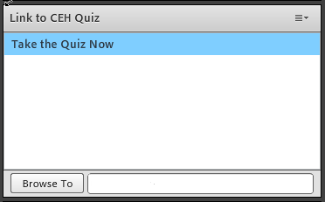
Questions?
1 NAADAC CEH
Pass 10-question quiz with 7 correct answers
Receive certificate immediately

Slide 66
RSAT Technical Assistance and Training Center
For more information on RSAT training and technical assistance visit:
http://www.rsat-tta.com/Home
or email Stephen Keller, RSAT TA Coordinator at
skeller@ahpnet.com

