Slide 1


RSAT Webinar on the Opioid Crisis
Anatomy of an Epidemic:
How did we get here?

Slide 2
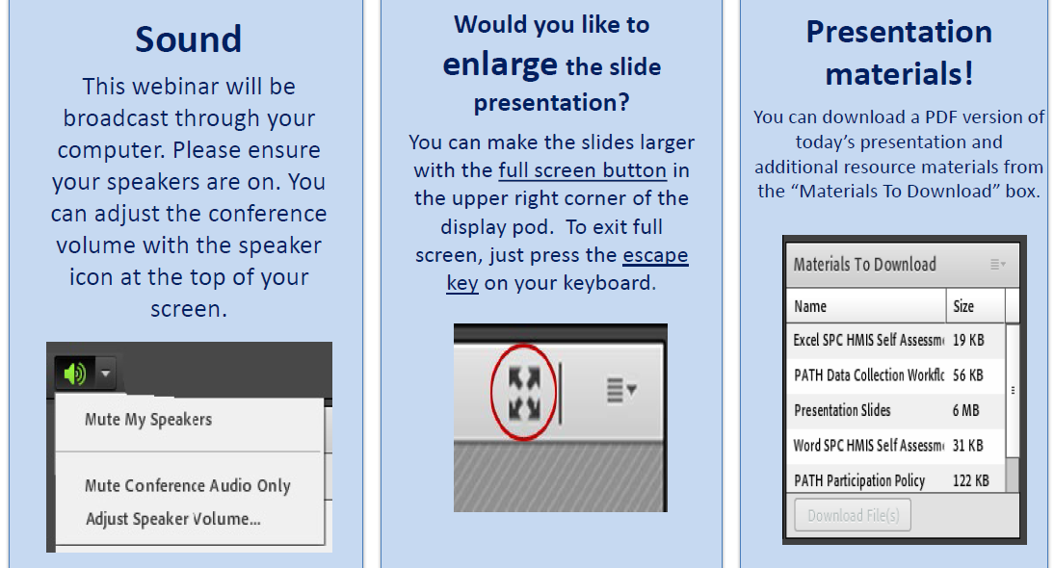
Housekeeping: Functions

Slide 3
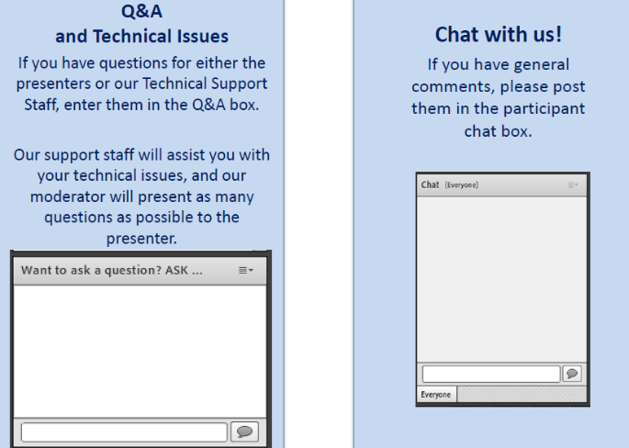
Housekeeping: Communication

Slide 4
  RSAT Webinar on the Opioid Crisis
  Anatomy of an Epidemic:
  How did we get here?
Moderator
Stephen Keller
Training/TA Coordinator, RSAT-TTA
Notes:
Example:
If you can understand the form that allows your insurance to bill at a hospital – you can’t be seen.
If you can’t understand the consent to treat form, you don’t’ get tx
Pretty basic, but the research shows that most people do not understand these forms….they mostly sign them anyway….but lets look at some research that applies to our populatiomn

Slide 5

Niki Miller, M.S., CPS
NMiller@ahpnet.com
Advocates for Human Potential, Inc.
www.ahpnet.com

Slide 6
Purpose
To examine historical trends in U.S. opioid use, sentinel events, important regulations and recent trends in prescribing practices. To look at factors that contributed to the tragedy that continues to devastate communities and families, especially those involved with the justice system.
Please feel free to ask questions. Misinformation and false assumptions about treatment and recovery are very common among people who use opioids, even those in recovery and also among service providers.

Slide 7
Learning Objectives
Participants will be able to:
Compare the current opioid epidemic to other periods of elevated opioid use in U.S. and name at least one unique characteristic of the current crisis;
Identify two properties of pharmaceutical opioids that may put the user at higher risk for certain harms than some illicit opiates;
Name the two different categories of medications approved for treating opioid use disorders and give an example of the advantages of each.
List at least three factors that heighten the risk of opioid overdose fatality among individuals recently released from custody.

Slide 8

Help!
An estimated one third of all individuals with an opioid use disorder pass through the criminal justice system each year.
A NIDA survey of 50 criminal justice agencies reported rates of opioid use disorders as high as 50%
Boutwell AE, Nijhawan A, Zaller N, Rich JD. Arrested on heroin: a national opportunity. J Opioid Manag. 2007;3:328–32. [PubMed]

Slide 9
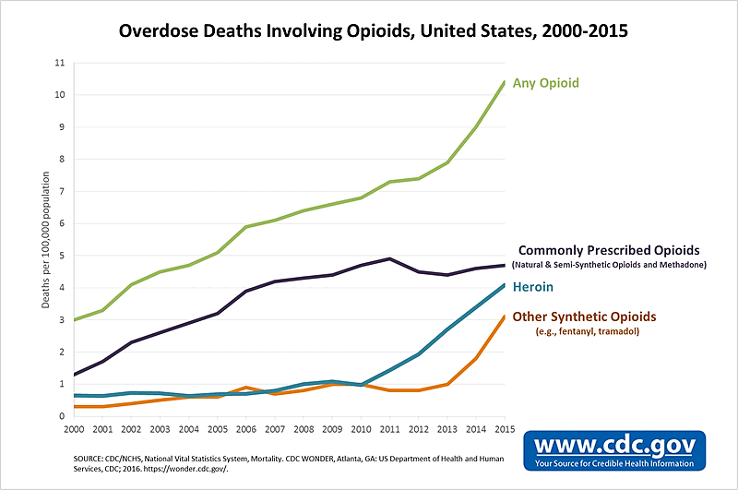
Opioid Fatality Trends

Slide 10
Timeline: Key Events
1972 – Methadone treatment formally approved for highly regulated treatment programs. Research: reduces crime among justice-involved individuals with addiction.
1995 - National Survey on Drug Use & Health increased heroin use, rise to epidemic levels
1996 – FDA approval of OxyContin for moderate to severe pain; drug companies make false claims of low addiction risk and urge doctors to aggressively treat pain.
2002 – FDA approves buprenorphine for treatment of opioid use disorders.
2004 - The World Health Organization & UN Office on Drugs and Crime call for ORT.
2007 – Purdue Pharma pleads guilty to misleading & false marketing – pays $634 million in damages; sales revenues exceed $22 billion over one decade.
2009 – Increased methadone prescribing for pain results in deaths among patents.
2013 – Seizures of illicitly manufactured Fentanyl more common - fatalities skyrocket.

Slide 11
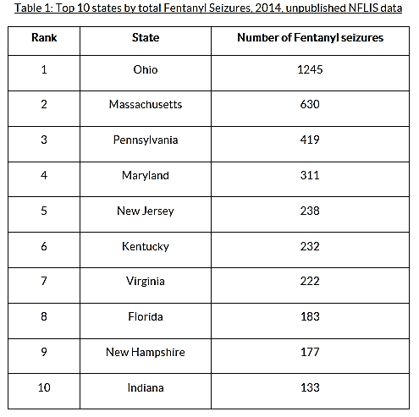
Fentanyl: Analogs, Diversion, Trafficking

Slide 12
Extremely High-risk Group
In U.S. studies, 53% of recently released opioid dependent individuals have overdosed at least once;
80% have witnessed an overdose;
28% have witnessed a fatal overdose;
Recent study: almost 15% of all deaths of formerly incarcerated (1999-2009) were related to opioids.
- Magura, S., Lee, J.D., Hershberger, J., Joseph, H., Marsch, L., Shropshire, C. & Rosenblum, A. (2009, Jan. 1). Buprenorphine and methadone maintenance in jail and post-release: a randomized clinical trial. Drug Alcohol Depend,1;99(1-3), 222-30.
- U.S. Department of Health and Human Services (HHS), Office of the Surgeon General, Facing Addiction in America: The Surgeon General’s Report on Alcohol, Drugs, and Health. Washington, DC: HHS, November 2016.

Slide 13
Facts About Methadone
Methadone prescriptions for pain increased
1000% from 1997-2005
2006 - FDA advisory about methadone for pain; “black box” warning added and dosing changed.
2008 - DEA asks manufacturers to restrict certain methadone products to opioid treatment programs and hospitals.
2012 – CDC: methadone involved in a third of prescription opioid overdose fatalities from 1999-2010.
2015 – First decreases (9% down) in methadone overdose deaths.
2016 – CDC prescribing guidelines caution against methadone for pain.

Slide 14
Buprenorphine: Blessing or Curse?
Abuse potential
Overdose risk
Combination formula
Potential for treating OUDs
Unique properties
Withdrawal and tapering
Contraband use in custody

Slide 15
Opioid Antagonist Therapy
Oral naltrexone studies with re-entering populations
Effect of opioid use with antagonist medications
Vivitrol – approved, uses, pros and cons
Successful re-entry treatment programs
What is doesn’t do
Who it works for

Slide 16
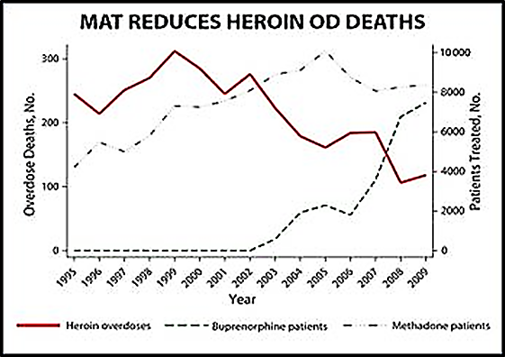
Decrease in Overdose Deaths w/
Approved Agonist Therapies
Source: UN Office on Drugs and Crime, 2014

Slide 17
Overdose Prevention Video
Video on Preventing Post Release Overdose
The Center for Prisoner Health and Human Rights
www.prisonerhealth.org
https://www.youtube.com/watch?v=gGJDAduzb1U
Notes:
Play from start to 3:45 on counter

Slide 18
Overdose: Prevention vs Emergency Measures
Overdose reversal with Naloxone (Narcan)
Education on tolerance and post-release risks
Harm reduction and safer use information
Flagging indicators of elevated risk
Integrating overdose prevention into release planning
Links to MAT w/agonist medications & harm reduction

Slide 19
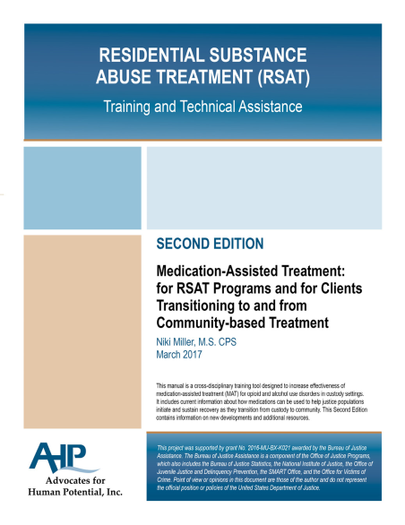
Resources for RSAT Programs
RSAT Promising Practice Guidelines for MAT
New Second Edition RSAT MAT Manual
New RSAT Health Literacy Manual
RSAT MAT Program Videos
MAT Promising Practice Guidelines for CJ

Slide 20
Other Resources
FDA: Using OTC and Prescription Meds Safety Taking Medicines Safely in Recovery Drug Interactions and Alcohol - NIAAA Medscape Drug Interaction Checker SAMHSA - How to Use Methadone Safely Decisions in Recovery – SAMHSA’s Shared Decision Making Tool for MAT What to ask When You are Prescribed Opioids - FDA Listing of Harm Reduction Service Providers by state SAMHSA TIP - Managing Chronic Pain in Adults w/or in Recovery from SUDs When the Seconds Count - \ American Society of Anesthesiologists/ONDCP

Slide 21
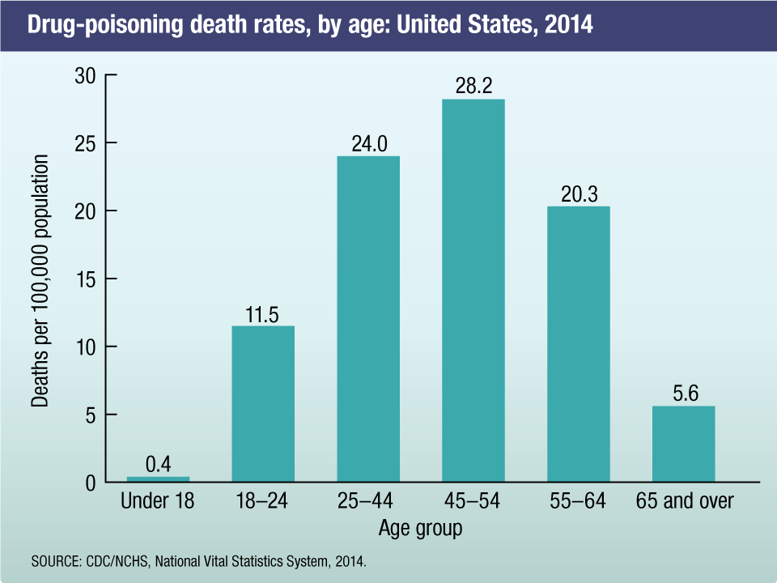
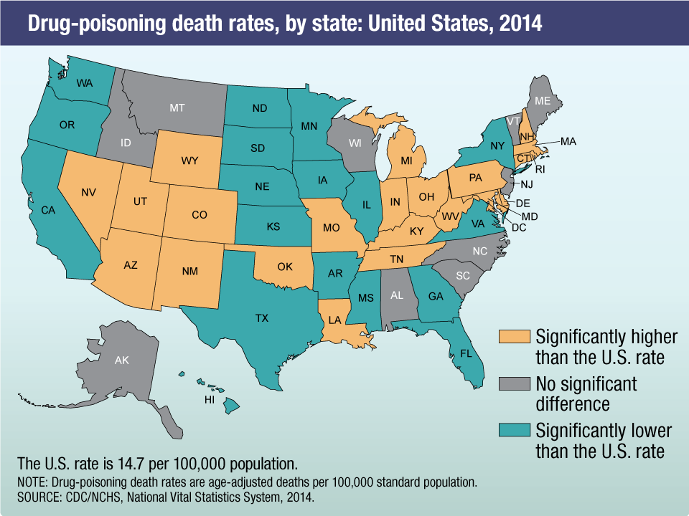
CDC: June 2017 – Opioid Overdose Leading Cause of Death for Americans Under 50 years of age

Slide 22

Questions?
Type your question in the Q&A box
on your computer screen
Speaker Contact Info
Niki Miller
Nmiller@ahpnet.com

Slide 23
Always Happy to Hear From You
Thank you all for the great work you do!
We know your job is not easy, but we aim to make it a bit easier & are always happy to hear how we can do so…
Contact me anytime with inquiries about the topics we have covered: Nmiller@ahpnet.com
Also appreciate hearing about your experiences & innovations…
Thank you for your participation …

Slide 24
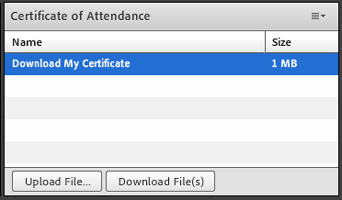
Certificate of Attendance
Download now!

Slide 25
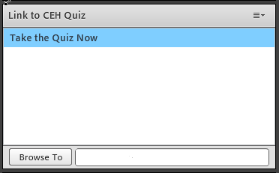
Questions?
1 NAADAC CEH
Pass 10-question quiz with 7 correct answers
Receive certificate immediately

Slide 26
RSAT Technical Assistance and Training Center
For more information on RSAT training and technical assistance visit:
http://www.rsat-tta.com/Home
or email Stephen Keller, RSAT TA Coordinator at
skeller@ahpnet.com

