Slide 1
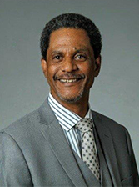
How to be a Good Facilitator
Winners’ Circle Peer Support Groups
Facilitator Training
Phillip Barbour TASC-IL

Slide 2
Housekeeping: Functions

Slide 3
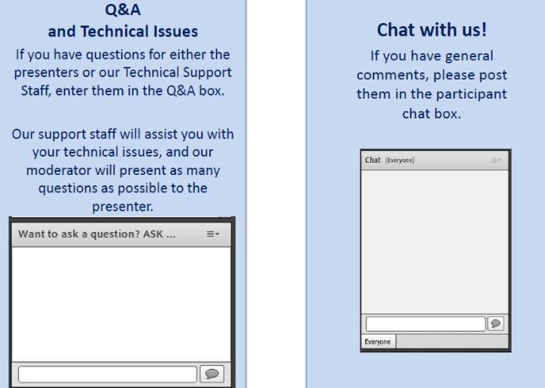
Housekeeping: Communication

Slide 4
How to be a Good Facilitator:
Winners’ Circle Peer Support Groups
Facilitator Training
Moderator
Stephen Keller
TTA Coordinator, RSAT-TTA
Notes:
Example:
If you can understand the form that allows your insurance to bill at a hospital, you can’t be seen.
If you can’t understand the consent to treat form, you don’t get treatment.
Pretty basic, but the research shows that most people do not understand these forms, but they mostly sign them anyway. Let’s look at some research that applies to our population.

Slide 5
Phillip Barbour
Pbarbour@tasc-il.org
TASC-IL
www.tasc.org

Slide 6
Objectives
Participants will be able to:
How to provide a low-cost, sustainable recovery support system in a community especially where treatment resources may not be readily available
How to become a Facilitator for Winners’ Circle groups
Understand why getting Facilitator training is so important

Slide 7
Brief Recap
From the January 2018 webinar

Slide 8
What is Winner’s Circle?
Peer led & driven support group
Open to formerly incarcerated individuals and family/friends
Supports recovery from addiction

Slide 9
Origins of Winner Circle
Began in Connecticut in 1988
Brought to Texas where it further developed through therapeutic community concepts
Currently operates in a number of states

Slide 10
What is a therapeutic support network?
Peer based group facilitated by positive role models
Role models share similar backgrounds and experiences
Support network allows opportunity for participants to share emotions resulting from release from CJS

Slide 11
Guiding Principles of Winner Circle
Winner’s Circle is a place to learn and practice pro-social skills.
Members should be encouraged to actively participate in family, recreational, and community projects.

Slide 12
What is Value of WC?
Low cost
Recovery Support Capacity
Entry point for starting recovery program
Improves treatment retention
Promotes best practices

Slide 13
Poll Question

Slide 14
Role of the facilitator
Skills and Knowledge
Notes:
The role of the Facilitator is that of a mentor and liaison, someone who will eventually step back from the project as the Leadership Committee and local groups become more active and self-governing. The section titled “Role of the Facilitator” describes the skills and knowledge needed to be effective. Most of the work is centered on developing leadership skills within the Winners’ Circle members and forming the Leadership Committee.

Slide 15
The Role
The main role of the facilitator is to guide the growth and development of existing and potential Winners’ Circles and Winners’ Circle Leadership Committees.
Notes:
The main role of the facilitator is to guide the growth and development of existing and potential Winners’ Circles and Winners’ Circle Leadership Committees. They do not run groups or meetings, but are required to have an active presence as advisor and liaison between stakeholders and the Winners’ Circle members. It would not be out of the realm of duties if the facilitator has some responsibility for documenting meeting events in accordance with a sponsoring agency policy, such as for incident reporting or security logs. However, facilitators are not part of the Winners’ Circle or Winners’ Circle Leadership Committee and should not be view as members.

Slide 16
What they Do
Have an active presence in the group (but do not run the group)
Act as an advisor
Liaison between stakeholders
Some documentation responsibilities
Notes:
As it relates to having an active presence in the group, the facilitator is there to ensure safety, keep disruptions from taking over, act as eyes and ears for the Chair person with regard to inappropriate behavior and be an advisor on issues that may arise in a meeting. For example, a facilitator might be called on to explain what a recovery home is, or what is meant by going in to detox. facilitators should have a working knowledge of treatment, recovery processes, procedural matters that might impact an ex-offenders recovery efforts. We will talk more about the clinical underpinnings of that later in the manual.
As a rule facilitators do not run the meeting. However, in situations where a new group is forming it may be necessary for the facilitator to act as Chair and model the meeting process in order to get things going. This should not be for an extended period of time, rather as soon as the Chair and Co-Chair are identified and trained, the facilitator should relinquish those duties to them.
As a Liaison to stakeholders for a meeting, the facilitator may have numerous obligations, but most likely it will be limited to facility management. Things like making sure the building is locked after the meeting is over and observing rules such as smoking only in designated areas. There will likely be some responsibility around maintaining attendance sheets for the meeting, verification of attendance and safekeeping of the documentation as needed.
Typically, a facilitator’s active role lasts 6-12 months, after which time he or she begins to step back in the oversight. They are still available for consultation as needed and continue to communicate stakeholder issues to the group. However, by and large, the Winners’ Circle and Leadership Committee have autonomy.
Of course any of these functions will depend on the setting of the meeting. Some WC are held in the community with little or no affiliation with community corrections and completely autonomous. Others may be held in secure facilities or treatment centers with higher levels of accountability. The key is the facilitator remain as neutral as possible so not to undermine the true spirit of peer-led recovery support.

Slide 17
Facilitator Training Why it’s so important!!!

Slide 18
Facilitator Definition
A person or thing that makes an action or process easy or easier.
"a true educator acts as a facilitator of learning"

Slide 19
Have you ever tried to assemble something without using the instructions?
Notes:
There this furniture company (I won’t mention the name, but it’s a Swedish company) I think hired engineers that were abused as children and now their out to get even with the world! While we made every effort to write the manual in easy to understand language, we could not foresee who the readers would be! So, if you have someone not skilled in the right ways they may experience difficulty being a good WC facilitator.

Slide 20
Skills and Knowledge
Knowledge
Skills
Re-entry issues (housing, jobs, etc.)
Process of ongoing recovery
Relapse prevention
Family pressures, especially in early re-entry/recovery
Community resources (including treatment providers)
Communication skills (both writing and speaking)
Delegation of tasks and responsibilities
Leadership coaching
Resource procurement
Conflict resolution
Recognizing Stages of Change
Notes:
This training and manual represents the formal application for training facilitators. In order to be effective as a facilitator of either a Winners’ Circle or Leadership Committee, it is important to have certain knowledge, skills, and attitudes. Most Circle members initially will not have the prior training needed to run a group, control a discussion, or redirect when things get off track. The facilitator should be a resource of information for members making plans or trying to adjust to returning to a community. The following lists identify some of these necessary attributes:

Slide 21
Recovery is an ongoing process
WC are designed to be “peer-lead, peer-driven”. The Facilitator should be empathic to that end.
How do you know if your group leaders are experiencing difficulties in their own recovery?
What do you do as a Facilitator?
Notes:
Understanding that recovery is an ongoing process, facilitators should have some knowledge of signs of relapse and or relapse prevention techniques. Equally as important
What would you do if you suspect something is wrong with your chair-person? Remove them from the position? Talk to your other leaders? Talk to the group? Confront the chair-person?

Slide 22
Family pressures, especially in early re-entry/recovery
You’re fix now!
I’ve changed, but they treat me the same!
“I don’t like meetings”
What REAL support from family is appropriate and/or needed
Notes:
Having some empathy and understanding of these early recovery issues is vital to the short and long term goal of sustained recovery. Many clients want to take on the world when they first get clean or get out of jail. Participating in a Winners’ Circle support group can help clients keep a more realistic pace, so to avoid the pitfalls of early recovery. The training will help navigate these common issues.

Slide 23
Community resources (including treatment providers)
A good facilitator should have some knowledge of these community resources
Know what's needed to access these resources
Linkages to other resources

Slide 24
Poll Question

Slide 25
Other aspects of the facilitator training
There’s always room for improvement!

Slide 26
Ethics and Boundaries
HIPPA, Confidentiality, and Mandated Reporting
Ethical decision making models
Scenario-based exercises
Stay in your lane as a Facilitator

Slide 27
Ethics and Boundaries
It is essential for the facilitator to behave in an ethical manner in his/her relationship with the Winners’ Circle members, treatment providers, and other key stakeholders. In this manner, the facilitator serves as a role model for the group.
Notes:
Additionally, the facilitator may be responsible for maintaining accurate documentation of meeting attendance (apart from the group secretary) and other records required by the sponsoring agency. This person must maintain a professional relationship with Winners’ Circle leaders and members, and demonstrate clearly-defined boundaries. For instance, the facilitator must avoid becoming romantically and/or intimately involved with leaders or show bias toward or against any member of the group.

Slide 28
About the training
2-days in length
One trainer for groups up to 25 people
The fee varies best on transportation cost, federal per diem rates and personnel cost
Cost sharing may be an option to help keep cost down (e.g. you pay for lodging, etc.)

Slide 29
Poll Question

Slide 30
Center for Health and Justice at TASC
For information on how to get a facilitator training at your location, contact:
Website: http://www.centerforhealthandjustice.org/
1-855-827-2444
Phillip Barbour - pbarbour@tasc.org

Slide 31
Questions?
Type your question in the Q&A box on your computer screen.
Speaker Contact Info
Phillip Barbour
Pbarbour@tasc.org

Slide 32
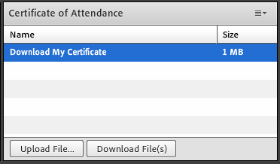
Certificate of Attendance
Download now!

Slide 33
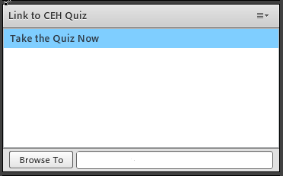
Continuing Education Hour (CEU Certificate)
1 NAADAC CEH
Pass 10-question quiz with 7 correct answers
Receive certificate immediately

Slide 34
RSAT TTA Center
For more information on RSAT training and technical assistance, visit
http://www.rsat-tta.com/Home
or
e-mail Stephen Keller, RSAT TTA Coordinator, at
skeller@ahpnet.com

