Slide 1
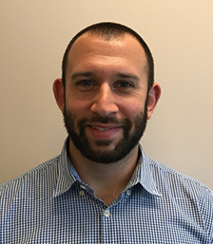
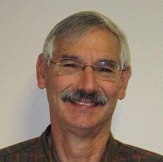
Pre-trial Medication Assisted Treatment
for Jail Populations
Steve Keller & Andy Klein Advocates for Human Potential, Inc.

Slide 2
Housekeeping: Functions

Slide 3
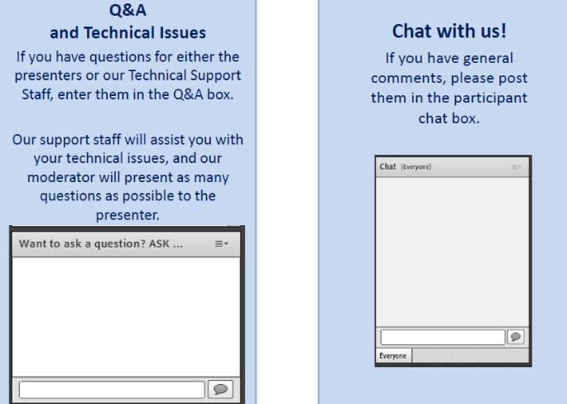
Housekeeping: Communication

Slide 4
Pre-trial Medication Assisted Treatment
for Jail Populations
Moderator
Stephen Keller
TTA Coordinator, RSAT-TTA
Notes:
Example:
If you can understand the form that allows your insurance to bill at a hospital, you can’t be seen.
If you can’t understand the consent to treat form, you don’t get treatment.
Pretty basic, but the research shows that most people do not understand these forms, but they mostly sign them anyway. Let’s look at some research that applies to our population.

Slide 5
Learning Objectives
During this webinar participants will learn about:
Understand the importance of pretrial diversion for individuals with opioid use disorders.
Identify treatment options, specifically medication assisted treatment, for pretrial diversion programs.
Explain the types of programming that make for a successful pretrial program, including peer-led programming and therapeutic communities.

Slide 6
Why Pretrial?
Approximately 750,000 in nation’s jails.
Almost 500,000 are there awaiting trial.
However, because the average stay of pretrial detainees is much shorter than those sentenced to jail, the number of pretrial detainees that pass through the nation’s jails are over 10 million a year.

Slide 7
Why Pretrial?
Like those sentenced to jail, the majority of these 10 million detainees have substance use disorders and, in many jurisdictions, many of these suffer from opioid use disorders.
The last BJS study that looked at jail populations found 12 to 20% were heroin/opioid users and that was before the current opioid epidemic.

Slide 8
Why Pretrial?
No response to the current epidemic can succeed if we miss this ideal opportunity to respond to persons with opioid use disorders.
It is estimate that more than a quarter of all persons with opioid use disorders become involved in the criminal justice system.
We know that the criminal justice system is the single largest referral source for drug treatment in the nation.
The several weeks persons are in jail awaiting return to court for trial or case resolution offer us an unique venue for initiating treatment and MAT.

Slide 9
Role of RSAT
And RSAT can play a tremendous role on multiple levels…
Support from correctional officers/staff
Support groups, staff and peer-led
Treatment

Slide 10
e.g. Essex County, Massachusetts Jail

Slide 11
e.g. Essex County, Massachusetts Jail
Essex County has the highest per capita drug overdose death rate in the Commonwealth of Massachusetts
flood of individuals with opioid use disorders both before and after trial.
Diversion program through drug court → clients can be referred to detoxification center
Former Sheriff founded center
Notes:
Several years ago, the former Sheriff of Essex County jail found his facility had become the busiest detoxification center in the county, notwithstanding lack of medical resources to provide safe, humane detoxification.

Slide 12
Essex County Jail Detox Unit
42-bed units for men & women
Facility is separated from both sentenced individuals and other pretrial detainees not referred to the detox unit
Sheriff and RSAT (TRAC) drug treatment staff realized that detoxification is not treatment
→ 28-Day Detox Program
Notes:
The Sheriff established a separate facility on the grounds of the jail housing two 42 bed units, one for men and one for women
Initial detoxification, in and of itself, does little to prevent future overdose deaths, much less long term recovery

Slide 13
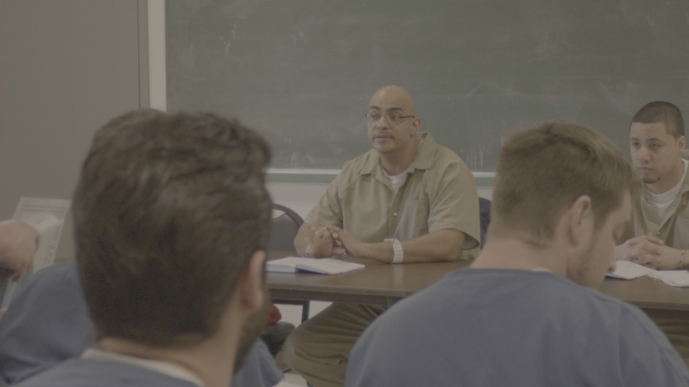
28 Day Detox Program
The Program:
Safe, humane, medically supervised detox as appropriate
Introduction to individual and group treatment for SUDs, including:
Peer-led recovery support by sentenced RSAT(TRAC) clients nearing the end of their RSAT program in the RSAT unit of the jail

Slide 14
28 Day Detox Program, cont.
Clinical and substance abuse evaluation, including eligibility for MAT, specifically injectable naltrexone before release
Drug and MAT education
If appropriate and if client opts for it, oral dose of naltrexone to test for allergic reaction
Injection of naltrexone before return to court
Development of continuing support and treatment plan in the community, including Medicaid enrollment or insurance negotiation, and linkage to prescribing physician as needed
Report to the court of plan to be implemented if approved by the judge and non-custodial disposition imposed
If the client elects MAT, a jail case manager will continue to work with them to ensure follow up in the community on a voluntary basis

Slide 15
How do detainees enter the detox unit program?
The arraignment judge, based on nature of charges, defendant’s criminal history, drug history, continues the case for 28 days and asks the detainee to be sent to the detox unit
The judge may indicate to the defendant, defense attorney and the prosecutor that the court will be more disposed to consider noncustodial alternatives upon a guilty finding or plea if he participates in the 28 day program
Drug court coordinator works closely with jail staff to identify an entering detainee as a good candidate for the program
Judge may make accommodations (i.e. change court date, pre-hearing communication with attorneys) if participation in the 28-day program is in their best interest

Slide 16
How RSAT can help?
RSAT RESOURCES
→ Expert staff support:
Incl. counselors, clinicians, transition coordinators, support staff, experienced correctional officers trained in motivational interviewing, and more….
→ RSAT Program Components:
MAT education, group/individual counseling initiation, aftercare planning, referral network post-release
→ Controlled Dissemination of medication

Slide 17
How RSAT can help?
→ Identifying eligible and appropriate candidates
→ Same clinical evaluation, medical procedures
→ Same briefing/education about role of MAT in recovery
→ Introduce counseling, support, and encouragement
→ Provision of peer support by appropriate RSAT clients
→ Same referral base, transition planning for post-release treatment/medication
→ Same in/out case managers

Slide 18
Questions?
Type your question in the Q&A box on your computer screen.
Speaker Contact Info
Steve Keller
Skeller@ahpnet.com
Andy Klein
Aklein@ahpnet.com

Slide 19
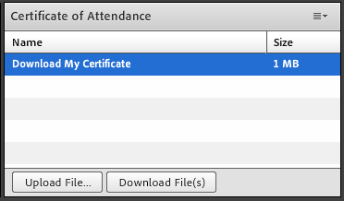
Certificate of Attendance
Download now!

Slide 20
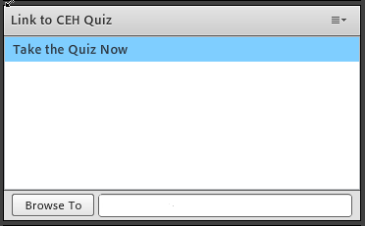
Continuing Education Hour (CEU Certificate)
1 NAADAC CEH
Pass 10-question quiz with 7 correct answers
Receive certificate immediately

Slide 21
RSAT TTA Center
For more information on RSAT training and technical assistance, visit
http://www.rsat-tta.com/Home
or
e-mail Stephen Keller, RSAT TTA Coordinator, at
skeller@ahpnet.com

