Slide 1


RSAT Promising Practices Webinar
Design, Implementation and Outcomes:
Components of Program Success

Slide 2

Housekeeping Functions

Slide 3
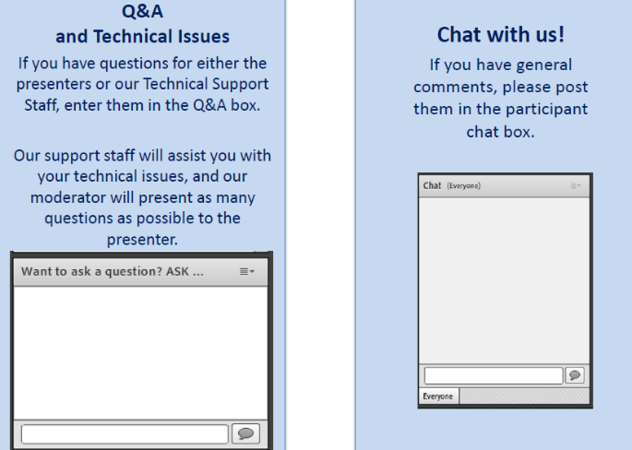
Housekeeping: Communication

Slide 4

Niki Miller, M.S. CPS nmiller@ahpnet.com
Advocates for Human Potential
www.ahpnet.com

Slide 5
Learning Objectives
Discuss the overarching mandates that guide RSAT program design.
List two target outcomes that RSAT programs prioritize.
Identify program components that enhance RSAT effectiveness.
Name steps programs can take to ensure implementation fidelity.

Slide 6
RSAT Mandates
Required by Statute:
  RSAT program practices/services are evidence-based, to the greatest extent possible; and
  RSAT programs develop participants’ cognitive, behavioral, social, vocational, and other skills to facilitate recovery from addiction and related problems.

Slide 7
RSAT Promising Practices - Section II:
Treatment Programming
RSAT programs and community-based treatment
have a lot in common
But are there aspects of treatment that are not the same?
Is a correctional treatment professional’s job more difficult?
Are some things easier? Are there unique rewards?

Slide 8
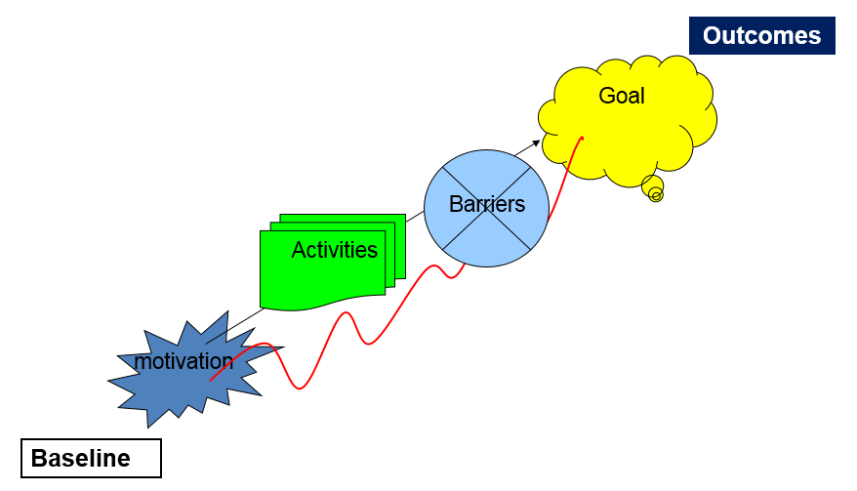
Begin with the end in mind

Slide 9

Substance Use Disorder Treatment NOMS
National Outcome Measures - Community Treatment
Abstinence: from alcohol/drug use
Retention: length of time in treatment & aftercare
Employment/Education: find/keep a job; stay in/go back to school
Criminal Justice: no increase/decreased criminal justice involvement
Housing stability: maintain/improved housing stability
Access to services: increased access to health & social services
Social connectedness: increased social support
Notes:
Substance Abuse and Mental Health Services Administration (SAMHSA)
The Community Mental Health Services block grant
Substance Abuse Prevention and Treatment block grant
NOMS across Mental Health, Substance Abuse Treatment, and Substance Abuse Prevention

Slide 10
Quick Audience Poling
What outcomes define RSAT program success?
Lower recidivism rates
Post-release abstinence from drugs and alcohol
Program completion
Engagement in post-release treatment/aftercare

Slide 11
RSAT targets factors associated w/criminal behavior
RSAT Programs
Criminal thinking
Anti-social beliefs
Anti-social associates
Manage anger
Deal with impulsivity
Consequences of crime
Develop empathy for others
Responsibility for behavior
Community Programs
Recovery thinking
Change belief systems
Sober associates/support
Cope with emotions
Thinking ‘the drink’ through
Consequences of addiction
Heal relationships
Try new leisure activities

Slide 12
RSAT Outcomes
Meta-analysis of 53 evaluations of drug correctional drug treatment programs (1990 -2004).
Only 20 studies looked at post-release drug use.
All types of programs showed some reductions in recidivism
6 out of 7 prison/jail-based TCs showed significant reductions in recidivism
None of the 20 studies that looked at post-release drug use found significant effects.
MacKenzie, Mitchell & Wilson in Handbook of Evidence-based Substance Abuse Treatment in Criminal Justice Settings (2011) Leukenfeld, Gullotta & Gregrich(eds.)

Slide 13
Promising Practices -Treatment Programming
Evidence-based approaches whenever possible
Integrated approach to co-occurring mental health problems
Medication options for alcohol, opioid use & mental health
Program duration is the minimum; longer stays as needed

Slide 14
Evidence?
Often the evidence we have tells us a program component or intervention works in community-based SUD treatment.
How do we know it will work in RSAT programs?
Can we delivery it in a custody setting without eliminating the ingredients that make it affective?
AA joke
Example: Contingency Management
Notes:
Contingency Management: system of pre-determined rewards used to acknowledge and reinforce target behaviors (behavioral contracting; “carrot and stick”)

Slide 15
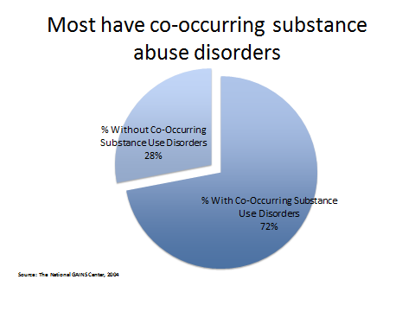
CODs Are Pervasive

Slide 16
Integrating approaches effective for both
Program components that benefit individuals with substance use and/or mental health disorders:
  Cognitive Behavioral Therapy
  Medication-Assisted Treatment
  Motivational Strategies
    Psycho-education
    Peer Support
    Trauma-informed & trauma-specific approaches
  Illness Self-Management and Recovery
    -Wellness Recovery and Action Plan (WRAP)
Notes:
Trainer: There are a number of approaches that are effective for offenders with both substance use and mental health disorders. The premise of all of these strategies is to change motivation, attitudes, thinking, and behaviors. Many of the strategies can be paired together into a single treatment plan. In this training, we will provide a basic overview of the components of each strategy. -Social and Independent Living Skills (SILS)

Slide 17
Psychiatric Medication Management
Benefits: Stabilizes psychiatric symptoms, provides relief to clients and can increase treatment engagement and responsivity.
Risks: Lack of continuity of care upon release, side effects, inmate refusal (forced medication by court order is ethically problematic) and mis-medication or overmedication.
Notes:
Trainer: RSAT staff needs to be aware of the potential benefits of medication assisted treatments for substance use disorders and also of potential drug interactions for client’s with co-occurring disorders who may be taking psychiatric medications.

Slide 18
Medication Assisted Treatment
  Opioid Replacement Therapy
Benefits: Stabilizes and manages withdrawal, reduces cravings, demonstrated significant decreases in relapse with justice populations.
Risks: Lack of availability within facilities, diversion, cost, continuity of care, medication interactions, stigma.
Notes:
Trainer: RSAT staff needs to be aware of the potential benefits of medication assisted treatments for substance use disorders and also of potential drug interactions for client’s with co-occurring disorders who may be taking psychiatric medications.

Slide 19
Opioid Antagonist Therapy (long-acting injectable naltrexone)
Benefits: Reduces cravings, impulsive drug use, no diversion or abuse potential; demonstrated significant decreases in relapse among re-entering individuals with both alcohol and opioid use disorders.
Risks: Lack of availability within facilities, cost, continuity of care, medication interactions, less stigma.
Notes:
Trainer: RSAT staff needs to be aware of the potential benefits of medication assisted treatments for substance use disorders and also of potential drug interactions for client’s with co-occurring disorders who may be taking psychiatric medications.

Slide 20
Pace of Recovery – Highly Individualized
Many factors influence the time it takes to adjust to treatment and achieve recovery milestones. Phases are marked by:
Physical/Psychological Stability
Behavioral change
Goal achievement
Skill acquisition

Slide 21
Promising Practices -Treatment Programming
Phases: progress is based on behavioral & recovery milestones
Positive programming fills the majority of the day
Programs are responsive to cultural backgrounds of clients
Recovery support is critical to success ongoing success

Slide 22
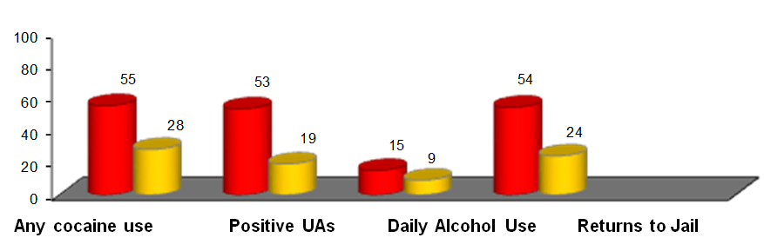
Dosage Principle: Treatment Duration
The American Society of Addiction Medicine defines long-term treatment as 90 days or more.
Differences in returns to drug use and jail among those who had more than 90 days of treatment (yellow) and those who had less (red).
Notes:
RSAT programs that promote the knowledge and skills resulting in changes to high-risk drug use and sexual behaviors can help arrest the spread of HIV/AIDS in communities and among vulnerable populations. Men who have sex with men, African Americans, women, juveniles, people with methamphetamine, cocaine and IV drug problems, and their partners are all examples of high risk groups entering or leaving correctional facilities. Communities where disproportionate numbers of individuals are incarcerated, a large number of them for drug related crimes, are often the same communities where health disparities abound. RSAT programs are uniquely positioned to serve individuals and their communities.

Slide 23
Dosage Principle: Treatment Intensity
High-risk = high intensity programs; minimum of 300 hours of cognitive-based interventions*
Moderate-risk = minimum of 200 hours
Low-risk = minimum of 100 hours
*First 3-9 months post-release: 40%–70% of free time should be structured, appropriate services (Bourgon and Armstrong, 2006; Latessa, 2004; Gendreau and Goggin, 1995).
Notes:
RSAT programs that promote the knowledge and skills resulting in changes to high-risk drug use and sexual behaviors can help arrest the spread of HIV/AIDS in communities and among vulnerable populations. Men who have sex with men, African Americans, women, juveniles, people with methamphetamine, cocaine and IV drug problems, and their partners are all examples of high risk groups entering or leaving correctional facilities. Communities where disproportionate numbers of individuals are incarcerated, a large number of them for drug related crimes, are often the same communities where health disparities abound. RSAT programs are uniquely positioned to serve individuals and their communities.

Slide 24
Module I: Research
Best Practices: Underserved Groups
Good
Better
Link clients to culturally-specific community groups that support re-entry/recovery
Best
Coordinate in-reach activities and events with these groups.
Use culturally specific program components and materials

Slide 25
Module I: Research
Examples of Culturally Responsive Interventions
Sistas–African American and Latina women at-risk for drug use, HIV, and intimate partner violence.
Winner’s Circle—Re-entry support and employment opportunities in African-American communities.
Safe on the Outs– For high-risk youth released from juvenile detention facilities.

Slide 26
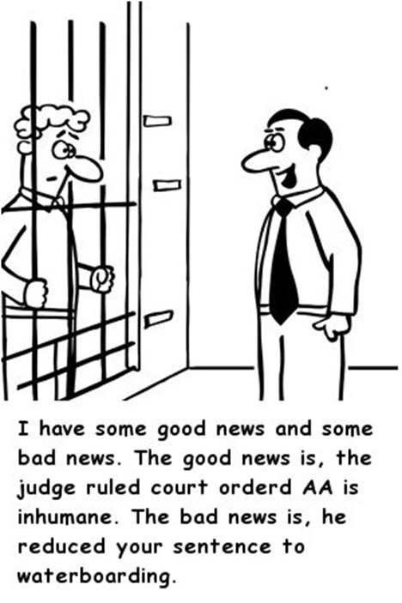
Linkage to Continuing Care & Recovery Support
Notes:
Probably the most powerful strategy for enhancing RSAT program effectiveness
Long-term treatment

Slide 27
Module I: Research
Promising Practices Section II: Treatment Programming
RSAT
Client
Culturally Responsive
Medication- Assisted Treatment
Evidence-based Approaches
Integrated Mental Health Treatment
‘Dosage’ Intensity &
Duration
Target Criminal Risk
Factors
Recovery Support
Linked to Continuing Care in Re-entry
Notes:
Motivating behavioral change, cultural responsiveness and skill rehearsal are key components of group or individual sessions. RSAT programs that incorporate HIV prevention groups should select an evidence-based curriculum suited to the population they serve. We will discuss resources and options later in this module. RSAT programs do not need to rely on existing staff to deliver these programs. Many correctional facilities make use of community providers, health departments, universities or cooperative extensions or local AIDS Service Organizations.

Slide 28
Quick Audience Polling
How does your program stack up?
We got this! It’s all there
We incorporate a lot of these components
We plan to include more of these practices
The basics are in place, but we have a ways to go

Slide 29
Module I: Research
The Best Laid Plans: Implementation Fidelity
Training and Refreshers
Supervision, Supervision, Supervision
Fidelity Checklists and Tools
Observation and Peer Supervision
Session Recording and Rating
Coming soon:
MAT for RSAT Programs and Clients Transitioning to and from Community-based Treatment, 2017 Edition
State Medicaid Formularies & Coverage of MAT Services

Slide 30
Questions?
Type your question in the Q&A box
on your computer screen
Speaker Contact Info
Niki Miller nmiller@ahpnet.com

Slide 31
Always Happy to Hear From You
Thank you all for the great work you do!
We know your job is not easy, but we aim to make it a bit easier & are always happy to hear how we can do so…
Contact me anytime with inquiries about the topics we have covered: nmiller@ahpnet.com
Also appreciate hearing about your experiences & innovations…
Thank you for your participation …

Slide 32

Certificate of Attendance
Download now!

Slide 33
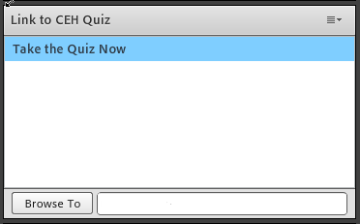
Questions?
1 NAADAC CEH
Pass 10-question quiz with 7 correct answers
Receive certificate immediately

Slide 34
RSAT Technical Assistance and Training Center
For more information on RSAT training and technical assistance visit:
http://www.rsat-tta.com/Home
or email Stephen Keller, RSAT TA Coordinator at
skeller@ahpnet.com
Email questions, requests for resources, research or other information any time to: nmiller@ahpnet.com

