Slide 1
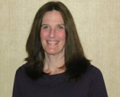
Stress, Secondary Trauma and Burnout
For Criminal Justice Professionals
Lisa Talbot-Lundrigan
Stephen K. Valle AdCare Criminal Justice Services, Inc.

Slide 2
Housekeeping: Functions

Slide 3
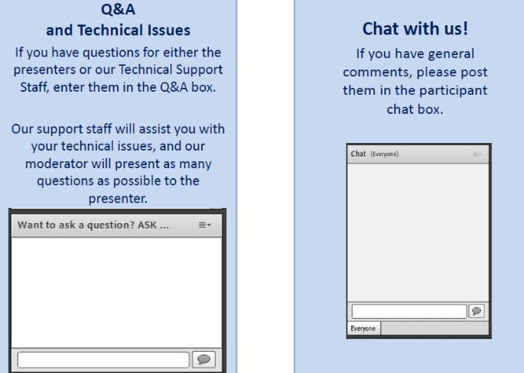
Housekeeping: Communication

Slide 4
Stress, Secondary Trauma, and Burnout
for Criminal Justice Professionals
Moderator
Stephen Keller
TTA Coordinator, RSAT-TTA
Notes:
Example:
If you can understand the form that allows your insurance to bill at a hospital, you can’t be seen.
If you can’t understand the consent to treat form, you don’t get treatment.
Pretty basic, but the research shows that most people do not understand these forms, but they mostly sign them anyway. Let’s look at some research that applies to our population.

Slide 5
Lisa Talbot-Lundrigan
ltalbotlundrigan@gmail.com
AdCare Criminal Justice Services, Inc.
adcare.com

Slide 6
Training Goals and Objectives
Define Stress
Distinguish Between Good and Bad Stress
Identify Potential Stressors in Corrections
Individual
Job
Organizational
List Physical and Mental Effects of Distress
Recognize the Warning Signs of Secondary Trauma and Burnout
Develop an Individual Action Plan for Resilience

Slide 7
What is Stress?
Stress is a condition or feeling experienced when a person perceives that demands exceed the personal and social resources the individual is able to mobilize. (Lazarus, 1996)
Notes:
People feel little stress when they have the time, experience and resources to manage a situation. They feel great stress when they think they can't handle the demands put upon them. Stress is therefore a negative experience. And it is not an inevitable consequence of an event: It depends a lot on people's perceptions of a situation and their real ability to cope with it.

Slide 8
IS Stress ever ok?

Slide 9
GOOD Stress
In certain instances, experiencing stress can have a positive outcome.
Studying for an Exam
Training for an Athletic Event
Rehearsing for a Play or Performance
Preparing for an Audit
Learning a New Skill
Staying “On One’s Toes”
Generating Excitement and Suspense
Happy Surprises
A New and Welcome Challenge
THE RIGHT KIND AND AMOUNT OF STRESS CAN INCREASE MOTIVATION AND PERFORMANCE

Slide 10
YERKES-DODSON HUMAN PERFORMANCE CURVE

Slide 11
DISTRESS
When the Level of Stress Exceeds the Person’s Ability To Respond:
Not Enough Time
Not Enough Resources
Not Enough Skills
Not Enough Support
YOU CAN’T GIVE WHAT YOU DON’T HAVE

Slide 12
DISTRESS CAN BE ACUTE OR CHRONIC
ACUTE DISTRESS
CHRONIC DISTRESS
A single shocking episode
Unexpected
Significantly Out of the Ordinary
Overwhelms the Ability to Cope
Often Traumatic
Repeated overwhelming demands or shocks
No “light at the end of the tunnel”
Sense of Futility
Erodes Coping Skills and Resilience
Can Be Traumatic

Slide 13
WHAT HAPPENS NEXT?
The Impact of Distress

Slide 14
The impact of time
Repeated Experiences of Distressing Episodes Can Result in a Chronic State of Distress Characterized by:
Physical Symptoms
Physical Illness / Immune System Overload
Emotional Numbing
Inability To Focus
Forgetting
Hyperarousal / Hypervigelance
Negative View of the World
Paranoia
THESE ARE SOME OF THE SAME SYMPTOMS EXPERIENCED BY PEOPLE WHO HAVE EXPERIENCED REPEATED TRAUMA

Slide 15
TRAUMA
Both ACUTE and CHRONIC distress can produce TRAUMA
Extreme stress that is brought on by shocking or unexpected events that overwhelm a person’s ability to cope, resulting in feelings of helplessness, and extreme fear and horror. The survivor perceives the event as a bodily violation or a threat of serious injury or death or to self or a loved one. The event may be witnessed or experienced directly.
The defining factor that separates a traumatic experience from a distressing one is the perception of a threat to survival to self or a loved one. (Miller, 2011)

Slide 16
Who Experiences Trauma?
Virtually everyone experiences distressing events, but not everyone experiences trauma.
What is traumatic for one person may not be traumatic for another.
We must, therefore, consider carefully not only the EVENT but the individual’s PERCEPTION of the event.

Slide 17
Shocking and acute trauma
Single Episodes

Slide 18
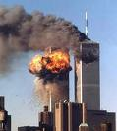
Shared Trauma-September 11th
Where Were You? What Were You Doing? Where Did You Go? How Did You Cope?

Slide 19
Boston Marathon 2013
3 KILLED, 260 + INJURED
NEARLY 6000 DIVERTED

Slide 20
Types of Traumatic Events
Physical
Emotional
Sexual
Neglect
Torture
Combat
Witnessing Extreme Injury or Death
Witnessing Abuse
Terrorism
Natural Disasters
Accidents

Slide 21
Chronic trauma
Trauma as a Lifestyle

Slide 22
The no snapshot trauma
Environment of Repeated Trauma
Addiction
Abuse
Violence
Threats
Coercion
Mental Illness
Chaos and Unpredictability
Loss of Control
A Place Where the Horrific is Normal

Slide 23
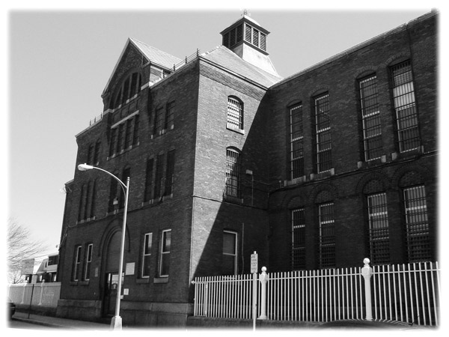
STRESS
What is Stress in Corrections?

Slide 24
DOES THIS LOOK FAMILIAR?
Working Ourselves Ragged

Slide 25
SOME DAILY STRESSORS IN A HOUSE OF CORRECTIONS
No Personal Property
Cut Off from the World
High Performance Expectations (Managers and Inmates)
Persistent Threat of Violence
High Noise Level
Bright Lights
Limited Movement
Insufficient Space
Insufficient Resources
Insufficient Compensation
Outnumbered
High Level of Need
Unrealistic Expectations
Little or No Positive Feedback
Lack of Autonomy

Slide 26
Job factors that correlate with increased stress
Frequent Inmate Contact
Forced Overtime
Management of Behavior that is Socially Inappropriate
Rotating Shifts
Poorly Defined Job Duties
Conflicting Role Obligations
Isolation from Peers
Negative Climate / Culture
Suspicion
Distrust of Helping or Compliant Behavior
Lack of Professional Support
Code of Silence

Slide 27
ORGANIZATIONAL FACTORS that correlate with burnout
Lack of Connection to Agency Mission
Feeling of Disempowerment
Unclear Expectations for Performance
Limited or No Ability to Seek Clarifications
Inconsistency
Undervalued in the Community

Slide 28
Individual factors that correlate with increased stress
Level of Interpersonal Support
Level of Involvement in Leisure Activities
Level of Cognitive Flexibility
Ability to Find Humor
Ability to Seek Balance
Ability to Set Boundaries
Ability to Sustain Hope
Number of “Non Corrections” Activities
Faith/ Spiritual Foundation
Level of Education
Prior History of Trauma

Slide 29
SOME ACUTE TRAUMA in CORRECTIONS
Witnessing Violence (Inmate-Inmate or Inmate-Staff)
Witnessing Use of Force
Strip Searches
Threats
Self-Harm
Riots
Hostage Taking
Overdose
Suicide
Approximately 26% of Corrections Professionals can be diagnosed with PTSD (Denhof and Spinaris, 2012)
rates of depression are also significantly higher

Slide 30
Corrections professionals
Working in the House of Acute and Chronic Trauma

Slide 31
THE PROCESS OF BURNOUT
PTSD and/or Burnout
Individual Distress or Trauma
Job Demands
Organizational Characteristics
Corrections Fatigue (Spinaris & Denhof)

Slide 32
Three Major Types of PTSD Symptoms
Avoidance
Voluntary suppression of memory
Restriction of daily activities
Dissociation; substance use
More women experience this category
Arousal
Startle reflex
Irritability and vigilance
Sleep disturbances
More men experience this category
Intrusion
Flashbacks
Nightmares
Trauma Re-enactment
Source: Miller (2011)

Slide 33
Resilience Factors that Reduce the Risk of Developing PTSD
Seeking out Support from Other People, such as Friends and Family
Finding a Support Group
Feeling Good about One’s Own Actions in the Face of Danger
Being Able to Act and Respond Effectively despite Feeling Fear
Having a Coping Strategy, a way of getting through the event and learning from it
Source: Miller, 2011

Slide 34
Secondary Trauma
Supervision, Self-Care and the Risks of Working with Trauma

Slide 35
Secondary Trauma
Our Work Demands Us to be Present and Fully Experiencing with Very Wounded People
Our Work Demands Us to be Consistent, Empathic, Collected and An Agent of Change
Our Work Demands Us to be Role Models of Effective Coping and Appropriate Boundaries
Our Work Demands SELF CARE

Slide 36
vicarious Trauma
Over time, professionals working with inmates, substance abusers, and trauma survivors can begin to change their world view in some concerning ways:
The world is a dangerous place
People are not to be trusted
Someone’s always looking for a way to get you
Violence is normal
And some trauma survival traits can appear:
Numbing
Disengagement/Avoidance
Hyper vigilance
Emotionality
Physical Illness

Slide 37
Prevention of Secondary Trauma
For Human Service Staff: Regular and Ongoing Clinical Supervision by a Trauma-Informed Professional
For Custody Staff: Support of Colleagues and Administration, Clear Job Expectations
Self Care in Personal Life
Good Support Systems
Adequate Rest
Proper Nutrition
Exercise
Hobbies
Spiritual Practices

Slide 38
Demographics for the profession
Average life span of an adult male = 75 years
Average life span of adult female = 80 years
Average life span of a correctional officer is 10-12 years shorter, depending on the source.
Higher Rate of Divorce
Higher Rate of Alcohol/Substance Abuse
Higher Suicide Rate

Slide 39
Demographics for the profession
Higher Rate of Memory Problems
Lowered Immune System Response
Higher Rate of Physical Problems
up to 75% of all doctor visits are for a stress-related problem
Higher Rate of Heart disease, chronic headaches, chronic diseases
Higher Rate of Depression and Anxiety
Source: National Institute of Corrections (2010) Hitting the Wall: Dealing With Stress in Corrections, Participant Manual, p.6

Slide 40
Demographics for the profession
Roughly 80% of Correctional Officers are Male (ACA, 2007)
Roughly 65% of Correctional Officers are White (ACA, 2006)
Roughly 70% of Correctional Officers are between the ages of 25 and 44 (ACA, 2007)
In the last three decades the number of Correctional Officers has risen by 150% (ACA, 2004) .
The number of men and women incarcerated in the United States has swelled to unprecedented levels in that same period (increases in excess of 600%).

Slide 41
Substance disorder treatment Workforce Issues
Trends in the Profession
Source: Partners for Recovery, SAMHSA
Substance Abuse Treatment Workforce Environmental Scan November 2003

Slide 42
Motivation for Entering the Field
According to NAADAC (2003) early career members indicated the following reasons for entering the substance abuse treatment field:
95% said the work is challenging or interesting;
91% had a desire to work in a helping profession;
78% were motivated by substance abuse problems in community; and
61% indicated that either they, a family member, or friends had substance abuse problems.

Slide 43
Employee Characteristics
134,000 Full-time Substance Abuse Counselors as of 2003
44,956 part-time staff and 22,283 contract staff employed in the substance abuse treatment system in 19961997 (SAMHSA 2003)
Of the Full Time Staff:
17% Medical staff
17% Graduate-degreed counselors
29% Bachelor’s level
37% Non-Degreed staff members

Slide 44
Characteristics of Staff
50-70% of Staff in the Field were Female and 70% of Employees Entering the Field were Female
** The client population is approximately 70% male in the general population, in Criminal Justice settings that percentage is closer to 85%

Slide 45
Characteristics of Staff
Counseling Staff Age averaged between early 40s-mid 50s
** The client population averages between mid 20s to late 30s
** Some estimates reveal that Director Level positions are most commonly assigned to men over the age of 40

Slide 46
Characteristics of Staff
Approximately 70%-90% of the Workforce identifies as White
** In Contrast, only 58% of Clients in the General Population identify as white, that percentage is decreased even further in the criminal justice setting.

Slide 47
Staff Tenure in the Field
Years in the Field Percent of Staff
One - Five Years 36%
Six – Ten Years 28%
Ten Years or More 35 %
The data from SAMSHA seem to indicate that employees remain in the field but change jobs about every 5 years.
Low pay and lack of training/supervision were most frequent reasons for quitting.

Slide 48
Characteristics of Effective Counselors (Valle, 1981)
Warmth
Genuineness
Empathy
Concreteness
Respect
Other studies have shown that genuineness and empathy can make one vulnerable to burnout

Slide 49
Burnout
Why does it happen?
How can we stop it?

Slide 50
Burnout: What is It?
Burnout is a predictable but avoidable condition associated with work in professions with a high degree of human interaction.
Burnout is characterized by:
Lack of Enthusiasm
Withdrawal
Frequent Absenteeism
Blunting of Empathy and Callousness
Dehumanizing of Inmates
Fatigue

Slide 51
Burnout: What is It?
Negativity
Powerlessness
Hopelessness
Lack of Confidence in Skills/Avoidance
Somatic symptoms including headaches, GI distress, elevated blood pressure, insomnia
Distress in Personal Life
Decrease in Healthy Self-Care
Increase in Maladaptive Coping Behaviors, including Substance Use
Relapse to Addiction

Slide 52
Burnout: Its Impact
Co-Workers may feel concern, a desire to intervene, resentment, a heavier burden to compensate.
Large number of staff members may “catch” the negativity, cynicism and indifference of a burned-out staff member over time without intervention.

Slide 53
Burnout is More Likely …
In a time when staff are being asked to:
Carry Higher Inmate: Staff Ratios
Rotate Shifts More Frequently
Work with Fewer Staff Members
Supervise More Violent and More Chronically Criminal Inmates
Implement Evidence-Based techniques and Measure Performance
Accept Less Pay/Less Frequent Increase in Pay

Slide 54
Predictors of Burnout
Correctional Officers | Program Service Staff
Ambiguous Work Assignment | Heavy Caseloads
Role Conflict (Morgan et. al, 2002) | Isolation from Peers
Negative Inmates Contact (Dignam, 1986; Lindquist & Whitehead, 1986) | Low pay/program funding
Poor Relationship with Peers | Inability to Detach
No Sense of Purpose | Increased Number of Performance Standards
 | Lack of Clinical Supervision
Sources: Morgan, VanHaveren, Pearson (2002);
Deighton et. al. (2007)

Slide 55
The Burnout Cycle behind the wall
Officer
Poorly Defined Role
Lack of Support
Counselor
Heavy, Demanding Caseload
Inadequate Supervision
Administration
Lack of Unified Leadership
Inadequate Staffing
Negative Interactions with Inmates
Depersonalized Relationship with Inmates
Inadequate Self-Care
Poorly Defined Job Descriptions
Poor Communication with Employees and Among Managers

Slide 56
Recognizing Burnout
Inability to Focus
Frequent Absence
Distance from Clients and Coworkers
Avoidance of Supervision
SEEK HELP BEFORE CRISIS OCCURS
EAP
Private Counseling
Support Group
www.nicic.org
www.headington-institute.org
www.desertwaters.com

Slide 57
Staying healthy
Managing and Preventing Burnout

Slide 58
1. Recognize the Symptoms
2. Learn to Ask for Help
3. Come to Grips with Your Limitations
4. Maintain Discipline and Structure, the Key Elements for Holding On During Burnout
5. Develop “Time Outs” On and Off the Job
6. Diversify Your Responsibilities
58
Notes:
58

Slide 59
Be Informed About Your Position
Role Clarity is a Buffer for Stress and Burnout
Asking For Guidance from Supervisors is a Buffer for Stress and Burnout
Actively Participate in Regular and Ongoing Clinical Supervision is Buffer for Stress and Burnout.
59
Notes:
59

Slide 60
Identify Your Goals and Evaluate a Position Accordingly Before You Say Yes
Professional growth does not always equate with promotions or positions of status.
Understand your work as a part of your life
When the Role Changes, Evaluate your Ability to Perform to the New Standard and Ask for Support
60
Notes:
60

Slide 61
Maintain Your Own Growth at all Costs
Losing track of individual needs in the needs of the client leads to disillusionment
Develop Personalized Methods of Managing Stress
Seek Lifestyle Balance
Have Strategies for Managing “out of balance times”
Be Prepared to Recognize and Respond to Early Warning Signs
Laugh
61
Notes:
61

Slide 62
resilience
Strategies that Support Growth

Slide 63
laughing and lasting in corrections

Slide 64
Characteristics of resilience
Feeling good about one’s choices
Maintaining a sense of meaning and hope
Finding Humor
Finding Support
Integrating the traumatic experience
Seeing the “bigger picture”
Feeling part of the solution
Keeping the trauma abnormal
Seeking Satisfaction
Remaining Discerning but Trusting

Slide 65
Self care plan
Identification of Stressors
Identification of Supporters
Identification of Barriers
Identification of Alternatives
Non-Negotiable
Spiritual Practices
Physical Wellness Practices
Family Activities

Slide 66
COPING

Slide 67
EXPECTATIONS
Being able to predict the event makes the event far less likely to be shocking and overwhelming
Recognize and Accept the Realities
…of the work
…of the population
…of the organization
Without
…losing hope
…losing humor
…losing yourself

Slide 68
STRESS REDUCTION PROGRAMS
How do they help?

Slide 69
BENEFITS A STRESS reduction PROGRAMs CAN BRING TO CORRECTIONAL ADMINISTRATORS
Financial savings through:
Reduced need to pay overtime to cover for officers on sick leave or who quit because of work-related stress.
Reductions in the time officers need off after a critical incident before returning to work.
Reduced fees paid into the retirement fund because of fewer stress-related early retirements.
Improved officer performance through:
Higher staff morale.
Higher rates of attendance/lower rates of sick time use
Less negativity in the workplace culture
Source: National Institute of Justice (2000) Addressing Correctional Officer Stress, p.7

Slide 70
BENEFITS A STRESS reduction PROGRAMs CAN BRING TO CORRECTIONAL ADMINISTRATORS
Increased institutional safety through:
Fewer inexperienced officers on duty.
Fewer officer distractions with work-related and personal stresses.
Improved relations with the union by working together on a mutually beneficial program.
A demonstrated concern for employees through providing officers with the means to cope with an undeniably tough working environment.
Source: National Institute of Justice (2000) Addressing Correctional Officer Stress, p.7

Slide 71
Talking About Trauma
Trauma is a fact of life. It does not, however, have to be a life sentence. Not only can trauma be healed, but with appropriate guidance and support, it can be transformative. Trauma has the potential to be one of the most significant forces for psychological, social, and spiritual awakening and evolution. How we handle trauma (as individuals, communities and societies) greatly influences the quality of our lives. It ultimately affects how or even whether we will survive as a species.
Trauma Therapist Peter Levine (Waking the Tiger, 1997, p.2)

Slide 72
Web Based Resources: A Small Sample
www.theannainstitute.org
www.seekingsafety.org
www.headington-institute.org
www.samhsa.gov/nctic/trauma.asp
www.nationaltraumaconsortium.org
www.riskingconnection.com
www.coce.samhsa.gov
www.healthrecovery.org
www.sidran.org
www.womensconsortium.org
www.va.gov
www.desertwaters.com

Slide 73
Questions?
Type your question in the Q&A box on your computer screen.
Speaker Contact Info
Lisa Talbot-Lundrigan
ltalbotlundrigan@gmail.com
And
Stephen Valle
svalle@comcast.net

Slide 74
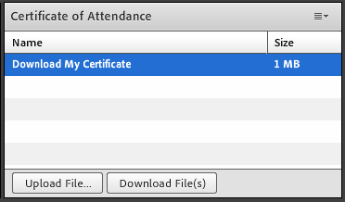
Certificate of Attendance
Download now!

Slide 75
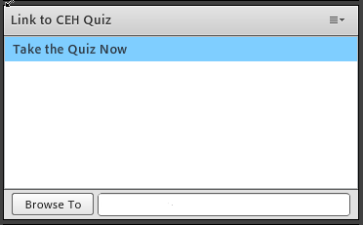
Continuing Education Hour (CEU Certificate)
1 NAADAC CEH
Pass 10-question quiz with 7 correct answers
Receive certificate immediately

Slide 76
RSAT TTA Center
For more information on RSAT training and technical assistance, visit
http://www.rsat-tta.com/Home
or
e-mail Stephen Keller, RSAT TTA Coordinator, at
skeller@ahpnet.com

