Slide 1



The Risk-Need-Responsivity Model of Assessing Justice Involved Clients
Roberta C. Churchill M.A., LMHC
ACJS, Inc.
Notes:
We’ll be talking about the RNR Model of Assessing Justice-Involved Clients today.
Much of what will be presented today is a result of ongoing research from studies and meta-analyses conducted since 1990. Some of the researchers and authors that today’s webinar will be drawing heavily from include:
Dr. Donald A. Andrews
Dr. James Bonta
Craig Dowden
Steven Wormith
Dr. Paul Gendreau
R.D. Hoge
Edward J. Latessa

Slide 2
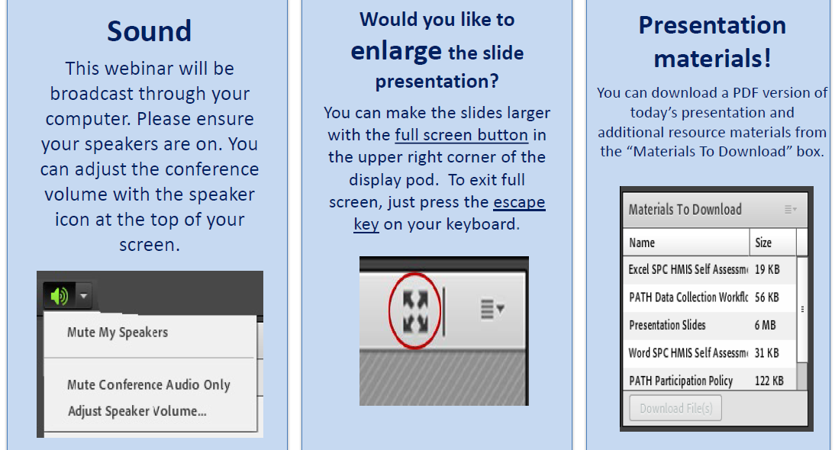
Housekeeping Functions

Slide 3
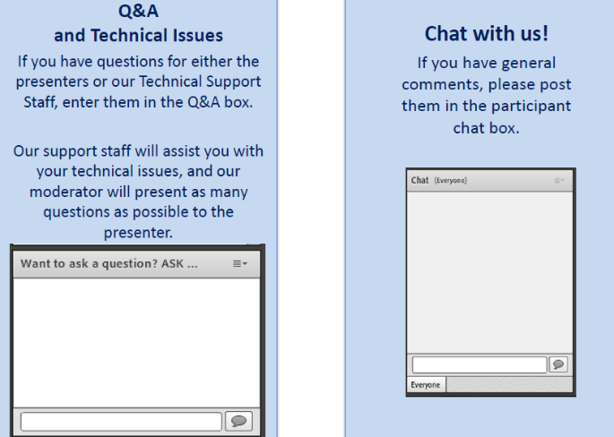
Housekeeping: Communication

Slide 4
The Risk-Need-Responsivity Model of Assessing Justice Involved Clients
Moderator
Stephen Keller
Training/TA Coordinator, RSAT-TTA

Slide 5

Roberta Churchill, M.A., LMHC
robertachurchill@gmail.com
AdCare Criminal Justice Services, Inc.

Slide 6
Course Objectives
Upon completion of this presentation, participants will be able to :
Define the role of intake, screening and assessment in the identification of service and treatment need
Describe the Risk – Need - Responsivity (RNR) Model
Discuss the role of the RNR Model in the development of criminal justice assessment instruments
Display and understanding of the connection between assessment, treatment planning and provision of services with justice involved individuals

Slide 7
Intake
  Personal identification of new entry into program / facility: fingerprints, photos, personal items, criminal history checks, etc.
  Affiliation with security threat groups, DNA testing (limited to those with certain offenses)
  Physical examinations, drug testing, medical testing including blood tests, dental / vision exams
  Mental health screens and psychological testing (if warranted)
Notes:
SLIDE 3
Correctional facilities and agencies have intake procedures that vary according to their goals, size and needs. There are some broad similarities however.
Intake usually refers to the capturing of data about people that will help classify inmates / clients into the appropriate setting.
Personal identification of new entry into program / facility: fingerprints, photos, personal items, criminal history checks, etc.
Affiliation with security threat groups, DNA testing (limited to those with certain offenses)
Physical examinations, drug testing, medical testing including blood tests, dental / vision exams
Mental health screens and psychological testing (if warranted)

Slide 8

Screening
  Short; used with every individual in an intake-type setting
  Identifies those who might have the characteristic in question (e.g., depression, trauma, substance abuse problem)
  Helps “triage” individuals for immediate attention
  Help decide need for a more comprehensive assessment
  Educational, vocational, lifeskills, other special needs populations (elderly, sex offenders, disabled)
Notes:
Screening is sometime part of the Intake Process or sometimes is done after the intake process – depending on the facility or agency.
Short; can be used with every individual in an intake-type setting
Many screening tools are actually included as part of initial intake process because they take so little time to complete. They can range from 3-5 minutes up to 15 minutes usually.
Identifies a specific characteristic of the client in question (e.g., depression, trauma, substance use disorder)
Some commonly used screening tools that identify substance use disorders are (note that some of the following are NOT designed specifically for the criminal justice population):
Helps “triage” individuals for immediate attention
May identify immediate need for detox services, or identify someone with suicidal ideation or other urgent care need.
Help decide need for a more comprehensive assessment
If a screening tool indicates an individual has a substance use disorder and/or is high-risk, then a more comprehensive assessment can be scheduled as part of the larger intake process for acceptance into a RSAT Program
There are also screenings for educational levels, vocational needs, various lifeskills deficits and other screenings for special needs categories such as elderly, disabled and sex offenders.

Slide 9
Module I: Research
Assessment
  Longer and more comprehensive; results give a multi-dimensional perspective of the criminal justice client
  Helps to develop specific recommendations for treatment and case planning
  Identifies needs that may require specialized services and/or community based referrals for re-entry planning
  Usually requires training to administer and interpret the results
Notes:
Assessment
Longer and more comprehensive; results give a multi-dimensional perspective of the criminal justice client
Assessments are not so narrow-focused on one characteristic but the “bigger picture” of the client. Much more information is being obtained which naturally takes more time to administer. Depending on the method of obtaining information, administration can vary.
Helps to develop specific recommendations for treatment and case planning
Because assessments are much broader in scope, information collected can be used for identifying areas of need which should be reflected in treatment / case plans.
Identifies needs that may require specialized services and/or community based referrals for re-entry planning
Assessments can also identify specialized needs and/or strengths of your client. Addressing those needs while in programming and/or through treatment planning is an integral piece of what makes a program successful; i.e. – reduces recidivism. Those needs that cannot be addressed while in the current program / facility can also be identified through assessments and be the basis for a Re-Entry Planning.
Usually requires training to administer and interpret the results
Because assessments cover many more domains, the scoring and interpretation of results are generally more complicated. The well-respected, reliable assessment instruments insist upon training to preserve the integrity of their instrument. If workers are using their product incorrectly, getting the wrong scores, misinterpreting the results, future research on that assessment instrument will be skewed. The creators of most assessment instruments are invested in the validity of their tool, and want to make sure that the people who are using it are doing so to the best of their ability.

Slide 10


Slide 11
RNR
RISK
NEED
RESPONSIVITY
11
Notes:
This webinar is going to focus more about those assessments that utilize the RNR model for justice involved clients.
Developed in the 1980’s and first formalize in the early 1990’s, the RNR model has been used with increasing success to not only assess but also treat criminal justice client in the US, Canada and around the world.
To understand how the role of RNR matters in assessment, we first have to understand the principles themselves.
Since 1990, a number of core theoretical principles have been developed to guide the design and implementation of effective evidence based interventions or practices. The three presented today in this webinar are Risk, Need and Responsivity, but there are many more.
They include the importance of using valid assessments for risk /needs, engaging clients in ways that promote intrinsic motivation, using cognitive behavioral, motivational interviewing skills and objective feedback on performance with clients, increasing positive reinforcements with clients, improving social supports within a client’s community and implementing fidelity management systems within treatment programming.

Slide 12
Module I: Research
RISK
How likely a person is to engage in criminal behaviors
Notes:
Risk … refers to how likely a person is to engage in criminal behaviors.

Slide 13
Module I: Research
NEED
What areas in a person’s life should be targeted for intervention / supervision in order to decrease their likelihood of future criminal behavior
Notes:
Need … refers to what areas in a person’ life should be targeted for intervention and supervision in order to decrease their likelihood of future criminal behavior.

Slide 14
Module I: Research
RESPONSIVITY
Identification of specific individual characteristics and personal strengths that might influence the effectiveness of services and interventions
Notes:
There are actually two parts to the Responsivity Principle.
General Responsivity states that treatment programs for justice-involved clients need to maximize the ability to learn / change by providing cognitive / behavioral treatment and utilizing motivational interviewing skills. Core correctional practices such as pro-social modeling, the appropriate use of reinforcement and sanctions, and problem solving (among others) are some of the specific skills represented in a cognitive social learning approach.
Specific Responsivity is what is defined above and is what we’ll be going into detail a little bit later about in this presentation

Slide 15
Module I: Research
Risk Principle
Match level of services to level of risk

Slide 16
Module I: Research
Risk Principle
Match level of services to level of risk
Prioritize supervision and treatment resources for higher risk clients

Slide 17
Module I: Research
Risk Principle
Match level of services to level of risk
Prioritize supervision and treatment resources for higher risk clients
Higher risk clients need more intensive services

Slide 18
Risk Principle
Match level of services to level of risk
Prioritize supervision and treatment resources for higher risk clients
Higher risk clients need more intensive services
Low risk clients require little to no intervention
Notes:
This slide is a compilation of data taken from a classic journal article by Andrews, Bonta and Hoge (1990) – Classification for Effective Rehabilitation: Rediscovering Psychology. It shows the results of four studies that took high / low risk probationers and place them into either minimal treatment or intensive treatment programming, then looked at their recidivism rates. You’ll see some interesting results. Let’s look at lower risk probationers first.
O’Donnell et al study refers to the arrest rates of juveniles and the intervention being studied involved a companionship program.
Baird et al study refers to probationers in Wisconsin who received intensive probation services.
Similarly, Andrews & Kiessling’s study refers to probationers in Ontario who also received intensive probation services.
The last study by Andrews and Friesen was a study of young adult probationers who were involved in a self-management program who were being supervised through weekly counseling sessions.
Not only does this chart show the marked negative effect that intensive services have on low risk clients, but we can see how much a positive impact that treatment does have on higher risk individuals.

Slide 19
Patterns in Risk Level & Tx Intensity
Offender
RISK LEVEL
% Recidivism:
Tx BY RISK LEVEL
Impact on
RECIDIVISM
Authors of
Study
Minimum
Intensive
Low Risk
High Risk
16%
78%
22%
56%
(↑ 6%)
(↓ 22%)
O’Donnell et al.,
1971
Low Risk
High Risk
3%
37%
10%
18%
(↑ 7%)
(↓ 19%)
Baird et al.,
1979
Low Risk
High Risk
12%
58%
17%
31%
(↑ 5%)
(↓ 27%)
Andrews & Kiessling,
1980
Low Risk
High Risk
12%
92%
29%
25%
(↑ 17%)
(↓ 67%)
Andrews & Friesen,
1987
Some studies combined intensive Tx with supervision or other services
Compiled from: Andrews, D.A., Bonta, J., Hoge, R.D. (1990).
Classification for Effective Rehabilitation: Rediscovering Psychology. Criminal Justice and Behavior, 17: 19.
19
Notes:
19
This slide is a compilation of data taken from a classic journal article by Andrews, D.A., Bonta, J., Hoge, R.D. (1990). Classification for Effective Rehabilitation: Rediscovering Psychology.
O’Donnell et al study refers to the arrest rates of juveniles and the intervention being studied involved a companionship program.
Baird et al study refers to probationers in Wisconsin who received intensive probation services.
Similarly, Andrews & Kiessling’s study refers to probationers in Ontario who also received intensive probation services.
The last study by Andrews & Friesen was a study of young adult probationers who were involved in a self-management program who were being supervised through weekly counseling sessions.
Not only does this chart show the marked negative effect that intensive services have on low risk offenders, but we can see how much a positive impact that treatment DOES have on higher risk offenders.

Slide 20
Recent Study of Intensive Rehabilitation
Supervision in Canada
Bonta, J. et al, 2000. A Quasi-Experimental Evaluation of an Intensive Rehabilitation Supervision Program. Vol. 27 No 3:317 – 329. Criminal Justice and Behavior
Notes:
A more recent study shows the same trend. Interestingly, the recidivism rates between those individuals who went through the treatment program and those who did not was only statistically insignificant until they broke the populations down into low / high risk using the LSI-R.
This study looked at 171 male released inmates on electronic monitoring supervision / inmates with sentences less than 6 months / probationers in St. John’s, Canada.
The experimental group took part in a 9 hour per week treatment program for approximately 7 – 8 weeks that included groups in criminal thinking, anger management and substance abuse using a highly structured cognitively-behaviorally based approach that also included individual counseling. The control group received no treatment.

Slide 21

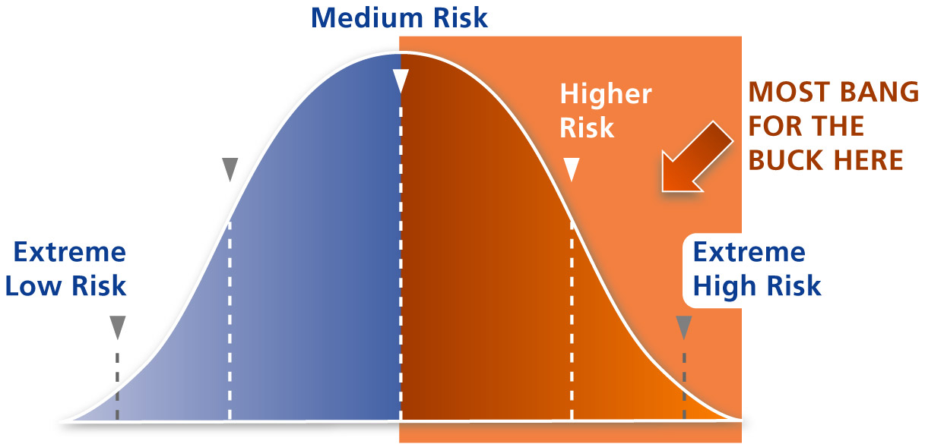

Risk Principle
Triage: Cutting the “Tail” Off One End of Your Caseload
Low Risk Offender – has more favorable pro-social thinking and behavior
than other risk levels.
Divert to voluntary programming, work units, early release / parole.
Notes:
The Risk Principle states, as the two previous slides have shown us, that it makes sense to direct our energies and resources toward the higher risk individual.
The lower risk clients have more pro-social thinking and behaviors and are less likely to commit crimes in the future. They are much better suited for voluntary programming within a correctional setting, work units / programs, more likely to successfully complete parole.
The people who would best benefit from intensive programming such as a six-month, residential substance abuse treatment program are those who are higher risk. Those are the ones whose recidivism rates can be greatly decreased by intensive programming.
Economically speaking, we can get the “most bang for the buck” when we provide services to the highest-risk individuals. Public safety wise, we are protecting our community by making sure those who are at greatest risk of re-offending are receiving services that will reduce the likelihood that will do so in the future! Humanely speaking, we are offering services to those who need it most.

Slide 22
Risk Principle tells us WHO to target …
… so now what do we DO?
Notes:
The Risk Principle tells us WHO to target – the HIGHER RISK CLIENT.
Thus an assessment based upon the RNR Model will be able to, as accurately as possible, identify and categorize our clients into categories of risk level. The higher the risk, the more likely the are to re-offend and thus, the more services / sanctions they need.
So now what do we DO with the higher risk clients?
That’s where the Need Principle comes in …

Slide 23

Need Principle
Assess criminogenic needs and target those needs with treatment and interventions
Notes:
The Need Principle informs us to assess clients’ criminogenic needs and target those need with treatment and interventions

Slide 24
Criminogenic ??

Slide 25
Criminogenic Needs
  Dynamic or “changeable” risk factors that contribute to the likelihood that someone will commit a crime.
Notes:
Criminogenic Needs
Dynamic or “changeable” risk factors that contribute to the likelihood that someone will commit a crime.
These are risk factors that are directly linked to criminal behavior.

Slide 26
Criminogenic Needs
  Dynamic or “changeable” risk factors that contribute to the likelihood that someone will commit a crime
  Changes in these needs / risk factors are associated with changes in recidivism.
Notes:
Changes in these needs / risk factors are associated with changes in recidivism.
Changes can be effected by many different reasons. One of those reasons is the provision of treatment / services / interventions.
If an individual successfully completes an effective evidence-based program, his / her risk level should be decreased measured by changes in their criminogenic need areas.
There are many areas of need in an offender’s life, but only SOME are criminogenic – that is, only SOME areas are directly linked to criminal behavior and are amenable to change.
Which are which??

Slide 27
“People involved in the justice system have many needs deserving treatment, but not all of these needs are associated with criminal behavior.”
- Andrews & Bonta (2006)

Slide 28
Central Eight Risk Factors
  Anti-social Attitudes
Notes:
The research is plentiful across race, ethnicity, gender, socio-economic, regions and even other countries. There seems to be eight risk factors that most highly correlated with criminal behavior. Let’s go through them now:
Anti-social Attitudes: values, core beliefs, rationalizations, and cognitive emotional states of anger, resentment, defiance

Slide 29
Central Eight Risk Factors
  Anti-social Attitudes
  Anti-social Peers
Notes:
2. Anti-social Peers: Anti-social friends / acquaintances and relative isolation from pro-social others; it increases an individual’s risk if they have few or no pro-social supports in their life.

Slide 30
Central Eight Risk Factors
  Anti-social Attitudes
  Anti-social Peers
  Anti-social Personality Pattern
Notes:
3. Anti-social Personality Pattern: restlessly aggressive, weak self control, adventurous pleasure seeking, egocentrism, weak socialization and problem solving skills

Slide 31
Central Eight Risk Factors
  Anti-social Attitudes
  Anti-social Peers
  Anti-social Personality Pattern
  History of Anti-Social Behavior
Notes:
4. History of Anti-Social Behavior: A history of anti-social behavior evident from a young age, involving a number and variety of anti-social acts; criminal record

Slide 32
Central Eight Risk Factors
  Anti-social Attitudes
  Anti-social Peers
  Anti-social Personality Pattern
  History of Anti-Social Behavior
These are knows as the “Big Four” Risk Factors
Most highly correlated with criminal behavior among all other factors
Notes:
These four factors of the Major Eight are the most powerful / most significant of the risk factors and for that reason are frequently referred to as the “Big Four”.
One of these “Big Four” factors, however, is NOT by definition a criminogenic need.
Remember, criminogenic mean that dynamic or changeable with intervention. So with that hint, do you know which of these Big Four factors is NOT, by definition, criminogenic?

Slide 33
Central Eight Risk Factors
  Anti-social Attitudes
  Anti-social Peers
  Anti-social Personality Pattern
  History of Anti-Social Behavior
  Family / Marital Factors
Notes:
5. Family / Marital Factors: low levels of affection, care, cohesiveness; poor parental supervision and inconsistent discipline; neglect and abuse

Slide 34
Central Eight Risk Factors
  Anti-social Attitudes
  Anti-social Peers
  Anti-social Personality Pattern
  History of Anti-Social Behavior
  Family / Marital Factors
  Lack of Achievement in Education / Employment
Notes:
6. Lack of Achievement in Education / Employment: Low levels of achievement and satisfaction in school and at work; it is noted that IQ testing has no significance in this need area. What is important in this factor is the weak ties to work and education – the lack of interest, not the aptitude or skills.

Slide 35
Central Eight Risk Factors
  Anti-social Attitudes
  Anti-social Peers
  Anti-social Personality Pattern
  History of Anti-Social Behavior
  Family / Marital Factors
  Lack of Achievement in Education / Employment
  Lack of Pro-social Leisure Activities
Notes:
7. Lack of Pro-social Leisure Activities: Little involvement in pro-social leisure and recreational pursuits

Slide 36
Central Eight Risk Factors
  Anti-social Attitudes
  Anti-social Peers
  Anti-social Personality Pattern
  History of Anti-Social Behavior
  Family / Marital Factors
  Lack of Achievement in Education / Employment
  Lack of Pro-social Leisure Activities
  Substance Use
Notes:
8. Substance Abuse: Abuse of alcohol and/or drugs
These Central Eight Risk Factors represent seven Major criminogenic need areas that should be assessed and targeted for treatment / services.

Slide 37
Central Eight Risk Factors
  Anti-social Attitudes
  Anti-social Peers
  Anti-social Personality Pattern
  History of Anti-Social Behavior (non-criminogenic)
These are knows as the “Big Four” Risk Factors
Most highly correlated with criminal behavior among all other factors
Notes:
History of Anti-Social Behavior is NOT a criminogenic need!
Although it is highly predictive of criminal behavior, it cannot be changed, and therefore does not fit the definition of a “criminogenic” need.
History cannot be changed.
A RNR assessment instrument will make sure that information is obtained in all these areas in order to assess the highest need areas for the offender.
The following slide lists some NON-criminogenic needs.
Dynamic or “changeable” risk factors that contribute to the likelihood that someone will commit a crime.

Slide 38
Module I: Research
Non-Criminogenic Needs
Low Self-Esteem
Anxiety
Parenting Issues
Medical Needs
Suicidal Ideation
Learning Disability
Notes:
Although these are legitimate need areas of some justice involved clients, research has shown they have no significant correlation with criminal behavior.
An illustrative example:
Pro-criminal attitudes: Shifting attitudes through treatment from the pro-criminal to the pro-social will lead to less criminal behavior and more pro-social behavior (what you think influences how you behave.)
Self-Esteem: Increasing self-esteem without changes in pro-criminal attitudes runs the risk of resulting in confident law-breakers. Decreasing self-esteem may lead to miserable law-breakers. The probability of changing criminal behavior may or may not changes as a function of self-esteem.

Slide 39

Although NOT criminogenic risk factors, they are important to include in an effective RNR assessment.
WHY?

Slide 40
Module I: Research
Non-Criminogenic Needs
They may need to be addressed before or concurrently along with criminogenic needs in treatment since they may represent a barrier to effective participation in treatment otherwise.

Slide 41
Module I: Research
Non-Criminogenic Needs
They may need to be addressed before or concurrently along with criminogenic needs in treatment since they may represent a barrier to effective participation in treatment otherwise.
IT’S THE HUMANE THING TO DO.

Slide 42



Module I: Research
Let’s Recap!
A RNR Assessment identifies offender risk level AND
obtains information about criminogenic need areas
High Risk individuals
need MORE treatment
and supervision to
DECREASE their
likelihood of
recidivism
Low Risk individuals
need LESS treatment
and supervision to
DECREASE their
likelihood of
recidivism
1. Anti-Social Attitudes 5. Family / Marital Issues
2. Anti-Social Peers 6. Lack of Achievement in Education
3. Anti-Social Personality Pattern and Employment
4. History of Anti-Social Behavior 7. Lack of Pro-social Leisure Activity
8. Substance Abuse

Slide 43
Risk Principle tells us WHO to target …
Need Principle tells us WHAT to target …
… so now HOW do we do it?
Notes:
Risk Principle tells us WHO to target … the high risk client.
Need Principle tells us WHAT to target … criminogenic needs but pay attention to some non-criminogenic needs to ensure that our client is able to participate meaningfully in treatment AND because it’s the right thing to do.
… so now HOW do we do it?

Slide 44

Module I: Research
Specific Responsivity Principle
Identification of specific individual characteristics that might influence the effectiveness of services and interventions.
How should we implement treatment to best ensure client success?
What is standing in the client’s way to successful program completion?

Slide 45

Module I: Research
Specific Responsivity Principle
Identify client strengths as they can be considered “protective” factors that may be built upon in treatment planning
Computer skills
Strong family relationships
High educational level
History of stable employment
Strong ties to recovering community

Slide 46
Examples of Specific Responsivity
Mental Health
Inter-Personal Anxiety
Depression
Cognitive / Intellectual Deficits
Learning Disability
Poor Verbal Skills
Demographic Variables
Age
Psychosis
Language Deficits
ADHD
Personality Characteristics
Psychopathy
Self-Esteem
Readiness to Change
Poor Social Skills
Gender
Race / Ethnicity
Socioeconomic Status
Adapted from Bonta, 1995; Van Hooris,1997
Notes:
Here are example of specific responsivity factors that need to be address by treatment programs, administrators and staff. How can we make sure that these factors don’t be come barriers to meaningful and effective participation in treatment programming and program completion?
Examples could include:
Avoiding highly confrontation interactions / large treatment groups for clients who experience interpersonal anxiety.
Limit the amount of reading for a client who has a reading disability.
Allow a client with ADHD to “doodle” while in class.

Slide 47

How important is this really?

Slide 48
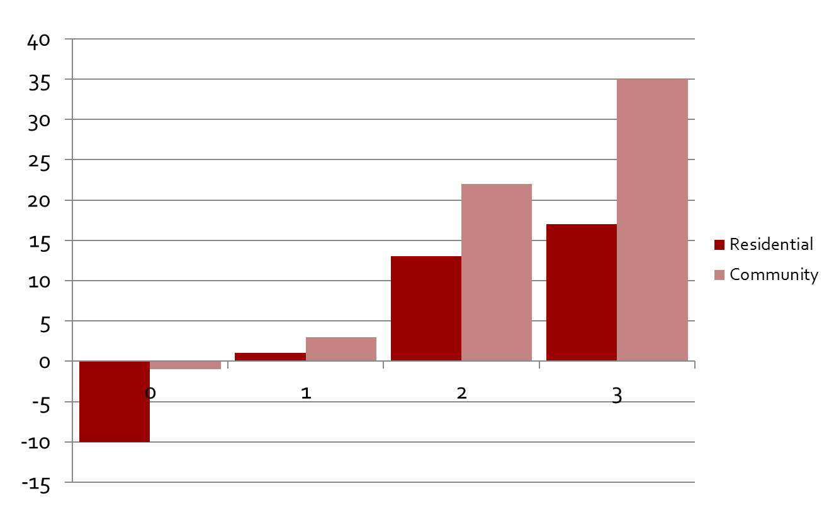
Adherence to Risk, Need, General Responsivity by Setting: Community Based versus Residential Programs
Decrease
Recidivism
Increase
# of Principles Adhered to in Treatment
Source: Adopted from Andrews and Bonta (2006). The Psychology of Criminal Conduct (4th). Newark: LexisNexis.
Notes:
This figure shows the mean differences in adherence levels ranging from 0 (none) to all 3 RNR principles in treatment programming.
For example: an agency that responds to only 1 of the 3 RNR principles (risk level alone), will not incur the level of positive outcomes as one that applies two of the RNR principles (risk / need).
What is more, the latter example is not likely to incur as high a level in recidivism reduction outcomes as another agency that adheres to all three of these principles.

Slide 49

What did we do before?
A Brief History of
Assessments

Slide 50
Module I: Research
First Generation
Based on Professional Judgment
Unreliable, inaccurate
Not helpful for case management
Notes:
The first generation of offender assessment, widely practiced in the 1950s to the late 70s, was unstructured judgments of client risk. That is, the risk to reoffend was based solely on professional judgments that turned out to be unreliable, often inaccurate and not helpful for case management.

Slide 51
Module I: Research
Second Generation
Better at predicting risk than First Generation
Based on historical / static items
Unable to show change post-treatment
Notes:
In the 1970s and 1980s, the field saw the development of risk instruments that were informed by evidence. These second generation instruments were reliable and provided better predictive accuracy. However, second generation risk scales are comprised mostly of static, historical factors and provide little information about clients’ needs.
Examples of these include the Salient Factor Score (US – Hoffman & Beck, 1974) and Statistical Information on Recidivism scale (Canada – Nuffield, 1982) still used today. Although better at predicting recidivism than professional judgment, they were not based on any theoretical model and as since all the items were static, the instruments could not show change in an offender’s life post-treatment. Most of the items were based of criminal / substance abuse history, and other items of historical nature that were not able to show change over time.

Slide 52
Module I: Research
Third Generation
Assessed client needs as well as risk level
Included dynamic / changeable items
Theoretically based
Capable of re-assessment
Notes:
Third generation offender assessment instruments, commonly referred to as risk/need scales, became the standard in the 1990s and enjoy wide popularity today. Third generation risk scales include the assessment of individual needs and are designed to give information of what needs to be changed in order to reduce recidivism.
For the first time, not only was the risk level important to assess, but the offender need areas became important to identify as well. Dynamic items were included and became much more important in third generation assessments and the term “risk / need” assessments was first used. These assessment were also theoretically based since results from meta-analyses were revealing what factors were important to target in offender treatment – criminogenic needs. Third Generation Risk / Need assessment instruments were also able to show change post-treatment and re-assessment became possible and important, not only for the offender but for programs to ensure they were being effective in reducing recidivism.

Slide 53
Module I: Research
Fourth Generation
Include identification of client strengths
Assess responsivity factors
Include particular non-criminogenic needs
Stress / include the integration of assessment results into treatment and case planning, review and interventions
Notes:
Today, there is a fourth generation of RNR assessment instruments emerging. These new instruments not only assess individual risk and needs but also factors that are important in case management (e.g., the assessment of strengths and responsivity factors). In addition, some fourth generation instruments provide structured treatment / case management plans for supervising criminal justice clients that arise from the assessment, something that third generation instruments did not do.

Slide 54
Module I: Research
Effective RNR Assessments
When choosing a RNR Assessment Instrument, make sure:
It actually DOES assess risk level, identify criminogenic needs and specific responsivity factors
Has a user’s / scoring manual and offers training in the administration and interpretation of results
Is normed on the population it is being administered, and preferably in the same setting
Notes:
When choosing a RNR Assessment Instrument, make sure:
It actually DOES assess risk level, identify criminogenic needs and specific responsivity factors
Has a user’s / scoring manual and offers training in the administration and interpretation of results
Is normed on the population it is being administered, and preferably in the same setting

Slide 55
Module I: Research
Effective RNR Assessments
When choosing a RNR Assessment Instrument, make sure:
It is “user-friendly”
Permits re-assessment to show change
Demonstrates inter-rater reliability: two different staff members would score the same client reaching the same / similar scores
Is valid for all criminal justice client types regardless of gender, ethnicity, race, offense type, state, region or country
Notes:
When choosing a RNR Assessment Instrument, make sure:
It is “user-friendly”
Permits re-assessment to show change
Demonstrates inter-rater reliability: two different staff members would score the same offender reaching the same / similar scores
Is valid for all justice involved client types regardless of gender, ethnicity, race, offense type, state, region or country

Slide 56
Module I: Research
It All Starts with the Assessment
Valid, Reliable
RNR
Assessment
Treatment Plan
*
Appropriate
Placement and
Services
*
Review & Revise
DECREASED RECIDIVISM
Re-Assessment
near end of
treatment cycle
Informed
Re-Entry /
Reintegration
Plan
Public Safety
is Ensured
*
Cost Efficient
Notes:
It all start with a valid and reliable assessment based upon the risk / needs / responsivity model.
Once completed, a treatment plan can be developed that targets services towards the individual’s criminogenic needs and recommend appropriate placement / classification within the correctional setting. Non-criminogenic needs may need attention as well, especially those dealing with mental health / medical issues. Since responsivity issues have been identified, treatment staff have been able to incorporate strengths into treatment planning and programming as well. If there are particular issues that treatment / correctional staff should know about how a particular client might learn / participate more meaningfully in programming, those too have already been noted and included into case planning.
After services / programming are in place, treatment goals are reviewed on a regular and consistent basis leading to revision / addition of goals as criminogenic needs change over time.
Since RNR assessment instruments show change in clients over time, re-assessment makes sense and should be done near the end of the treatment cycle / upon discharge.
Re-Entry planning starts when a client enters your Program. RNR assessment results have already started this process upon intake and re-assessment tightens the process up for you.

Slide 57
References
Andrews, D.A., Bonta, J., Hoge, R.D. (1990). Classification for Effective Rehabilitation: Rediscovering Psychology. Criminal Justice and Behavior March 1990 vol. 17 no. 1 19-52
Andrews and Bonta (2006). The Psychology of Criminal Conduct (4th). Anderson Publishing, Newark, New Jersey
Andrews and Bonta (2006-2007). Risk-need-responsivity model for offender assessment and rehabilitation. Public Safety Canada, Ottowa, Ontario.
http://www.publicsafety.gc.ca/res/cor/rep/risk_need_200706-eng.aspx
Bonta, J. et al, 2000. A Quasi-Experimental Evaluation of an Intensive Rehabilitation Supervision Program. Criminal Justice and Behavior Vol. 27 No 3:317 – 329. http://www.sedgwickcounty.org/corrections/resources/Risk_Need_Responsivity/A%20Quasi-Experimental%20Evaluation%20of%20an%20Intensive%20Rehabilitation%20Supervision%20Program.pdf
Gendreau, P., Little, T., & Goggin, C. (1996). A meta-analysis of adult offender recidivism: What works! Crimionology: 34, 575-607
Lowenkamp, C.T., & Latessa, E.J. (2004). Understanding the Risk Principle: How and Why. Correctional Interventions Can Harm Low-Risk Offenders. Topics in Community Corrections
http://www.yourhonor.com/dwi/sentencing/RiskPrinciple.pdf
Wormith, J.S. (1997) Research to practice: Applying risk/needs assessment to offender classification. Forum on Corrections Research, 9, 26-31.

Slide 58
Questions?
Type your question in the Q&A box
on your computer screen
Speaker Contact Info
Roberta Churchill robertachurchill@gmail.com

Slide 59

Certificate of Attendance
Download now!

Slide 60
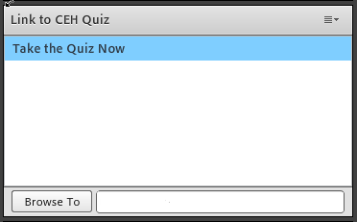
Continuing Education Hours
1 NAADAC CEH
Pass 10-question quiz with 7 correct answers
Receive certificate immediately

Slide 61
For more information on RSAT training and technical assistance visit:
http://www.rsat-tta.com/Home
or email Stephen Keller, RSAT TA Coordinator at
skeller@ahpnet.com

