Slide 1
CBT Insights & Tools for Justice Professionals Part II Wednesday July 20, 2016
Notes:
Welcome to Part II of this webinar series on cognitive behavioral therapy for Justice Professionals. If you were with us for Part I – Welcome back.
Today’s webinar will build on the foundational information we covered in Part I, but will also cover different material. So if you were not able to join us for Part I, you can probably still get a lot out of the information we will cover today.
You can also access the presentation slides and handouts from part 1 and hear the recorded presentation by visiting www.rsat-tta.com and clicking on the tab for archived webinars.

Slide 2
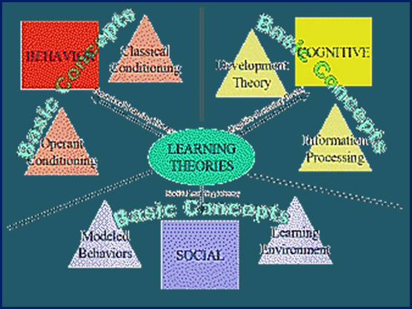
Topics we will cover in Part II
- Part I Review
-‘Homework’ – Worksheets & Tools
- Conducting Group Sessions
- Outcomes & Manualized Treatments (SUD & Trauma)
- Resources & Practice Tools
Notes:
We will review a few of the points we covered in part 1 with the goal of applying the theoretical elements we discussed to
Delivering CBT interventions in group settings
We will also look at some of the tools and worksheets we distributed in part 1 and also introduce additional practice tools and resource (public domain)
Last month we will looked at outcome research on CBT effectiveness for the treatment of mental health issues related to depression and anxiety and evidence-based CBT interventions aimed addressing reducing criminogenic needs. Today we’ll look at examples of evidence-based CBT interventions for treating SUDs and touch on CBT approaches that can help RSAT clients with co-occurring trauma-related disorders.
We will also introduce a resource listing with links to practical tools that will be included in the handouts for today’s session.

Slide 3
Part II Learning Objectives
Conducting CBT groups:
Using CBT techniques & tools
Avoiding what is incompatible
Evidence-based CBT for addiction treatment
Elements of effective sessions
Public domain manuals & resources
Notes:
The goals is to help RSAT programs deliver effective CBT group sessions and use CBT tools and techniques. Part of this includes understanding what does not work well in CBT session, the common issues that can derail sessions and some tips for maintaining the group’s focus and redirecting clients towards achieving their goals.
These directive elements of CBT sessions are part of what keep makes it an effective, time limited approach.

Slide 4
Review – CBT Background
“The thing that upsets people is not what happens but what
they think it means” - Epictetus
Notes:
Epictetus Greek Philosopher – born a Slave around 50 A.D.
His quote and the example on the slide of an incident ‘mapped’ out in a way that analyzes the relationship between events, thoughts, feeling and behaviors is sometimes referred to as ‘Attribution Theory.’
It shows how an event can take on the meaning an individual assigns to it from the thoughts it triggers and the how feelings associated with those thoughts can contribute to behaviors that cause distress.
For clients with substance use disorders, using alcohol and drugs is usually their default response to distress. So in this example the thoughts or attribution of mom’s silence is cognitively perceived as evidence of anger, which leads to anxious feelings. The behavior listed in the column to the far right is sleep disturbance.
But for our clients – we could almost insert another column to the far right for the ultimate behavior that occurs in response to almost all examples…..and that column would say “use” or “drink” or both. It’s easy to see how attributions habitually set people up to use.
So much of the time these sequences are so automatic, that clients do not even see it as something they can control or modify. Part of the goal of CBT is to increase the client’s belief that they can change these patterns by mapping out the cognitive/emotional pathways and breaking down the processes that set them up for using behavior.
The lower row that refers to alternative thoughts…..is the beginning of reshaping behaviors by changing the cognitive and emotional antecedents.

Slide 5
Assumptions of CBT
Substance use & other ‘target’ behaviors are learned.
Triggered by environmental cues, thoughts & feelings.
Learning new coping skills & modifying reinforcers helps stop or reduce these behaviors.
People are easily motivated to try techniques that reduce distress.
CBT requires a strong therapeutic alliance to enlist clients in learning, shaping & practicing new responses.
5
Notes:
In part 1 we talked about the influence social learning theory on CBT and its compatibility with motivational enhancement therapy and motivational interviewing techniques.
In the case of substance abuse or behaviors that contribute to criminogenic risks, target behaviors are generally ones we want to extinguish.
But, it is often easier to replace a behavior than to extinguish. The famous example from philosophy that illustrates this come from Martin Heidegger: “I’ll give you a dollar not to think of a bear.”
So it’s good to use the motivational approaches to also encourage the adoption of pro-social behaviors and activities that offer alternatives to drug use.
Next we are going to take a look at the ‘homework’ from part one. Some objections to CBT include an assumption that clients will not complete assigned homework between sessions.
I want to address this concern. In RSAT programs certain natural consequences can help motivate clients to complete homework, such as failure to attain the next level of privileges or otherwise delaying progress in treatment.
A couple of other helpful approaches: homework doesn’t need to be written. Actions such as calling transitional housing programs, or checking out a perception with someone close to them and similar commitments are valid assignments. Also, it is permissible, especially when groups include people with SUDs and COD’s to walk participants through assignments in group at the beginning of treatment.
Eventually, if the therapist consistently structures group around homework assignments, clients generally begin to adapt to it, as it is reinforced as a framework for participation.

Slide 6
Homework: First Things First
‘Homework’ – Comments on the worksheets & follow-up discussion questions….
Cocaine refusal skills
Functional analysis worksheet
Cravings log
Anger management exercise
Notes:
So, the component of conducting effective CBT sessions is to always follow up on homework/commitments early in the group.
Write down commitments or assign a group member to do so. In keeping with this structure, lets follow up on the ‘homework’ from part 1.
Please enter your responses to the discussion questions in the chat box as we continue.
For those of you who were not with us last month, participants reviewed at least one of the tools listed on the slide. These were all one-page worksheets that you might assign to group members to complete between sessions.
The questions were: do you think this tool might be useful in your RSAT program? How might wish to modify it? Where do you think it is from?
While you are commenting I want to address a question that came up last week that I promised to research.

Slide 7
Assumptions Behind CBT Groups
Therapist can model, observe & provide feedback on behaviors
Breaks through isolation; allows for observational learning
Helps with skill deficits that are inter-personal in nature
Realistic yet “safe” setting in which to practice
Links problem behaviors with consequences
Notes:
CBT for Batters Intervention: Most experts agree
The research does not support the effectiveness of batterers intervention. Generally, the content of the program makes no difference. All were equally effective or ineffective depending on the seriousness of the methodology employed in the study. The more scientific the study, the less effectiveness found, although there is a suggestion that there may be a suppression effect that lasts only as long as the abuser is in “treatment.” Battering is not a cognitive problem, an addiction, or a symptom of mental illness.
I shared my position during the webinar. I think that in most cases it is ineffective, although there may be some individuals that get something out of it, provided they are motivated to change the power dynamics of their relationship.
But CBT can be effective for anger management:
Meta-analysis studies (Beck & Fernandez, 1998; Edmondson & Conger, 1996; Trafate, 1995) conclude that there are moderate anger reduction effects for CBT interventions, with average effect sizes ranging from 0.7 to 1.2 (Deffenbacher, 1999). From these studies, it can be inferred that the average participant under CBT conditions fared better than 76 percent of control participants.
However, typically, batterers manage their anger very well when they are dealing with someone who might fight back or someone capable of holding them accountable for their actions, such as the police or the courts. Controlling their anger is not the problem.
Therefore, effective CBT anger management interventions that might help other individuals may not be effective for batterers.
Please comment if you delivery it and you have had a different experience.

Slide 8
Conducting the Sessions
20/ 20/ 20 Format - basic session structure, flexible to group size, session order and content
80/ 20 Rule – client(s) talk 80% of the time; therapist 20% of the time
WAIT- Why am I talking?

Slide 9
Structure of Sessions

Slide 10
Inconsistent with CBT groups
Breaking down denial
Allowing clients to confront others in group
Extensive exploration of past experiences
Deviating from session structure or focus
Devoting a session to a dysregulated or triggered group member

Slide 11
Effective Group Sessions
Counselor/clients model or role play in group - rehearsal of real life situations & skills practice is the strongest tool to reshape behaviors

Slide 12
Individualized Skills
Match content, focus, skill acquisition & behavioral change to client needs/goals
May focus on coping with urges & unlearning old habits
Reducing emotional distress or anxiety; relaxation
Increasing pro-social supports
Other individualized skills (anger management, etc.)

Slide 13
Tips for Using CBT in Group Work
Individualize - respond to issues clients deal with on a day to day basis (real life practice).
Use short cuts, workbooks, charts,
worksheets, and assignments
Always follow up on homework &
find out about commitments.
Reinforce all progress

Slide 14
Reshaping behavior though Cognitive Restructuring
Challenge thinking errors & automatic thoughts
Change reinforcement contingencies – positive activities & rewards
Foster management of painful effects – urges, anger & depression with alternative coping
Notes:
accurate thinking

Slide 15
Cognitive Reshaping Techniques
Thought stopping; find the logical error
Challenging irrational beliefs; examine the evidence
Cognitive rehearsal; generate alternative explanations
De-catastrophize; debunk “shoulds”
(see today’s handouts)

Slide 16
Questions Used to Formulate Rational Responses
Weigh evidence - automatic thought true or untrue?
What is the effect of believing the automatic thought?
What is the worst that could happen?
What’s the best that could happen?
What’s the most realistic outcome?
If a friend was in this situation and had this thought, what would I tell him/her?

Slide 17
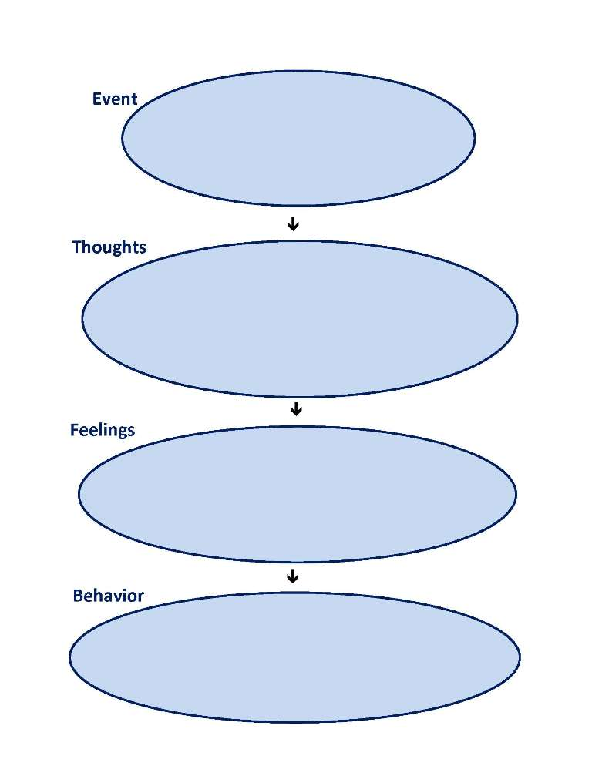
Examining Belief Systems
Precursors
Messages
Choice of behavior
Personalization
Confirm/conflicts with beliefs
New choice of new reactions

Slide 18
Research on CBT for Trauma
Meta-analysis of 7 studies on Trauma-focused CBT adults who began treatment within 3 month of exposure prevented and reduced symptoms (Kornor, et al., 2008).
Meta-analysis of 57 studies of various trauma interventions concluded CBT was a treatment of choice (Ponniah, K., & Hollon, S. D., 2009).
More that 20 research studies on Seeking safety show improvement in PTSD symptoms (Najavits & Hien, 2013)

Slide 19
CBT for Trauma
Skills Training in Affect & Interpersonal Regulation (STAIR)
Acceptance and Commitment Therapy
Cognitive Processing Therapy
Trauma-focused CBT
Seeking Safety
Trauma, Addiction, Mental Health & Recovery (TAMAR)
Trauma Recovery & Empowerment Model (TREM)
Addiction & Trauma Recovery Integration Model (ATRIUM)
Beyond Trauma

Slide 20
Outcomes Studies - CBT for SUDs
Review of 57 studies supports the efficacy of CBT for substance abuse, but effect sizes are small with the exception of some cannabis treatment studies.
Effect sizes may be greater for CBT for women and for brief interventions (Magill & Ray, 2009)
New research on CBT in combination with other psychosocial treatments and pharmacological therapies is promising.

Slide 21
Examples of CBT for Substance Abuse
Project MATCH - Cognitive Behavioral Skills for Therapy for AUDs
Motivational Enhancement/Cognitive Behavioral Therapy (MET/CBT)
Combined CBT & Pharmacotherapy for CODs
Cognitive Behavioral Approach to Treating Cocaine Addiction
Anger Management for Substance & Mental Health Clients
Functional Family Therapy for Adolescent Alcohol & Drug Abuse
Alcohol Behavioral Couple Therapy

Slide 22
Planning for Emergencies & Coping with Relapse
Anticipate & plan for high risk situations
Brainstorm events that could lead to relapse
Plan & rehearse ways to cope
Develop an emergency plan for after a lapse
Recognize guilt & shame associated with failure
Use emergencies & lapses as learning experiences

Slide 23
Increasing support networks & pleasant activities ( example of optional skills training session)
Improves confidence; introduces new supports & behaviors
Discusses who & what might help
Discusses how to get the support you need
Role play asking for help & support
Brainstorm pleasant activities
Select activity to ‘sample’

Slide 24
Resources
Blank maps & worksheets
Therapistaid.com
Evidenced-based CBT interventions (all types)
Links to public domain CBT manuals from major SUD treatment studies

Slide 25
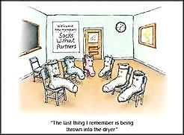
Questions?
Questions about content or resources - email nmiller@ahpnet.com
For more information on RSAT training & technical assistance, email Jon Grand, RSAT TA Coordinator at jgrand@ahpnet.com or visit: http://www.rsat-tta.com
Thank you!

