Slide 1
Correctional MAT Programming Andy Klein, Ph.D.
Advocates for Human Potential, Inc.

Slide 2
I. Guiding Principles
Medication is considered part of the contemporary standard of care for the treatment of individuals with alcohol and opioid use disorders and also for individuals with co-occurring mental illness. Justice-involved populations with substance and/or alcohol use, as well as co-occurring disorders, should have access to medication and behavioral therapies.

Slide 3
I. Guiding Principles
Example:
The National Commission on Correctional Health Care updated its position statement on the treatment of substance use disorders for incarcerated individuals at the end of 2016 to include the following:
Inmates not receiving MAT prior to entry, or whose MAT is discontinued while incarcerated (which is not preferred), should be offered MAT prerelease when post release continuity can be arranged.

Slide 4
I. Guiding Principles
Whether an individual obtains medication for opioid or alcohol use disorders, as well as the specific medication chosen, is to be decided by the individual after consultation with medical and treatment providers, not imposed by a justice or treatment agency.
MAT, as its name implies, “assist” in the treatment of substance and alcohol use disorders. It is coupled with counseling and appropriate wraparound services—the same services provided to individuals who do not elect MAT but receive other substance use disorder treatment.

Slide 5
I. Guiding Principles
Justice agency staff should receive training and education about MAT and its proper application.
MAT programming within residential correctional facilities and other justice environments requires special attention to prevent diversion of agonist medications and to safeguard participating individuals.
The administration of MAT requires testing of participants to ensure clients are receiving the appropriate doses as prescribed.

Slide 6
I. Guiding Principles
The selection of community-based aftercare treatment and medication providers must be carefully considered and may require justice agency collaboration to encourage providers to meet the needs of justice-involved referrals.

Slide 7
II. CJ MAT Components
Detoxification protocols support screening for withdrawal severity and poly-substance use, monitoring, and medical management of withdrawal symptoms, which may include the use of appropriate over-the-counter medications.
National Commission on Correctional Health Care
Low—should be monitored but do not require medical attention
Medium—require immediate medical attention but do not have complicating medical conditions
High—require immediate medical attention and intensive monitoring due to other medical conditions that elevate risker-the-counter and prescription medications

Slide 8
II. CJ MAT Components
Utilization of prescribing physicians and treatment providers (as well as later referral to them of released individuals) by correctional administrators is selective, restricted, for example, to physicians who have required certification and are knowledgeable about addiction, the medication sought, substance abuse or behavioral health programs, and the role of MAT in substance abuse treatment.

Slide 9
II. CJ MAT Components
Correctional agencies implementing comprehensive MAT programs develop strong relationships with treatment and MAT providers, including regular communication regarding participant progress.
Correctional officials rely heavily on the clinical judgment of treatment providers, as well as their agency’s own clinical staff if they have one. Individuals should be assessed before MAT is recommended or promoted.
Monitoring for illicit use of medication-assisted treatment medication or other drugs is a key component of the program.

Slide 10
II. CJ MAT Components
Correctional agencies facilitating MAT work with their state Medicaid agencies to facilitate healthcare coverage for MAT medication
Navigators—Navigators receive extensive training from CMS, responsible for providing unbiased info about public and private health insurance programs in a culturally competent manner.
Non-navigator assistors (in-person assisters)—Similar to navigators, provide in-person assistance and informing consumers about coverage options, but funding for assistors is more flexible than navigator funding. Many states opt to train staff of existing community-based agencies to carry out in-person assistor duties.
Certified application counselors (CACs)—CMS designates organizations to certify counselors who perform these functions. CACs complete pre-service training and receive ongoing in-service training via CMS webinars and newsletters.
Brokers, agents, and contracted assistors—Usually act on behalf on the consumer and are compensated by insurers or consumers. Some states contract with brokers or agents to act as “navigators.”

Slide 11
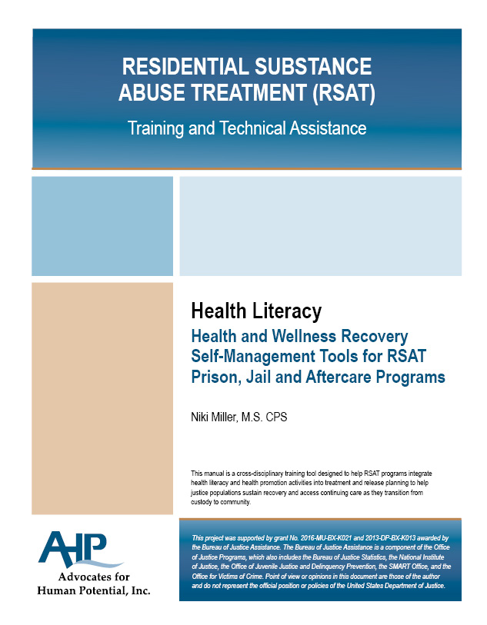
II. CJ MAT Components
Correctional agencies include “health literacy” as key component of treatment program.

Slide 12
II. CJ MAT Components
Assisting individuals to choose the medication that is right for them requires shared decision-making.
Methadone
Buprenorphine with or without naloxone
Naltrexone, oral or injected

Slide 13
II. CJ MAT Components
Correctional MAT Program Models:
Most common: Injection of naltrexone immediately before release
Limited Naltrexone maintenance (oral or injections) followed by injection immediately before release
Agonist maintenance for those entering with prescription
(licensed methadone clinics come into jail/prison to provide daily medication to their incarcerated clients)
d) Agonist medication induction as requested and determined to be appropriate for post-release treatment

Slide 14
II. CJ MAT Components
Pregnant women with opioid and alcohol use disorders require specialized services to prevent and reduce the health risks resulting from these disorders during pregnancy. Medication-assisted treatment (methadone) readily available to stabilize pregnant women with opioid use disorders during pregnancy. There are also services for tobacco cessation which is also important for this population.

Slide 15
III. Special MAT Concerns for Corrections
Detoxification of individuals in crisis that come to jail, if necessary and appropriate, is only the first step in promoting their long-term recovery from substance use disorders.
Addition of MAT to SUD treatment programs does not unduly burden corrections.
Jail and prison MAT programs break down barriers between in-house treatment and follow-up treatment in the community post release.

Slide 16
Model Correctional MAT Programs
Opioid &/or Alcohol Use Disorders
Concurrent with treatment programs (6 mos)
Informed about all FDA approved medications, incl. adverse effects
Volunteer to participate
Enroll in Medicaid, health insurance exchanges before release.
Medical examination (liver test, drug test for 7-10 day abstinence for naltrexone, oral test dose
Some offer naltrexone maintenance before pre-release injection

Slide 17
Model Correctional MAT Programs - Post Release
Warm hand off to treatment that also provides access to FDA approved medications
Provide Continuity of Recovery Support before/after release
Client may choose to remain on injected Naltrexone or switch to other medication after consultation with physician/treatment provider
Encourage to remain on medication to avoid relapse one year
While treatment/abstinence may be mandated by parole/probation, medication is not

Slide 18
Model Correctional MAT Programs - Challenges
Getting buy-in and leadership from Correctional/Behavior Health agency officials and line staff
Getting buy-in from incarcerated, their families
Getting contracted prison medical physicians to prescribe medications, educating them about medications; linking to methadone clinic or becoming satellite methadone clinic
Getting network of community-based treatment providers on-board so continued medication/counseling accessible across state/county
Getting state Medicaid managed care plans and health insurance providers to include funding of medication without pre-conditions/accessing free care

Slide 19
Challenges
Co-occurring disorders: CODs are more often the rule than the exception in justice settings
Jail inmates with mental health problems are more likely than those without such problems to report drug use in the month before their recent arrest (60% vs. 40%; Mumola & Karberg, 2006).
Prison inmates with mental disorders are also more likely to have substance use disorders than inmates without mental disorders (74% vs. 56%; Mumola & Karberg, 2006).
CODS more likely to be reincarcerated within 1 year of discharge than those with only a mental or substance use disorder (48% vs. 31%;Messina et al., 2004).

Slide 20
Does it Work?
Uniformly very high rates of entrance into post release treatment, even where inmates are not under correctional supervision (83% Methadone, 78% Vivitrol)
Uniformly low re-incarceration rates within one to three years (18%) (Barnstable); Half the recidivism rate of California state average, cost avoidance $125 per day/inmate (Sacramento)
Not to forget: reduced police, prosecution, court, correctional costs as well as medical/health costs

Slide 21
Does it Work?
…but
Relapse and re-arrest rate after six shots in PA convinced DOC officials to encourage one year of injections; confirmed by J. Lee study comparing MAT/abstinence
Methadone/Buprenorphine in prison/jail require special security measures although also may reduce demand for contraband drugs

Slide 22
Overdose Mortality Rates
For methadone
2.6 per 1,000 person years while in maintenance
12.7 per 1,000 person years after stopping methadone
For buprenorphine
1.4 per 1,000 person years while in maintenance
4.6 per 1,000 person years after stopping maintenance
Sordo L et al., 2017. Mortality risk during and after opioid substitution treatment: systematic review and meta-analysis of cohort studies. BMJ. Apr 26;357:j1550. doi: 10.1136/bmj.j1550

Slide 23
Overdose Mortality Rates
For Injectable Naltrexone
?, but….
Compared 153 receiving 24 weeks of naltrexone injections compared with 155 receiving counseling only, tracked one year after treatment; Participants from 5 studies of offenders w/OUD, under supervision of parole, probation, or court.
Naltrexone group longer time to relapse (10.5 vs. 5 weeks); lower relapse rate (43% vs 64%). After one year results equalized between two groups, only 46% in each group tested negative for opioids; reincarceration rates 1,651 vs 2,628 days, but not statistically significant.
Overdose Rates: “All recorded overdose events, fatal or nonfatal, occurred among participants assigned to usual treatment (0 events vs. 5 from week 0 to 25, P=0.10; 0 vs. 7 events from week 0 to 78, P=0.02); no overdoses occurred in the extended-release naltrexone group after discontinuation of the agent.”
Lee et al., 2016. Extended release naltrexone to prevent opioid relapse in criminal justice offenders. NEJM 2016 Mar 31;374(13):1232-42. doi: 10.1056/NEJMoa1505409

Slide 24
Overdose Mortality Rates
David Stojcevski Credit Family photo Picked up for reckless driving, in lieu of $774 fine, jailed for 30 days. On prescribed methadone, requested medication previously prescribed for opioid. Instead sent to 2-day jail detox. Then began long, painful decline featuring hallucinations, loss of 50 pound, ending in death on 16th day of sentence from dehydration, starvation and “acute withdrawal.” Macomb County Jail, Michigan, 2017

Slide 25
Questions?
Andy Klein, Ph.D
Aklein@ahpnet.com
Advocates for Human Potential, Inc.

