Slide 1
What Does Evidence-Based Practice Mean and How Do We Know We Have it?
adapted from NIC, Implementing EBP in Community Corrections: The Principles of Effective Intervention, 2004, & Crime and Justice Institute, Implementing Evidence- Based Practices, Revised, Center for Effective Public Policy, 2010; & Taxman & Belenko, 2012

Slide 2
What is Evidence Based Practice?
“The term “evidence based practices” is, in essence, interventions or practices that should be widely used because research indicates that they positively alter human behavior.”
Taxman & Belenko, 2012

Slide 3

The Science Behind
Evidence-Based Principles
Based upon previous compilations
of research findings and
recommendations, there now exists
a coherent framework of guiding
principles. These principles are
interdependent and each is
supported by existing research.
(Burrell, 2000; Carey, 2002; Currie, 1998;
Corbett et al, 1999; Elliott et al, 2001; McGuire,
2002; Latessa et al, 2002; Sherman et al, 1998; Taxman & Byrne, 2001)

Slide 4
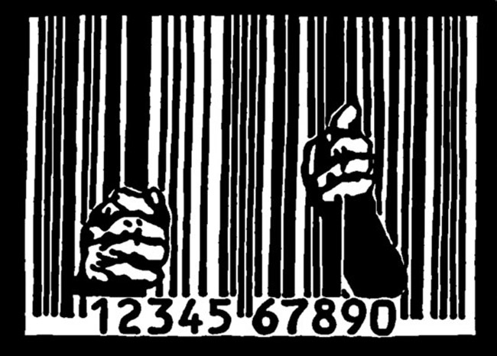
Evidence-Based Practice (EBP)
Why?
According to BJS, 67% of individuals released from prison with alcohol or substance use disorders are rearrested within 3 years, rates that have remained relatively stable for decades.
(Andrews & Bonta, 1998; Hughes & Wilson, 2005).

Slide 5
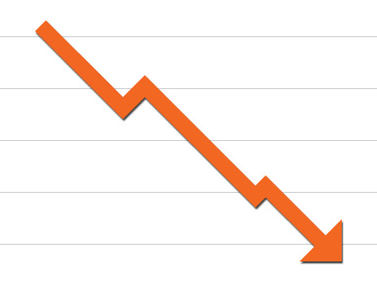
Principles for Evidence-Based Practice
But,
two decades of research demonstrates that a 30% to 50% reduction in recidivism is possible if current knowledge – “evidence based practice” – is applied with fidelity.
(Andrews, Zinger, et al, 1990)

Slide 6
Examples of EB Programs utilized by RSATs
Criminal and Addictive Thinking (CAT)
Craving Identification and Management (CIM)
Matrix Model
Anger Management for Substance Abuse and Mental Health Clients
Mindfulness-Based Relapse Prevention (MBRP)
Seeking Safety (Trauma and substance abuse)
Thinking for a Change (T4C)
Motivational Interviewing (MI)
Moving On
TCU Mapping-Enhanced Counseling (TMEC)
Courage to Change Curriculum
Medication Assisted Treatment (MAT)

Slide 7

Challenge of Evidence Based Practice
Naive assumption that adopting an EB Program is magic cure solution.
Real challenge is getting agencies to implement EB Practices.

Slide 8

Additional Challenge - Identifying EB Practice for Rx of RSAT Inmates
Large divide between treatment and correctional supervision.

Slide 9
Bridging the Divide
First:
Must identifying EB Program for offenders that reconciles treatment and other criminogenic needs (e.g. antisocial values and peers, impulsivity and decision-making).

Slide 10
Bridging the Divide
Recipes for Failure (D. Marlowe):
→Direct referral to substance abuse treatment program that offers one-size-fits-all GROUP COUNSELING.
→ → When the client fails, offer more GROUP COUNSELING!
→ → → And when clients fails again, offer still more GROUP COUNSELING!
→ → →→90 AA Meetings within the first 90 days of treatment

Slide 11
EB Practice Means Changing Culture/Structures
Second:
Must change how we do business in our jails/
prisons & treatment programs so that organizational structures and cultures enable rather than hinder the implementation of programs and services that are known to work in treating justice involved and reducing criminal behavior.

Slide 12

Changing Culture/Practice
Re-examining what we believe to be true….

Slide 13

What Evidence Based Practice Isn’t
Offender Accountability
Holding offenders account-
able without consistently
providing skills, tools, &
resources that science
indicates are necessary to
accomplish risk and recidivism reduction is a recipe for failure.

Slide 14
e.g.
Immediate transfer out of RSAT pod for any program violation or probation/parole revocation for first positive test for drug of abuse,
before client has the information, tools and skills to conform to program rules or maintain sobriety
vs.
Violations that makes
participation untenable for
Inmate or others

Slide 15
This we believe (wrongly):
Assessment:
Relying on our experience to predict the likelihood that an offender will commit another offense. Clinical judgment has consistently under predicted rearrest rates when compared to empirically-based tools.
Allowing the current offense to dictate how intensely to treat or supervise an offender. The offender’s characteristics predict future offenses more than the current offense. For risk reduction, risk profile – rather than offense – should drive the intervention.

Slide 16
e.g.
No Felons
No Violent Offenders
vs
Individual Assessment for Risk/Needs
& Responsivity

Slide 17

This we believe (wrongly):
Motivation:
Believing that the offender has
got to want to change in order
to change, minimizing our role as treatment providers and correctional professionals.
Motivation is dynamic and can be influenced through effective engagement techniques to increase the likelihood that offenders will become motivated to change.

Slide 18
eg.
He just wants to get into RSAT to influence
parole board or judge,
not interested in treatment
vs
Doesn’t matter how he got here

Slide 19

This we believe (wrongly):
Behavioral Management:
Lecturing, threatening & confronting best
way to influence
inmates’ behavior.
Offenders are more
likely to respond to
positive reinforce-
ment and incentives.
.

Slide 20

This we believe (wrongly):
Keep ‘em guessing. Make sanctions and consequences for rule breaking secret to keep offenders off-guard and fearful
(i.e. Power & Control tactics).
Offenders are more likely
to comply when they know
the rules and consequences,
and are less likely to resist
the consequences when
the rules are broken and a sanction is imposed.
a

Slide 21

This we believe (wrongly):
Offenders do not pay attention to, or respect, subtle messages they receive through their interactions with us. Every interaction with offenders represents an opportunity to role-model for offenders, affirm pro-social values, and demonstrate disapproval for anti-social thinking/behavior. If COs and treatment staff
don’t respect each
other in their inter-
                actions, both will be
undermined in the
eyes of RSAT inmates.
. .

Slide 22

This we believe (wrongly):
Programming:
Any program is better than
nothing.
Programs that are mismatched
to offender traits can actually
do harm. Programs must be
appropriate based upon
offenders’ level of risk and
criminogenic needs as well
as recognize offender gender, culture and other responsivity factors.

Slide 23
And finally, this we also believe (wrongly):
Evidence Based Practices = Best Practices =
What Works
“Best practices” - collective experience and wisdom of the field, not scientifically tested knowledge of outcomes, evidence or measurable standards.
“What works” - linked to general outcomes (e.g. organizational efficiency, offender accountability, just desserts, rehabilitation, etc.), not specifically to recidivism reduction/relapse prevention.
(Harris 1986; O'Leary and Clear 1997).

Slide 24
What Evidence?
What Research?
True Experimental, Randomized Control Trials in Different Settings & Populations
vs.
No research, no sound theory behind it (“way it was always done”), anecdotal evidence…

Slide 25

Next Best Thing
Treatment Effect:
Hard to Come by, especially with small samples
N = 3

Slide 26
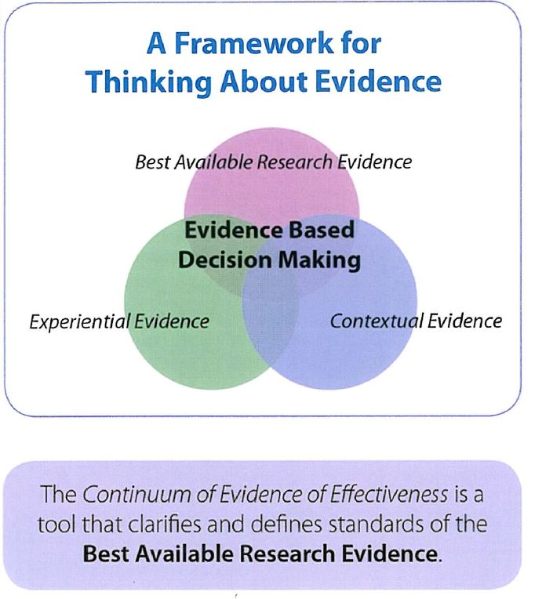

Slide 27

Keys to EBP
Evidence-based practice
Definable and measurable
outcome(s)
(if you don’t know where you
are going, any road will get
you there…)
Practical realities, i.e.
recidivism, relapse after
first phase of treatment….

Slide 28
8 Principles for Effective EB Practice
1. Assess Actuarial Risk/Needs.
2. Enhance Intrinsic Motivation.
3. Target Interventions.
4. Provide Skill Training with Directed Practice (Cognitive Behavioral Treatment/ MAT).
5. Increase Positive Reinforcement.
6. Engage Ongoing Support in Offender’s Community
7. Measure Relevant Processes/Practices.
8. Provide Measurement Feedback.

Slide 29

Assess Actuarial Risk/Needs
Train staff to complete Reliable/Valid Offender Assessments, using tools that focus on dynamic and static risk factors, profile criminogenic needs, and have been validated on similar populations.
Offender assessment ongoing function, not just formal event. Case information that is gathered informally through routine interactions and observations with offenders is as important as formal assessment guided by Instruments.
(Andrews, et al, 1990; Andrews & Bonta, 1998; Gendreau, et al, 1996; Kropp, et al, 1995; Meehl, 1995; Clements,1996)

Slide 30

Enhance Intrinsic Motivation
Behavioral change: often an inside job, needs to be a level of intrinsic motivation for lasting change.
Research strongly suggests that motivational interviewing techniques, rather than persuasion
tactics, more effectively enhance motivation for initiating and maintaining behavior changes.
(Miller & Rollnick, 2002; Miller & Mount, 2001; Harper & Hardy, 2000; Ginsburg, et al, 2002; Ryan & Deci, 2000)

Slide 31
Enhancing Motivation for Change in Substance Abuse Treatment
http://store.samhsa.gov/product/TIP-35-Enhancing-Motivation-for-Change-in-Substance-Abuse-Treatment/SMA13-4212

Slide 32

Target Interventions (getting more bang for the buck…)
Risk Principle: Prioritize higher risk offenders.
Need Principle: Target criminogenic needs.
Responsivity Principle: Be responsive to temperament, learning style, motivation, culture, and gender.
Dosage: Structure 40-70% of high-risk offenders’ time for 3-9 months.
Treatment Principle: Integrate treatment into the full correctional environment (collaboration between Rx and CJ)

Slide 33

Ideal target justice population
Dysfunctional family relations, anti-social/criminal peers, substance abuse, low self-control, anti-social values/attitudes.
(Gendreau, 1997; Andrews & Bonta, 1998; Harland, 1996; Sherman, et al, 1998; McGuire, 2001, 2002, Lipton, et al, 2000; Elliott, 2001; Harland, 1996)

Slide 34

Risk Factors
Common Historical Risk Factors (Static Risk Factors)
Age at first arrest
Current age
Gender
Criminal history****
**** 1of Big Four

Slide 35
Common Criminogenic Needs
Responses
1. History of anti-social behavior ---
2. Anti-social personality pattern --- ****
3. Anti-social attitudes, cognition--- ****
**** 2 & 3 of Big Four
Build non-criminal alternative behavior in risky situations
Build problem solving, self-management, anger management, and coping skills
Reduce anti-social thinking; recognize risky thinking and feelings; adopt alternative identity/thinking patterns

Slide 36
Common Criminogenic Needs
Responses
Anti-social associates, peers--- ****
(4 of Big Four)
5. Family and/or marital stressors communication–
6. Lack of employment stability, achievement/ educational achievement--
Reduce association with anti-social others; enhance contact with pro-social others
Reduce conflict; build positive relationships and communication
Increase vocational skills; seek employment stability; increase educational achievement

Slide 37
Common Criminogenic Needs (Dynamic Risk Factors)
Responses
7. Lack of pro-social leisure activities–
8. Substance abuse–
(Andrews, 2007; Andrews, Bonta, &
Increase involvement in and level of satisfaction with pro-social activities
Aftercare/Continuing Care in Community; Reduce the supports for substance abusing lifestyle; increase alternative coping strategies and leisure activities
Wormith, 2006, p. 11.)

Slide 38

Risk/Need/Responsivity
Responsivity Principle:
Matching Considerations:
1) treatment to offender;
2) treatment provider to offender
3) style and methods of communication with offender’s stage of change readiness.
Note: Cognitive-behavioral methodologies with MAT have consistently produced reductions in recidivism with offenders based on most rigorous research.
(Guerra, 1995; Miller & Rollnick, 1991; Gordon, 1970; Williams,
et al, 1995)

Slide 39
Responsivity
Integrating trauma-informed care and mental illness assessment and treatment, where possible, or referral is crucial for quality treatment.

Slide 40
Medication Assisted Treatment
When treatment for justice-involved opioid users combined prescribed medication, behavioral counseling and ongoing support, the effects are many times greater than treatment without medication.
Marlowe, D. 2003

Slide 41
Dosage
Correctional Treatment Programming:
Why modified therapeutic communities work in jail/prisons: 24/7 positive programming; limiting RSAT programming to specific counseling/group sessions risks inmates being overwhelmed by jail house culture negative influences. Also why COs must be integral part of program.
Aftercare: Occupy offender’s free time at least 4 to 7 months in the community, providing appropriate doses of services, pro-social structure, and supervision.
(Palmer, 1995; Gendreau & Goggin, 1995; Steadman, 1995; Silverman, et al, 2000)

Slide 42

Note: The quality of the interpersonal relationship between staff and the offender, along with the skills of staff, are as or more important to risk reduction than the specific programs in which offenders participate.
(Andrews, 2007; Andrews, 1980; Andrews & Bonta, 1998; Andrews & Carvell, 1998; Dowden & Andrews, 2004)

Slide 43

Skill Training and Directed Practice:
Staff must understand antisocial thinking, social learning, and appropriate communication techniques. Skills are not just taught to the offender, but are practiced or role-played. Pro-social attitudes and behaviors are positively reinforced by staff.
(Mihalic, et al, 2001; Satchel, 2001; Miller & Rollnick, 2002; Lipton, et al, 2000; Lipsey, 1993; McGuire, 2001, 2002; Aos, 2002)

Slide 44

Increase Positive Reinforcement
Carrots over sticks
Research: ratio of 4 to 1 positive reinforcement is optimal for promoting behavior changes.
But
not at the expense of or undermining swift, certain, and real responses for negative and unacceptable behavior.

Slide 45
Note: While offenders generally respond positively to reasonable and reliable boundaries, initially may overreact to new demands for accountability, seek to evade detection or consequences, and deny any personal responsibility.
However, exposure to clear rules that are consistently (and swiftly) enforced with appropriate and graduated consequences, offenders will tend to comply in the direction of the most rewards and least punishments.
(Gendreau & Goggin, 1995; Meyers & Smith, 1995; Higgins & Silverman, 1999; Azrin, 1980; Bandura et al,1963;Bandura, 1996)

Slide 46

Rx Program & CJ Collaboration
Duet not a Solo

Slide 47

Engage On-going Support in Home Communities:
Community Reinforcement Approach (CRA)
Mobilize pro-social supports for offenders in their communities. Successful interventions with extreme populations (e.g., inner city substance abusers, homeless, dual diagnosed) actively recruit and use family members, spouses, and supportive others in the offender’s immediate environment to positively reinforce desired new behaviors
Note: Worst , most deadly alternative
for recently released: Homeless shelters,
often located in drug markets

Slide 48
Engage On-going Support in Home Communities
Research indicates the efficacy of twelve step programs, religious activities, and restorative justice initiatives that are geared towards improving bonds and ties to pro-social community members.
(Azrin, & Besalel, 1980; Emrick et al, 1993; Higgins & Silverman, 1999; Meyers & Smith, 1997; Wallace, 1989; Project MATCH Research Group, 1997; Bonta et al, 2002; O’Connor & Perryclear, 2003; Ricks, 1974; Clear & Sumter; 2003; Meyers et al, 2002)

Slide 49

Measure Relevant Processes/Practices:
Document case information, including formal/valid mechanism for measuring outcomes. Programs must routinely assess offender change in cognitive and skill development, and evaluate recidivism of clients...

Slide 50
Measure Relevant Practices
Periodical staff performance evaluation achieves greater fidelity to program design, service delivery principles, and outcomes. Staff whose performance is not consistently monitored, measured, and subsequently reinforced work less cohesively, more frequently at cross-purposes and provides less support to the agency mission.
(Henggeler et al, 1997; Milhalic & Irwin, 2003; Miller, 1988; Meyers et al, 1995; Azrin, 1982; Meyers, 2002; Hanson & Harris, 1998; Waltz et al, 1993; Hogue et al, 1998; Miller & Mount, 2001; Gendreau et al, 1996; Dilulio, 1993)

Slide 51

Provide Measurement Feedback:
Both clients and staff need feedback
(Miller, 1988; Project Match Research Group, 1997; Agostinelli et al, 1995; Alvero et al, 2001; Baer et al, 1992; Decker, 1983; Luderman, 1991; Miller, 1995; Zemke, 2001; Elliott, 1980)

Slide 52

Implementing EBProgram(s)
Need:
strong leadership and commitment;
more than simply adding an evidence-based program or two.

Slide 53
What Practice?
What implementation?
Evidence Based Program replicated with fidelity, with on-going evaluated to make sure it is achieving required outputs and outcomes for population in specific setting
vs.
Partial replication (what fits, only), no evaluation of the replication

Slide 54

Organization Change
Note: Most organizational change initiatives fail; mostly due to flawed execution.
(Rogers, Wellins, and Connor, 2002, The Power of Realization: Building Competitive Advantage by Maximizing Human Resource Initiatives)

Slide 55
Beating the Odds to Succeed
Need steadfast and dedicated commitment to change by managers, line staff, and everyone in between.
The change cannot be “owned” by just a few, or units within an organization, or even by a single agency within the jurisdiction. Successful offender treatment depends on full alignment within and among criminal justice and treatment providers. So too is the case for effective implementation of evidence-based practices.
(Rogers, Wellins, & Connor, 2002)

Slide 56

Beating the Odds
An openness to doing things differently.
Changing the status quo takes clarity of purpose, the courage to challenge the status quo, and a fundamental willingness to do things differently. Effective implementation of
EB P cannot simply be adding it or exchanging piecemeal one past practice for a new one. Evidence-based practice requires a comprehensive review of vision, mission, policies, practices, attitudes and skills, and a thoughtful transition from what has been to what will be.

Slide 57

Beating the Odds
Transparency and accountability.
Research demonstrates that the strategic use of public funds can produce a profoundly positive impact on public safety, as measured by fewer new victims and fewer new crimes committed by offenders under correctional supervision.
Collecting and analyzing performance data, making performance data available to others, and holding ourselves accountable for improvements
in public safety are key components of
evidence-based work.

Slide 58
Successful RSAT Aftercare Completion

Slide 59
Non-Completion
Failure to meet program requirements | 40%
Voluntary drop out | 22%
Termination for new charge | 18%
Release/Transfer to Another Facility | 8%
Absconded | 6%
Other | 5%

Slide 60
Choosing an Evidence Bases Program
→Is EBP transferable to local setting?
→ Was the research of the EBP based on a program that served equivalent population and setting?
→ Can the EBP be implemented with fidelity?
→ Does the organization have the resources and capacity to implement the EBP?
→ Does the staff perceive the utility of the EBP?

Slide 61
Implementing a new Evidence Based Program
→New EBP must be aligned with existing process and procedures which will require either adaptation of the EBP or modification of the existing procedures.
→ Staff needs the knowledge and skills to use the EBP.
→ The feedback loop needs to be instituted.

Slide 62

Note: Staff may cling to programs that helped them & be particularly resistant to others, i.e. why EB MAT programs critically underutilized.

Slide 63
EBP Fidelity
→ developing staff knowledge, skills, and attitudes congruent with current research-supported practice
→ implementing offender programming consistent with research recommendations
→ sufficiently monitoring staff and offender programming to identify discrepancies or fidelity issues
→ routinely obtaining verifiable outcome evidence associated with staff performance and offender programming.

Slide 64
e.g. CBT Program Fitness
CBT teaches clients to identify, evaluate &respond to their dysfunctional thoughts & beliefs.
Do all staff understand program’s basic CBT approach and key terms?
Are CBT Groups monitored to assure appropriate techniques used?
Do staff reinforce CB principles or skills outside CBT sessions?
Are your other program tools and rules consistent w/ CBT principles?
Are clients accountable for CB homework and applying CB skills or principles to their ongoing program activities?
Are staff behaviors on-site consistent with the CB skills and principles?
1=almost never; 3=somewhat; 5= pretty much; & 7=very much so
35 plus=congrats 30 or below=back to the drawing board
Fred Zackon, 2011

Slide 65

Finding EB Program

Slide 66

Mental Illness Awareness Wee

Slide 67
Finding EB Programs
SAMHSA
A Guide To Evidence-Based Practices (EBP) on The Web

Slide 68
Finding EB Programs
BJA: Resources on Evidence-Based Programs and Practices (https://www.bja.gov/evaluation/evidence-based.htm)
General Resources
Center for Evidence-Based Crime Policy
Cochrane Collaboration
CrimeSolutions.gov
Evidence-Based Medicine Resource Center
Evidence-Based Policy Help Desk
National Implementation Research Network
Office of Management and Budget (OMB)
Preventing Crime: What Works, What Doesn't, What's Promising (Sherman et al., 1997)

Slide 69
Finding EB Programs
BJA: Information on Specific Evidence-based Programs and Practices https://www.bja.gov/evaluation/evidence-based.htm
The Campbell Collaboration
Center for the Study and Prevention of Violence ("Blueprints Programs")
Coalition for Evidence-Based Policy
Department of Education What Works Clearinghouse
Office of Juvenile Justice and Delinquency Prevention Model Programs Guide
Substance Abuse and Mental Health Services Administration National Registry of Evidence-Based Programs and Practices (NREPP)
Washington State Institute for Public Policy (WSIPP)

Slide 70

More on EBP
National Institute of Corrections
Annotated Bibliography
Http://static.nicic.gov/Library/026917.pdf
COGNITIVE-BEHAVIORALPROGRAMS
A RESOURCE GUIDE TO EXISTING SERVICES

Slide 71
Aklein@ahpnet.com

