Slide 1
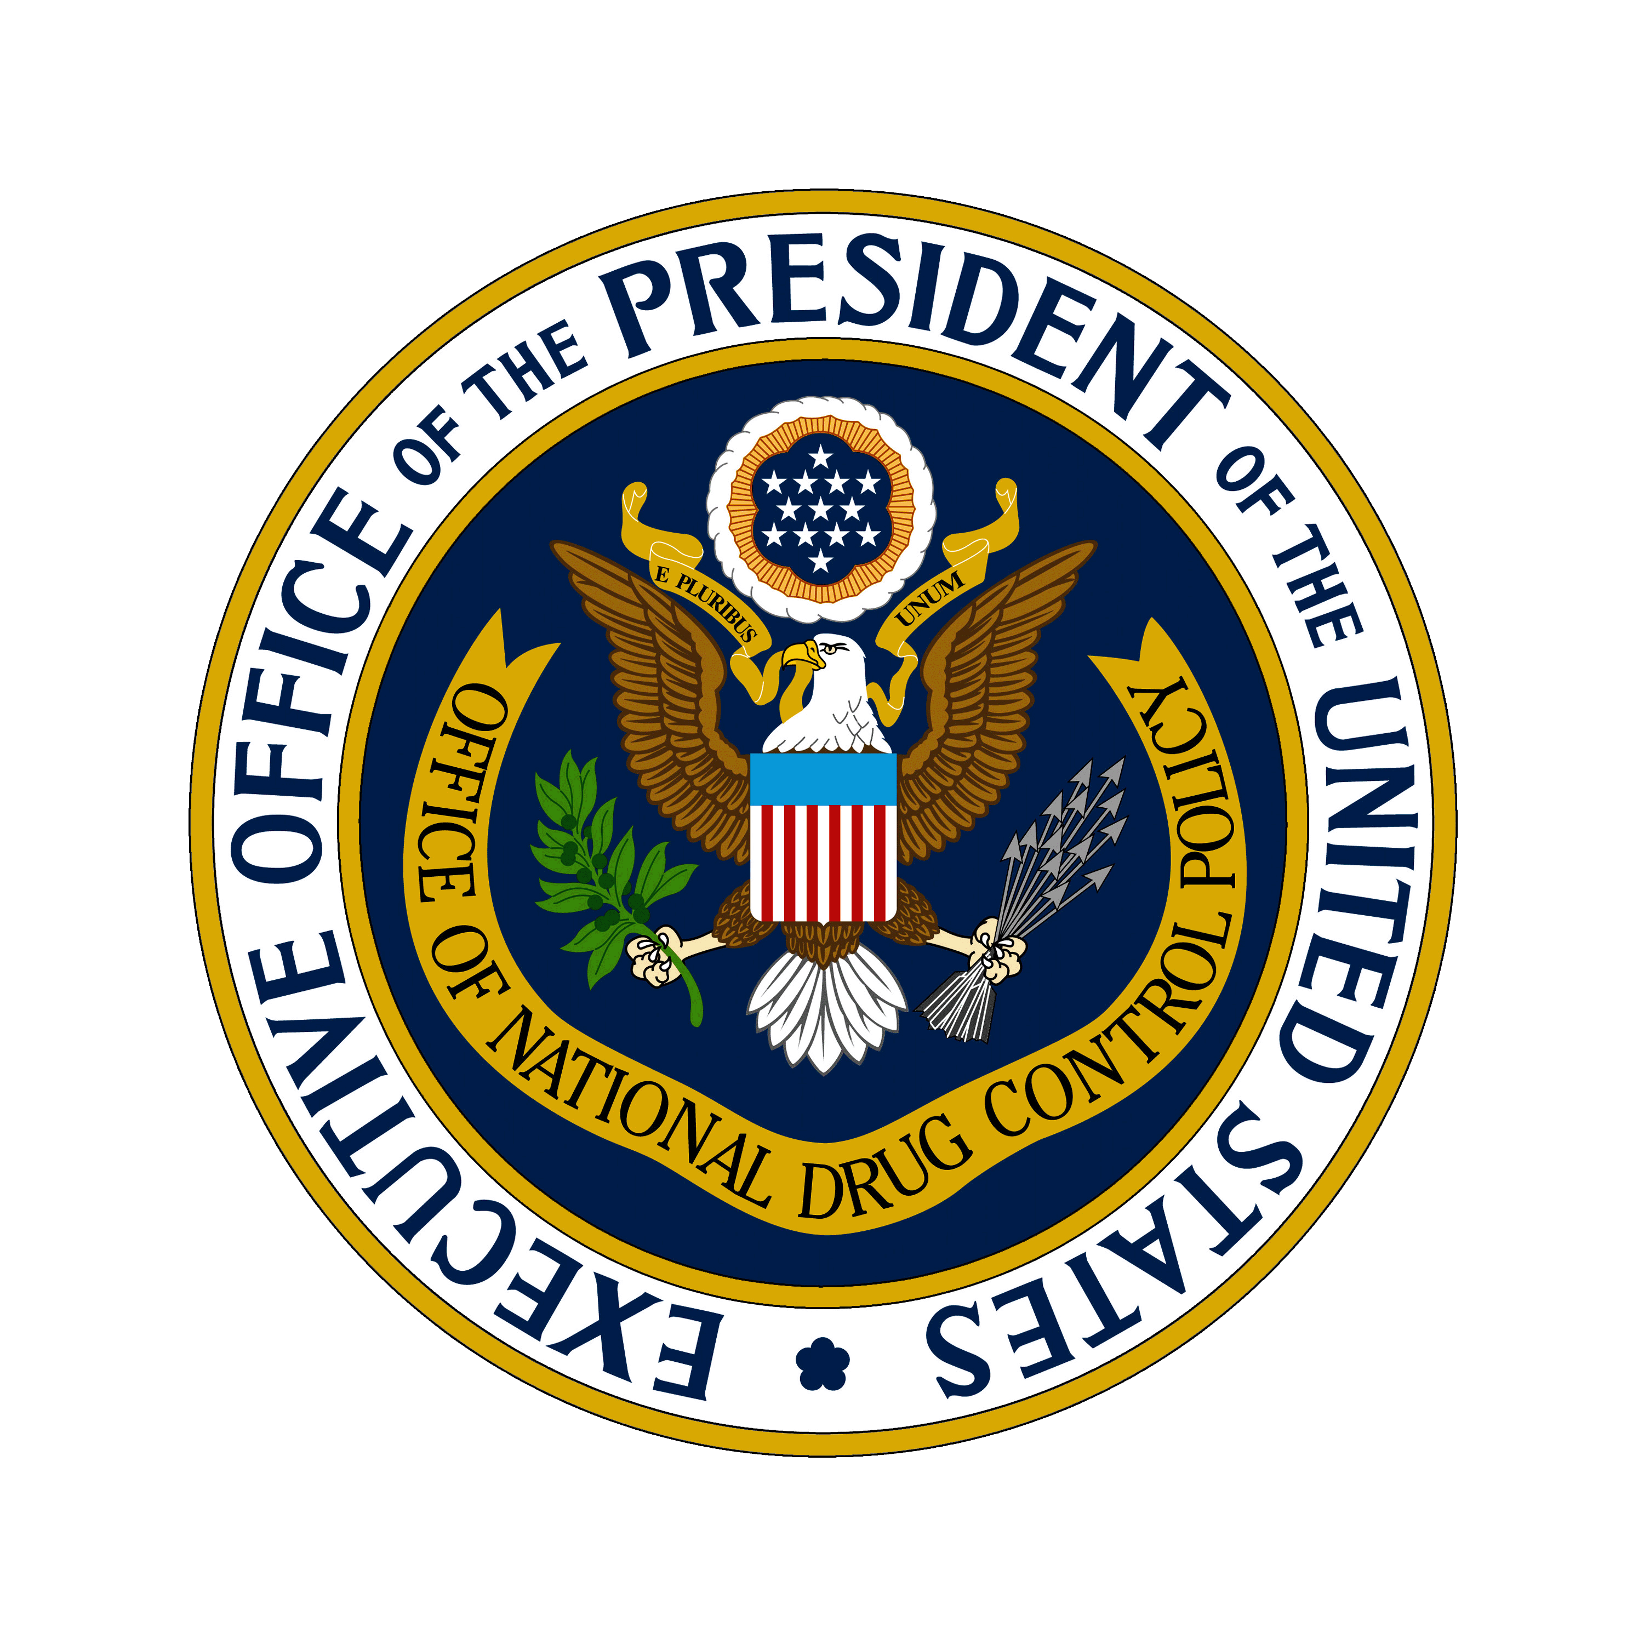
A Drug Policy for the 21st Century
National RSAT Conference
New Orleans, LA
July 16, 2015
Mary Lou Leary
Deputy Director for State, Local, and Tribal Affairs
Office of National Drug Control Policy
Notes:
Thank you, Denise, for the introduction and for the opportunity to speak to you today. On behalf of Director Botticelli and the Office of National Drug Control Policy, I thank you for being part of the Administration’s efforts to reform the criminal justice system. You play an important role in addressing substance use and its consequences.
Today, I’d like to talk about the Federal Government’s activities to change the dialogue around substance use disorders and the efforts underway by the Office of National Drug Control Policy to further drug policy reform.
[CLICK FOR NEXT SLIDE]

Slide 2
National Drug Control Strategy
The President’s science-based plan to reform drug policy:
Prevent drug use before it ever begins through education
Expand access to treatment for Americans struggling with substance use disorders
Reform our criminal justice system
Support Americans in recovery
Notes:
The Office of National Drug Control Policy (ONDCP) is a component of the Executive Office of the President and was created by the Anti-Drug Abuse Act of 1988 to advise the President on drug-control issues.
Its mission is simple: To reduce illegal drug use and its consequences.
Fulfilling that mission is not always so simple.
The Administration articulates its mission in the National Drug Control Strategy and is committed to restoring balance to U.S. drug policy efforts by coordinating an unprecedented government-wide public health and public safety approach.
Specifically, the Strategy is guided by three concepts:
Substance use disorder is a brain disease that can be prevented and treated;
People with substance use disorders can recover; and
Innovative criminal justice reforms can help stop the revolving door of drug use, crime, incarceration, and re-arrest.
[CLICK FOR NEXT SLIDE]

Slide 3
Major Causes of Death from Injury, 1999-2013
% CHANGE
2008 to 2013
MOTOR VEHICLE ACCIDENTS
+ 21%
+ 14%
-11%
SUICIDE
+ 6%
FIREARMS
DRUG POISONING
HOMICIDE
-10%
Source: Centers for Disease Control and Prevention, National Center for Health Statistics. Multiple Cause of Death 1999-2012 on CDC WONDER Online Database, released 2014. Data for 1999 to 2012 were extracted by ONDCP on December 2, 2014. Data for 2013 are from Detailed Tables for the National Vital Statistics Report “Deaths: Final Data for 2013” (December 30, 2014).
1/2015
Notes:
The Administration works on myriad issues involving drug policy each day, and the opioid epidemic in our country factors into every facet of our work.
In 2013, there were more than 16,000 overdose deaths in this country involving prescription pain relievers and over 8,000 involving heroin.
CDC surveillance experts were the first to note the rise in opioid overdose. Viewing it through the lens of preventable injury and showing it here in comparison with other forms of injury drives home not only its magnitude but also how much work we have to do.
You can see on this slide that motor vehicle accidents have come down and, in the same period, drug poisonings have continued to rise.
[CLICK FOR NEXT SLIDE]
[Slide grabbed from Rx summit slideshow]

Slide 4
Prescription Drugs and Heroin:
The Federal Response
Prescription Drug Abuse Prevention Plan
    Education
    Prescription Drug Monitoring Programs
    Proper Disposal of Medication
    Enforcement
Naloxone for Overdose Reversal
Syringe Services Programs to Prevent Infectious Disease
Medication-Assisted Treatment for Opioid
Use Disorders
Notes:
[CLICK]
In 2011, the Administration published the Prescription Drug Abuse Prevention Plan, which calls on individuals and organizations at Federal, state, and local levels to educate people on prescription drug abuse – including prescribers and the public – to monitor prescriptions being written and filled, to offer opportunities to safely dispose of unused or unneeded medication, and to reduce the number of illegal and unethical prescription practices (so-called pill mills).
We are working with medical associations to encourage and expand education that will help prescribers make informed decisions about appropriate quantities and qualities of prescription painkillers, as well as recognizing and referring individuals with substance use disorders to treatment.
The Prescription Drug Abuse Prevention Plan also calls for the reduction of non-medical use of prescription medications AND the reduction of negative medical consequences, including overdose.
Expanding overdose education and naloxone distribution are key to achieving these results. For those of you not familiar, Naloxone is a quick-acting medication that rapidly blocks the effects of opioids and quickly restores breathing. Easily administered, the drug generally works within 5 minutes and wears off within 30 to 90 minutes.
[CLICK]
The National Drug Control Strategy supports comprehensive overdose prevention efforts, to include:
Public education campaigns about overdose, including signs of overdose, emergency interventions, and connecting individuals to treatment. We are also working to increase education to inform patients using opioids (and their family members/caregivers) about potential for, signs of, and interventions in case of overdose.
And ONDCP is collaborating with state health and law enforcement officials to promote best practices and connect officials interested in starting their own naloxone programs.
Prior to 2012, just six states had any laws which expanded access to naloxone or limited criminal liability for those who administered it to someone who appeared to be overdosing.
Today, 35 states and the District of Columbia have passed laws that offer criminal and/or civil liability protections to lay persons or first responders who administer naloxone, and many jurisdictions have extended liability protections to prescribers and prescriptions to third parties.
[CLICK]
Beyond overdose deaths, one emerging and alarming consequence of the opioid epidemic is the increase in infectious disease caused by injection drug use.
From 2006 to 2012, data from Kentucky, Tennessee, Virginia, and West Virginia showed a substantial increase--364%--in the number of cases of acute Hepatitis C infection among people 30 years of age or younger. Many of these young people reported injection drug use.^{[i]}
But hepatitis C is not the only concern. As of July 7, the Indiana Department of Health confirmed HIV infection in 174 persons in a community of 4,200.^{[ii]} And 80 percent of these individuals reported injection drug use with a prescription opioid. ^{[iii]}
Syringe Service Programs are traditionally found in urban areas but with increasing rates of injection drug use in rural areas, we may continue to see higher rates of injection drug use in areas without such Programs. Syringe Service Programs can provide opportunities for education and testing for infectious diseases, as well as referral to treatment for substance use disorders.
[CLICK]
While these actions can prevent some of the more harmful effects of continued opioid use, we need to ensure that people with opioid use disorders have an opportunity to achieve long-term recovery with the help of FDA-approved medications.
If we recognize substance use disorder as a disease, just like diabetes or a heart condition, medication can be an important part of one’s treatment – helping them manage their disease. So too with opioid use disorders.
[CLICK FOR NEXT SLIDE]
^{[i]} Zibbell et al. Increases in Hepatitis C Virus Infection Related to Injection Drug Use Among Persons Aged ≤30 Years — Kentucky, Tennessee, Virginia, and West Virginia, 2006–2012. MMWR 2015; 64(17);453-458.
^{[ii]} 7/7/15 email from Joan Marie Duwve, Chief Medical Consultant to the Indiana State Department of Health.
^{[iii]} CDC. Community Outbreak of HIV Infection Linked to Injection Drug Use of Oxymorphine – Indiana. 2015. MMWR 2015; 64(16); 442-444.

Slide 5
Medication-Assisted Treatment (MAT)
  Medication-assisted treatment (MAT)
  is the standard of care for opioid use disorders.
Source: Weiss RD, Potter JS, Griffin ML, McHugh RK, Haller D, Jacobs P, Gardin J 2nd, Fischer D, Rosen KD. Adjunctive Counseling During Brief and Extended Buprenorphine-Naloxone Treatment for Prescription Opioid Dependence: A 2-Phase Randomized Controlled Trial Published in final edited form as: Arch Gen Psychiatry. 2011 December; 68(12): 1238–1246.
Notes:
Medication-assisted treatment is the standard of care for opioid use disorders. Medications, when combined with behavioral treatment, can be effective.
Compared with using MAT only for detoxification, ongoing MAT leads to higher abstinence rates:
50% abstinent at the end of active treatment vs 8% when medication is withdrawn (e.g., detox).
As you may know, individuals newly released from incarceration are more vulnerable and at a higher risk of overdose, especially within the first two weeks.^{[fn1]}
A study in Baltimore found that increased access to medication-assisted treatment for heroin use disorder – particularly expansion of buprenorphine treatment – may have significantly contributed to the reduction in heroin overdose deaths from 1995 to 2009.^{[fn2]}
Therefore, it is crucial that providers in both health care and justice settings become trained in medication-assisted treatment (MAT) for patients with opioid use disorders.
Equally important, corrections officials, justice practitioners, and policy makers must strive to learn about available medicines and promote policies that ensure use of these medications is part of a comprehensive approach to treating prescription and other opioid use disorders.
[CLICK FOR NEXT SLIDE]
^{[fn1]}Binswanger IA, Stern MF, Deyo RA, Heagerty PJ, Cheadle A, Elmore JG, Koepsell TD: Release from prison-a high risk of death for former inmates. N Engl J Med. January 2007, 356(2):157-165 Erratum in N Engl J Med. 2007 Feb 1;356(5):536 http://www.nejm.org/doi/pdf/10.1056/NEJMsa064115
^{[fn2]}Schwartz RP, Gryczynski J, O'Grady KE, Sharfstein JM, Warren G, Olsen Y, Mitchell SG, Jaffe JH. Opioid agonist treatments and heroin overdose deaths in Baltimore, Maryland, 1995-2009. Am J Public Health. 2013 May;103(5):917-22. doi: 10.2105/AJPH.2012.301049. Epub 2013 Mar 14

Slide 6
Medications Currently Available
For Opioid Use Disorder
Methadone
Buprenorphine
Naltrexone (Vivitrol)
For Nicotine Use Disorder
Nicotine Replacement Therapies (NRT)
Bupropion
Varenicline
For Alcohol Use Disorder
Disulfiram
Naltrexone
Acamprosate
Naltrexone Depot
Principles of Drug Addiction Treatment, National Institutes of Health – National Institute on Drug Abuse
Notes:
This slide lists the medications for treating nicotine, alcohol, and opioid use disorders. While there are no medications to treat cocaine, methamphetamine, and marijuana use disorders, there are 3 FDA-approved medications for the treatment of opioid use disorders.
We support the use of all three—methadone, buprenorphine, and long-lasting, injectable naltrexone—as prescribed by a licensed clinician. The clinician must make the decision on the appropriate medication for each individual.
Methadone is an opioid agonist, meaning it mitigates withdrawal symptoms and can block the effects of heroin and other drugs containing opiates. Methadone must be dispensed by a DEA-registered opioid treatment program. It has been successfully used to manage opioid use disorders for more than 40 years.
Buprenorphine is a partial opioid agonist. It mitigates withdrawal symptoms, and while it can produce euphoria and other opioid use symptoms, they are generally milder than full agonists like heroin and methadone. Buprenorphine
Naltrexone is a non-addictive opioid antagonist. It adheres to the receptors that would be affected by opioids, and thereby blocks the effects of abused opioids. Naltrexone is commonly administered in a long-lasting, injectable formulation called “Vivitrol.”
[Placeholder for diversion info]
[CLICK FOR NEXT SLIDE]

Slide 7
How RSAT Programs Can Help
TREAT people with opioid use disorders using every tool at our disposal, including medication-assisted treatment where appropriate
Help people TRANSITION to their communities with connections to treatment
PREVENT overdose by educating your program clients on their risk of overdose and the tools that exist to help prevent it
Notes:
You play a key role in the Administration’s efforts to stem the tide of opioid use disorders and overdose deaths:
Many of you are already incorporating medications into your treatment programs for opioid use disorders.
Treatment alone may not be enough to put someone on a path to long-term recovery. You should work toward developing partnerships with treatment providers and other supportive services in the communities where your clients will live after release, and help clients identify the services they will need upon release. This includes treatment and supportive recovery communities, but may also include educational services, employment, transportation, housing, or family services.
Finally, part of the transition plan should include education on the risk of overdose after release, should a client return to using opioids. After a period of non-use, like their time in the RSAT program, people may be at higher risk for overdose when they return to the community and use the same amounts they were using before. You should also seek out resources for syringe support in the communities you serve.
Medication-assisted treatment before and after release can help with treatment program adherence. Once people are released, it can be harder to connect them to MAT programs. While they are incarcerated, we should make every effort to connect them with the most effective, appropriate treatment we can.
[CLICK FOR NEXT SLIDE]

Slide 8
For More Information
WhiteHouse.gov/ONDCP
Notes:
For more information about the work of the Office of National Drug Control Policy, please visit WhiteHouse.gov/ONDCP.
Thank you for the work you are doing to improve the health and safety of your communities.

