Slide 1
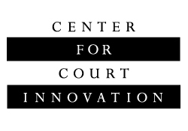
RSAT and Drug Courts:
Working Together
Aaron Arnold
Director, Drug Court Programs
Annie Schachar
Associate Director, Drug Court Programs

Slide 2
Center for Court Innovation
Demonstration projects
Original research
Expert assistance
Justice reform through:

Slide 3

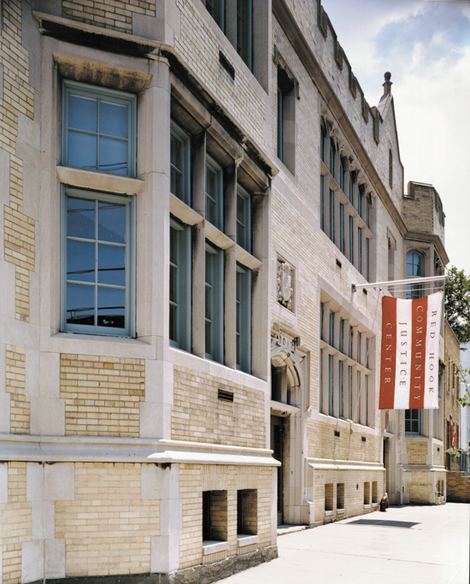
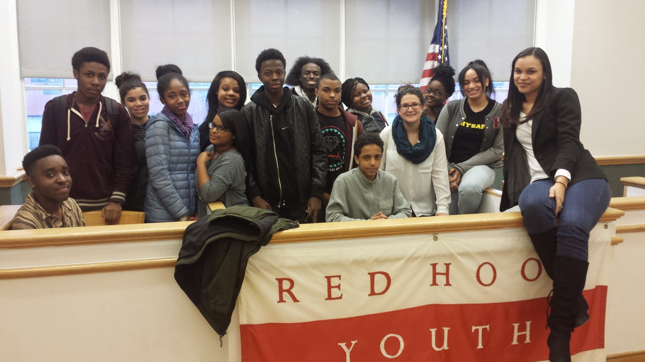
Demonstration Projects

Slide 4
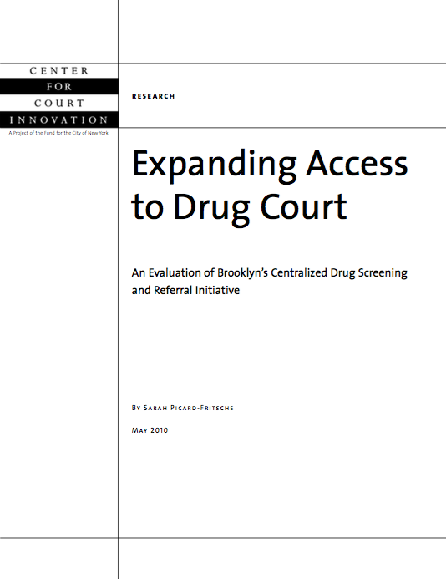
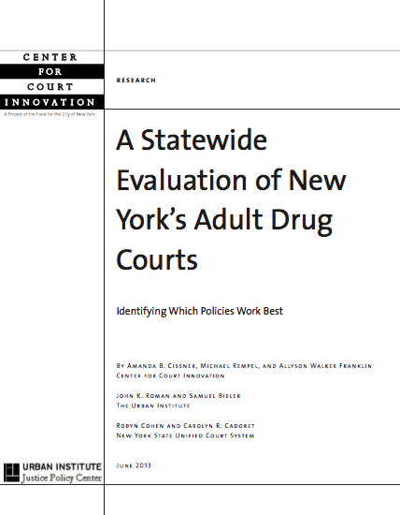
Original Research

Slide 5
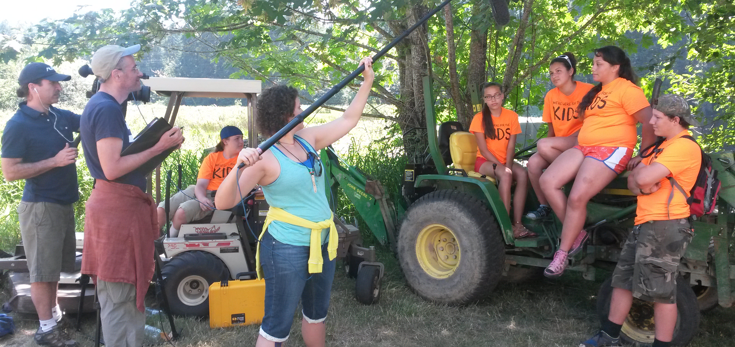
Expert Assistance

Slide 6
Center for Court Innovation
Drug Court Programs
BJA’s “statewide” drug court T/TA provider
Work with state drug court coordinators
Help with statewide strategic planning
Promote evidence-based practices
Develop statewide training strategy
National Drug Court Online Learning System (www.drugcourtonline.org)

Slide 7
Drug Court Training and Technical Assistance Collaborative
CENTER FOR COURT INNOVATION
Statewide drug court T/TA; Online Learning System
AMERICAN UNIVERSITY
Local drug court T/TA
NAT’L ASSOC. OF DRUG COURT PROFESSIONALS
Annual conference; national standards
TRIBAL LAW AND POLICY INSTITUTE
Tribal Healing to Wellness Court T/TA

Slide 8
What is a Drug Court?
There are approximately 3000 drug courts in the United States
Alternative to traditional case processing for offenders with substance use disorders
Combines strict court monitoring with community-based treatment and services
Notes:
There are approximately 300 drug courts in the United States

Slide 9
What is a Drug Court?
Intensive treatment
Judicial monitoring
Team approach
Frequent, random drug testing
Incentives and sanctions
Offender accountability
Notes:
There are approximately 300 drug courts in the United States

Slide 10
Institutionalization of Drug Courts
~20 states have a position dedicated to the oversight of drug courts and ~14 more have an administrator for problem solving courts
Well-established infrastructure for RSAT collaboration

Slide 11
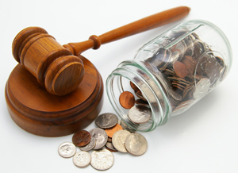
Drug Court Funding
Most drug courts are funded by their state court systems
BJA provides grants for implementation, local court enhancement, and statewide enhancement

Slide 12
Drug Courts & RSAT

Slide 13
Potential areas for collaboration
Split
sentences
Incarcerated drug court participants
Medication Assisted Treatment

Slide 14
Split sentencing
Split sentence: incarceration followed by probation
Drug courts could be part of the probation portion
Could be eligible for RSAT aftercare awards
Could free up RSAT slots

Slide 15
Incarceration of Drug Court Participants
Drug court participants maybe be incarcerated…
while awaiting admission
after failing drug court
as part of a sanction

Slide 16

Incarceration of Drug Court Participants
Partnership between drug courts and RSAT programs can help ensure that these participants are receiving substance use treatment while incarcerated
Better access to Medication Assisted Treatment

Slide 17
Medication Assisted Treatment
Drug courts have been slow to embrace MAT
New federal funding guidelines deny funding to drug courts that prohibit MAT
RSATs are well versed in MAT
Fertile ground for cross training
RSAT aftercare programs might be a suitable placement for drug court participants who are receiving MAT
Notes:
Drug courts have historically been weak in MAT because of the prevailing philosophy that drug court participants must abstain from anything that would show up as +ve on a drug screen
RSATs are well versed in MAT, fertile ground for cross training

Slide 18
Discussion
How can partnering with drug courts benefit RSAT programs?
Notes:
Drug courts have historically been weak in MAT because of the prevailing philosophy that drug court participants must abstain from anything that would show up as +ve on a drug screen
RSATs are well versed in MAT, fertile ground for cross training

Slide 19
Thank you!
Next steps? Questions?
Aaron Arnold
Director, Drug Court Programs
aarnold@nycourts.gov
Annie Schachar
Associate Director, Drug Court Programs
aschachar@nycourts.gov

