Slide 1


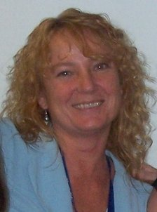

Medication Assisted Treatment (MAT) for Offender Populations
July 19th, 2014
Stephen K. Valle, Sc. D., M.B.A.
Core Faculty
Roberta C. Churchill, L.M.H.C.
Core Faculty

Slide 2

This presentation is adapted from
“RSAT Training Tool: Medication Assisted Treatment (MAT) for Offender Populations”
- Niki Miller, M.S. CPS
For access to full curriculum, please go to http://www.rsat-tta.com/Files/Trainings/FinalMAT
With contributions from:
Phillip Barbour - TASC
Roberta C. Churchill, MA, LMHC – AdCare Criminal Justice Services
The author would like to acknowledge Dr. Lisa Mistler, University of Massachusetts Medical School , Department of Psychiatry, for her research which informed the medication sections and Andrew Klein, Ph.D. Senior Research Analyst, AHP, Inc. for his editorial assistance.

Slide 3

What is Medication Assisted Treatment (MAT)?
MAT is pharmacotherapy used to support treatment and recovery efforts for people seeking to overcome addictive disorders.
It combines prescribed medications with counseling and behavioral therapies, monitoring, community-based services, and recovery support.
It provides the client with a comprehensive treatment approach for the bio-psychosocial condition known as addiction / substance dependence.
MAT is designed to assist, not replace other treatment and recovery efforts.
See Page 4

Slide 4

When MAT is part of a larger treatment program:
Decreased illicit opiate use
Decreased injection drug use
Decreased hepatitis and HIV infections
Decreased sexually transmitted infections
Decrease in overdoses and lower death rates
Decreased criminal activities
MAT is associated with reductions in recidivism, incarceration and decreased crime
See Page 5

Slide 5

When MAT is part of a larger treatment program:
Increased retention in treatment
Improved family stability
Increased employment
Improved birth outcomes for the children of women treated during pregnancy
It is a cost effective form of treatment
Results are realized through increases in public safety and public health
See Page 5

Slide 6
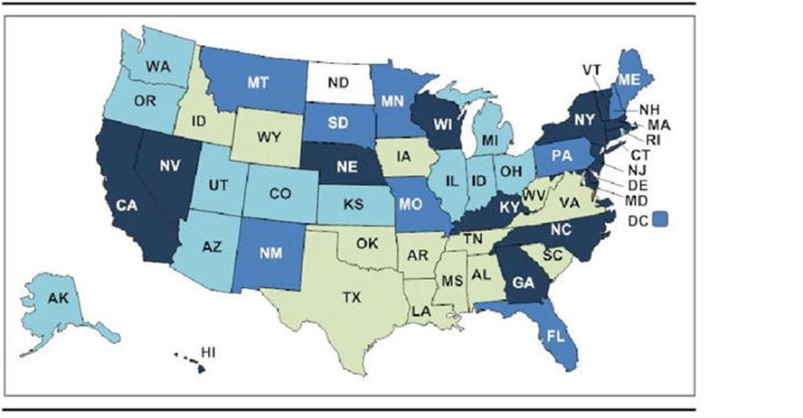
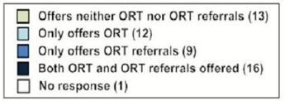
MAT is currently under-utilized
Despite all the evidence, Opiate Replacement Therapy (ORT) prescribing and referral practices in US systems are under-utilized tools
See Page 9

Slide 7
Module I: Research
Opioids and Addiction
Lasting changes in the brain resulting from regular use of opioid drugs: An “endorphin deficiency” that persists…
With continued use the body relies on the drug as its own opioid system shuts down. Negative reaction if the external supply is cut off:
Withdrawal
Tolerance
Need for larger and larger amounts of the drug to get the desired effects – or after prolonged use, just to feel “normal”.
See Page 16

Slide 8
Module I: Research
Opioids and Addiction
Most people can’t just walk away even when they are motivated to quit…
Often they manage the short term period of severe withdrawal
But long-term recovery can involve fighting continuous cravings
Long-term distress due to altered brain chemistry from opioid use
Research shows at least 12 months of MAT with counseling & recovery support is best to begin to restore normal functions
See Pages
17 - 18

Slide 9
Module I: Research
MAT and Other Conditions
Chronic Pain
About 29% - 60% of people with opioid addiction deal with chronic pain
Prolonged opioid use results in deficiencies in the body’s capacity to neutralize pain
Pre-existing chronic pain results in opioid use, abuse, then addiction
hyper-sensitivity to pain
(opioid-induced hyper-analgeisia)
See Page 21

Slide 10
Module I: Research
MAT and Co-occurring Disorders
Ironically, people tend to experience “dysphoria” and develop a heightened sensitively to pain when they quit a drug they began taking to experience euphoria and/or relief from pain
Prolonged opioid use results in deficiencies in the brain’s capacity to regulate mood
Pre-existing depression increases risk of use. Powerful reinforcing effects increase the likelihood of addiction
See Page
21 - 22
dysphoria

Slide 11
Module I: Research
MAT during Pregnancy
Pregnancy
Methadone is considered the safest course of treatment for the health of the mother and for the developing fetus
Pregnant women treated with methadone are 3x times more likely to stay in treatment
A few promising studies show Subutex (buprenorphine only) is safe and may be a good alternative
If a pregnant woman stops opioid use and goes into withdrawal, it can harm the developing fetus
High risk of relapse after delivery, especially if MAT is discontinued too quickly
See Pages
23 - 24

Slide 12
Module I: Research
MAT and HIV / Hepatitis C
Incarceration may be an offender’s first contact with treatment, medical care and HIV / Hepatitis C testing
RSAT Programs can be a prime opportunity to detect, treat and prevent HIV and Hepatitis C
Methadone and other MAT reduces the spread of HIV and Hepatitis C
MAT improves HIV and Hepatitis C treatment adherence significantly, especially among re-entering offenders
See Page 23

Slide 13
Module I: Research
MAT for Parolees & Probationers
Studies show:
Decreased recurrent drug use
Decreased violations and arrests
Decreased behavior problems and crime
Fewer difficulties for parole /probation officers
Increased retention & engagement in treatment
See Page 29

Slide 14
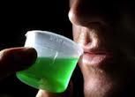
Methadone
Methadone is a long-acting opioid medication that reduces cravings and withdrawal symptoms
The person taking a prescribed dose of methadone feels normal, can continue to work and perform daily tasks, like driving
          Only dispensed in licensed, registered clinics; long-term patients can be approved for “take-home” doses
          Recommended for people with longer use histories and intense cravings and withdrawal histories, those living with chronic pain and pregnant women.
See Pages
41 - 43

Slide 15
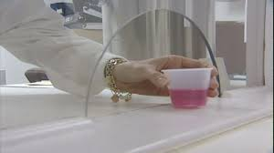
Methadone
  Can be started at any time.
  HIGH RISK of overdose at start of treatment and when combined with other substances such as alcohol and benzodiazepines.
  Increases risk of serious heart problems & sudden cardiac death; unsafe to drive until client has adjusted to dose.
See Pages
41 - 43

Slide 16
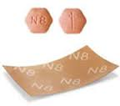
Buprenorphine
Buprenorphine is a long-acting opioid medication that reduces cravings and withdrawal symptoms
Suboxone: combined with naloxone to prevent misuse.
Subutex: Buprenorphine alone.
The person taking a prescribed dose of buprenorphine feels normal, can continue to work and perform daily tasks, like driving.
Available through doctors who have special training and certification; dispensed through pharmacies.
See Pages
44 - 46
Notes:
.

Slide 17
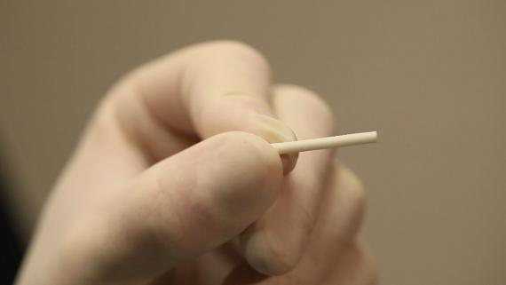
Buprenorphine
Recommended for people with light to moderate opioid users with shorter use histories and less severe craving and withdrawal.
Can be started 12-24 hours after last opioid use.
RISK of overdose and when
combined with other
substances such as alcohol
and benzodiazepines.
See Pages
44 - 46
Notes:
.

Slide 18
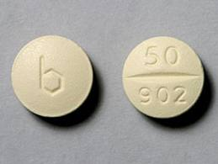
Naltrexone
Naltrexone is an opioid blocker –
it blocks the euphoric and pain relieving effects
of opioids and has a similar effect with alcohol
Available through any doctor, P.A. or N.P.; pills / film dispensed through pharmacies.
Naltrexone: available in pill form
Vivitrol: monthly injection form
Naltrexone is NOT a controlled substance
and has NO potential for addiction or
abuse; people feel completely normal
while taking naltrexone.
See Pages
46 - 49
Notes:
.

Slide 19
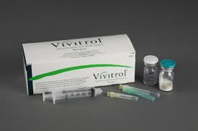
Naltrexone
Recommended for people with less intense withdrawal symptoms and cravings, who are highly motivated for recovery, adolescents and mandated clients.
Can be started 7 – 10 days after last opioid use; can be started anytime for clients using it for alcohol treatment.
RISK of overdose if people use large amounts of opioids to override blocking effects or during relapses due to lowered tolerance.
See Pages
46 - 49
Notes:
.

Slide 20
Module I: Research
Legal Issues
Legal Issues
Methadone / Buprenorphine does not affect the ability to get a driver’s license. Some commercial licenses may be restricted.
People receiving MAT are protected by confidentiality laws and anti-discrimination laws as long as they are not using illegal drugs.
Methadone / Buprenorphine may show up on a drug screen. An employer cannot legally fire someone for being in MAT as long as he or she can document that it is prescribed and uses it as prescribed.
It is illegal to discriminate against people because they are receiving MAT.
Government services, student loans and food stamps cannot be denied because of MAT.
Child welfare or probation/parole cannot legally require people to stop MAT.
Opioid treatment programs are required to help with medical, counseling, and vocational needs.
Notes:
State laws may differ in the type of consent they require (verbal versus written), their implementation of opt-out testing, pre-test and post-test counseling requirements and reporting requirements.

Slide 21
MAT for Alcohol Dependence
Despite FDA approval, medication use for alcohol dependence is still limited among community providers
Vivitrol / Naltrexone are effective adjuncts to treatment and help to reduce relapses, the number of drinking days, the number of drinks and to increase periods of abstinence.
Disulfiram (Antabuse) is limited to highly motivate clients and those who can be directly observed while they take the medication; contraindicated for those that are still drinking.
Acamprosate (Campral) treats post-acute withdrawal from alcohol and controls the anxiety, restlessness and dysphoria that leads to relapse in abstinent alcoholics.
See Pages
50 - 52
Notes:
.

Slide 22
Module I: Research
Vivitrol Program at Barnstable County Correctional Facility - Massachusetts
April 2012 – BCCF started offering Vivitrol treatment to inmates as part of a comprehensive pre-release program.
BCCF is the first county correctional facility in the state, and one of the few in the country to offer this treatment.
To date, BCCF has assisted 6 other MA counties and MA DOC in offering Vivitrol treatment to their inmates. BCCF has also assisted correctional facilities across the country to design and implement Vivitrol programs like the one offered at BCCF.
BCCF now offers the largest Correctional Vivitrol treatment program in the country
Prelimanary results indicate that the BCCF Vivitrol program may be effective in reducing relapse and recidivism rates.

Slide 23
Module I: Research
Why Offer a Vivitrol Program?
Indications for Pre- and Post-Release Substance Abuse Treatment
Approximately 25% of new intakes at BCCF require opioid detox
Approximately 35% of all inmates meet criteria for drug or alcohol dependence
Highest risk of death is in the first 2 weeks after release; i.e. overdose
Recidivism is tightly linked to relapse
Expense of incarcerating non-violent offenders
Substance abuse is a causative factor for criminogenic behavior

Slide 24

Module I: Research
Current Options for Opioid/Alcohol
Addicted Individuals After Release
Indications for Pre- and Post-Release Substance Abuse Treatment
Relapse
Abstinence
Counseling
12 Step Programs
Medication Assisted Treatment
  To treat addiction to Opioids: Methadone, Suboxone
  To treat addiction to Opioids AND Alcohol: Vivitrol

Slide 25
Vivitrol (Extended Release Naltrexone)
Vivitrol is an opioid blocker –
it blocks the euphoric and pain relieving effects
of opioids and has a similar effect with alcohol
An injectable form of the medication Naltrexone
Each dose lasts about 30 days
Reduces cravings / blocks positive effects of substances
Recommended abstinence from opioids for 7-10 days prior administration
Non mood-altering, non-addictive, no withdrawal
Not a controlled substance, no street value
Notes:
.

Slide 26

Module I: Research
MAT at BCCF
The Vivitrol Program is a Medication ASSISTED Treatment
  The medication is only one aspect of treatment
                The medication is intended to help prevent relapse while the addicted individual works to make lasting behavioral changes through treatment
                Other treatments – counseling / meetings – are necessary for lasting recovery

Slide 27
Module I: Research
Vivitrol Program Outline
How does it work at BCCF?
Programs Department present information about Medication Assisted Treatment to inmates
Interested inmates request treatment / information from the Medical Department
Medical Director, Assistant Director or Transitional Healthcare Coordinator meets one on one with inmate to determine if appropriate treatment for individual
Medical Clearance to receive the medication is obtained by Medical Director

Slide 28
Module I: Research
Vivitrol Program Outline
How does it work at BCCF?
A Motivation Assessment (for involvement in available programs) is administered
A Risk/Needs assessment (LS/CMI) is administered
Two counseling sessions with Mental Health staff are offered
Inmate is given the pill form of Vivitrol (Naltrexone) for 3 days to ensure no allergy or adverse reaction to the medication
Vivitrol injection is administered 3 days prior to release
Mass Health insurance initiated and follow-up treatment at community clinic scheduled prior to release

Slide 29
Module I: Research
Collaboration with Barnstable Drug Court
March 2013 – BCCF began collaborating with the Barnstable Drug Court to offer participation in the Vivitrol Pre-Release program to selected pre-trial inmates.
This collaboration has provided the Drug Court with another option for alternative sentencing
In these cases the Judge orders an individual held for 30 days with a recommendation that while they are held, they seek information about / consider participating in the Vivitrol Pre-Release Program.
This option allows for the individual to achieve sobriety, begin treatment and be set up with an aftercare plan while safely in holding at the correctional facility.

Slide 30
Module I: Research
Vivitrol Program Data Collection
Data being collected to determine efficacy of program
Inmate self-reported craving level pre- and post-treatment compared
Validated assessment tool: LS/CMI applied to assess for risk of recidivism
Recividism: CORI reports run for 2 years after release to confirm no incarcerations; is there increased time between incarcerations
Clean time history compared to current clean time
Compliance with appointments, counseling requirements and monthly Vivitrol injections at community clinic
Is the individual employed?

Slide 31

Module I: Research
MAT at BCCF: Preliminary Results
As of January 2014, BCCF has treated approximately 65 inmates with Vivitrol prior to release.
51% of these individuals remain active in recovery treatment or have completed treatment in the community
25% are suspected to have relapsed (compared to the national average relapse rate of 85%)
9% of participants have been re-incarcerated, meaning that 91% of the inmates treated have NOT returned to BCCF.

Slide 32
Module I: Research
MAT and RSAT Program Guidelines
Concrete ways RSAT Programs benefit
from MAT Education
Inmate Education dispels misinformation & allows offenders with alcohol / opioid problems to understand what’s available
Support choices and decisions that offenders make about giving MAT a try or not trying it; No one treatment is for everyone.
Hope for difficult cases: research shows some of those with a stronger physical addiction may respond well to MAT when they have not responded to other treatments
Staff and Volunteer training brings everyone onto the same page regarding MAT, despite personal opinions
See Pages 25 - 26

Slide 33
Module I: Research
Module II: RSAT Program Guidelines
Concrete ways RSAT Programs benefit
from MAT Education
Encourage use of resources: multiple sources for educational materials, fact sheets, decisions aids and treatment locators
Referral Networks can take an active part in educating inmates, training staff and enrolling re-entering clients in benefit programs
Cost effectiveness MAT can help more re-entering offenders succeed in outpatient programs while they continue to work and take care of their families
Health care costs for MAT patients are a fraction of the cost of healthcare for actively addicted offenders
See Pages 25 - 26

Slide 34

A Final Word
“Vivitrol is for the brain and
the 12 steps are for the soul.”
Clark, L., Haram, E., Johnson, K., & Molfenter, T. (2010). Getting started with medication-assisted treatment. University of Wisconsin–Madison: Network for the Improvement of Addiction Treatment (NIATx).
Notes:
“Everyone who touches the process has to be involved,” says Rhonda Bohs,
Vice President of Banyan Health Systems, a partner to SPI.
“We were focused on medication that treats addiction as a brain disease.
After the training, the tech staff were more accepting of MAT, stating –

Slide 35
For more information on
“RSAT Training Tool: Medication Assisted Treatment (MAT) for Offender Populations” visit: http://www.rsat-tta.com/Files/Trainings/FinalMAT
or email Jon Grand, RSAT TA Coordinator at
jgrand@ahpnet.com

