Slide 1
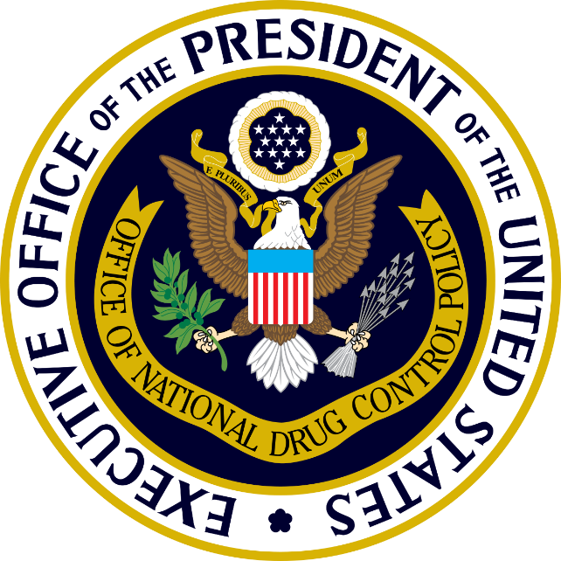
6th Annual Residential Substance Abuse Treatment Conference
Richard J. Baum
Acting Director
Office of National Drug Control Policy
August 1, 2017

Slide 2
Drug Poisoning Deaths Continue to Climb
Deaths Involving Opioid Analgesics, Cocaine, Heroin, and Psychostimulants
% CHANGE
2010 to 2015
+31%
+ 328%
+ 62%
+ 208%
Note: Not all drug poisoning deaths specify the drug(s) involved, and a death may involve more than one specific substance. The rise in 2005-2006 in opioid deaths is related to non-pharmaceutical fentanyl (see http://www.cdc.gov/mmwr/preview/mmwrhtml/mm5729a1.htm).
Source: Centers for Disease Control and Prevention, National Center for Health Statistics. Multiple Cause of Death 1999-2015 on CDC WONDER Online Database, released 2016. Data were extracted by ONDCP from http://wonder.cdc.gov/mcd-icd10.html on December 8, 2016.
12/2016
Notes:
All drug poisoning (overdose) deaths include unintentional (accidental), intentional (suicide or homicide), and undetermined intent. Of the deaths that specify a drug involved, the most commonly mentioned is a class of prescription painkillers called opioid analgesics.
For several years now, there have been more deaths involving opioid analgesics than heroin or cocaine combined. AND these figures are likely underestimates because death certificates do not always specify the drugs involved.

Slide 3
Need/Receipt of Drug Treatment at a Specialty Facility Among Persons Aged 12 or Older: 2015
Felt They Needed Treatment and Did Not Make an Effort
(321,000)
Did Not Feel They Needed Treatment (6,369,000)
4%
Felt They Needed Treatment and Did Make an Effort
(197,000)
2%
76%
18%
Received Specialty Treatment
(1,541,000)
8,428,000 Needing Drug Treatment at a Specialty Facility
9/2016
Source: SAMHSA, 2015 National Survey on Drug Use and Health (September 2016).
Notes:
Many people do not voluntarily seek treatment, even if they would benefit from it.

Slide 4
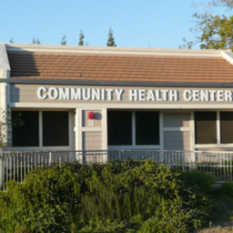
Pathways to Treatment
Healthcare providers
Community health centers
Police and first responders
Credit: McGraw-Hill

Slide 5
Workforce Challenges
Medical field
Doctors
Physician’s assistants
Nurses
Counseling
Peer counselors
Recovery coaches
Case managers
Drug Court professionals

Slide 6
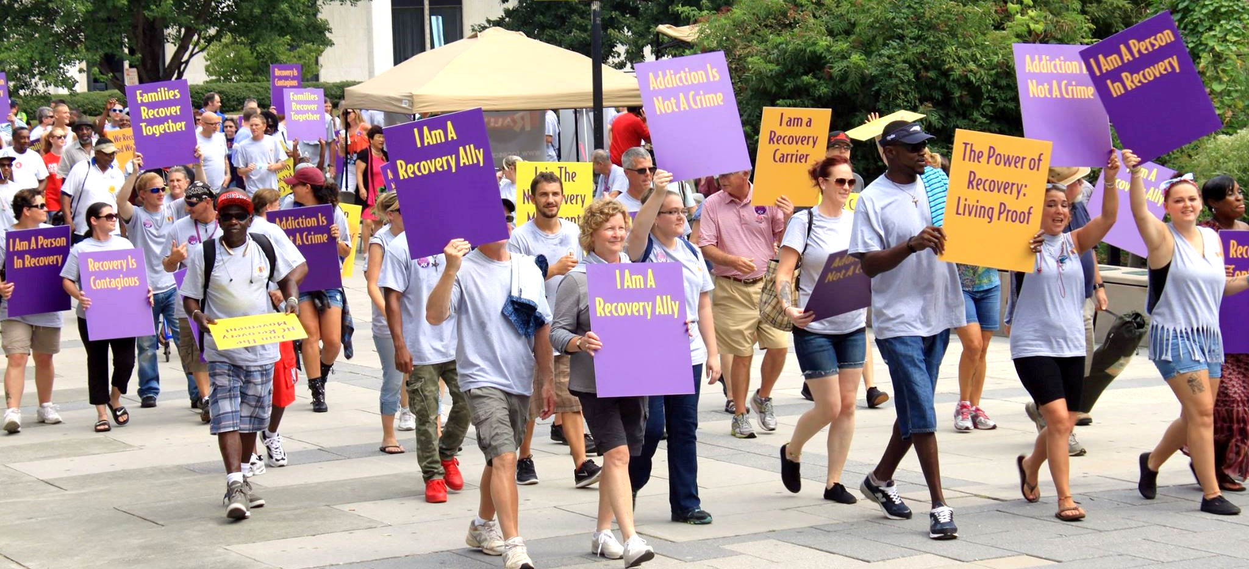
The Power of Recovery
People in recovery are great advocates and resources
Credit: Recovery Communities of North Carolina

Slide 7
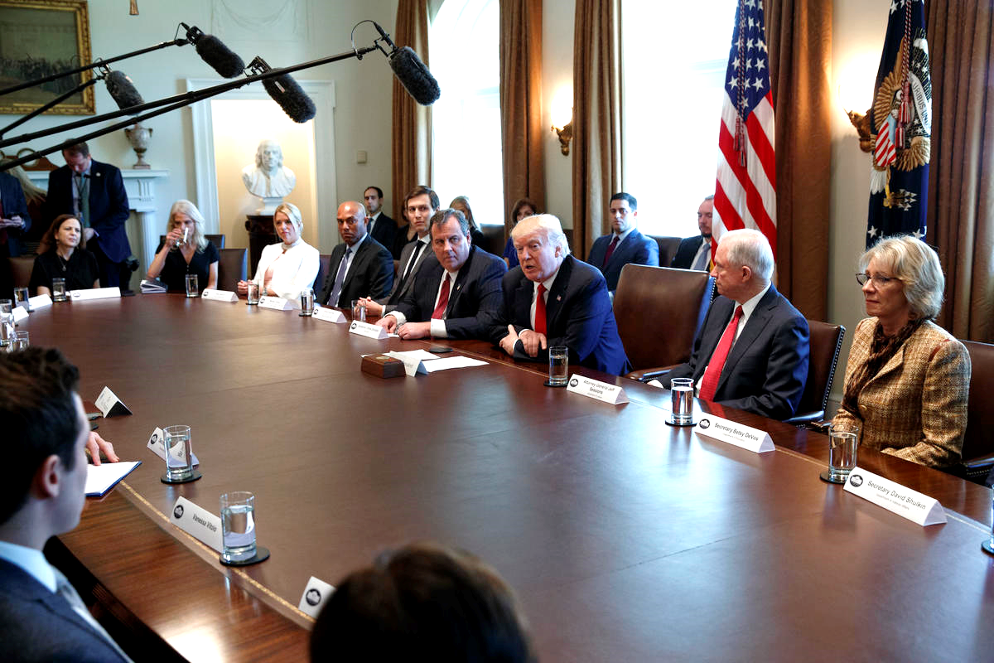
Opioid and Drug Abuse Listening Session Cabinet Room, The White House March 29, 2017
Credit: The Associated Press

Slide 8
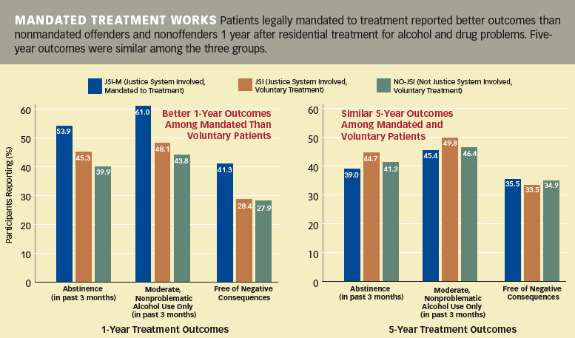
Treatment in Criminal Justice System
Kelly, J.F.; Finney, J.W.; and Moos, R. Substance use disorder patients who are mandated to treatment: Characteristics, treatment process, and 1- and 5-year outcomes. Journal of Substance Abuse Treatment 28(3):213-223, 2005
Notes:
The findings from a NIDA- and Department of Veterans Affairs (VA) Health Services Research and Development Service-supported analysis of data on treatment outcomes affirm the results of shorter term studies that have shown similar therapeutic outcomes for voluntary and legally mandated patients. The new study also included an important, but largely unstudied, comparison group: people who had been in court, but were not mandated to enter treatment.
Regardless of their impetus for participating in drug treatment—internal drive or external pressure—men had similar outcomes in the long term.
At the end of treatment, all three groups of patients demonstrated enhanced coping skills and expressed more confidence that they could resist alcohol or drugs in high-risk situations. Symptoms of psychological distress improved for participants in all groups. At the 1-year followup, larger proportions of JSI-M participants reported abstinence, successful moderation in their use of alcohol, and freedom from drug-related consequences .

Slide 9
Treatment Referral Source for All Admissions: 2014
School (educational) (0.7%)
Employer/EAP (0.4%)
Other health care provider (7.0%)
Substance abuse care provider (10.7%)
Self or individual
(37.5%)
Other community referral (10.8%)
Court/criminal justice system (32.9%)
1.614 Million Treatment Admissions for a Drug or Alcohol Problem
Source: SAMHSA, Center for Behavioral Health Statistics and Quality. Treatment Episode Data Set:2004-2014, Detailed Tables, Table 2.6B (May 2016).
2/2017
Notes:
Source: SAMHSA, Center for Behavioral Health Statistics and Quality. Treatment Episode Data Set:2004-2014, Detailed Tables, Table 2.6B (May 2016).

Slide 10
Medication-Assisted Treatment Is Effective
Patients taking methadone with counseling were over four times more likely to stay in treatment
Treatment with methadone significantly improves treatment outcomes alone and when added to counseling
Treatment with buprenorphine results in a 75-80 percent reduction of patients testing positive for opioids
Volkow, N. (2016). What Science tells us About Opioid Abuse and Addiction. Testimony to the Senate Judiciary Committee. National Institute on Drug Abuse. Mattick, R. P. et al. (2014). Buprenorphine maintenance versus placebo or methadone maintenance for opioid dependence. Cochrane Database Syst. Rev. 2, CD002207. Mattick, R. Pet al. (2009). Cochrane Database of Systematic Reviews (ed. The Cochrane Collaboration) (John Wiley & Sons, Ltd). at http://doi.wiley.com/10.1002/14651858.CD002209.pub2.

Slide 12
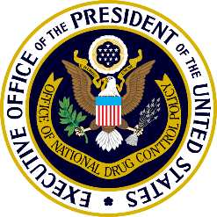
Follow ONDCP on Twitter
@ONDCP

