Slide 1
Women Recovering with A Purpose
Bartholomew County
Courts Services
Columbus, Indiana

Slide 2
W R A P
Program
History
In March of 2011, the WRAP Program began as a partnership between Bartholomew County Court Services and Centerstone of Indiana.
When looking at the average daily jail population in the Bartholomew County Jail, the need for intensive Residential Substance abuse Treatment was identified as a problem in our community.
On Average, 20 to 25 percent of the daily jail population were female
Of these females, the majority were in jail on substance related offenses, or they had committed offenses to purchase drugs

Slide 3
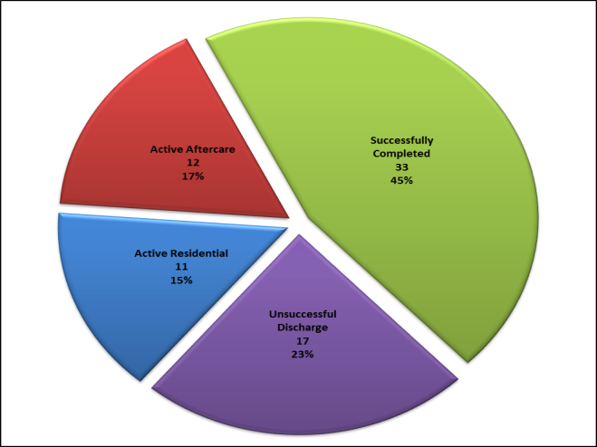
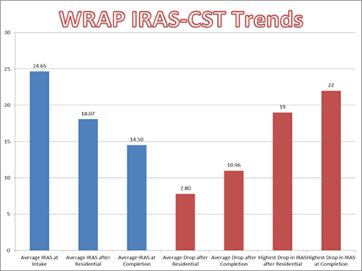
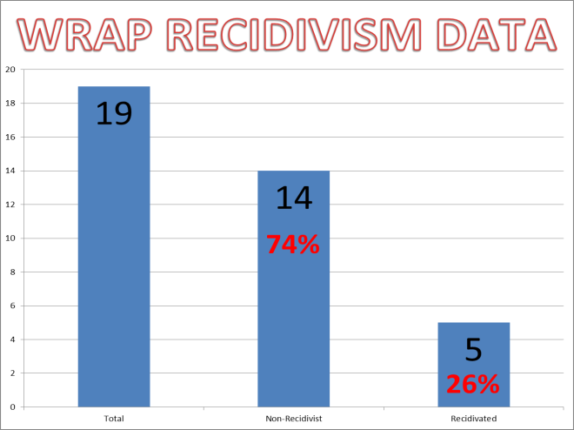
W R A P
Program
Statistics

Slide 5
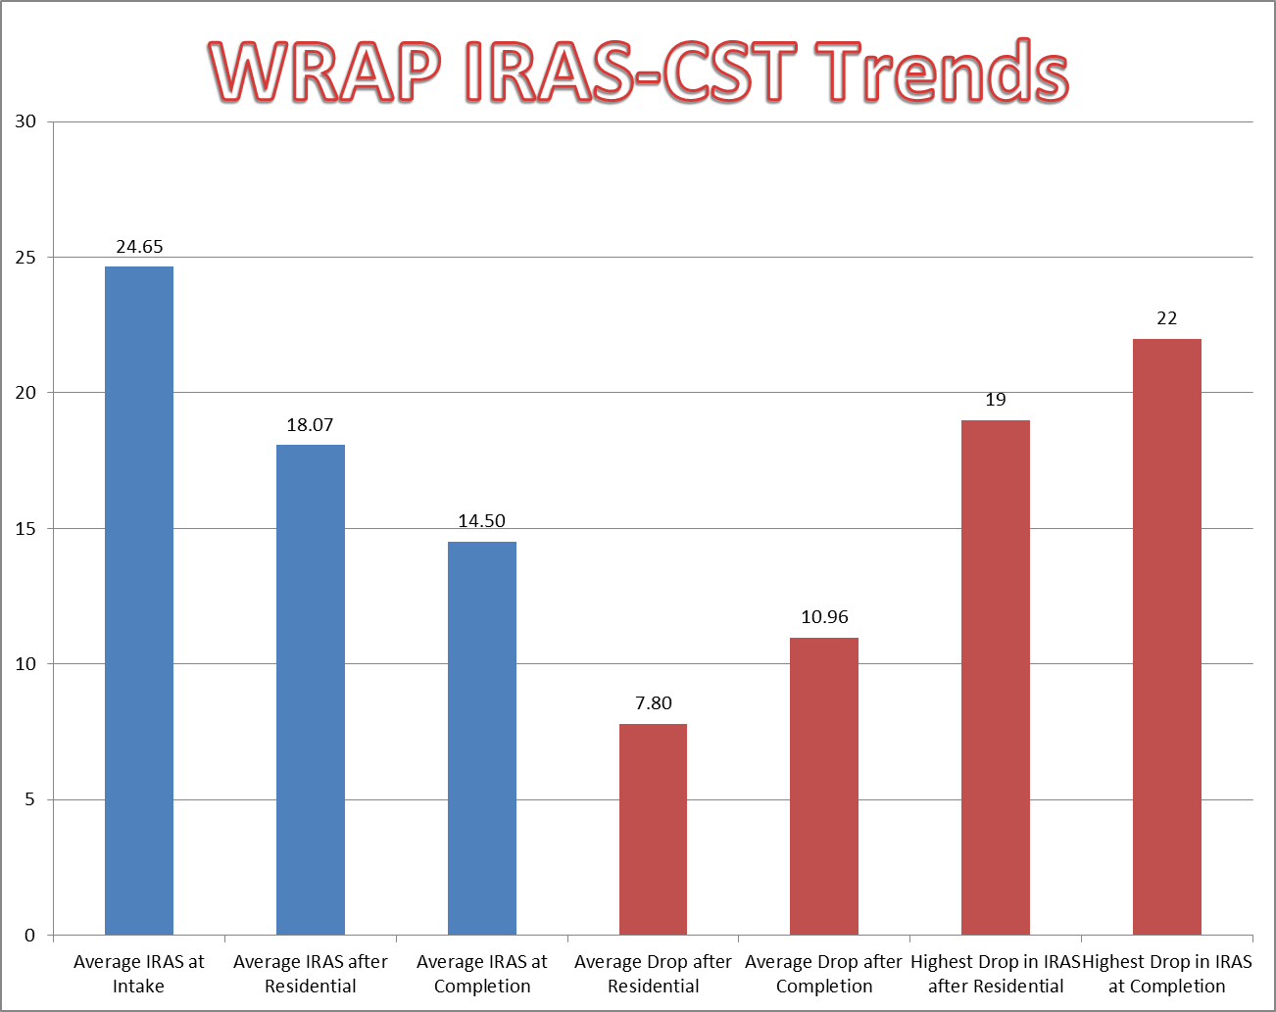

Slide 7
W R A P
Admission Criteria
Adult female non-violent offenders may be placed into the WRAP Program if:
So ordered to the WRAP Program as part of the original sentence or revocation proceeding by a Bartholomew County Court, or an approved referral from another Indiana County.
There is sufficient space, and;
The offender is being placed as a result of a criminal conviction, and;
The offender is determined to be moderate to high risk to recidivate as determined by the Indiana Risk Assessment System (IRAS) and;
The offender is moderate to high risk in Substance Use and has been clinically assessed and diagnosed to have an addictive disorder, and;
It is determined that there is no other Community Corrections Program that is able to meet the risks and needs of the offender in a lesser restrictive environment, and;
The offender is accepted into the WRAP Program.

Slide 8
W R A P
Program
Description
The WRAP Program partnership with Bartholomew County Community Corrections and Centerstone. The WRAP Program is a year long Substance Abuse Program which consists of four to six months of intensive residential treatment in the Bartholomew County Community Corrections Center and the balance of the year on aftercare on Day Reporting with an electronic monitor.

Slide 9
W R A P
Program
Description
The Residential Portion of the WRAP Program will utilize staff from Community Corrections and Centerstone to deliver the program components; Seeking Safety, Residential Drug Abuse Program (RDAP), and Texas Christian University’s Mapping Enhanced Counseling.
A Treatment Plan will be developed based on the Indiana Risk Assessment System (IRAS) and treatment will be individualized as needed.

Slide 10
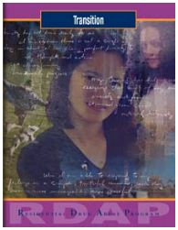
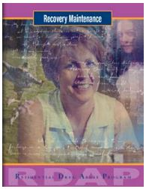
W R A P
Residential Drug Abuse Program (RDAP)
RDAP is a female specific Interactive journaling program Developed by the Change Company (http://www.changecompanies.net/series.php?id=4) that is tailored to help participants face criminal justice and drug use issues that are specific to them.
Emphasis is placed on learning the necessary skills and accepting responsibility for making positive life changes.
Participants complete homework individually in their journals outside of class and meet as a group four (4) times weekly for two (2) hours to process their answers with staff and other members of their group.

Slide 11
W R A P
Residential Drug Abuse Program (RDAP)
Topics covered in the RDAP Interactive Journals are:
Orientation
Rational Thinking
Criminal Lifestyles
Living with Others
Lifestyle Balance
Transition
Recovery Maintenance

Slide 12
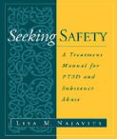
W R A P
Seeking safety
Seeking Safety is a present-focused therapy to help clients attain safety from Post Traumatic Stress Disorder (PTSD) and substance abuse. Seeking Safety consists of 25 topics that can be conducted in any order, Topics included in Seeking Safety include:
Introduction/Case Management, Safety, PTSD: Taking Back Your Power, When Substances Control You, Honesty, Asking for Help, Setting Boundaries in Relationships, Getting Others to Support Your Recovery, Healthy Relationships, Community Resources, Compassion, Creating Meaning, Discovery, Integrating the Split Self, Recovery Thinking, Taking Good Care of Yourself, Commitment, Respecting Your Time, Coping with Triggers, Self-Nurturing, Red and Green Flags, Detaching from Emotional Pain (Grounding), Life Choices and Termination.

Slide 13
W R A P
Seeking safety
Seeking Safety is taught 3 times weekly for 1.5 hours per session.
Seeking Safety consists of 25 sessions and participants continuously are in Seeking Safety.
Seeking Safety is facilitated by the Program Coordinator

Slide 14
W R A P
Texas Christian University
Mapping Enhanced Counseling
Mapping-enhanced counseling is a cognitive strategy shown to be effective in increasing client motivation, engagement, participation, and retention in treatment. It also promotes more positive interactions with other clients and treatment staff, both in community-based and correctional settings.
TCU manuals provide guidance on the use of mapping techniques, using a variety of structured and free-flow formats, as well as a related series of motivational readiness interventions.
Manuals are based on improving psychosocial and related decision-making skills.
TCU Mapping Enhanced Counseling is facilitated by program staff six (6) times weekly for an hour and a half (1 ½) per session.

Slide 15
W R A P
Texas Christian University
Mapping Enhanced Counseling
Topics covered in the TCU Mapping Enhanced Counseling are:
Mapping Your 12 Steps
Getting Motivated to Change
Preparation for Change
Understanding and Reducing Angry Feelings
Unlock Your Thinking-Open Your Mind
Ideas for Better Communication
Building Social Networks
Time Out for Me
Partners in Parenting
Straight Ahead-Transition Skills
Mapping Your Reentry Plan
Common Sense Ideas on HIV Prevention, and HIV/AIDS Education.

Slide 16
W R A P
Moving On
The primary goal of Moving On is to provide opportunities for women to mobilize and enhance existing strengths and to access personal and community resources.
This is achieved by:
Treating women with respect and dignity,
Providing an environment that is supportive, empathic, accepting, collaborative, and challenging,
Assisting women to build a healthy and mutually supportive network,
Introducing an array of personal strategies, including decision-making, problem-solving, assertiveness skills, emotional regulation, and,
Assisting women with the challenges of reintegration.

Slide 17
W R A P
Moving On
Moving On is a 26-session, curriculum-based program. The program consists of six modules:
Orientation
Listening and Being Heard
Building Healthy Relationships
Expressing Emotions
Making Connections and Staying Healthy
Transitions
Moving On is facilitated 1 time weekly during aftercare by Court Services’ Case Managers.

Slide 18
W R A P
Other Resources
GED/ABE
Celebrate
Recovery
Non-Denominational
Church Services
Art of Invitation
Iron Aprons
Bible Studies
AA/NA

Slide 19
Women Recovering with A Purpose
Contact Information
Rob Gaskill, MBA Director of Residential Services 812-418-3137 rgaskill@bartholomew.in.gov | Bethany Peetz, LCAC, LMHC WRAP Coordinator 812-418-3132 Bethany.peetz@centerstone.org

