Slide 1

Health Literacy Integration
How & Why
Wellness, Recovery and Health Management in RSAT
Niki A. Miller, M.S. CPS
nmiller@ahpnet.com
Advocates for Human Potential
www.ahpnet.com

Slide 2
New Toolkit
A primary responsivity factor …
Key to achieving priority objectives
Realizing a return on an array of investments
Research suggests a major role in reducing recidivism
Reducing costly services and programs
Can be operationalized across divisions/departments
Support from public and private resources available
Extended public health and safety benefits and cost savings
Health Literacy Manual available at www.rsat-tta.com

Slide 3
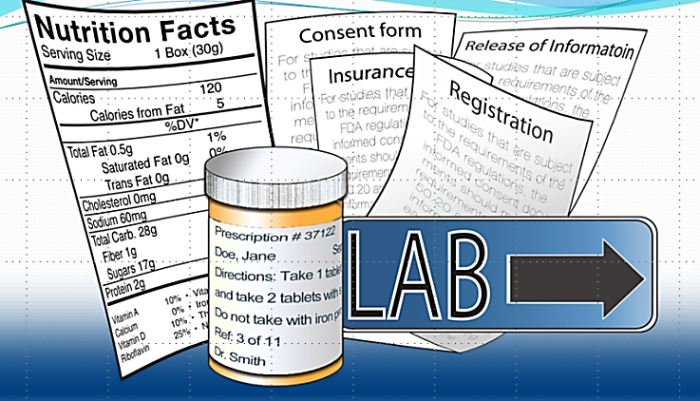
What is Health Literacy?
Health literacy the “degree to which individuals can obtain, process, and understand basic health information and services needed to make appropriate health decisions.
Heath insurance literacy is one aspect of this….
BUT… one that can pose barriers at the outset
“The major obstacle to achieving a more informed and active healthcare consumer is the lack of basic health literacy in the US.”
Notes:
Example:
If you can understand the form that allows your insurance to bill at a hospital – you can’t be seen.
If you can’t understand the consent to treat form, you don’t’ get tx
Pretty basic, but the research shows that most people do not understand these forms….they mostly sign them anyway….but lets look at some research that applies to our populatiomn

Slide 4
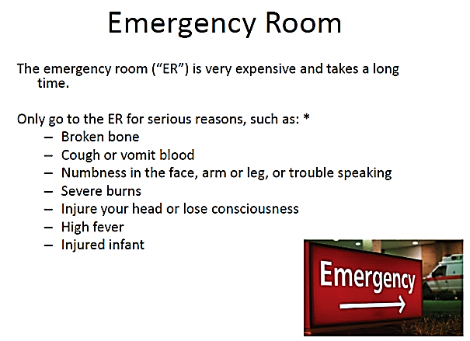
Medicaid, Medicaid Managed Care (MMC), Medicare
Medicaid: Did not understand Medicaid application rights & responsibilities - 60%
Medicare: Didn’t have capacity to understand health information - 33%
MMC *: Didn’t know coverage for ER visits had limits - 80%
Didn’t know they had a network of providers - 30%
Didn’t know they need a referral to see a specialist - 60%
No coverage: Couldn’t tell if they were eligible for free care from hospital - 50%
Notes:
These numbers only refer to the English speaking population
What they understand the least is assessments
But that percentage increases with age & with non-native ESL elderly to 50%
MMC – has a star because it is more complicated to understand and it is going to be what most RSAT clients and re-entering folks are going to have……(about 80% of newly enrolled in expanded Medicaid programs)
See insert from very simple handouts that are from one of the health literacy resources listed in the toolkit. Why all this stuff about ER visits:
Really super expensive
Overused by our population – especially justice-involved – with SUDs!!! (MH too)
Care is the worst quality and least effective
Hospital/ Medical errors are the 3rd leading cause of death
IOM report, hospitalization is the third leading cause of death accounting for upwards of 400,000 preventable deaths/year (James, 2013).
Institute for Healthcare Improvement. (n.d.). ED Fast Track Criteria. Retrieved from www.ihi.org/resources/Pages/Tools/EDFastTrackTool.aspx
Institute of Medicine. (2007). Hospital based emergency care: At the breaking point. Washington, DC: National Academies Press.

Slide 5
Heightened impact on RSAT populations
Low literacy is linked to poor health outcomes:
higher hospitalization rates
higher use of Emergency Rooms
less frequent use of preventive services.
2. Re-entry populations more vulnerable because, they are:
new to the health care system, lack access
high levels of functional illiteracy
high stigma, low income, marginalized conditions
compromised health status, behavioral health issues
5
Notes:
The reading levels of incarcerated populations - largest concentration of functional literacy in US (HUGE RISK FACTOR)
Health care is a pro-social activity (maintenance , preventive and effective tx)
Feeling unwelcome into that system makes you feel like a hopeless outlaw
Having untreated MH and or SUD diminished what understanding you do have
When folks feel better they can act better.
Massachusetts data on enrollment and emergency room use……. SUD folks are

Slide 6
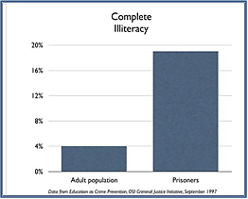
Module I: Research
Compounded by literacy levels
Researchers have found the highest concentrations of adult illiteracy among prisoners.
Notes:
Nearly half of all American adults (90 million people) have difficulty understanding and using health information as it is currently presented (Institute of Medicine, 2004). Hundreds of studies have confirmed that most patients cannot understand materials that are intended to inform about important health issues. Research has shown that this problem affects people from all ages, races
Most correctional systems scan materials developed for inmates for appropriate reading levels (usually between fourth and eighth grade), but health information on HIV may not be included.

Slide 7
Social Determinates of Health
Each person’s health is also determined by biology and genetic factors , but these are static. They can’t be modified…
Health-related Social Needs
40%
Health Services
20%
Health Behaviors 30%
Physical Environment
10%
Many of the largest drivers of health care costs relate to social determinates of health. They profoundly effect RSAT clients before they enter justice system and upon release.

Slide 8
Disparities: HIV/AIDS
1 in 5 HIV+ individuals passes through a correctional facility; Opportunity for reducing the spread of HIV and related medical costs extends beyond prison walls.
  Rates of HCV are epidemic = 10 x the rate of the general public; 33% higher for women offenders
At least a quarter of the 1 million people infected with HIV in the U.S. do not know it.
Harm reduction, early detection, new therapies extend life – can delay the onset of AIDS related health problems indefinitely.
Notes:
HIV testing in correctional and in substance treatment settings has the potential to reach populations at risk for HIV/AIDS that might not otherwise learn of their HIV status, giving them an opportunity to access care.
Substance abuse negatively impacts HIV/AIDS outcomes and multiplies a person’s risk for HIV infection nearly 12 times (CSAT, 2000). The adverse impact of untreated substance use disorders on the criminal justice system and the prevalence of HIV among incarcerated populations make it critical to integrate knowledge about HIV detection and prevention into RSAT programs.

Slide 9

Help!
An estimated one third of all individuals with an opioid use disorder pass through the criminal justice system each year.
A NIDA survey of 50 criminal justice agencies reported rates of opioid use disorders as high as 50%
Boutwell AE, Nijhawan A, Zaller N, Rich JD. Arrested on heroin: a national opportunity. J Opioid Manag. 2007;3:328–32. [PubMed]

Slide 10
Module I: Research
Challenges of Complex Care Needs
Costly, complex and underserved:
RSAT
Client
Chronic Medical Conditions
Addiction Treatment
Case Management
Mental Health Treatment
Cognitive-Behavioral Treatment
Social Skills Training
Housing
Re-Entry Support
Notes:
Facilitating access to appropriate health care services among justice-involved
individuals with SUDs is a multifaceted process supported by health literacy.
This requires introducing Residential Substance Abuse Treatment (RSAT) participants to a body of knowledge and a skillset that few justice-involved individuals are likely to
possess. And, just as re-entry planning begins when people enter custody, integrating
health literacy and wellness into RSAT programming must start at the outset and
continue through re-entry planning to achieve the desired post-release results.
Even though health services are not the primary focus of correctional systems, prisons
and jails have, in effect, become the default health care provider for people with some of
the highest and most complex clinical needs coupled with histories of very limited
access to care.

Slide 11
Outcomes: Due to the Persistent Efforts of Justice Professionals
Relationship between coverage and recidivism reductions
    Access to care improves CJ outcomes
      Not only access to MH and SUD treatment, but primary care and dental
      Findings from the Washington State study and other recent research
    As health outcomes improve, costs to the correctional and health care systems decline
Notes:
Studies in Florida, Washington state, Rhode Island, and Michigan have shown a
16% to 17% reduction in re-incarceration for re-entering individuals who are
covered by Medicaid at the time of release.16
• Justice-involved populations with Medicaid or private insurance are more likely to
receive treatment for serious mental illness or alcohol use disorders than the
general population. Those with Medicaid are even more likely than those with
private insurance to get treatment for depression or a drug problem.17
• Individuals with OUDs are more likely to receive medication-assisted treatment
(MAT) when they are enrolled in a Medicaid plan that covers their treatment.
Rates of utilization for opioid replacement therapy were 45% for Medicaidenrolled
individuals compared with 30% in states with block grant coverage only
and 17% in states with no coverage.18
If mere access to Medicaid has resulted in such significant gains for justiceinvolved
populations, it stands to reason that as their health literacy increases,
these gains will increase even more.

Slide 12
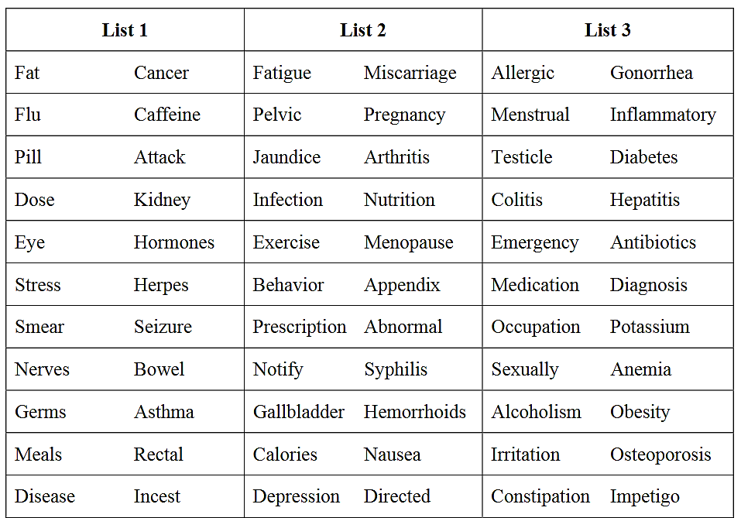
Health Literacy Screening:
Simple, Flexible, Critical Tools
Notes:
1How often do you have someone help you read hospital materials?
How often do you have problems learning about your medical condition because of difficulty understanding written information?
How often do you have a problem understanding what is told to you about your medical condition?
How confident are you filling out medical forms by yourself?

Slide 13
Resources – Tailored to Individuals Entering Facilities
When | What | Educational Materials & Tools
Entry/Intake | Detoxification/withdrawal – Substances with high-risk withdrawal syndromes, symptom relief and self-care. Information for those experiencing post-acute withdrawal symptoms. | CDC Infographic on Alcohol & Health CDC Infographic on Alcohol Poisoning NIDA Drug Facts (see summary handout in appendix)
Entry/Intake | Accessing Institutional Health Services – Menu/schedule of medical & mental health services; how to request care, charges/waiving charges, when outside services are required. | Your Institution’s Orientation Materials ACLU National Prison Project: Know Your Medical, Mental Health & Dental Rights
Entry/Intake | Testing and Test Results – Tests routinely administered; the meaning of positive or negative results, when to get tested, other tests and the meaning of results. | Rapid HIV & Hep C Testing: Know the Facts-Video Sexually Transmitted Diseases HIV Simple Information Sheet HIV and Substance Use
Entry/Intake | Support for Dealing with Diagnoses/Treatment Options – Counseling for HIV & positive test results or Hepatitis C diagnosis; treatment options | After You’ve Tested Positive- HIV Wellness Pro-Patient Online Hep C Patient Resource Hep C Counseling Manual
Entry/Intake | Institutional Health Hazards- Prevention/Risk Reduction Handwashing, communicable disease risks - sharing personal items, syringes, tattooing, MRSA etc. | Handwashing Preventing the Spread of HIV Hepatitis C Brochure for MH & SUD MRSA Info & Prevention
Entry/Intake | PEP & PrEP – Availability of Post-Exposure Prophylaxis for HIV exposures and information about Pre-Exposure Prophylaxis (PrEP) and availability in the community. | PrEP and PEP Pocket Cards PrEP and PEP Posters
Entry/Intake | Depression, Mental Health & Suicide – Information on depression and suicide prevention tools. | WHO Prevention Suicide in Prisons & Jails BOP Clinical Guidelines: Management of Major Depressive Disorder
Notes:
1. Yes – while they are here
Yes – upon release, they are referred or given contact information
No, not at all
2. Yes, working with them
Yes, refer to them or have some contact info
No contact or knowledge of local assistor agencies
We will circle back to the response and talk about assistor duties and resource after we take a look at health literacy….

Slide 14
Responsive to Programing and Pre-release Planning
When | What | Educational Materials & Tools
Treatment | Women’s Health Topics – Women, SUDs and pregnancy, alcohol and drug-related health risks for women, trauma and abuse and domestic violence. | Alcohol-free Pregnancy Substance Use in Women & Men Infographic Domestic Violence Recovering Woman’s Guide to Coping w/Child Abuse Issues
Treatment | Psychiatric Meds, Medication Interactions & MAT- Information on medications for mental health disorders, medication-assisted treatment, multiple drug interaction checkers and medication safety. | FDA OTC and Prescription Meds Safety NIMH Psych Medication Information Drug Interactions and Alcohol Medscape Drug Interaction Checker Shared Decision Making for MAT
Treatment | Common Mental Health Disorders – Easy to understand information and tips on mental health disorders common among recovering individuals. | Mental Health Brochures and Fact Sheets ADHD Fact Sheet for Patients Adult ADHD Brochure PTSD and Addiction
Treatment | Recovery Self-Management and Wellness – Mental health wellness and recovery management, nutritional information, information on prescription drug use in recovery and smoking cessation. | Wellness Recovery Action Planning Nutrition Shortfall Questionnaire Taking Medicines Safely in Recovery Smoking Cessation in Recovering Alcoholics
Treatment | Culturally Responsive Health Information – Resources for Native American/Alaska Native populations, Latinos/Hispanics and African Americans on behavioral health topics; Substance use among LGBT communities. | Black/African Am. Communities & Mental Health Native American Behavioral Health Topics Hispanic/Latino Communities & Mental Health SUD Treatment-Lesbian, Gay, Bisexual & Transgender One Sky Center
Notes:
1. Yes – while they are here
Yes – upon release, they are referred or given contact information
No, not at all
2. Yes, working with them
Yes, refer to them or have some contact info
No contact or knowledge of local assistor agencies
We will circle back to the response and talk about assistor duties and resource after we take a look at health literacy….

Slide 15
Leveraging Enrollment Assistor Resources
In-person help has consistently proven to be the most effective &
best utilized type of assistance for the beneficiaries we serve
Where states offer in-person-assistance
♦ 69% provide onsite assistance at state agency offices.
♦ 55% make assistance available at clinics.
♦ 67% offer assistance local nonprofits or community centers.

Slide 16
What do they offer besides enrollment help?
Often funded though performance-based grants and contracts
Mandated to reach out to and educate underserved groups and trained to hold outreach events that attract these target populations and improve health literacy
In-person assistors are embedded into community agencies re-entering populations may already have ties with (drug treatment program or a transitional housing agency)
They also link people who do not qualify for public benefits to other available care
Beyond enrollment & public education, they’re required to improve utilization & retention
Link individuals to other types of benefit programs they qualify for
Make referrals to appropriate covered health care services
Follow-up contact with beneficiaries to see if they are using their coverage
Help to overcome any barriers they encounter
Facilitate re-enrollment so that coverage is maintained.
Notes:
In approx. 20 states, navigator grantees & assistor programs specifically identify justice-involved as a priority population (flagged in Toolkit)
They can and do hold outreach and informational sessions at jail, prisons, re-entry programs, probation and parole, etc. (they should jump at this chance if you offer it to them)
Navigators have a target enrollment retention rate of 65 percent.
All these assistor services can help newly covered, justice-involved individuals get services for mental health and substance use disorders and other needed health care.

Slide 17
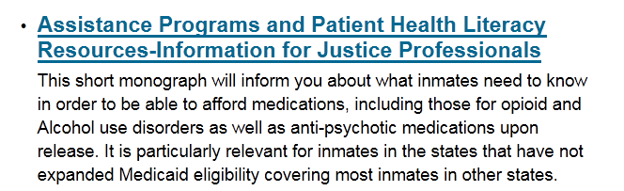
Other Resources & Toolkit highlights
HRSA - 340B Drug Pricing Program (see toolkit)
Patient-Center Medical Homes (see toolkit)
Indian Health Services; Alaska Native Health (see toolkit)
Advocacy and Policy Groups (Center for Prisoner Health & Human Rights)
Re-entry councils and resources (state listings)
Prescription Assistance Programs (see RSAT): http://www.rsat-tta.com/Home

Slide 18
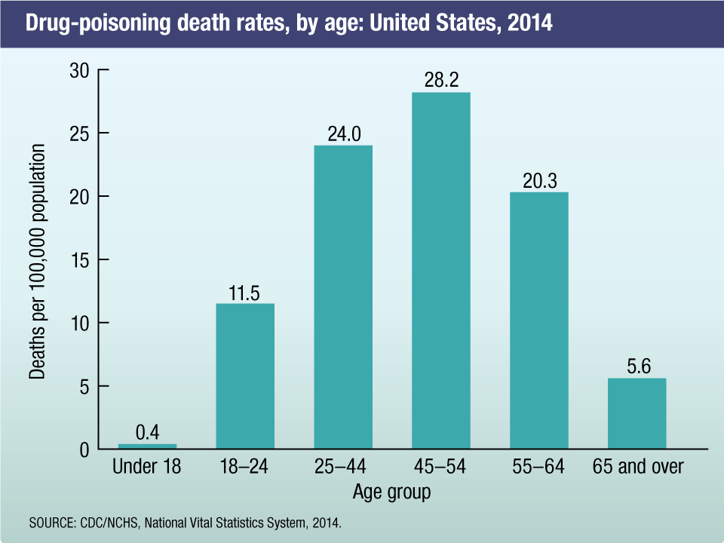
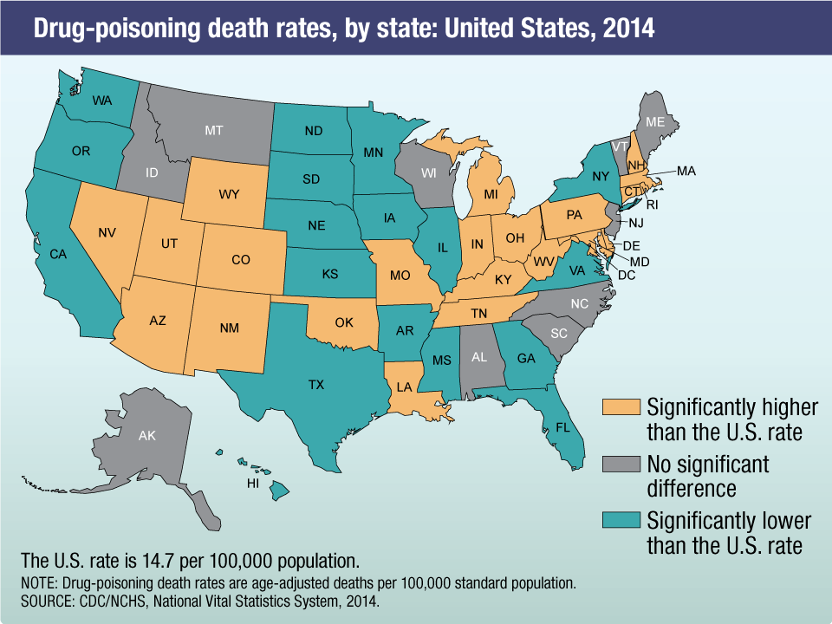
CDC: June 2017 – Opioid Overdose Leading Cause of Death for Americans Under 50 years of age
Notes:
19-25 = 10 percent US population
25-44 = 25 percent
45-54 = 13 percent
55-64 = 13 percent
65 + = 15 percent
By JOSH KATZ JUNE 5, 2017
New data compiled from hundreds of health agencies reveals the extent of the drug overdose epidemic last year.
AKRON, Ohio — Drug overdose deaths in 2016 most likely exceeded 59,000, the largest annual jump ever recorded in the United States, according to preliminary data compiled by The New York Times.
The death count is the latest consequence of an escalating public health crisis: opioid addiction, now made more deadly by an influx of illicitly manufactured fentanyl and similar drugs. Drug overdoses are now the leading cause of death among Americans under 50.
Although the data is preliminary, the Times’s best estimate is that deaths rose 19 percent over the 52,404 recorded in 2015. 2016 is estimated to report from 59,ooo to 6,500 drug OD deaths, And all evidence suggests the problem has continued to worsen in 2017.

Slide 19
Overdose Prevention: An opportunity to make a difference in the world
‘Gold standard’ - coverage effective on the day of release
First 48 hours to 2 weeks elevated hazards
  Drug overdose is highest cause of death : from 40-129 times risk for individuals who are not re-entering from corrections.
  Can remain elevated for the following 4-6 weeks
  Greatest chance of recidivism in the first 30 days
Twelve-times higher risk of death from all causes - first two weeks
  Suicide, homicide and other accidents
  Smoking-related cancers and health disease

Slide 20
Extremely High-risk Group
In U.S. studies, 53% of recently released opioid dependent individuals have overdosed at least once;
80% have witnessed an overdose;
28% have witnessed a fatal overdose;
Recent study: almost 15% of all deaths of formerly incarcerated (1999-2009) were related to opioids.
- Magura, S., Lee, J.D., Hershberger, J., Joseph, H., Marsch, L., Shropshire, C. & Rosenblum, A. (2009, Jan. 1). Buprenorphine and methadone maintenance in jail and post-release: a randomized clinical trial. Drug Alcohol Depend,1;99(1-3), 222-30.
- U.S. Department of Health and Human Services (HHS), Office of the Surgeon General, Facing Addiction in America: The Surgeon General’s Report on Alcohol, Drugs, and Health. Washington, DC: HHS, November 2016.

Slide 21
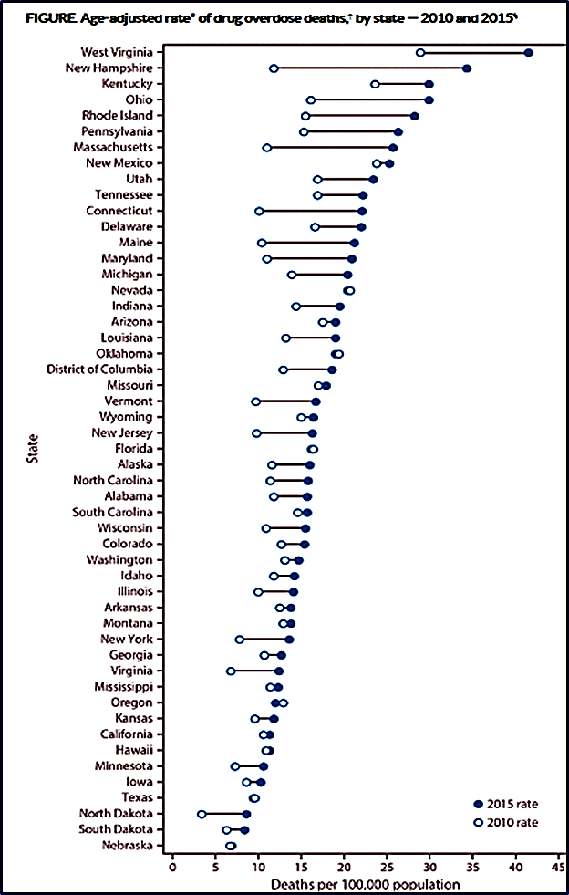
Drug overdose deaths by state 2010 – 2015
High = WV 41.5
Low = NE 6.9
2015 opioid overdose deaths per 100,000
U.S. = 10.4
Notes:
2014 – 28,647 opioid overdose deaths, rate of opioid overdose deaths 9.0 per 100,000
2015 – 33,091 opioid overdose deaths, rate of opioid overdose deaths 10.4 per 100,000
Last 16 years 183,000 American deaths related to prescription opioids

Slide 22
Steps and Materials
Harm and risk reduction education
Overdose prevention release planning and linkages
Medication-assisted treatment and opioid replacement therapy
Post-release SUD treatment continuity of care, coverage and access
Naloxone provision and administration training
Syringe exchanges
Overdose risk assessments
Notes:
Family outreach and involvement
Drug testing and monitoring
Trauma-informed approaches and integrated trauma and SUD treatments
Public health community alliances

Slide 23
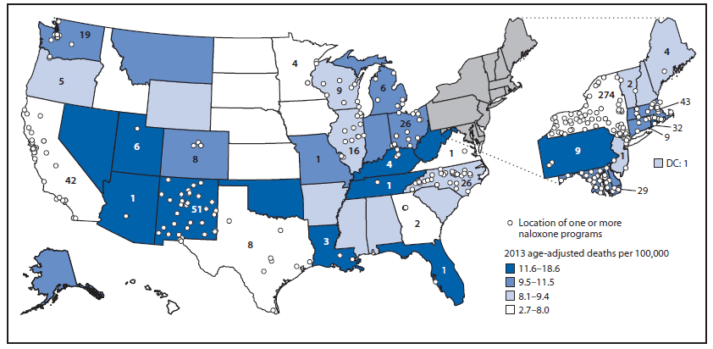
Naloxone Distribution and Death Rates by State

Slide 24
What Else Can We Do?
Don't go it alone!
Don’t re-invent the wheel…
Use all of the resources that make sense…
Tap into any efforts you can through collaboration
Focus on helping people use their coverage effectively
    Simple education tools
    Leverage assistors, navigators, FQHC’s
    Keep your eye on international research and practice
Notes:
Lots of programs to increase HL in many state (adult) Florida, California, Alabama, Massachusetts, Texas, Va, PA, New Mexico
You can’t present a curriculum but they might send in someone who could; get health services and education involved, local university extension programs and interns, Managed Care Organizations, and Assistors/Navigator entities.
Many state exchanges and federal agencies have developed simple easy to understand tool –short videos, webpages, pamphlets to give new beneficiaries the basics that are practical for justice professionals for release planning groups, even RSAT groups etc. They are listed in the Toolkit. Let’s visit one:
JOE: Can we bring up the page live and scroll through it, then play a 30 seconds of the YOUTUNES video that have on the page?
If not we can play it from YouTube. Here is a link: https://www.youtube.com/watch?v=JZkk6ueZt-U

Slide 25

Questions?
Questions?
Comments, experiences or concerns…
Email questions at any time to: nmiller@ahpnet.com

Slide 26
Always Happy to Hear From You
Thank you all for the great work you do!
We know your job is not easy, but we aim to make it a bit easier & are always happy to hear how we can do so…
Contact me anytime with inquiries about the topics we have covered: nmiller@ahpnet.com
Also appreciate hearing about your experiences & innovations…
Thank you for your participation …

