Slide 1


Pathways to Health Literacy & Health Care Utilization:
A Critical Next Step for the Newly Eligible Pre-release Population

Slide 2
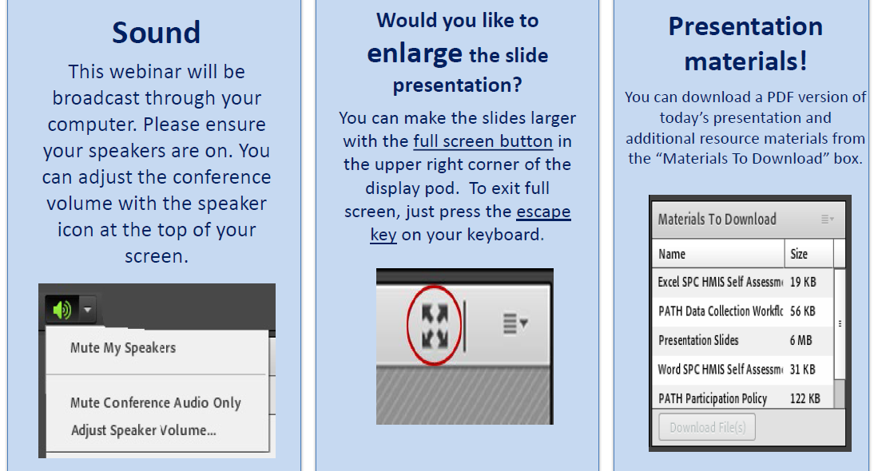
Housekeeping: Functions

Slide 3
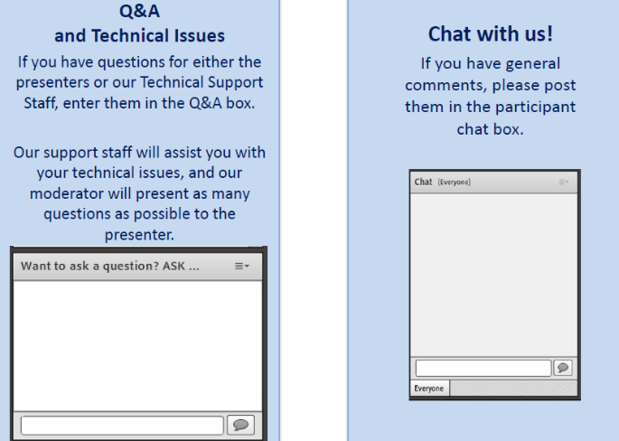
Housekeeping: Communication

Slide 4
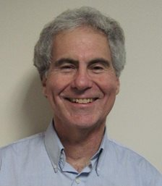
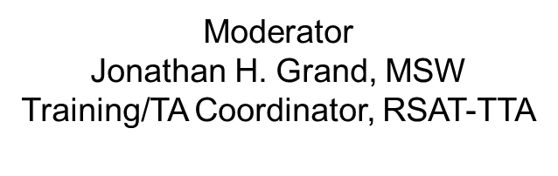
Pathways to Health Literacy & Health Care Utilization:
A Critical Next Step for the Newly Eligible Pre-release Population

Slide 5

Niki Miller, M.S. CPS nmiller@ahpnet.com
Advocates for Human Potential
www.ahpnet.com

Slide 6
Objectives
Participants will be able to:
Disseminate information to RSAT clients that explains the basics of the health care system in understandable terms.
Locate and refer RSAT clients to enrollment assistance in local communities to help make the most of benefits and health care resources.
Suggest options to individuals who are not eligible for Medicaid or other public benefit programs.
Discuss models of successful collaboration with community health programs that target the re-entry population

Slide 7
New Toolkit:
The RSAT
Outreach, Assistors, and Health/Insurance Literacy Toolkit
Note: You can download the toolkit at any time during this presentation.
You’ll see the file in the presentation materials box on your screen….
Features…
Examples of Assistor resources justice professionals can leverage
Info about some little-known resources (for non-expansion states too)
Health and insurance literacy resources
State by state listing of assistor programs, agencies & navigator grantees
  *The PDF of the Toolkit will also available on the on RSAT site.

Slide 8
Quick Audience Polling: 2 questions
How does your facility handle health benefit enrollment?
What level of contact does your program have with community
based assistor agencies or staff?
Notes:
1. Yes – while they are here
Yes – upon release, they are referred or given contact information
No, not at all
2. Yes, working with them
Yes, refer to them or have some contact info
No contact or knowledge of local assistor agencies
We will circle back to the response and talk about assistor duties and resource after we take a look at health literacy….

Slide 9
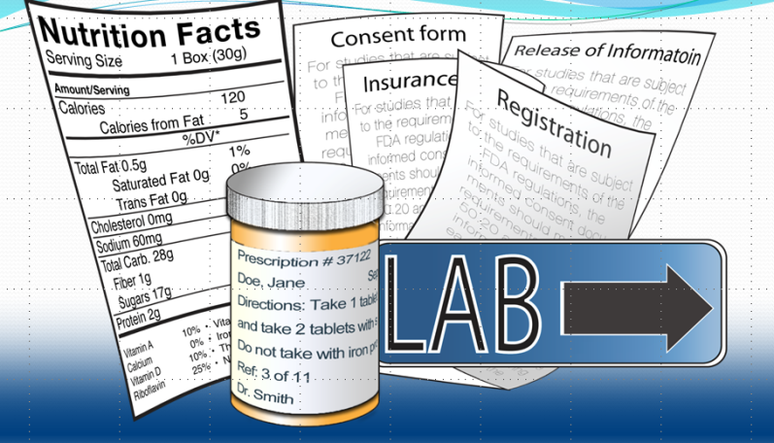
What is Health Literacy?
Health literacy the “degree to which individuals can obtain, process, and understand basic health information and services needed to make appropriate health decisions.
Heath insurance literacy is one aspect of this….
BUT…it is one that can pose barriers at the outset
Notes:
Example:
If you can understand the form that allows your insurance to bill at a hospital – you can’t be seen.
If you can’t understand the consent to treat form, you don’t’ get tx
Pretty basic, but the research shows that most people do not understand these forms….they mostly sign them anyway….but lets look at some research that applies to our populatiomn

Slide 10
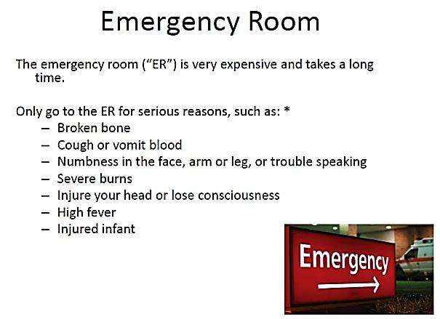
Medicaid, Medicaid Managed Care (MMC), Medicare
Medicaid: Did not understand Medicaid application rights & responsibilities - 60%
Medicare: Didn’t have capacity to understand health information - 33%
MMC *: Didn’t know coverage for ER visits had limits 80%
Didn’t know they had a network of providers 30%
Didn’t know they need a referral to see a specialist 60%
No coverage: Couldn’t tell if they were eligible for free care from hospital: 50%
Notes:
These numbers only refer to the English speaking population
But that percentage increases with age & with non-native ESL elderly to 50%
MMC – has a star because it is more complicated to understand and it is going to be what most RSAT clients and re-entering folks are going to have……(about 80% of newly enrolled in expanded Medicaid programs)
See insert from very simple handouts that are from one of the health literacy resources listed in the toolkit. Why all this stuff about ER visits:
Really super expensive
Overused by our population – especially justice-involved – with SUDs!!! (MH too)
Care is the worst quality and least effective
Hospital/ Medical errors are the 3rd leading cause of death
IOM report, hospitalization is the third leading cause of death accounting for upwards of 400,000 preventable deaths/year (James, 2013).
Institute for Healthcare Improvement. (n.d.). ED Fast Track Criteria. Retrieved from www.ihi.org/resources/Pages/Tools/EDFastTrackTool.aspx
Institute of Medicine. (2007). Hospital based emergency care: At the breaking point. Washington, DC: National Academies Press.

Slide 11
Health literacy is huge for our folks
1. Low literacy is linked to poor health outcomes:
higher hospitalization rates
higher use of Emergency Rooms
less frequent use of preventive services.
2. Re-entry populations more vulnerable because, they are:
new to the health care system, lack access
high levels of functional illiteracy
high stigma, low income, marginalized conditions
compromised health status, behavioral health issues
Notes:
The reading levels of incarcerated populations - largest concentration of functional literacy in US (HUGE RISK FACTOR)
Health care is a pro-social activity (maintenance , preventive and effective tx)
Feeling unwelcome into that system makes you feel like a hopeless outlaw
Having untreated MH and or SUD diminished what understanding you do have
When folks feel better they can act better.
Massachusetts data on enrollment and emergency room use……. SUD folks are

Slide 12
What Can We Do?
Don't go it alone!
Don’t re-invent the wheel…
Use some of resources that make sense…
Tap into any efforts you can through collaboration
Focus on helping them to be able to use their coverage
Simple education tools
Assistors and navigators
Washington State Health Benefit Exchange: Know Your Plan webpage:
http://www.wahbexchange.org/current-customers/know-your-plan/
Notes:
Lots of programs to increase HL in many state (adult) Florida, California, Alabama, Massachusetts, Texas, Va, PA, New Mexico
You can’t present a curriculum but they might send in someone who could; get health services and education involved, local university extension programs and interns, Managed Care Organizations, and Assistors/Navigator entities.
Many state exchanges and federal agencies have developed simple easy to understand tool –short videos, webpages, pamphlets to give new beneficiaries the basics that are practical for justice professionals for release planning groups, even RSAT groups etc. They are listed in the Toolkit. Let’s visit one:
JOE: Can we bring up the page live and scroll through it, then play a 30 seconds of the YOUTUNES video that have on the page?
If not we can play it from YouTube. Here is a link: https://www.youtube.com/watch?v=JZkk6ueZt-U

Slide 13
Learning Styles
People learn new information in different ways….
Using more than one way is always best
Look at it * | Palm cards, posters, infographics, signs, visuals, websites.
Talking one-to- one | Likes an explanation from another person, a chance to ask clarifying questions.
Read it | May be the biggest challenge for RSAT clients, but short handouts can mirror that was covered face to face.
Discuss in small group ** | RSAT clients may be used to learning through small groups.
Hear it | The patient, or the patient’s family, states that talking and asking questions is a preferred style of learning.
Video*** | Media (kiosk, videos, films, animation) always helps capture our attention.

Slide 14
Leveraging Assistor Resources: Poll Results
Let’s look at our poll results before we talk about Assistors…..
In-person help has consistently proven to be the most effective &
best utilized type of assistance for the beneficiaries we serve
Where states offer in-person-assistance
♦ 69% provide onsite assistance at state agency offices.
♦ 55% make assistance available at clinics.
♦ 67% offer assistance local nonprofits or community centers.

Slide 15
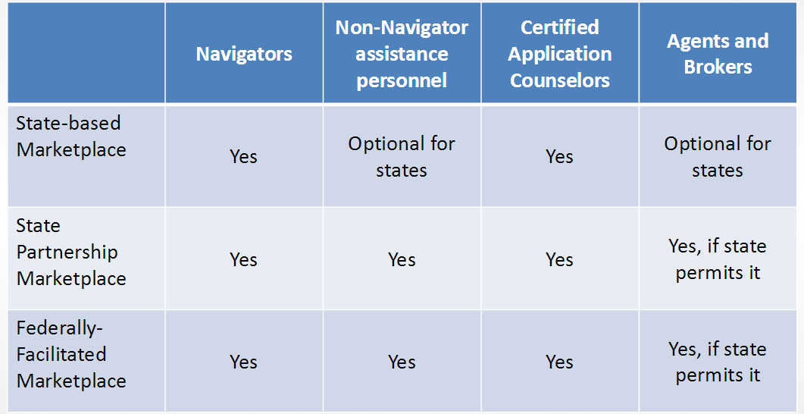
The term ‘assistor’ encompasses all categories

Slide 16
Health Insurance Exchanges: Assistor Priorities
CHARACTERISTICS of current Medicaid enrollee
Feel disrespected; seeking common courtesy and respect
Dislikes application process (especially at a state DHHS office)
Prefers help from real people
CHARACTERISTICS of new to Medicaid
Resistance; don’t want to go to a Medicaid office and apply
Would rather do it online or by phone
But usually require a lot of help and information
Like in-person help at from community outlets they already know and trust

Slide 17
What do they offer besides enrollment help?
Often funded though performance-based grants and contracts
Mandated to reach out to and educate underserved groups and trained to hold outreach events that attract these target populations
In-person assistors are embedded into community agencies re-entering populations may already have ties with
They also link people who do not qualify for public benefits to other available care
Beyond enrollment & public education, they’re required to improve utilization & retention
Link individuals to other types of benefit programs they qualify for
Make referrals to appropriate covered health care services
Follow-up contact with beneficiaries to see if they are using their coverage
Help to overcome any barriers they encounter
Facilitate re-enrollment so that coverage is maintained.
Notes:
In approx. 20 states, navigator grantees & assistor programs specifically identify justice-involved as a priority population (flagged in Toolkit)
They can and do hold outreach and informational sessions at jail, prisons, re-entry programs, probation and parole, etc. (they should jump at this chance if you offer it to them)
Navigators have a target enrollment retention rate of 65 percent.
All these assistor services can help newly covered, justice-involved individuals get services for mental health and substance use disorders and other needed health care.

Slide 18
What about those that don’t qualify for Medicaid
FQHCs – (see Toolkit for locators)
Assistors are funded to help them with options – (state listings)
SHIP – If approaching 65 – (see Toolkit for info & link to locator)
State Aging and Disability Office—services and navigators
Some local, faith-based, charitable, healthcare for homeless, programs are listed for each state
Condition-specific resources (HIV, SUD, MH, but others exist)
AHC navigator model – Health-related social needs
Minority Health Initiatives

Slide 19
Social Determinates of Health
Each person’s health is also determined by biology and genetic, but those factors are static. They can’t be modified…
Health-related Social Needs
40%
Health Services
20%
Health Behaviors 30%
Physical Environment
10%
Many of the largest drivers of health care costs relate to social determinates of health. They profoundly effect RSAT clients before they enter justice system and upon release.

Slide 20
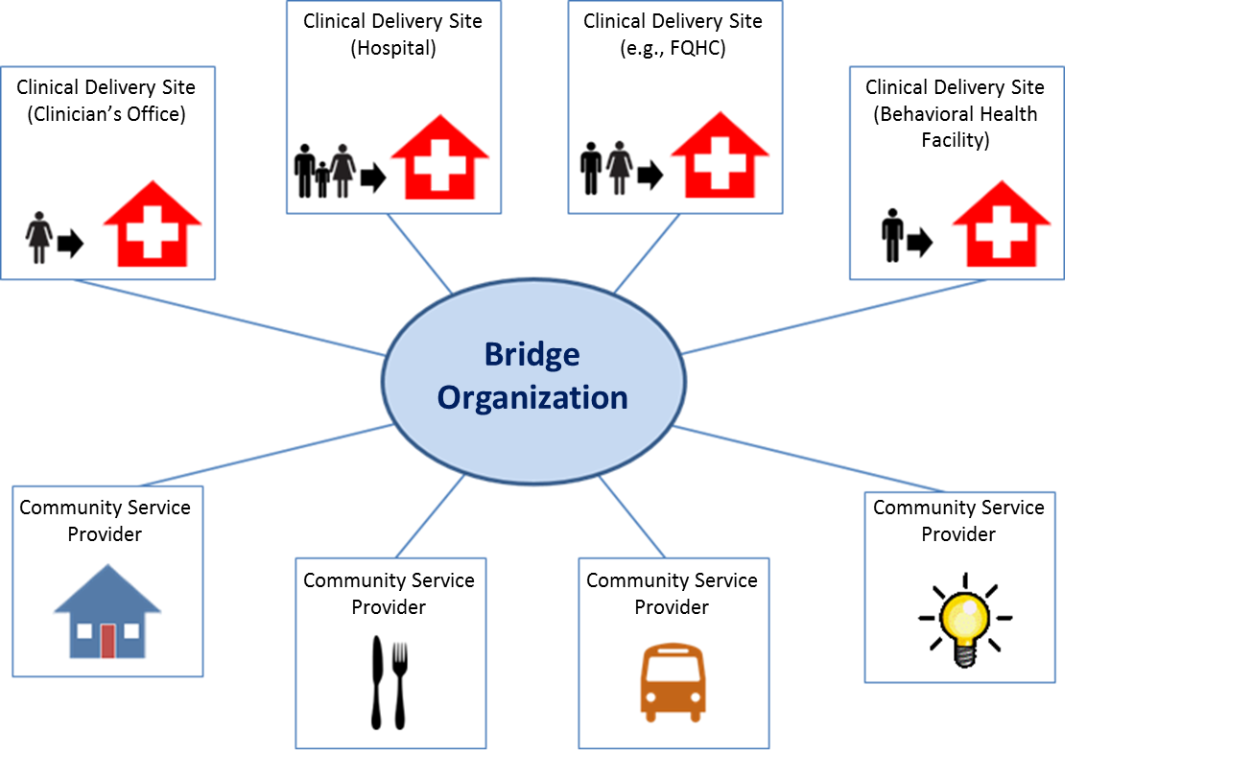
Assistor Agencies Address Health-Related Social Needs

Slide 21
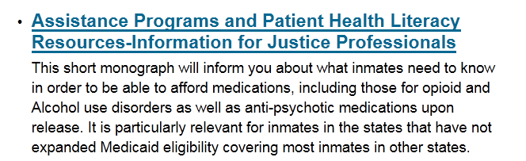
Other Resources & Toolkit highlights
HRSA - 340B Drug Pricing Program (see toolkit)
Patient-Center Medical Homes (see toolkit)
Indian Health Services; Alaska Native Health (see toolkit)
Advocacy and Policy Groups (Center for Prisoner Health & Human Rights)
Re-entry councils and resources (state listings)
Prescription Assistance Programs (see RSAT): http://www.rsat-tta.com/Home

Slide 22
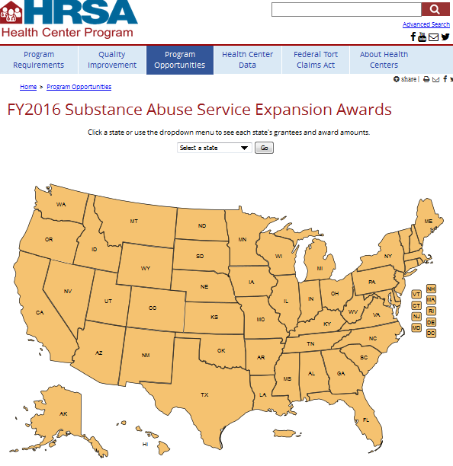
One More Bit of Good News Re: Opioid Addiction Treatment Capacity
http://bphc.hrsa.gov/programopportunities/fundingopportunities/substanceabuse/2016awards/index.html
Notes:
Only four states not funded!
Map tells you how much and who got it if you click on a state.

Slide 23
Always Happy to Hear From You
Thank you all for the great work you do!
We know your job is not easy, but we aim to make it a bit easier & are always happy to hear how we can do so…
Contact me anytime with inquiries about the topics we have covered: nmiller@ahpnet.com
Also appreciate hearing about your experiences & innovations…
Thank you for your participation …

Slide 24
For more information on RSAT training and technical assistance visit:
http://www.rsat-tta.com/Home
or email Jon Grand, RSAT TA Coordinator at
jgrand@ahpnet.com

