Slide 1


CBT Insights & Tools for Justice Professionals
Part I
Wednesday June 15, 2016

Slide 2
Cognitive Behavioral Therapy (CBT)
CBT is a general psycho-therapeutic approach
-Social Learning Theory origins
-Present focused problem solving approach
-Emphasizes interaction of thoughts, feelings & behavior
Basis of many effective, time-limited interventions for behavioral health disorders & other problems
2

Slide 3
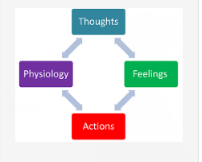
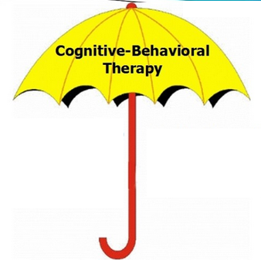
Part I Learning Objectives
Key elements of CBT
Compatible practices & approaches
Specific CBT interventions/tools
Notes:
Counselors and Correctional staff have different goals but share common objectives like staff and institutional safety, a firm, fair and consistent environment and helping offenders change their behavior.
Both need to know how to bring an inmate back to the hererand now, when his or her response is rooted in terror, defensiveness or disconnection precipitated by a resurfacing fear they are powerless to control.

Slide 4

Topics we will cover in Part I
CBT’s central elements
Research on outcomes & benefits
Practice components critical to success
Tools & worksheets to try before next webinar
Notes:
The goal is to introduce Trauma theory, research, and practices that will help you work with people in substance treatment within the justice system who may be effected by histories of exposure to violence and trauma

Slide 5
Background on CBT
Useful for myriad psycho/social/behavioral & medical issues
To alleviate emotional distress & promote positive change
Present focus - learned behaviors can be unlearned
Impact of irrational thinking, faulty learning & automatic thoughts on feelings & behaviors
Helper & client collaboration – active, directive, structured, brief
Goals: Improved emotional states & behavior; accurate, rational thinking; increased self-efficacy
Notes:
learning theory
(not positive thinking)

Slide 6
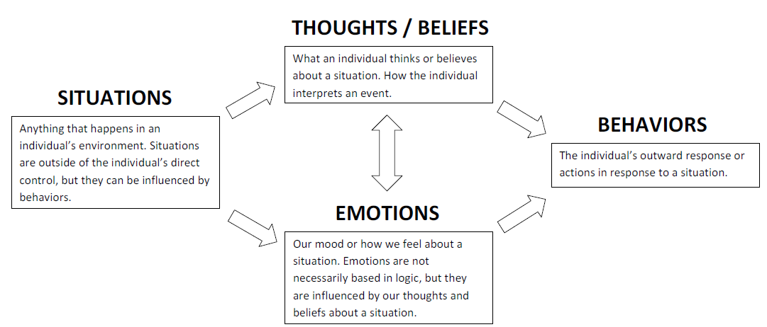
The CBT Model
Maps the relationship between behaviors, thoughts/beliefs & emotions – to clarify patterns & ways to change them

Slide 7
CBT: Theoretical Influences
Rogers: Person-centered therapeutic alliance
Bandura: Social Learning Theory
Skinner: Behavioral reinforcement
Miller & Rollnick : Motivational Interviewing
Notes:
Significant learning takes place when subject matter is relevant to the personal interests of the learner. Self-initiated learning is the most lasting & pervasive.
Humans can learn by observing others. Individuals are most likely to model behavior observed in others they identify with. The highest level of observational learning is achieved by first organizing & rehearsing the modeled behavior symbolically & then enacting it overtly.
Behavior that is positively reinforced will reoccur; intermittent reinforcement is particularly effective
Help the individual to explore behavior for her/himself. Decrease potential resistance to change. Create a safe, non-threatening environment for discussion of behavior and change. Clarify goals. Assist in developing realistic strategies to facilitate behavior change.
.

Slide 8
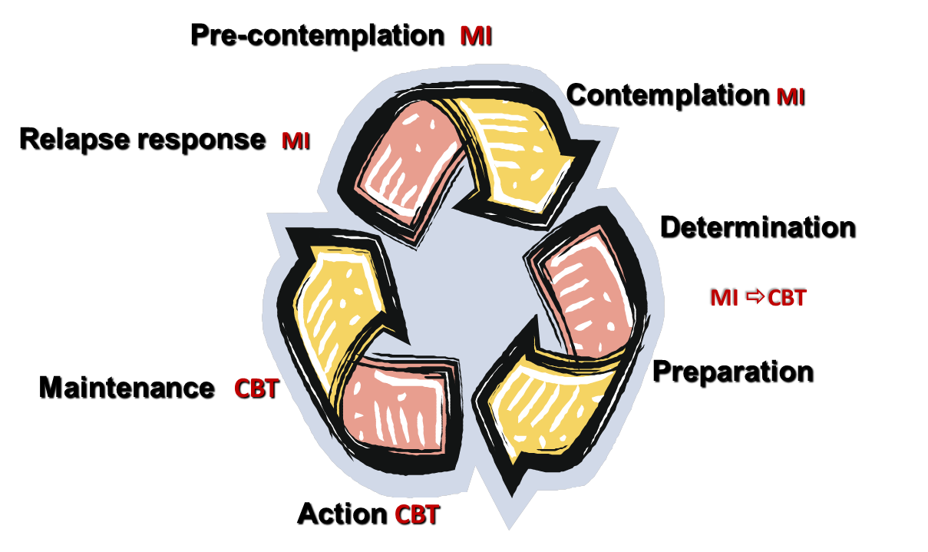
MI when there’s ambivalence; CBT once ambivalence is resolved
Relapse prevention CBT

Slide 9
Cognitive Therapies Cognitive/Behavioral
Aims to change the way the client thinks
Reduce emotional reactions by understanding & correcting maladaptive beliefs; modifying faulty thinking
Self-defeating behaviors change as a result
Aims to change the way the client thinks & acts
Similar strategies plus Functional Analysis; focus on practicing new behaviors & learning new skills
New behaviors & cognitive
skills result in change

Slide 10
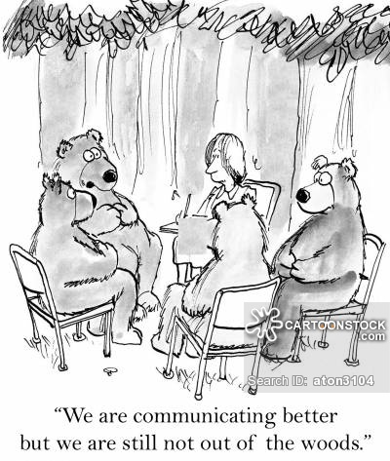
Elements of CBT
Sound Therapeutic Relationship
Brief/Time-Limited
Present Centered
Thought Focused
Specific Goals
Structured Sessions
Practice/Homework
Notes:
General prevalence:
Men are statistically more likely to be exposed to violence, but less likely to develop PTSD as a result.
Men are most commonly exposed to traumatic events that involve seeing someone killed or critically injured or being physically assaulted
Women are more likely to have been sexually victimized
Women may also take longer to recover from trauma and are four times more likely than men to have long-lasting PTSD, and to have accompanying depression and anxiety (GAINS Center, 2002; National Center for PTSD, 2007).

Slide 11
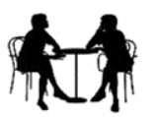
Polling our audience
CBT vs Meds for Depression & Anxiety disorders
Meds CBT
  Preferred by clients □ □
  More expensive □ □
  Lower response rate □ □
  Fewer associated risks □ □
  Lower relapse rate □ □

Slide 12
Social Phobia: Treatment Effect Sizes CBT vs Meds
Meta-Analysis Of 24 Studies
Gould et al., 1997

Slide 13
CBT for Treatment of Major Depression
Recent meta-analysis indicates psychotherapy is preferred 3:1 to pharmacotherapy for depression (McHugh et al., 2013, J Clin Psychiatry)
CBT is more cost-effective than pharmacotherapy over follow-up periods (Dobson et al. 2009; Hollon et al. 200x)
Long-term maintenance of gains-CBT has a strong enduring effect over time; lower relapse rate (Cuijpers et al., 2013, BMJ open; Tyrell & Elliot, 2016)
Response rate higher? Outcome research on response to antidepressants (STAR*D Study, 2009)
Notes:
As has been found for the anxiety disorders (panic disorder in particular), the advantageous costs/benefit ratio for CBT vs. medication is due to the strong maintenance of treatment gains for brief CBT. Whereas patients in CBT stop treatment or make use of only occasional booster sessions, medication and clinical visit costs keep accruing. STAR*D, the largest clinical trial study of treatments for major depressive disorder, funded by the National Institute of Mental Health. (One-third of patients do have a remission of their depression symptoms.)

Slide 14
Meta-Analytic Results of
Panic Disorder Treatment Studies
Effect Size (Cohen’s d)
CBT
CBT
(IE+CR)
Non-SSRI
antidepressant
Benzodiazepine
SSRI
antidepressant
Gould et al, 1995; Otto et al., 2001
Notes:
This slide depicts the controlled effect sizes from two meta-analyses of controlled (comparisons of CBT to a control condition) trials. Because some of the early CBT trials used weight-list vs. placebo control groups, effect sizes for CBT may have a slight advantage; yet, even taking this advantage into account, there is no evidence that CBT outcome, particularly that for CBT utilizing interoceptive exposure, is worse than that provided by medications.
In the slide, CBT (generally defined) is compared to CBT emphasizing cognitive restructuring plus interoceptive exposure interventions, broadly defined antidepressant treatment, benzodiazepine treatment, and , specific SSRI treatment.
Sources: Gould, R. A., Otto, M. W., & Pollack, M. H. (1995). A meta-analysis of treatment outcome for panic disorder. Clinical Psychology Review, 15, 819-844.
Otto, M. W., Tuby, K. S., Gould, R. A., McLean, R. Y. S., & Pollack, M. H. (2001). An effect-size analysis of the relative efficacy and tolerability of serotonin selective reuptake inhibitors for panic disorder. American Journal of Psychiatry, 158, 1989-1992.

Slide 15
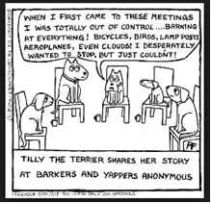
Combination Treatments & Compatibility
Evidence-based CBT interventions plus pharmacotherapy
  For depression & co-occurring disorders
  Medication-assisted treatment for opioid addiction
Compatible w/ family & couples therapy & parenting groups
Career counseling, HIV risk reduction, pain management
Self-help & 12-step groups

Slide 16
What the Research Tells Us
CBT is very effective; results achieved in a short period (16 – 22 sessions average)
Evidence-based treatment for anxiety disorders & depression
Effective reshaping cognition related to criminality, substance use disorders, and trauma.
Core components of therapy & sessions
are required for CBT to work!
Notes:
Treating clients with multiple disorders is often challenging.

Slide 17
Key Components of CBT
Functional analysis – ID thoughts, feelings, behaviors before & after difficult circumstances
Skills training – learn, model, rehearse, observe, effective strategies for coping
Cognitive modification – specific &
general strategies

Slide 18
Functional Analysis
Core component of CBT – sets it apart
Examines antecedents of recent problem behaviors
Relapse information helps plan alternative responses
When, where, what were you doing?
What happened just prior?
What were you feeling & thinking before? After?
Positive and negative consequences?
Individualizes skills building & additional session topics

Slide 19
Cognitive Reshaping & Skill Acquisition
Cognitive Restructuring
Education (role &
nature of thoughts)
Self-monitoring
thoughts or cravings
Feelings associated w/ automatic thoughts & errors
Substituting accurate thinking
Identifying, challenging & changing core beliefs
Skill acquisition
Assertiveness
Interpersonal/relational
Communication skills
Parenting
Problem solving
Refusal Skills
Conflict resolution
Real life practice
Increased self-efficacy
Notes:
In cognitive-restructuring, thoughts are treated as “guesses” about the world and patients are taught to examine the evidence for or against a thought. Periods of negative moods are used to cue formal cognitive restructuring. In addition, attention is devoted to the development of more useful thinking (self-coaching) strategies.
Cognitive-behavioral therapy is a therapy of doing, and care is taken to ensure that patients have adequate skills for the demands of life.
20

Slide 20
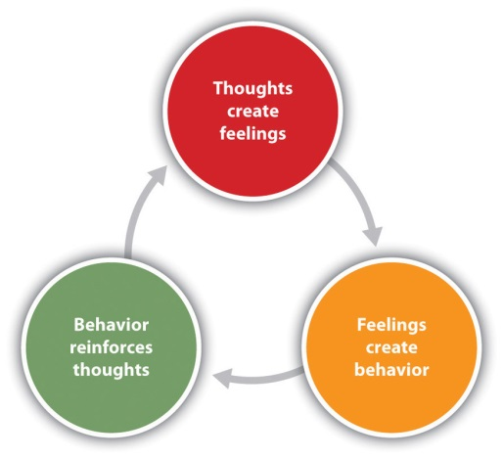
Meta-Analysis of Cognitive Behavioral
Treatment for Offenders (Landenberger & Lipsey, 2004)
Reviewed 79 studies:
-26 random samples
-27 matched samples
-26 convenience samples
Found that on average CBT reduced recidivism by 35%

Slide 21
Examples of Cognitive/Behavioral Correctional Curricula
Controlling Anger and Learning to Manage It (CALM)
Aggression Replacement Therapy (ART)
Criminal Conduct & Substance Abuse Treatment (Strategies for Self-Improvement & Change) (SSC)
Thinking for a Change (T4C)
Choices, Changes, and Challenges
Persistently Violent Curriculum
Corrective Thinking/Truthought
Reasoning and Rehabilitation
Moral Reconation Therapy
Drug Abuse Treatment Program (FBOP)
Moving On (Female Offenders)

Slide 22

Effective behavioral models:
How do you get to Carnegie Hall?
Structured social learning - new skills & behavioral are modeled & rehearsed
Cognitive behavioral groups target criminogenic risk factors
Family based approaches train clients to use appropriate techniques

Slide 23
Topics Part II will cover & ‘homework’
More examples of CBT evidence-based interventions for substance abuse & trauma
Structure & components of group sessions that increase effectiveness
Using individualized techniques, tools & worksheets
Compatible practice guidelines & useful resources
‘Homework’ – Look over one of the worksheets; try filling it out, or test it with clients. Think about the two follow-up discussion questions for next time.
.

Slide 24
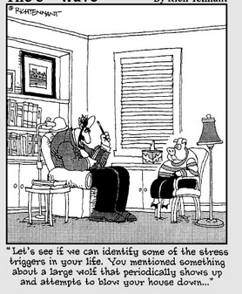
Questions?
Questions about content or homework, email nmiller@ahpnet.com
For more information on RSAT training & technical assistance, email Jon Grand, RSAT TA Coordinator at jgrand@ahpnet.com or visit: http://www.rsat-tta.com
Thank you!

