Slide 1


Evidence-Based Substance Use Disorder Treatment & Use of Medication Assisted Treatment
Michele Staton, Ph.D., M.S.W.
University of Kentucky Department of Behavioral Science
Center on Drug & Alcohol Research
Kevin Pangburn, L.M.F.T., L.C.A.D.C.
Director, Division of Substance Abuse
Kentucky Department of Corrections

Slide 2

Notes:
I hope I’m not the first person to say this to you – but welcome to the Commonwealth of Kentucky. I’m a native Kentuckian, and I am very proud of our state and I’m excited to have this opportunity to talk to this important group of people during your time here. I want to begin by just sharing a bit about KY – just in case this is your first visit.

Slide 3




Some things we are proud of…

Slide 4

Notes:
The most successful basketball program in NCAA division I history with the most all-time wins, NCAA tournament appearances, 17 Final Fours including four out of the last six years, and 8 national titles. Just want to make sure you have all the facts just in case anyone from this fair city of Louisville attempts to convince you otherwise.

Slide 5
Some things we are not so proud of….
Nationally known for some of the highest rates in the nation for…
  - Poverty
  - Obesity
  - Smoking
  - Diabetes
  - Cancer related deaths
  - Cardiovascular deaths
  - Preventable hospitalizations
  - Premature death
Source: United Health Foundation (2016). America’s Health Rankings. http://www.americashealthrankings.org/explore/2016-annual-report/state/KY.
Notes:
On a much more serious note, there are a number of things that KY is known for that we are not so proud of.

Slide 6
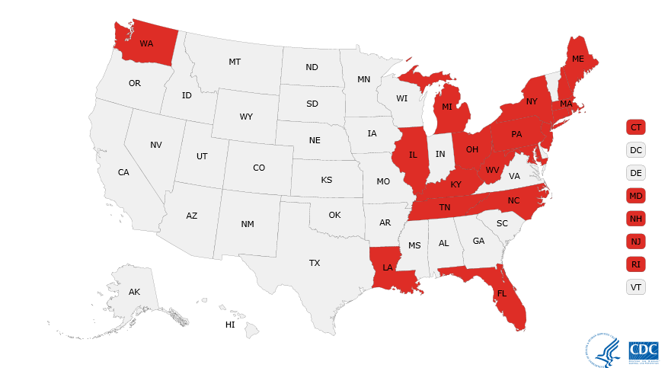
Kentucky ranks 3rd in the nation for drug overdose deaths –
increasing 21% from 2014-2015.
Source: Centers for Disease Control and Prevention. Drug overdose death data. https://www.cdc.gov/drugoverdose/data/statedeaths.html.

Slide 7

Also nationally known for high rates of drug related health consequences like Hepatitis C (HCV).
Kentucky had the highest rate of new HCV infections in the nation between 2008-2015.

Slide 8
While a number of state systems have been impacted by the drug epidemic in our state in recent years, the criminal justice system has disproportionately experienced a rise in the inmate population – largely attributed to drug-related crimes. We have become the single largest provider for substance abuse services in the state of Kentucky.
Kevin Pangburn
Director, Division of Substance Abuse
Kentucky Department of Corrections

Slide 9
Prevalence of drug use among offenders
Five times higher than the general population¹.
More than 80% report lifetime drug use, and more than half (53%) meet diagnostic criteria for substance use disorder².
Substance users typically become involved in the criminal justice system due to
(1) possession of an illicit substance,
(2) sale or illegal distribution of a substance, or
(3) engaging in illegal activity to support on-going drug use⁴
Sources: ¹SAMHSA - Substance Abuse and Mental Health Services Administration. (2009). Results from the 2008 National Survey on Drug Use and Health: National Findings (Office of Applied Studies, NSDUH Series H-36, HHS Publication No. SMA 09-4434). Rockville, MD.; ²Mumola, C.J. & Karberg, J.C. Drug use and dependence, state and federal prisoners, 2004. Washington, DC: US Dept. of Justice, January, 2007. ³Staton-Tindall, M., et al., (2011) Substance use prevalence in criminal justice settings. In Gulotta, T, Leukefeld, C., & Gregrich, J. (Eds) Handbook on evidence-based substance abuse treatment practice in criminal justice settings. New York: Springer. ⁴NIDA [National Institute on Drug Abuse] (2006) Principles of Drug Abuse Treatment for Criminal Justice Populations: A Research-Based Guide. US Department of Health and Human Services, Washington, DC. Publication #06-5316.
Notes:
The substance use prevalence rate among offender populations is five times higher than the general population¹.
A large majority (more than 80%) of incarcerated individuals report lifetime drug use, and more than half (53%) meet diagnostic criteria for substance use disorder².
High rates of drug use are consistently noted across individuals in different criminal justice venues including jail, prison, and community supervision³.
Substance users typically become involved in the criminal justice system due to
(1) possession of an illicit substance,
(2) sale or illegal distribution of a substance, or
(3) engaging in illegal activity to support on-going drug use⁴

Slide 10

Rich history of drug treatment and research in Kentucky
Notes:
Some of you may know – some may not. We have a rich history of drug abuse treatment in corrections here in KY. This book profiles the history of the federal narcotic hospital – the treatment program operated within an institutional setting by the US Public Health Service between 1935 and 1975. While they got a few things wrong with regard to the ethical treatment of individuals engaged in research studies – some of the most significant advances in research on addition and treatment began here.

Slide 11
Two decades of KY research on drug use and crime
Prisons…
92% state inmates met DSM criteria for lifetime drug dependence (Leukefeld et al., 1999).
85% of substance users recruited from KY prisons reported using multiple substances in the 30 days prior to incarceration
(Leukefeld et al., 2002).
Jails…
The prevalence of injection drug use has been reported as high as 75% among rural women recruited from jails
(Staton et al., 2017).
Drug Court…
The majority of drug court participants reported frequent use of alcohol, marijuana, crack/cocaine, sedatives, and multiple substance use before drug court. (Stoops et al., 2005).
Community supervision…
The prevalence of prescription opioid misuse increased significantly during the early 2000s among rural probationers (Havens, et al., 2007).
Notes:
Our team has been involved in research with drug users in criminal justice settings since the late 1990s.

Slide 12
By integrating drug abuse treatment into criminal justice settings, we can take optimal advantage of both systems. Just because a person has been kept from using drugs does not mean they have gained the necessary skills to build a successful drug-free life in the community. Drug addiction may re-emerge following release from incarceration, at which time continued care is not only a necessity for the individual's recovery, it becomes a public health and safety issue for us all.
Nora Volkow
Director, National Institute on Drug Abuse
Testimony before subcommittee on crime
US House of Representatives
February 8, 2006
Notes:
This statement really captures the essence of what we hope to talk about today. The overall goal of our short time together is to share what the research describes as being important for working with substance users in criminal justice settings and to describe how those approaches are being implemented in our small state of Kentucky. So, we really appreciate and recognize this vision statement from the Director of the National Institute on Drug Abuse.

Slide 13
Thank you…
RSAT
Secretary John Tilley – Secretary of the Justice and Public Safety Cabinet
Key KY Legislators like Representative Jason Nemes
Jim Erwin – Commissioner of the Department of Corrections
DOC program supervisors administrators
Notes:
We are grateful for that vision forwarded from Dr. Volkow at NIDA. That vision is shared by so many people in the room today. And without that vision from people like Andy Klein, Steve Amos, and so many of the good folks at RSAT, funding for programs like we are going to talk about today would not be possible. And – not just the programs, but the resources and training that RSAT makes available are invaluable. We are also grateful for the shared vision within the Kentucky state government – influential leaders like Secretary John Tilley who works tirelessly to increase opportunities for substance abuse treatment within corrections. The vision of key legislators like State Representative Jason Nemes who reviewed our recent report and said hey – please come to my office and tell me more about this. The vision of the Commissioner of DOC – Jim Erwin – who continues to advocate for substance abuse treatment and increasing the efficacy and effectiveness of the programs. And the shared vision of DOC program supervisors and administrators for the day to day work they do to make everything happen. Without these people and a number of others who probably should be on this slide but aren’t, the work we are going to talk about today would not be possible and lives would not be saved. So – before moving to far along – we just want to stop for a minute and acknowledge the efforts of these individuals and the teams who work with them.

Slide 14
Guidelines and Principles for Offender Substance Abuse Treatment

Slide 15

RSAT practices guidelines
NIDA
Principles of drug treatment for offenders
Source: RSAT Training and Technical Assistance (2017). Promising practices guidelines for residential substance abuse treatment. Advocates for Human Potential, Inc. Principles of Drug Abuse Treatment for Criminal Justice Populations: A Research-Based Guide. National Institute on Drug Abuse (2014). NIH Publication #11-5316

Slide 16
Drug addiction is a brain disease that affects behavior.
Source: Principles of Drug Abuse Treatment for Criminal Justice Populations: A Research-Based Guide. National Institute on Drug Abuse (2014). NIH Publication #11-5316

Slide 17

1980s campaign

Slide 18
Addiction is a brain disease
Different parts of the brain communicate to regulate everything that we think, feel, and do.
Communication is possible through:
  Neurons
  Neurotransmitters
  Chemical receptors
  Transporters
  Drugs affect the brain through this communication networks – affecting the ways that neurons send, receive, and process information.

Slide 19
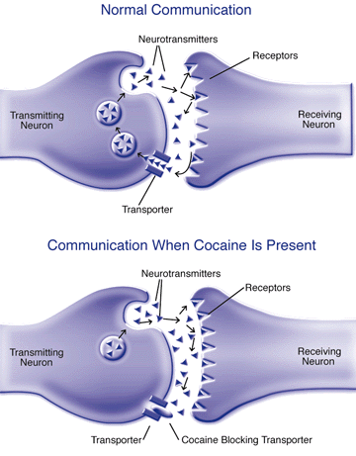
Source: Stocker (1999) NIDA Notes; Cocaine’s pleasurable effects may involve multiple chemical sites. https://archives.drugabuse.gov/NIDA_Notes/NNVol14N2/Cocaine.html
Notes:
Most drugs of abuse affect the dopamine neurotransmitters – leading to euphoria and reinforcing effects of drug.
Addictive drugs can release 2 – 10 times more dopamine than natural rewards like eating or sex.
These neurological rewards are also more immediate and last longer than natural rewards.

Slide 20
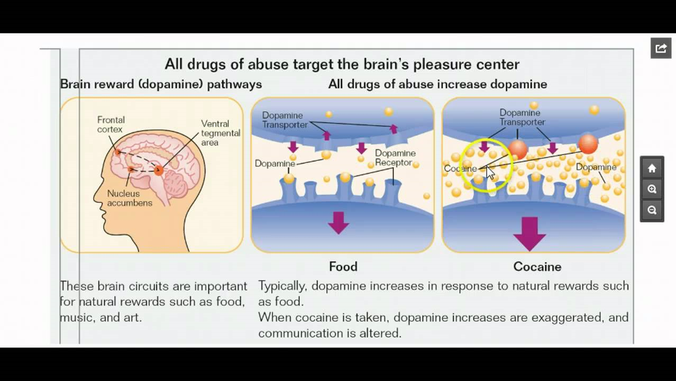
Source: NIDA (2014) Drugs, brains, and behavior: The science of addiction. NIH Pub#14-5605

Slide 21
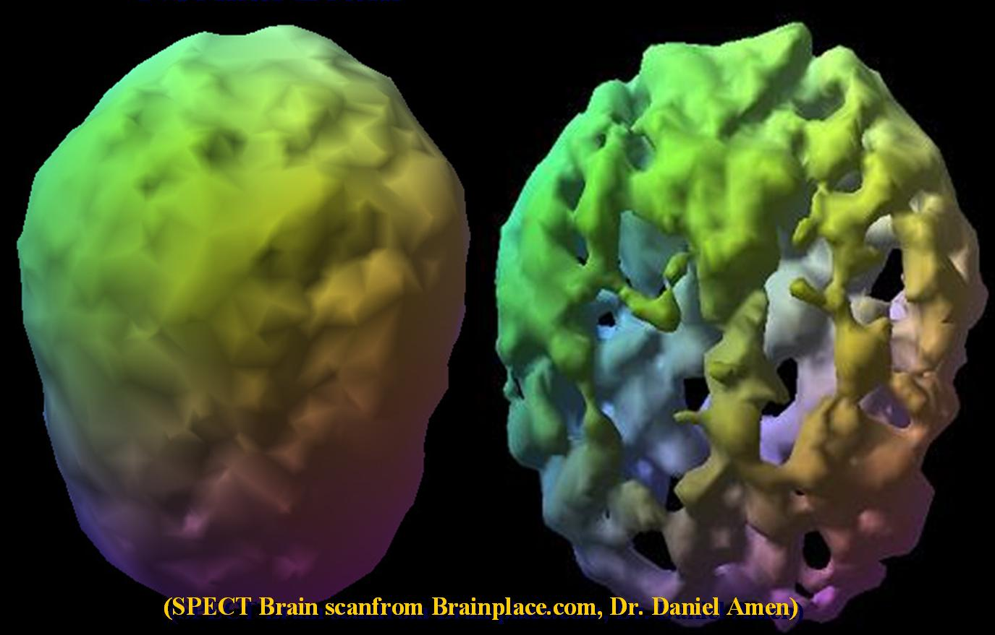
A “normal” brain and the brain of a person with 7 years of opiate use
Notes:
So, if we think about this in the context of a therapy session, the counselor has – in essence – the brain on the left. The long-term, chronic substance abuser has the brain on the right. All other things held constant, these two brains simply aint wired the same way. There are some inherent “deficits”, if you will, as a person begins the therapeutic process.

Slide 22
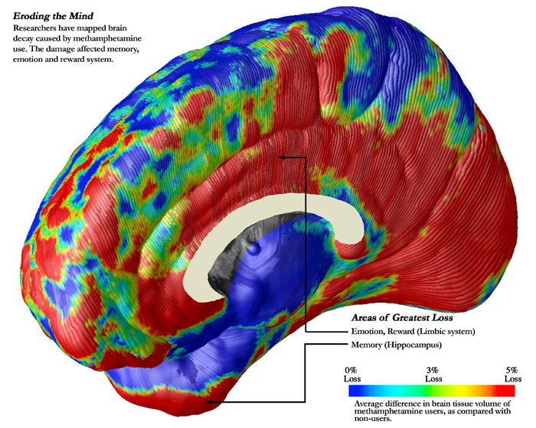
Methamphetamine use
Notes:
This slide shows the brain delay caused by methampethamine use – particularly damage to critical regions of the brain associated with attention, memory, emotion, and reward experiences over time. The red areas here reflect 5% cell volume loss, followed by the green regions with around 3% cell loss. The blue areas are reflective of normal cell volume.

Slide 23
Long-term effects on the brain
Decreased ability to feel pleasure – tolerance and dependence
Impaired cognitive function
Impaired memory
Impaired self-control and decision making
Compromised processing of punishment and rewards
Sources: NIDA (2014) Drugs, brains, and behavior: The science of addiction. NIH Pub#14-5605; Volkow (2006) An examination of drug treatment programs needed to ensure successful re-entry.
Notes:
Typically not just drug use – lifestyle, chaotic environment, poverty, childhood trauma/victimization
Decreased ability to feel pleasure – tolerance and dependence
Impaired cognitive function
Impaired memory
Impaired self-control and decision making
Compromised processing of punishment and rewards

Slide 24
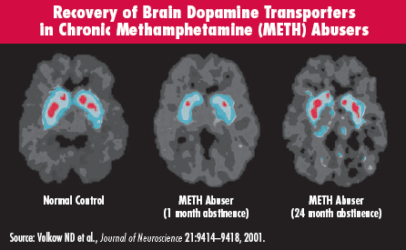
But recovery changes brains…
Notes:
The brain on the right shows significant improvements – return to images consistent with a normal control – for critical brain regions in the reward/pleasure pathway following just two years of abstinence.

Slide 25
The treatment process begins with assessment.
Notes:
TRANSITION TO KEVIN HERE. Our purpose today is to highlight the recent research on the evidence-based process – what we know works. But we also want to share how those evidence-based processes are being implemented in Kentucky. And not just implemented, implemented with integrity and in a way that works with positive outcomes for substance users. At this time, I would like to welcome my colleague Kevin Pangburn, Director of the Division of Substance Abuse for KY DOC to tell the story of assessment and treatment in Kentucky.

Slide 26
Assessment
System level assessment for SAP eligibility
Offender level assessment at SAP intake
Notes:
KEVIN
System level assessment for SAP eligibility
DOC philosophy – it is a priority to get people into treatment.
5921 treatment slots – 25% of entire inmate population can be in treatment at any point in time
Designated person – the air traffic controller – the story of Marka
Based on time, classification, application to SAP
Systems level adaptation to SAP
**INSERT EXAMPLE HERE – LIKE UBER, OR A TAXI COMPANY THAT DIRECTS TAXIS TO WHERE PEOPLE ARE, SAME PROCESS AS MARKA
Offender level assessment at SAP intake
The American Society of Addiction Medicine (ASAM) calls for the following to constitute comprehensive assessment:
A physical exam
A mental status exam
Medical and psychiatric history
Detailed substance abuse history and other addictive behaviors
Substance use disorder and addictive disorder treatment history and response
Family health and behavioral health history
Current medications
Social history
A summary of the patient’s readiness to engage in treatment
Diagnostic formulation(s)
Identification of facilitators and barriers to treatment engagement

Slide 27
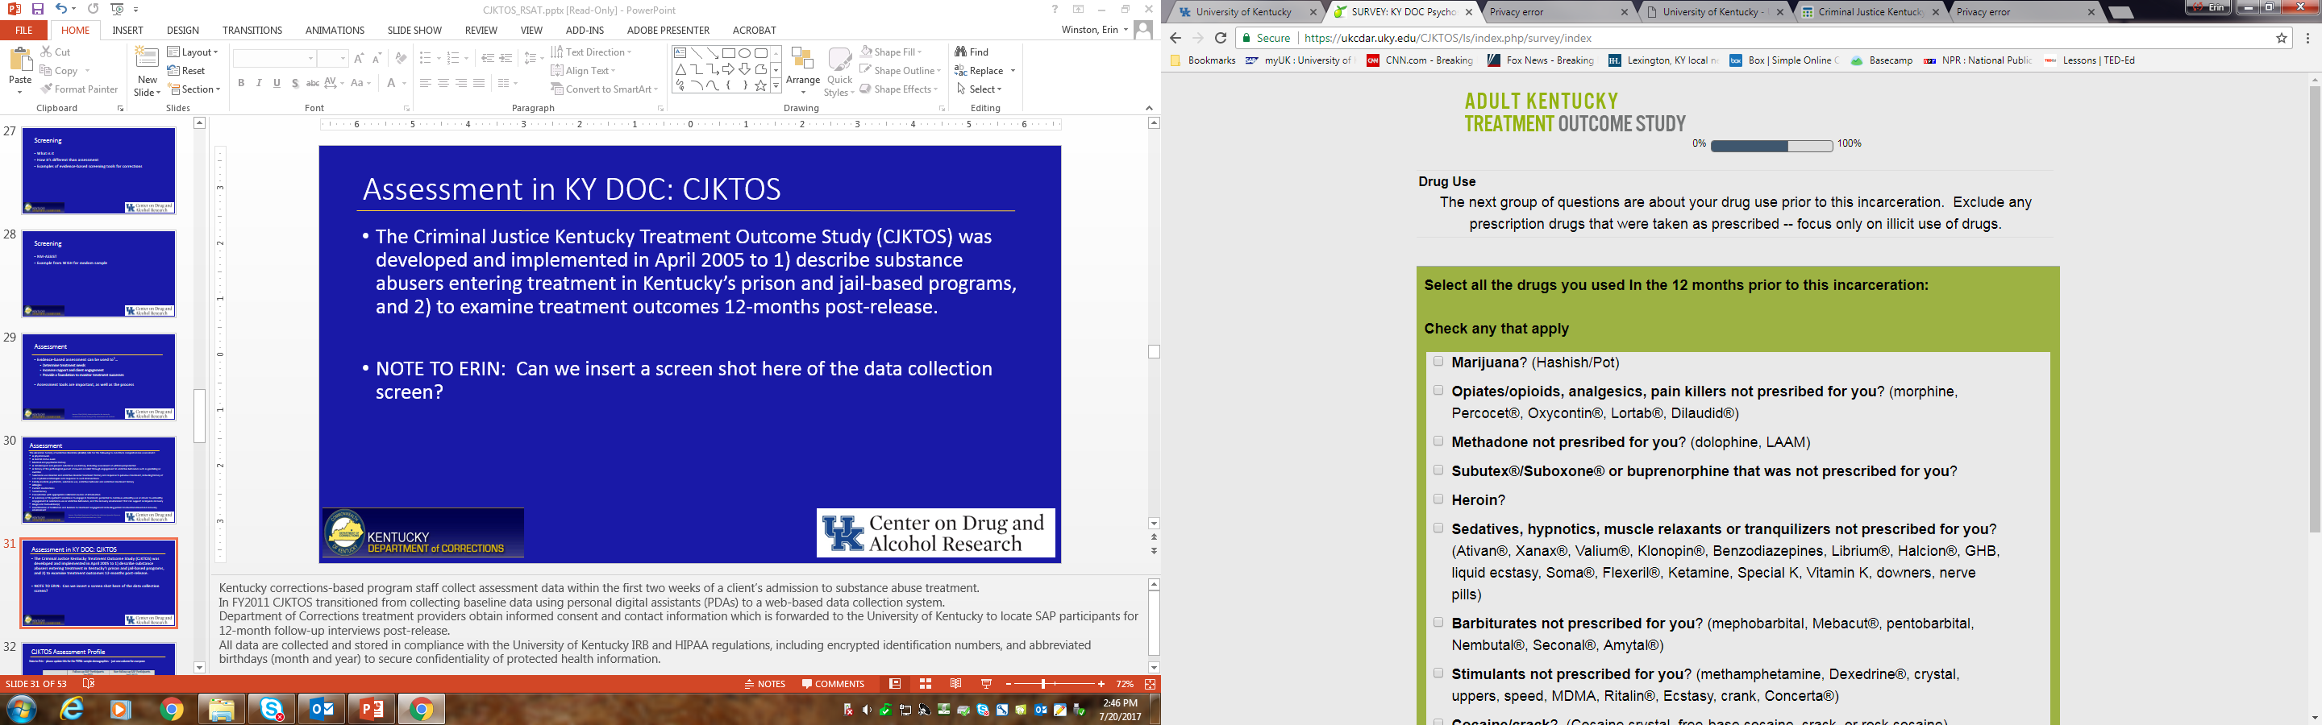
Assessment in KY DOC: CJKTOS
The Criminal Justice Kentucky Treatment Outcome Study (CJKTOS) was developed and implemented in April 2005.
Data system allows us to:
describe substance abusers entering treatment in Kentucky’s prison and jail-based programs,
examine treatment outcomes 12-months post-release.
Notes:
KEVIN
Kentucky corrections-based program staff collect assessment data within the first two weeks of a client’s admission to substance abuse treatment. In FY2011 CJKTOS transitioned from collecting baseline data using personal digital assistants (PDAs) to a web-based data collection system. Department of Corrections treatment providers obtain informed consent and contact information which is forwarded to the University of Kentucky to locate SAP participants for 12-month follow-up interviews post-release. All data are collected and stored in compliance with the University of Kentucky IRB and HIPAA regulations, including encrypted identification numbers, and abbreviated birthdays (month and year) to secure confidentiality of protected health information.

Slide 28
CJKTOS Assessment Profile
Demographics
 | FY2017 Baseline CJKTOS Assessments (n=5,928)
Average Age | 34.5 years old (range 18 to 72)
Race/ethnicity | 83.5% white
Gender | 84.1% male
Education | 71.8% GED or high school diploma
Marital Status | 49.8% Single, never married
Notes:
KEVIN
And we can use the data to tell us things like this – who are we serving?

Slide 29
CJKTOS Assessment Profile
Notes:
KEVIN
And what kinds of drugs are they using? WE have been able to monitor trends in our data over the years using a profile just like this one. Data like this served as one of the key factors in the Heroin Bill legislation.

Slide 30
Treatment should be evidence-based and be tailored to fit the needs of the individual.
Notes:
KEVIN

Slide 31
Evidence-based treatment
What does this really mean?
Disclaimer: We have to use caution when we make decisions about evidence-based treatments.
Sources: ¹Sackett et al. (2000); ²APA (2002)
Notes:
KEVIN
Institute of Medicine: Evidence-based practice is the integration of best research evidence with clinical expertise and patient values.¹
“Best research evidence” is generally derived from clinically relevant research based on systematic reviews, reasonable effect sizes, statistical and clinical significance, and a body of supporting evidence.²
Evidence-based treatment includes the approaches that have demonstrated efficacy and effectiveness through the EBP process.

Slide 32
Something to think about…
Typical client in a research-based, federally funded, clinical trial
Typical client in a prison with a substance abuse disorder
Example of how EBPs might be implemented differently with these clients
Notes:
KEVIN
Evidence-based treatment is typically based largely on clinical trials – which are conducted under the best of circumstances. Tightly controlled laboratories with tightly controlled recruitment conditions. Interventions are delivered with clear doses and outcomes are based on clearly documented follow-up points in time. A typical client in a clinical trial is a user of the drug of choice for that trial, compliant with treatment conditions, and engaged in the treatment process.
A typical client in a prison-based treatment program is none of those things – he/she is likely a poly substance user, with a history of violence, victimization, poverty, and chaotic lifestyles that surround his use.
Does this mean that an evidence-based treatment may not work for the person in prison? NO! It just means that you shouldn’t just grab a manual off a shelf and expect to implement it in the same way and expect similar results – just because it’s an evidence-based treatment.
Think about this as an example – you are working with Mary in outpatient treatment in your clinic. Mary is a 34-year old white woman, mother of 2, recently divorced, employed part-time as a receptionist at a business firm, and seeking treatment for problematic opioid use after a recent back surgery. Mary is motivated for treatment and is a good candidate for the use of motivational interviewing during the outpatient sessions. Success – in Mary’s case – will be largely measured by her ability to stop using opioids.
Now – let’s change the story – let’s say that Mary was recently arrested for driving while under the influence of opioids with her two children in the car. All of a sudden, she is facing jail time due to her endangering the welfare of her minor children. Because of her charge, she is motivated for treatment. But – her success is all of a sudden measured by the risk that she could recidivate.
Talk about the differences in these two folks and the implications for evidence-based practices.

Slide 33
Remember….
Evidence based practices were tested among selected participants (no poly-drug users), no co-occurring mental health, and among carefully managed clinical settings.
Prisons include people with poly-drug use and many mental health problems, multiple ethnicities, ages, and genders.
And prison-based treatment is not a neat orderly laboratory!
In the real world, things are messy.
Notes:
KEVIN

Slide 34
Why is a therapeutic community evidence-based for substance abuse in prisons?
Notes:
KEVIN

Slide 35
Therapeutic communities in prison
TCs are widely used and evidence-based for correctional populations.
Solid evidence-base for reduction of drug use and recidivism.
TCs are the primary modality of institutional treatment in KY.
Source: ¹DeLeon et al (2000)
Notes:
KEVIN
What do we know about TCs??
Introduced in the 1960s, they are a hierarchical model of care where increased stages reflect increased responsibility to the community
Community peer influence is used to determine norms and enhance social skills
The “community” is the agent of change
TCs have become a widely used framework for substance abuse treatment in prisons because they typically operate on the key principle that drug use is part of a larger, more complex behavior disorder and that behavior change depends on adoption of prosocial behaviors.¹
Thus, TCs share similar behavior change philosophies as correctional institutions, making them an appropriate treatment modality for delivery within prisons and jails.
The literature examining outcomes of corrections-based TC treatment has consistently shown positive results for reduction of drug-use following release¹.
Participation was a robust predictor of sustained abstinence in the community at 42 and 60 months post-release from prison².
Not only reduced drug use over time, but also result in improved post-release mental health outcomes among individuals with co-occurring disorders³.
Program graduates were significantly less likely than program non-completers to be reincarcerated six months post-release.⁴
Among graduates who may return to custody, they are likely to spend more time on the street than non-treatment participants.⁵
Outcomes shown to be strengthened by participation in aftercare programming in the community.⁶

Slide 36
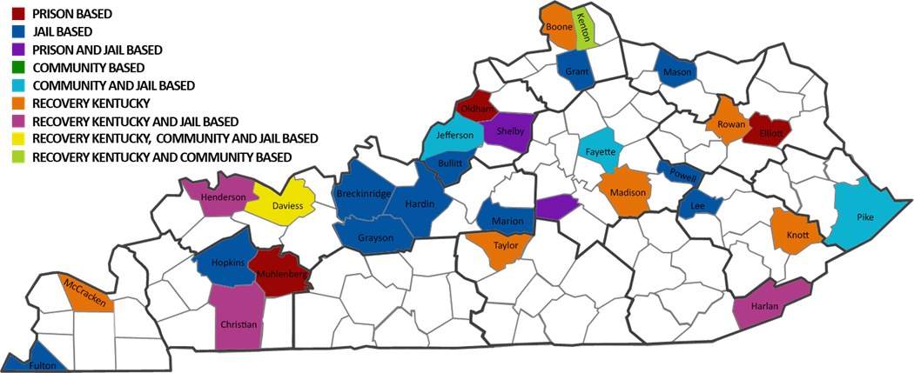
TCs in Kentucky (SAP)
In FY2016, there were 3,628 corrections-based substance abuse treatment slots in jails, prisons, and community custody modified therapeutic community programs.
Statewide, 8 prisons and 24 jails operate Substance Abuse Programs (SAP).
Notes:
KEVIN

Slide 37
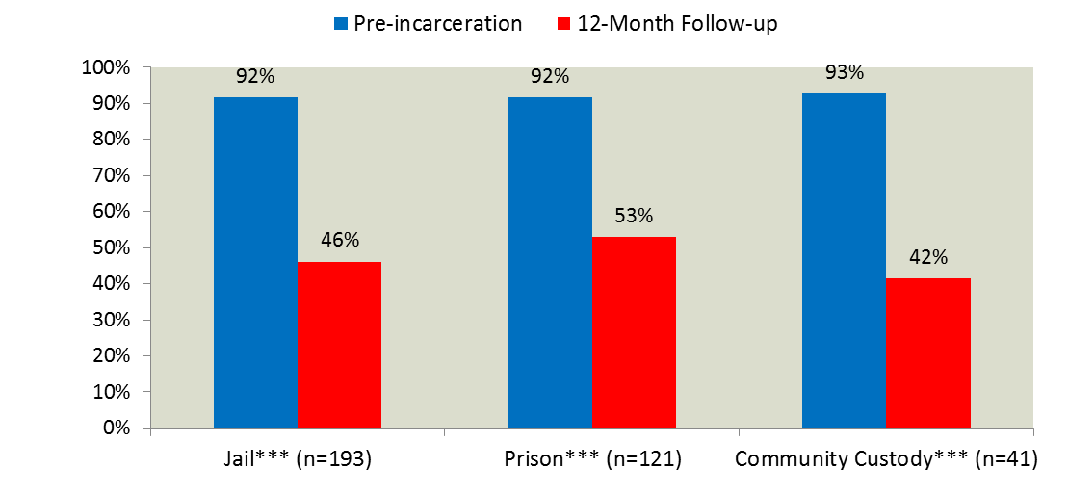
KY SAP Outcomes – Substance use
Notes:
KEVIN
And here is why we continue to use these programs – because they are effective. Significant reductions in substance use across institutional programs in jails, prisons, and community programs.

Slide 38
KY SAP Outcomes - Recidivism
 | Jail (n=193) | Prison (n=121) | Community Custody (n=41) | Total (n=355)
Not Incarcerated | 71.5% | 65.3% | 85.4% | 71.0%
Incarcerated | 28.5% | 34.7% | 14.6% | 29.0%
Of those who returned to custody, they spent an average of 6.4 months on the street.
Notes:
KEVIN
Also – TCs associated with low rates of recidivism. While we really want to emphasize placing value on other outcomes than just recidivism, we recognize the importance of this to DOC systems. But – also please note the box at the bottom – even among those who returned to custody, they spent a little more than 6 months in the community – which translates to reductions in costs to DOC.

Slide 39
Establishing a continuum of care during community re-entry is critical to sustaining treatment successes.
Notes:
KEVIN

Slide 40
KY Model for Re-entry
Re-entry high risk period.
Social Service Clinicians (SSCs) co-located in KY community P&P offices, serve as the primary liaison to community treatment.
KY has 36 SSCs across the state with an average caseload of 160 in the community.
What to do when assessment and referral may not be enough?
  KY SOOPer group
Notes:
KEVIN
Treatment doesn’t stop when a person leaves the gates. In fact, studies have shown that re-entry is a very risky period for people as they transition to the community. People recently released from prison have…
High risk for contracting infectious diseases¹
Increased risk for drug relapse and overdose deaths²
Increased risk for stress and anxiety³
Barriers to attaining stable housing⁴
Challenges in finding stable employment⁴
Barriers to seeking needed health care⁵
Increased risk for sustaining health relationships⁶
What to do when assessment and referral may not be enough? SOOPer group

Slide 41

Notes:
KEVIN
Spring, 2015 KY launched a Supervision Of Optimal Practices (SOOP)er group.
The goal of the CSC was to provide SSCs with training in EBPs to bridge the gap in service accessibility, particularly in rural areas.
SSCs were provided not only with knowledge about EBPs, but the opportunity to practice and discuss critical points of EBP among one another.
CSC workgroups began in May 2015 and 9 meetings were held over the course of 11 months.
The CSC included 10 regular members from across the state including clinicians working with substance using offenders in corrections-based programs.
Participants reported that learning, sharing, and engaging one another over the course of months allowed for the complex principles of EBPs to be more fully integrated into clinical thinking and application.

Slide 42
What about the use of medication?
Notes:
TRANSITION BACK TO MICHELE – I think what you can see from this discussion is that KY has been very successful in recent years in establishing, implementing, and evaluating an intensive continuum of care that begins with assessment and continues into the community during the very high-risk period of re-entry. KY is also gaining national recognition for their success in implementing a medication-assisted treatment protocol.

Slide 43
Why medications work
All medically assisted treatments interfere with the chemistry of drugs of abuse.
But they all work somewhat differently.
And not all medications are equally effective – even though all are evidence-based.

Slide 44
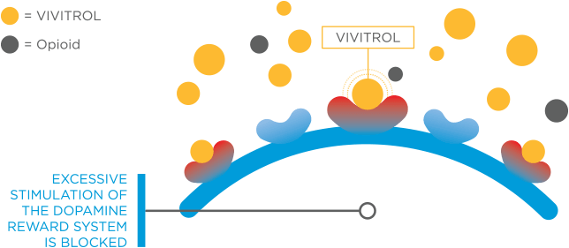
Why medications work…
Source: https://www.vivitrol.com/opioid-dependence/how-vivitrol-works
Notes:
XR-NTX – or Vivitrol – is an opioid antagonist. Relate this back to the earlier discussion of the impact of illicit drugs on the brain and neurotransmitter receptor sites. Antagonists attach to opioid receptors, but do not cause the release of dopamine. They are non-addictive and do not lead to physical dependence. Antagonists create a barrier that blocks opioid molecules from attaching to opioid receptors. VIVITROL blocks opioid receptors in the brain for one month at a time, helping patients to prevent relapse to opioid dependence, following detox, while they focus on counseling.

Slide 45
What are the MATs? - Antabuse
Antabuse (disulfiram) works on alcohol by preventing it from breaking down completely in metabolism.
It arrests ethanol at the stage of acetaldehyde and formaldehyde – both of which are toxic.
If you are on Antabuse and drink, you have violent vomiting and a host of other symptoms.
It is cheap, but only works on alcohol.
Notes:
Go through these quickly – short description and summary

Slide 46
What are the MATs? – Acomprosate
Used for treating alcoholism.
Works on the glutamate neurotransmitter system and has weak effects elsewhere.
It can make the GABA system less dependent on alcohol for relaxation effects, does not produce a noticeable euphoriant effect.

Slide 47
What are MATs? - Methadone
Methadone was invented by Nazi Germany when their supplies of Middle eastern opium was cutoff.
It is a synthetic opioid that gives the user pain relief (it’s used with cancer patients today) and moderate euphoria (not as much as heroin).
Methadone has some blockade action against other opioids by occupying the opioid receptor sites on neurons – meaning they cannot absorb other opioid molecules.
Methadone last about 24 hours in the human body. It’s very inexpensive.

Slide 48
What are MATs? Buprenorphine and Bup + Naloxone (Subutex and Suboxone)
Buprenorphine is a synthetic opioid with mild pain-killing effects, euphoriant effects and blocking action against other opioid molecules.
Combined with naloxone, it also has preventive effects against opioid overdose when used with other opioids for greater euphoria.
Buprenorphine lasts a full day and has a slow half-life.
It is expensive.

Slide 49
What are MATs? Naloxone (Narcan)
Rapidly block opioid sites and can reverse opiate or opioid intoxication within minutes.
May cause opioid withdrawal symptoms.
It has a half-life of only one hour.
It does not have euphoriant effects.

Slide 50
What are MATs? - Naltrexone
Naltrexone (Vivitrol) is an opioid antagonist that mostly blocks the effects of an opioid. So getting high with it in the system is very difficult.
It has only minimal effects on craving but it curbs the desire for alcohol.
It has some noticeable side effects largely resembling opioid withdrawal.
Injectable forms are very costly (over $1,000/month) but they avoid compliance problems.

Slide 51
Medication Assisted Treatment (MAT)
MAT is well established as an effective approach to treat opioid use disorder.^{1,2}
MAT is, however, under-utilized – particularly in the criminal justice system.
About half of state jails and prisons nationally use some form of MAT.^{4,5}
Individuals on community supervision are the least likely to have access to MAT.⁵
Re-entry presents challenges for maintaining MAT.¹
Source: ¹Sharma et al. (2016); ²Syed & Keating (2013); ³Saloner & Karthikeyan 2015); ⁴Oser et al. (2009); ⁵Friedmann et al. (2012).
Notes:
Medication-assisted treatment (MAT) has been well established as an effective approach to treat opioid use disorder.^{1,2}
However, only about 1 in 5 individuals with OUD nationally receive treatment³, with even fewer receiving treatment in resource-deprived areas.
In addition, MAT is underutilized in the criminal justice system despite high rates of OUD.
About half of state jails and prisons nationally use some form of MAT, mostly with pregnant women or for chronic pain management or detoxification.^{4,5}
Individuals transitioning from prison or jail to the community are the least likely to have access to MAT programs (i.e., probation and parole offices).⁵
A high percentage of individuals who initiate MAT in custody struggle to continue the treatment regimen during community re-entry.¹

Slide 52
KY MAT programs
KY Senate Bill 192 – The Heroin Bill
KY MAT approach
MAT is currently being implemented in 8 prisons and 24 jails in the Kentucky DOC.
Notes:
MAT for corrections was funded through the passage of KY Senate Bill 192 in order to facilitate the transition of inmates upon release to aid in substance abuse treatment aftercare.
The KY MAT approach combines medications (Vivitrol® injections) with counseling and behavioral therapies, monitoring, community-based services and recovery support to treat the bio-psychosocial aspects of alcohol and opioid use disorders.
Two injections prior to release, follow-up injections in the community in order to increase likelihood of sustained recovery.
MAT is currently being implemented in 8 prisons and 24 jails in the Kentucky DOC.

Slide 53
XR-NTX (Vivitrol®)
XR-NTX injections have shown significant reductions in opioid relapse among re-entering offenders^{.1,2,3}
XR-NTX is a sustained release depot formulation.³
In a pilot trial⁴, XR-NTX acceptance was high among males with OUD from NYC jails.
Re-entering individuals who received monthly injections in Baltimore remained opioid abstinent.⁵
Lee et al. (2016) enrolled 308 offenders on community supervision in five cities. Significant differences for XR-NTX with fewer opioid relapses and time to opioid relapse.
Sources: ¹Friedmann et al. (2017); ²Gordon et al (2017); ³Lee et al. (2016); ⁴Lee et al. (2015); ⁵Gordon et al. (2015).
Notes:
Advances in MAT like XR-NTX (Vivitrol) have overcome some of the challenges associated with compliance with MAT during community re-entry.
Recent studies on XR-NTX injections have shown significant reductions in opioid relapse among offenders re-entering the community compared to standard care.^{1,2,3}
XR-NTX is a sustained release depot formulation which eases challenges associated with medication adherence by providing 30 days of medication.³
In a pilot trial⁴, XR-NTX acceptance was high among males with OUD from NYC jails - 88% initiated prior to release and engaged in less post-release opioid use.
In another XR-NTX pilot trial⁵, individuals transitioning from Baltimore prisons in were more likely to remain opioid abstinent if they received monthly injections.
In the first large-scale XR-NTX trial to date, Lee et al. (2016) enrolled 308 offenders on community supervision across five large urban cities in the northeast U.S.
Significant differences were found for XR-NTX with fewer opioid relapses and time to opioid relapse compared to usual treatment (community treatment referrals).

Slide 54
What affects the effectiveness of MATs?
While evidence-based, MAT is not a magic wand.
Compliance is key.
MATs are not stand-alone treatments.
All MATs require supportive services to achieve solid clinical outcomes.
Other successes – like employment – matter.
Notes:
What everybody wants to know – is it effective?
Important to include some caveats to interpreting evaluation findings…
Everyone of the MATs depend on careful monitoring of compliance and the availability of other wrap-around supports.
Employed parolees on MAT will do better than unemployed parolees on MATs.
The MATs are not stand-alone treatments.
All of them require supportive services to achieve solid clinical outcomes.

Slide 55
MAT initiators in KY
 | Initiated (N= 54) | Refused (N= 193) | Total (N=247)
Average Age | 34.5 | 34.4 | 34.4
Housed** | 87.0% | 96.9% | 94.7%
White** | 81.5% | 59.1% | 64.0%
Employed full-time or part-time | 70.4% | 60.1% | 62.4%
Female*** | 33.3% | 3.6% | 10.1%
GED, high school diploma or higher | 59.3% | 58.0% | 58.3%
Rural* | 53.7% | 37.8% | 41.3%
Single, never married | 44.4% | 53.9% | 51.8%

Slide 56
Preliminary MAT outcomes
Eligible for follow-up | N = 20
Received at least one community injection | 40%
Received more than one injection | 15%
Of the 8 people who received one or more injections in the community, only 2 relapsed to opioid use (25%).
Notes:
Emphasize PRELIMINARY
Emphasize that the follow-up window is limited
These findings do not reflect DOC changes like additional incentives to increase compliance in the community and additional attention to introduction of the protocol in the prison
Ways in which the program has evolved over time – constant learning process – again, relate back to EBP discussion…just because it’s supposed to work doesn’t mean we just roll it out and let it go…it’s a constant process!!

Slide 57
Special considerations
Evidence-base practices should be considered and used, but special consideration should be given for:
- Co-morbidities (2 modified TC programs in KY prisons)
- Women
- Ethnic minorities

Slide 58
Lessons learned
Addiction is a chronic relapsing disorder.
Programs should be evidence-based, but tailored to the clients.
Evaluation is critical.
Employment is a key factor in success.
Drug-related health conditions must be considered.
Treatment successes should be measured more broadly than relapse and recidivism.

Slide 59

Lessons learned
Infrastructure and systems-level support is necessary.
Staff supervision and professional development is also important.
“Nobody can drop the rope”
– Secretary John Tilley
Notes:
Nobody can drop the rope – Secretary Tilley – everybody has to play their part or people get lost.

Slide 60
Questions?

Slide 61
For additional information:
Michele Staton, Ph.D., M.S.W.
University of Kentucky Department of Behavioral Science
Center on Drug & Alcohol Research
859-312-8245
mstaton@uky.edu
Kevin Pangburn, L.M.F.T., L.C.A.D.C.
Director, Division of Substance Abuse
Kentucky Department of Corrections
502-564-6490
kevin.pangburn@ky.gov

