Slide 1
Ethical Issues in Offender Treatment: Professional Boundaries
Roberta C. Churchill M.A., LMHC
ACJS, Inc.

Slide 2
Course Objectives
Upon completion of this presentation, participants will be able to :
Define the concept of “power differential”
Identify three types of boundaries and their relevance to offender treatment
List three warning signs that boundaries may be at risk of being crossed / compromised
Develop a plan of action if boundaries are in danger of becoming unprofessional / boundaries have been crossed

Slide 3
THE PROVIDER-CLIENT RELATIONSHIP
3

Slide 4
The Power Differential
The unbalance of power between provider and client
Control over the services provided to the client
Access to private knowledge about the client

Slide 5
Module I: Research
Examples of the Power Differential
Set the time and place: Set / changes schedules, begin / end classes, decide where / how to run classes, when / how drug testing occurs
Set the stage: Can arrange seating, change classroom, allow / deny participants to leave classroom, etc.
Right to ask questions: Ask offenders questions in the course of their work, but do not necessarily answer all their questions

Slide 6
Module I: Research
Examples of the Power Differential
Maintain anonymity: Know much more about offenders than offenders know about staff
Power to label, name and diagnose: Interpret, analyze, recommend and review progress of offenders; this can affect eligibility for parole, classification and aftercare recommendations
Authority to determine the rules of the relationship: Staff review program rules, probation / parole conditions, and “set the tone” for interactions

Slide 7
Module I: Research
"Because a relationship begins with a power differential, I shall not exploit relationships with current or former clients for personal gain, including social or business relationships."
(National Association of Alcoholism and Drug Abuse Counselors, 2004)

Slide 8
BOUNDARIES
What are they?
Where are they?
When are they at risk?
8

Slide 9
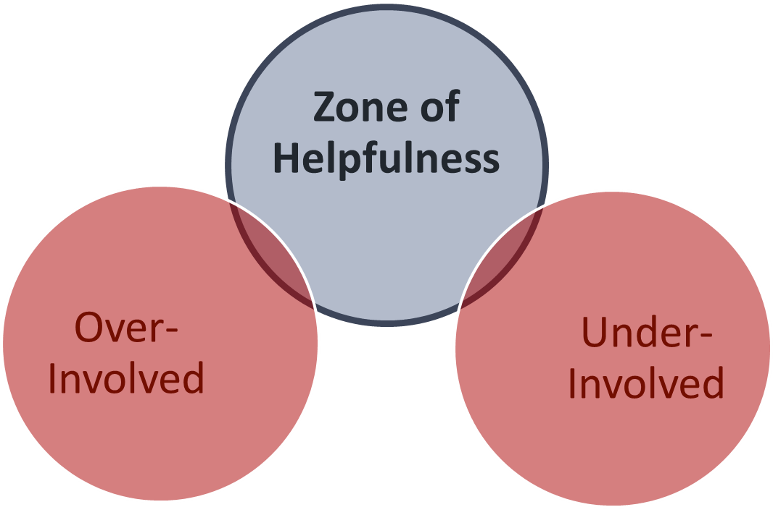
Module I: Research
Zone of Helpfulness
Staying within the “zone” helps you to stay “in bounds”.

Slide 10
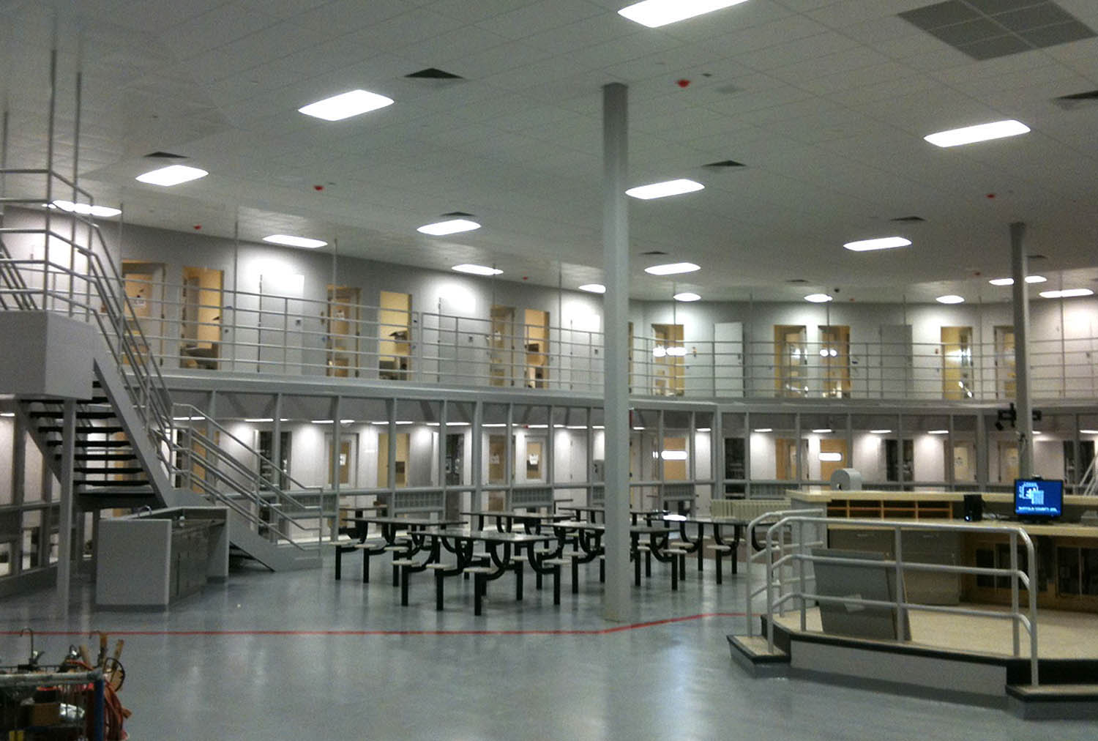
Context is Key
Context – not content – often determines the appropriate boundary.

Slide 11
Physical Boundaries
Hugging, hand holding, any type of intentional touching
Aggressive / violent intent behaviors
Invading another’s “space” or personal property

Slide 12
Physical Boundaries
An educator leans over a seated client touching his shoulder while looking over his written work

Slide 13
Physical Boundaries
An educator leans over a seated client touching his shoulder while looking over his written work
An Officer touches a client’s hand as she begins to cry when telling them about her children at home

Slide 14
Physical Boundaries
An educator leans over a seated client touching his shoulder while looking over his written work
An Officer touches a client’s hand as she begins to cry when telling them about her children at home
A counselor gives a hug to a client after they receive bad news from home

Slide 15
Emotional / Psychological Boundaries
Using clients / client information to satisfy one’s own emotional / dependency needs
Using psychologically manipulative behaviors in an attempt to intentionally or unintentionally gain more control of the situation or be the more powerful person

Slide 16
Module I: Research
Emotional Boundaries
A counselor talks about her past sexual abuse in detail with the female clients that disclose to her a similar background

Slide 17
Module I: Research
Emotional Boundaries
A counselor talks about her past sexual abuse in detail with the female clients that disclose to her a similar background
An RSAT Officer offers to be an AA sponsor to one of his RSAT community members

Slide 18
Module I: Research
Emotional Boundaries
A counselor talks about her past sexual abuse in detail with the female clients that disclose to her a similar background
An RSAT Officer offers to be an AA sponsor to one of his RSAT community members
A facilitator shares the gruesome details of his divorce during a Healthy Relationships group with clients

Slide 19
Module I: Research
“Are my actions more about my needs
than about the needs of the client?”

Slide 20
Module I: Research
Psychological Boundaries
Shaming a client in front of others - “You aren’t doing anything right in this Unit. Maybe you need some time in isolation.”

Slide 21
Module I: Research
Psychological Boundaries
Shaming a client in front of others - “You aren’t doing anything right in this Unit. Maybe you need some time in isolation.”
During an intake interview with a client, a staff member answers the phone several times

Slide 22
Module I: Research
Psychological Boundaries
Shaming a client in front of others - “You aren’t doing anything right in this Unit. Maybe you need some time in isolation.”
During an intake interview with a client, a staff member answers the phone several times
A white staff member calls a black client a racist name

Slide 23
Sexual Boundaries
Any type of sexual behavior (touching or not) in the office
Any type of inappropriately sexual innuendo or language with clients
Any type of inappropriate clothing in the office

Slide 24
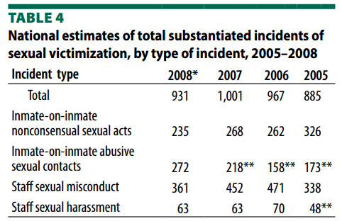
Sexual Boundaries
2007
About 54% of substantiated incidents of sexual victimization
involved only inmates, while 46% of substantiated incidents
involved staff with inmates.
Paul Guerino and Allen J. Beck, Bureau of Justice Statistics, “Sexual Victimization
Reported by Adult Correctional Authorities, 2007-2008,” January 2011

Slide 25
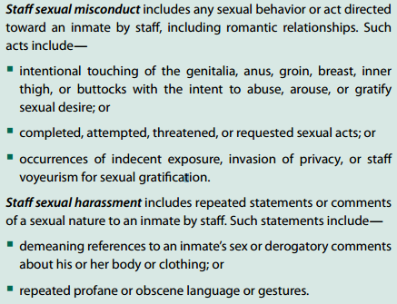
Sexual Boundaries
Paul Guerino and Allen J. Beck, Bureau of Justice Statistics, “Sexual Victimization
Reported by Adult Correctional Authorities, 2007-2008,” January 2011

Slide 26
Sexual Boundaries
A staff member winks at a client seductively during group

Slide 27
Sexual Boundaries
A staff member winks at a client seductively during group
A counselor asks about a client’s past sexual history that have nothing to do with current treatment

Slide 28
Sexual Boundaries
A staff member winks at a client seductively during group
A counselor asks about a client’s past sexual history that have nothing to do with current treatment
An Officer wants to know about a client’s sexual preferences; always tries to steer the conversation back to the topic of sex

Slide 29
Module I: Research
Prevention and Avoidance of
Sexual Misconduct
Do not use:
Refrain from:
Do not make:
Gestures, tone of voice, expressions or any other behavior that a client could interpret as seductive, sexually demeaning or sexually abusive
Treating a client with whom you have had a previous intimate relationship
Sexualized comments about a client’s body or clothing; sexualized or sexually demeaning comments to a client
Do not:
Criticize sexual orientation; ask details of sexual history – unless it’s part of your job

Slide 30
Module I: Research
Prevention and Avoidance of
Sexual Misconduct
Do not:
Learn:
Do not:
Engage in inappropriate “affectionate” behavior with a client; talk about your own sexual preference, fantasies, problems, etc.
To detect and deflect seductive clients
Request a date with a client; engage in any sexual conduct
Maintain:
Good records that reflect any intimate questions of a sexual nature and document any and all comments or concerns made by a client relative to alleged sexual abuse, and any other unusual incident that may occur during the course of the work day

Slide 31
THE GRAY AREAS
The Warning Signs
31

Slide 32
Module I: Research
The Gray Areas
Self Disclosure
Using personal experience as guiding life lessons can add credibility and be helpful on a more personal level
Inappropriate disclosure may occur because of deep-seated emotional or dependency needs

Slide 33
Module I: Research
The Gray Areas
Is it consistent with client’s treatment needs and goals?
Is it consistent with Treatment Unit’s / Facility’s Mission and theoretical orientation?
Does it mainly reflect or express your own personal needs?
What is your assessment of the possible risks, costs and downsides of self-disclosure?
Does self-disclosure represent a significant departure from your usual practice?
Would you hesitate to discuss this disclosure with your supervisor or document it in the client’s record? If so, why?

Slide 34
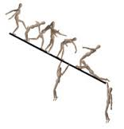
Module I: Research
The Gray Areas
Slippery Slope
Over-familiarity
Gift giving and receiving
Keeping secrets
Favors

Slide 35
Module I: Research
The Gray Areas
Dual Relationships
When staff and client are engaged in relationships other than that of staff-client
Social, professional, sexual / emotional
Staff should never engage in any role and/or relationship
that may:
Impair their judgment and objectivity
Affect their ability to render effective services
Result in harm and/or exploitation to clients
Corey, G., Schneider-Corey, M., & Callanan, P. (2011). Issues and ethics in the helping
profession (8th ed.). Belmont, CA: Brooks & Cole, Cengage Learning.

Slide 36
Warning Signs that Boundaries
may be at Risk
I frequently think of this client when I am away from work
I spend time with this client outside of work or my work area
I share personal information with this client
I have unnecessary or out of proportion concern for this client
I am defensive of the client or my interaction with the client
I advocate for this client more than other clients
This client could / has hurt my feelings

Slide 37
Warning Signs that Boundaries
may be at Risk
I am flirtatious or have overt sexual content in my interactions with this client
I feel I understand the client better than other staff
I feel that I can help this client better than other staff
I touch this client more or differently than other clients
This client can only deal with me
This client waits for me to be available rather than deal with other staff
I am willing to accept secrets from this client

Slide 38
Personal Conduct
Examine your own boundaries – how might they affect your work with clients?
Monitor and maintain boundaries with co-workers ; overlapping roles with co-workers make boundary-setting even more difficult.

Slide 39
COMPETENT PROFESSIONALS
Making Decisions about Boundaries
39

Slide 40
Making Decisions About Boundaries
Am I doing this for the best of the client or some other motivation? Whose needs are being served?
Am I feeling angry? Frustrated? Resentful? Towards the client or for other reasons?
Am I treating this client differently?
How would my interactions be viewed by:
My supervisor
The client’s family or partner
My family and my partner
My co-workers
A licensing agency

Slide 41
Making Decisions About Boundaries
Pay attention to any uneasy feelings, doubts, or confusion you may be having during or right after a possible boundary crossing.
Talk to another staff member, your supervisor, or your clinical supervisor about a possible boundary crossing.
Document (as necessary), acknowledge, consider an apology.

Slide 42
Competent Professionals
Receive routine Clinical Supervision: be familiar with their code of ethics / agency rules and follow them
Respect Chain of Command: use Supervisors as a source of information; keep them informed of problems and/or questions
Document, Document, Document: if it’s not in writing, it never happened
Crisis judgment: protect yourself, report, respond properly, document, follow procedure

Slide 43
Competent Professionals
Accept the complexity of maintaining boundaries
Admit when they have boundary dilemmas
Wrestle with these dilemmas and discuss them with colleagues
“Who do we serve?” “Do no harm.”

Slide 44
References
Bissell, L., Royce, J., (1994) Ethics for Addiction Professionals, Hazelden Educational Materials, Center City, Minnesota.
McGuire, S. (1996) Subtle Boundary Dilemmas: Ethical Decision Making for Helping Professionals, Hazelden Educational Materials, Center City, Minnesota.
Pope, Kenneth S. (2008) A Practical Approach to Boundaries in Psychotherapy, Journal of Clinical Psychology, 64, (5) pp. 638-652.
Trotter, Chris (2010) Effective Supervision of Offenders, 145th International Training Course
Trotter, Chris (2009) European Journal of Probation, 1 (2), pp. 142 – 152.
University of Wisconsin Oshkosh (2010) Professional Boundaries for Caregivers Facilitator Guide www.uwosh.edu/ccdet/caregiver
White, William L. (2007) Ethical Guidelines for the Delivery of Peer-based Recovery Support Services, ATTCC / SAMHSA
Zur, O. (2010) Power in Psychotherapy and Counseling, Online Publication by the Zur Institute.

Slide 45
Next Presentation
Choosing and Using Evidence-Based Curricula
February 20, 2013
2:00 – 3:00 p.m. EST
This presentation grapples with two questions:
What treatment issues matter most in selecting evidence-based curricula (i.e., specific EB content and protocols) for one’s program?
What matters most for effective implementation of any curricula?
These questions loom larger as more EB interventions enter a growing market of tools available to RSAT programs. Without critiquing or ranking specific products, we will focus on:
Deciding what your program wants a product to accomplish;
Selecting a product with evident capacity to do the job that might also fit well into your program; and,
Implementing the curriculum/intervention with both rigor and sensible adaptations.
The webinar is for program decision-makers who want to get the most treatment impact from any given EB curriculum. And it’s for treatment staff who must deliver that curriculum and need to somehow make it their own.
Presenter: Fred Zackon

