Slide 1
Telemedicine-delivered treatment interventions for substance use disorders
Lewei (Allison) Lin MD, MS
Research Investigator and Staff Psychiatrist, Center for Clinical Management Research, VA Ann Arbor Healthcare System
Assistant Professor, Department of Psychiatry, University of Michigan Medical School
David T. Moore, MD, PhD
Assistant Professor of Psychiatry, Yale University School of Medicine
Director, VISN 1 Clinical Resource Hub, VA Connecticut
September 18, 2019

Slide 2
Disclosures
Dr. Allison Lin
No financial disclosures
I receive funding from SAMHSA, VHA and CDC
The views expressed in this presentation are solely my own and do not necessarily reflect the position or policy of the Department of Veterans Affairs or any other organization
Dr. David Moore
No financial disclosures
I receive funding from VHA
The views expressed in this presentation are solely my own and do not necessarily reflect the position or policy of the Department of Veterans Affairs or any other organization

Slide 3
Outline
Background on current challenges with substance use disorder (SUD) treatment access
Evidence for telemedicine for SUD treatment
Specific case of telemedicine for buprenorphine treatment of OUD
Telemedicine for OUD treatment in the VA and patient cases

Slide 4
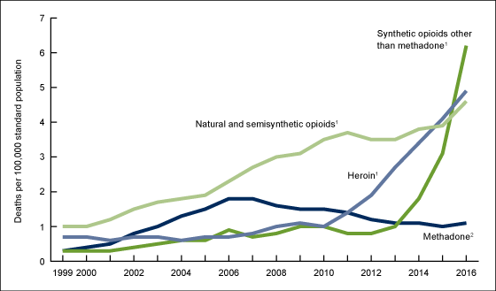
US opioid related overdose deaths
(Hedegaard, 2017)

Slide 5
Not just opioids…
(Kariisa et al., 2019)

Slide 6
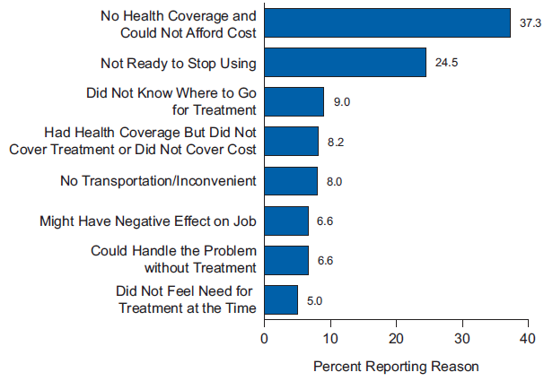
Barriers to SUD Treatment
Stigma
Limited access/accessability of treatment
Complex symptoms of addiction
(SAMHSA, 2015)

Slide 7
Challenges in the incarcerated population
High prevalence of substance use: up to two-thirds of jail detainees have problems with alcohol or drugs
Few currently receive medication treatment in jails or prisons for opioid and other substance use disorders
High risk for overdose especially in first month after release
(Karberg and James, 2005, Merrall et al., 2010)

Slide 8
Effects of treatment in incarcerated population
Treatment initiated during incarceration
Medication treatment reduces substance use and overdose
Those initiated into treatment while incarcerated are more engaged in treatment long term
(Brinkley-Rubinstein et al., 2018)

Slide 9
Approaches to increasing SUD treatment access
Hire more SUD providers in low treatment jails/prisons
Train non-SUD providers in existing jail/prison
Use telehealth to expand access and reach of treatment to facilities lacking providers
Likely all of these are needed!

Slide 10
What is telemedicine?
Synchronous/live videoconferencing: connects providers and patients in real time for direct care delivery (most common modality reimbursed)
Asynchronous/store and forward: not ”real time,” allow for electronic transmission of medical information, such as digital images
Other modalities such as telephone, text or
web-based interventions not included

Slide 11
Numerous successful telemedicine models for other chronic disease management
RCT of telehealth for depression w/ med management and brief supportive counseling. (Ruskin et al 2004)
Depression outcomes improved with no difference between telehealth and in-person treatment.
There were also no differences in drop-out or patient satisfaction, which was high in both conditions.
Telehealth collaborative care management for Veterans with depression (Fortney et. al 2012)
3 VA Medical Centers and 11 of their affiliated community clinics
Localized tailoring of the telemedicine-based CCM model
Over 90% of the CBOCs chose to maintain program after research study

Slide 12
Evidence for telemedicine - Systematic review of telemedicine treatment for SUDs
Lit search Included:
Published manuscripts and conference abstracts
In English
from January, 1998 through October, 2018
Examine real-time videoconference-delivered medication or psychotherapy to treat adults with SUDs.
Outcomes of interest included substance use, treatment adherence, acceptability of the intervention, and satisfaction with treatment.
Studies that were randomized, experimental, quasi-experimental or observational in design

Slide 13
Summary of studies
For alcohol use disorder (n = 5)
All studies provided a psychotherapy intervention but no studies included any forms of medication treatment
Mixed findings: some found lower treatment dropout in telemedicine groups, generally high patient satisfaction, others found no difference w/ usual care.
For opioid use disorder (n = 5)
2 studies delivered psychotherapy to patients at home. Found similar outcomes on substance use and satisfaction compared to in-person care
3 non-randomized studies examined use of buprenorphine and methadone, delivered in outpatient treatment. Patient located at a rural clinic and a physician at a distant site and included other components such as urine toxicology screens.

Slide 14
Summary
Evidence for telemedicine is robust for mental health and other conditions, but limited number of studies for SUD
Some indicators of comparable therapeutic alliance and retention in care though small size and no non-inferiority studies conducted
Need to consider technology, personnel and other logistics
May be particularly promising when in-person care is not available

Slide 15
Particular need for telemedicine for OUD treatment
Counties with no OUD treatment providers in the US
Need for providers who are X-waivered for buprenorphine and trained to treat OUD
(Haffajee et al., 2019)
Notes:
Rebecca Haffajee’s current unpublished work updates this for bup, methadone, naltrexone and looks unmet treatment need (counties w/ high overdose but low treatment) and characteristics associaqtedw tih those counties -> many are rural

Slide 16
Effective treatments for OUD
Opioid agonist medications
Methadone: Can only be used in DEA approved opioid treatment programs
Buprenorphine maintenance (Suboxone®, Subutex®, Sublocade®, etc)
Since 2004, providers allowed to prescribe in office based setting after obtaining training
Opioid antagonist
Long acting naltrexone (Vivitrol®)
Notes:
Naloxone is important tool, but is not treatment. long acting naltrexone efficacious in RCT’s for those who can get initiated, and may be helpful for some patients, but retention is likely not great and been shown to reduce mortality

Slide 17
OUD treatment effectiveness
Reductions in overdose and overall death rates
Reductions in opioid use
Improved HIV and Hep C outcomes
Recent evidence suggesting cost effective and improved quality of life
Medications are the most effective treatment for OUD. Without medication treatment, patients have much higher rates of substance use and overdose rates.
(Norton et al 2017, Altice et al 1999, Kenworthy et al., 2017; Nosyk et al., 2015
Schwartz et al 2013, Sordo et al 2017)

Slide 18
Things to consider for OUD telemedicine
Induction (initiation) and maintenance stages of treatment
Logistics of conducting urine drug screens
Providing therapy with medication
Staffing and comfort with telemedicine at patient and provider sites
Federal and state regulations

Slide 19
Ryan Haight Online Pharmacy Act of 2008
Concerns prescribing of controlled medications when provider and patient are not in the same location
Prescription must be a “valid prescription” issued for legitimate medical purpose in the usual course of professional practice
Must conduct an initial face-to-face evaluation unless:
the facility where the patient is physically present has its own DEA license
Covering provider or emergencies
And other exceptions

Slide 20
Additional questions
Adhering to state laws on prescribing controlled medications
How to treat more complex patients who may at times need higher level of care and you may want to assess in person?
Logistics (lab testing, delivering/administering medications, etc)
Interest/comfort level in using telehealth technology by clinic staff
https://www.cchpca.org/telehealth-policy/current-state-laws-and-reimbursement-policies

Slide 21
Upcoming Slides
Tele-MAT is a great way to flexibly increase access to MAT
Implementation of MAT in the VHA
Overview of telehealth in the VHA
Case examples of tele-MAT

Slide 22
Are there Similarities Between MAT Implementation in Criminal Justice Systems and the Veterans Health Administration?
MAT implementation needs to be tailored to the local healthcare delivery system, but can be guided by regional and national support.

Slide 23
Making MAT Available Everywhere: Stepped Care for Opioid Use Disorder
Most patients do not need specialty care
MAT accounts for the majority of the treatment effect
Reserve “rare” specialists for consultation and the most complicated patients
Self-management
Addiction-focused medical management
SUD Specialty Care
Step 2
Step 1
Addiction specialists
Addiction groups
IOPs
Residential programs
Primary Care
General Mental Health

Slide 24
Expanding Step 1 MAT with “Virtual” Support
Remove barriers
Provide incentives: Performance pay
Increase support:
Virtual X-waiver trainings
Project ECHO
Self-management
Addiction-focused medical management
SUD Specialty Care
Step 2
Step 1
Addiction specialists
Addiction groups
IOPs
Residential programs
Primary Care
General Mental Health

Slide 25
Augmenting Step 1 and Step 2 with Telemedicine
Tele-Specialty Prescribers
Tele-SUD CBT
Tele-IOP/Groups
Tele-PCP
Tele-MH
Tele-Care Management
Self-management
Addiction-focused medical management
SUD Specialty Care
Step 2
Step 1
Addiction specialists
Addiction groups
IOPs
Residential programs
Primary Care
General Mental Health

Slide 26
What is Needed to Prescribe MAT by Telemedicine?
DEA waivered provider
Nursing/clinical staff
PDMP monitoring
Reliable pharmacy
Laboratory testing
Ability to refer to a higher level of care.
Compliance with Federal tele-prescribing laws (Ryan Haight Act)
Compliance with state tele-prescribing laws

Slide 27
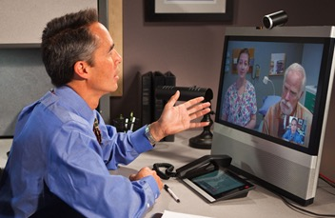
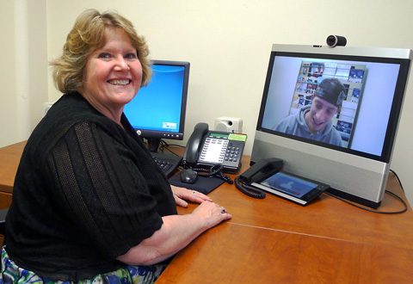
Veterans Health Administration Telemental Health
Goals
Evidence Based Psychotherapy (EBPs)—CBT for SUD
Psychiatric medication management – MAT
Mental health groups – SUD groups
Gap coverage—Filling in temporary gaps

Slide 28
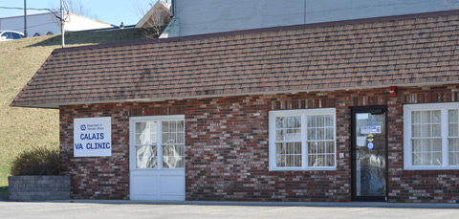
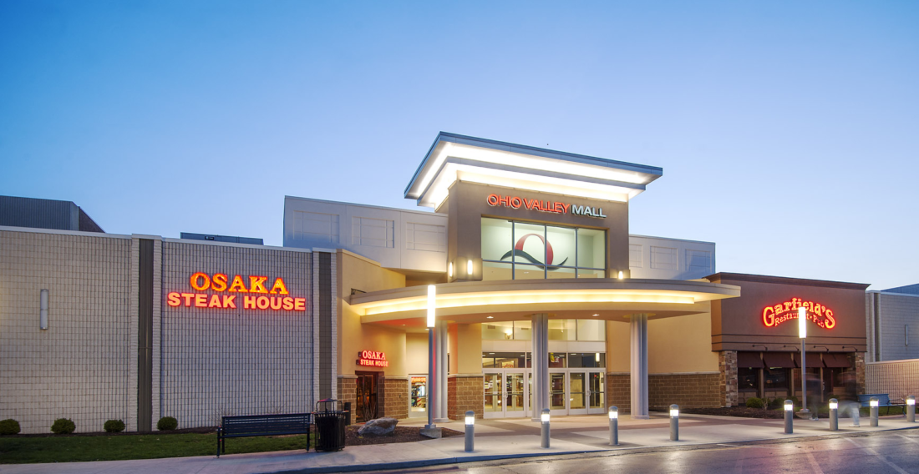
Veterans Health Administration Community Based Outpatient Clinics (CBOCs)
On-site services are variable:
Only primary care
On-site mental health
Specialty medical services
Relatively high provider turnover
Telemedicine requirements
All have on-site nursing support
Most have on-site telehealth technicians to seat veterans
Most collect urine samples on-site

Slide 29
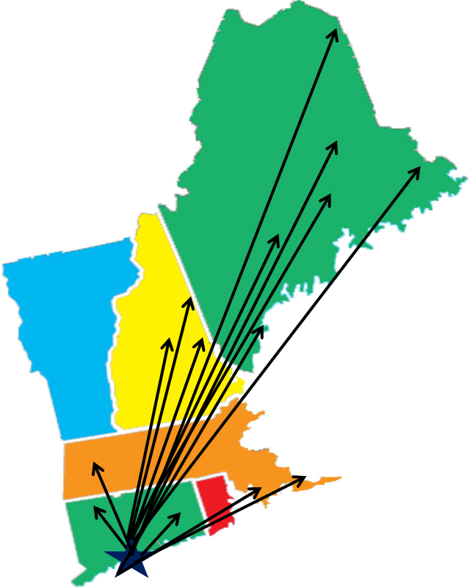
VA Telemental Health Hubs Proide Serve Rural Community Based Outpatient Clinics (CBOCs)
Initially focused on general mental health treatments, but now expanding to MAT

Slide 30
Telemedicine can be Easier in the VA
VA providers can treat veterans in any state with a single medical license
Similar rules for Federal BOP providers
Would not apply to state jails or prisons
Must still local state PDMPs
Most VA Community Based Outpatient Clinics have DEA registrations (Satisfies the Ryan Haight Act)
VA providers can start buprenorphine without an in-person visit (usually) unless…..
The local state places additional telemedicine restrictions on controlled substances

Slide 31
Advantages of Telemedicine: Filling in Buprenorphine Provider Gaps at Large Clinics
On two occasions, large MAT clinics temporarily lost their providers
Bangor CBOC
On-site mental health nursing
On-site SUD groups for aftercare
Can perform monitored inductions:
-Vital Signs, COWS, and medical backup
-One CVT provider can cover a single large population of patients
Augusta VA Medical Center
Ability to store buprenorphine on-site
On-site inpatient services
Bangor
Augusta

Slide 32
Advantages of Telemedicine: Covering Three Small Rural Clinics With One MAT Prescriber
Few buprenorphine providers in the local communities
On-site primary care, nursing, UDS collection, and scheduling
Unmonitored buprenorphine induction
CBT for SUD provided via telehealth
Example: 30 y/o patient presenting to PCP in opioid withdrawal.
Caribou
Lincoln
Calais

Slide 33
Advantages of Telemedicine: Following Patients where they Live and Work
One provider can follow one patient as they move throughout the state.
Example: 50 y/o patient started on MAT in Caribou.
Moved to Augusta and then Portland for employment
Returned to Caribou to be closer to family
300 miles
Seen at 3 VA clinics in 2 months
NO DELAYS IN TREATMENT
Caribou
Augusta
Portland

Slide 34
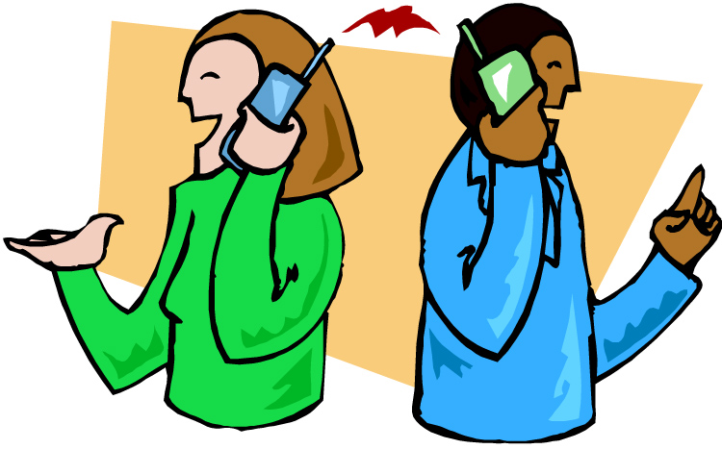
Advantages of Telemedicine: Flexibly Covering Patients Discharged from Inpatient Treatment Centers
Patient discharged from treatment center in Vermont
Treatment center contacted the telehealth hub to plan MAT coverage at discharge.
No gap in treatment after discharge
Caribou

Slide 35
Disadvantages of Telemedicine: There are barriers.
Patient was discharged from the same treatment center in Vermont
Buprenorphine could not be prescribed into the Conway VA
New Hampshire law requires that the patient be seen first in-person at an OTP prior to tele-prescribing
Conway
Sometimes there has been local resistance at the clinics we serve

Slide 36
Summary
Most of the benefit from opioid treatments come from MAT
Tele-MAT is a great way to flexibly increase access to MAT
There can be some barriers
Providing MAT to remote sites can be rewarding for providers

Slide 37
References
Finlay, A.K., Harris, A.H.S., Rosenthal, J., Blue-Howells, J., Clark, S., McGuire, J., Timko, C., Frayne, S.M., Smelson, D., Oliva, E., Binswanger, I., 2016. Receipt of pharmacotherapy for opioid use disorder by justice-involved U.S. Veterans Health Administration patients. Drug Alcohol Depend. 160, 222–226. https://doi.org/10.1016/j.drugalcdep.2016.01.013
Fortney, J., Enderle, M., McDougall, S., Clothier, J., Otero, J., Altman, L., Curran, G., 2012. Implementation outcomes of evidence-based quality improvement for depression in VA community based outpatient clinics. Implement. Sci. IS 7, 30. https://doi.org/10.1186/1748-5908-7-30
Gryczynski, J., Mitchell, S.G., Jaffe, J.H., O’Grady, K.E., Olsen, Y.K., Schwartz, R.P., 2014. Leaving buprenorphine treatment: Patients’ reasons for cessation of care. J. Subst. Abuse Treat. 46, 356–361. https://doi.org/10.1016/j.jsat.2013.10.004
Haffajee, R.L., Lin, L.A., Bohnert, A.S.B., Goldstick, J.E., 2019. Characteristics of US Counties With High Opioid Overdose Mortality and Low Capacity to Deliver Medications for Opioid Use Disorder. JAMA Netw. Open 2, e196373. https://doi.org/10.1001/jamanetworkopen.2019.6373
Hedegaard, H., 2017. Drug Overdose Deaths in the United States, 1999–2016 8.
Huskamp, Haiden A., Busch, Alisa B., Souza, Jeffrey, Uscher-Pines, Lori, Rose, Sherri, Wilcock, Andrew, Landon, Bruce E., Mehrotra, Ateev, 2018. How Is Telemedicine Being Used In Opioid And Other Substance Use Disorder Treatment? | Health Affairs. Health Aff. (Millwood) 37.
Kariisa, M., Scholl, L., Wilson, N., Seth, P., Hoots, B., 2019. Drug Overdose Deaths Involving Cocaine and Psychostimulants with Abuse Potential - United States, 2003-2017. MMWR Morb. Mortal. Wkly. Rep. 68, 388–395. https://doi.org/10.15585/mmwr.mm6817a3
Lin, L.A., Peltzman, T., McCarthy, J.F., Oliva, E.M., Trafton, J.A., Bohnert, A.S.B., 2019. Changing Trends in Opioid Overdose Deaths and Prescription Opioid Receipt Among Veterans. Am. J. Prev. Med. 57, 106–110. https://doi.org/10.1016/j.amepre.2019.01.016
Manhapra, A., Petrakis, I., Rosenheck, R., 2017. Three-year retention in buprenorphine treatment for opioid use disorder nationally in the Veterans Health Administration. Am. J. Addict. 26, 572–580. https://doi.org/10.1111/ajad.12553
Oliva, E.M., Harris, A.H.S., Trafton, J.A., Gordon, A.J., 2012. Receipt of opioid agonist treatment in the Veterans Health Administration: facility and patient factors. Drug Alcohol Depend. 122, 241–246. https://doi.org/10.1016/j.drugalcdep.2011.10.004
Powers, B.B., Homer, M.C., Morone, N., Edmonds, N., Rossi, M.I., 2017. Creation of an Interprofessional Teledementia Clinic for Rural Veterans: Preliminary Data. J. Am. Geriatr. Soc. 65, 1092–1099. https://doi.org/10.1111/jgs.14839
Ruskin, P.E., Silver-Aylaian, M., Kling, M.A., Reed, S.A., Bradham, D.D., Hebel, J.R., Barrett, D., Knowles, F., Hauser, P., 2004. Treatment outcomes in depression: comparison of remote treatment through telepsychiatry to in-person treatment. Am. J. Psychiatry 161, 1471–1476. https://doi.org/10.1176/appi.ajp.161.8.1471
SAMHSA, 2015. Receipt of Services for Behavioral Health Problems: Results from the 2014 National Survey on Drug Use and Health.

