Slide 1
Criminal Justice Presentation
+
September 2019
Copyright 2019, Sandoz Inc, 100 College Road West, Princeton, NJ. All rights reserved.

Slide 2
Introduction
The speaker is an employee of Pear Therapeutics®. Information provided constitutes scientific exchange, including information on:
reSET® an FDA-authorized prescription digital therapeutic for Substance Use Disorder (SUD) intended to provide cognitive behavioral therapy (CBT) as an adjunct to a contingency management system, for patients 18 years of age and older who are currently enrolled in outpatient treatment under the supervision of a clinician
reSET-O® an FDA-authorized prescription digital therapeutic (PDT) for Opioid Use Disorder (OUD) intended to increase retention of patient in outpatient treatment by providing cognitive behavioral therapy (CBT), as an adjunct to outpatient treatment that includes transmucosal buprenorphine and contingency management, for patient 18 years of older who are currently under the supervision of a clinician.
This presentation is not intended to provide medical advice. There are no data on the use of reSET® or reSET-O® in the incarcerated population.
Dr. Audrey Kern, MD, FASAM
Global Medical Director, SUD/OUD
Pear Therapeutics®

Slide 3
Agenda | Today’s Goal and Discussion Topics
Today’s Agenda
Introduction
The Unmet Medical Need in the Incarcerated Population
Barriers to treatment for Substance Abuse in this population
Evidence Based Approaches for Effective Treatment
Prescription Digital Therapeutics
Clinical Data
Today’s Goal
Understand the potential utility of Prescription Digital Therapeutics for substance use disorder and opioid use disorder in individuals with a history of incarceration

Slide 4
Unmet Medical Need in Substance Abusing Offenders in the Criminal Justice System
Offenders engage in disproportionately high rates of substance use while in the community.
53% of state and 45% of federal prisoners meet criteria for a Substance Use Disorder compared with only 3% of the general U.S. population¹
83% of prisoners report lifetime drug use and more than two thirds report regular use¹
50% of male and 33% of female inmates with Substance Use Disorders require substance abuse treatment services in prison; However, the best available estimates show that while incarcerated, only 20% to 25% of those in need of treatment actually receive it¹
Chaple, M., Sacks, S., McKendrick, K., Marsch, L. A., Belenko, S., Leukefeld, C., French, M. (2016). A Comparative Study of the Therapeutic Education System for Incarcerated Substance-Abusing Offenders. The Prison Journal, 96(3), 485–508. https://doi.org/10.1177/0032885516636858

Slide 5
Unmet Medical Need in Substance Abusing Offenders in the Criminal Justice System
Pricing/Cost
Access to Care
Cost of Evidence Based Therapies
Ensuring fidelity given high-turnover of staff
Patient caseload volume making it a challenge to coordinate care
Access to qualified treatment providers
Time to Support Behavioral Interventions
Chaple, M., Sacks, S., McKendrick, K., Marsch, L. A., Belenko, S., Leukefeld, C., … French, M. (2016). A Comparative Study of the Therapeutic Education System for Incarcerated Substance-Abusing Offenders. The Prison Journal, 96(3), 485–508. https://doi.org/10.1177/0032885516636858

Slide 6
SUD Treatment | Approach Landscape Some evidence-based practice treatment approaches are difficult to provide for patients in an outpatient setting
US Treatment Facilities Therapeutic Approach offerings¹
Substance abuse counseling | 99%
Relapse prevention | 96%
Cognitive-Behavioral therapy | 94%
Motivational interviewing | 93%
Anger Management | 83%
Brief Intervention | 82%
Trauma Counseling | 79%
12-step facilitation | 73%
Contingency management | 56%
Dialectical behavioral therapy | 54%
Rational emotive behavioral therapy | 46%
Cognitive-Behavioral Therapy (CBT) for SUD:²
Helps patients learn to identify and correct behaviors that lead to substance use
Helps patients learn how to deal with problems related to substance use and teaches strategies to encourage abstinence
Each lesson ends with Fluency Training to promote learning and improve retention
Community Reinforcement Approach (CRA):
Focuses on managing behavior related to substance use, to help patients adopt a healthier lifestyle without alcohol or drug use³
Psychosocial support to support behavioral change and emotional wellbeing
Contingency Management (CM):
An evidence-based adjunct to counseling that uses positive reinforcement to support treatment goals
Offers rewards for desired behaviors, designed to weaken drug use by helping replace the ‘reward’ patients previously received from substance use⁴
6
Notes:
Goal of Slide: Highlight common, evidence-based practices used in SUD treatment and found in reSET. Discuss additional approaches reSET enables
e.g. Contingency Management: Low utilization of CM is considered a result of administration challenges, given that providers often don't have appropriate infrastructure/mechanisms to effectively deliver CM in their clinics

Slide 7
Cognitive Behavioral Therapy (CBT) for SUD
COGNITIVE
Maladaptive thoughts
BEHAVIORAL
Poor coping skills
CBT is intended to treat SUD by
Understanding the connection between thoughts and behaviors
Functional analysis to identify triggers and understand consequences of use
Identify factors that promote/maintain use
Modifying cognitive barriers to change
Identify rationalizing, giving up, overgeneralizations, or personalizing in thinking
Use cognitive restructuring to evaluate and alter negative thinking
Improving behavioral strategies
Enhanced coping skills
Drug refusal skills
Problem solving skills
Enhanced social experiences
Drug craving, seeking, use, and reinforcement
Calkins AW, et al. (2016) Basic Principles and Practice of Cognitive Behavioral Therapy. In: Petersen T., E. Sprich S., Wilhelm S. (eds) The Massachusetts General Hospital Handbook of Cognitive Behavioral Therapy. Current Clinical Psychiatry. Humana Press, New York, NY.
McHugh, KW et al. (2010). Cognitive Behavioral Therapy for Substance Use Disorders. Psychiatric Clinics of North America, 33, 511-525.
Data on File: reSET-O Lesson Content. Boston, MA: Pear Therapeutics, Inc; 2017.

Slide 8
Cognitive Behavioral Therapy (CBT) for SUD
CM: Contrived Contingencies^{1,2}
Promote initial abstinence
Put in place explicitly and exclusively for therapeutic purposes; Monetary/other gift tied to defined abstinence endpoints
Allows time for the therapist and patient to work toward reestablishing naturalistic contingencies
CRA: Naturalistic Contingencies^{1,2}
Promote sustained long-term abstinence once the contrived reinforcers are discontinued
Systematically increasing the availability and frequency of alternative reinforcing activities (stable family life, job, participation in self-help, etc.)
Use aversive events or the loss of reinforcing event as a consequence of drug use
+
Higgins ST, Budney AJ, Bickel WK, Foerg FE, Donham R, Badger GJ. Incentives improve outcome in outpatient behavioral treatment of cocaine dependence. Arch Gen Psychiatry. 1994;51(7):568-576. doi:10.1001/archpsyc.1994.03950070060011.
Higgins ST, Redner R, White TJ. Contingency management and the community reinforcement approach. In: Ries RK et al, eds. Principles of Addiction Medicine. Philadelphia, PA: Wolters Kluwer; 2014:877-893.

Slide 9
Prescription Digital Therapeutics (PDTs) A new class of therapies that are being integrated into standard of care
& beyond
“Software as therapeutics” that treat serious diseases with high unmet medical need
PDTs meet stringent regulatory requirements related to:
Safety and effectiveness clinical data ^{1,2}
Regulatory labeling³
Payers to evaluate coverage based on traditional therapeutic coverage mechanisms
Campbell ANC, Nunes EV, Matthews AG, et al. Internet-delivered treatment for substance abuse: a multisite randomized controlled trial. Am J Psychiatry. 2014;171(6):683-690.
Christensen DR, Landes RD, Jackson L, et al. Adding an internet-delivered treatment to an efficacious treatment package for opioid dependence. J Consult Clin Psychol. 2014;82(6):964-972.
Federal Drug Administration permits marketing of mobile medical application for substance use disorder [press release]. FDA News Release; Site https://www.fda.gov/NewsEvents/Newsroom/PressAnnouncements/ucm576087.htm Published September 14, 2017. Accessed July 2019
9
Notes:
Goal of Slide: Define and contextualize PDTs as a legitimate and established, albeit new treatment modality
Digital therapeutics are clinically validated solutions:
May be used as stand-alone interventions or in association with other treatments to engage patients
Used by physicians to improve the overall quality, outcomes, and value of healthcare delivery.
Products demonstrate:
Safety and effectiveness
in randomized clinical trials
Receive regulatory clearance when used as a medical device
Integrate into clinical practice
Tailor to patients’ clinical needs, goals, and lifestyles

Slide 10
What Does Regulatory Authorization Mean in The Context of Digital Therapeutics?
FDA-
Authorized
PDTs
Evidence of clinical effectiveness, patient safety, and GMP quality that is reviewed and authorized by a regulatory body to support quality, safety and treatment claims^{1,5}
Regulatory Authorization follows a rigorous review of a therapy’s:
Authorization enables licensed providers to prescribe and gives payers the level of confidence in PDT quality, value, and effectiveness given to other FDA-regulated therapies they cover
Clinically-Validated Digital Health Interventions
Evidence of effectiveness and patient safety in RCTs
Safety
Effectiveness
Instructions for Use
Level of rigor and review
Wellness & Data
Collection Apps
Generally have no or minimal evidence of clinical effectiveness or patient safety
Scrutiny from regulatory bodies has resulted in millions of dollars in fines and settlements for companies unable to substantiate effectiveness claims⁶
FDA: Food and Drug Administration PDT: Prescription Digital Therapeutic GMP: Good Manufacturing Practice
10
Software as a Medical Device (SAMD): Clinical Evaluation. Guidance for Industry and Food and Drug Administration Staff. Published 2017. Website: https://www.fda.gov/media/100714/download. Accessed July 2019
NY Attorney General Press Release: AG Announces Settlement. March 2017. Website: https://ag.ny.gov/press-release/ag-schneiderman-announces-settlements-three-mobile-health-application-developers. Accessed July 2019
Notes:
Goal of Slide: Highlight the rigor applied to Prescription Digital Therapeutics vs. other digital offerings
PDTs are prescribed by a physician
Directly treat serious diseases
Are built under current Good Manufacturing Practices
Demonstrate safety and efficacy in randomized clinical trials
Receive labeled claims from the FDA
Are reimbursed as products, via Pharmacy and Medical benefits
Have barriers to entry that span regulatory exclusivity and intellectual property
Examples of non-authorized digital therapeutics that have received warnings/been pulled from the market for false efficacy claims or safety reasons– Luminosity: FTC complaint for false claims and deceptive advertising resulting in $2M settlement. See:
https://www.healthline.com/health-news/who-regulates-all-these-health-related-apps#3
https://www.wired.com/2016/01/ftc-hits-lumosity-with-fine-for-deceptive-brain-health-ads/

Slide 11
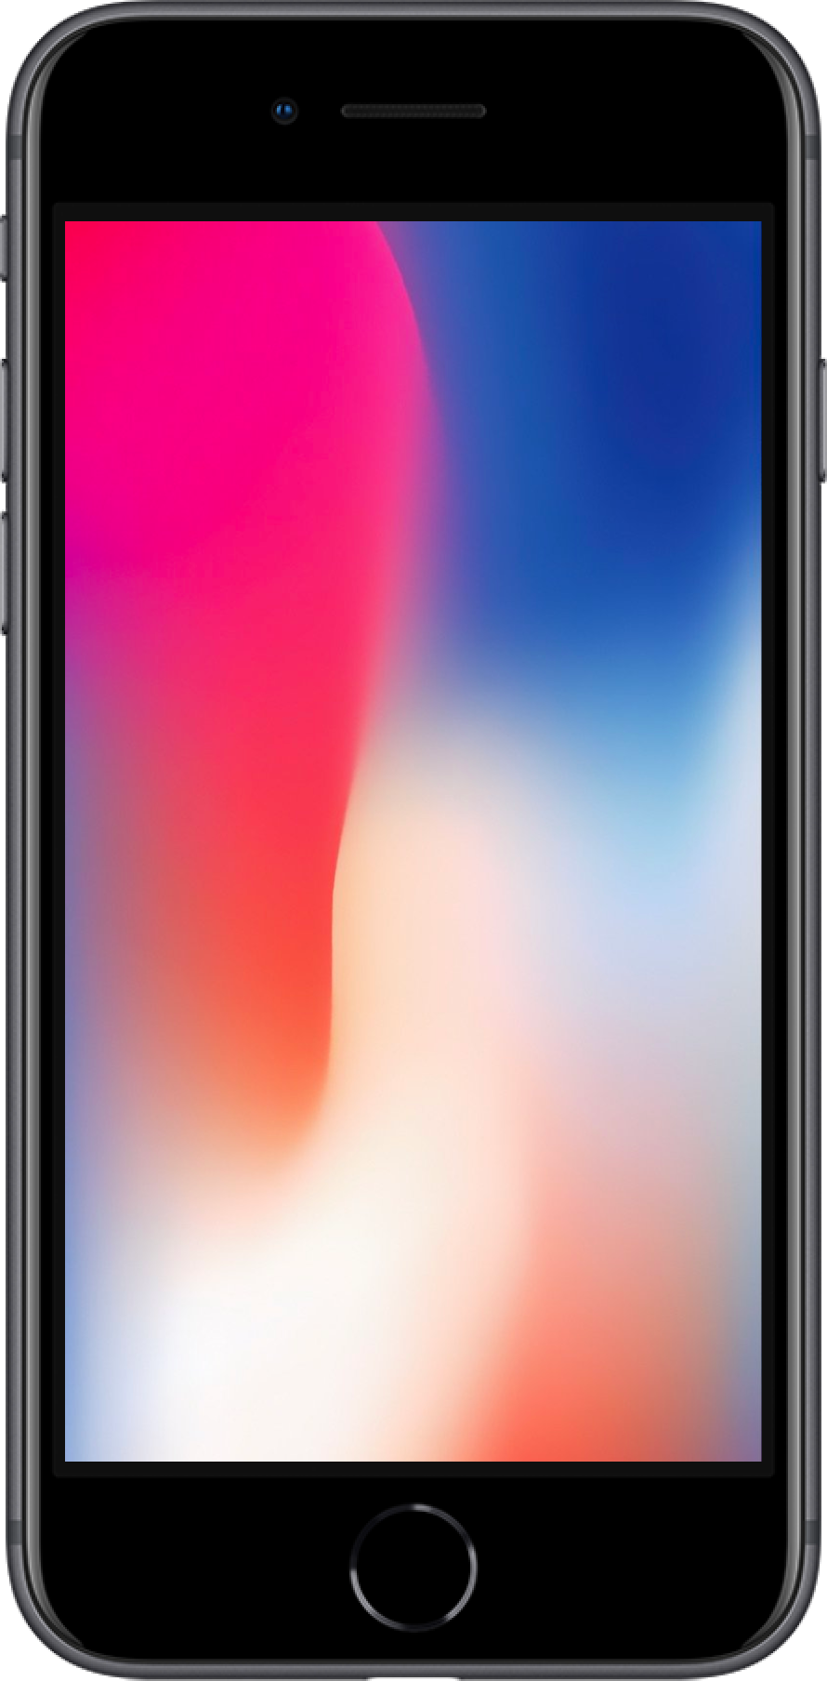
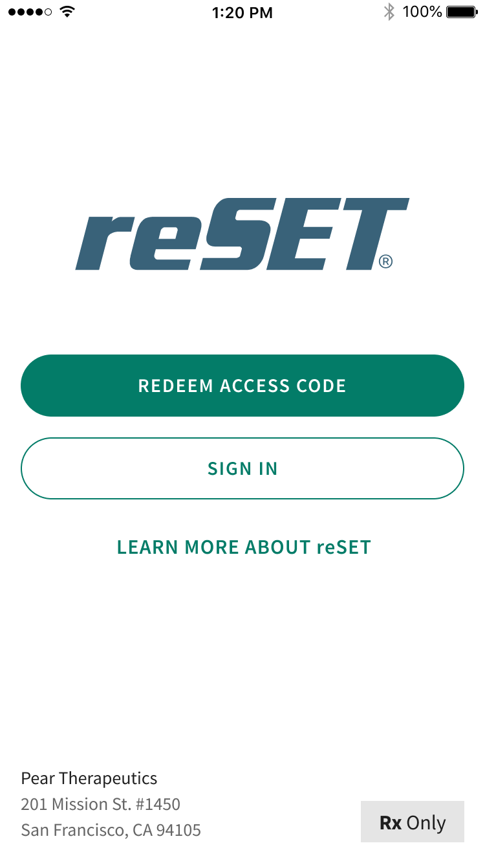
reSET® | Mechanism of Action An FDA-authorized Prescription Digital Therapeutic (PDT) for SUD
Mechanism of Action | Delivers therapy based on the community reinforcement approach (CRA), an intensive form of validated neurobehavioral therapy for SUD, along with contingency management and fluency training to enhance learning.
Product Description | Based on the Therapeutic Education System (TES) Comprised of 62 interactive modules: 32 core modules and 30 supplemental modules Core modules focus on key CRA concepts, building skills to support behavior change and prevent relapse Supplemental modules provide more in-depth information on specific topics such as relationship skills or living with Hepatitis C Each module can be completed in approximately 10-20 minutes
Pear regulatory submission. DEN160018

Slide 12
reSET® | Indications for Use reSET® is the only therapy approved for marijuana and stimulant patients
Indication(s) | reSET® is intended to provide cognitive behavioral therapy, as an adjunct to a contingency management system, for patients18 years of age and older, enrolled in outpatient treatment under the supervision of a clinician 12-week prescription duration Patient population: Patients with SUD, under treatment for the following: Stimulants Alcohol + another substance Marijuana Cocaine Opioids (when not primary substance of abuse) All other substances Not indicated for patients who are on opioid replacement therapy, or abusing alcohol solely, or abusing opioids as their primary substance
Effectiveness Data | Pivotal study demonstrated significant improvements in abstinence and treatment retention^{1,2}
American Journal of Psychiatry. 2014. 171(6):683-690.
Pear Internal data and Pear regulatory submission. DEN160018

Slide 13
reSET® | Safety Information An FDA-authorized PDT for SUD
reSET® is intended for patients whose primary language is English and who have access to an Android/iOS tablet or smartphone. reSET is intended only for patients who own a smartphone and are familiar with use of smartphone apps (applications).
Clinicians should not use reSET to communicate with their patients about emergency medical issues. Patients should be clearly instructed not to use reSET to communicate to their clinician any urgent or emergent information.
reSET® is not to be used for emergencies. In case of an emergency, patients should dial 911 or go to the nearest emergency room.
The long-term benefit of treatment with reSET on abstinence has not been evaluated in studies lasting beyond 12-weeks in the Substance Use Disorder (SUD) population. The ability of reSET to prevent potential relapse after treatment discontinuation has not been studied.
Pear regulatory submission. DEN160018

Slide 14
reSET® Clinical Data | Pivotal Trial Summary
Pivotal Trial Overview¹
Study Results²
399 patients with SUD (alcohol, cannabis, cocaine, stimulants) received either:
Treatment-as-Usual (TAU), consisting of intensive face-to-face therapy
Reduced TAU and reSET (rTAU+ reSET®) for 12 weeks¹
Patients provided urine samples twice per week to objectively monitor abstinence
Co-primary study endpoints
Abstinence in weeks 9-12
Retention in treatment
Outcomes | rTAU+reSET® | TAU | P-value
Abstinence: all patients | 40.3% | 17.6% | 0.0004
Abstinence: non-abstinent at study start | 16.1% | 3.2% | 0.0013
Retention in treatment: all patients | 76.2% | 63.2% | 0.0042
American Journal of Psychiatry. 2014. 171(6):683-690.
Pear Internal data and Pear regulatory submission. DEN160018

Slide 15
reSET® | Additional Clinical Data Highlights
Highlights | Clinical Outcomes Summary
Abstinence | Among patients whose primary addiction was not opioids, adding reSET® to outpatient therapy more than doubled abstinence rates (40% vs. 18%)
Retention Rates | Among all patients, adding reSET® to outpatient therapy improved rates of retention (76% vs. 63%) Patients who adhered to reSET® module completion in the first six weeks of the trial were 7x more likely to complete treatment than those who did not
Treatment Attendance | Clinical trial data revealed a positive correlation between module completion and appointment attendance¹
Safety | reSET® did not demonstrate a significant difference in unanticipated adverse events¹
Module Completion | Average Core Modules Completed: 38² (of 48) Number of reSET® modules completed correlated with abstinence (R²=0.21, p<.001 with n=206)²
Retention
Percentage of patients who completed the 12-week study¹
reSET ® +
rTAU
(n=255)
TAU (n=252)
Abstinence
Abstinence Rates by Treatment Group
reSET ® + rTAU (n=206)
40%
TAU (n=193)
18%
OR=3.17 [95% CI: 1.68, 5.99]; P=0.0004
⁰ ^{100%}
†Among patients whose primary addiction was not opioids
Pear Internal data and Pear regulatory submission. DEN160018
Luderer HF, Campbell ANC, Nunes EV, Maricich YA. A Digital Therapeutic for SUD, reSET®, Demonstrates a Correlation Between Dose and Treatment Outcomes. Poster presented at: 29th Annual Meeting of the American Academy of Addiction Psychiatry; December 6-9, 2018; San Diego, CA.
Notes:
5 key points

Slide 16
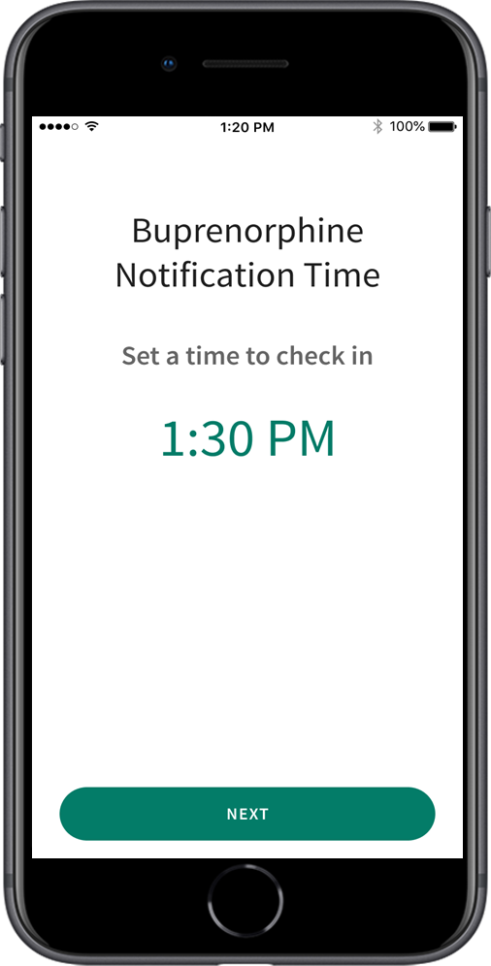
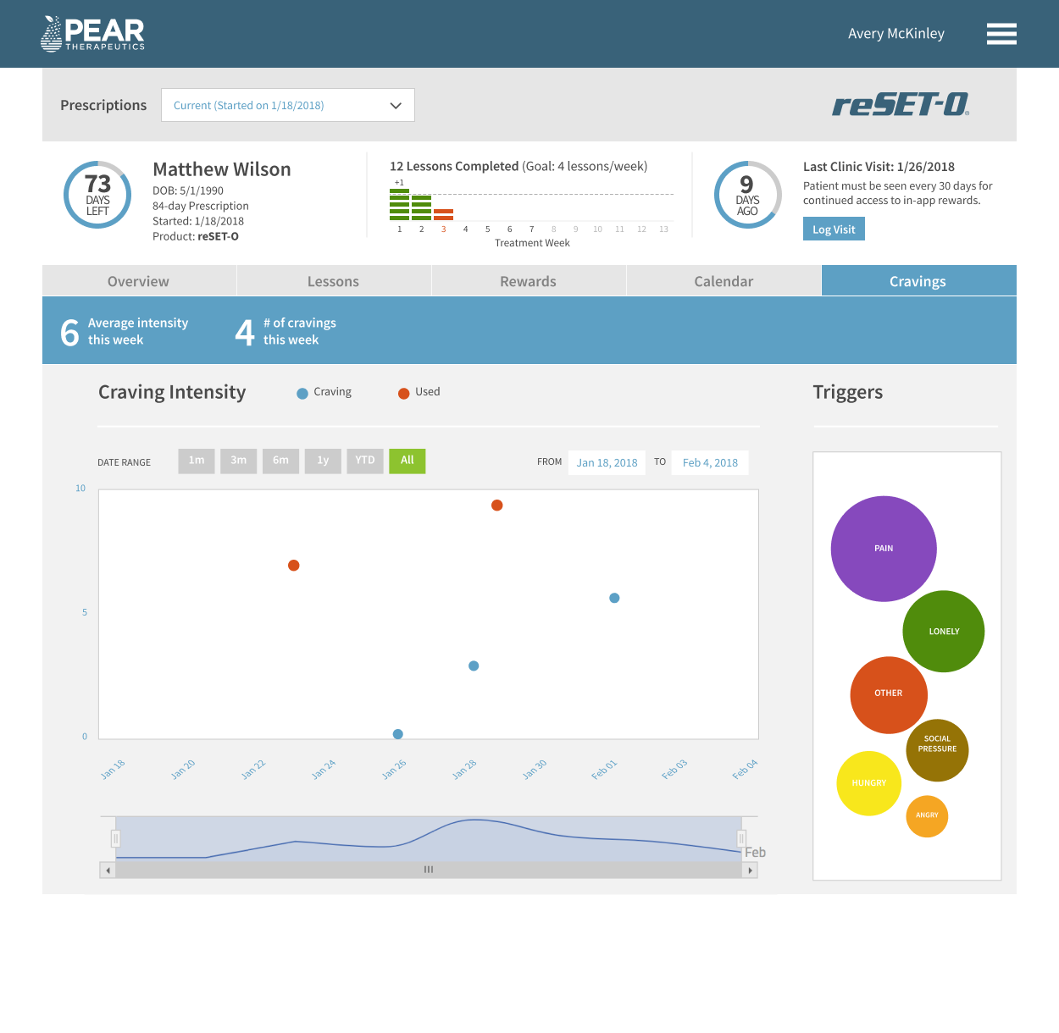
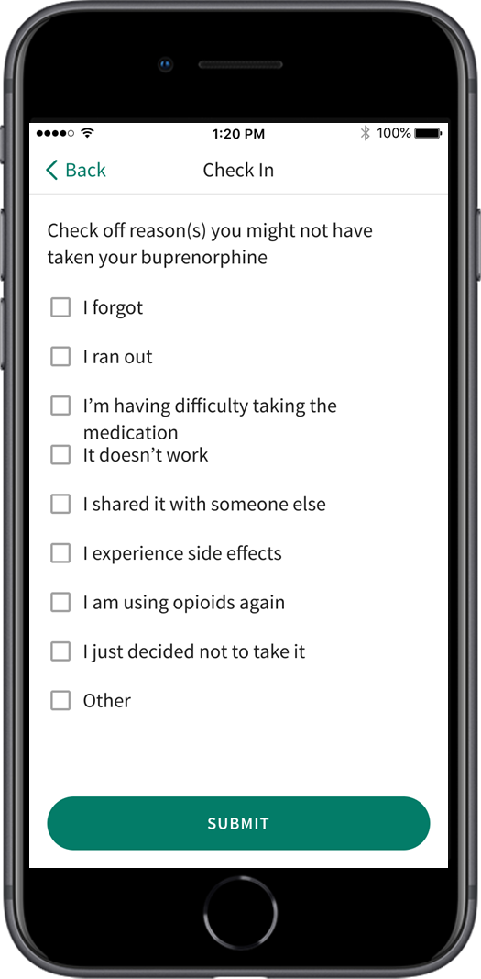
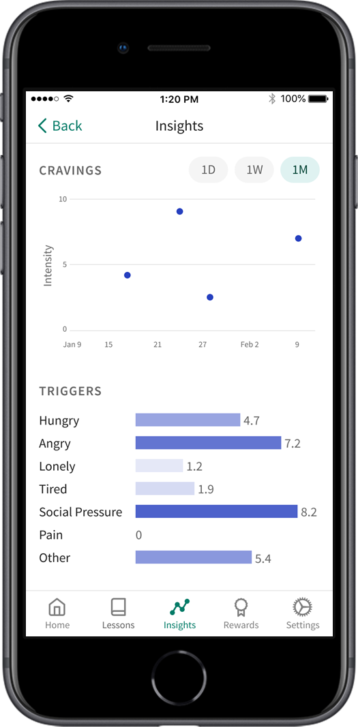
reSET-O® | Capabilities and Functionality Used in conjunction with Medication Assisted Treatment, under clinician supervision
ENTER drug and alcohol screen results, to guide conversation and inform clinicians
SEE the intensity of patient-reported cravings and triggers. Each metric can be expanded for greater detail— increasing transparency in patient-HCP dialogue
FOLLOW patient-reported cravings, triggers, buprenorphine use, and substance use; track lesson completion, progress over time, and appointment compliance
VIEW patient summary, personal information, prescription status, and drug screen results
Intervention
Medication Reminders & Tracking
Craving & Trigger Assessment
CBT Module Delivery
Fluency Training
Contingency Management
Insight
Abstinence & Appointment Attendance Tracking
CBT Module Completion Tracking
Fluency Training
Contingency Management
Cravings & Triggers Reporting
+
PATIENT
CLINICIAN

Slide 17
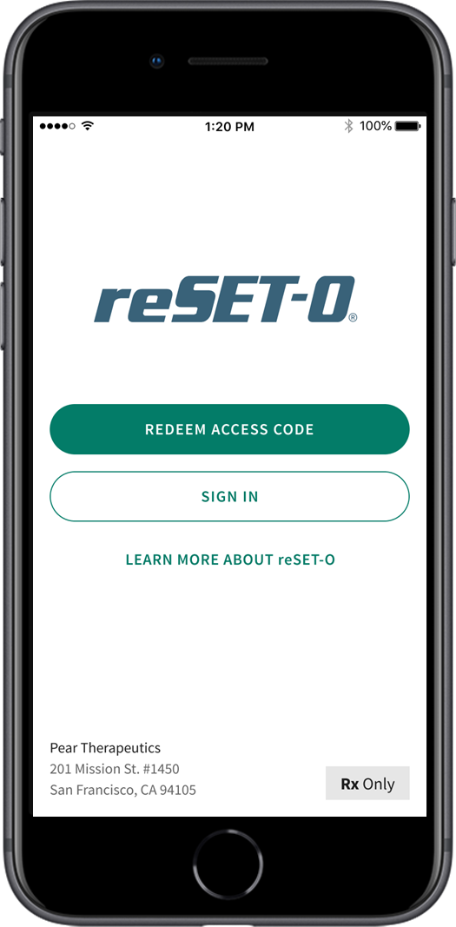
reSET-O® | Mechanism of Action An FDA Cleared Digital Therapy for OUD
Mechanism of Action | Delivers addiction-specific form of CBT, fluency training, and contingency management for opioid use disorder (OUD)
Product Description | Based on the Therapeutic Education System (TES) Comprised of 67 interactive modules: 31 core modules and 36 supplemental modules Core modules focus on key CRA concepts, building skills to support behavior change and prevent relapse Supplemental modules provide more in-depth information on specific topics such as relationship skills or living with hepatitis Each module is lasts approx. 10-20 minutes Voluntary buprenorphine check-in feature to support buprenorphine use

Slide 18
reSET-O® | Indications for Use
Indication(s) | reSET-O® is intended to increase retention of patients with opioid use disorder (OUD) in outpatient treatment by providing cognitive behavioral therapy, as an adjunct to outpatient treatment that includes transmucosal buprenorphine and contingency management, for patients 18 years or older who are currently under the supervision of a clinician. 12-week prescription duration indicated as a prescription-only Mobile Medical Application
Intended Use | Intended for use in combination with buprenorphine pharmacotherapy
Effectiveness Data | Pivotal study demonstrated significant improvements in retention in treatment²
American Journal of Psychiatry. 2014. 171(6):683-690.
Pear Internal data and Pear regulatory submission. DEN160018hcf

Slide 19
reSET-O® | Safety Information An FDA Cleared Digital Therapy for OUD
reSET-O® is intended for patients whose primary language is English and who have access to an Android/iOS tablet or smartphone. reSET-O® is intended only for patients who own a smartphone and are familiar with use of smartphone apps (applications).
Clinicians should not use reSET-O® to communicate with their patients about emergency medical issues. Patients should be clearly instructed not to use reSET-O® to communicate to their clinician any urgent or emergent information.
The long-term benefit of treatment with reSET-O® on abstinence has not been evaluated in studies lasting beyond 12-weeks in the Opioid Use Disorder (OUD) population. The ability of reSET-O to prevent potential relapse after treatment discontinuation has not been studied.

Slide 20
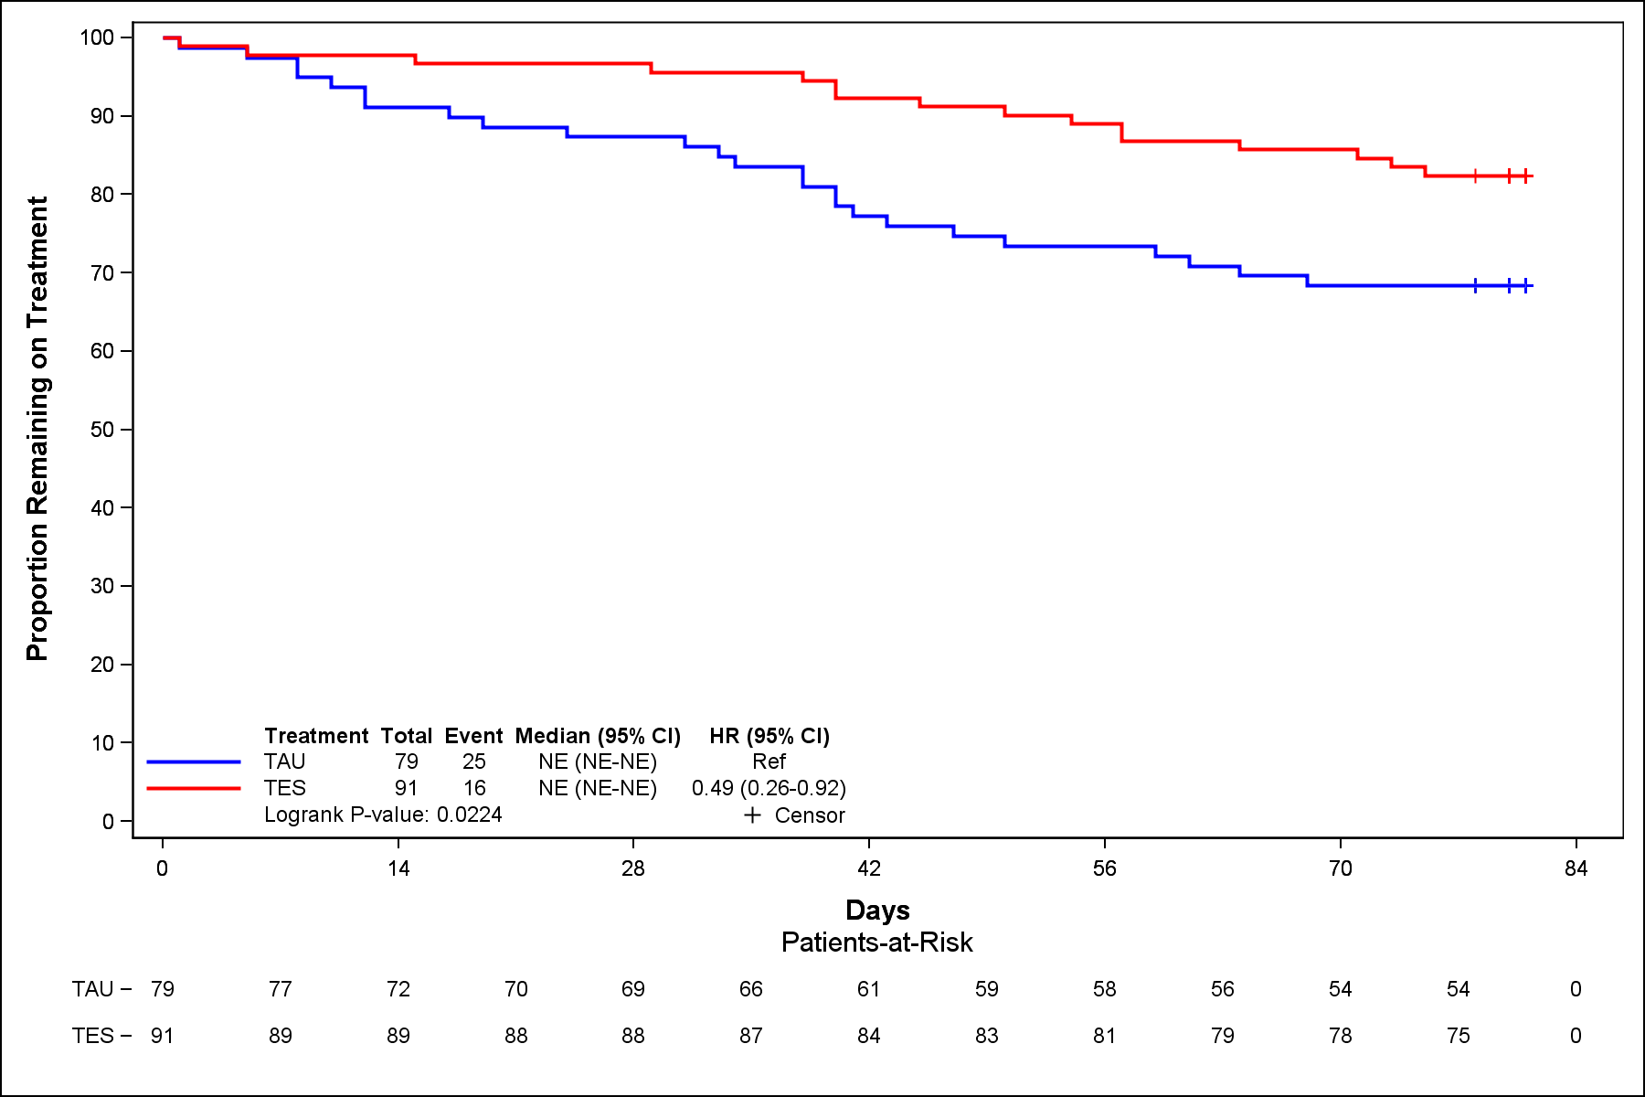
reSET-O® Clinical Data | Pivotal Trial Summary
k
Pivotal Trial Overview
Study Results¹
170 patients were randomized to receive either:
Treatment-as-Usual (TAU), consisting of Contingency Management + buprenorphine¹ or
TAU + reSET-O® (academic name Therapeutic Education System, or TES) + Contingency Management + buprenorphine
All patients received 30 mins. of face-to-face counseling every other week.
Patients provided urine samples 3x per week to objectively monitor abstinence.
Co-primary endpoint analysis²
Abstinence/Negative urine drug screens in weeks 9-12
Retention in treatment
 | TAU + reSET-O® | TAU | P-value
Abstinence (Opioids) | 77.3% (n=91) | 62.1% (n=79) | 0.0248
Retention (All) | 82.4% | 68.4% | 0.0224
Christensen DR, Landes RD, Jackson L, et al. Adding an internet-delivered treatment to an efficacious treatment package for opioid dependence. J Consult Clin Psychol. 2014;82(6):964-972. doi:10.1037/a0037496., and Pear regulatory submission. DEN160018hcf, and reSET-O Clinician Directions for Use. Boston, MA: Pear Therapeutics, Inc; 2019.
Pear regulatory submission. DEN160018hcf

Slide 21
reSET-O® | Additional Clinical Data Highlights
Highlights | Clinical Outcomes Summary
Retention Rates | Adding reSET-O® to outpatient treatment using buprenorphine increased retention of patients with OUD almost 15%
Safety | The observed adverse events (AE) were of type and frequency as anticipated in a large population of patients with OUD, or associated with buprenorphine pharmacotherapy, particularly during the induction phase. The AEs observed were not adjudicated to be device related.
Module Completion | reSET-O® vs TAU did not demonstrate any significant safety differences between the cohorts
Treatment Retention Rate¹
Patients Retained at 12-week endpoint
P=.0224
Pear regulatory submission. DEN160018hcf
Notes:
5 key points

Slide 22
Technology Enabled Behavioral Therapy¹ Clinical Data in Incarcerated Substance Abuse Offenders
A Comparative Study of the Therapeutic Education System for Incarcerated Substance-Abusing Offenders:
Objectives and Design
Study compared the effectiveness of the Therapeutic Education System (TES) vs. Standard of Care on measures of crime (including re-incarceration at 12 months), drug use, and HIV risk behavior 3 and 6 months after prison release.
Participants were randomized into two study groups, Standard of Care (C) (n=255) and E-TES (n=258)
Note: These data were not the basis for reSET® or reSET-O® FDA review/authorization. The incarcerated population were not specifically studied in the pivotal trials used as the basis for authorization There are no data on the use of reSET® or reSET-O® in the incarcerated population.
Randomized into two study groups: Standard of Care (C) (n=255) and E-TES (n=258)
Treatment conditions included 48 interactive modules: once a week for two hours or twice a week for one hour
Standard of Care: Group activities 1 day per week for 2 hours a day over 8-12 weeks.
Outcomes: Results showed TES and standard treatment were equally effective across facilities in reducing criminality, relapse to drug use, and HIV risk behavior.
In prisons, where a majority of substance-using offenders do not receive treatment, identifying an equally effective high-volume alternative such as TES can greatly expand access to quality psychosocial interventions.
Objective: comparing TES with standard care in a sample of substance-abusing offenders in prison
Chaple, M., Sacks, S., McKendrick, K., Marsch, L. A., Belenko, S., Leukefeld, C., … French, M. (2016). A Comparative Study of the Therapeutic Education System for Incarcerated Substance-Abusing Offenders. The Prison Journal, 96(3), 485–508. https://doi.org/10.1177/0032885516636858
Notes:
5 key points

Slide 23
Technology Enabled Behavioral Therapy Clinical Data in Incarcerated Substance Abuse Offenders*
Clinical Outcomes:
Analysis indicated similar rates of re-incarceration for the two groups overall and separately for new offenses or for re-incarceration; no statistical significance (181.8 days for E-TES vs 225.1 days for C)
The degree of change was statistically similar for drug use (54% E-TES; 54% C) and alcohol intoxication (54% E-TES; 57% C) fell more than half and the number of days of abstinent increased by nearly 3 months (80 E-TES; 85 C)
Computer-based treatment required much less therapist time
Key Takeaway: There was no significant difference between groups, indicating that E-TES is equally effective compared with standard of care.
*There are no data on the use of reSET® or reSET-O® in the incarcerated population.
Chaple, M., Sacks, S., McKendrick, K., Marsch, L. A., Belenko, S., Leukefeld, C., … French, M. (2016). A Comparative Study of the Therapeutic Education System for Incarcerated Substance-Abusing Offenders. The Prison Journal, 96(3), 485–508. https://doi.org/10.1177/0032885516636858
Notes:
5 key points

Slide 24
Thank You!
Dr. Audrey Kern
Audrey.Kern@peartherapeutics.com

